Slide 1
CFD Pre-Lab 1 Simulation of Laminar Pipe Flow Seong Mo Yean, and Timur Dogan 10/14/2013

Slide 2
Outline
Overview of Pipe Flow
CFD Process
ANSYS Workbench
ANSYS Design Modeler (Geometry)
ANSYS Mesh
ANSYS Fluent
Physics (Setup)
Solution
Results

Slide 3
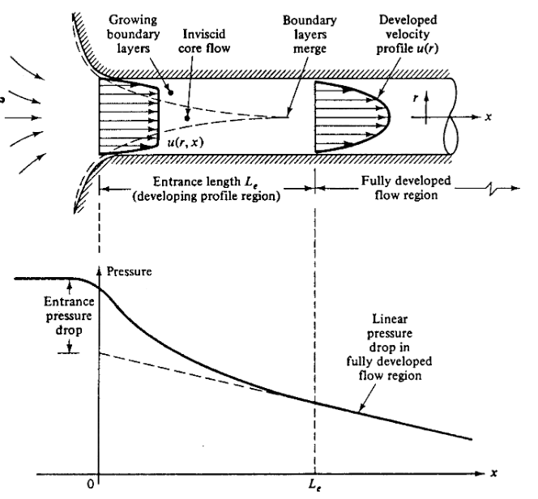
Overview of Pipe Flow
Simulation of laminar pipe flow will be conducted for this lab
Axial velocity profile, centerline velocity, centerline pressure, and wall shear stress will be analyzed
Computational fluid dynamics (CFD) results for friction factor and velocity profile will be compared to analytical fluid dynamics (AFD)
This lab will cover concept of laminar vs. turbulent flow and developing length for pipe flows
Flow visualization between two parallel plates
(starts at 14:25)

Slide 4
Overview of Pipe Flow
Flow in pipe with Reynolds(Re) number
$Re=\frac{UD}{ν}=\frac{Inertial Forces}{Viscous Forces}$
where U inflow velocity, D diameter of pipe, $ν$ kinetic viscosity
Laminar : Re < 2300
Turbulent : Re > 2300
Differences between laminar and turbulent flow
(mean) Velocity profile
Pressure drop
Developing length
Wall shear stress and friction factor
Note: Refer to Chapter 8 of your book for more details
Flow visualization of transition from laminar to turbulent flow

Slide 5
CFD Process
The overall procedure for simulation of pipe flow is shown on chart below
Although we will be making the mesh before we define the physics you have to know the physics to design appropriate mesh.
Geometry
Physics
Mesh
Solution
Results
Pipe (ANSYS Design Modeler)
General (ANSYS Fluent - Setup)
Structure (ANSYS Mesh)
Solution Methods (ANSYS Fluent - Solution)
Plots (ANSYS Fluent- Results)
Model (ANSYS Fluent - Setup)
Uniform (ANSYS Mesh)
Graphics and Animations (ANSYS Fluent- Results)
Laminar
Boundary Conditions (ANSYS Fluent -Setup)
Monitors (ANSYS Fluent - Solution)
Reference Values (ANSYS Fluent - Setup)
Solution Initialization (ANSYS Fluent -Solution)

Slide 6
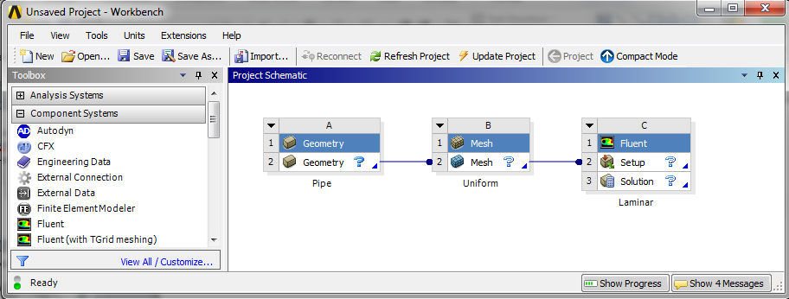
ANSYS Workbench (Overview)
Design your simulation using ANSYS Workbench
ANSYS Mesh
(Mesh)
ANSYS Design Modeler
(Geometry)
ANSYS Fluent
(Physics, Solution and Results)

Slide 7
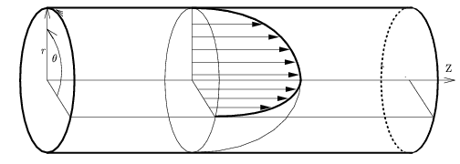
ANSYS Design Modeler (Geometry)
Symmetric property of the flow is used to create 2D representation of the 3D pipe flow
R
D
L
Parameter | Value
Radius of pipe, R | 0.02619 m
Diameter of pipe, D | 0.05238 m
Length of pipe, L | 7.62 m
Wall
Flow
Inlet
Outlet
Center

Slide 8
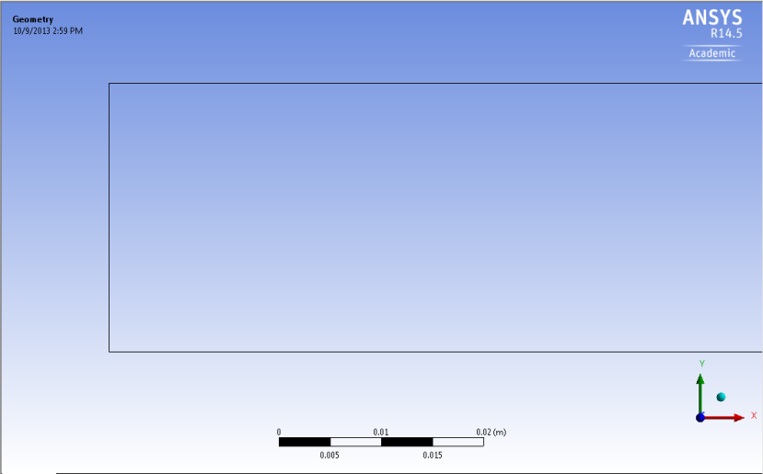
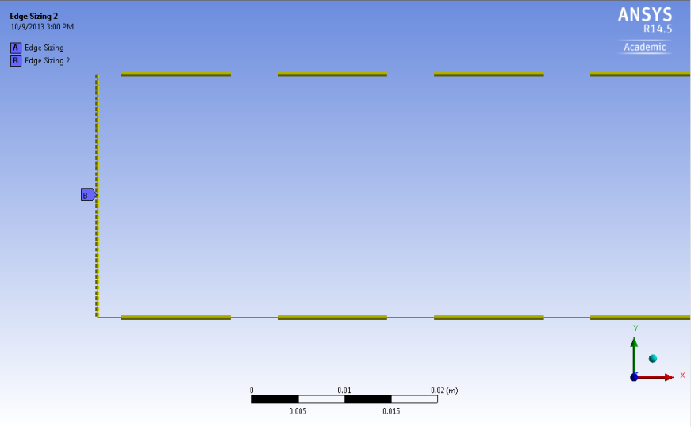
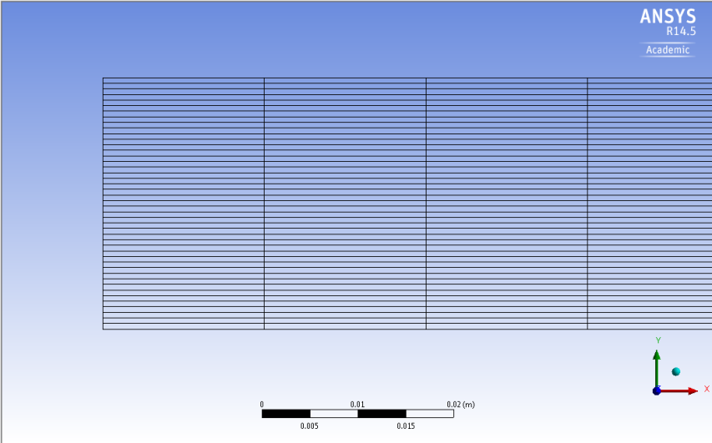
ANSYS Mesh
Create uniform grid distribution

Slide 9
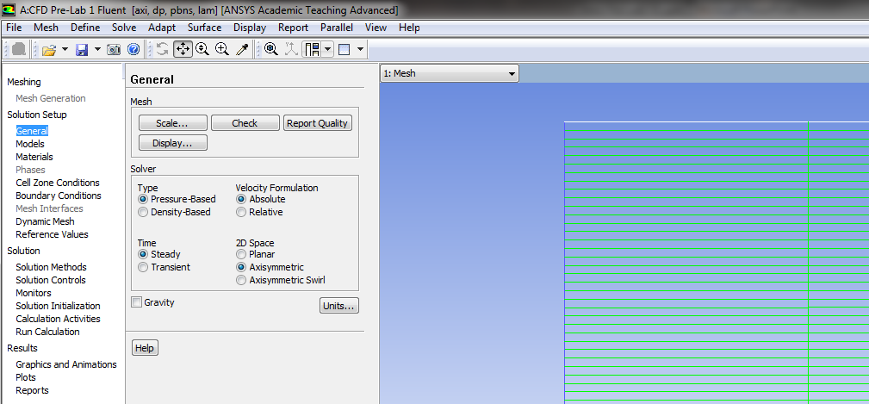
ANSYS Fluent
Using ANSYS fluent define physics of the flow, solve CFD simulation and analyze results
Physics (Setup)
Solution
Results

Slide 10
Physics
ANSYS Fluent
r
Wall – No slip BC
Inlet – Velocity inlet BC
Flow
Outlet – Pressure outlet BC
x
Center – Axisymmetric BC
Zero slop at center or $\frac{du}{dr}=0$
Laminar flow
Air properties
Boundary Conditions (BC)
No-slip: velocities are zero ($u,v=0$), pressure gradient ($\frac{dp}{dr}=0$) is zero
Symmetric: radial velocity is zero ($v=0$), gradients of axial velocity and pressure are zero ($\frac{du}{dr}=0$, $\frac{dp}{dr}=0$)
Inlet velocity: uniform constant velocity ($u=0.2\frac{m}{s}, v=0,\frac{dp}{dr}=0$)
Outlet: (gauge) pressure is imposed to the boundary ($p=0,\frac{du}{dx}=0$, $\frac{dv}{dx}=0$)

Slide 11
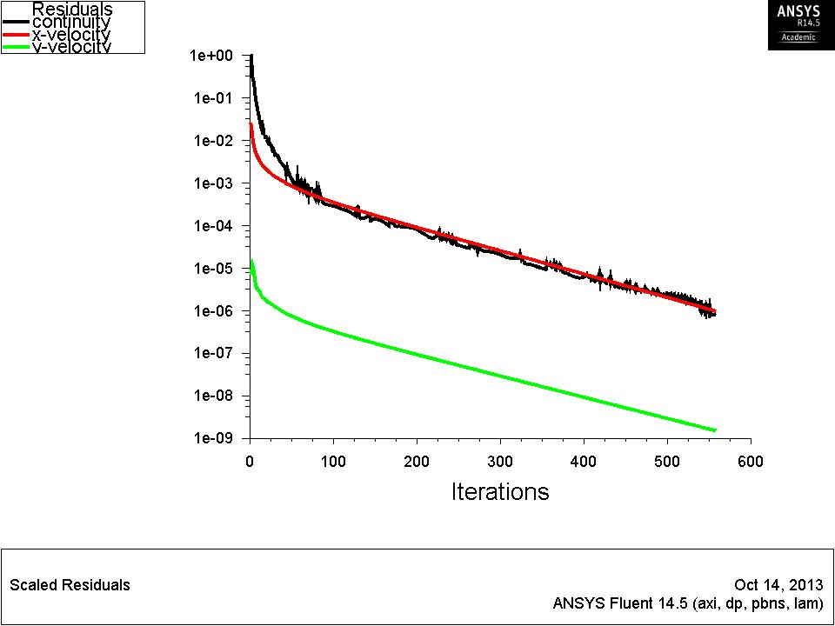
ANSYS Fluent
Solution
A limiting behavior in the solution of the equations
Represented by the history of residuals or errors made by previous iterative solutions.
A converged solution is not necessarily an accurate one due to iteration number, domain size, mesh resolution and numerical schemes
Continuity, momentum equation have their own residual histories.

Slide 12
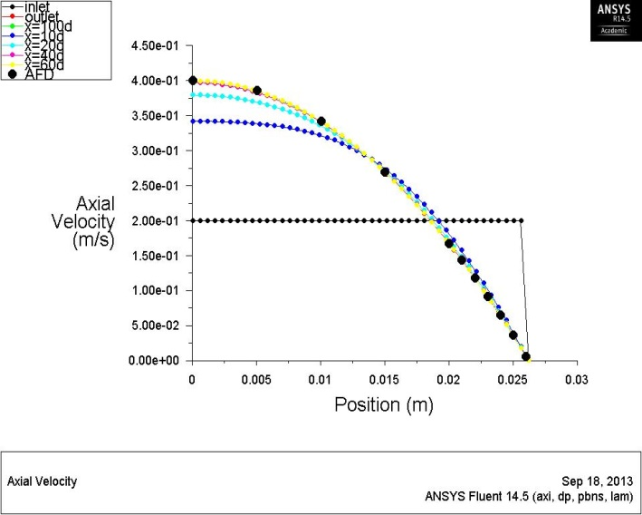
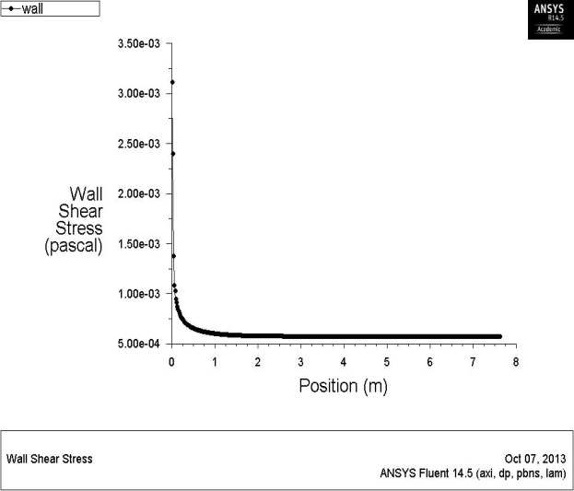
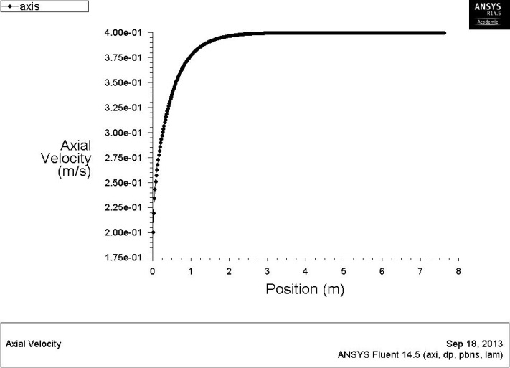
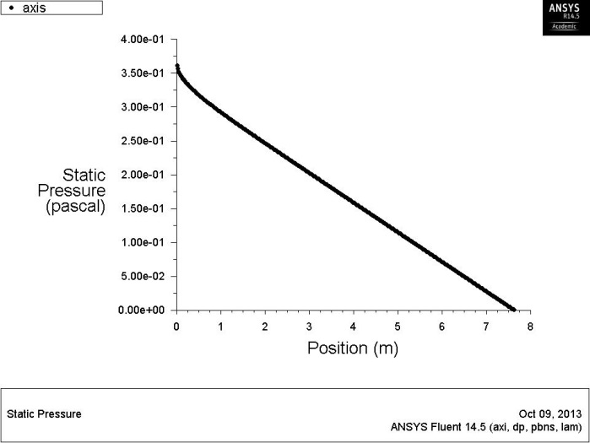
ANSYS Fluent
Results
Developed length is distance from entrance to a point where flow is fully developed.
Fully developed flow does not change velocity profile or velocity gradient in axial direction is zero.
Pressure drops linearly.
Axial velocity or skin friction distribution along axis can be used to determine the length.
Developed region
Developing
region

Slide 13
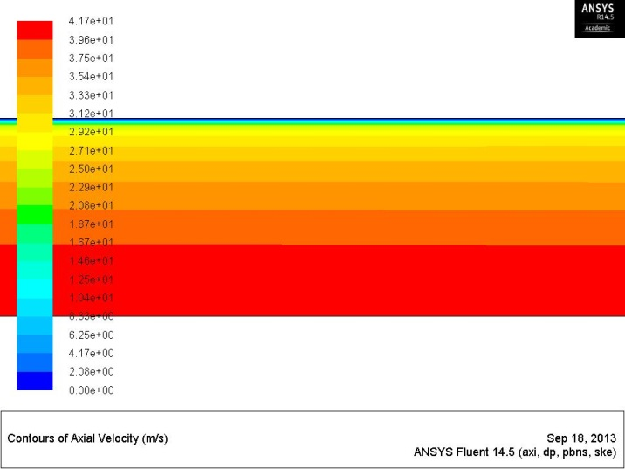
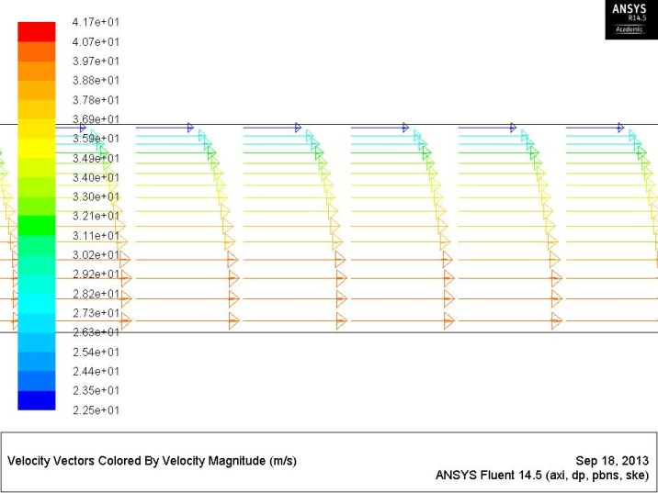
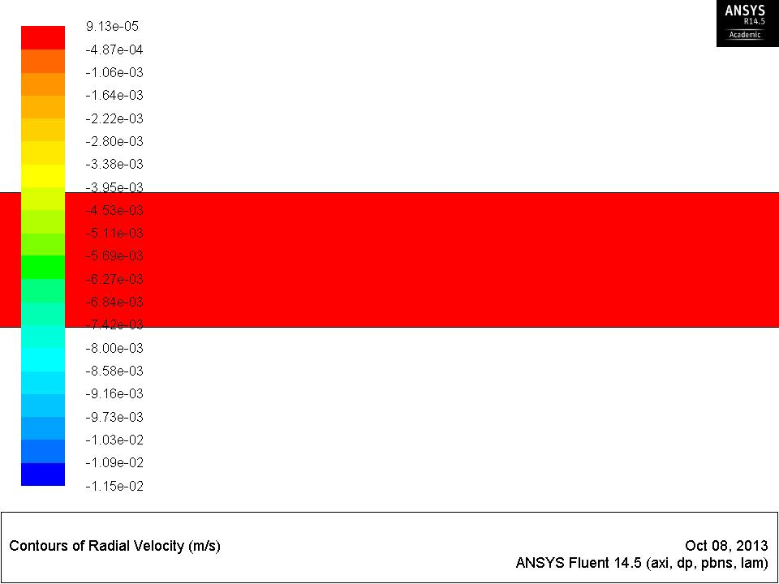
ANSYS Fluent
Results
Flow can be visualized in detail using CFD

Slide 14
Questions?
Bring your Data Reduction Sheet for the CFD Labs
Deadline for CFD Lab report is two weeks after your CFD lab (not pre-lab)
Use lab drop-box when turning in your lab reports
Come to the office hours for help

