Slide 1
Review for FE Exam: Fluids
3/22/2011
Hyunse Yoon, Ph.D.
(hyun-se-yoon@uiowa.edu or hyn@engineering.uiowa.edu)
Postdoctoral Research Scholar
Department of Mechanical Engineering, University of Iowa
IIHR-Hydroscience & Engineering, University of Iowa

Slide 3

1) FE Supplied-Reference Handbook
This is the official reference material used in the FE exam room. Review it prior to exam day and familiarize yourself with the charts, formulas, tables, and other reference information provided. Note that personal copies will not be allowed in the exam room. New copies will be supplied at the exam site. 8th edition, 2nd revision ©2011
Use the reference and review materials sold by CEE's ASCE student chapter. This year, the CEE department will again reimburse any CEE students who are registered for the FE exam for related study materials (not exam fees). The department can afford to pay for the cost of reference and review books up to ~$60. Bring your original receipt to the department administrative assistant, Angie Schenkel.
$13.95
ISBN: 978-1-932613-59-9
2) 57:020 Fluids Class Lecture Note: http://www.engineering.uiowa.edu/~fluids

Slide 4



Slide 5
Contents:
Fluids properties: Density, specific volume, specific weight, and specific gravity
Stress, pressure, and viscosity
Surface tension and capillarity
The pressure field in a static liquid
Manometers
Forces on submerged surfaces and the center of pressure
Archimedes principle and buoyancy
One-dimensional flows
The field equation (Bernoulli equation)
Fluids measurements (Pitot tube, Venturi meter, and orifices)
Hydraulic Grade Line (HGL) and Energy Line (EL)
Reynolds number
Drag force on immersed bodies
Aerodynamics
Fluid flow (Pipe flow; Energy equation)
The impulse-momentum principle (Linear momentum equation)
Dimensional homogeneity and dimensional analysis and similitude
Open-channel flow

Slide 6

The density of a fluid is defined as its mass per unit volume.
The specific volume is the volume per unit mass and is therefore the reciprocal of the density.
Specific weight is weight per unit volume;
Specific gravity is the ratio of fluid density to the density of water at a certain temperature.

Slide 8
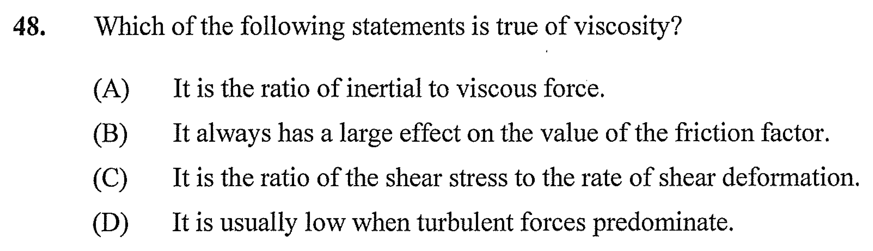
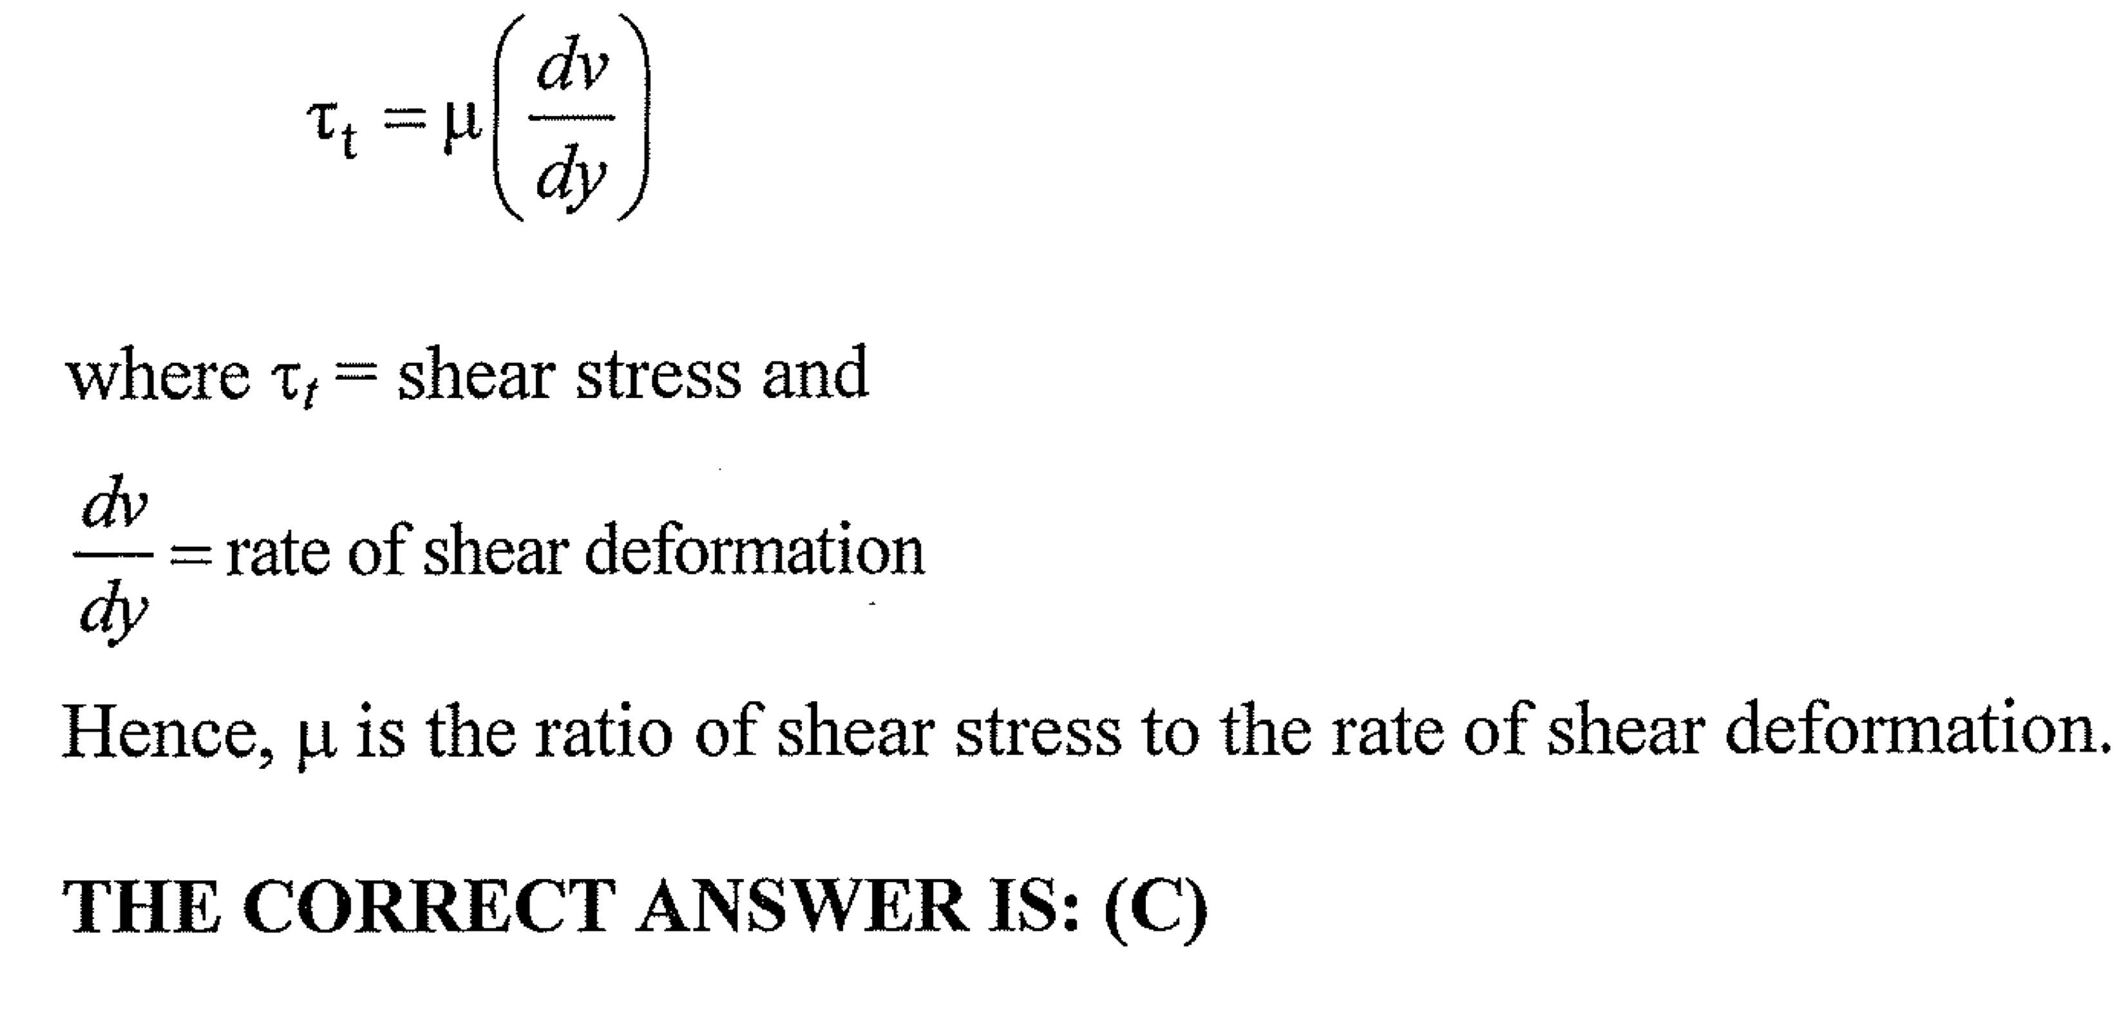

Slide 9

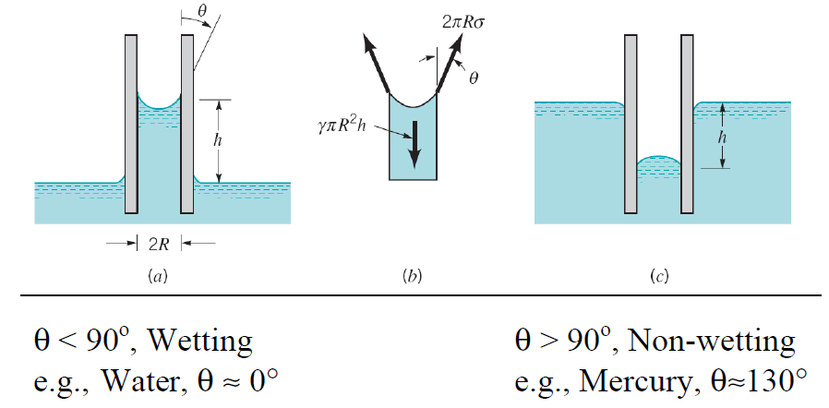
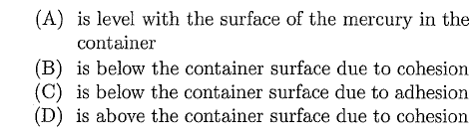


Slide 11
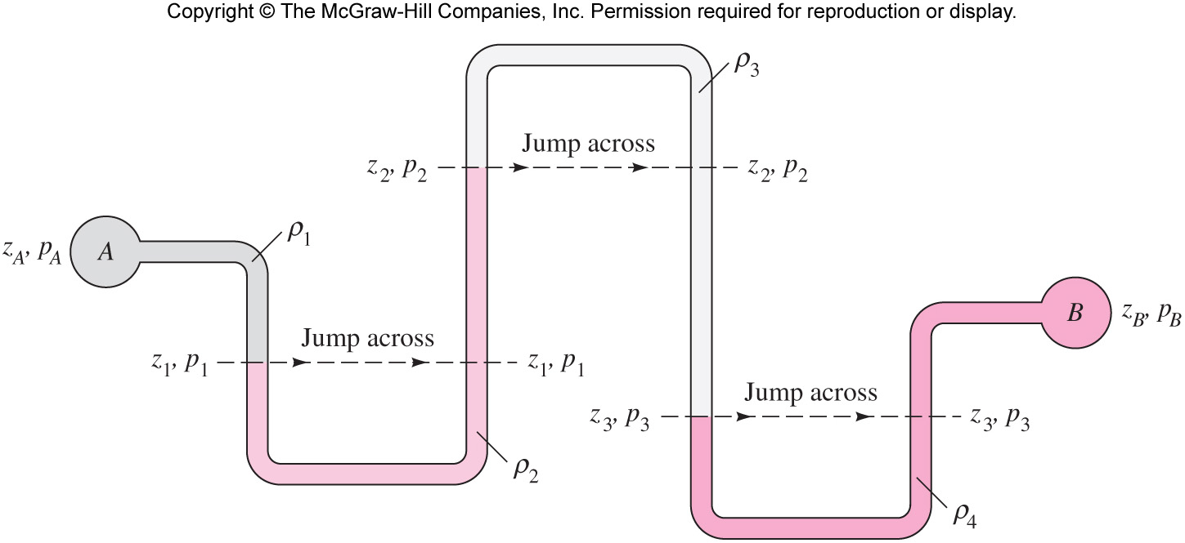
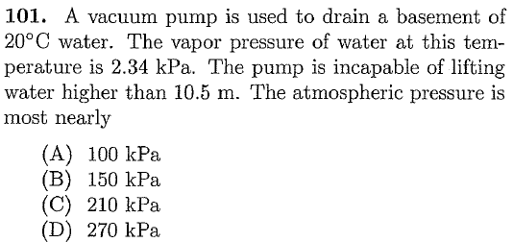
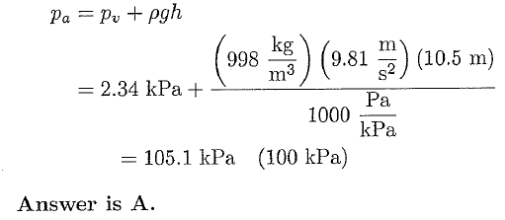
↓: add γh
Jump across: no change
↑: subtract γh

Slide 12
Note
→: when γ_{1,} γ₃ << γ₂
_{e.g.) gas vs. liquid}

Slide 16
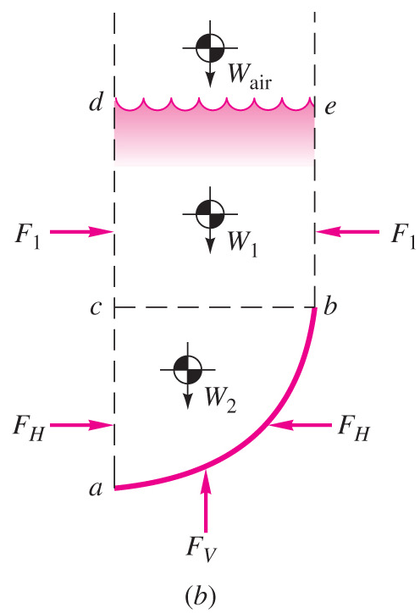

Slide 17
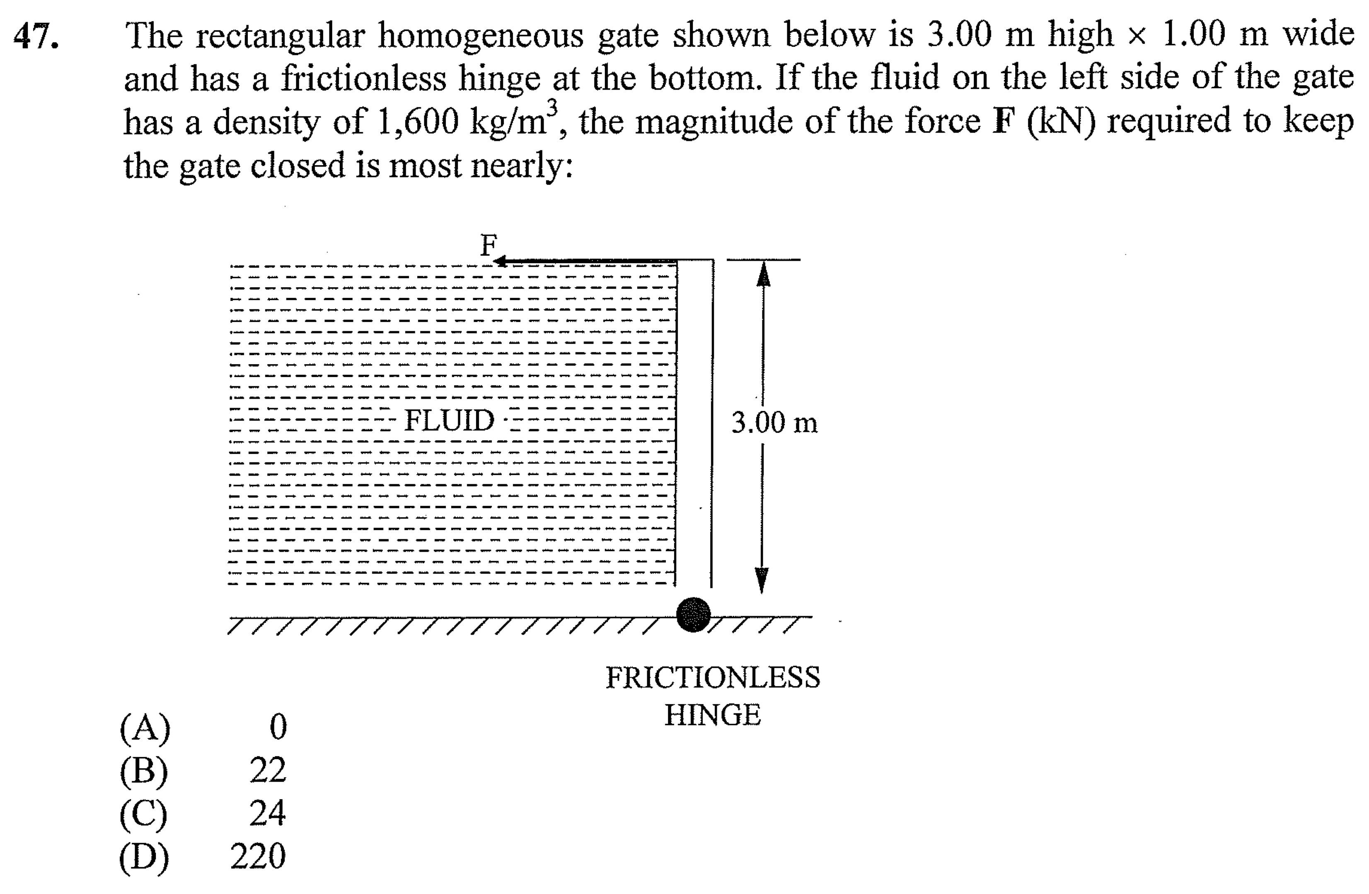
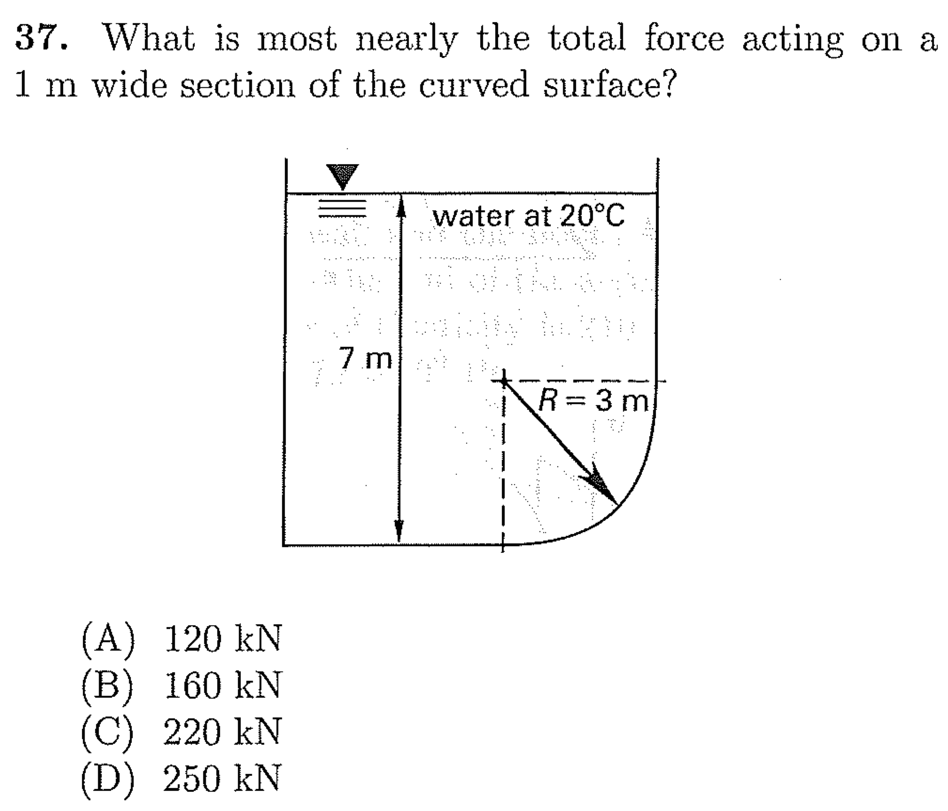
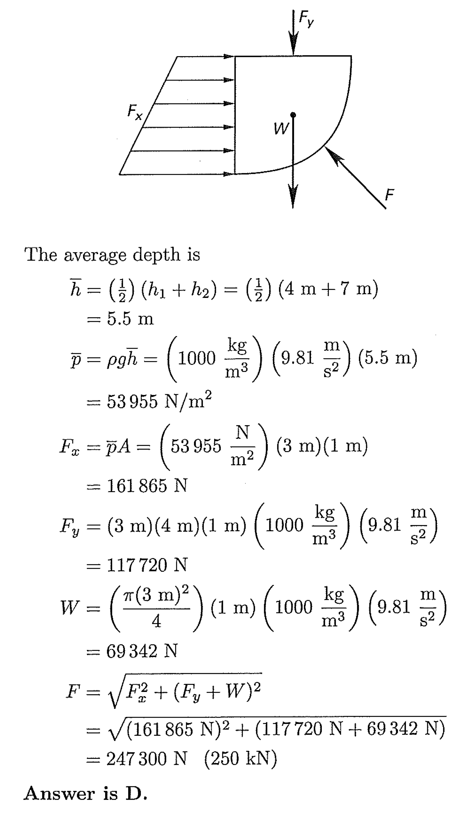
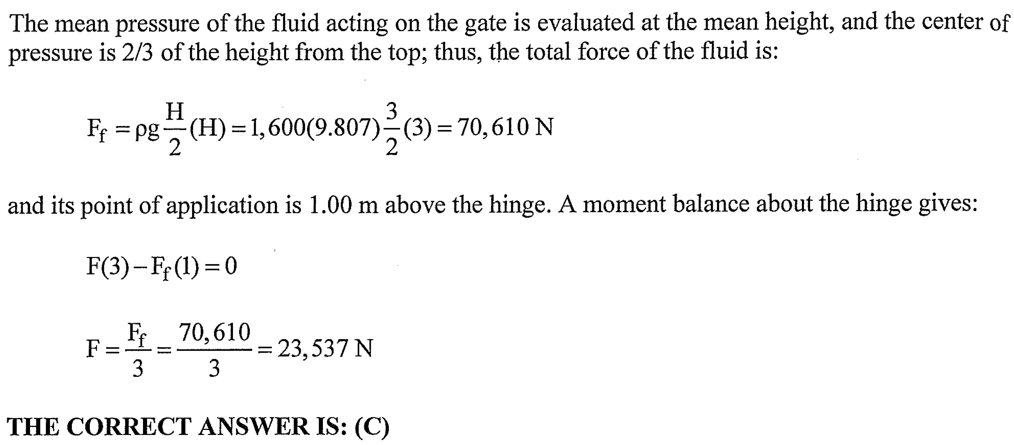

Slide 18
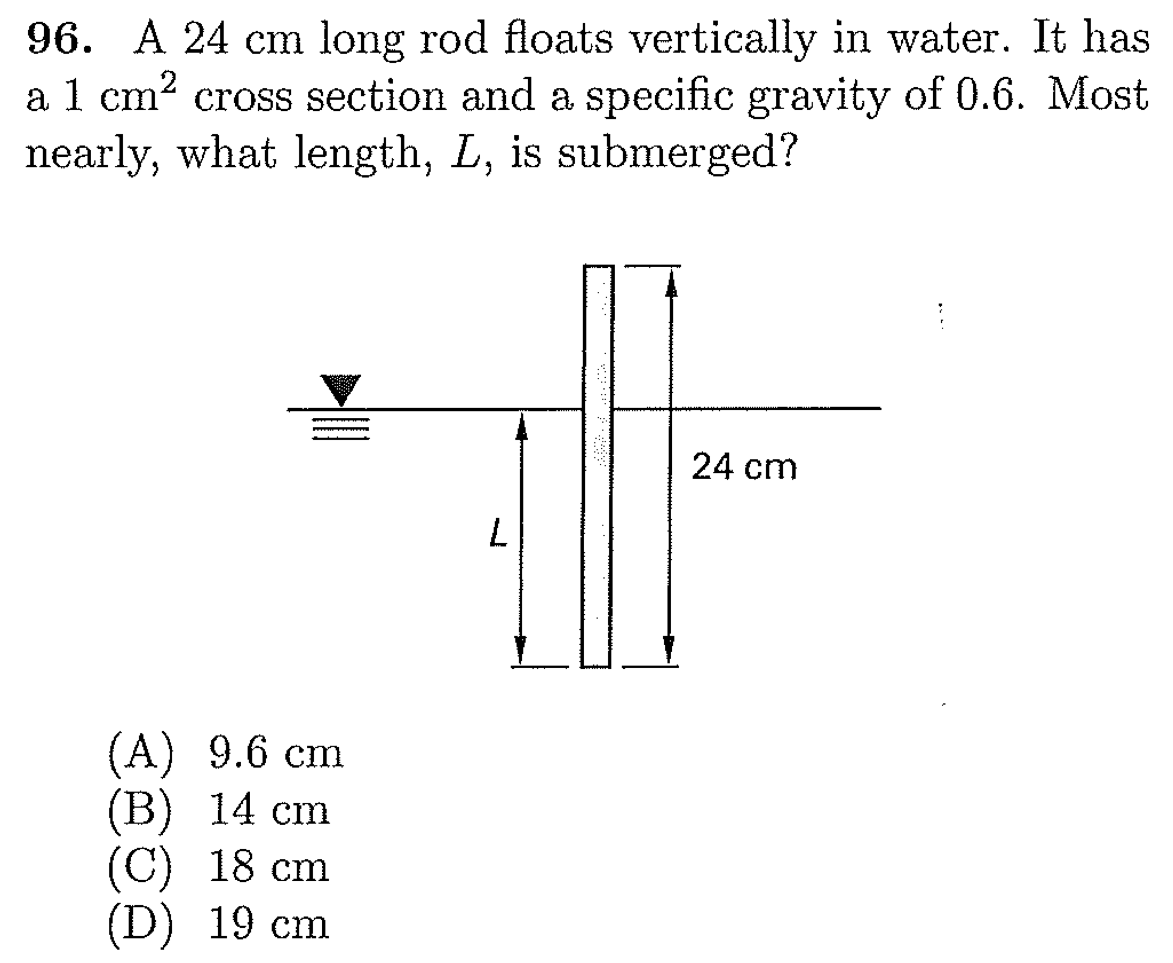
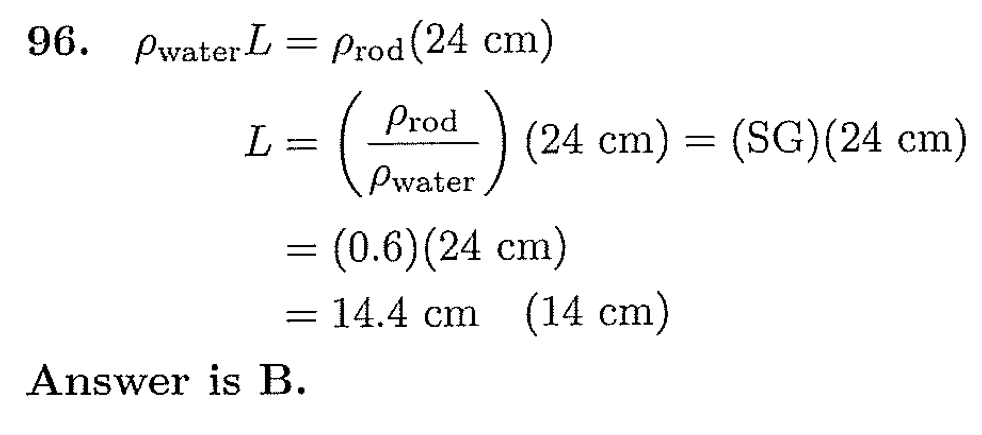

Slide 19
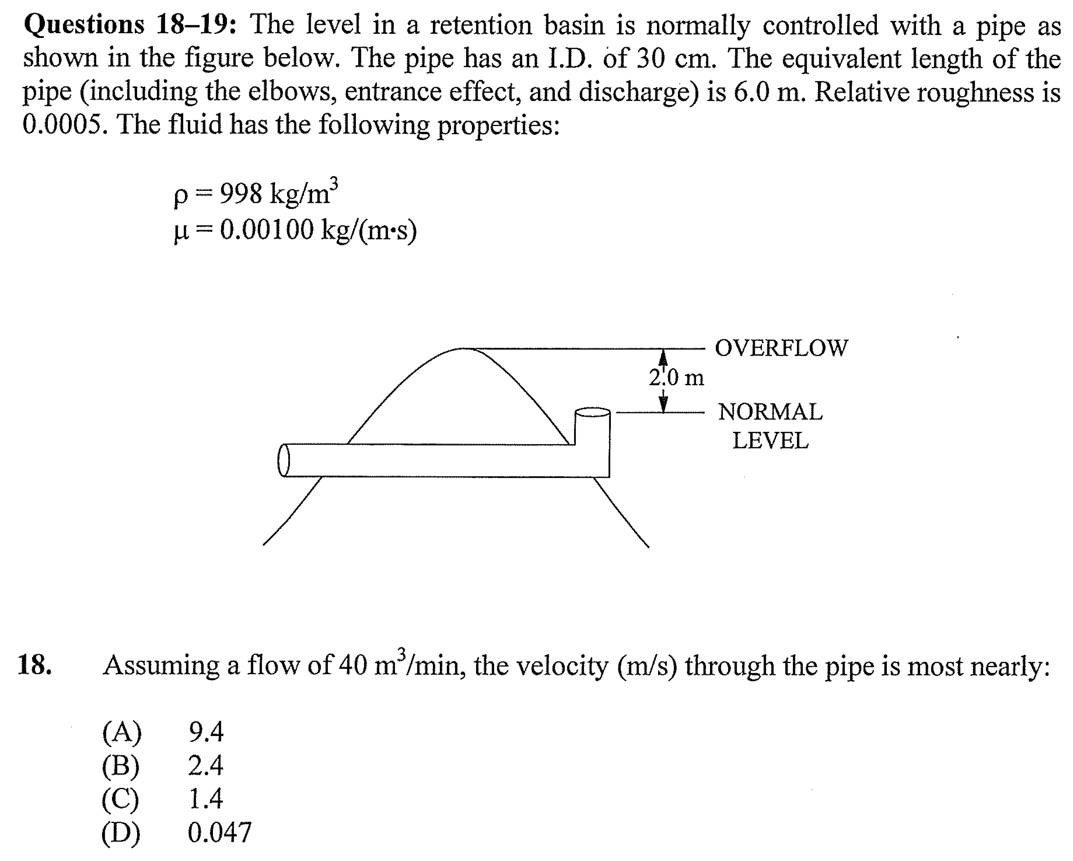
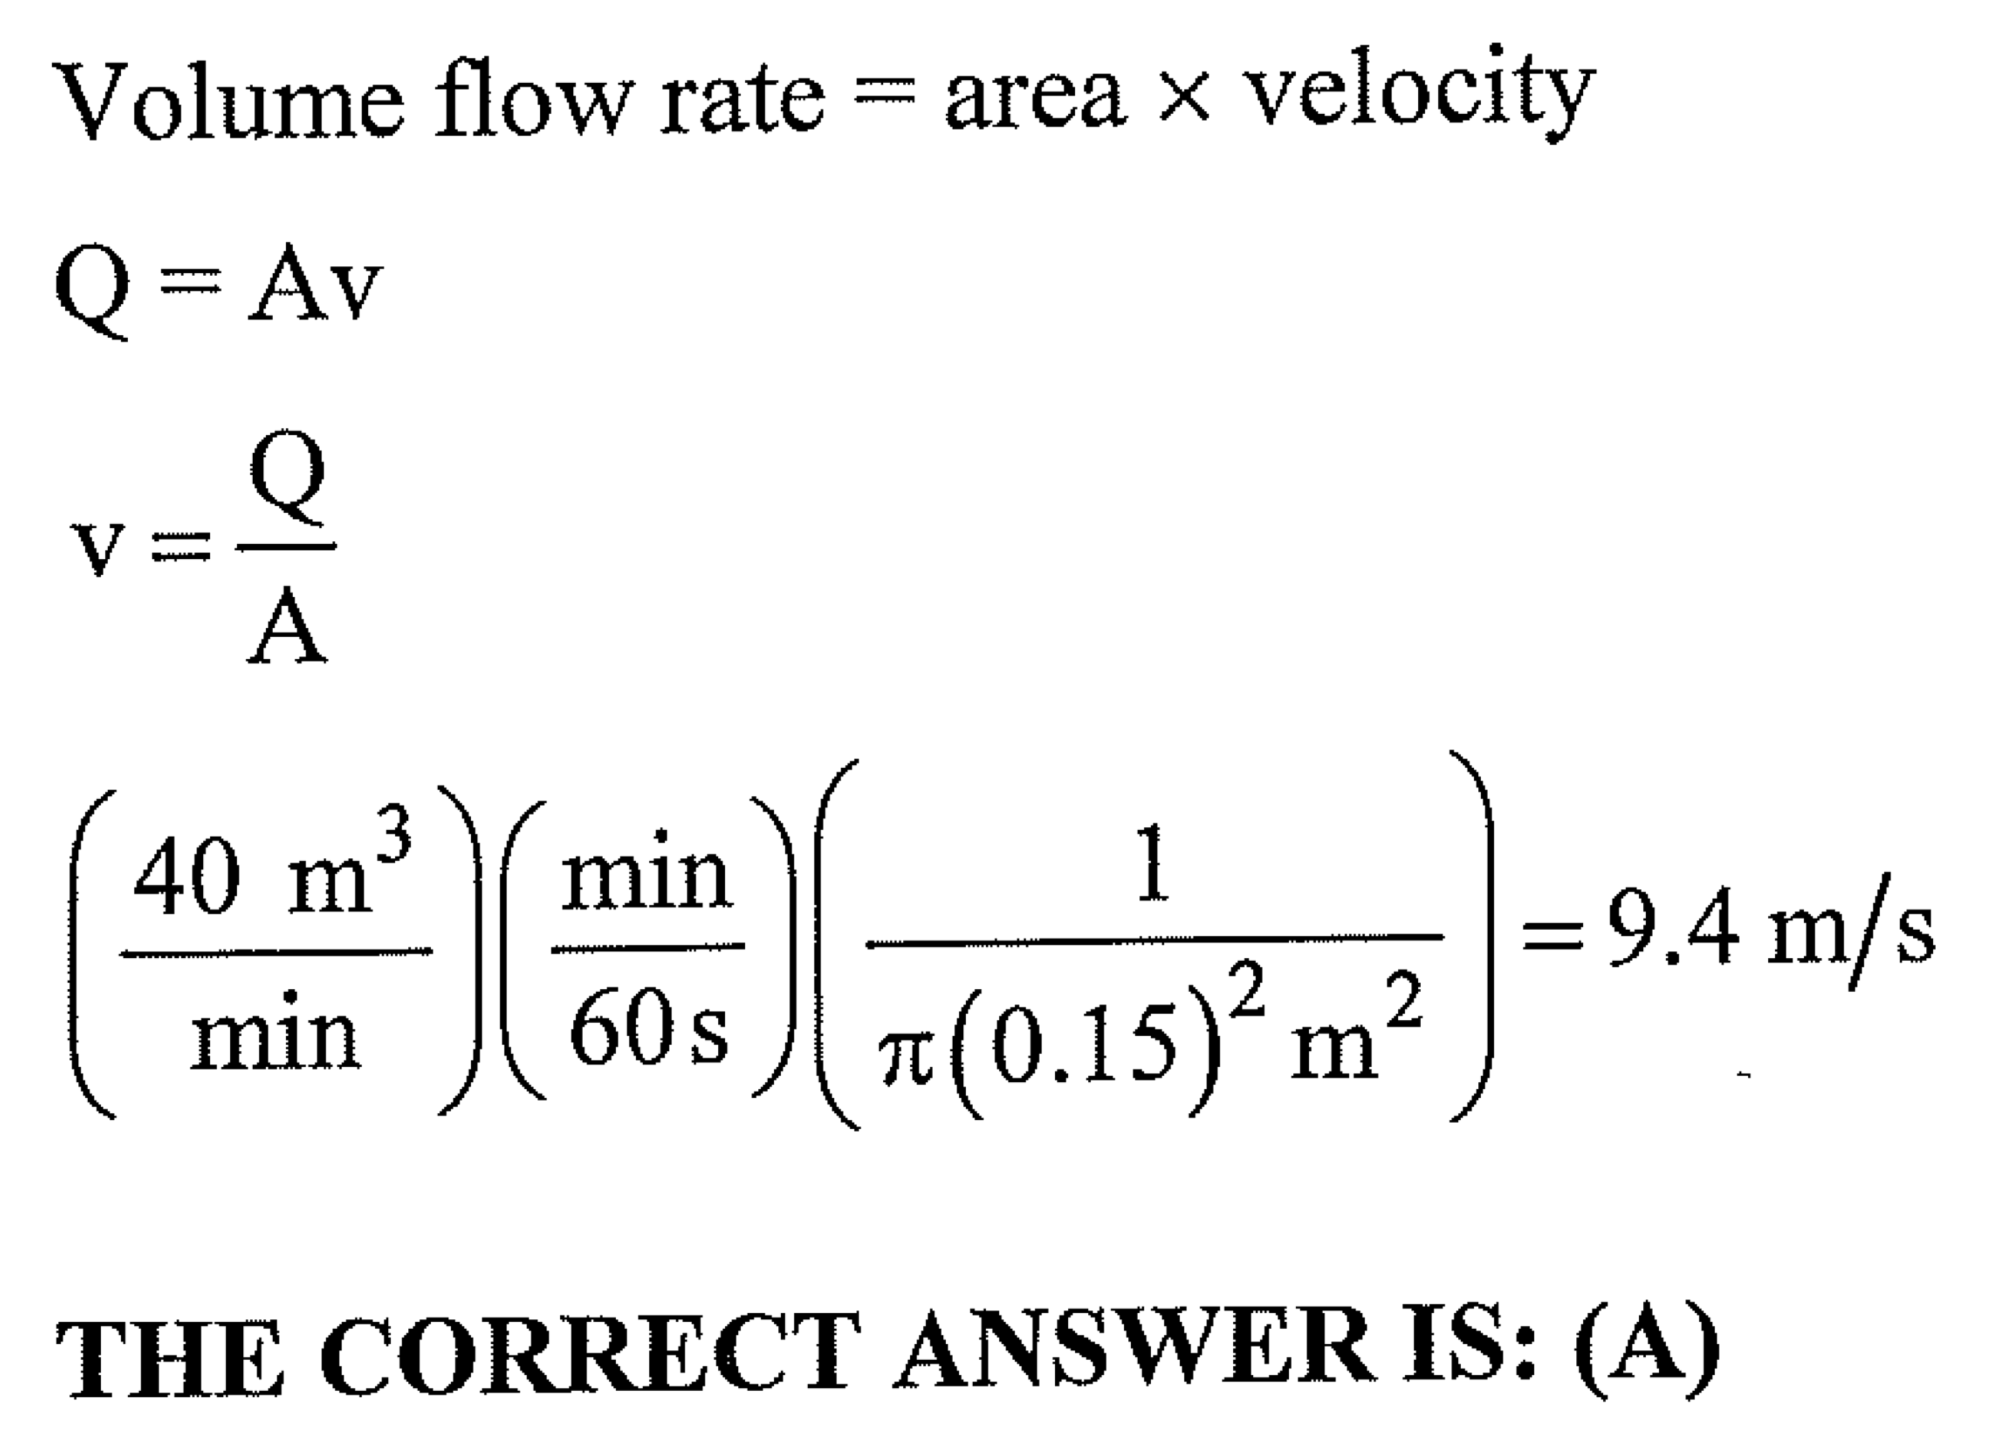

Slide 20

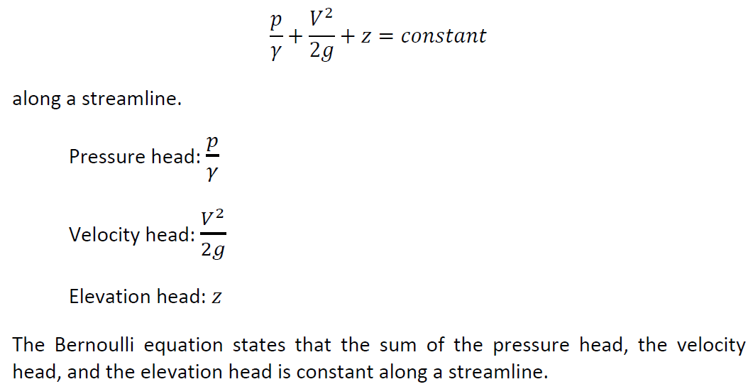
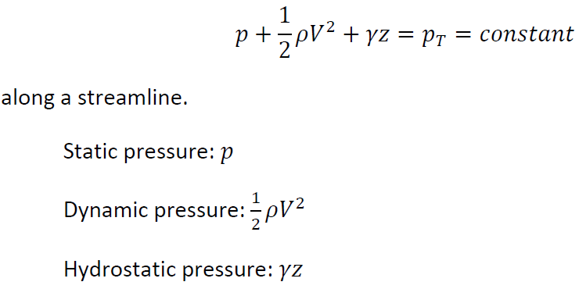

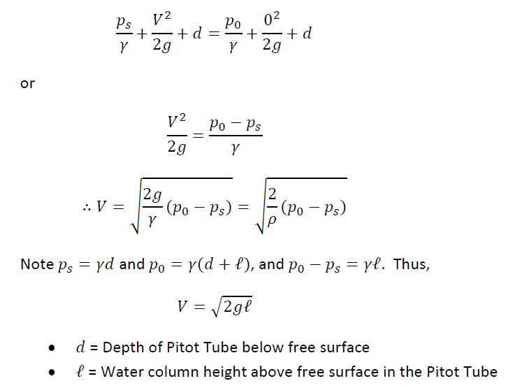

Slide 21
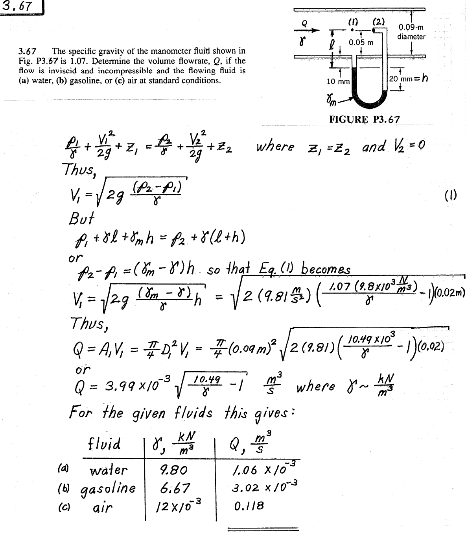
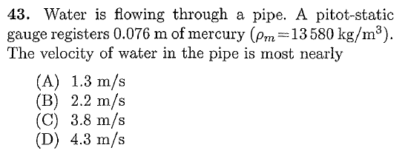
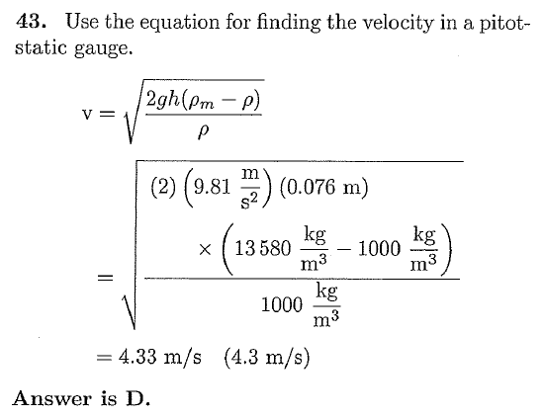

Slide 22
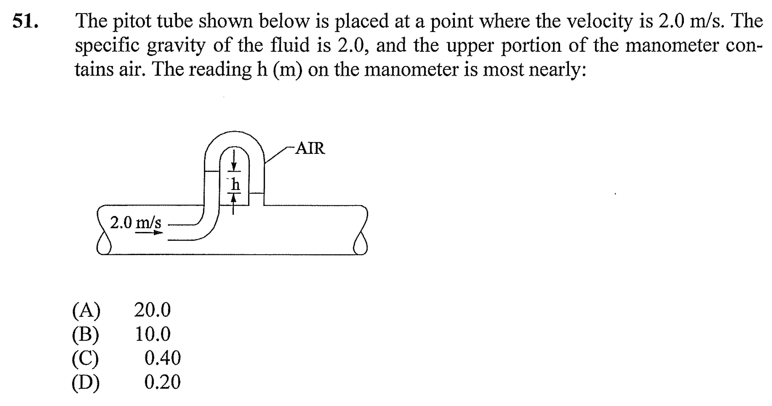
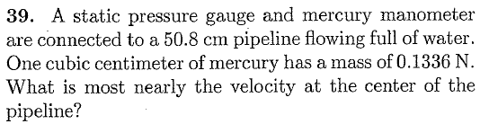
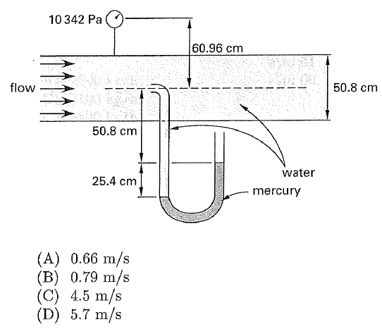
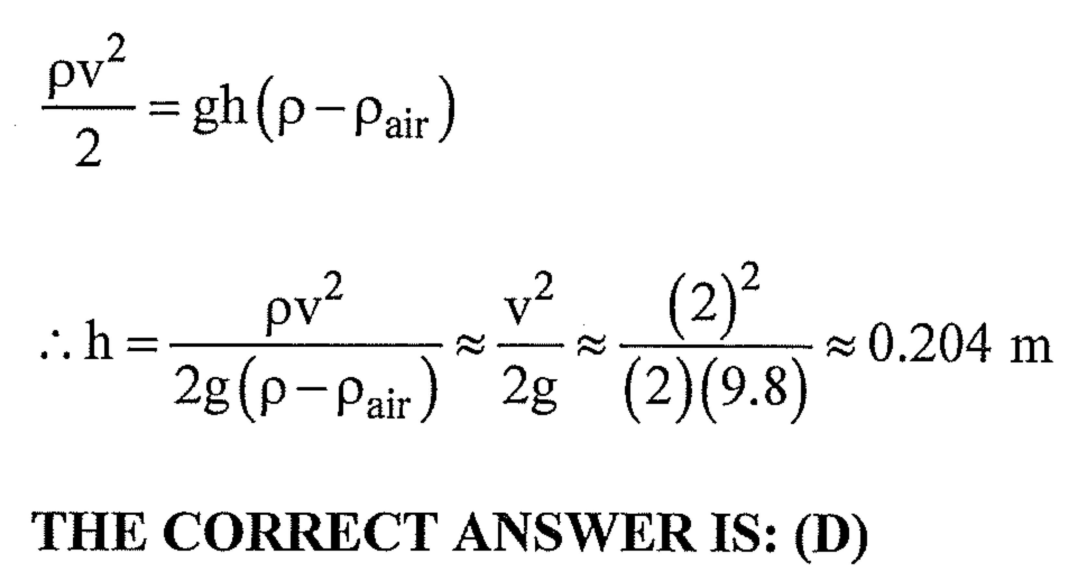
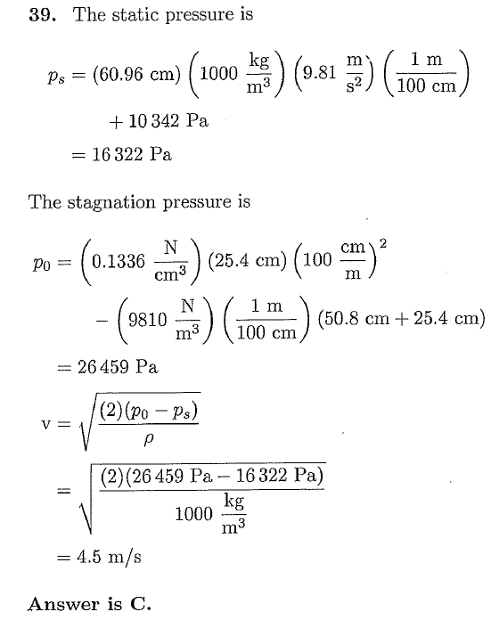

Slide 23
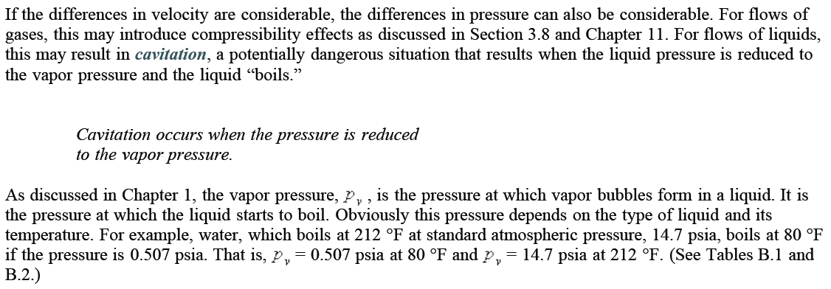

Slide 24
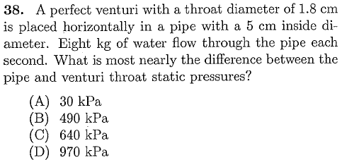
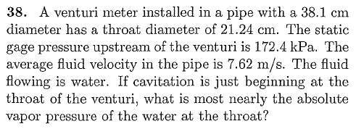
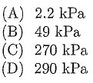
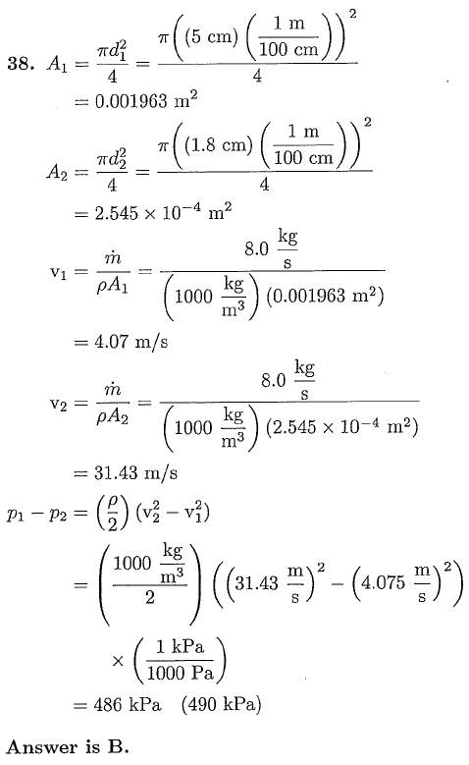
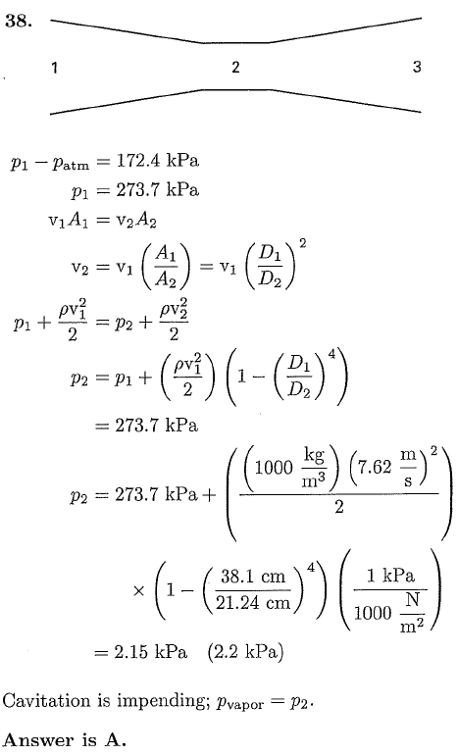

Slide 25
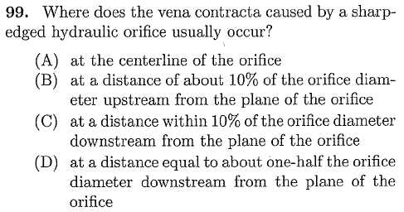


Slide 26
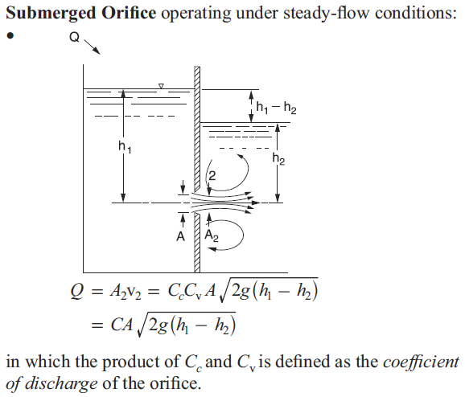
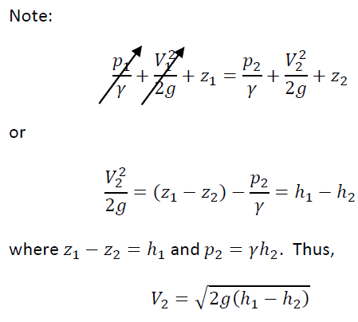
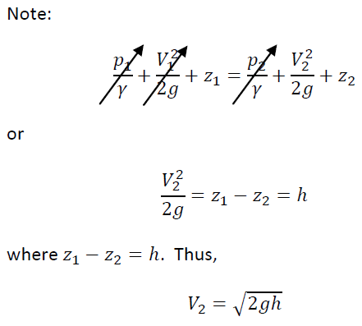

Slide 27
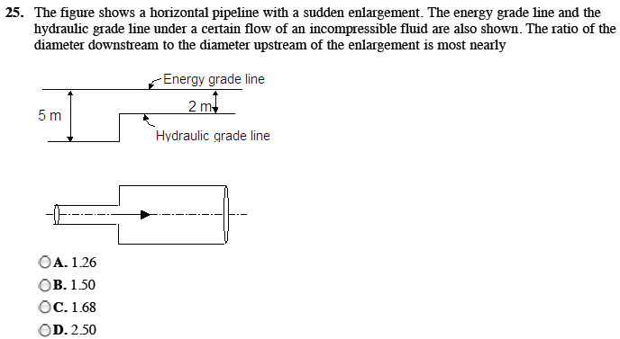
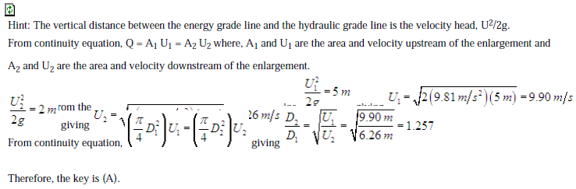

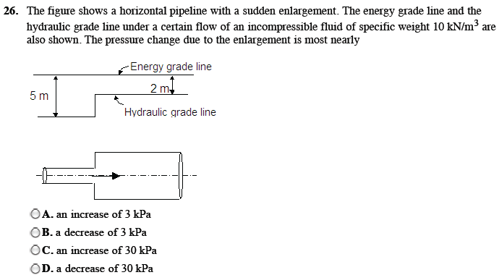
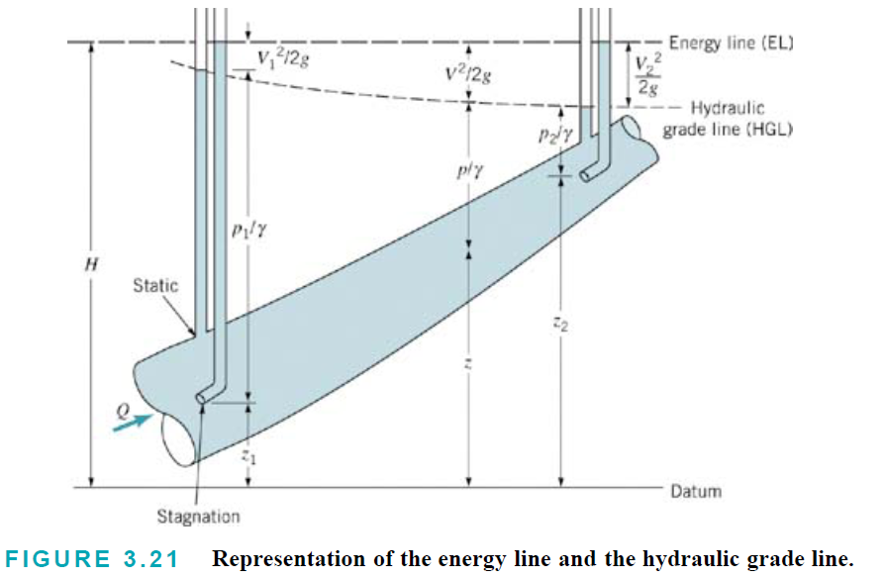
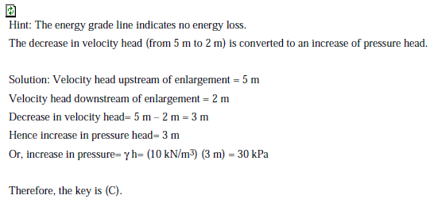

Slide 28
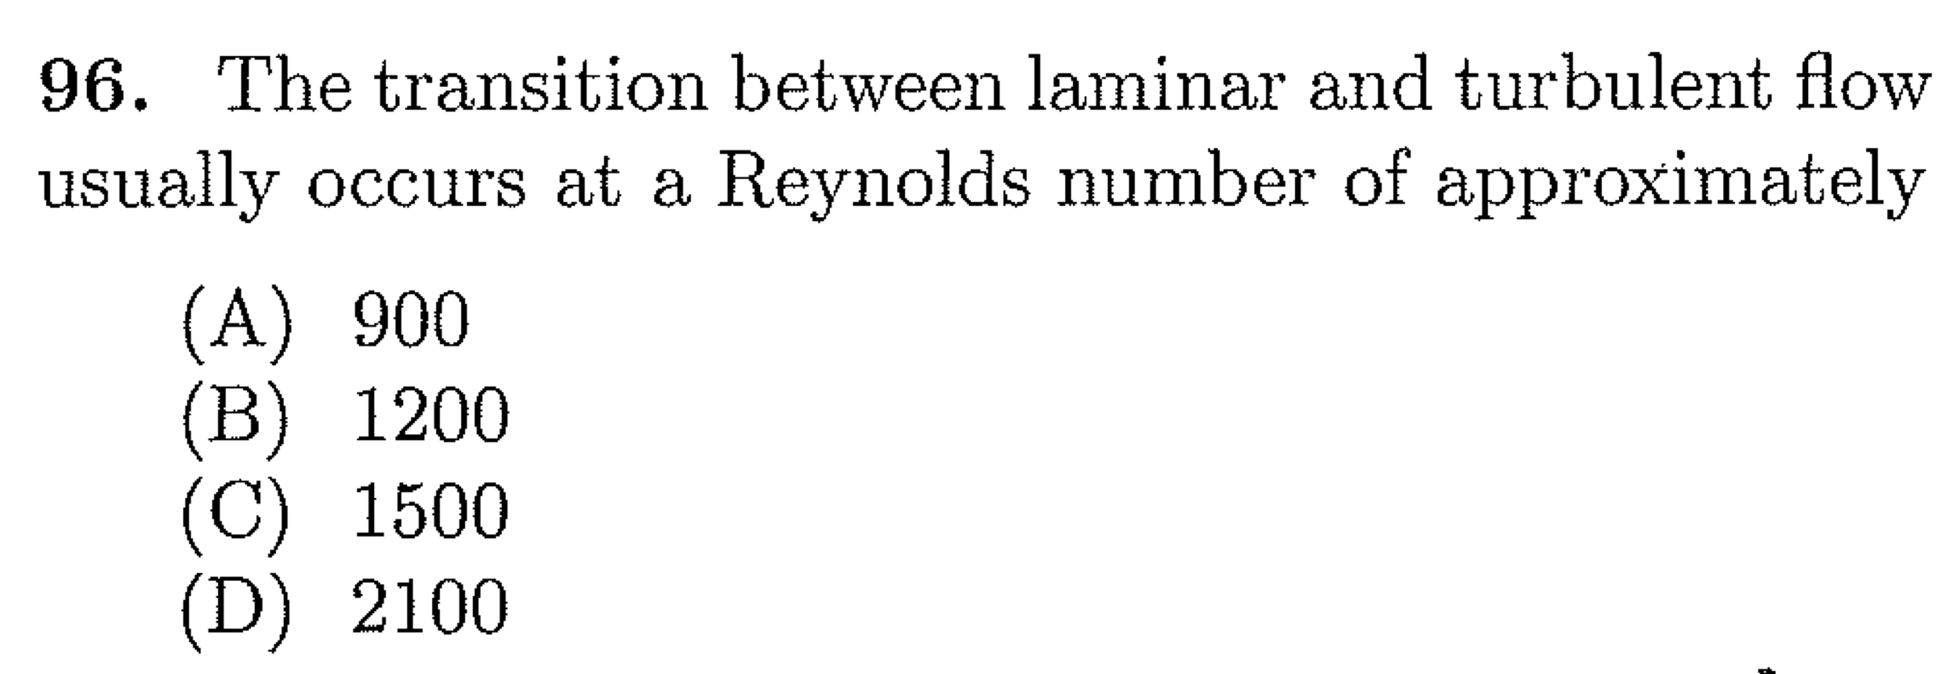
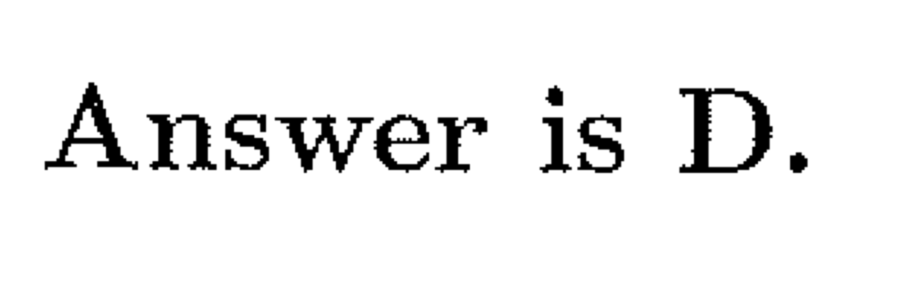

Slide 29
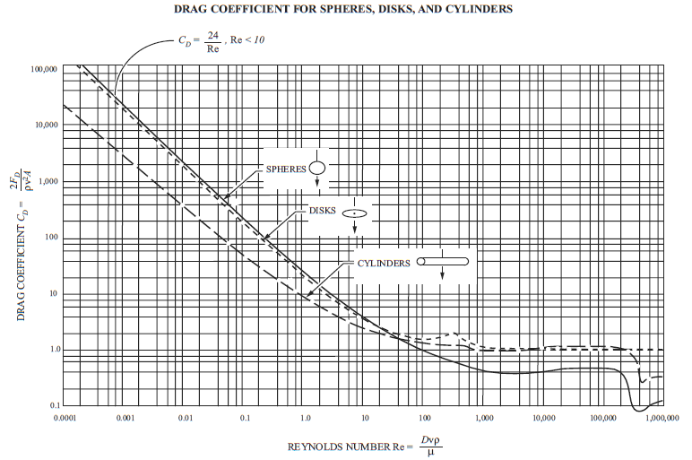

Slide 31
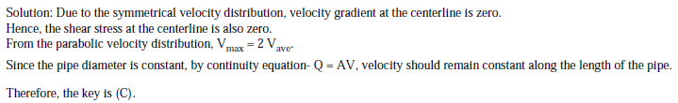
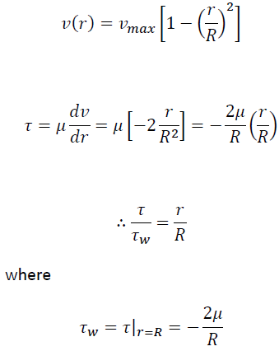
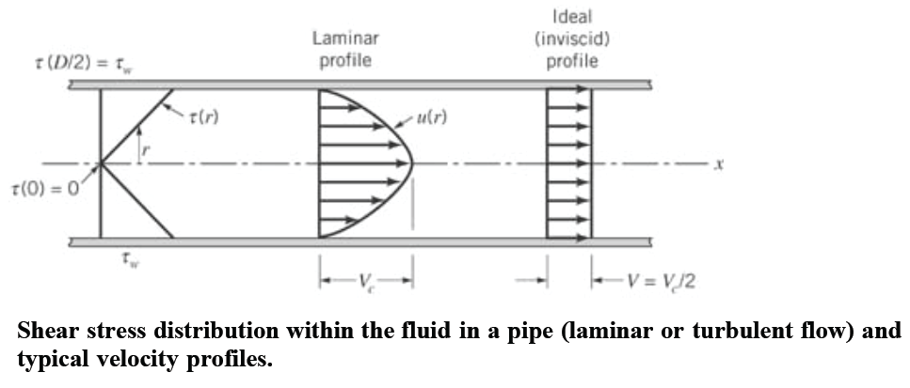
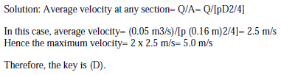

Slide 32
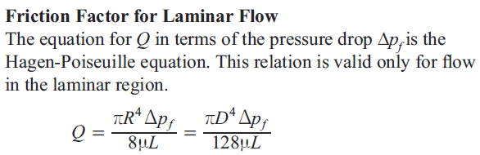


Slide 33







Slide 35


Slide 36




Slide 37


(2)
(1)
(3)

Slide 38



Slide 39






Slide 40







Slide 41


Slide 43

(1)
(2)

Slide 44





Slide 45






Slide 46







Slide 47





Slide 48

Good Luck!

