Slide 1
CFD Pre-Lab 2
Simulation of Turbulent
Flow around an Airfoil
Seong Mo Yeon, and Timur Dogan
11/12/2013

Slide 2
Outline
Overview of Flow Around Airfoil
CFD Process
Workbench Geometry
Physics
Mesh
Solution
Results

Slide 3
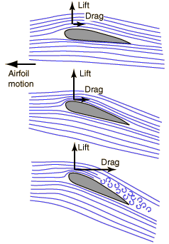
Overview of Flow Around Airfoil
Simulation of flow around airfoil will be conducted for this lab
Computational fluid dynamics (CFD) results for drag and lift coefficients, coefficient of pressure around the airfoil will be compared to experimental fluid dynamics (EFD)
This lab will cover concept of boundary layer and flow separation
Flow visualization around airfoil
(starts at 5:34)

Slide 4
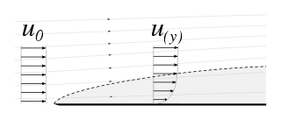
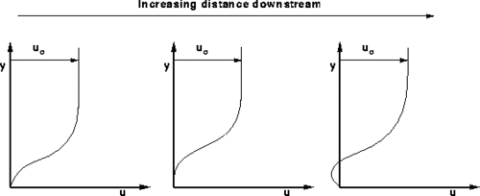
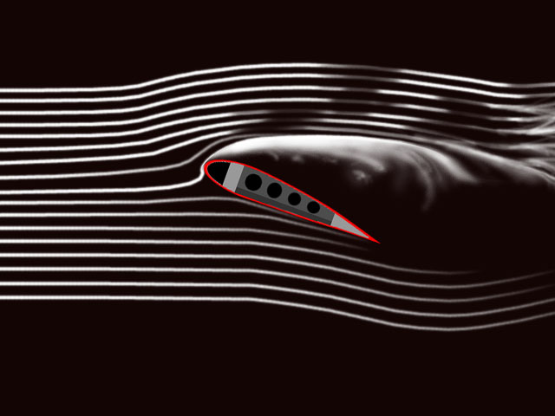
Overview of Flow Around Airfoil
Boundary Layer
  Defined by Ludwig Prandtl
  Generated by viscosity near wall
  Cause of lift and drag forces
  Inviscid vs. viscous flow
  Flow separation
  Note: Refer to Chapter 9 of your book for more details
Flow visualization of boundary layer
(Start at 3:21)

Slide 5
CFD Process
The overall procedure for simulation of flow around airfoil is shown on chart below
Although we will be making the mesh before we define the physics you have to know the physics to design appropriate mesh.
Geometry
Physics
Mesh
Solution
Results
Airfoil (ANSYS Design Modeler)
General (ANSYS Fluent - Setup)
Structured (ANSYS Mesh)
Solution Methods (ANSYS Fluent - Solution)
Plots (ANSYS Fluent- Results)
C-Domain (ANSYS Design Modeler)
Model (ANSYS Fluent - Setup)
Graphics and Animations (ANSYS Fluent- Results)
Boundary Conditions (ANSYS Fluent -Setup)
Non-uniform (ANSYS Mesh)
Solution Controls (ANSYS Fluent - Solution)
O-Domain (ANSYS Design Modeler)
Monitors (ANSYS Fluent - Solution)
Reference Values (ANSYS Fluent - Setup)
Turbulent
Solution Initialization
(ANSYS Fluent - Solution)
Solution Initialization (ANSYS Fluent -Solution)
Run Calculation
(ANSYS Fluent - Solution)

Slide 6
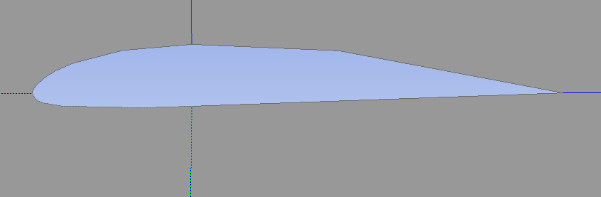
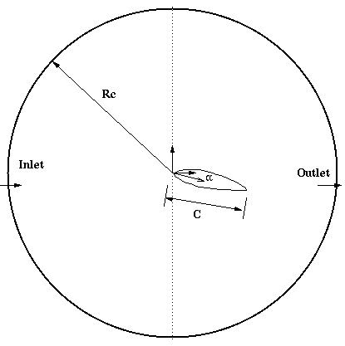
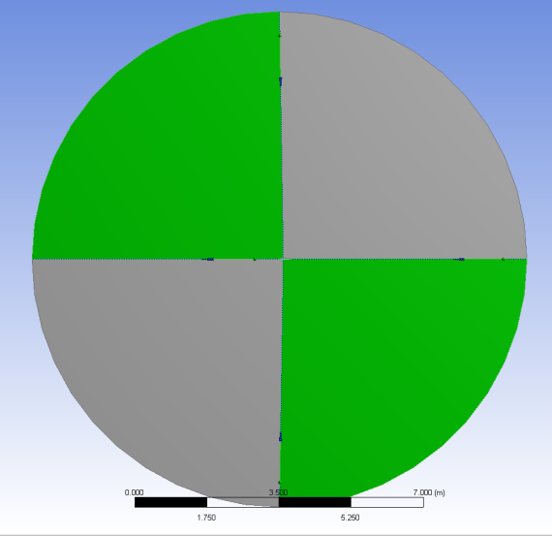
Geometry
Import Clark-Y airfoil geometry
Split O-type domain into four pieces
Parameter | Value
Chord length, c | 0.3048 m
Radius of domain, Rc | 12.0 m
Angle of attack, α | 0, 16

Slide 7
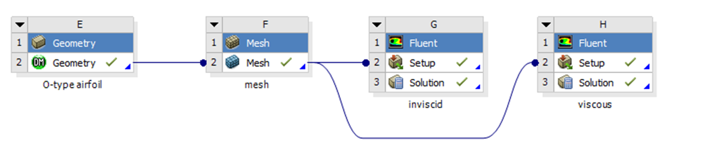
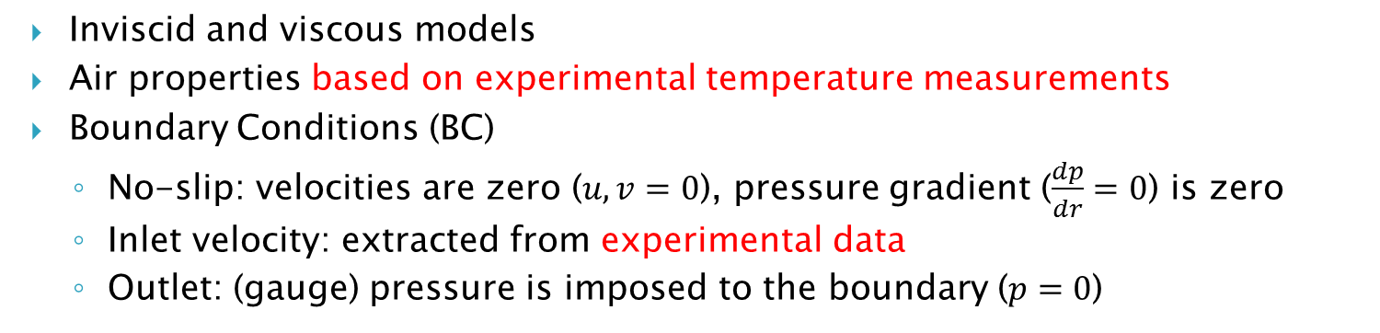
Physics
Wall – No slip BC
Inlet – Velocity inlet BC
Outlet – Pressure outlet BC
Inviscid and viscous models
Air properties based on experimental temperature measurements
Boundary Conditions (BC)
  No-slip: velocities are zero ($u,v=0$), pressure gradient ($\frac{dp}{dr}=0$) is zero
  Inlet velocity: extracted from experimental data
  Outlet: (gauge) pressure is imposed to the boundary ($p=0$)

Slide 8
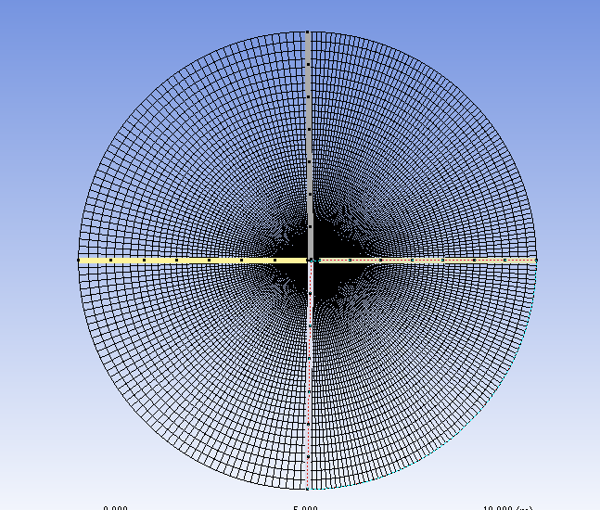
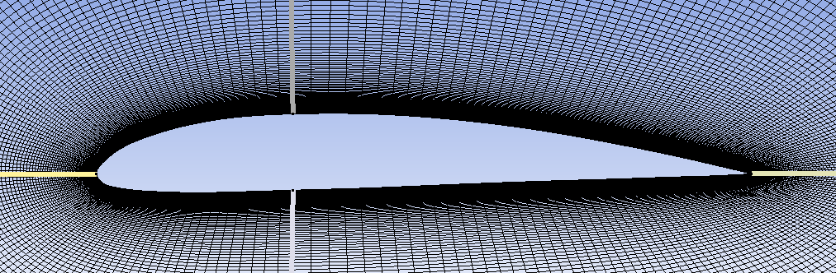
Mesh
Fine mesh at the boundary layer region to resolve large velocity gradients

Slide 9
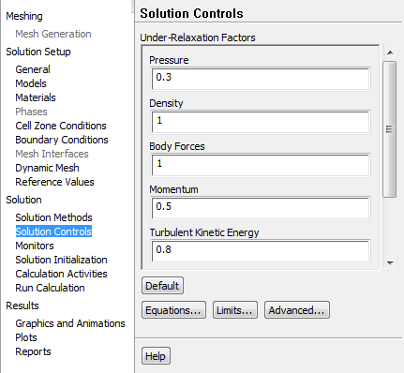
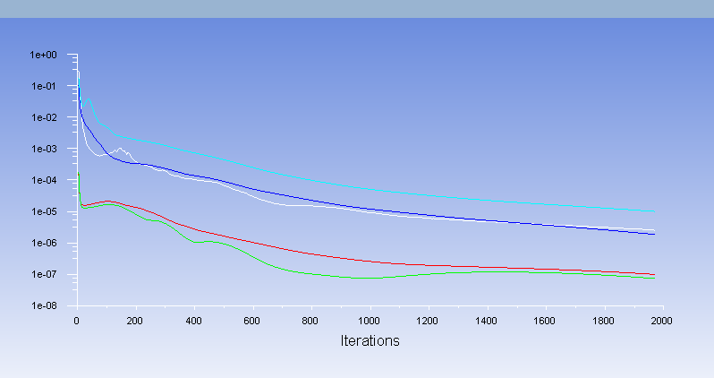
Solution
If you have problems with solution convergence reduce Under-Relaxation Factors. This issue is more likely to occur for large angle of attack cases.
Also you may need to increase the number of iterations

Slide 10
Results

Slide 11
Possible Sources of Error
Inaccurate measurements by load cell 1 was observed.
The voltage for load cell 1 was significantly larger than the voltage for load cell 2.
Accurate results for C_{D}, compared to benchmark data, were achieved using load cell 2 data.
Some students used incorrect directions for lift and drag, Y-direction indicates drag and z-direction indicates lift.

Slide 12
Load Cell Error Fix
If you are experiencing large errors when comparing CFD to EFD for C_{D}, you will need to recalculate C_{D}.
aoa 0 | C_{L} | C_{D} | % Diff C_{L} | % Diff C_{D}
Benchmark (U=15m/s) | 0.184 | 0.017 | - | -
EFD (15.6 m/s) | 0.1585 | 0.0178 | 14% | 5%
EFD with incorrect load cell measurement (15.6 m/s) | 0.1585 | 0.0506 | 14% | 198%

Slide 13
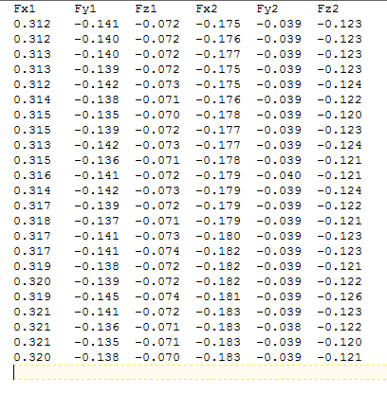
Load Cell Error Fix
Instead of inputting the summed voltage from the two load cells into the calibration curve for drag, input two times the voltage of load cell 2.
Load Cell 1
Load Cell 2
Drag Lift
Drag Lift

Slide 14
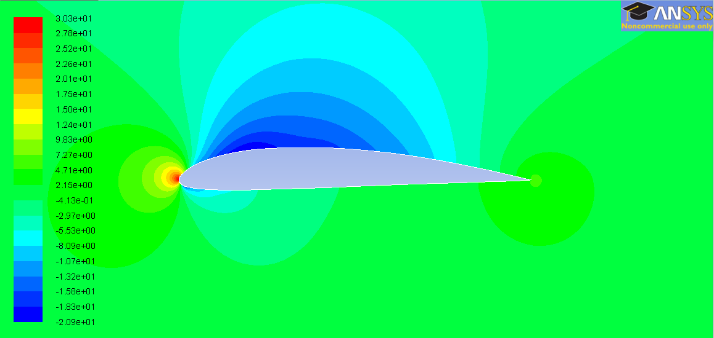
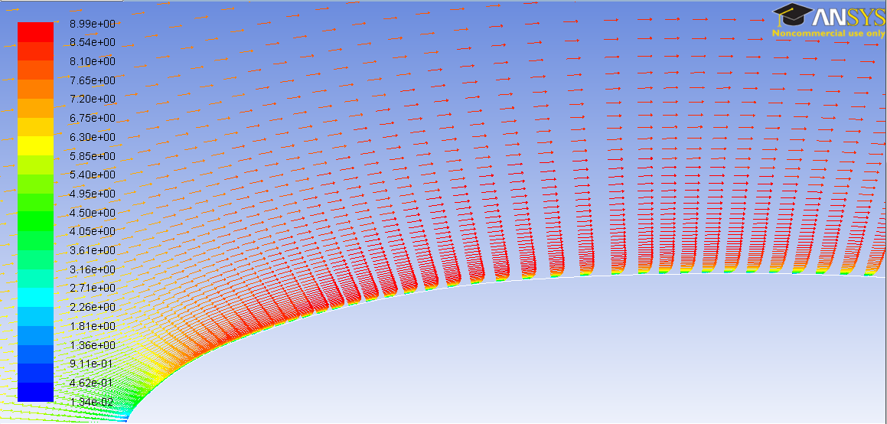
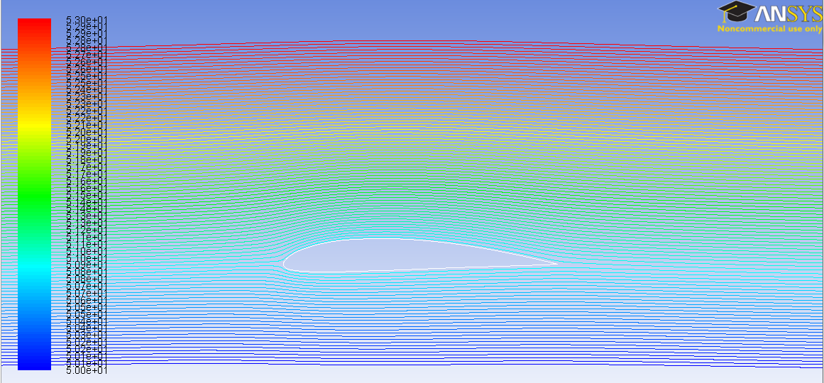
Results
Pressure distribution around airfoil
Velocity vectors near wall and boundary layer development
Stream lines around airfoil

