Slide 1
CFD Pre-Lab 1 Simulation of Laminar Pipe Flow Seong Mo Yeon, Timur Dogan, and Michael Conger 10/07/2015
Notes:
Introduce yourself
Introduce Lab – Simulation of Laminar Pipe Flow in smooth pipe

Slide 2
Outline
Overview of Pipe Flow
CFD Process
ANSYS Workbench
ANSYS Design Modeler (Geometry)
ANSYS Mesh
ANSYS Fluent
Physics (Setup)
Solution
Results

Slide 3
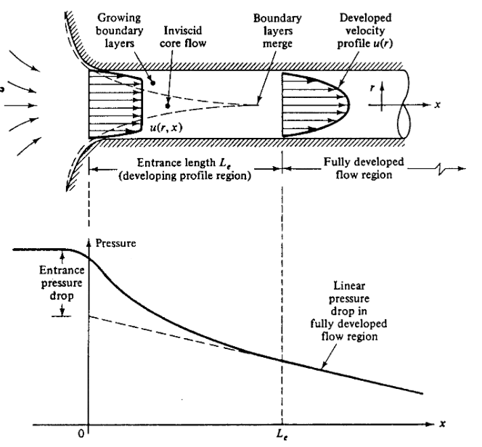
Overview of Pipe Flow
Simulation of laminar pipe flow will be conducted for this lab
Axial velocity profile, centerline velocity, centerline pressure, and wall shear stress will be analyzed
Computational fluid dynamics (CFD) results for friction factor and velocity profile will be compared to analytical fluid dynamics (AFD)
This lab will cover concept of laminar vs. turbulent flow and developing length for pipe flows
Flow visualization between two parallel plates
(starts at 14:25)
Notes:
Questions:
What is the velocity at the wall?
Talking Points:
Simulating laminar pipe flow
Comparing CFD results to AFD solutions
Look at the developing profile
Uniform inlet to quadratic
Linear pressure drop in fully developed flow
Developing length

Slide 4
Overview of Pipe Flow
Flow in pipe with Reynolds (Re) number
$Re=\frac{UD}{ν}=\frac{Inertial Forces}{Viscous Forces}$
where U inflow velocity, D diameter of pipe, $ν$ kinematic viscosity
Laminar : Re < 2300
Turbulent : Re > 2300
Differences between laminar and turbulent flow
(mean) Velocity profile
Pressure drop
Developing length
Wall shear stress and friction factor
Note: Refer to Chapter 8 of your book for more details
Flow visualization of transition from laminar to turbulent flow
Notes:
Talking Points:
Laminar flow is viscous dominated
Low Re #
Turbulent flow is inertial dominated
High Re #

Slide 5
CFD Process
The overall procedure for simulation of pipe flow is shown on chart below
Although we will be making the mesh before we define the physics you have to know the physics to design appropriate mesh.
Geometry
Physics
Mesh
Solution
Results
Pipe (ANSYS Design Modeler)
General (ANSYS Fluent - Setup)
Structure (ANSYS Mesh)
Solution Methods (ANSYS Fluent - Solution)
Plots (ANSYS Fluent- Results)
Model (ANSYS Fluent - Setup)
Uniform (ANSYS Mesh)
Graphics and Animations (ANSYS Fluent- Results)
Laminar
Boundary Conditions (ANSYS Fluent -Setup)
Monitors (ANSYS Fluent - Solution)
Reference Values (ANSYS Fluent - Setup)
Solution Initialization (ANSYS Fluent -Solution)
Notes:
Talking Points:
Physics must be known to properly construct mesh/grid
Example: must know if flow is turbulent to determine grid refinement for B.L.
Need many grid points to resolve large velocity grads noticed in turbulent B.L.
In ANSYS mesh comes before physics

Slide 6
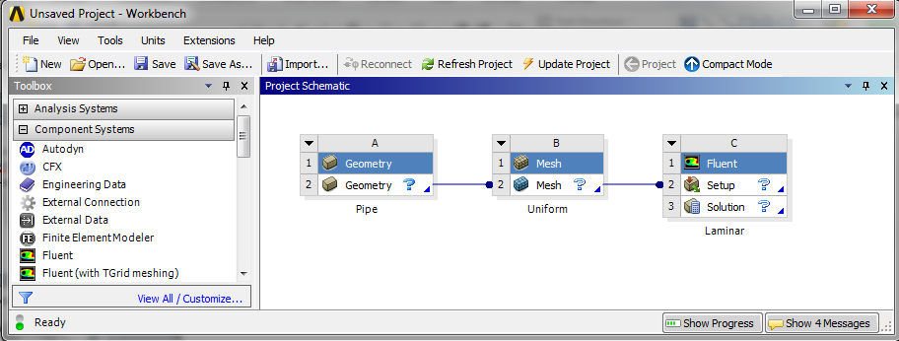
ANSYS Workbench (Overview)
Design your simulation using ANSYS Workbench
ANSYS Mesh
(Mesh)
ANSYS Design Modeler
(Geometry)
ANSYS Fluent
(Physics, Solution and Results)
Notes:
Talking Points:
ANSYS Workbench Project Schematic screen
Modular interface
Geometry-> Mesh-> Physics-> Solution->Results

Slide 7
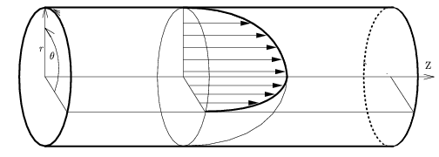
ANSYS Design Modeler (Geometry)
Symmetric property of the flow is used to create 2D representation of the 3D pipe flow
R
D
L
Parameter | Value
Radius of pipe, R | 0.02619 m
Diameter of pipe, D | 0.05238 m
Length of pipe, L | 7.62 m
Wall
Flow
Inlet
Outlet
Center
Notes:
Talking Points:
In CFD it is best to simplify problem for efficiency
Pipe can be simplified into 2D rectangle axisymmetric about centerline

Slide 8
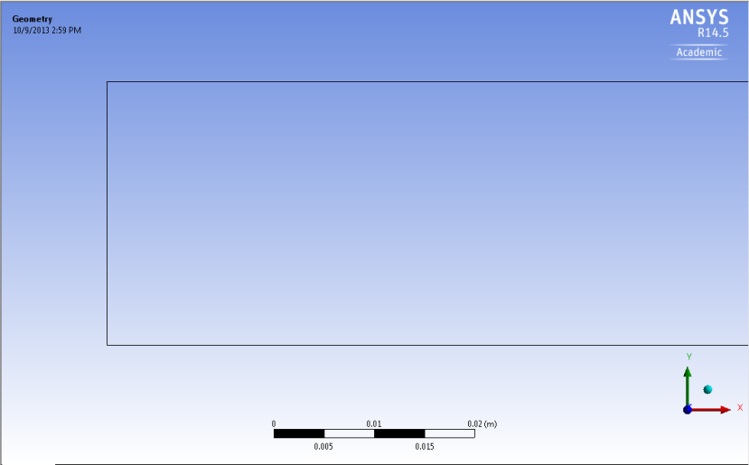
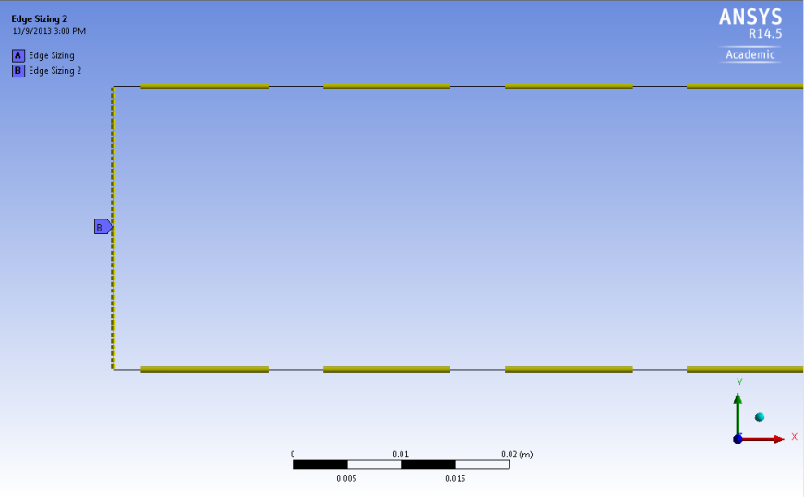
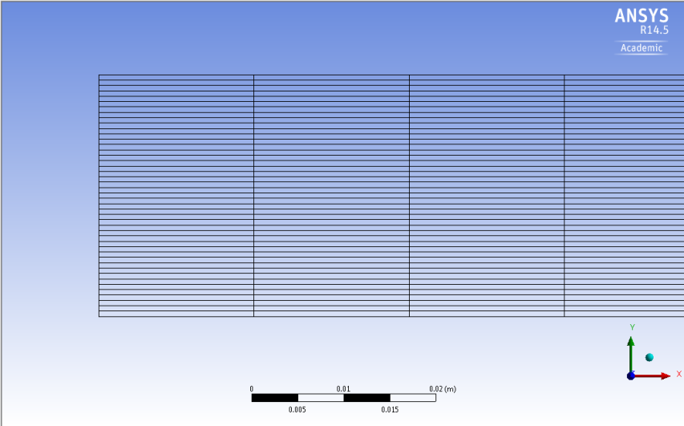
ANSYS Mesh
Create uniform grid distribution
Notes:
Talking Points:
CFD is discretizing the fluid flow and solving N.S. eqns numerically at each grid point
Discretize geometry by splitting sides
Can get information at any discretized point

Slide 9
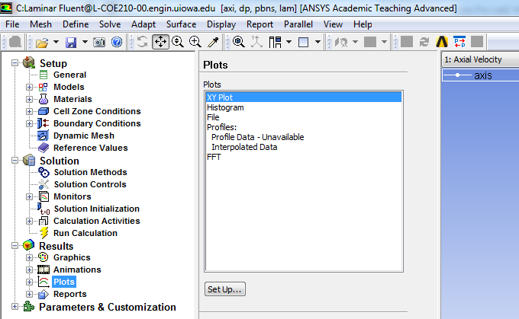
ANSYS Fluent
Using ANSYS fluent define physics of the flow, solve CFD simulation and analyze results
Physics (Setup)
Solution
Results
Notes:
Talking Points:
User interface of Fluent
Physics (Setup)
Solution
Numerical methods setup
Results

Slide 10
Physics
ANSYS Fluent
r
Wall – No slip BC
Inlet – Velocity inlet BC
Flow
Outlet – Pressure outlet BC
x
Center – Axisymmetric BC
Zero slop at center or $\frac{dvx}{dr}=0$
Laminar flow
Air properties
Boundary Conditions (BC)
No-slip: velocities are zero ($vx,vr=0$), pressure gradient ($\frac{dp}{dr}=0$) is zero
Symmetric: radial velocity is zero ($vr=0$), gradients of axial velocity and pressure are zero ($\frac{dvx}{dr}=0$, $\frac{dp}{dr}=0$)
Inlet velocity: uniform constant velocity ($vx=0.2\frac{m}{s}, vr=0,\frac{dp}{dr}=0$)
Outlet: (gauge) pressure is imposed to the boundary ($p=0,\frac{dvx}{dx}=0$, $\frac{dvr}{dx}=0$)
Notes:
Talking Points:
No slip wall
Symmetric about axis for axial velocity and pressure
Uniform inlet velocity
Outlet pressure

Slide 11
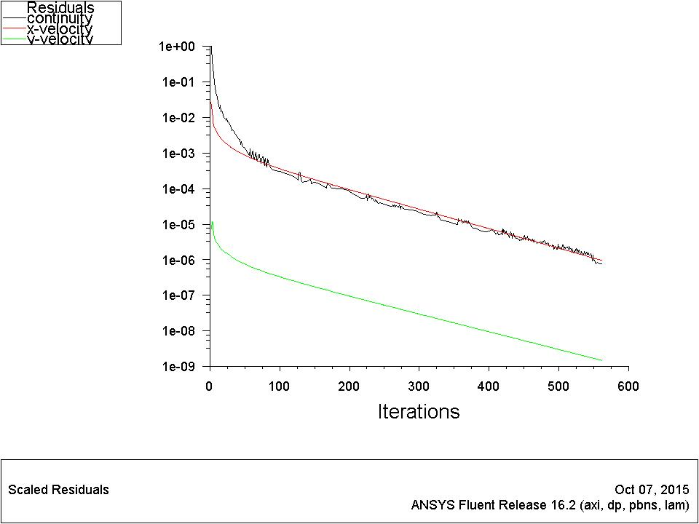
ANSYS Fluent
Solution
A limiting behavior in the solution of the equations
Represented by the history of residuals or errors made by previous iterative solutions.
A converged solution is not necessarily an accurate one due to iteration number, domain size, mesh resolution and numerical schemes
Continuity, momentum equation have their own residual histories.
Notes:
Talking Points:
Residuals are relative errors, taking the difference between the previous solution and current solution
Just because residuals go to zero does not mean solution is perfectly accurate
May be converging to the wrong solution
Dependent on many factors such as turbulence modeling

Slide 12
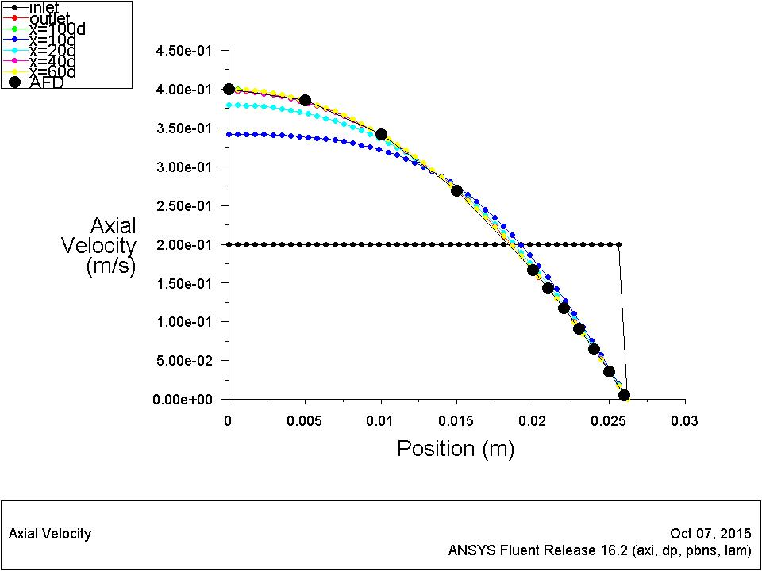
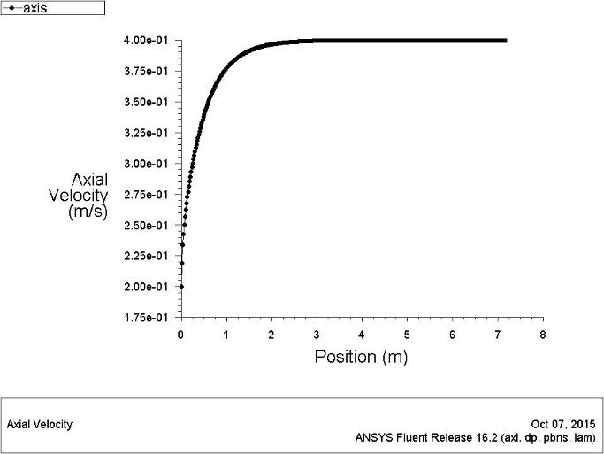
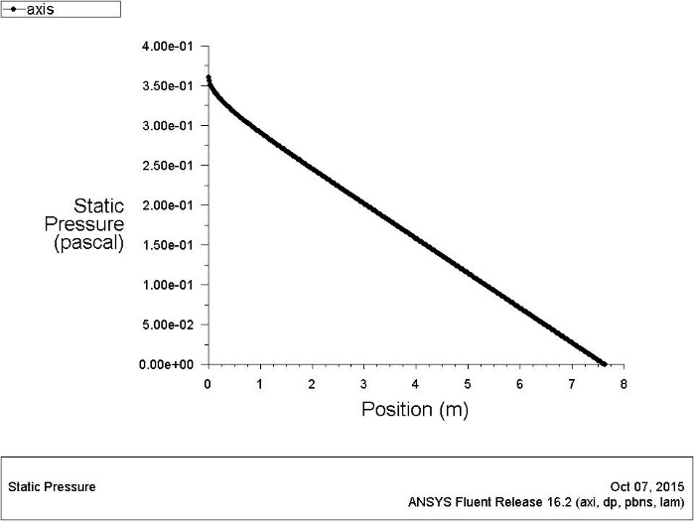
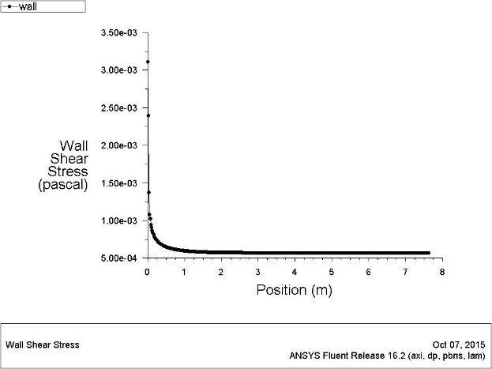
ANSYS Fluent
Results
Developed length is distance from entrance to a point where flow is fully developed.
Fully developed flow does not change velocity profile or velocity gradient in axial direction is zero.
Pressure drops linearly.
Axial velocity or skin friction distribution along axis can be used to determine the length.
Developed region
Developing
region
Notes:
Questions:
Can anyone explain what fully developed flow is?
Why is friction coefficient constant in fully developed
Talking Points:
Explain developing length
Linear pressure drop in fully developed

Slide 13
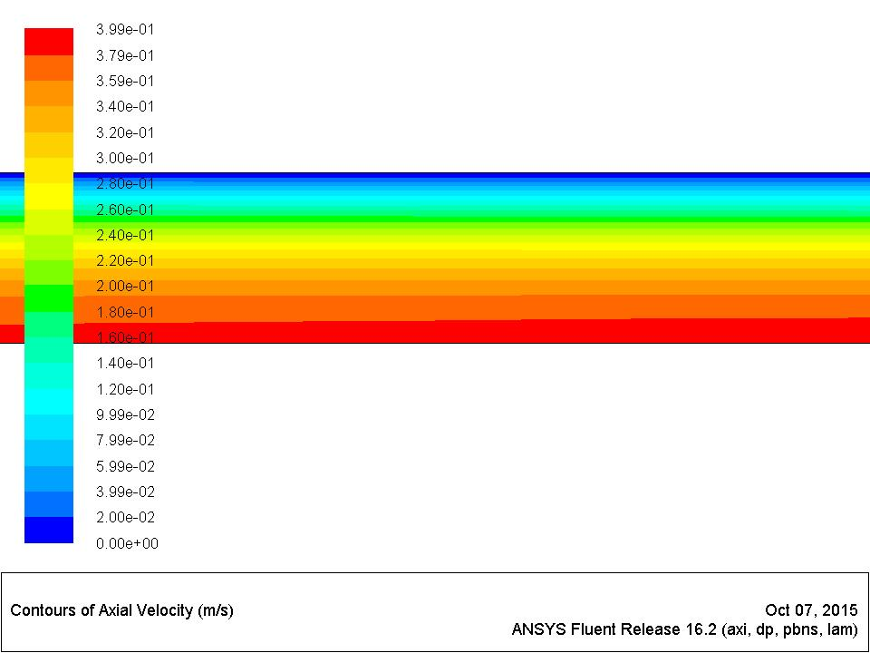
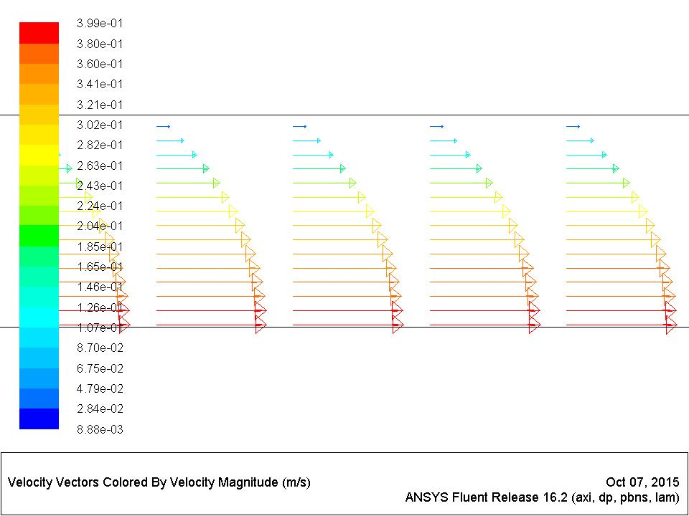
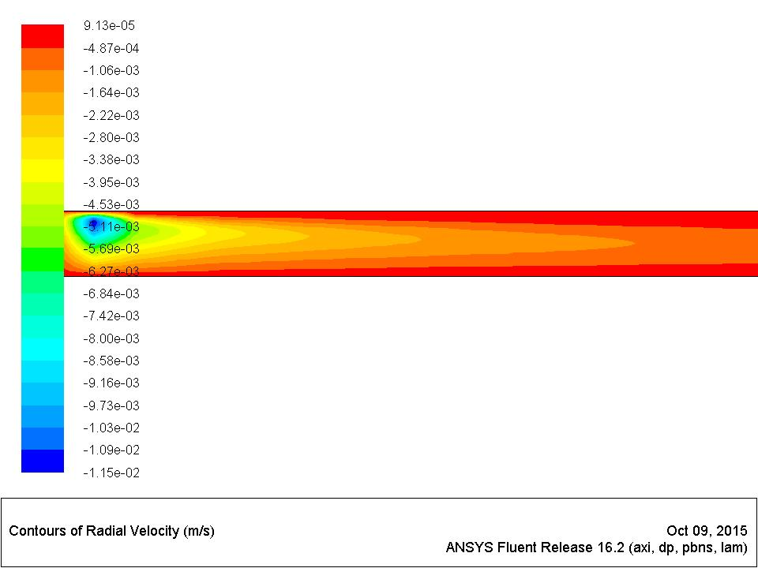
ANSYS Fluent
Results
Flow can be visualized in detail using CFD
Notes:
Questions:
What happens to radial velocity in developed region?
Talking Points:
Shows contours of axial velocity
Vectors of axial velocity
CFD allows you to find fluid properties at any point in the fluid domain

Slide 14
Questions?
Bring your Data Reduction Sheet for the CFD Labs
Deadline for CFD Lab report is two weeks after your CFD lab (not pre-lab)
Use lab drop-box when turning in your lab reports
Come to the office hours for help

