Slide 1
Course Syllabus
Color
Camera models, camera calibration
Advanced image pre-processing
Line detection
Corner detection
Maximally stable extremal regions
Mathematical Morphology
binary
gray-scale
skeletonization
granulometry
morphological segmentation
Scale in image processing
Wavelet theory in image processing
Image Compression
Texture
Image Registration
rigid
non-rigid
RANSAC

Slide 2



Quiz
Object = black
original
?
?

Slide 3
13.5 Skeletons and object marking
13.5.1 Homotopic transformations
transformation is homotopic if it does not change the continuity relation between regions and holes in the image.
this relation is expressed by homotopic tree
its root ... image background
first-level branches ... objects (regions)
second-level branches ... holes
etc.
transformation is homotopic if it does not change homotopic tree

Slide 4
Homotopic Tree

Slide 5
Homotopic Tree

Slide 6
Homotopic Tree
r₁
r₂
h₂
h₁
b
r₁
r₂
h₂
h₁

Slide 7
Quitz: Homotopic Transformation
What is the relation between an element in the ith and i+1th levels?

Slide 8
13.5.2 Skeleton, maximal ball
skeletonization = medial axis transform
‘grassfire’ scenario
A grassfire starts on the entire region boundary at the same instant – propagates towards the region interior with constant speed
skeleton S(X) ... set of points where two or more fire-fronts meet
Figure 13.22: Skeleton as points where two or more fire-fronts of grassfire meet.
Formal definition of skeleton based on maximal ball concept
ball B(p, r), r ≥ 0 ... set of points with distances d from center ≤ r
ball B included in a set X is maximal if and only if there is no larger ball included in X that contains B

Slide 9
Figure 13.23: Ball and two maximal balls in a Euclidean plane.

Slide 10
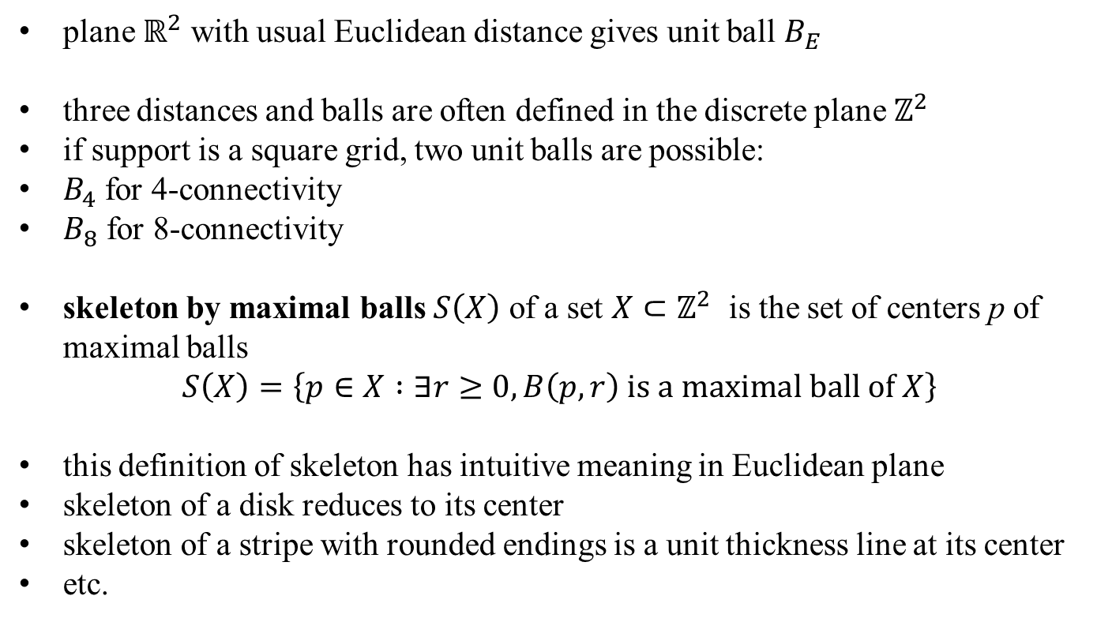
Figure 13.24: Unit-size disk for different distances, from left side: Euclidean distance, 6-, 4-, and 8-connectivity, respectively.
plane $ℝ^{2}$ with usual Euclidean distance gives unit ball $B_{E}$
three distances and balls are often defined in the discrete plane $ℤ^{2}$
if support is a square grid, two unit balls are possible:
$B_{4}$ for 4-connectivity
$B_{8}$ for 8-connectivity
skeleton by maximal balls $S\left(X\right)$ of a set $X⊂ℤ^{2}$ is the set of centers p of maximal balls
$$S\left(X\right)=\left\{p∈X :∃r≥0, B\left(p,r\right) is a maximal ball of X\right\}$$
this definition of skeleton has intuitive meaning in Euclidean plane
skeleton of a disk reduces to its center
skeleton of a stripe with rounded endings is a unit thickness line at its center
etc.

Slide 11
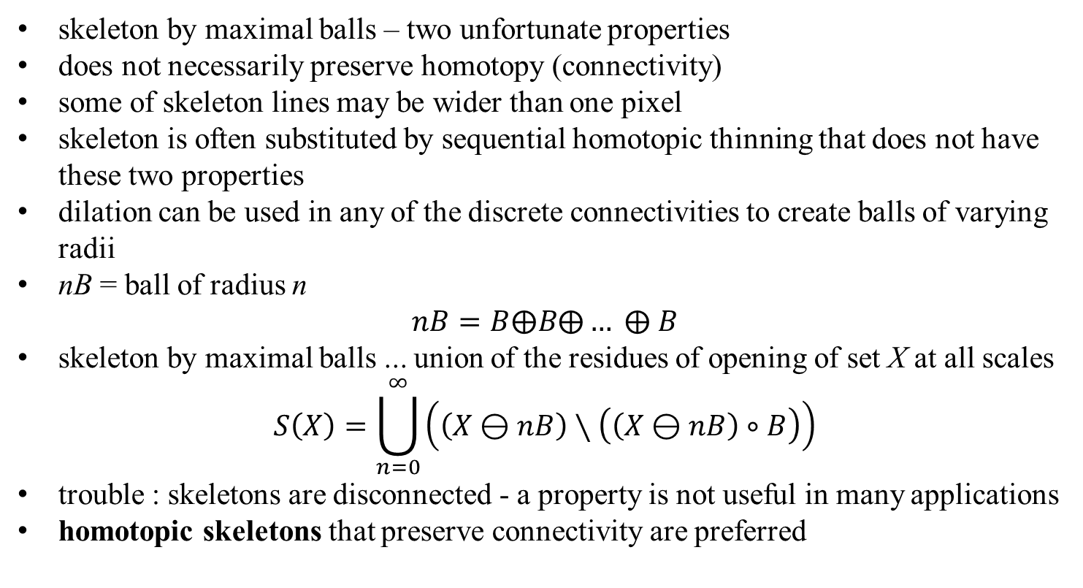
Figure 13.25: Skeletons of rectangle, two touching balls, and a ring.
skeleton by maximal balls – two unfortunate properties
does not necessarily preserve homotopy (connectivity)
some of skeleton lines may be wider than one pixel
skeleton is often substituted by sequential homotopic thinning that does not have these two properties
dilation can be used in any of the discrete connectivities to create balls of varying radii
nB = ball of radius n
$$nB=B⨁B⨁… ⨁ B$$
skeleton by maximal balls ... union of the residues of opening of set X at all scales
$$S\left(X\right)=\bigcup_{n=0}^{∞}{\left(\left(X⊖nB\right)∖\left(\left(X⊖nB\right)∘B\right)\right)}$$
trouble : skeletons are disconnected - a property is not useful in many applications
homotopic skeletons that preserve connectivity are preferred

Slide 12
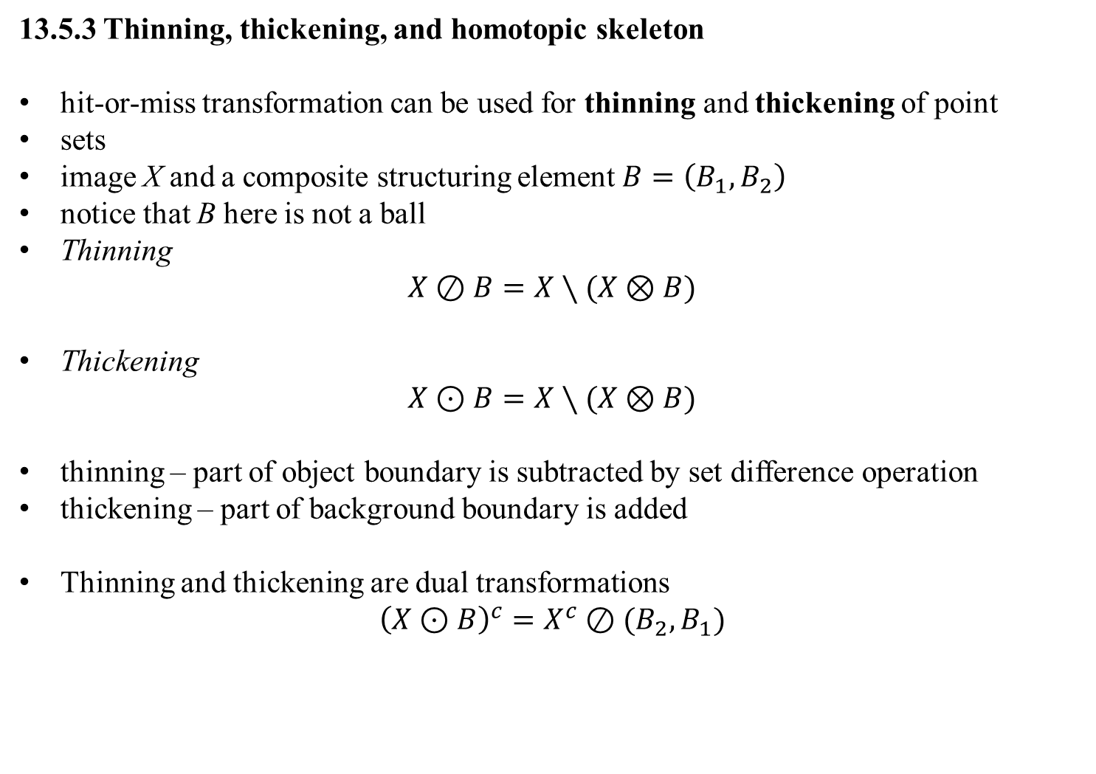
13.5.3 Thinning, thickening, and homotopic skeleton
hit-or-miss transformation can be used for thinning and thickening of point
sets
image X and a composite structuring element $B=\left(B_{1}, B_{2}\right)$
notice that B here is not a ball
Thinning
$$X⊘B=X∖(X⊗B)$$
Thickening
$$X⊙B=X∖(X⊗B)$$
thinning – part of object boundary is subtracted by set difference operation
thickening – part of background boundary is added
Thinning and thickening are dual transformations
$${\left(X⊙B\right)}^{c}=X^{c}⊘(B_{2},B_{1})$$

Slide 13
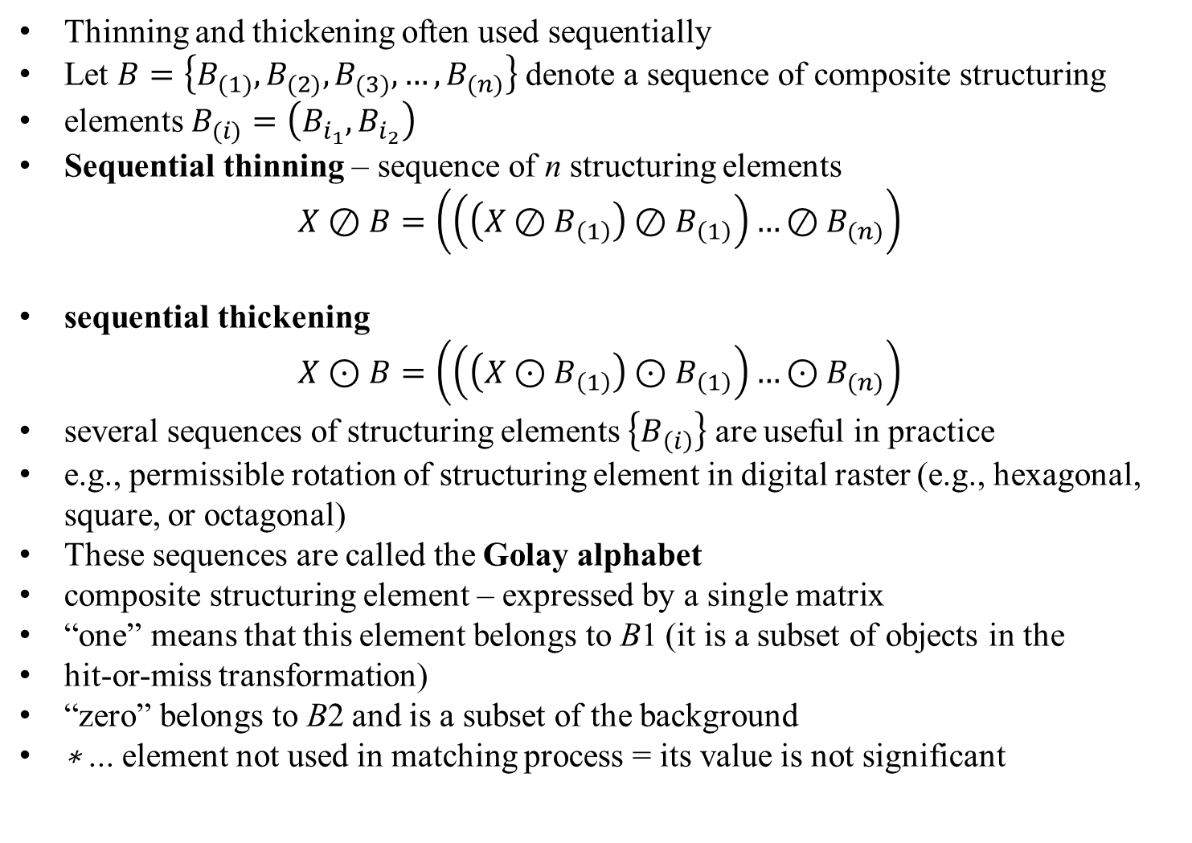
Thinning and thickening often used sequentially
Let $B=\left\{B_{(1)},B_{(2)},B_{(3)},…,B_{(n)}\right\}$ denote a sequence of composite structuring
elements $B_{(i)}=\left(B_{i_{1}},B_{i_{2}}\right)$
Sequential thinning – sequence of n structuring elements
$$X⊘B=\left(\left(\left(X⊘B_{\left(1\right)}\right){⊘B}_{\left(1\right)}\right)…{⊘B}_{(n)}\right)$$
sequential thickening
$$X⊙B=\left(\left(\left(X⊙B_{\left(1\right)}\right){⊙B}_{\left(1\right)}\right)…{⊙B}_{(n)}\right)$$
several sequences of structuring elements $\left\{B_{\left(i\right)}\right\}$ are useful in practice
e.g., permissible rotation of structuring element in digital raster (e.g., hexagonal, square, or octagonal)
These sequences are called the Golay alphabet
composite structuring element – expressed by a single matrix
“one” means that this element belongs to B1 (it is a subset of objects in the
hit-or-miss transformation)
“zero” belongs to B2 and is a subset of the background
∗ ... element not used in matching process = its value is not significant

Slide 14
Thinning and thickening sequential transformations converge to some image — the number of iterations needed depends on the objects in the image and the structuring element used
if two successive images in the sequence are identical, the thinning (or thickening) is stopped

Slide 15
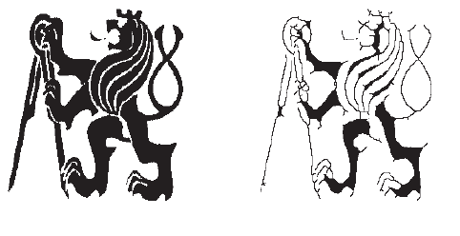
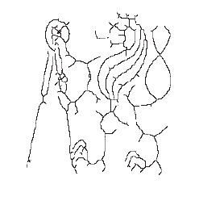
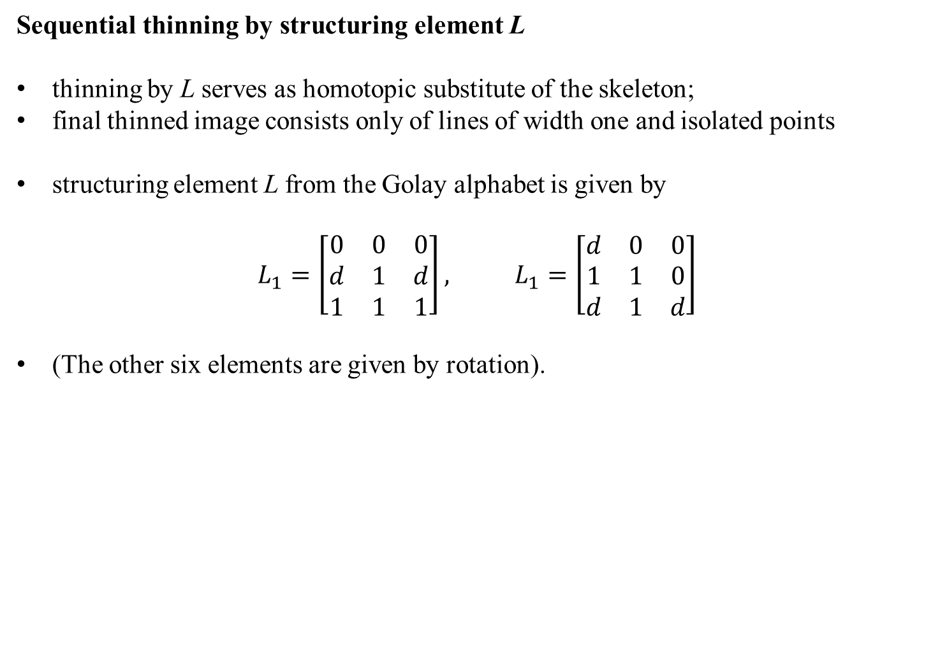
Sequential thinning by structuring element L
thinning by L serves as homotopic substitute of the skeleton;
final thinned image consists only of lines of width one and isolated points
structuring element L from the Golay alphabet is given by
$$L_{1}=\left[\begin{matrix}0 & 0 & 0 \\ d & 1 & d \\ 1 & 1 & 1\end{matrix}\right], L_{1}=\left[\begin{matrix}d & 0 & 0 \\ 1 & 1 & 0 \\ d & 1 & d\end{matrix}\right]$$
(The other six elements are given by rotation).
Original after 5 iteration final result

Slide 16
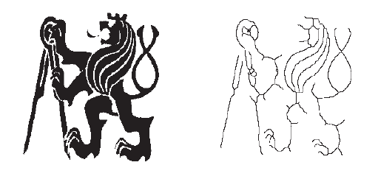

Sequential thinning by structuring element E
• structuring element E from the Golay alphabet is given by
$$E_{1}=\left[\begin{matrix}d & 1 & d \\ 0 & 1 & 0 \\ 0 & 0 & 0\end{matrix}\right], L_{1}=\left[\begin{matrix}0 & d & d \\ 0 & 1 & 0 \\ 0 & 0 & 0\end{matrix}\right]$$
Less jagged skeletons
Original skeleton

Slide 17
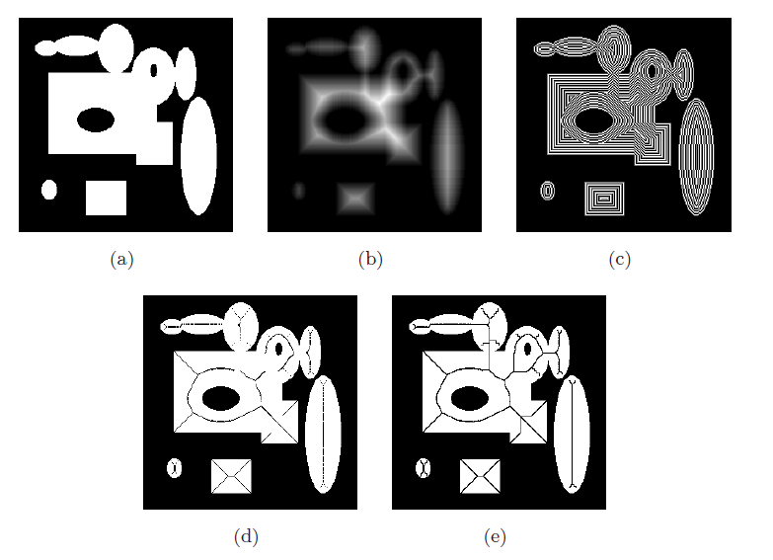

Slide 18

Axial line detection using Distance transform
a point $p$ is an axial point if there is no point $p^{′}$ such that a shortest path from $p^{′}$ to the boundary passes through $p$.
a point $p$ is an axial point if there is no point $q$ in the neighborhood of p such that
$DT\left(q\right)=DT\left(p\right)+\left|p−q\right|$

Slide 19
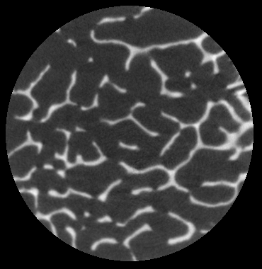
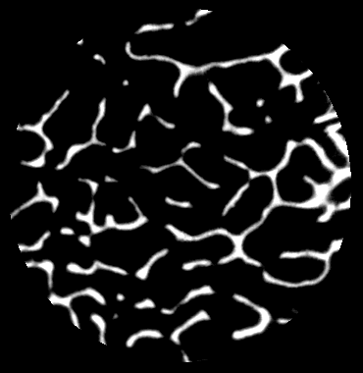
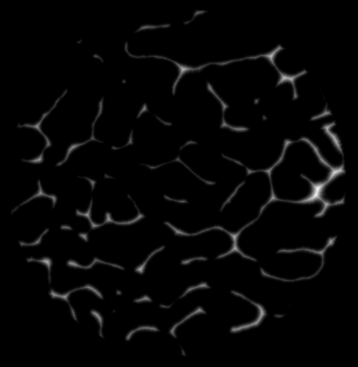
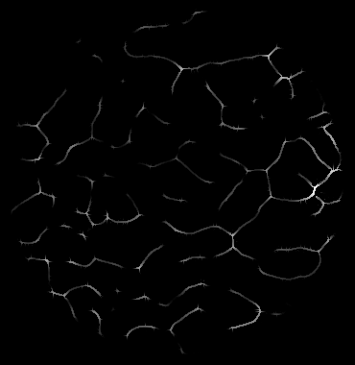
Axial line detection using Distance transform

Slide 20
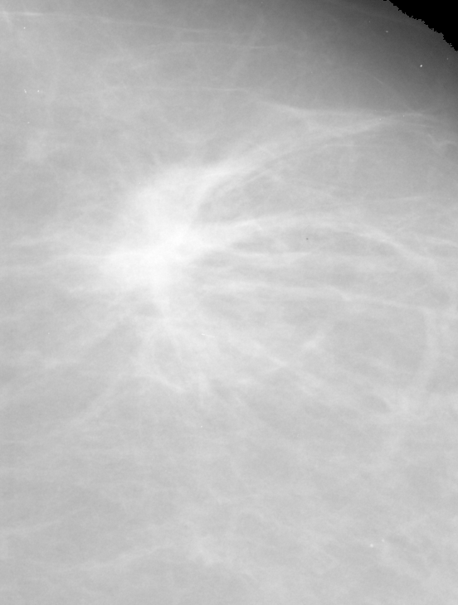
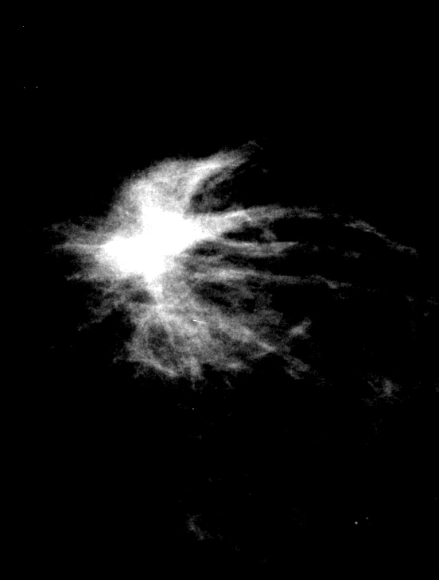
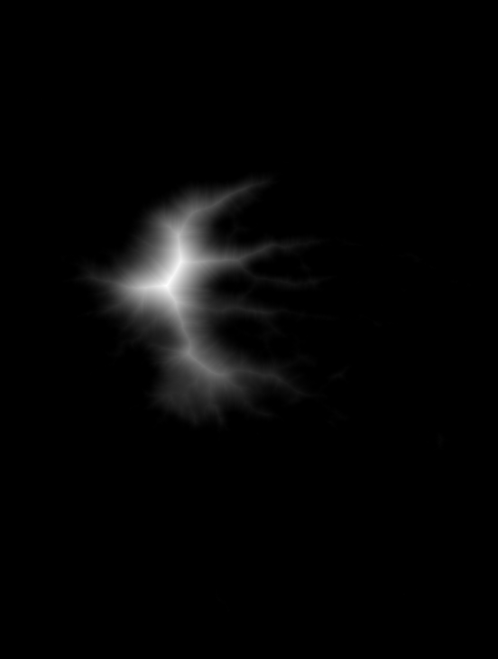
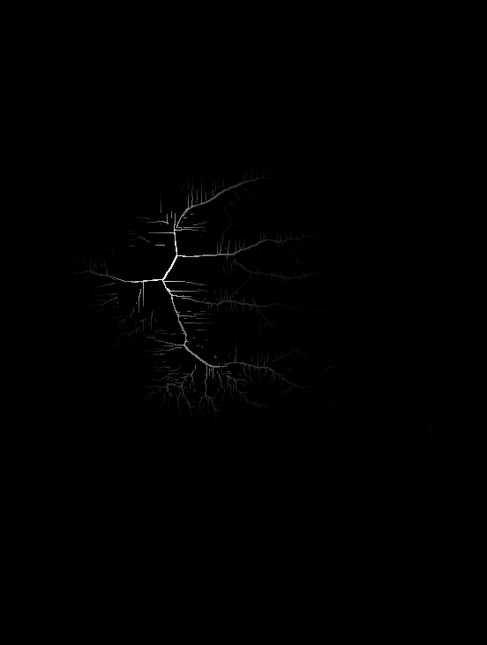
Axial line detection using Distance transform

Slide 21

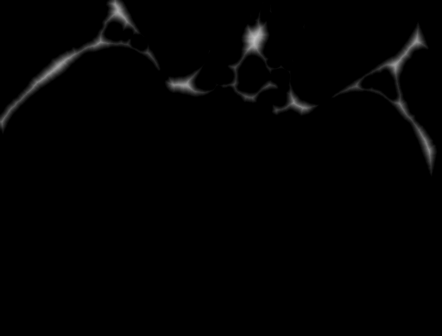
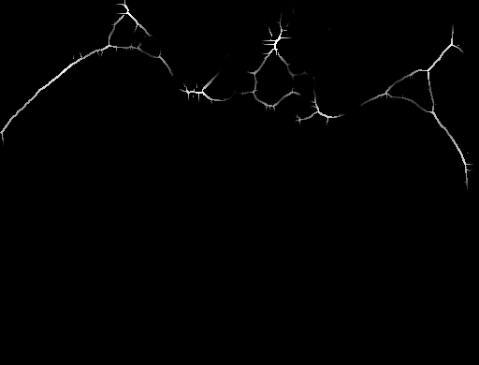
Axial line detection using Distance transform

