Slide 1
Course Syllabus
Color
Camera models, camera calibration
Advanced image pre-processing
Line detection
Corner detection
Maximally stable extremal regions
Mathematical Morphology
binary
gray-scale
skeletonization
granulometry
morphological segmentation
Scale in image processing
Wavelet theory in image processing
Image Compression
Texture
Image Registration
rigid
non-rigid
RANSAC

Slide 2
13.4 Gray-scale dilation and erosion
Binary morphological operations are extendible to gray-scale images using the ‘min’ and ‘max’ operations.
Erosion – assigns to each pixel minimum value in a neighborhood of corresponding pixel in input image
structuring element is richer than in binary case
structuring element is a function of two variables, specifies desired local gray-level property
value of structuring element is subtracted when minimum is calculated in the neighborhood
Dilation – assigns maximum value in neighborhood of corresponding pixel in input image
value of structuring element is added when maximum is calculated in the neighborhood

Slide 3
13.4 Gray-scale dilation and erosion continued
Such extension permits topographic view of gray-scale images
gray-level is interpreted as height of a particular location of a hypothetical landscape
light and dark spots in the image correspond to hills and valleys
such morphological approach permits the location of global properties of the image
valleys
mountain ridges (crests)
watersheds

Slide 4
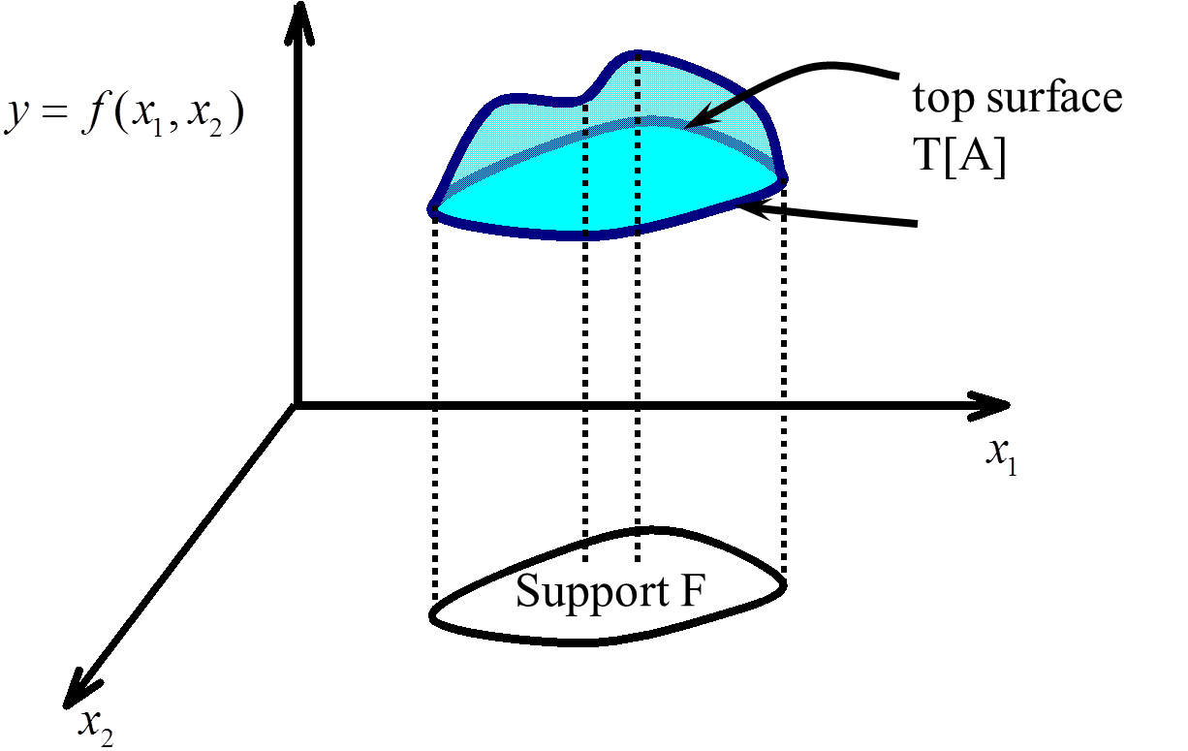
13.4 Gray-scale dilation and erosion continued
Concepts of umbra and top of the point set
Set A

Slide 5
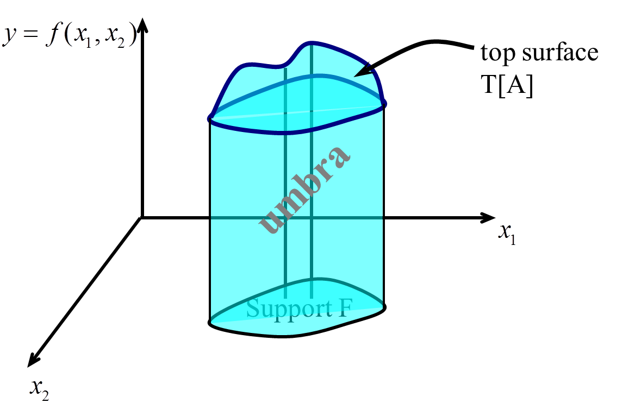
13.4 Gray-scale dilation and erosion continued
Concepts of umbra and top of the point set
Gray-scale dilation is expressed as the dilation of umbras.

Slide 6
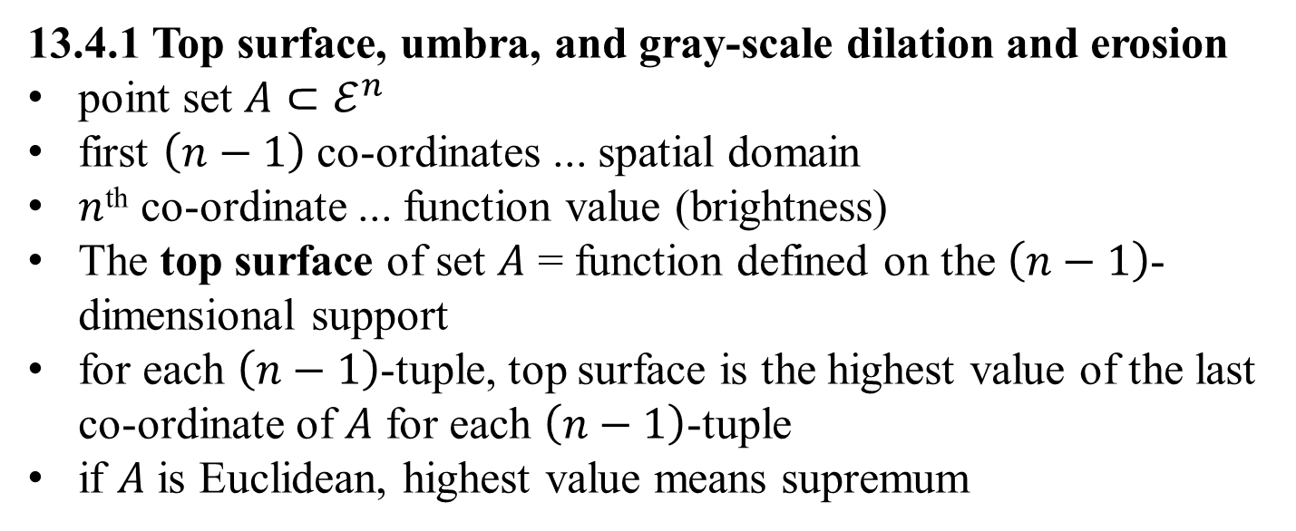
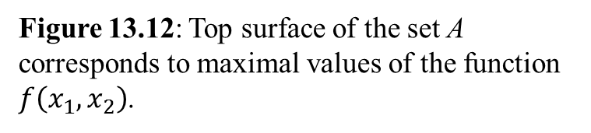
13.4.1 Top surface, umbra, and gray-scale dilation and erosion
point set $A⊂ℰ^{n}$
first $\left(n−1\right)$ co-ordinates ... spatial domain
$n$^{th} co-ordinate ... function value (brightness)
The top surface of set $A$ = function defined on the $\left(n−1\right)$-dimensional support
for each $\left(n−1\right)$-tuple, top surface is the highest value of the last co-ordinate of $A$ for each $\left(n−1\right)$-tuple
if $A$ is Euclidean, highest value means supremum
Figure 13.12: Top surface of the set A corresponds to maximal values of the function
$f\left(x_{1},x_{2}\right)$.

Slide 7
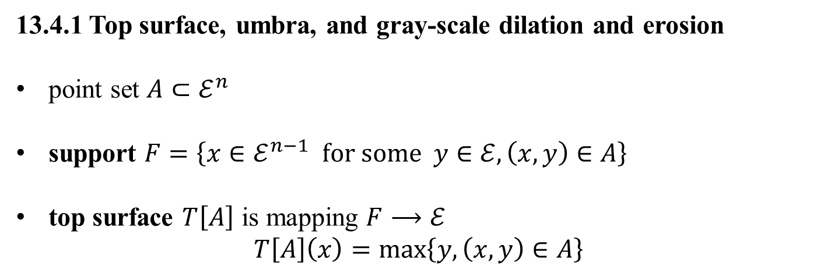
13.4.1 Top surface, umbra, and gray-scale dilation and erosion
point set $A⊂ℰ^{n}$
support $F=\left\{x∈ℰ^{n−1} for some y∈ℰ, \left(x,y\right)∈A\right\}$
top surface $T\left[A\right]$ is mapping $F⟶ℰ$
$$T\left[A\right]\left(x\right)=\max\left\{y, \left(x,y\right)∈A\right\}$$
Figure 13.12: Top surface of the set A corresponds to maximal values of the function
$f\left(x_{1},x_{2}\right)$.

Slide 8
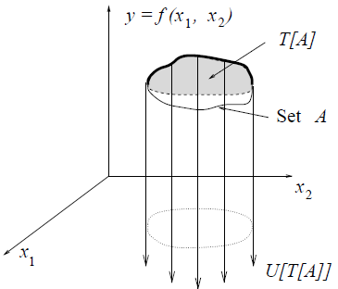
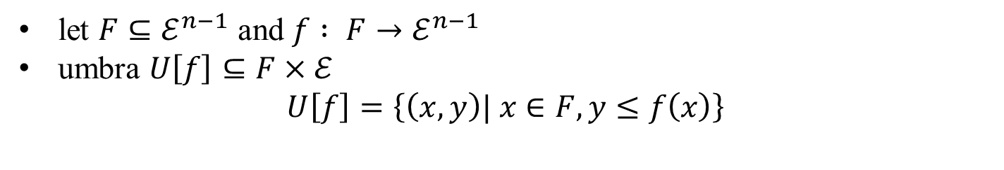
umbra of function f is defined on some subset F (support) of (n−1)-dimensional space
umbra – region of complete shadow when obstructing light by non-transparent object
umbra of f ... set consisting of top surface of f and everything below it
Figure 13.13: Umbra of the top surface of a set is the whole subspace below it.
let $F⊆ℰ^{n−1}$ and $f : F→ℰ^{n−1}$
umbra $U\left[f\right]⊆F×ℰ$
$$U\left[f\right]=\left\{\left(x,y\right)| x∈F, y≤f\left(x\right)\right\}$$

Slide 9
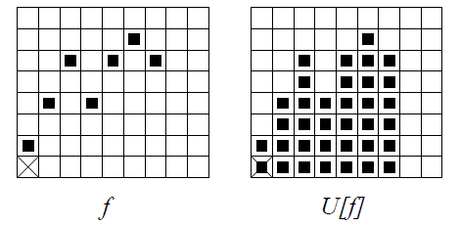
umbra of an umbra of f is an umbra.
Figure 13.14: Example of a 1D function (left) and its umbra (right).
umbra of an umbra of f is an umbra.

Slide 10
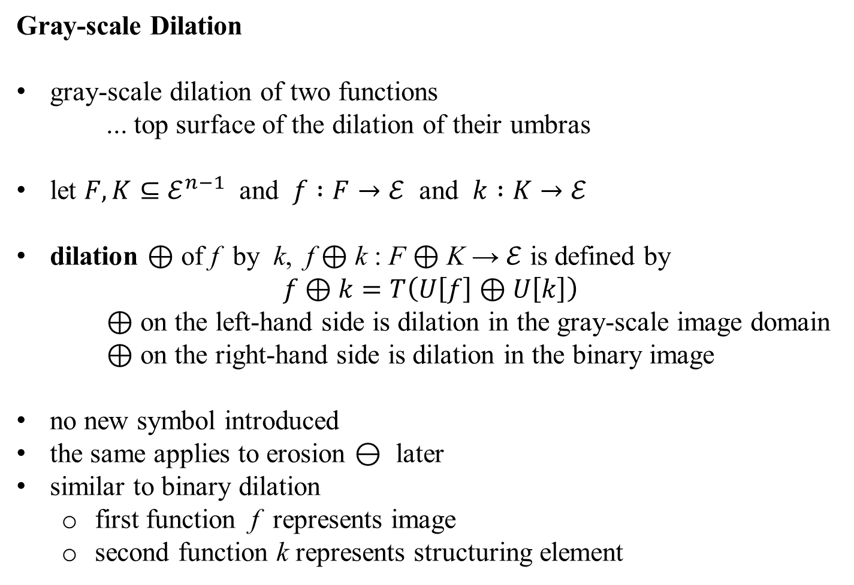
Gray-scale Dilation
gray-scale dilation of two functions
... top surface of the dilation of their umbras
let $F,K⊆ℰ^{n−1}$ and $f :F→ℰ$ and $k :K→ℰ$
dilation ⊕ of f by k, f ⊕ k : F ⊕ K → $ℰ$ is defined by
$$f⊕k=T\left(U\left[f\right]⊕U\left[k\right]\right)$$
⊕ on the left-hand side is dilation in the gray-scale image domain
⊕ on the right-hand side is dilation in the binary image
no new symbol introduced
the same applies to erosion ⊖ later
similar to binary dilation
first function f represents image
second function k represents structuring element

Slide 11
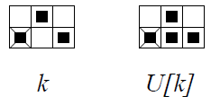
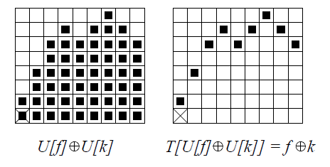
Gray-scale Dilation: Illustration
Figure 13.14: Example of a 1D function (left) and its umbra (right).
Figure 13.15: A structuring element: 1D function (left) and its umbra (right).
Figure 13.16: 1D example of gray-scale dilation. The umbras of the 1D function f and structuring element k are dilated first, U[f] ⊕ U[k]. The top surface of this dilated set gives the result,
f ⊕ k = T(U[f] ⊕ U[k])
.

Slide 12
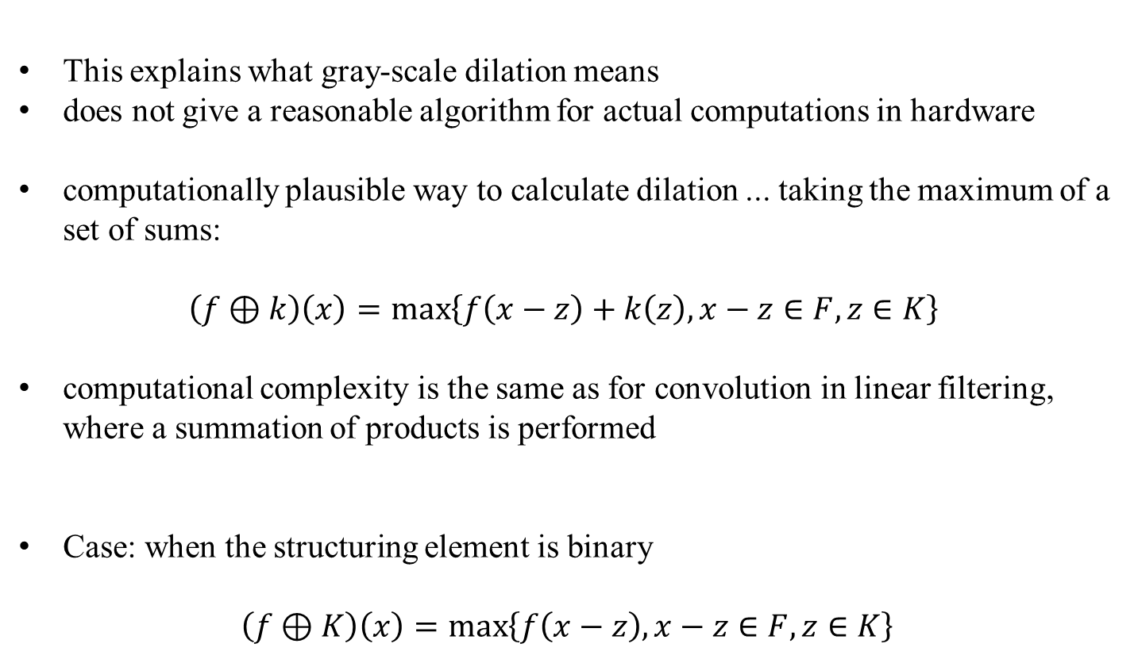
This explains what gray-scale dilation means
does not give a reasonable algorithm for actual computations in hardware
computationally plausible way to calculate dilation ... taking the maximum of a set of sums:
$$\left(f⊕k\right)\left(x\right)=\max\left\{f\left(x−z\right)+k\left(z\right), x−z∈F, z∈K\right\}$$
computational complexity is the same as for convolution in linear filtering, where a summation of products is performed
Case: when the structuring element is binary
$$\left(f⊕K\right)\left(x\right)=\max\left\{f\left(x−z\right), x−z∈F, z∈K\right\}$$

Slide 13
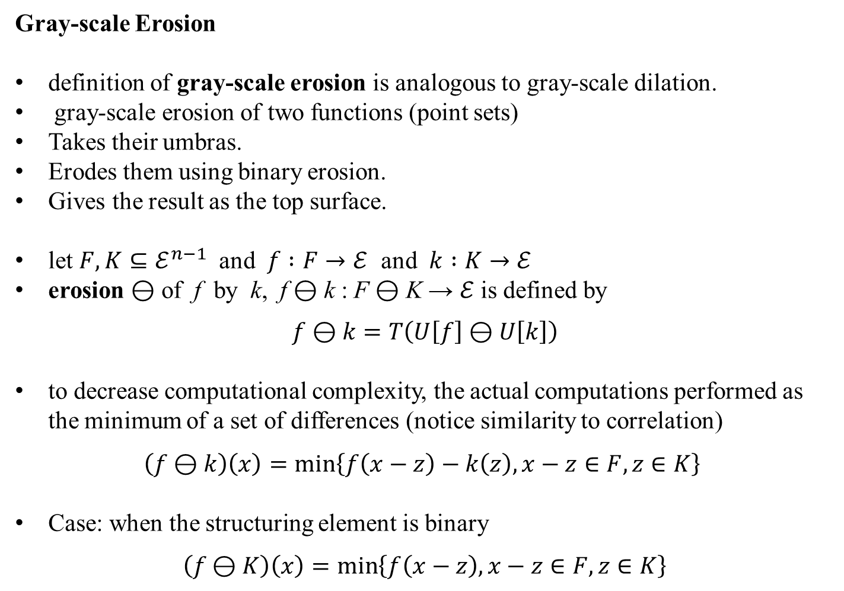
Gray-scale Erosion
definition of gray-scale erosion is analogous to gray-scale dilation.
gray-scale erosion of two functions (point sets)
Takes their umbras.
Erodes them using binary erosion.
Gives the result as the top surface.
let $F,K⊆ℰ^{n−1}$ and $f :F→ℰ$ and $k :K→ℰ$
erosion ⊖ of f by k, f ⊖ k : F ⊖ K → $ℰ$ is defined by
$$f \text{⊖} k=T\left(U\left[f\right] \text{⊖} U\left[k\right]\right)$$
to decrease computational complexity, the actual computations performed as the minimum of a set of differences (notice similarity to correlation)
$$\left(f \text{⊖} k\right)\left(x\right)=\min\left\{f\left(x−z\right)−k\left(z\right), x−z∈F, z∈K\right\}$$
Case: when the structuring element is binary
$$\left(f \text{⊖} K\right)\left(x\right)=\min\left\{f\left(x−z\right), x−z∈F, z∈K\right\}$$

Slide 14
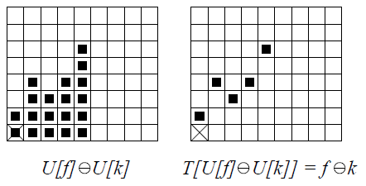
Gray-scale Erosion: Illustration
Figure 13.14: Example of a 1D function (left) and its umbra (right).
Figure 13.15: A structuring element: 1D function (left) and its umbra (right).
Figure 13.17: 1D example of gray-scale
erosion. The umbras of 1D function f
and structuring element k are eroded
first, U[f] ⊖ U[k]. The top surface of
this eroded set gives the result,
f ⊖ k = T( U[f] ⊖ U[k] )

Slide 15
Example
microscopic image of cells corrupted by noise
aim is to reduce noise and locate individual cells
3×3 structuring element used for erosion/dilation
individual cells can be located by the reconstruction operation (Section 13.5.4)
original image is used as a mask and the dilated image in Figure 13.18c is an input for reconstruction
black spots in (d) panel depict cells
Figure 13.18: Morphological pre-processing: (a) cells in a microscopic image corrupted by noise; (b) eroded image; (c) dilation of (b), the noise has disappeared; (d) reconstructed cells. Courtesy of P. Kodl, Rockwell Automation Research Center, Prague, Czech Republic.

Slide 16
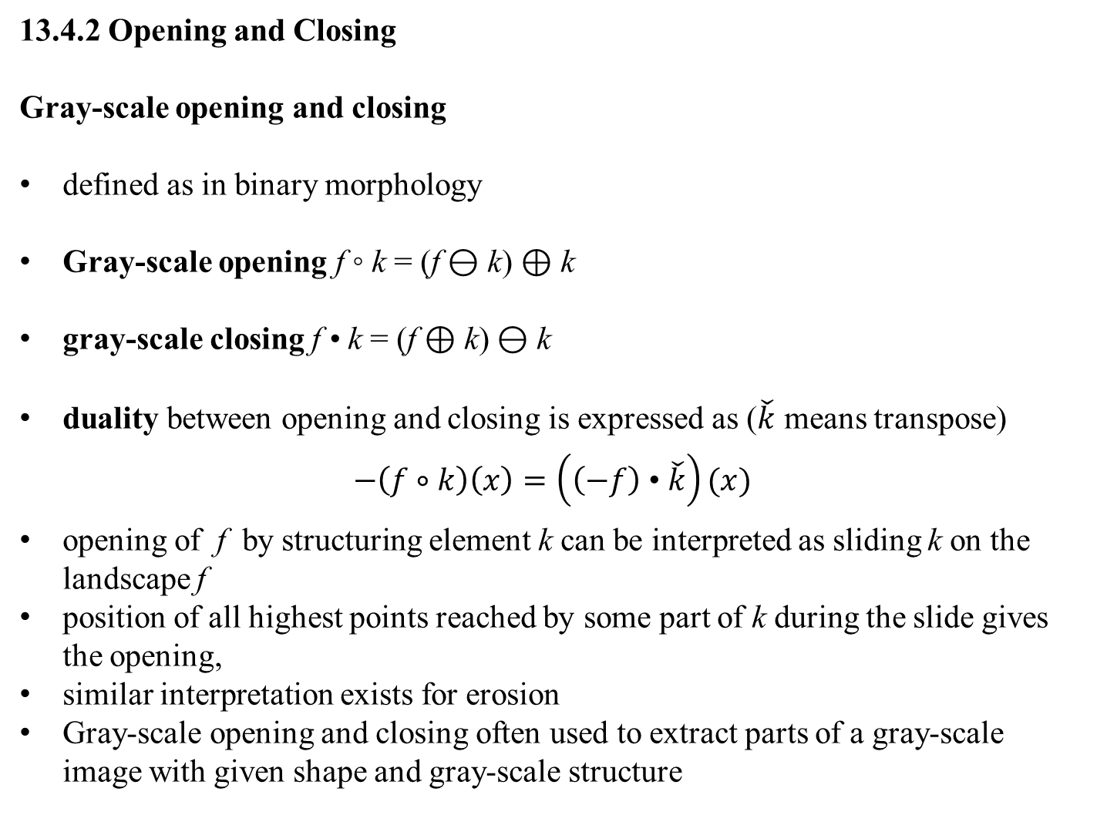
13.4.2 Opening and Closing
Gray-scale opening and closing
defined as in binary morphology
Gray-scale opening f ◦ k = (f ⊖ k) ⊕ k
gray-scale closing f • k = (f ⊕ k) ⊖ k
duality between opening and closing is expressed as ($\check{k}$ means transpose)
$$−\left(f∘k\right)\left(x\right)=\left(\left(−f\right) \text{•} \check{k}\right)(x)$$
opening of f by structuring element k can be interpreted as sliding k on the landscape f
position of all highest points reached by some part of k during the slide gives the opening,
similar interpretation exists for erosion
Gray-scale opening and closing often used to extract parts of a gray-scale image with given shape and gray-scale structure

Slide 17
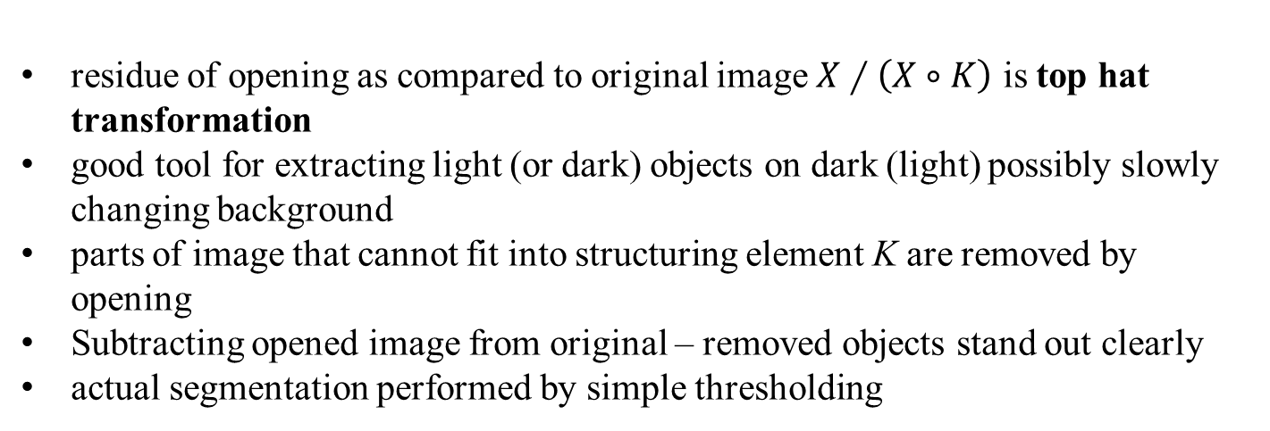
13.4.3 Top hat transformation
simple tool for segmenting objects in gray-scale images that differ in brightness from background even when background is uneven
top-hat transform superseded by watershed segmentation for more complicated backgrounds
gray-level image X, structuring element K
residue of opening as compared to original image $X∕\left(X∘K\right)$ is top hat transformation
good tool for extracting light (or dark) objects on dark (light) possibly slowly changing background
parts of image that cannot fit into structuring element K are removed by opening
Subtracting opened image from original – removed objects stand out clearly
actual segmentation performed by simple thresholding

Slide 18
Figure 13.19: The top hat transform permits the extraction of light objects from an uneven background.

Slide 19
Example from visual industrial inspection
glass capillaries for mercury maximal thermometers had the following problem: thin glass tube should be narrowed in one particular place to prevent mercury falling back when the temperature decreases from the maximal value done by using a narrow gas flame and low pressure in the capillary
capillary is illuminated by a collimated light beam—when the capillary wall collapses due to heat and low pressure, an instant specular reflection is observed and serves as a trigger to cover the gas flame
Originally, machine was controlled by a human operator who looked at the tube image projected optically on the screen; the gas flame was covered when the specular reflection was observed
task had to be automated and the trigger signal obtained from a digitized image
⇒ specular reflection is detected by a morphological procedure

Slide 20
Figure 13.20: An industrial example of gray-scale opening and top hat segmentation, i.e., image-based control of glass tube narrowing by gas flame. (a) Original image of the glass tube, 512×256 pixels. (b) Erosion by a one-pixel-wide vertical structuring element 20 pixels long. (c) Opening with the same element. (d) Final specular reflection segmentation by the top hat transformation. Courtesy of V. Smutný, R. Šára, CTU Prague, P. Kodl, Rockwell Automation Research Center, Prague, Czech Republic.

Slide 21
13.5 Skeletons and object marking
13.5.1 Homotopic transformations
transformation is homotopic if it does not change the continuity relation between regions and holes in the image.
this relation expressed by homotopic tree
its root ... image background
first-level branches ... objects (regions)
second-level branches ... holes
etc.
transformation is homotopic if it does not change homotopic tree

Slide 22
Homotopic Tree

Slide 23
Homotopic Tree

Slide 24
Homotopic Tree

Slide 25
Homotopic Tree
r₁
r₂
h₂
h₁
b
r₁
r₂
h₂
h₁

Slide 26
Quitz: Homotopic Transformation
What is the relation between an element in the ith and i+1th levels?

Slide 27
13.5.2 Skeleton, maximal ball
skeletonization = medial axis transform
‘grassfire’ scenario
A grassfire starts on the entire region boundary at the same instant – propagates towards the region interior with constant speed
skeleton S(X) ... set of points where two or more fire-fronts meet
Figure 13.22: Skeleton as points where two or more fire-fronts of grassfire meet.
Formal definition of skeleton based on maximal ball concept
ball B(p, r), r ≥ 0 ... set of points with distances d from center ≤ r
ball B included in a set X is maximal if and only if there is no larger ball included in X that contains B

Slide 28
Figure 13.23: Ball and two maximal balls in a Euclidean plane.

Slide 29
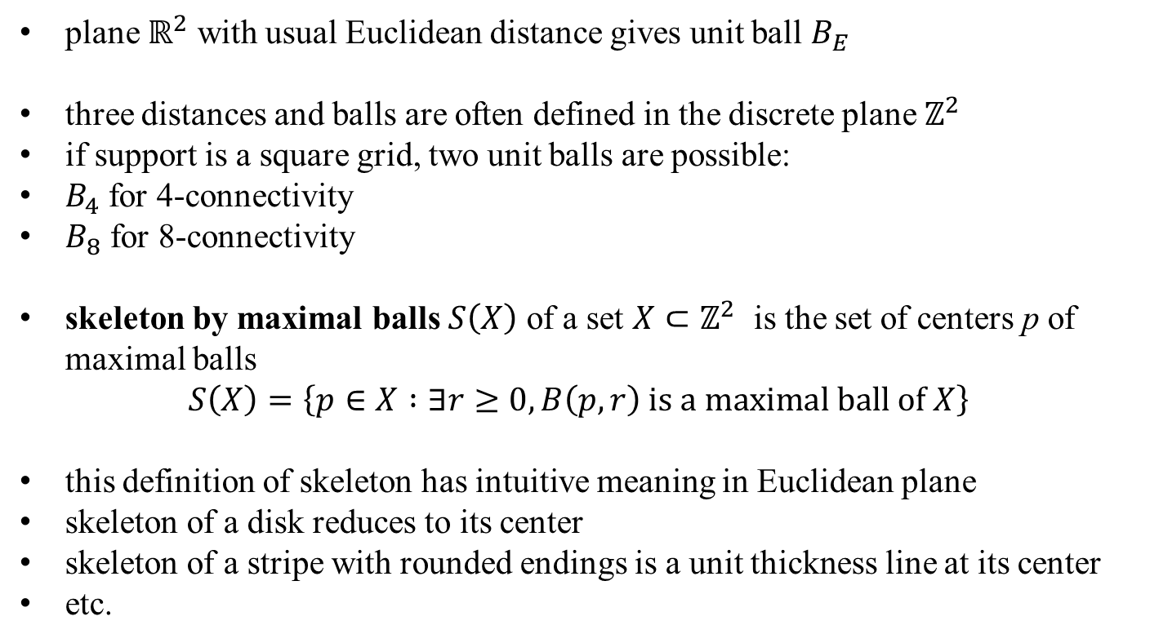
Figure 13.24: Unit-size disk for different distances, from left side: Euclidean distance, 6-, 4-, and 8-connectivity, respectively.
plane $ℝ^{2}$ with usual Euclidean distance gives unit ball $B_{E}$
three distances and balls are often defined in the discrete plane $ℤ^{2}$
if support is a square grid, two unit balls are possible:
$B_{4}$ for 4-connectivity
$B_{8}$ for 8-connectivity
skeleton by maximal balls $S\left(X\right)$ of a set $X⊂ℤ^{2}$ is the set of centers p of maximal balls
$$S\left(X\right)=\left\{p∈X :∃r≥0, B\left(p,r\right) is a maximal ball of X\right\}$$
this definition of skeleton has intuitive meaning in Euclidean plane
skeleton of a disk reduces to its center
skeleton of a stripe with rounded endings is a unit thickness line at its center
etc.

Slide 30
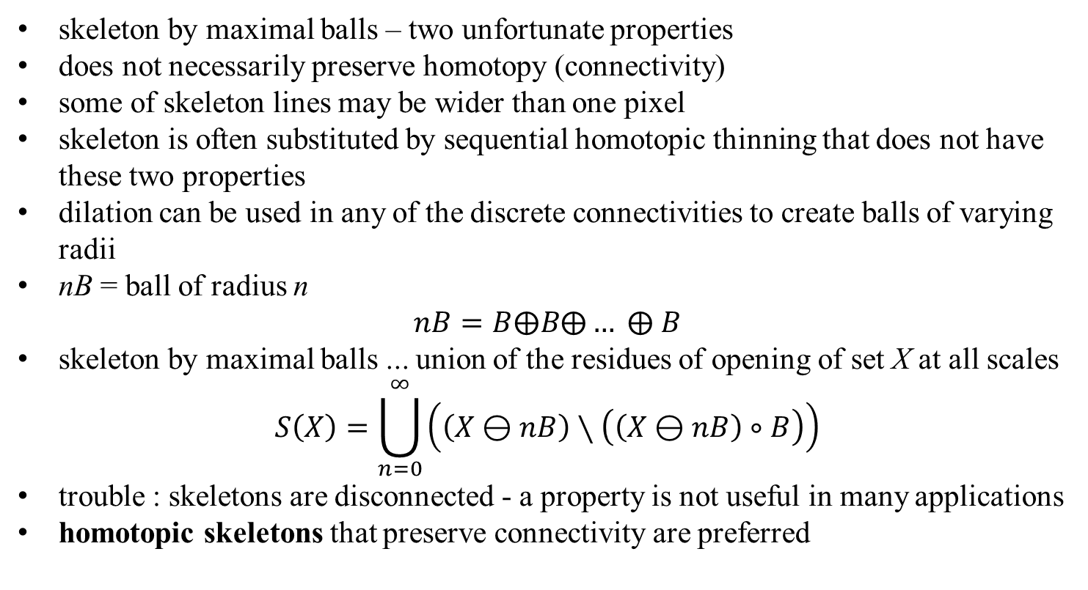
Figure 13.25: Skeletons of rectangle, two touching balls, and a ring.
skeleton by maximal balls – two unfortunate properties
does not necessarily preserve homotopy (connectivity)
some of skeleton lines may be wider than one pixel
skeleton is often substituted by sequential homotopic thinning that does not have these two properties
dilation can be used in any of the discrete connectivities to create balls of varying radii
nB = ball of radius n
$$nB=B⨁B⨁… ⨁ B$$
skeleton by maximal balls ... union of the residues of opening of set X at all scales
$$S\left(X\right)=\bigcup_{n=0}^{∞}{\left(\left(X⊖nB\right)∖\left(\left(X⊖nB\right)∘B\right)\right)}$$
trouble : skeletons are disconnected - a property is not useful in many applications
homotopic skeletons that preserve connectivity are preferred

