Slide 1
55:148 Digital Image Processing
Chapter 11
3D Vision, Geometry
Topics:
  Basics of projective geometry
    Points and hyperplanes in projective space
    Homography
    Estimating homography from point correspondence
  The single perspective camera
    An overview of single camera calibration
    Calibration of one camera from the known scene
  Scene reconstruction from multiple views
  Triangulation
  Projective reconstruction
  Matching constraints
  Bundle adjustment
  Two cameras, stereopsis
    The geometry of two cameras. The fundamental matrix
    Relative motion of the camera; the essential matrix
    Estimation of a fundamental matrix from image point correspondences
    Camera Image rectification
    Applications of the epipolar geometry in vision
  Three and more cameras
    Stereo correspondence algorithms
  Review

Slide 2
Three cameras and trifocal tensor

Slide 3

Three cameras and trifocal tensor
Three camera matrices:
$$M=\left[I | 0\right]; M^{′}=\left[{\tilde{M}}^{′} | e^{′}\right]; M^{′′}=\left[{\tilde{M}}^{′′} | e^{′′}\right]$$
$e^{′}, e^{′′}$: projection of the optical center $C$ on respective camera

Slide 4
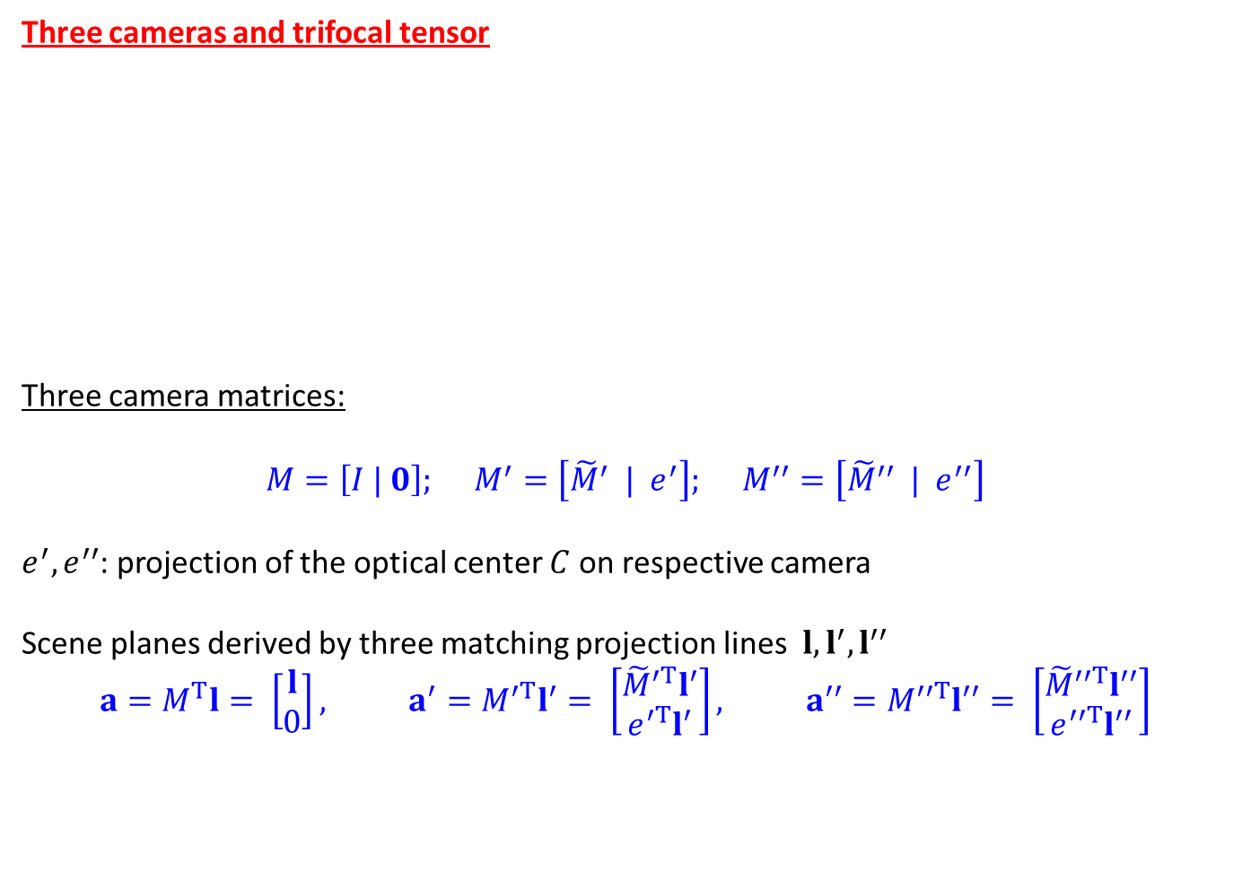
Three cameras and trifocal tensor
Three camera matrices:
$$M=\left[I | 0\right]; M^{′}=\left[{\tilde{M}}^{′} | e^{′}\right]; M^{′′}=\left[{\tilde{M}}^{′′} | e^{′′}\right]$$
$e^{′}, e^{′′}$: projection of the optical center $C$ on respective camera
Scene planes derived by three matching projection lines $l, l^{′}, l^{′′}$
$$a=M^{T}l= \left[\begin{matrix}l \\ 0\end{matrix}\right], a^{′}=M^{′T}l^{′}= \left[\begin{matrix}{\tilde{M}}^{′T}l^{′} \\ e^{′T}l^{′}\end{matrix}\right], a^{′′}=M^{′′T}l^{′′}= \left[\begin{matrix}{\tilde{M}}^{′′T}l^{′′} \\ e^{′′T}l^{′′}\end{matrix}\right]$$

Slide 5
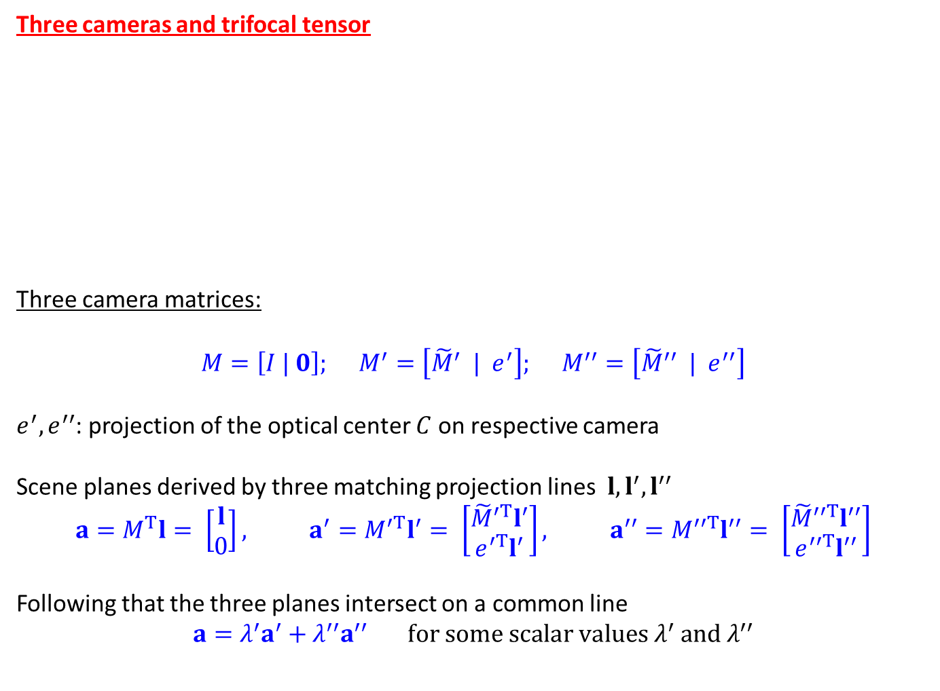
Three cameras and trifocal tensor
Three camera matrices:
$$M=\left[I | 0\right]; M^{′}=\left[{\tilde{M}}^{′} | e^{′}\right]; M^{′′}=\left[{\tilde{M}}^{′′} | e^{′′}\right]$$
$e^{′}, e^{′′}$: projection of the optical center $C$ on respective camera
Scene planes derived by three matching projection lines $l, l^{′}, l^{′′}$
$$a=M^{T}l= \left[\begin{matrix}l \\ 0\end{matrix}\right], a^{′}=M^{′T}l^{′}= \left[\begin{matrix}{\tilde{M}}^{′T}l^{′} \\ e^{′T}l^{′}\end{matrix}\right], a^{′′}=M^{′′T}l^{′′}= \left[\begin{matrix}{\tilde{M}}^{′′T}l^{′′} \\ e^{′′T}l^{′′}\end{matrix}\right]$$
Following that the three planes intersect on a common line
$$a=λ^{′}a^{′}+λ^{′′}a^{′′} for some scalar values λ^{′} and λ^{′′}$$

Slide 6

Three cameras and trifocal tensor Continued…..
Using
$a= \left[\begin{matrix}l \\ 0\end{matrix}\right], a^{′}= \left[\begin{matrix}{\tilde{M}}^{′T}l^{′} \\ e^{′T}l^{′}\end{matrix}\right], a^{′′}= \left[\begin{matrix}{\tilde{M}}^{′′T}l^{′′} \\ e^{′′T}l^{′′}\end{matrix}\right]$ and $a=λ^{′}a^{′}+λ^{′′}a^{′′}$

Slide 7

Three cameras and trifocal tensor Continued…..
Using
$a= \left[\begin{matrix}l \\ 0\end{matrix}\right], a^{′}= \left[\begin{matrix}{\tilde{M}}^{′T}l^{′} \\ e^{′T}l^{′}\end{matrix}\right], a^{′′}= \left[\begin{matrix}{\tilde{M}}^{′′T}l^{′′} \\ e^{′′T}l^{′′}\end{matrix}\right]$ and $a=λ^{′}a^{′}+λ^{′′}a^{′′}$
We get
$$0=λ^{′}e^{′T}l^{′}+λ^{′′}e^{′′T}l^{′′} ⇒λ^{′}e^{′T}l^{′}=−λ^{′′}e^{′′T}l^{′′}$$

Slide 8
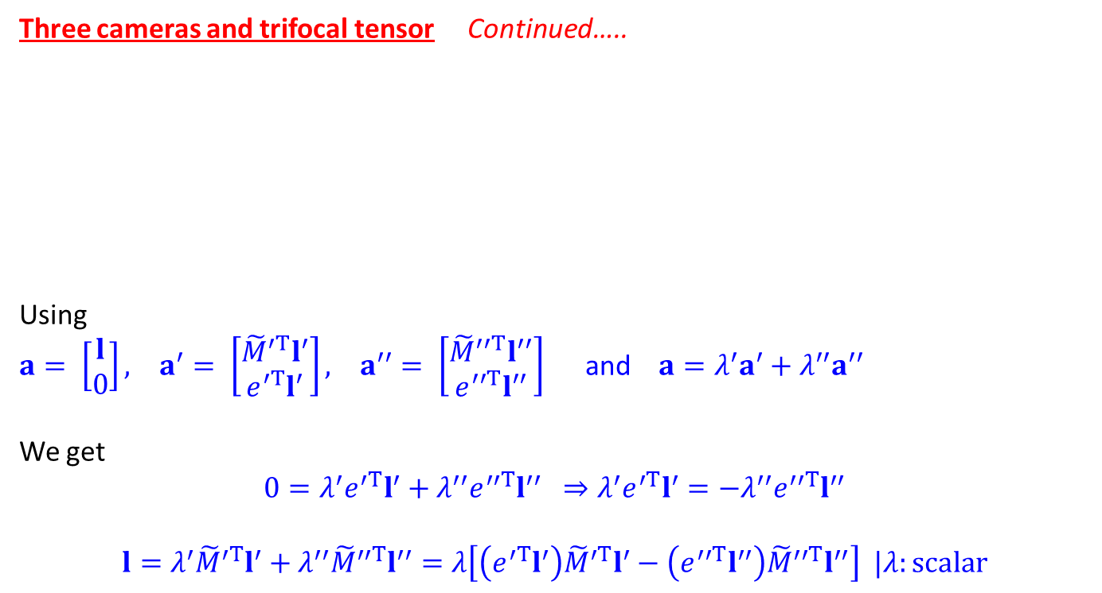
Three cameras and trifocal tensor Continued…..
Using
$a= \left[\begin{matrix}l \\ 0\end{matrix}\right], a^{′}= \left[\begin{matrix}{\tilde{M}}^{′T}l^{′} \\ e^{′T}l^{′}\end{matrix}\right], a^{′′}= \left[\begin{matrix}{\tilde{M}}^{′′T}l^{′′} \\ e^{′′T}l^{′′}\end{matrix}\right]$ and $a=λ^{′}a^{′}+λ^{′′}a^{′′}$
We get
$$0=λ^{′}e^{′T}l^{′}+λ^{′′}e^{′′T}l^{′′} ⇒λ^{′}e^{′T}l^{′}=−λ^{′′}e^{′′T}l^{′′}$$
$$l=λ^{′}{\tilde{M}}^{′T}l^{′}+λ^{′′}{\tilde{M}}^{′′T}l^{′′}=λ\left[\left(e^{′T}l^{′}\right){\tilde{M}}^{′T}l^{′}−\left(e^{′′T}l^{′′}\right){\tilde{M}}^{′′T}l^{′′}\right] |λ:scalar$$

Slide 9
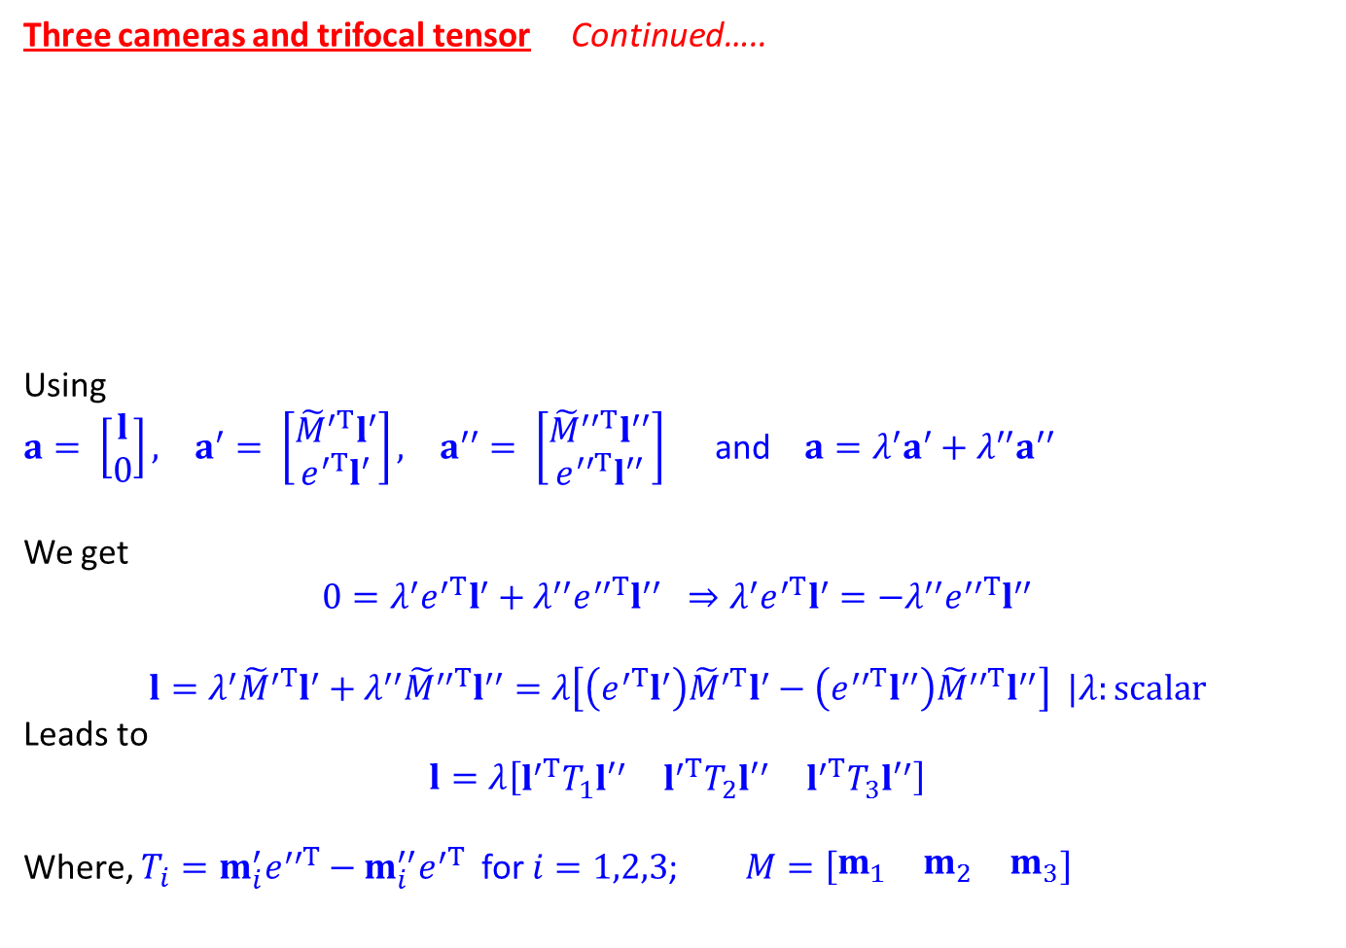
Three cameras and trifocal tensor Continued…..
Using
$a= \left[\begin{matrix}l \\ 0\end{matrix}\right], a^{′}= \left[\begin{matrix}{\tilde{M}}^{′T}l^{′} \\ e^{′T}l^{′}\end{matrix}\right], a^{′′}= \left[\begin{matrix}{\tilde{M}}^{′′T}l^{′′} \\ e^{′′T}l^{′′}\end{matrix}\right]$ and $a=λ^{′}a^{′}+λ^{′′}a^{′′}$
We get
$$0=λ^{′}e^{′T}l^{′}+λ^{′′}e^{′′T}l^{′′} ⇒λ^{′}e^{′T}l^{′}=−λ^{′′}e^{′′T}l^{′′}$$
$$l=λ^{′}{\tilde{M}}^{′T}l^{′}+λ^{′′}{\tilde{M}}^{′′T}l^{′′}=λ\left[\left(e^{′T}l^{′}\right){\tilde{M}}^{′T}l^{′}−\left(e^{′′T}l^{′′}\right){\tilde{M}}^{′′T}l^{′′}\right] |λ:scalar$$
Leads to
$$l=λ\left[\begin{matrix}l^{′T}T_{1}{l′}^{′} & l^{′T}T_{2}{l′}^{′} & l^{′T}T_{3}{l′}^{′}\end{matrix}\right]$$
Where, $T_{i}=m_{i}^{′}e^{′′T}−m_{i}^{′′}e^{′T}$ for $i=1,2,3$; $M=\left[\begin{matrix}m_{1} & m_{2} & m_{3}\end{matrix}\right]$

Slide 10
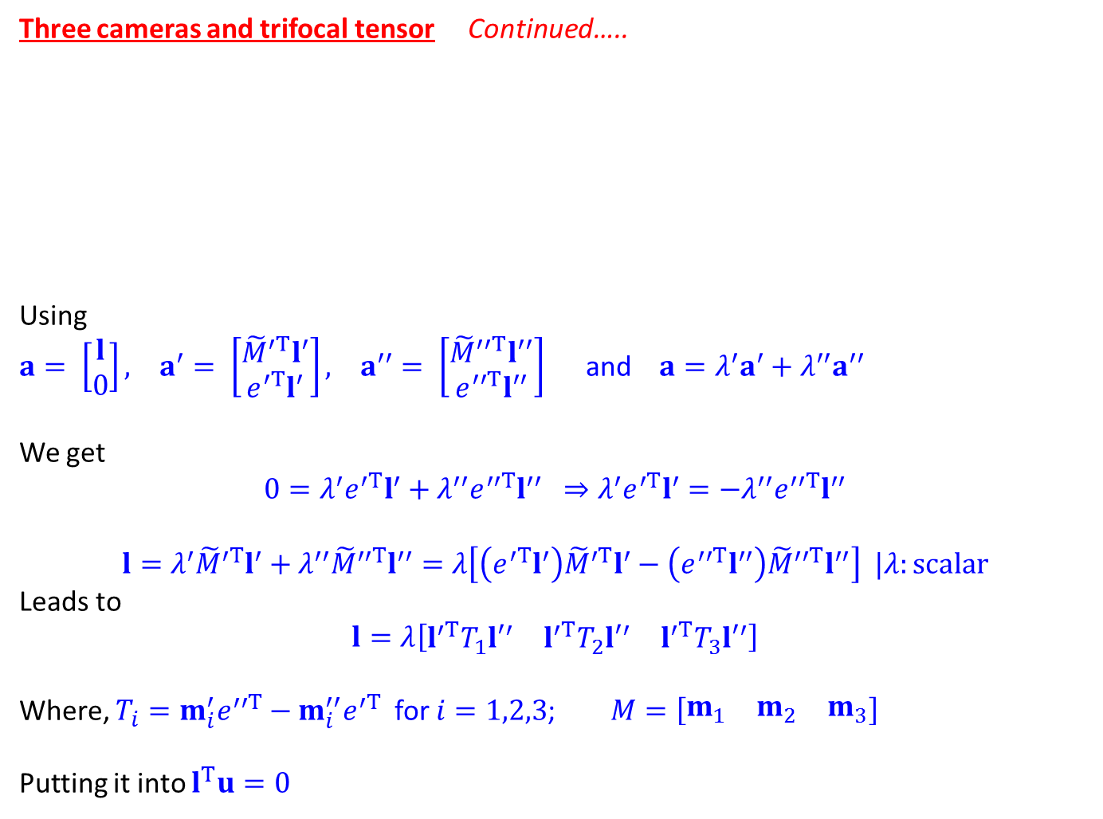
Three cameras and trifocal tensor Continued…..
Using
$a= \left[\begin{matrix}l \\ 0\end{matrix}\right], a^{′}= \left[\begin{matrix}{\tilde{M}}^{′T}l^{′} \\ e^{′T}l^{′}\end{matrix}\right], a^{′′}= \left[\begin{matrix}{\tilde{M}}^{′′T}l^{′′} \\ e^{′′T}l^{′′}\end{matrix}\right]$ and $a=λ^{′}a^{′}+λ^{′′}a^{′′}$
We get
$$0=λ^{′}e^{′T}l^{′}+λ^{′′}e^{′′T}l^{′′} ⇒λ^{′}e^{′T}l^{′}=−λ^{′′}e^{′′T}l^{′′}$$
$$l=λ^{′}{\tilde{M}}^{′T}l^{′}+λ^{′′}{\tilde{M}}^{′′T}l^{′′}=λ\left[\left(e^{′T}l^{′}\right){\tilde{M}}^{′T}l^{′}−\left(e^{′′T}l^{′′}\right){\tilde{M}}^{′′T}l^{′′}\right] |λ:scalar$$
Leads to
$$l=λ\left[\begin{matrix}l^{′T}T_{1}{l′}^{′} & l^{′T}T_{2}{l′}^{′} & l^{′T}T_{3}{l′}^{′}\end{matrix}\right]$$
Where, $T_{i}=m_{i}^{′}e^{′′T}−m_{i}^{′′}e^{′T}$ for $i=1,2,3$; $M=\left[\begin{matrix}m_{1} & m_{2} & m_{3}\end{matrix}\right]$
Putting it into $l^{T}u=0$

Slide 11
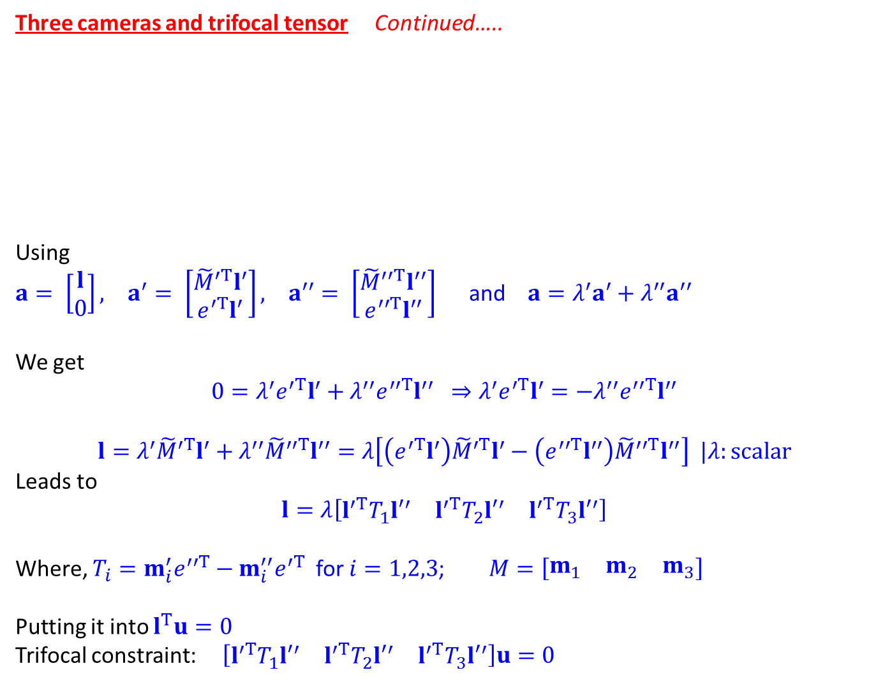
Three cameras and trifocal tensor Continued…..
Using
$a= \left[\begin{matrix}l \\ 0\end{matrix}\right], a^{′}= \left[\begin{matrix}{\tilde{M}}^{′T}l^{′} \\ e^{′T}l^{′}\end{matrix}\right], a^{′′}= \left[\begin{matrix}{\tilde{M}}^{′′T}l^{′′} \\ e^{′′T}l^{′′}\end{matrix}\right]$ and $a=λ^{′}a^{′}+λ^{′′}a^{′′}$
We get
$$0=λ^{′}e^{′T}l^{′}+λ^{′′}e^{′′T}l^{′′} ⇒λ^{′}e^{′T}l^{′}=−λ^{′′}e^{′′T}l^{′′}$$
$$l=λ^{′}{\tilde{M}}^{′T}l^{′}+λ^{′′}{\tilde{M}}^{′′T}l^{′′}=λ\left[\left(e^{′T}l^{′}\right){\tilde{M}}^{′T}l^{′}−\left(e^{′′T}l^{′′}\right){\tilde{M}}^{′′T}l^{′′}\right] |λ:scalar$$
Leads to
$$l=λ\left[\begin{matrix}l^{′T}T_{1}{l′}^{′} & l^{′T}T_{2}{l′}^{′} & l^{′T}T_{3}{l′}^{′}\end{matrix}\right]$$
Where, $T_{i}=m_{i}^{′}e^{′′T}−m_{i}^{′′}e^{′T}$ for $i=1,2,3$; $M=\left[\begin{matrix}m_{1} & m_{2} & m_{3}\end{matrix}\right]$
Putting it into $l^{T}u=0$
Trifocal constraint: $\left[\begin{matrix}l^{′T}T_{1}{l′}^{′} & l^{′T}T_{2}{l′}^{′} & l^{′T}T_{3}{l′}^{′}\end{matrix}\right]u=0$

Slide 12
Stereo correspondence algorithms
We know how to determine 3D depth using point correspondence after image rectification

Slide 13
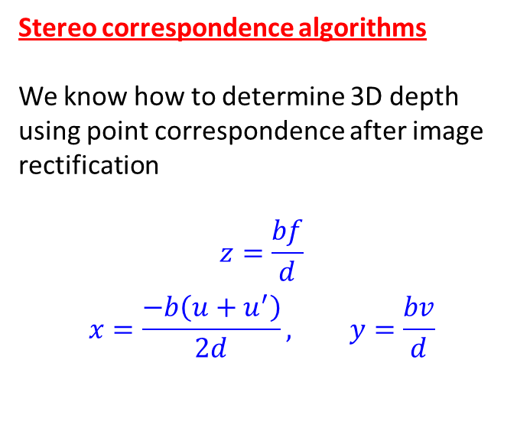
Stereo correspondence algorithms
We know how to determine 3D depth using point correspondence after image rectification
$$z=\frac{bf}{d}$$
$$x=\frac{−b\left(u+u^{′}\right)}{2d}, y=\frac{bv}{d}$$

Slide 14
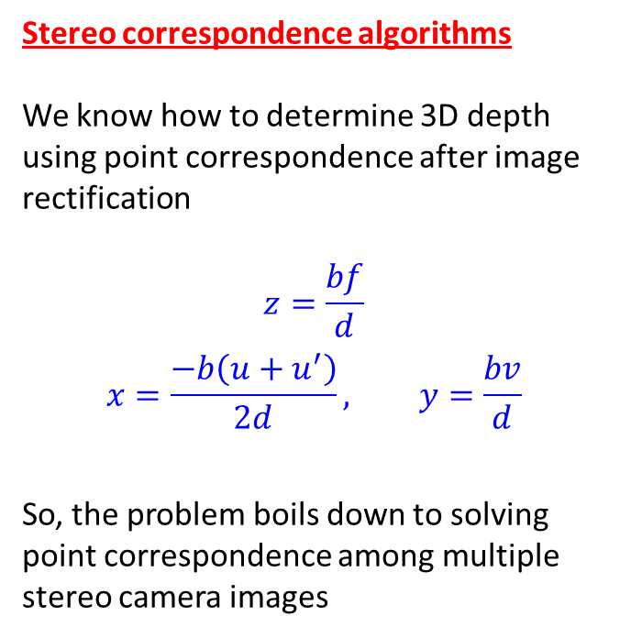
Stereo correspondence algorithms
We know how to determine 3D depth using point correspondence after image rectification
$$z=\frac{bf}{d}$$
$$x=\frac{−b\left(u+u^{′}\right)}{2d}, y=\frac{bv}{d}$$
So, the problem boils down to solving point correspondence among multiple stereo camera images

Slide 15
Challenges: Self occlusion and inherent ambiguity

Slide 16
Approach
Reduce possible candidate pairs of corresponding points using various geometric and photometric constraints

Slide 17
Approach
Reduce possible candidate pairs of corresponding points using various geometric and photometric constraints
Built point correspondence using “correspondence scoring” and optimization techniques

Slide 18
Approach
Reduce possible candidate pairs of corresponding points using various geometric and photometric constraints
Built point correspondence using “correspondence scoring” and optimization techniques
Different constraints:

Slide 19
Approach
Reduce possible candidate pairs of corresponding points using various geometric and photometric constraints
Built point correspondence using “correspondence scoring” and optimization techniques
Different constraints:
Epipolar constraint
Uniqueness constraint
Symmetry constraint
Photometric compatibility constraint
Geometry similarity constraint
Disparity smoothness constraint
Disparity search range
Disparity gradient limit
Ordering Limit

Slide 20
Feature based stereo correspondence
Objective: determine the disparity gradient of a pair of matches and use that to score “goodness” of a matching pair

Slide 21
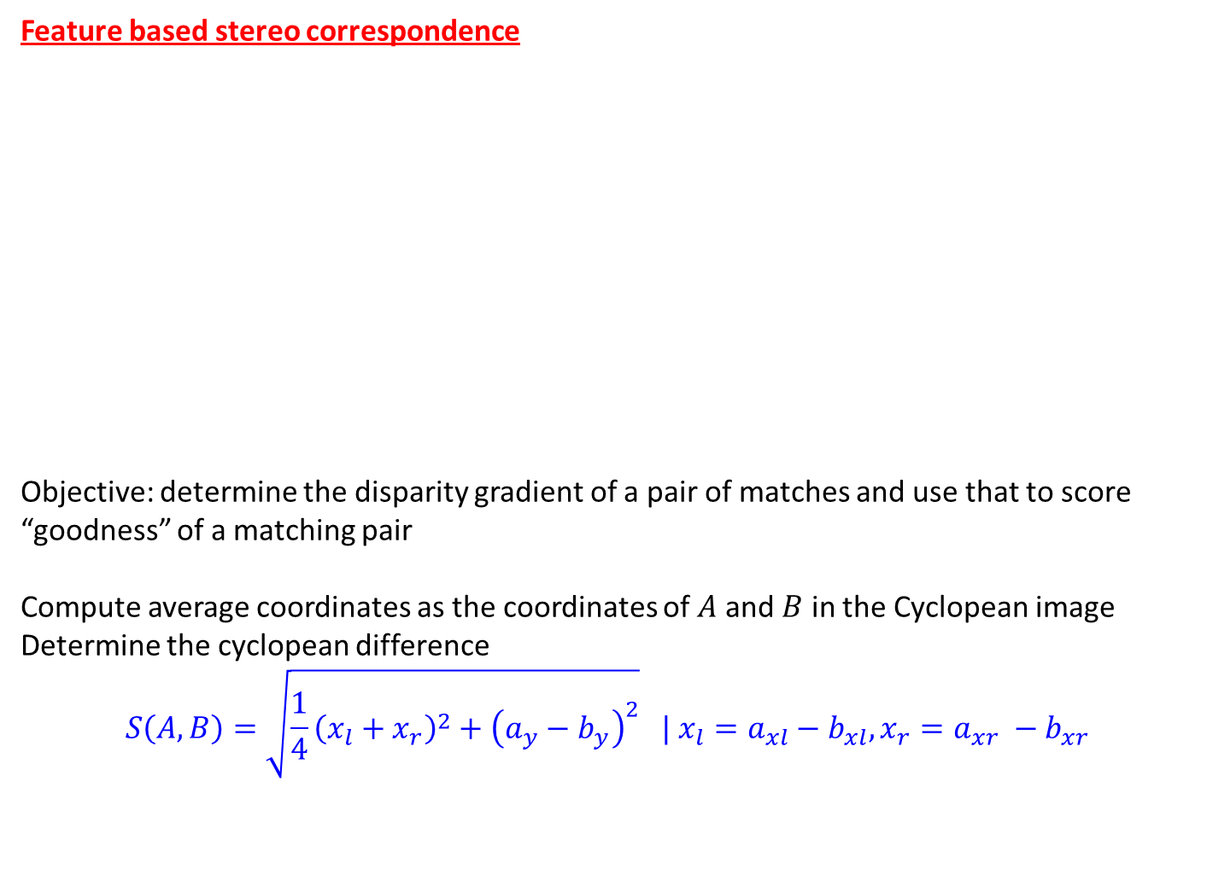
Feature based stereo correspondence
Objective: determine the disparity gradient of a pair of matches and use that to score “goodness” of a matching pair
Compute average coordinates as the coordinates of $A$ and $B$ in the Cyclopean image
Determine the cyclopean difference
$$S\left(A,B\right)=\sqrt{\frac{1}{4}{\left(x_{l}+x_{r}\right)}^{2}+{\left(a_{y}−b_{y}\right)}^{2}} | x_{l}=a_{xl}−b_{xl}, x_{r}=a_{xr} −b_{xr}$$

Slide 22
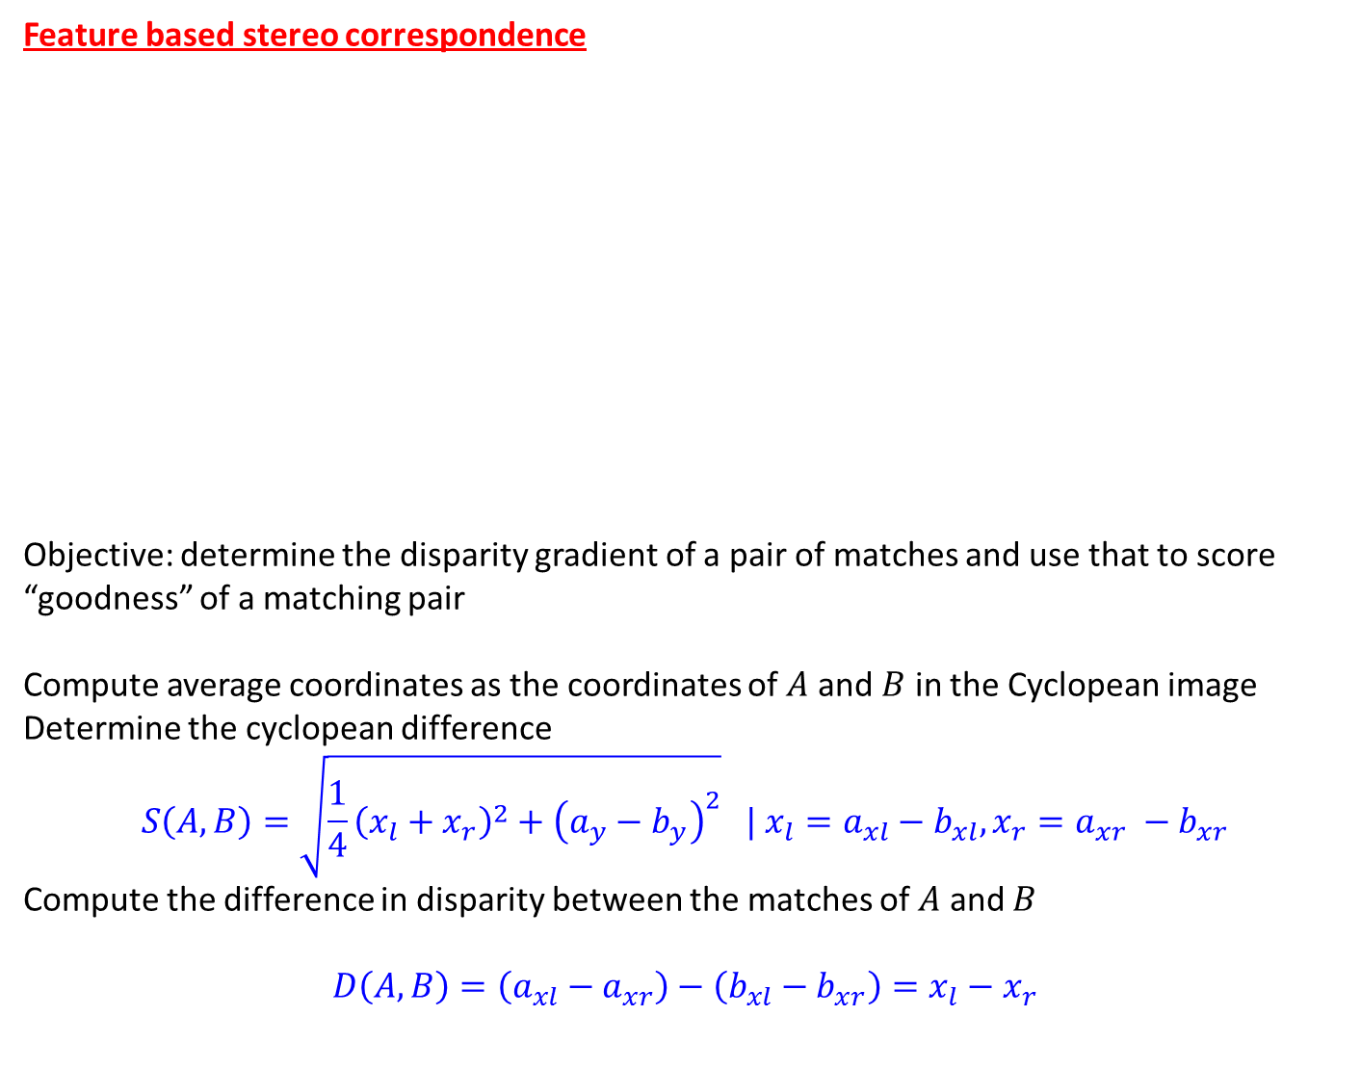
Feature based stereo correspondence
Objective: determine the disparity gradient of a pair of matches and use that to score “goodness” of a matching pair
Compute average coordinates as the coordinates of $A$ and $B$ in the Cyclopean image
Determine the cyclopean difference
$$S\left(A,B\right)=\sqrt{\frac{1}{4}{\left(x_{l}+x_{r}\right)}^{2}+{\left(a_{y}−b_{y}\right)}^{2}} | x_{l}=a_{xl}−b_{xl}, x_{r}=a_{xr} −b_{xr}$$
Compute the difference in disparity between the matches of $A$ and $B$
$$D\left(A,B\right)=\left(a_{xl}−a_{xr}\right)−\left(b_{xl}−b_{xr}\right)=x_{l}−x_{r}$$

Slide 23

Disparity gradient constraint
Disparity gradient:
$$Γ\left(A,B\right)=\frac{D\left(A,B\right)}{S(A,B)}=\frac{x_{l}−x_{r}}{\sqrt{\frac{1}{4}{\left(x_{l}+x_{r}\right)}^{2}+{\left(a_{y}−b_{y}\right)}^{2}}}$$

Slide 24

Disparity gradient constraint
Disparity gradient:
$$Γ\left(A,B\right)=\frac{D\left(A,B\right)}{S(A,B)}=\frac{x_{l}−x_{r}}{\sqrt{\frac{1}{4}{\left(x_{l}+x_{r}\right)}^{2}+{\left(a_{y}−b_{y}\right)}^{2}}}$$
Disparity constraint: Impose a constraint on the disparity gradient measure that $Γ$ should not exceed a preset threshold (say, ‘1’)

Slide 25
Algorithm

Slide 26
Algorithm
Extract feature-based points in the left and right images to build the correspondence

Slide 27
Algorithm
Extract feature-based points in the left and right images to build the correspondence
For each point in the left image, build initial list of correspondence points in the right image

Slide 28
Algorithm
Extract feature-based points in the left and right images to build the correspondence
For each point in the left image, build initial list of correspondence points in the right image
For each possible candidate match, find the number of other possible matches

Slide 29
Algorithm
Extract feature-based points in the left and right images to build the correspondence
For each point in the left image, build initial list of correspondence points in the right image
For each possible candidate match, find the number of other possible matches fulfilling the disparity gradient constraint and use the number as the “likelihood” measure for the candidate match
Find the highest scoring match; remove all matches involving any of the two points impose uniqueness constraint

Slide 30
Algorithm
Extract feature-based points in the left and right images to build the correspondence
For each point in the left image, build initial list of correspondence points in the right image
For each possible candidate match, find the number of other possible matches fulfilling the disparity gradient constraint and use the number as the “likelihood” measure for the candidate match
Find the highest scoring match; remove all matches involving any of the two points impose uniqueness constraint
Repeat Step 2 until all possible matches are established

Slide 31
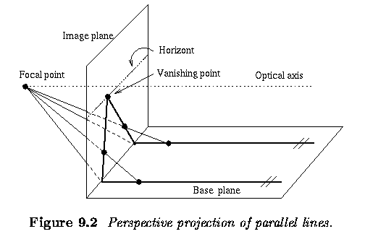
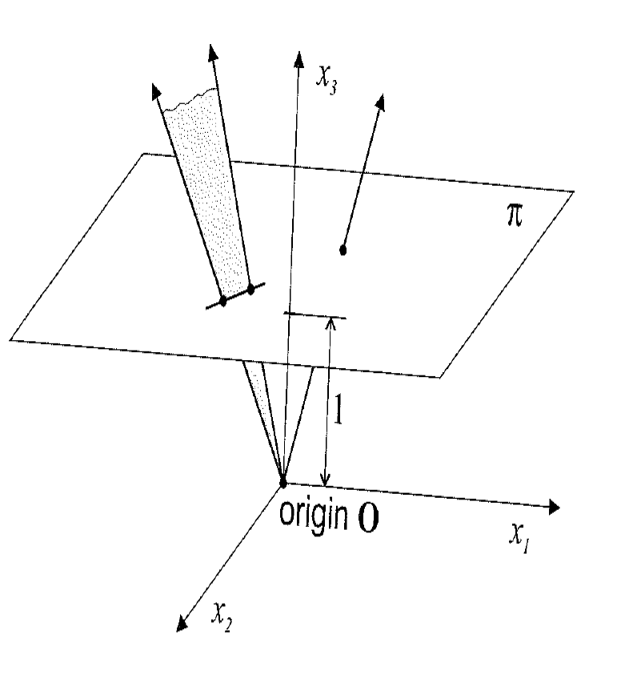
Review
Basics of projective geometry
  Points and hyperplanes in projective space
Perspective projection of parallel lines Properties of projection

Slide 32
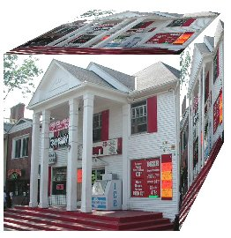
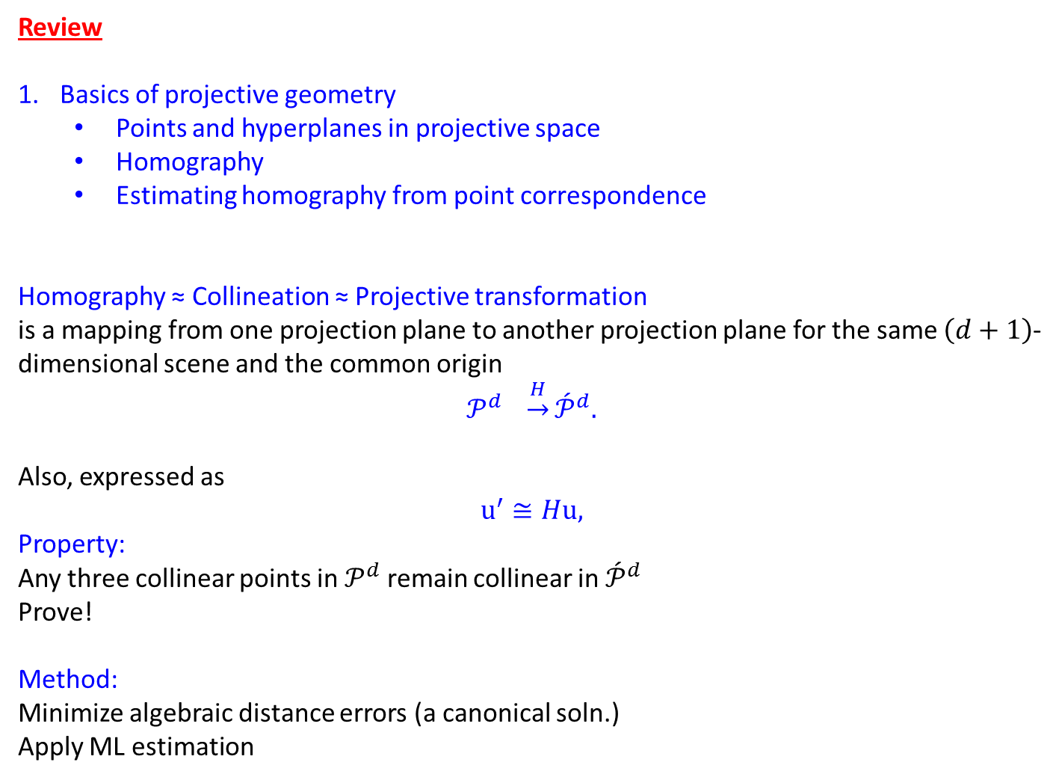
Review
Basics of projective geometry
  Points and hyperplanes in projective space
  Homography
  Estimating homography from point correspondence
Homography ≈ Collineation ≈ Projective transformation
is a mapping from one projection plane to another projection plane for the same $\left(d+1\right)$-dimensional scene and the common origin
$$𝒫^{d} \underset{→}{H}{\acute{𝒫}}^{d}.$$
Also, expressed as
$$u^{′}≅Hu,$$
Property:
Any three collinear points in $𝒫^{d}$ remain collinear in ${\acute{𝒫}}^{d}$
Prove!
Method:
Minimize algebraic distance errors (a canonical soln.)
Apply ML estimation

Slide 33
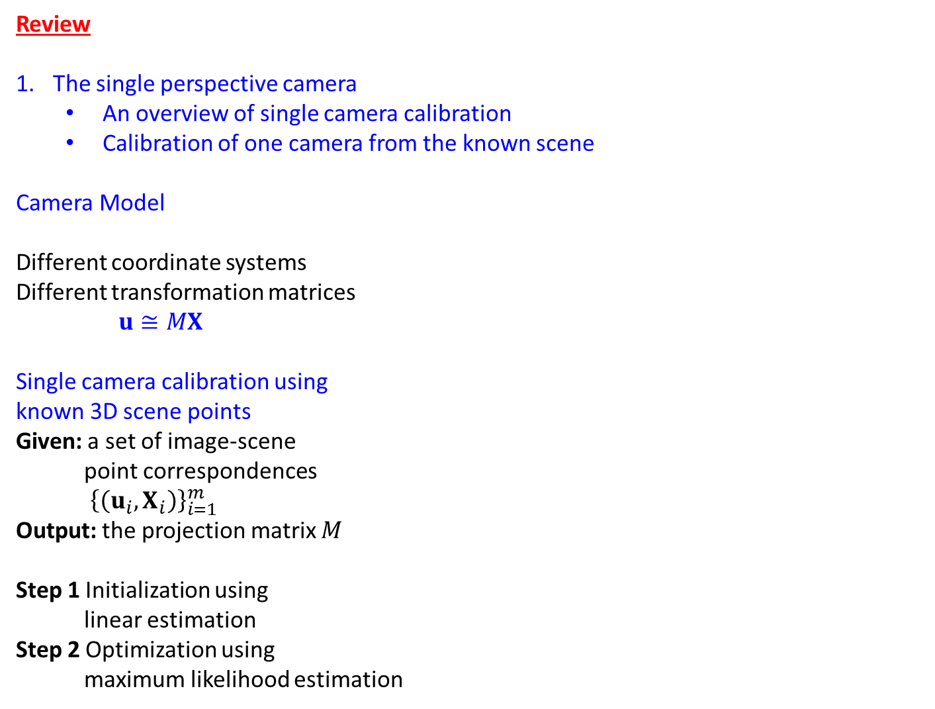
Review
The single perspective camera
  An overview of single camera calibration
  Calibration of one camera from the known scene
Camera Model
Different coordinate systems
Different transformation matrices
$u≅MX$
Single camera calibration using
known 3D scene points
Given: a set of image-scene
point correspondences
${\left\{\left(u_{i},X_{i}\right)\right\}}_{i=1}^{m}$
Output: the projection matrix $M$
Step 1 Initialization using
linear estimation
Step 2 Optimization using
maximum likelihood estimation

Slide 34
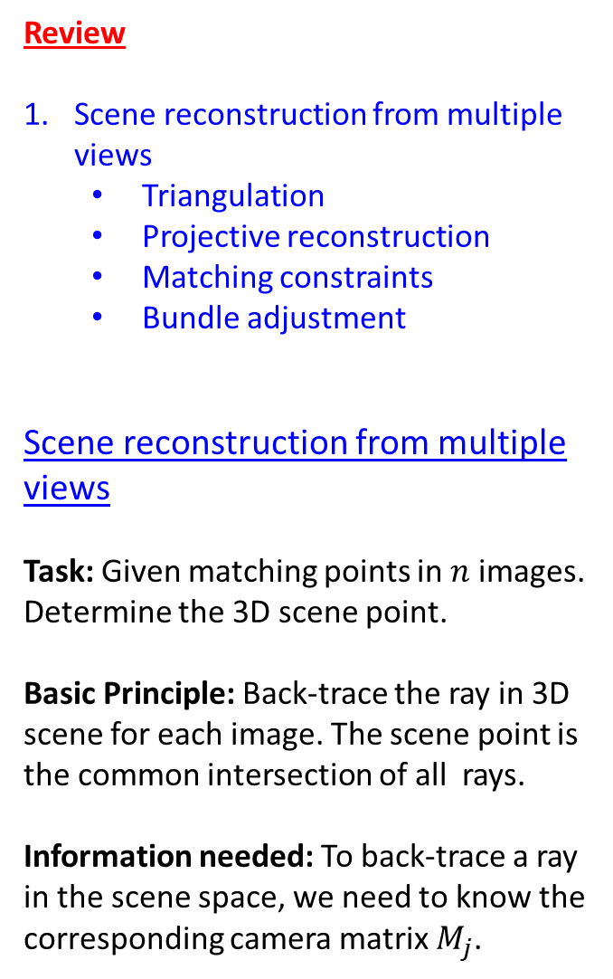
Review
Scene reconstruction from multiple views
  Triangulation
  Projective reconstruction
  Matching constraints
  Bundle adjustment
Scene reconstruction from multiple views
Task: Given matching points in $n$ images. Determine the 3D scene point.
Basic Principle: Back-trace the ray in 3D scene for each image. The scene point is the common intersection of all rays.
Information needed: To back-trace a ray in the scene space, we need to know the corresponding camera matrix $M_{j}$.

Slide 35
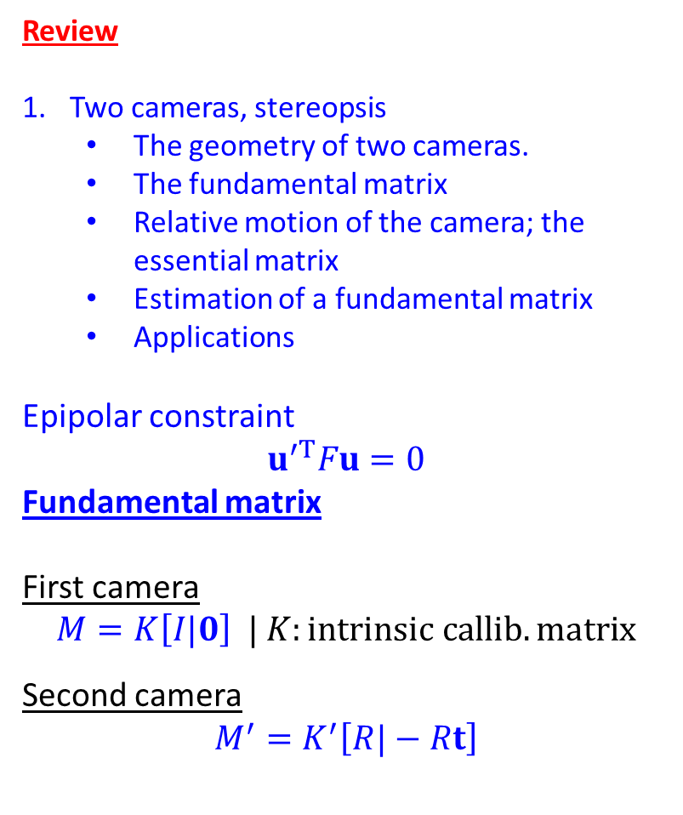
Review
Two cameras, stereopsis
  The geometry of two cameras.
  The fundamental matrix
  Relative motion of the camera; the essential matrix
  Estimation of a fundamental matrix
  Applications
Epipolar constraint
$$u^{′T}Fu=0$$
Fundamental matrix
First camera
$$M=K\left[I|0\right] | K:intrinsic callib. matrix$$
Second camera
$$M^{′}=K^{′}\left[R|−Rt\right]$$

Slide 36
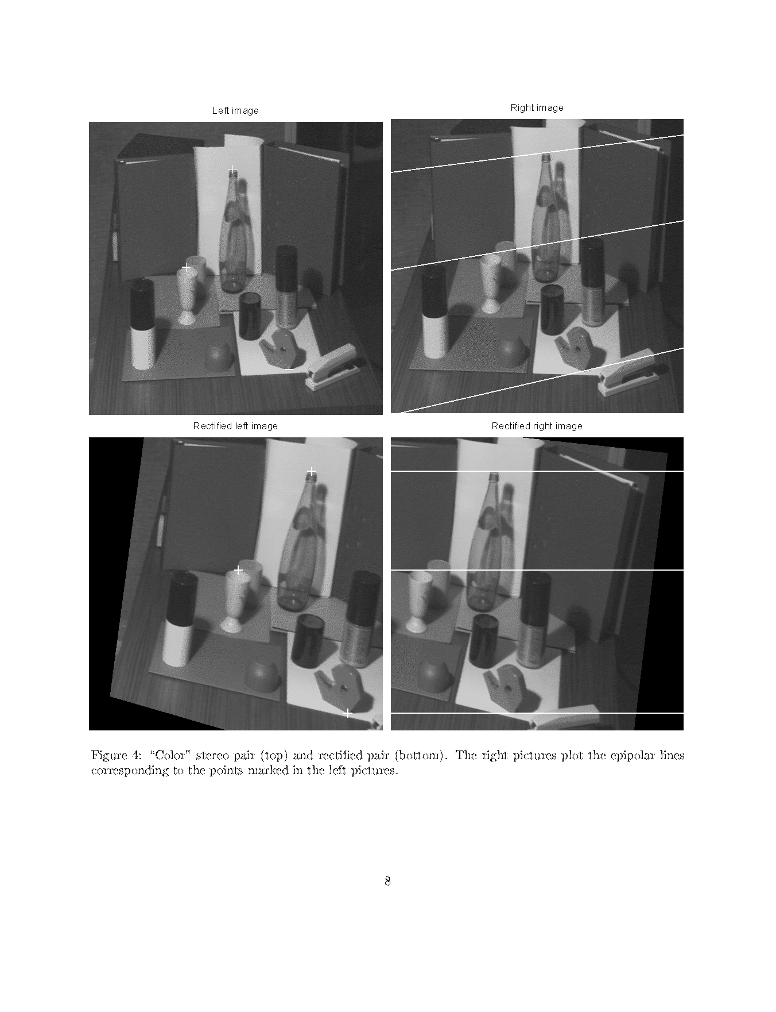
Review
Two cameras, stereopsis
  The geometry of two cameras.
  The fundamental matrix
  Relative motion of the camera; the essential matrix
  Estimation of a fundamental matrix
  Applications
Epipolar lines

Slide 37
Review
Two cameras, stereopsis
  The geometry of two cameras.
  The fundamental matrix
  Relative motion of the camera; the essential matrix
  Estimation of a fundamental matrix
  Applications
Image Rectification

Slide 38
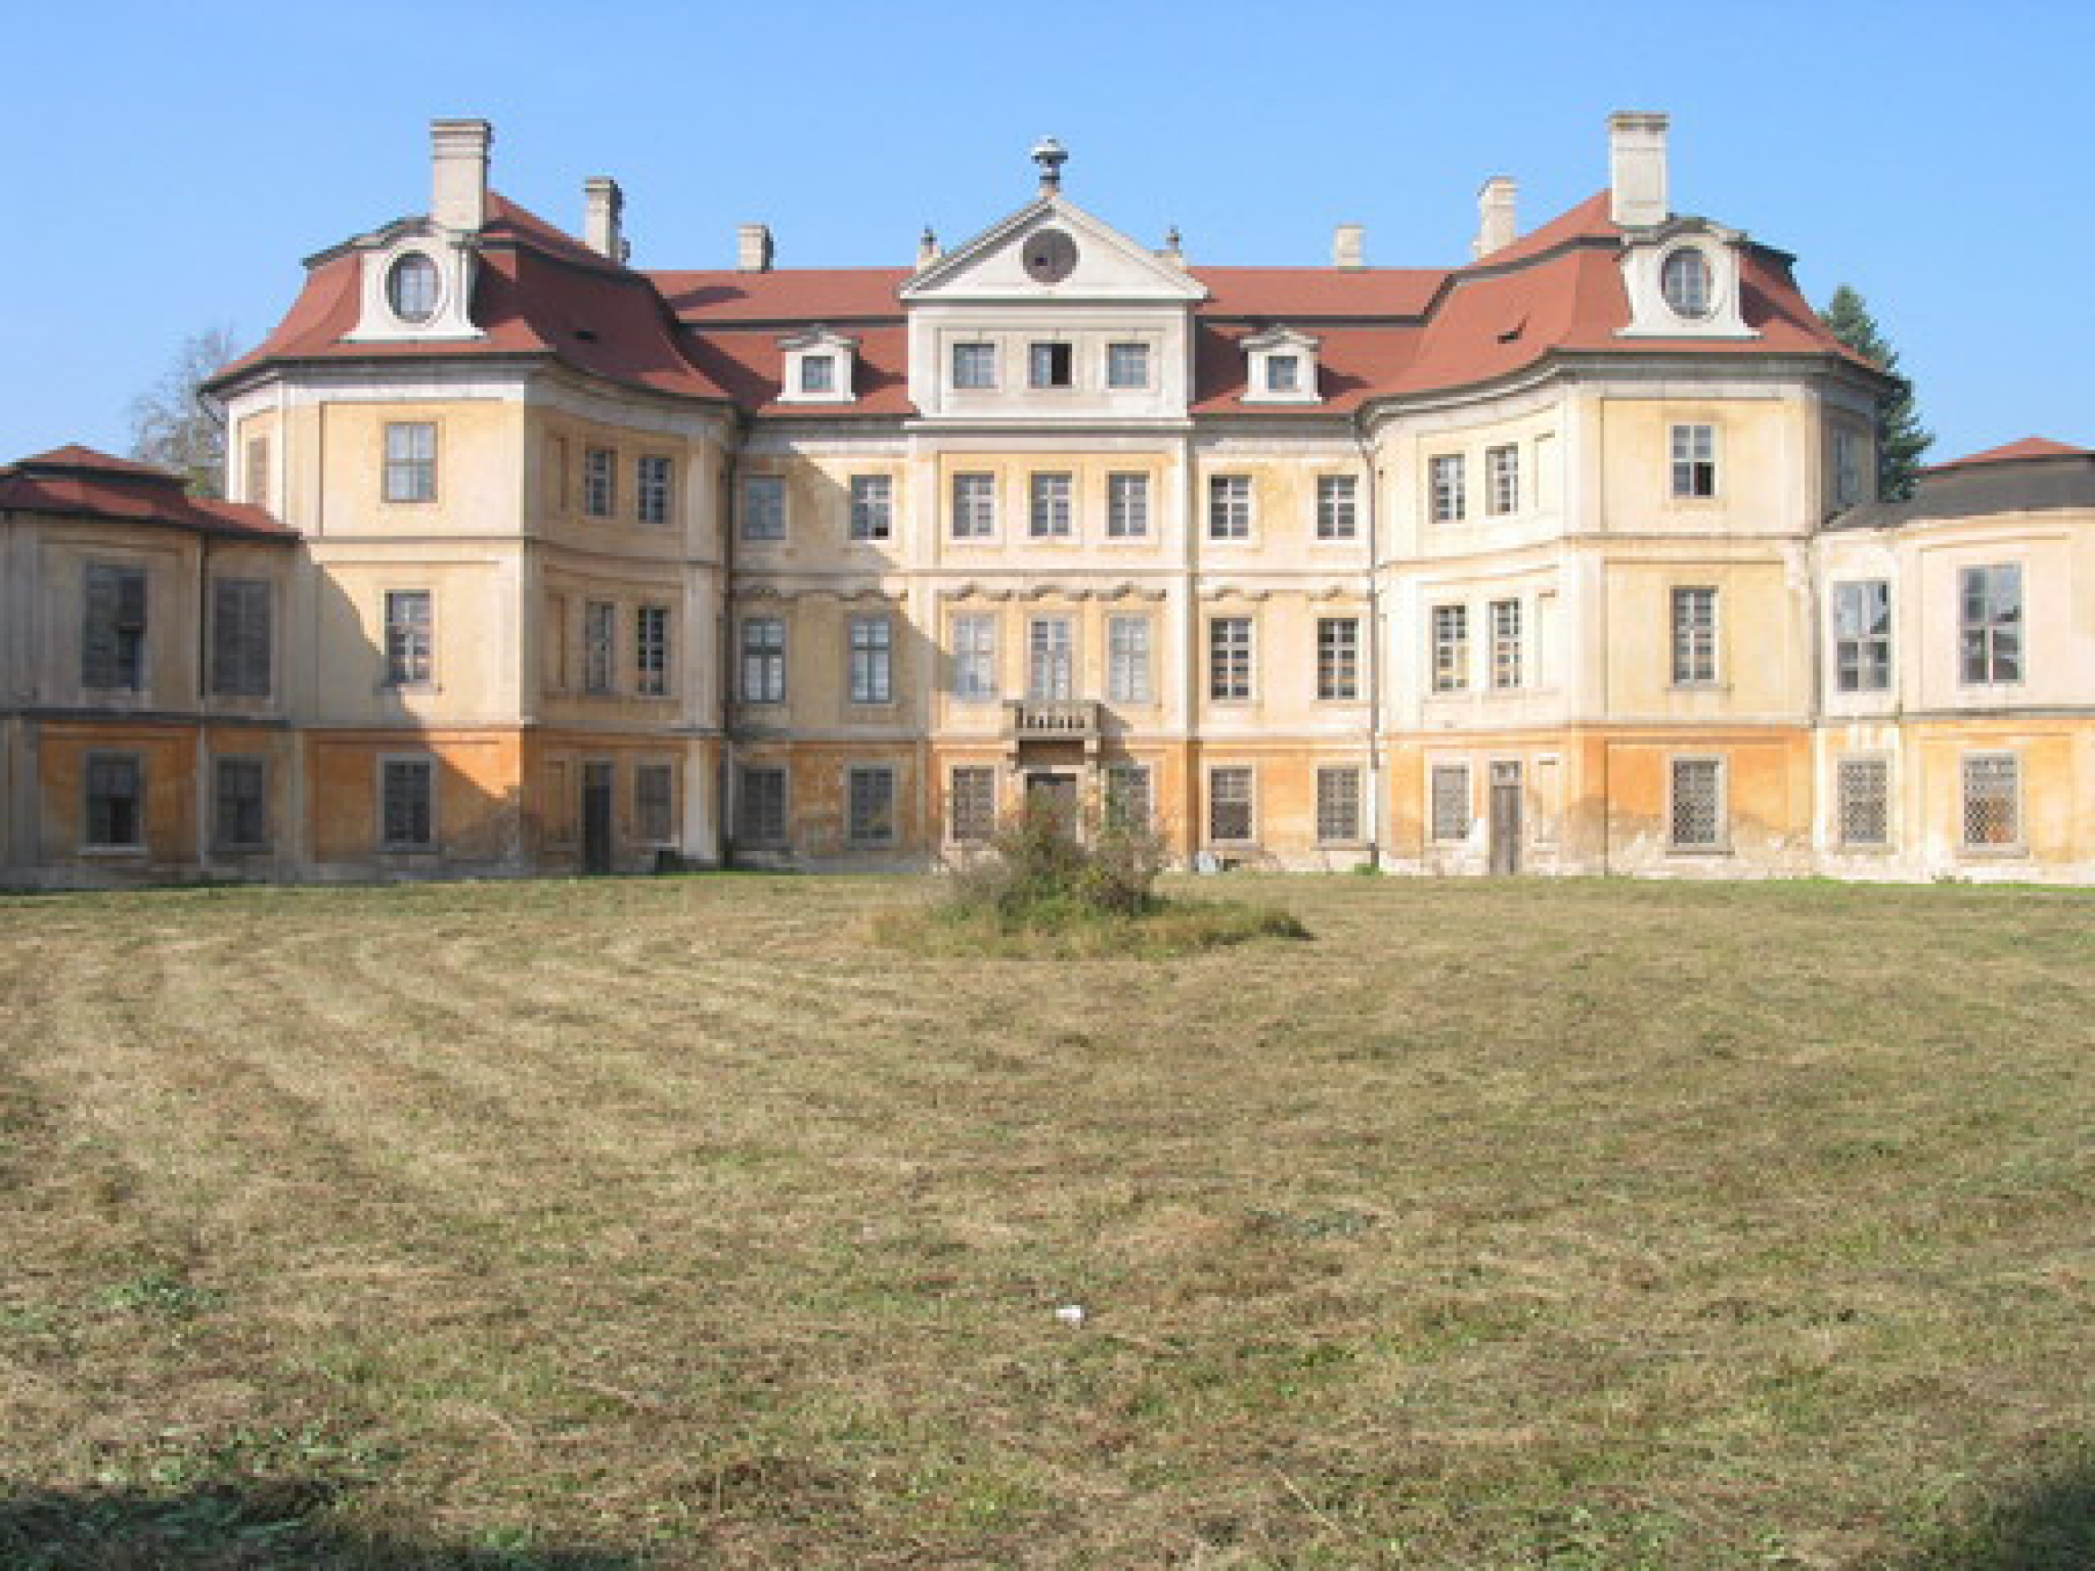
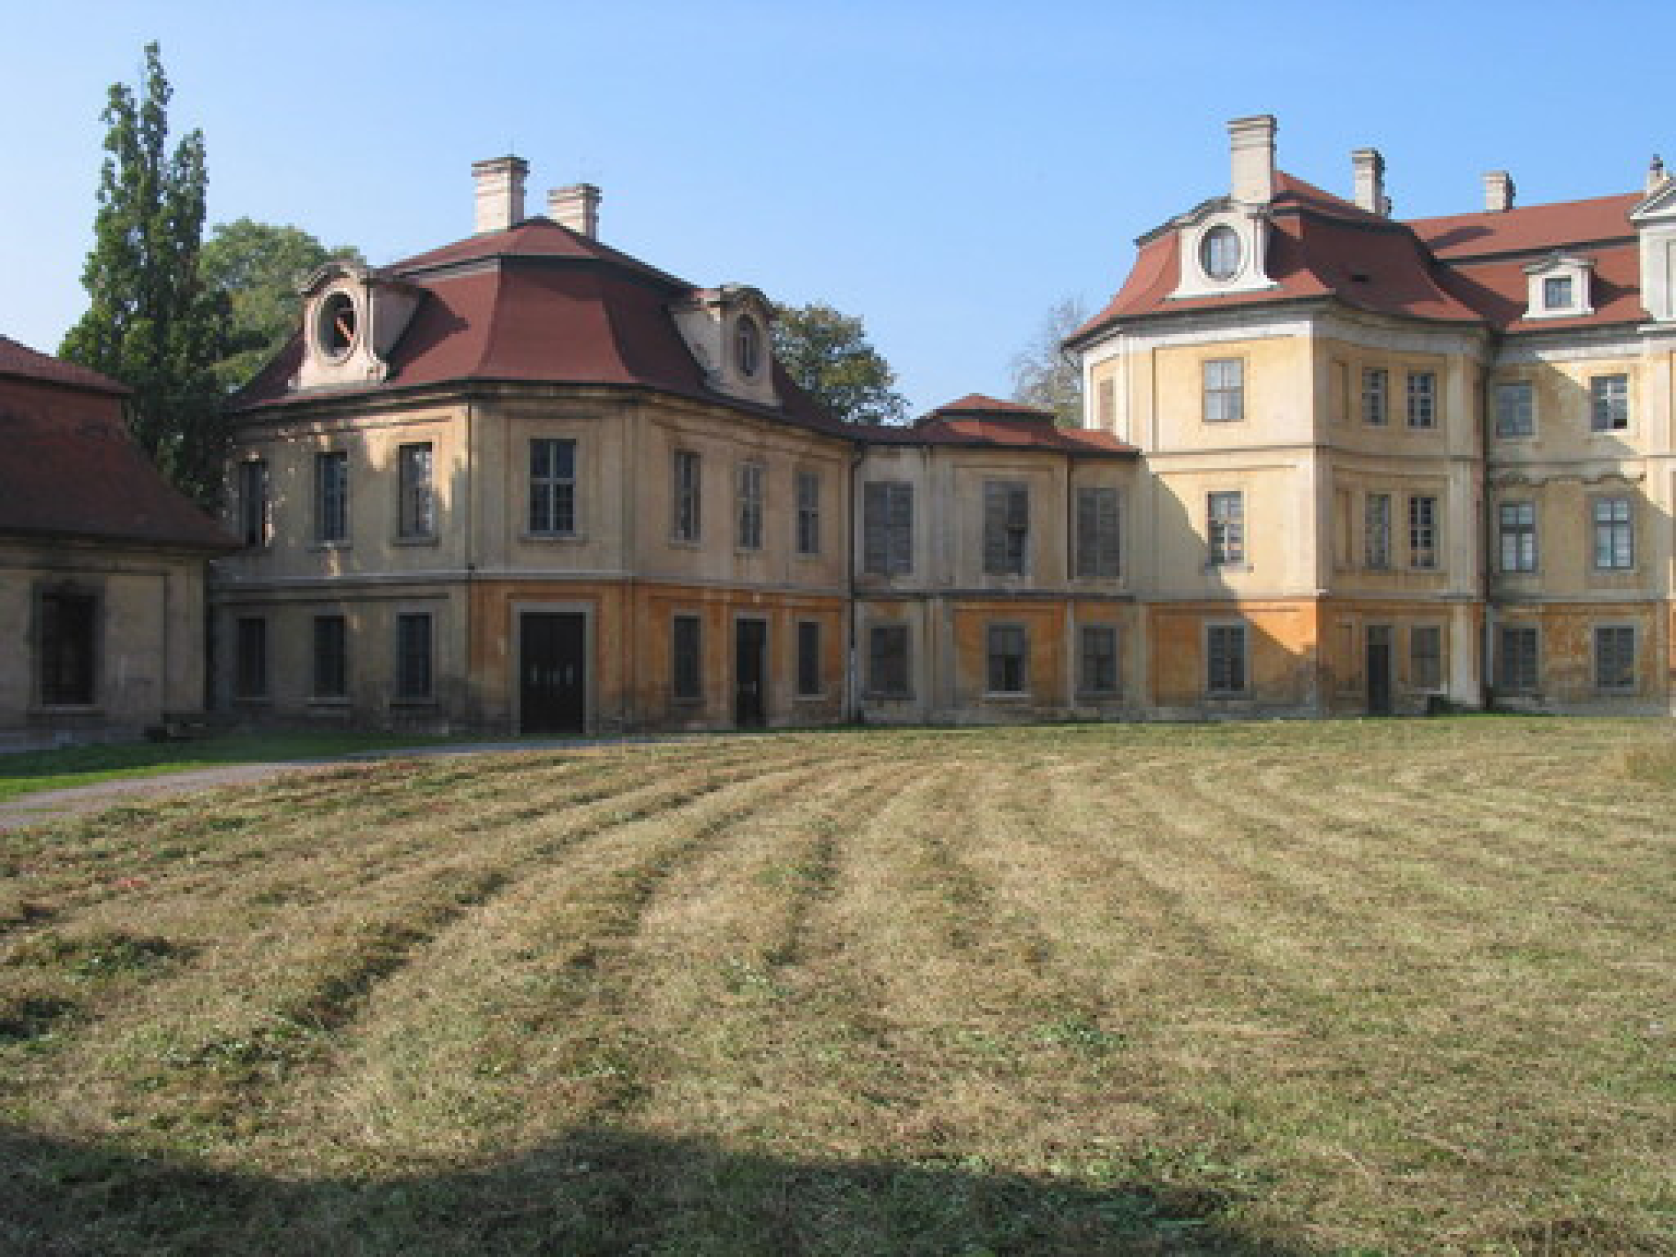
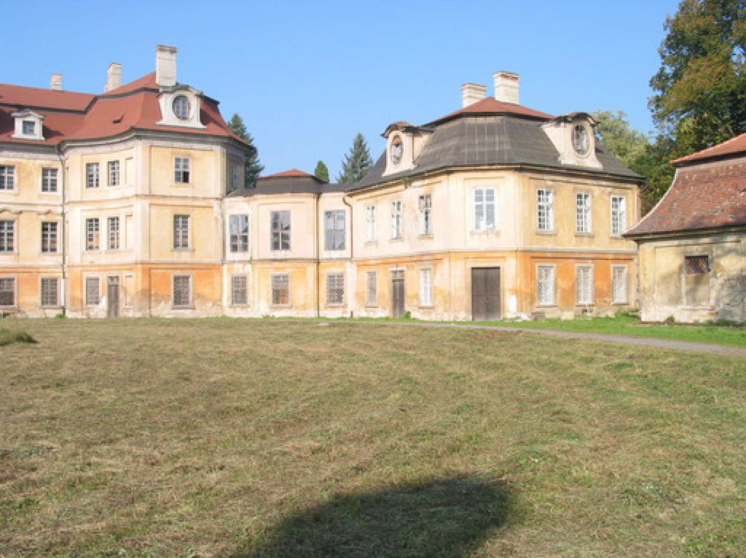
Review
Two cameras, stereopsis
  The geometry of two cameras.
  The fundamental matrix
  Relative motion of the camera; the essential matrix
  Estimation of a fundamental matrix
  Applications
Panoramic view

Slide 39
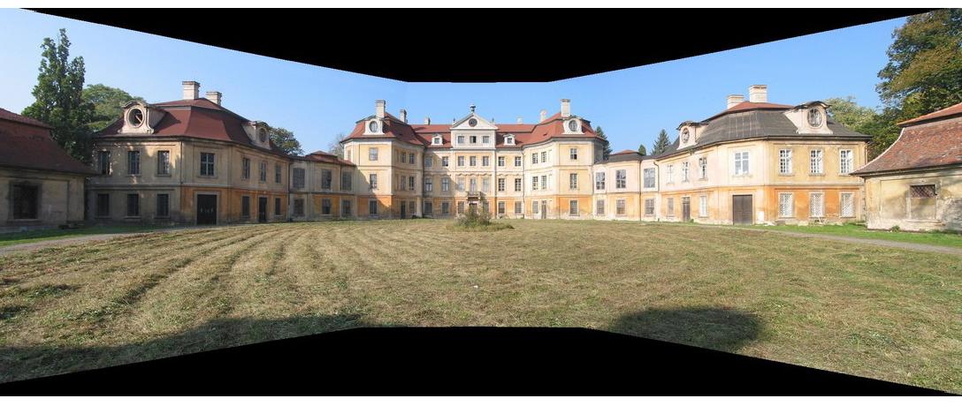
Review
Two cameras, stereopsis
  The geometry of two cameras.
  The fundamental matrix
  Relative motion of the camera; the essential matrix
  Estimation of a fundamental matrix
  Applications
Panoramic view

