Slide 1
55:148 Digital Image Processing
Chapter 11 3D Vision, Geometry
Topics:
Basics of projective geometry
Points and hyperplanes in projective space
Homography
Estimating homography from point correspondence
The single perspective camera
An overview of single camera calibration
Calibration of one camera from the known scene
Scene reconstruction from multiple views
Triangulation
Projective reconstruction
Matching constraints
Bundle adjustment
Two cameras, stereopsis
The geometry of two cameras. The fundamental matrix
Relative motion of the camera; the essential matrix
Estimation of a fundamental matrix from image point correspondences
Camera Image rectification
Applications of the epipolar geometry in vision
Three and more cameras
Stereo correspondence algorithms
Review

Slide 2
Three cameras and trifocal tensor
Three camera matrices:
$$M=\left[I | 0\right]; M^{′}=\left[{\tilde{M}}^{′} | e^{′}\right]; M^{′′}=\left[{\tilde{M}}^{′′} | e^{′′}\right]$$
$e^{′}, e^{′′}$: projection of the optical center $C$ on respective camera
Scene planes derived by three matching projection lines $l, l^{′}, l^{′′}$
$$a=M^{T}l= \left[\begin{matrix}l \\ 0\end{matrix}\right], a^{′}=M^{′T}l^{′}= \left[\begin{matrix}{\tilde{M}}^{′T}l^{′} \\ e^{′T}l^{′}\end{matrix}\right], a^{′′}=M^{′′T}l^{′′}= \left[\begin{matrix}{\tilde{M}}^{′′T}l^{′′} \\ e^{′′T}l^{′′}\end{matrix}\right]$$
Following that the three planes intersect on a common line
$$a=λ^{′}a^{′}+λ^{′′}a^{′′} for some scalar values λ^{′} and λ^{′′}$$

Slide 3
Three cameras and trifocal tensor Continued…..
Using
$a= \left[\begin{matrix}l \\ 0\end{matrix}\right], a^{′}= \left[\begin{matrix}{\tilde{M}}^{′T}l^{′} \\ e^{′T}l^{′}\end{matrix}\right], a^{′′}= \left[\begin{matrix}{\tilde{M}}^{′′T}l^{′′} \\ e^{′′T}l^{′′}\end{matrix}\right]$ and $a=λ^{′}a^{′}+λ^{′′}a^{′′}$
We get
$$0=λ^{′}e^{′T}l^{′}+λ^{′′}e^{′′T}l^{′′} ⇒λ^{′}e^{′T}l^{′}=−λ^{′′}e^{′′T}l^{′′}$$
$$l=λ^{′}{\tilde{M}}^{′T}l^{′}+λ^{′′}{\tilde{M}}^{′′T}l^{′′}=λ\left[\left(e^{′T}l^{′}\right){\tilde{M}}^{′T}l^{′}−\left(e^{′′T}l^{′′}\right){\tilde{M}}^{′′T}l^{′′}\right] |λ:scalar$$
Leads to
$$l=λ\left[\begin{matrix}l^{′T}T_{1}{l′}^{′} & l^{′T}T_{2}{l′}^{′} & l^{′T}T_{3}{l′}^{′}\end{matrix}\right]$$
Where, $T_{i}=m_{i}^{′}e^{′′T}−m_{i}^{′′}e^{′T}$ for $i=1,2,3$; $M=\left[\begin{matrix}m_{1} & m_{2} & m_{3}\end{matrix}\right]$
Putting it into $l^{T}u=0$
Trifocal constraint: $\left[\begin{matrix}l^{′T}T_{1}{l′}^{′} & l^{′T}T_{2}{l′}^{′} & l^{′T}T_{3}{l′}^{′}\end{matrix}\right]u=0$

Slide 4
Stereo correspondence algorithms
We know how to determine 3D depth using point correspondence after image rectification
$$z=\frac{bf}{d}$$
$$x=\frac{−b\left(u+u^{′}\right)}{2d}, y=\frac{bv}{d}$$
So, the problem boils down to solving point correspondence among multiple stereo camera images

Slide 5
Challenges: Self occlusion and inherent ambiguity

Slide 6
Approach
Reduce possible candidate pairs of corresponding points using various geometric and photometric constraints
Built point correspondence using “correspondence scoring” and optimization techniques
Different constraints:
Epipolar constraint
Uniqueness constraint
Symmetry constraint
Photometric compatibility constraint
Geometry similarity constraint
Disparity smoothness constraint
Disparity search range
Disparity gradient limit
Ordering Limit

Slide 7
Feature based stereo correspondence
Objective: determine the disparity gradient of a pair of matches and use that to score “goodness” of a matching pair
Compute average coordinates as the coordinates of $A$ and $B$ in the Cyclopean image
Determine the cyclopean difference
$$S\left(A,B\right)=\sqrt{\frac{1}{4}{\left(x_{l}+x_{r}\right)}^{2}+{\left(a_{y}−b_{y}\right)}^{2}} | x_{l}=a_{xl}−b_{xl}, x_{r}=a_{xr} −b_{xr}$$
Compute the difference in disparity between the matches of $A$ and $B$
$$D\left(A,B\right)=\left(a_{xl}−a_{xr}\right)−\left(b_{xl}−b_{xr}\right)=x_{l}−x_{r}$$

Slide 8
Disparity gradient constraint
Disparity gradient:
$$Γ\left(A,B\right)=\frac{D\left(A,B\right)}{S(A,B)}=\frac{x_{l}−x_{r}}{\sqrt{\frac{1}{4}{\left(x_{l}+x_{r}\right)}^{2}+{\left(a_{y}−b_{y}\right)}^{2}}}$$
Disparity constraint: Impose a constraint on the disparity gradient measure that $Γ$ should not exceed a preset threshold (say, ‘1’)

Slide 9
Algorithm
Extract feature-based points in the left and right images to build the correspondence
For each point in the left image, build initial list of correspondence points in the right image
For each possible candidate match, find the number of other possible matches fulfilling the disparity gradient constraint and use the number as the “likelihood” measure for the candidate match
Find the highest scoring match; remove all matches involving any of the two points impose uniqueness constraint
Repeat Step 2 until all possible matches are established

Slide 10
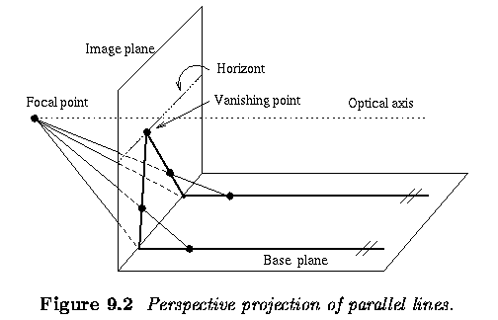
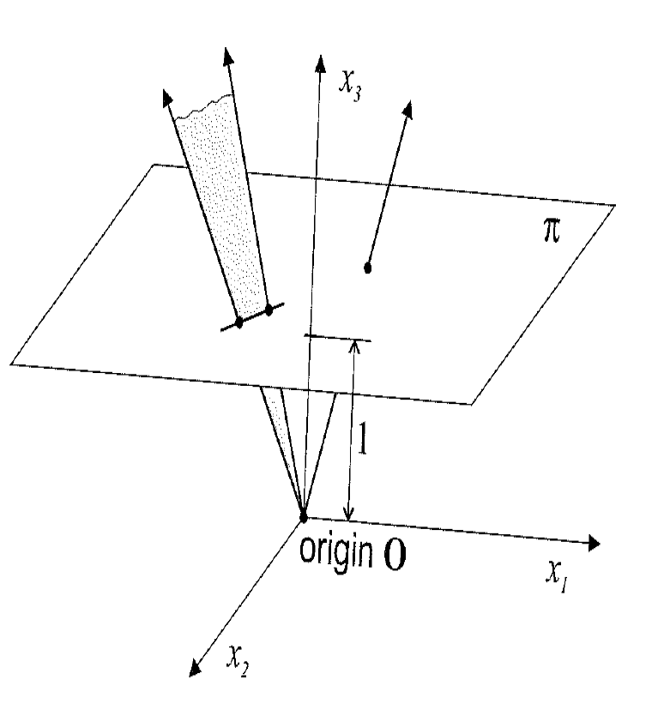
Review
Basics of projective geometry
Points and hyperplanes in projective space
Perspective projection of parallel lines Properties of projection

Slide 11
Review
Basics of projective geometry
Points and hyperplanes in projective space
Homography
Estimating homography from point correspondence
Homography ≈ Collineation ≈ Projective transformation
is a mapping from one projection plane to another projection plane for the same $\left(d+1\right)$-dimensional scene and the common origin
$$𝒫^{d} \underset{→}{H}{\acute{𝒫}}^{d}.$$
Also, expressed as
$$u^{′}≅Hu,$$
Property:
Any three collinear points in $𝒫^{d}$ remain collinear in ${\acute{𝒫}}^{d}$
Prove!
Method:
Minimize algebraic distance errors (a canonical soln.)
Apply ML estimation

Slide 12
Review
The single perspective camera
An overview of single camera calibration
Calibration of one camera from the known scene
Camera Model
Different coordinate systems
Different transformation matrices
$u≅MX$
Single camera calibration using
known 3D scene points
Given: a set of image-scene
point correspondences
${\left\{\left(u_{i},X_{i}\right)\right\}}_{i=1}^{m}$
Output: the projection matrix $M$
Step 1 Initialization using
linear estimation
Step 2 Optimization using
maximum likelihood estimation

Slide 13
Review
Scene reconstruction from multiple views
Triangulation
Projective reconstruction
Matching constraints
Bundle adjustment
Scene reconstruction from multiple views
Task: Given matching points in $n$ images. Determine the 3D scene point.
Basic Principle: Back-trace the ray in 3D scene for each image. The scene point is the common intersection of all rays.
Information needed: To back-trace a ray in the scene space, we need to know the corresponding camera matrix $M_{j}$.

Slide 14
Review
Two cameras, stereopsis
The geometry of two cameras.
The fundamental matrix
Relative motion of the camera; the essential matrix
Estimation of a fundamental matrix
Applications
Epipolar constraint
$$u^{′T}Fu=0$$
Fundamental matrix
First camera
$$M=K\left[I|0\right] | K:intrinsic callib. matrix$$
Second camera
$$M^{′}=K^{′}\left[R|−Rt\right]$$

Slide 15
Review
Two cameras, stereopsis
The geometry of two cameras.
The fundamental matrix
Relative motion of the camera; the essential matrix
Estimation of a fundamental matrix
Applications
Epipolar lines

Slide 16
Review
Two cameras, stereopsis
The geometry of two cameras.
The fundamental matrix
Relative motion of the camera; the essential matrix
Estimation of a fundamental matrix
Applications
Image Rectification

Slide 17
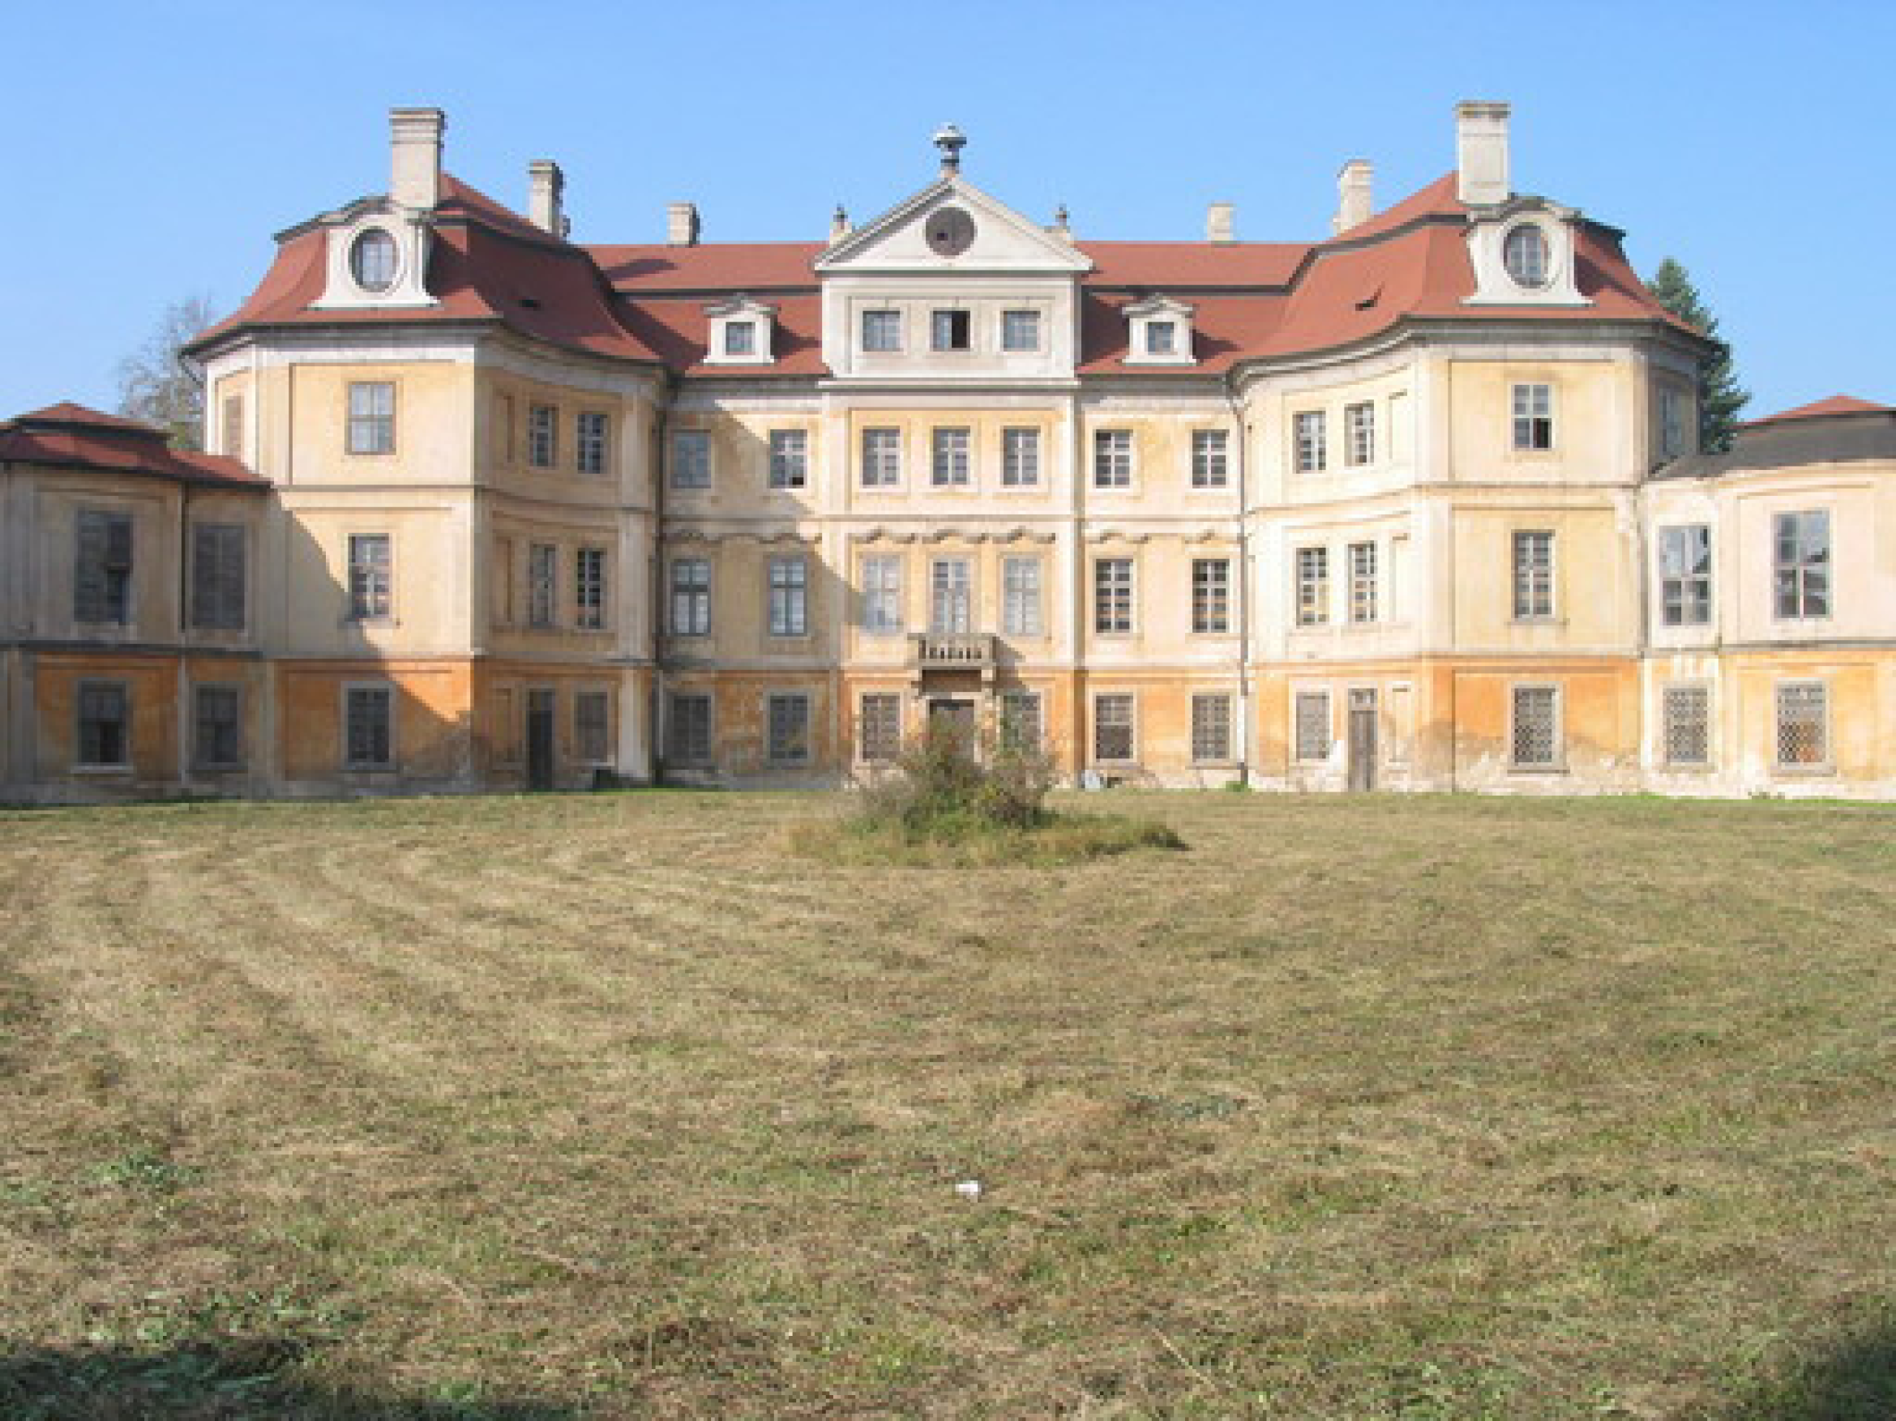
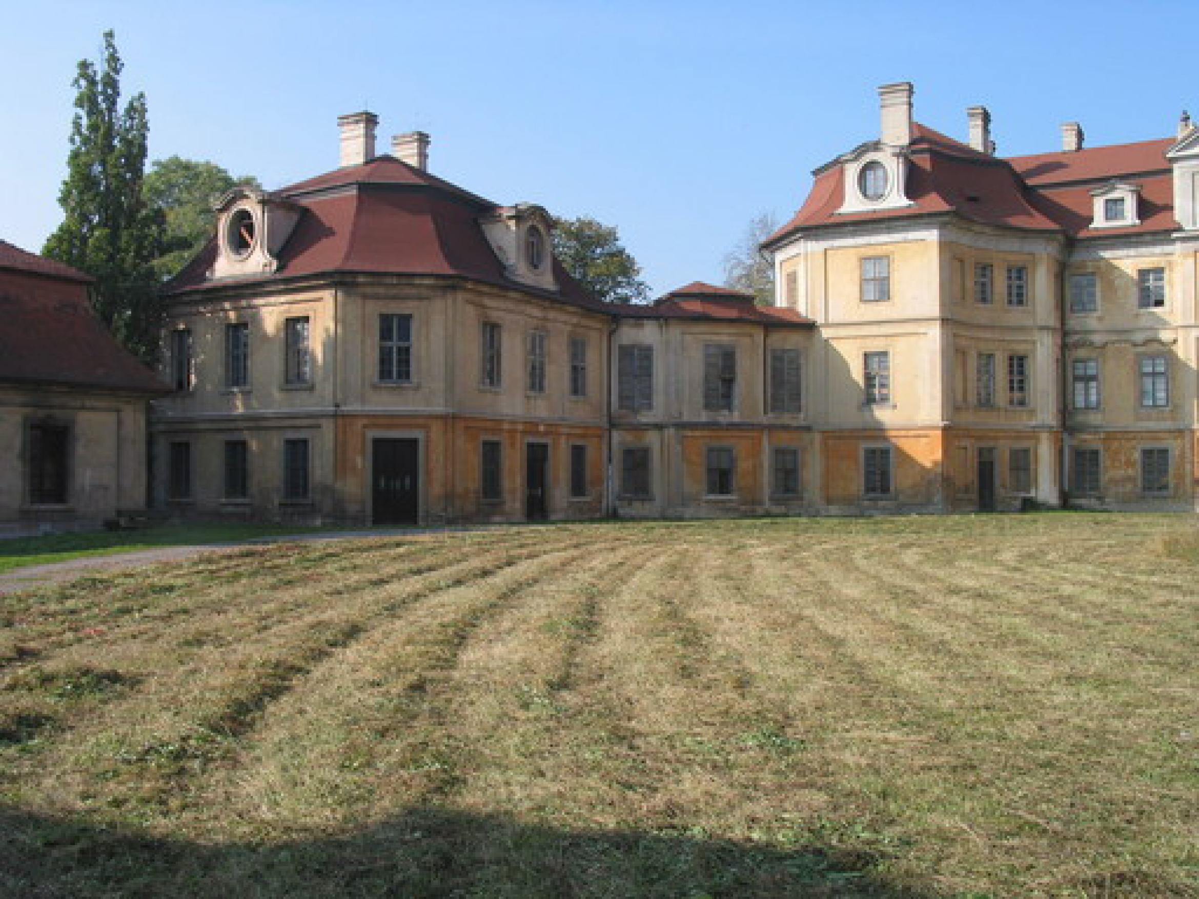
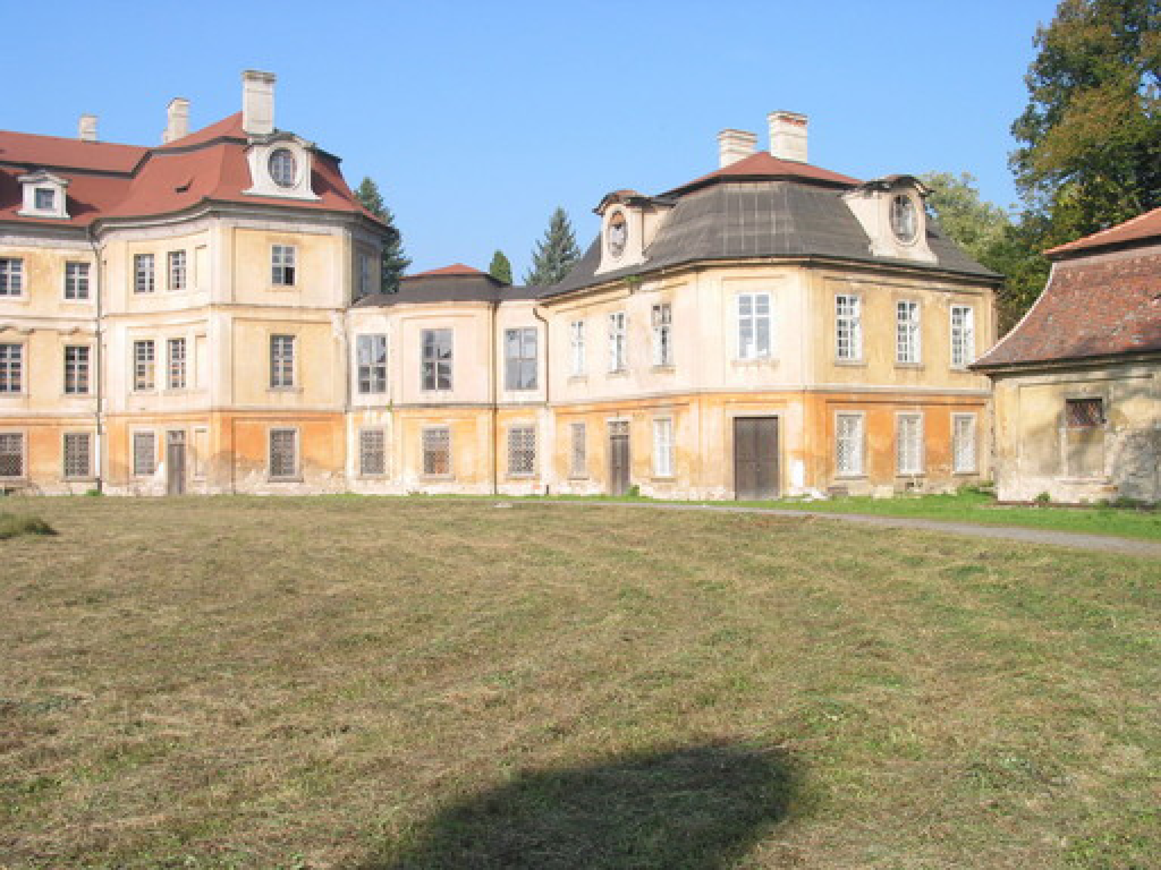
Review
Two cameras, stereopsis
The geometry of two cameras.
The fundamental matrix
Relative motion of the camera; the essential matrix
Estimation of a fundamental matrix
Applications
Panoramic view

Slide 18
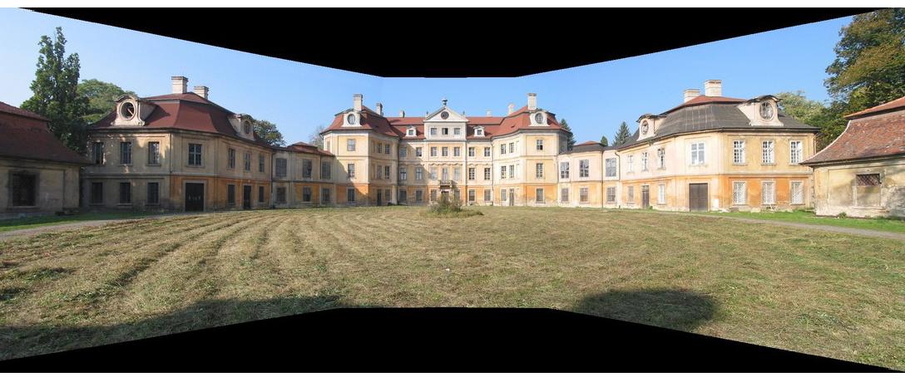
Review
Two cameras, stereopsis
The geometry of two cameras.
The fundamental matrix
Relative motion of the camera; the essential matrix
Estimation of a fundamental matrix
Applications
Panoramic view

