Slide 1
55:148 Digital Image Processing
Chapter 11
3D Vision, Geometry
Topics:
  Basics of projective geometry
    Points and hyperplanes in projective space
    Homography
    Estimating homography from point correspondence
  The single perspective camera
    An overview of single camera calibration
    Calibration of one camera from the known scene
  Scene reconstruction from multiple views
  Triangulation
  Projective reconstruction
  Matching constraints
  Bundle adjustment
  Two cameras, stereopsis
    The geometry of two cameras. The fundamental matrix
    Relative motion of the camera; the essential matrix
    Estimation of a fundamental matrix from image point correspondences
    Camera Image rectification
    Applications of the epipolar geometry in vision
  Three and more cameras
    Stereo correspondence algorithms

Slide 2
Image epipolar rectification
Illustrative description
Both image planes being coplanar
Baseline along the horizontal axis (x-axis) of the image plane
Two epipoles at infinity along the horizontal direction
Horizontal epipolar lines
Before
After

Slide 3
Image epipolar rectification
Illustrative description
Both image planes being coplanar
Baseline along the horizontal axis (x-axis) of the image plane
Two epipoles at infinity along the horizontal direction
Horizontal epipolar lines
Method: Apply suitable homographic transformation on each image
Before
After

Slide 4
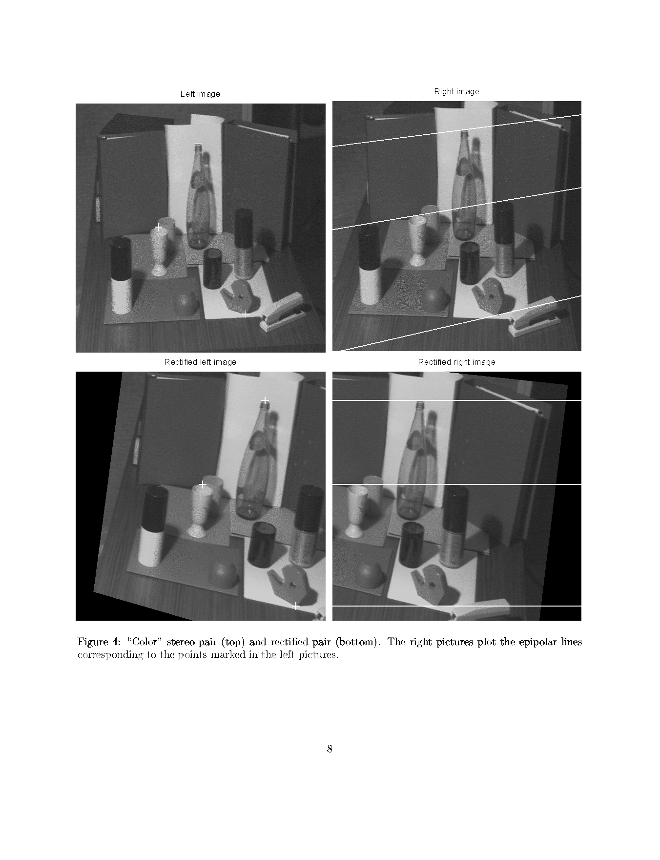
Image rectification (before)

Slide 5
Image rectification (after)

Slide 6
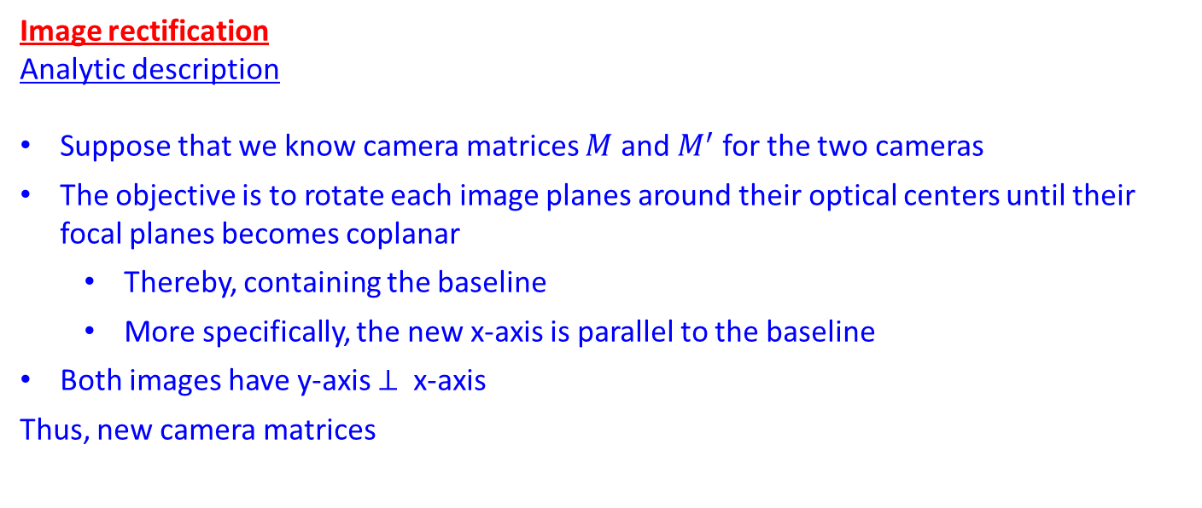
Image rectification
Analytic description
Suppose that we know camera matrices $M$ and $M^{′}$ for the two cameras
The objective is to rotate each image planes around their optical centers until their focal planes becomes coplanar
  Thereby, containing the baseline
  More specifically, the new x-axis is parallel to the baseline
Both images have y-axis $⊥$ x-axis
Thus, new camera matrices

Slide 7
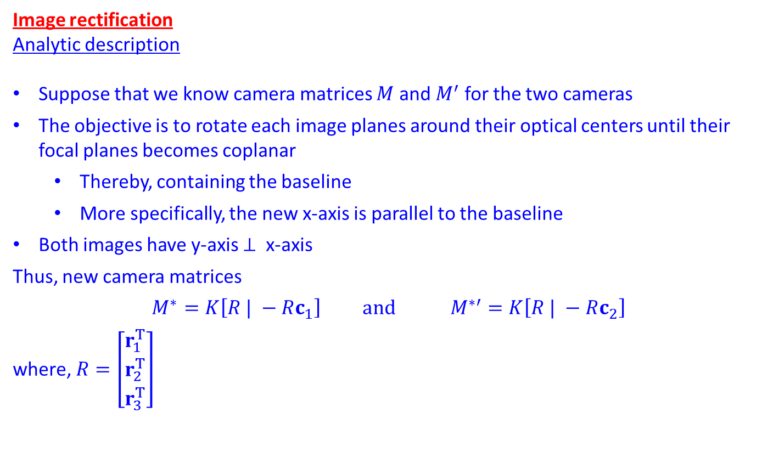
Image rectification
Analytic description
Suppose that we know camera matrices $M$ and $M^{′}$ for the two cameras
The objective is to rotate each image planes around their optical centers until their focal planes becomes coplanar
  Thereby, containing the baseline
  More specifically, the new x-axis is parallel to the baseline
Both images have y-axis $⊥$ x-axis
Thus, new camera matrices
$$M^{∗}=K\left[R | −Rc_{1}\right] and M^{∗′}=K\left[R | −Rc_{2}\right]$$
where, $R=\left[\begin{matrix}r_{1}^{T} \\ r_{2}^{T} \\ r_{3}^{T}\end{matrix}\right]$

Slide 8
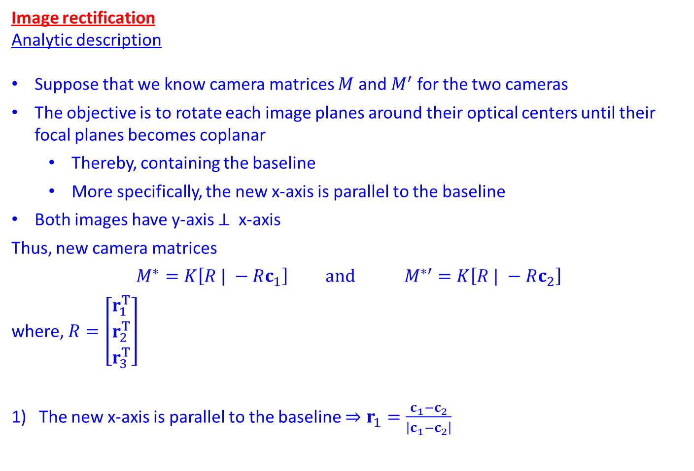
Image rectification
Analytic description
Suppose that we know camera matrices $M$ and $M^{′}$ for the two cameras
The objective is to rotate each image planes around their optical centers until their focal planes becomes coplanar
  Thereby, containing the baseline
  More specifically, the new x-axis is parallel to the baseline
Both images have y-axis $⊥$ x-axis
Thus, new camera matrices
$$M^{∗}=K\left[R | −Rc_{1}\right] and M^{∗′}=K\left[R | −Rc_{2}\right]$$
where, $R=\left[\begin{matrix}r_{1}^{T} \\ r_{2}^{T} \\ r_{3}^{T}\end{matrix}\right]$
The new x-axis is parallel to the baseline $⇒r_{1}=\frac{c_{1}−c_{2}}{\left|c_{1}−c_{2}\right|}$

Slide 9
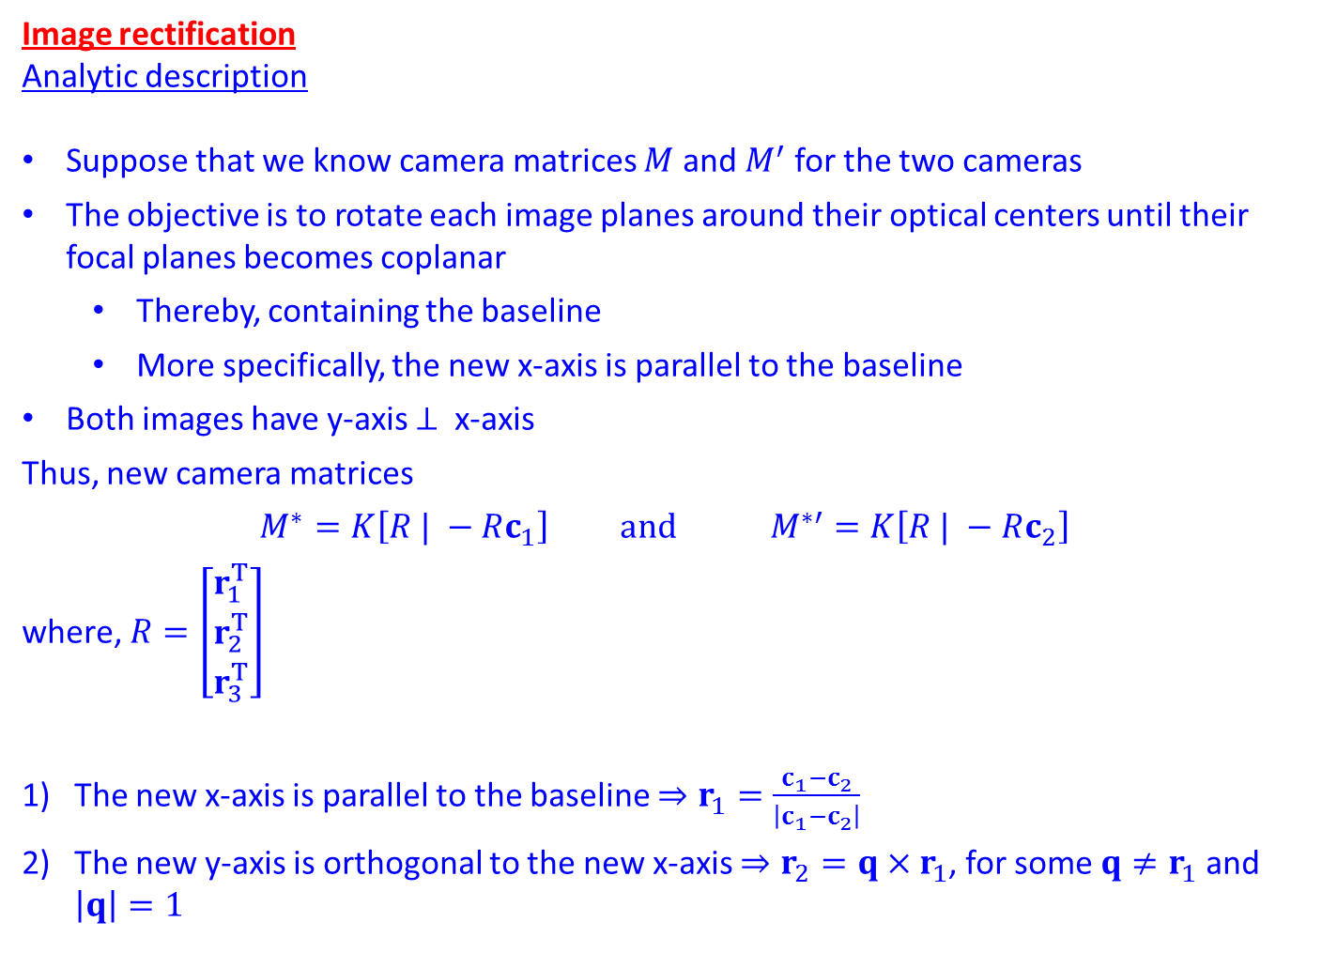
Image rectification
Analytic description
Suppose that we know camera matrices $M$ and $M^{′}$ for the two cameras
The objective is to rotate each image planes around their optical centers until their focal planes becomes coplanar
  Thereby, containing the baseline
  More specifically, the new x-axis is parallel to the baseline
Both images have y-axis $⊥$ x-axis
Thus, new camera matrices
$$M^{∗}=K\left[R | −Rc_{1}\right] and M^{∗′}=K\left[R | −Rc_{2}\right]$$
where, $R=\left[\begin{matrix}r_{1}^{T} \\ r_{2}^{T} \\ r_{3}^{T}\end{matrix}\right]$
The new x-axis is parallel to the baseline $⇒r_{1}=\frac{c_{1}−c_{2}}{\left|c_{1}−c_{2}\right|}$
The new y-axis is orthogonal to the new x-axis $⇒r_{2}=q×r_{1}$, for some $q≠r_{1}$ and $\left|q\right|=1$

Slide 10
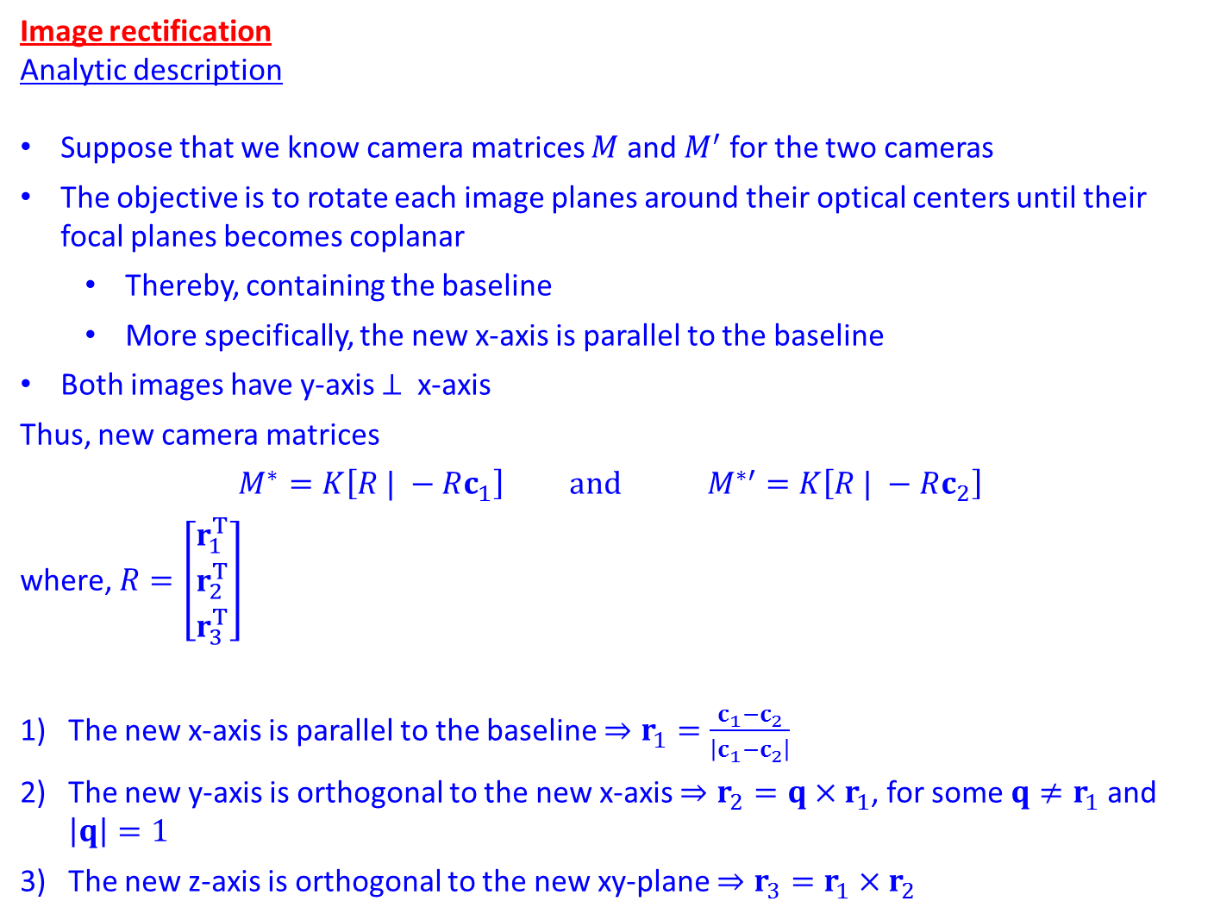
Image rectification
Analytic description
Suppose that we know camera matrices $M$ and $M^{′}$ for the two cameras
The objective is to rotate each image planes around their optical centers until their focal planes becomes coplanar
  Thereby, containing the baseline
  More specifically, the new x-axis is parallel to the baseline
Both images have y-axis $⊥$ x-axis
Thus, new camera matrices
$$M^{∗}=K\left[R | −Rc_{1}\right] and M^{∗′}=K\left[R | −Rc_{2}\right]$$
where, $R=\left[\begin{matrix}r_{1}^{T} \\ r_{2}^{T} \\ r_{3}^{T}\end{matrix}\right]$
The new x-axis is parallel to the baseline $⇒r_{1}=\frac{c_{1}−c_{2}}{\left|c_{1}−c_{2}\right|}$
The new y-axis is orthogonal to the new x-axis $⇒r_{2}=q×r_{1}$, for some $q≠r_{1}$ and $\left|q\right|=1$
The new z-axis is orthogonal to the new xy-plane $⇒r_{3}=r_{1}×r_{2}$

Slide 11

A proof that Image rectification $≅$ a suitable homographic transformation

Slide 12
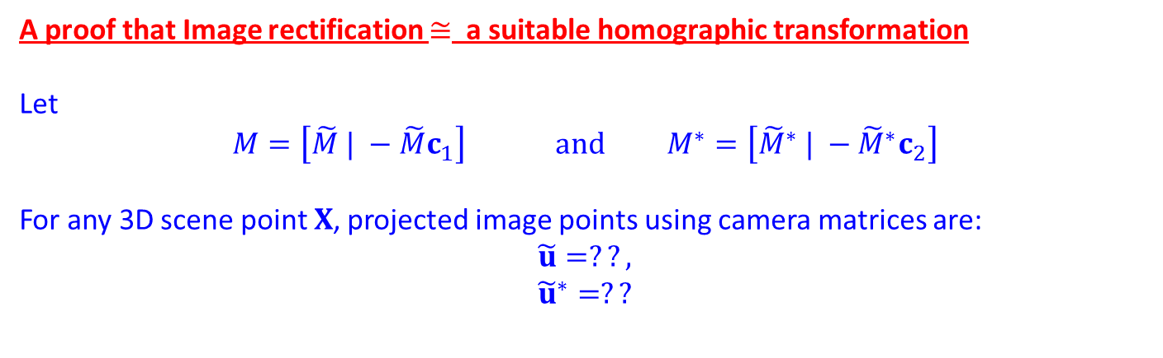
A proof that Image rectification $≅$ a suitable homographic transformation
Let
$$M=\left[\tilde{M} | −\tilde{M}c_{1}\right] and M^{∗}=\left[{\tilde{M}}^{∗} | −{\tilde{M}}^{∗}c_{2}\right]$$
For any 3D scene point $X$, projected image points using camera matrices are:
$$\tilde{u}=??,$$
$${\tilde{u}}^{∗}=??$$

Slide 13
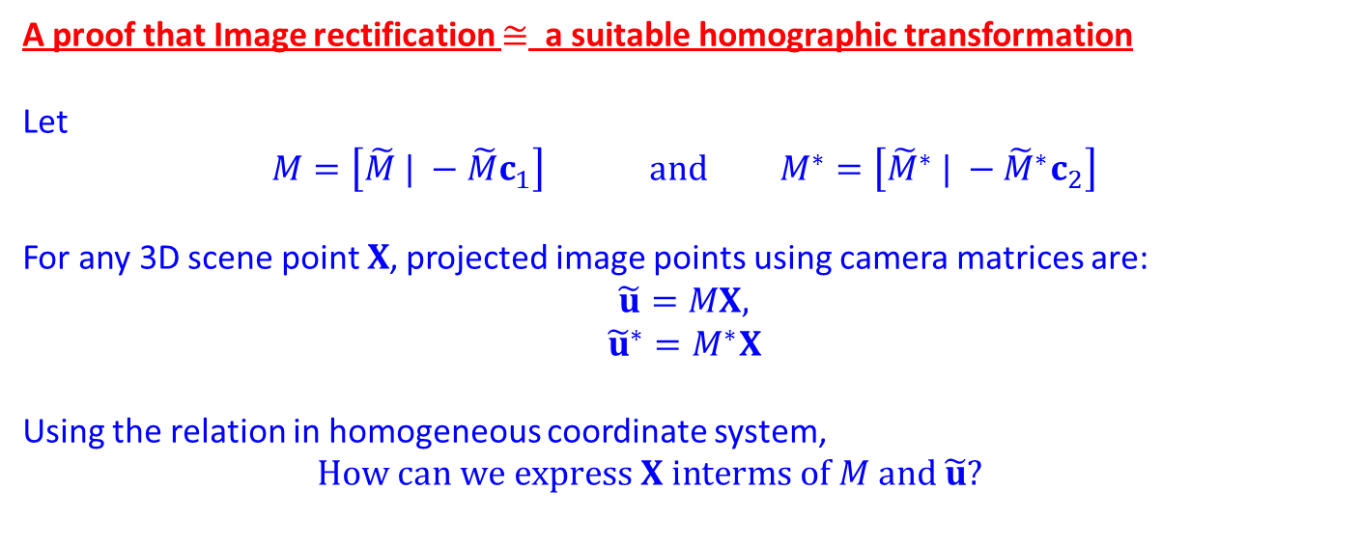
A proof that Image rectification $≅$ a suitable homographic transformation
Let
$$M=\left[\tilde{M} | −\tilde{M}c_{1}\right] and M^{∗}=\left[{\tilde{M}}^{∗} | −{\tilde{M}}^{∗}c_{2}\right]$$
For any 3D scene point $X$, projected image points using camera matrices are:
$$\tilde{u}=MX,$$
$${\tilde{u}}^{∗}=M^{∗}X$$
Using the relation in homogeneous coordinate system,
$$\begin{matrix}How can we express X interms of M and \tilde{u}? & \\ & \end{matrix}$$

Slide 14
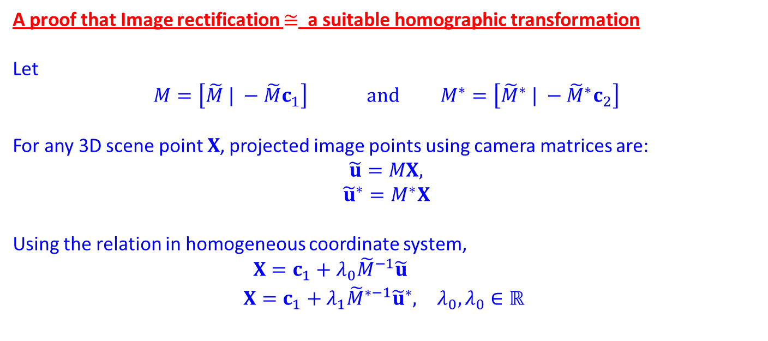
A proof that Image rectification $≅$ a suitable homographic transformation
Let
$$M=\left[\tilde{M} | −\tilde{M}c_{1}\right] and M^{∗}=\left[{\tilde{M}}^{∗} | −{\tilde{M}}^{∗}c_{2}\right]$$
For any 3D scene point $X$, projected image points using camera matrices are:
$$\tilde{u}=MX,$$
$${\tilde{u}}^{∗}=M^{∗}X$$
Using the relation in homogeneous coordinate system,
$$\begin{matrix}X=c_{1}+λ_{0}{\tilde{M}}^{−1}\tilde{u} & \\ X=c_{1}+λ_{1}{\tilde{M}}^{∗−1}{\tilde{u}}^{∗}, & λ_{0},λ_{0}∈ℝ \end{matrix}$$

Slide 15
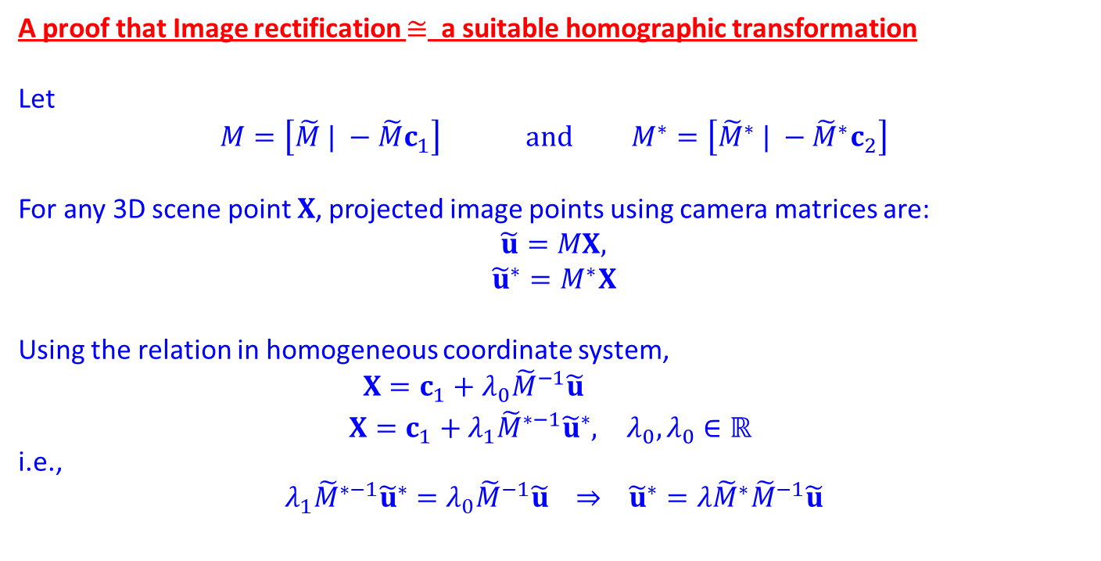
A proof that Image rectification $≅$ a suitable homographic transformation
Let
$$M=\left[\tilde{M} | −\tilde{M}c_{1}\right] and M^{∗}=\left[{\tilde{M}}^{∗} | −{\tilde{M}}^{∗}c_{2}\right]$$
For any 3D scene point $X$, projected image points using camera matrices are:
$$\tilde{u}=MX,$$
$${\tilde{u}}^{∗}=M^{∗}X$$
Using the relation in homogeneous coordinate system,
$$\begin{matrix}X=c_{1}+λ_{0}{\tilde{M}}^{−1}\tilde{u} & \\ X=c_{1}+λ_{1}{\tilde{M}}^{∗−1}{\tilde{u}}^{∗}, & λ_{0},λ_{0}∈ℝ \end{matrix}$$
i.e.,
$$λ_{1}{\tilde{M}}^{∗−1}{\tilde{u}}^{∗}=λ_{0}{\tilde{M}}^{−1}\tilde{u} ⇒ {\tilde{u}}^{∗}=λ{\tilde{M}}^{∗}{\tilde{M}}^{−1}\tilde{u}$$

Slide 16
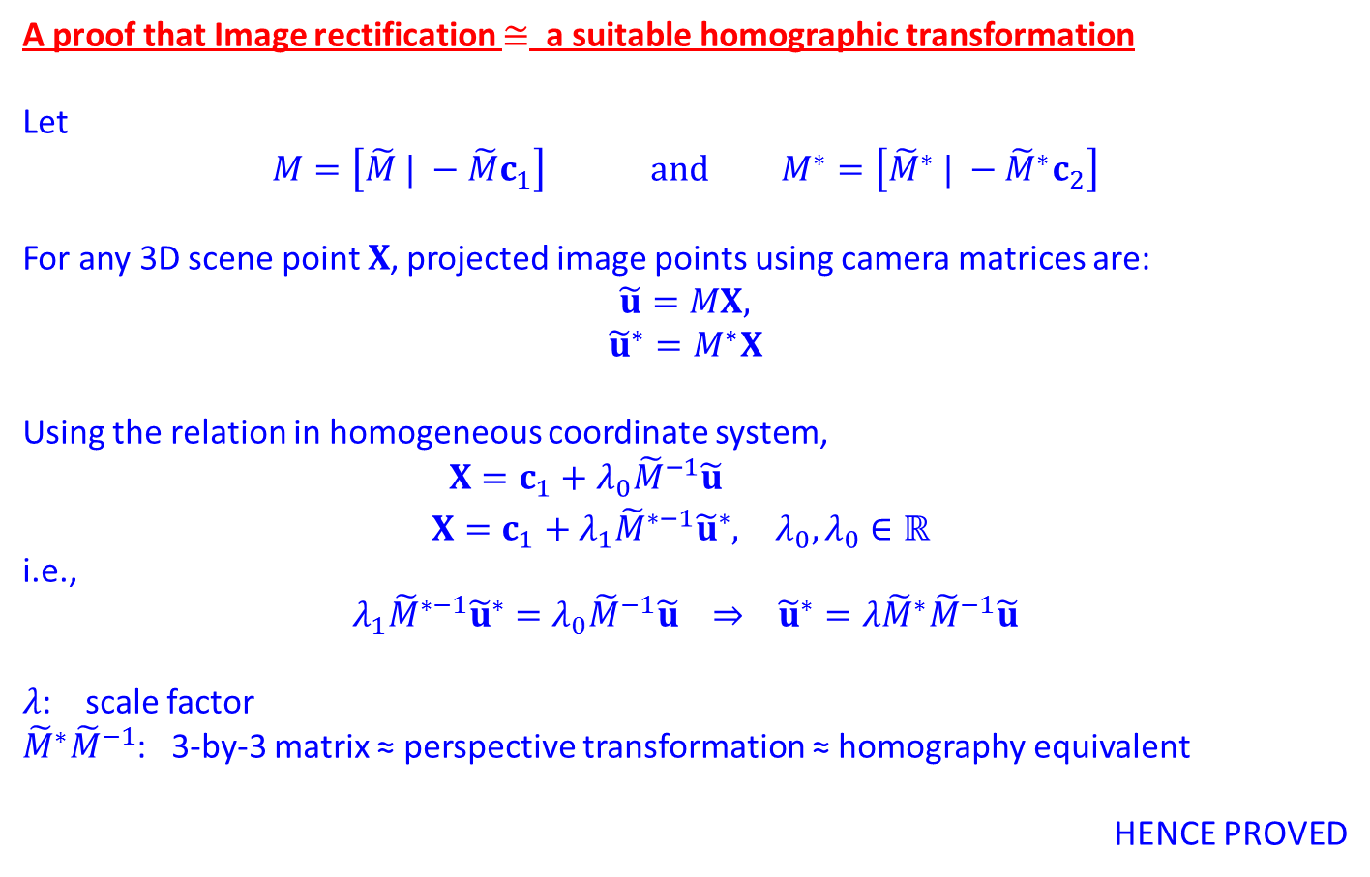
A proof that Image rectification $≅$ a suitable homographic transformation
Let
$$M=\left[\tilde{M} | −\tilde{M}c_{1}\right] and M^{∗}=\left[{\tilde{M}}^{∗} | −{\tilde{M}}^{∗}c_{2}\right]$$
For any 3D scene point $X$, projected image points using camera matrices are:
$$\tilde{u}=MX,$$
$${\tilde{u}}^{∗}=M^{∗}X$$
Using the relation in homogeneous coordinate system,
$$\begin{matrix}X=c_{1}+λ_{0}{\tilde{M}}^{−1}\tilde{u} & \\ X=c_{1}+λ_{1}{\tilde{M}}^{∗−1}{\tilde{u}}^{∗}, & λ_{0},λ_{0}∈ℝ \end{matrix}$$
i.e.,
$$λ_{1}{\tilde{M}}^{∗−1}{\tilde{u}}^{∗}=λ_{0}{\tilde{M}}^{−1}\tilde{u} ⇒ {\tilde{u}}^{∗}=λ{\tilde{M}}^{∗}{\tilde{M}}^{−1}\tilde{u}$$
$λ$: scale factor
${\tilde{M}}^{∗}{\tilde{M}}^{−1}$: 3-by-3 matrix ≈ perspective transformation ≈ homography equivalent
HENCE PROVED

Slide 17
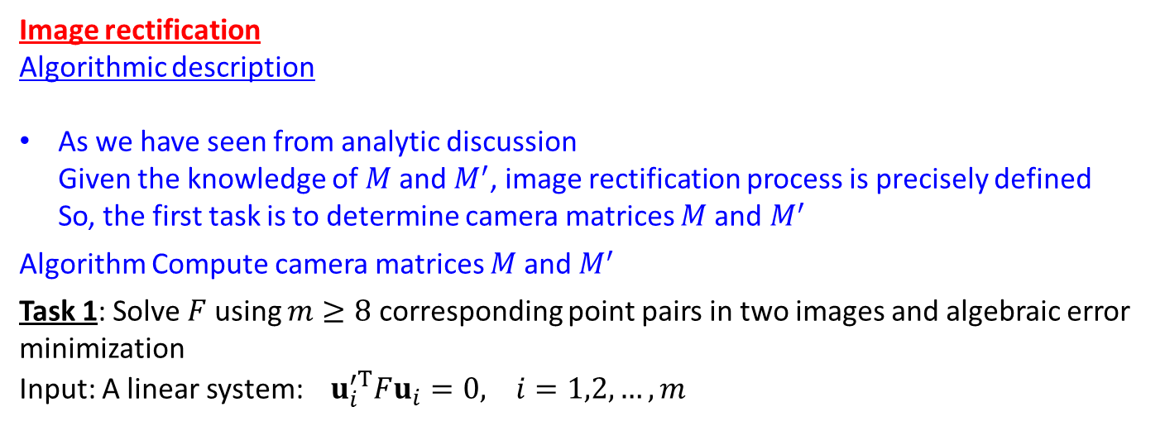
Image rectification
Algorithmic description
As we have seen from analytic discussion
Given the knowledge of $M$and $M^{′}$, image rectification process is precisely defined
So, the first task is to determine camera matrices $M$and $M^{′}$
Algorithm Compute camera matrices $M$and $M^{′}$
Task 1: Solve $F$ using $m≥8$ corresponding point pairs in two images and algebraic error minimization
Input: A linear system: $u_{i}^{′T}Fu_{i}=0, i=1,2,…, m$

Slide 18
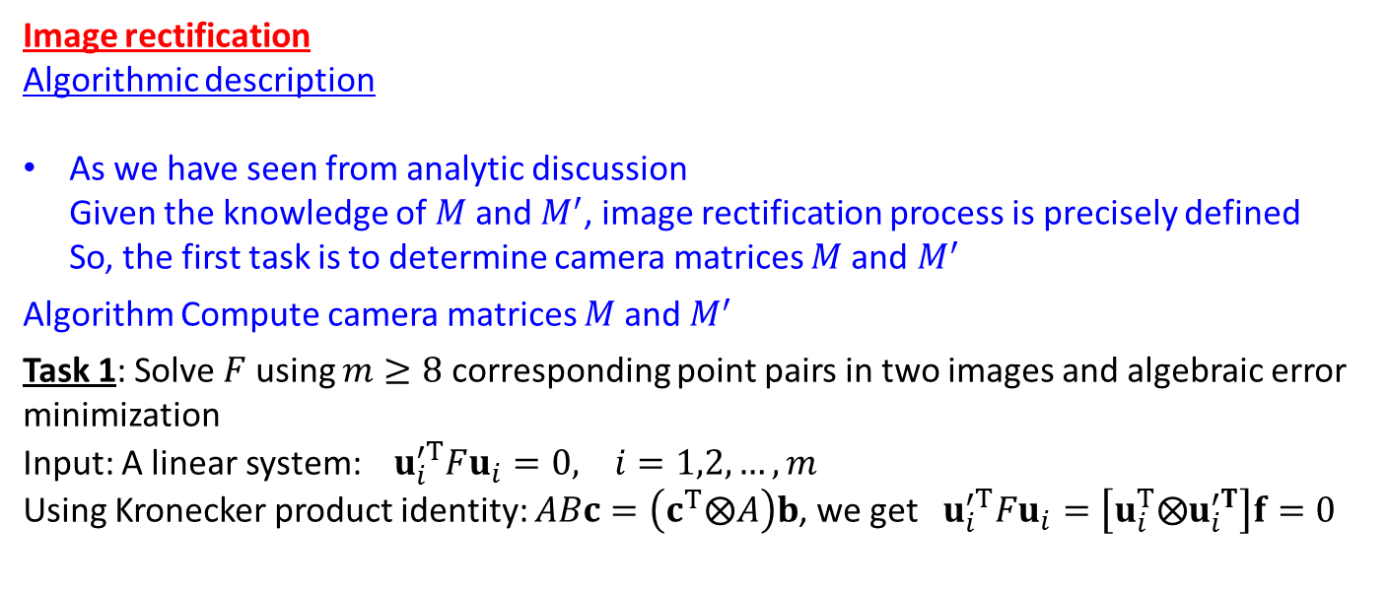
Image rectification
Algorithmic description
As we have seen from analytic discussion
Given the knowledge of $M$and $M^{′}$, image rectification process is precisely defined
So, the first task is to determine camera matrices $M$and $M^{′}$
Algorithm Compute camera matrices $M$and $M^{′}$
Task 1: Solve $F$ using $m≥8$ corresponding point pairs in two images and algebraic error minimization
Input: A linear system: $u_{i}^{′T}Fu_{i}=0, i=1,2,…, m$
Using Kronecker product identity: $ABc=\left(c^{T}⨂A\right)b$, we get $u_{i}^{′T}Fu_{i}=\left[u_{i}^{T}⨂u_{i}^{′T}\right]f=0$

Slide 19
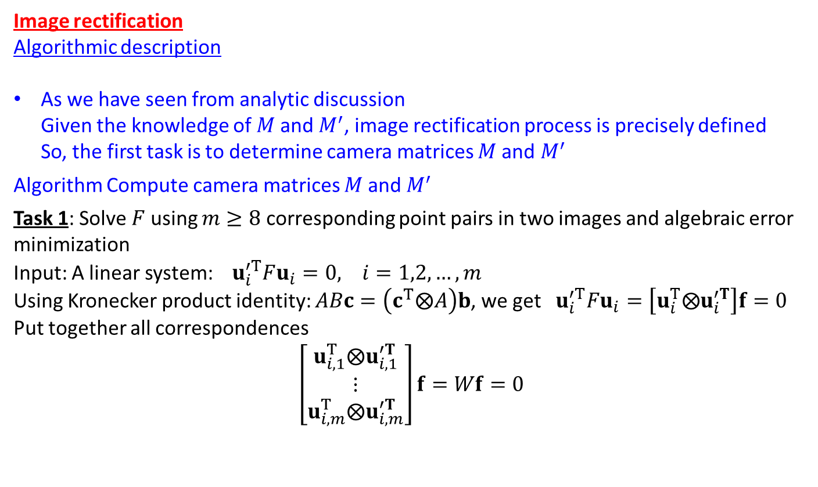
Image rectification
Algorithmic description
As we have seen from analytic discussion
Given the knowledge of $M$and $M^{′}$, image rectification process is precisely defined
So, the first task is to determine camera matrices $M$and $M^{′}$
Algorithm Compute camera matrices $M$and $M^{′}$
Task 1: Solve $F$ using $m≥8$ corresponding point pairs in two images and algebraic error minimization
Input: A linear system: $u_{i}^{′T}Fu_{i}=0, i=1,2,…, m$
Using Kronecker product identity: $ABc=\left(c^{T}⨂A\right)b$, we get $u_{i}^{′T}Fu_{i}=\left[u_{i}^{T}⨂u_{i}^{′T}\right]f=0$
Put together all correspondences
$$\left[\begin{matrix}u_{i,1}^{T}⨂u_{i,1}^{′T} \\ ⋮ \\ u_{i,m}^{T}⨂u_{i,m}^{′T}\end{matrix}\right]f=Wf=0$$

Slide 20
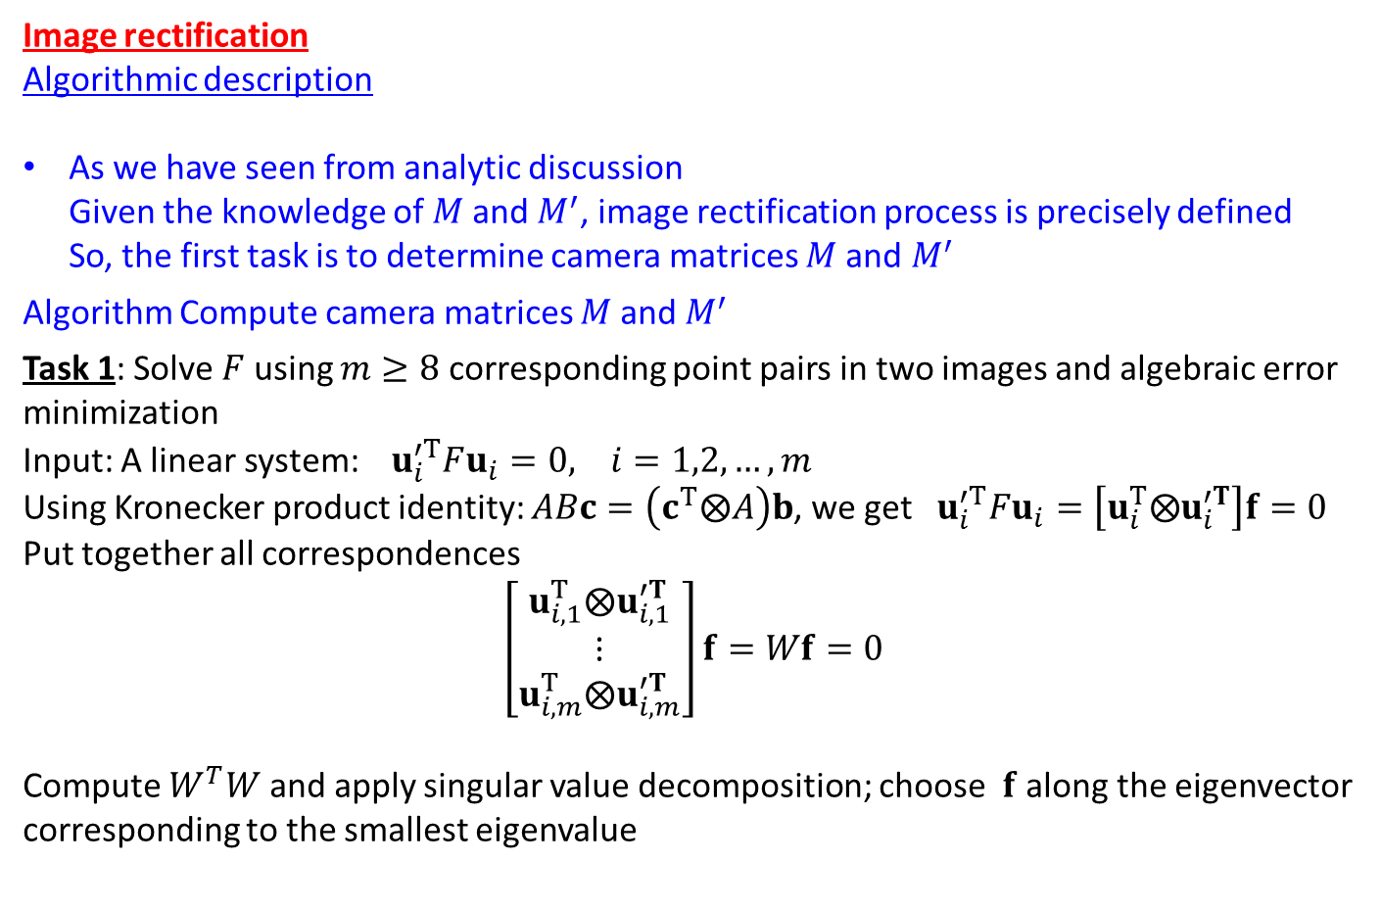
Image rectification
Algorithmic description
As we have seen from analytic discussion
Given the knowledge of $M$and $M^{′}$, image rectification process is precisely defined
So, the first task is to determine camera matrices $M$and $M^{′}$
Algorithm Compute camera matrices $M$and $M^{′}$
Task 1: Solve $F$ using $m≥8$ corresponding point pairs in two images and algebraic error minimization
Input: A linear system: $u_{i}^{′T}Fu_{i}=0, i=1,2,…, m$
Using Kronecker product identity: $ABc=\left(c^{T}⨂A\right)b$, we get $u_{i}^{′T}Fu_{i}=\left[u_{i}^{T}⨂u_{i}^{′T}\right]f=0$
Put together all correspondences
$$\left[\begin{matrix}u_{i,1}^{T}⨂u_{i,1}^{′T} \\ ⋮ \\ u_{i,m}^{T}⨂u_{i,m}^{′T}\end{matrix}\right]f=Wf=0$$
Compute $W^{T}W$ and apply singular value decomposition; choose $f$ along the eigenvector corresponding to the smallest eigenvalue

Slide 21
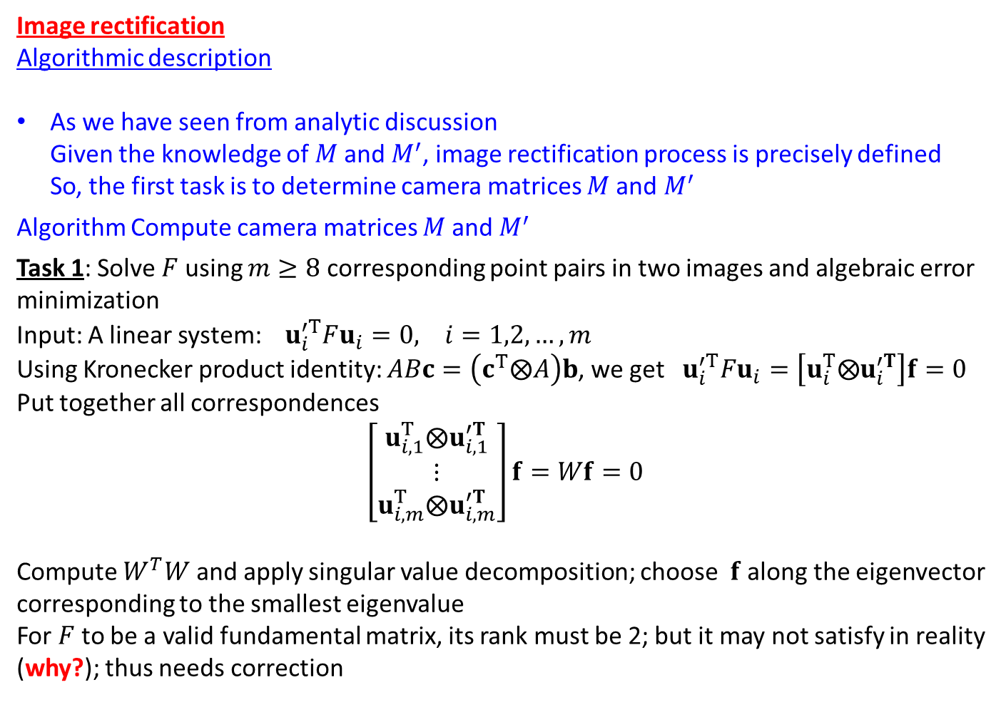
Image rectification
Algorithmic description
As we have seen from analytic discussion
Given the knowledge of $M$and $M^{′}$, image rectification process is precisely defined
So, the first task is to determine camera matrices $M$and $M^{′}$
Algorithm Compute camera matrices $M$and $M^{′}$
Task 1: Solve $F$ using $m≥8$ corresponding point pairs in two images and algebraic error minimization
Input: A linear system: $u_{i}^{′T}Fu_{i}=0, i=1,2,…, m$
Using Kronecker product identity: $ABc=\left(c^{T}⨂A\right)b$, we get $u_{i}^{′T}Fu_{i}=\left[u_{i}^{T}⨂u_{i}^{′T}\right]f=0$
Put together all correspondences
$$\left[\begin{matrix}u_{i,1}^{T}⨂u_{i,1}^{′T} \\ ⋮ \\ u_{i,m}^{T}⨂u_{i,m}^{′T}\end{matrix}\right]f=Wf=0$$
Compute $W^{T}W$ and apply singular value decomposition; choose $f$ along the eigenvector corresponding to the smallest eigenvalue
For $F$ to be a valid fundamental matrix, its rank must be 2; but it may not satisfy in reality (why?); thus needs correction

Slide 22
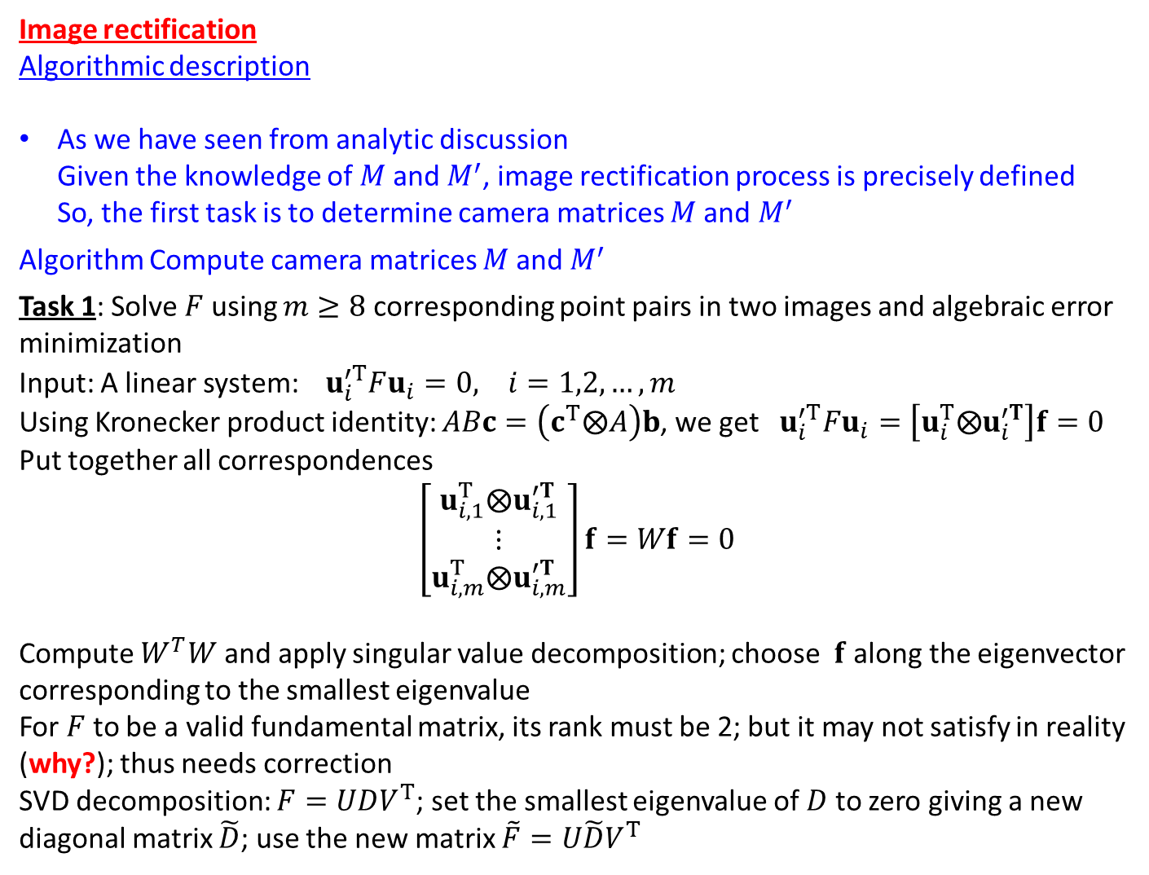
Image rectification
Algorithmic description
As we have seen from analytic discussion
Given the knowledge of $M$and $M^{′}$, image rectification process is precisely defined
So, the first task is to determine camera matrices $M$and $M^{′}$
Algorithm Compute camera matrices $M$and $M^{′}$
Task 1: Solve $F$ using $m≥8$ corresponding point pairs in two images and algebraic error minimization
Input: A linear system: $u_{i}^{′T}Fu_{i}=0, i=1,2,…, m$
Using Kronecker product identity: $ABc=\left(c^{T}⨂A\right)b$, we get $u_{i}^{′T}Fu_{i}=\left[u_{i}^{T}⨂u_{i}^{′T}\right]f=0$
Put together all correspondences
$$\left[\begin{matrix}u_{i,1}^{T}⨂u_{i,1}^{′T} \\ ⋮ \\ u_{i,m}^{T}⨂u_{i,m}^{′T}\end{matrix}\right]f=Wf=0$$
Compute $W^{T}W$ and apply singular value decomposition; choose $f$ along the eigenvector corresponding to the smallest eigenvalue
For $F$ to be a valid fundamental matrix, its rank must be 2; but it may not satisfy in reality (why?); thus needs correction
SVD decomposition: $F=UDV^{T}$; set the smallest eigenvalue of $D$ to zero giving a new diagonal matrix $\tilde{D}$; use the new matrix $\tilde{F}=U\tilde{D}V^{T}$

Slide 23
Image rectification
Algorithmic description
As we have seen from analytic discussion
Given the knowledge of $M$and $M^{′}$, image rectification process is precisely defined
So, the first task is to determine camera matrices $M$and $M^{′}$
Algorithm Compute camera matrices $M$and $M^{′}$
Task 1: Solve $F$ using $m≥8$ corresponding point pairs in two images and algebraic error minimization
Input: A linear system: $u_{i}^{′T}Fu_{i}=0, i=1,2,…, m$
Using Kronecker product identity: $ABc=\left(c^{T}⨂A\right)b$, we get $u_{i}^{′T}Fu_{i}=\left[u_{i}^{T}⨂u_{i}^{′T}\right]f=0$
Put together all correspondences
$$\left[\begin{matrix}u_{i,1}^{T}⨂u_{i,1}^{′T} \\ ⋮ \\ u_{i,m}^{T}⨂u_{i,m}^{′T}\end{matrix}\right]f=Wf=0$$
Compute $W^{T}W$ and apply singular value decomposition; choose $f$ along the eigenvector corresponding to the smallest eigenvalue
For $F$ to be a valid fundamental matrix, its rank must be 2; but it may not satisfy in reality (why?); thus needs correction
SVD decomposition: $F=UDV^{T}$; set the smallest eigenvalue of $D$ to zero giving a new diagonal matrix $\tilde{D}$; use the new matrix $\tilde{F}=U\tilde{D}V^{T}$
Note that ML estimation method incorporate the validity condition of F into the optimization process

Slide 24
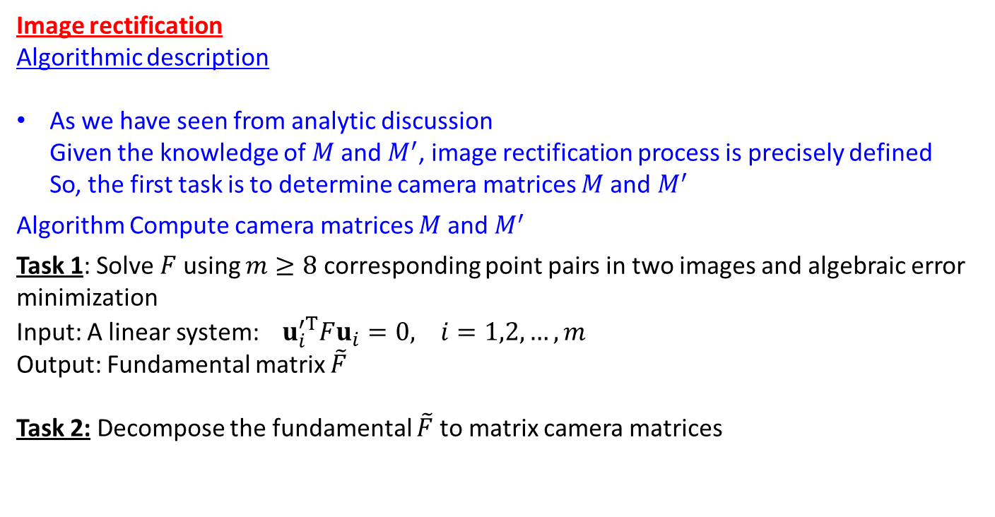
Image rectification
Algorithmic description
As we have seen from analytic discussion
Given the knowledge of $M$and $M^{′}$, image rectification process is precisely defined
So, the first task is to determine camera matrices $M$and $M^{′}$
Algorithm Compute camera matrices $M$and $M^{′}$
Task 1: Solve $F$ using $m≥8$ corresponding point pairs in two images and algebraic error minimization
Input: A linear system: $u_{i}^{′T}Fu_{i}=0, i=1,2,…, m$
Output: Fundamental matrix $\tilde{F}$
Task 2: Decompose the fundamental $\tilde{F}$to matrix camera matrices

Slide 25
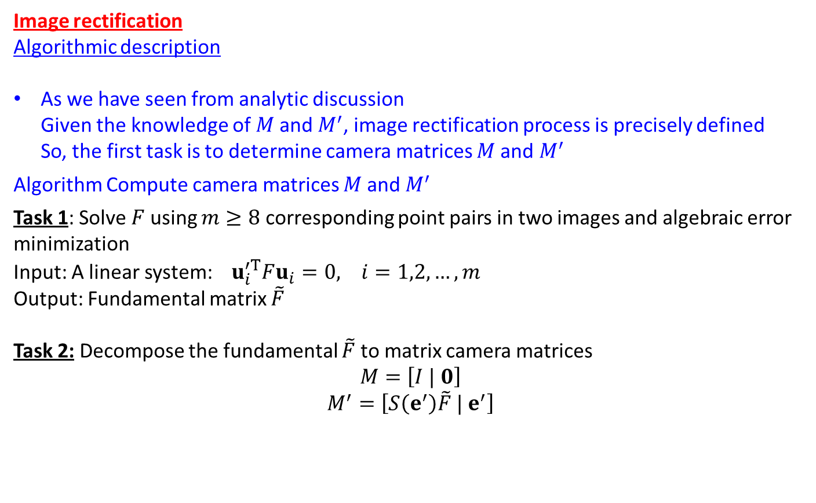
Image rectification
Algorithmic description
As we have seen from analytic discussion
Given the knowledge of $M$and $M^{′}$, image rectification process is precisely defined
So, the first task is to determine camera matrices $M$and $M^{′}$
Algorithm Compute camera matrices $M$and $M^{′}$
Task 1: Solve $F$ using $m≥8$ corresponding point pairs in two images and algebraic error minimization
Input: A linear system: $u_{i}^{′T}Fu_{i}=0, i=1,2,…, m$
Output: Fundamental matrix $\tilde{F}$
Task 2: Decompose the fundamental $\tilde{F}$to matrix camera matrices
$$M=\left[I | 0\right]$$
$$M^{′}=\left[S\left(e^{′}\right)\tilde{F} | e^{′}\right]$$

Slide 26
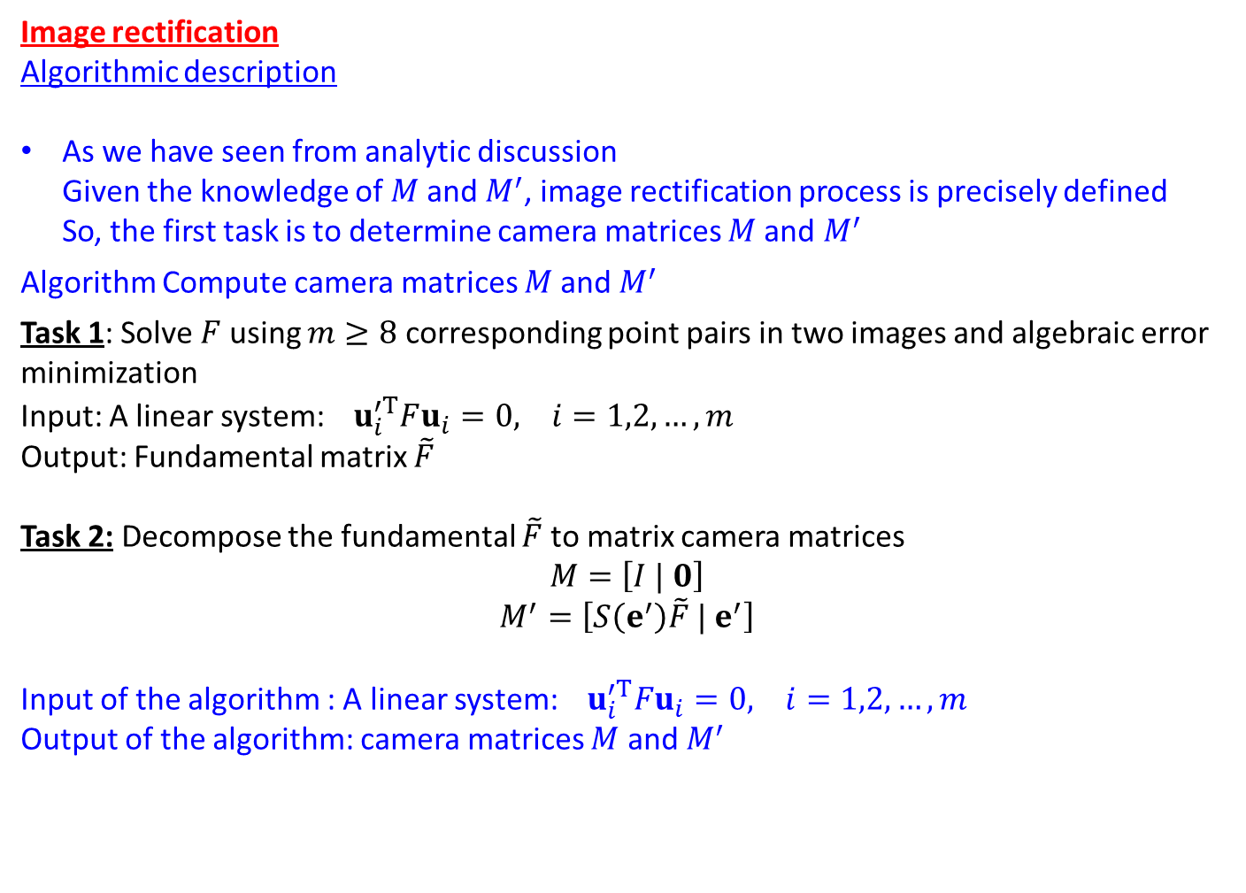
Image rectification
Algorithmic description
As we have seen from analytic discussion
Given the knowledge of $M$and $M^{′}$, image rectification process is precisely defined
So, the first task is to determine camera matrices $M$and $M^{′}$
Algorithm Compute camera matrices $M$and $M^{′}$
Task 1: Solve $F$ using $m≥8$ corresponding point pairs in two images and algebraic error minimization
Input: A linear system: $u_{i}^{′T}Fu_{i}=0, i=1,2,…, m$
Output: Fundamental matrix $\tilde{F}$
Task 2: Decompose the fundamental $\tilde{F}$to matrix camera matrices
$$M=\left[I | 0\right]$$
$$M^{′}=\left[S\left(e^{′}\right)\tilde{F} | e^{′}\right]$$
Input of the algorithm : A linear system: $u_{i}^{′T}Fu_{i}=0, i=1,2,…, m$
Output of the algorithm: camera matrices $M$ and $M^{′}$

Slide 27
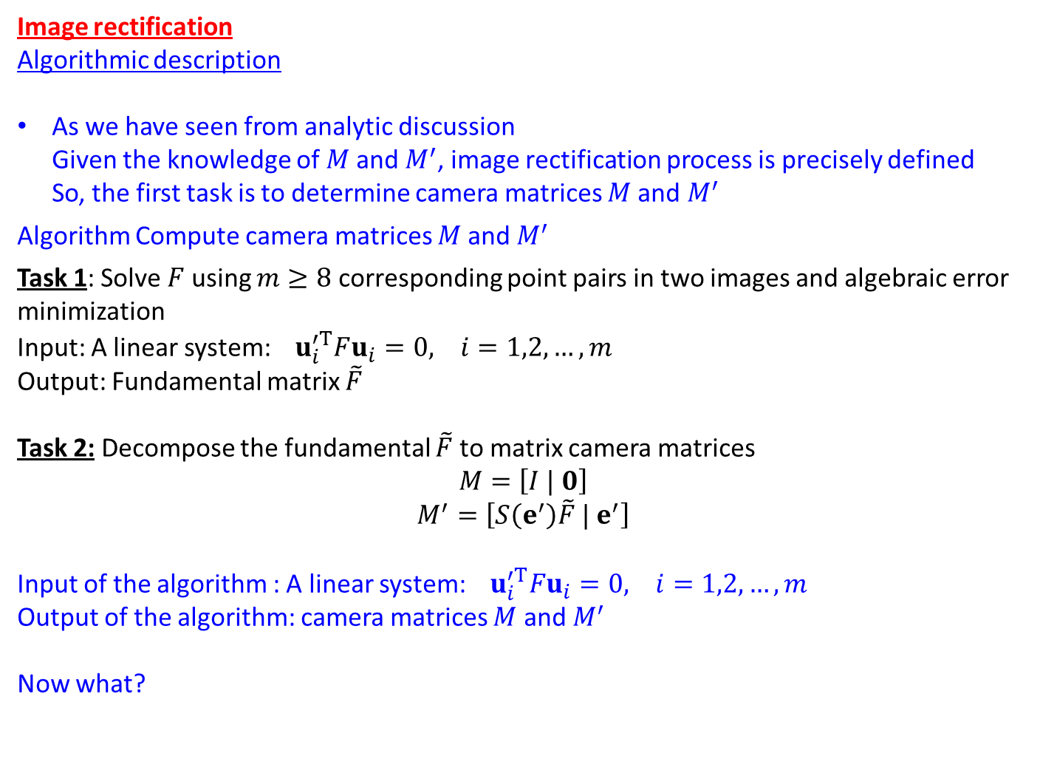
Image rectification
Algorithmic description
As we have seen from analytic discussion
Given the knowledge of $M$and $M^{′}$, image rectification process is precisely defined
So, the first task is to determine camera matrices $M$and $M^{′}$
Algorithm Compute camera matrices $M$and $M^{′}$
Task 1: Solve $F$ using $m≥8$ corresponding point pairs in two images and algebraic error minimization
Input: A linear system: $u_{i}^{′T}Fu_{i}=0, i=1,2,…, m$
Output: Fundamental matrix $\tilde{F}$
Task 2: Decompose the fundamental $\tilde{F}$to matrix camera matrices
$$M=\left[I | 0\right]$$
$$M^{′}=\left[S\left(e^{′}\right)\tilde{F} | e^{′}\right]$$
Input of the algorithm : A linear system: $u_{i}^{′T}Fu_{i}=0, i=1,2,…, m$
Output of the algorithm: camera matrices $M$ and $M^{′}$
Now what?

Slide 28
Image rectification
Algorithmic description
Algorithm Compute image rectification

Slide 29
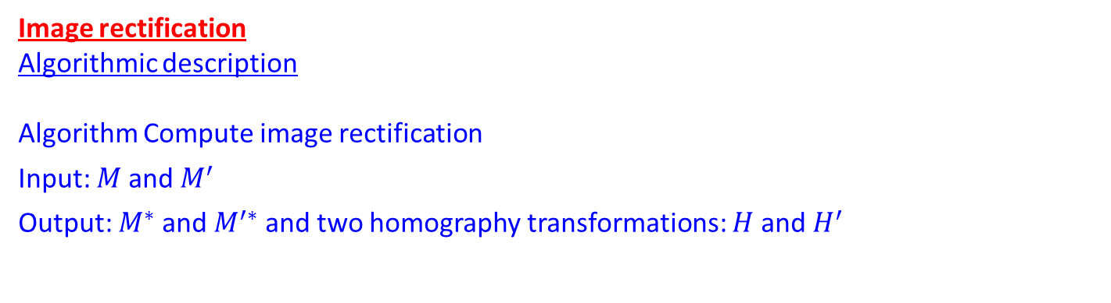
Image rectification
Algorithmic description
Algorithm Compute image rectification
Input: $M$and $M^{′}$
Output: $M^{∗}$and $M^{′∗}$ and two homography transformations: $H$and $H^{′}$

Slide 30
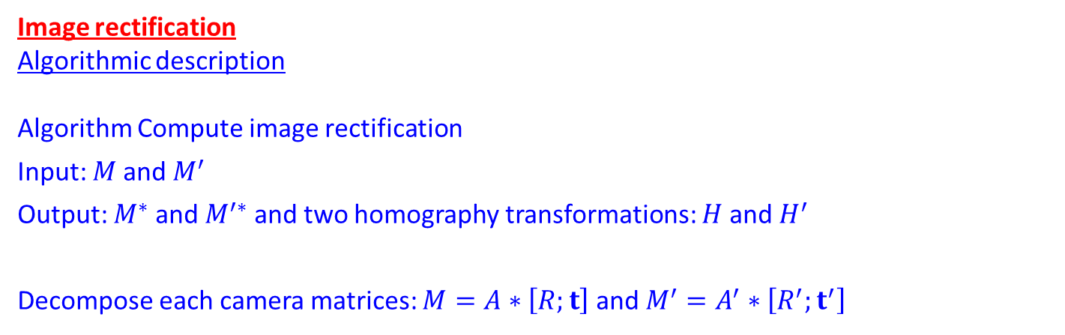
Image rectification
Algorithmic description
Algorithm Compute image rectification
Input: $M$and $M^{′}$
Output: $M^{∗}$and $M^{′∗}$ and two homography transformations: $H$and $H^{′}$
Decompose each camera matrices: $M=A∗\left[R;t\right]$ and $M^{′}=A^{′}∗\left[R^{′};t^{′}\right]$

Slide 31
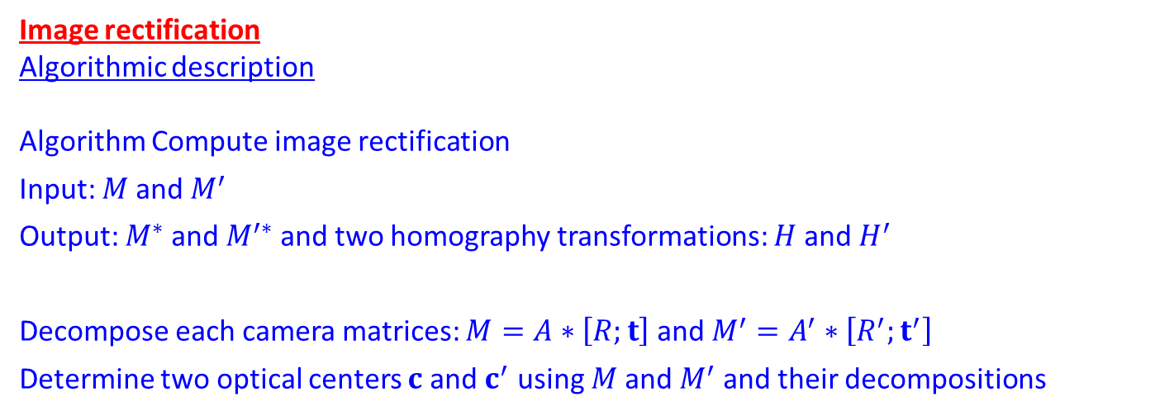
Image rectification
Algorithmic description
Algorithm Compute image rectification
Input: $M$and $M^{′}$
Output: $M^{∗}$and $M^{′∗}$ and two homography transformations: $H$and $H^{′}$
Decompose each camera matrices: $M=A∗\left[R;t\right]$ and $M^{′}=A^{′}∗\left[R^{′};t^{′}\right]$
Determine two optical centers $c$ and $c^{′}$ using $M$and $M^{′}$ and their decompositions

Slide 32
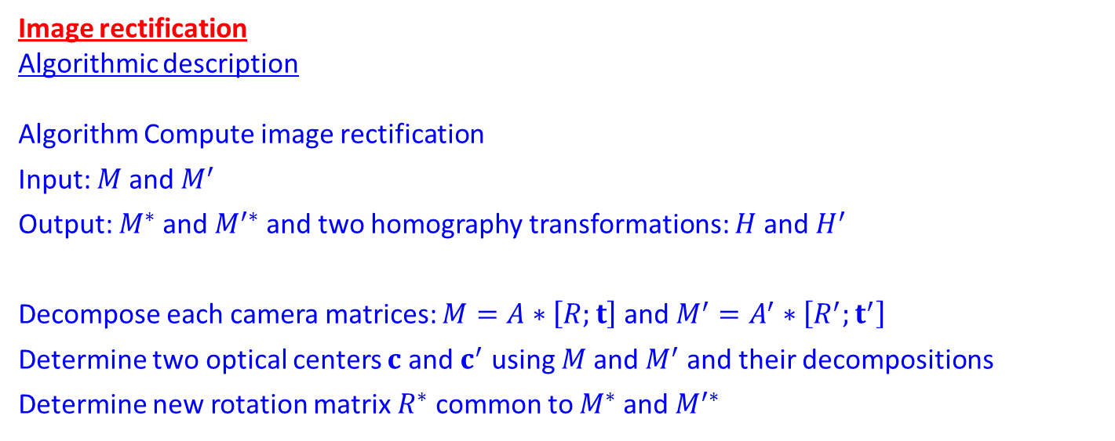
Image rectification
Algorithmic description
Algorithm Compute image rectification
Input: $M$and $M^{′}$
Output: $M^{∗}$and $M^{′∗}$ and two homography transformations: $H$and $H^{′}$
Decompose each camera matrices: $M=A∗\left[R;t\right]$ and $M^{′}=A^{′}∗\left[R^{′};t^{′}\right]$
Determine two optical centers $c$ and $c^{′}$ using $M$and $M^{′}$ and their decompositions
Determine new rotation matrix $R^{∗}$ common to $M^{∗}$and $M^{′∗}$

Slide 33
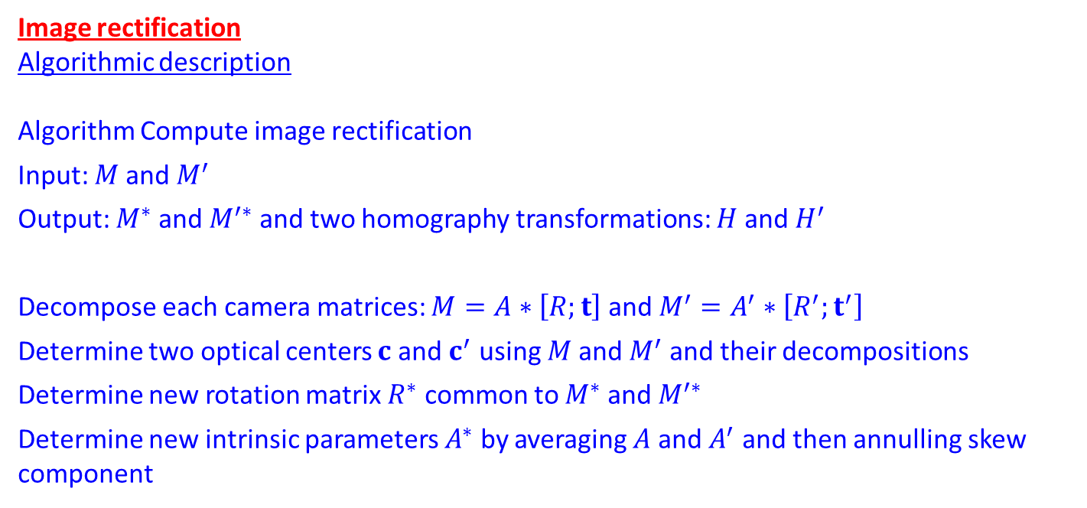
Image rectification
Algorithmic description
Algorithm Compute image rectification
Input: $M$and $M^{′}$
Output: $M^{∗}$and $M^{′∗}$ and two homography transformations: $H$and $H^{′}$
Decompose each camera matrices: $M=A∗\left[R;t\right]$ and $M^{′}=A^{′}∗\left[R^{′};t^{′}\right]$
Determine two optical centers $c$ and $c^{′}$ using $M$and $M^{′}$ and their decompositions
Determine new rotation matrix $R^{∗}$ common to $M^{∗}$and $M^{′∗}$
Determine new intrinsic parameters $A^{∗}$ by averaging $A$ and $A^{′}$ and then annulling skew component

Slide 34
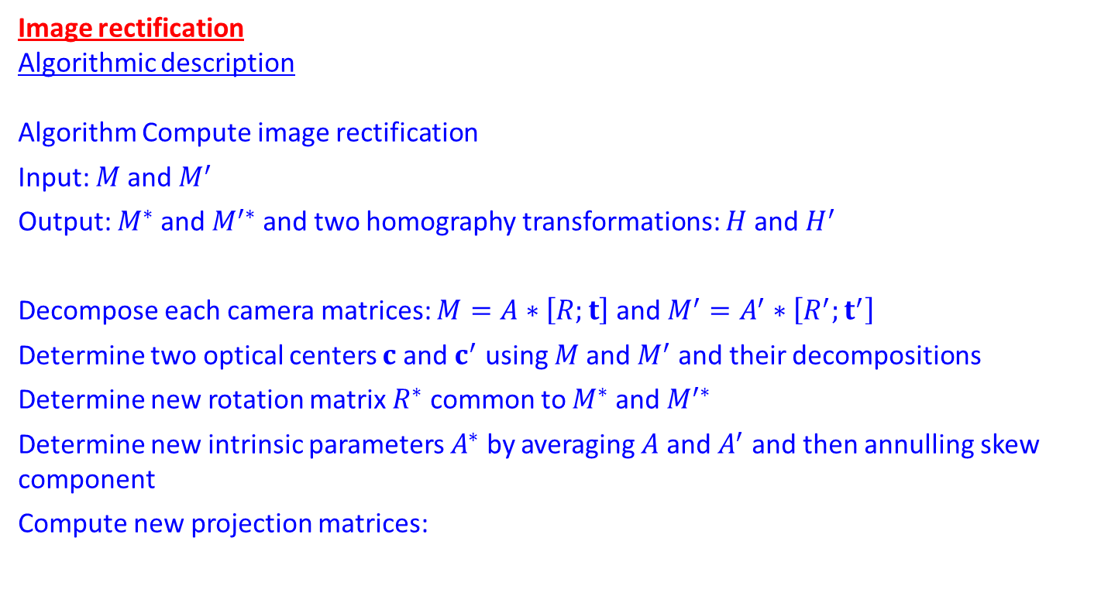
Image rectification
Algorithmic description
Algorithm Compute image rectification
Input: $M$and $M^{′}$
Output: $M^{∗}$and $M^{′∗}$ and two homography transformations: $H$and $H^{′}$
Decompose each camera matrices: $M=A∗\left[R;t\right]$ and $M^{′}=A^{′}∗\left[R^{′};t^{′}\right]$
Determine two optical centers $c$ and $c^{′}$ using $M$and $M^{′}$ and their decompositions
Determine new rotation matrix $R^{∗}$ common to $M^{∗}$and $M^{′∗}$
Determine new intrinsic parameters $A^{∗}$ by averaging $A$ and $A^{′}$ and then annulling skew component
Compute new projection matrices:

Slide 35
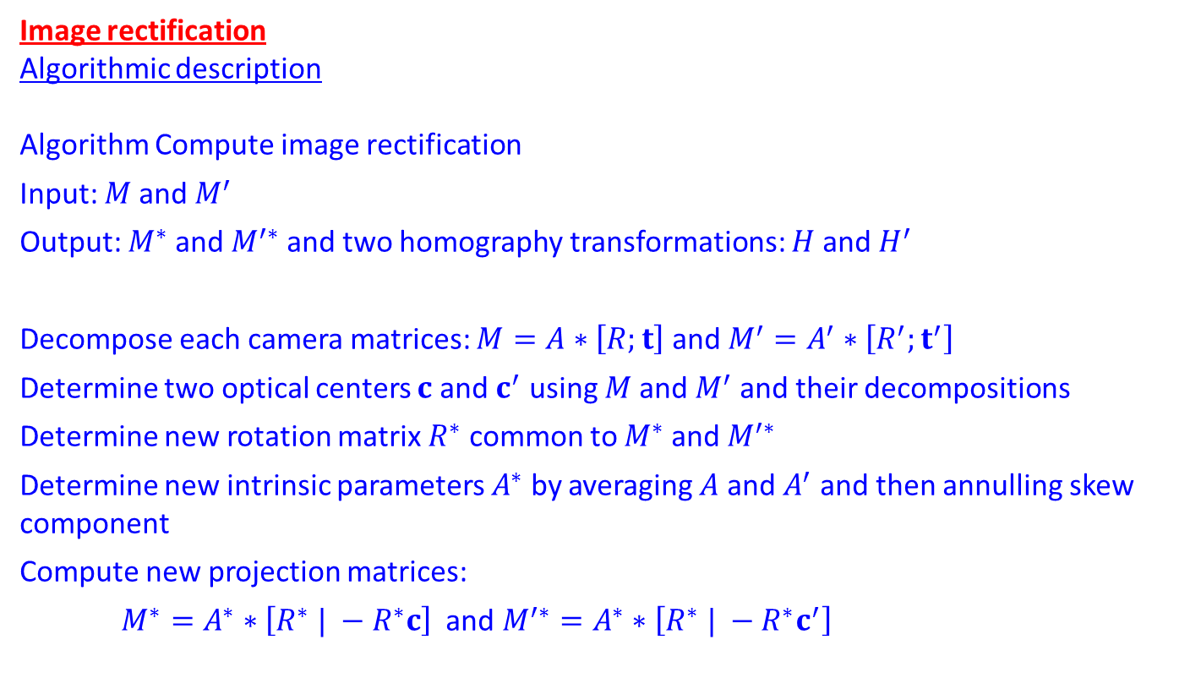
Image rectification
Algorithmic description
Algorithm Compute image rectification
Input: $M$and $M^{′}$
Output: $M^{∗}$and $M^{′∗}$ and two homography transformations: $H$and $H^{′}$
Decompose each camera matrices: $M=A∗\left[R;t\right]$ and $M^{′}=A^{′}∗\left[R^{′};t^{′}\right]$
Determine two optical centers $c$ and $c^{′}$ using $M$and $M^{′}$ and their decompositions
Determine new rotation matrix $R^{∗}$ common to $M^{∗}$and $M^{′∗}$
Determine new intrinsic parameters $A^{∗}$ by averaging $A$ and $A^{′}$ and then annulling skew component
Compute new projection matrices:
$M^{∗}=A^{∗}∗\left[R^{∗} | −R^{∗}c\right]$ and $M^{′∗}=A^{∗}∗\left[R^{∗} | −R^{∗}c^{′}\right]$

Slide 36
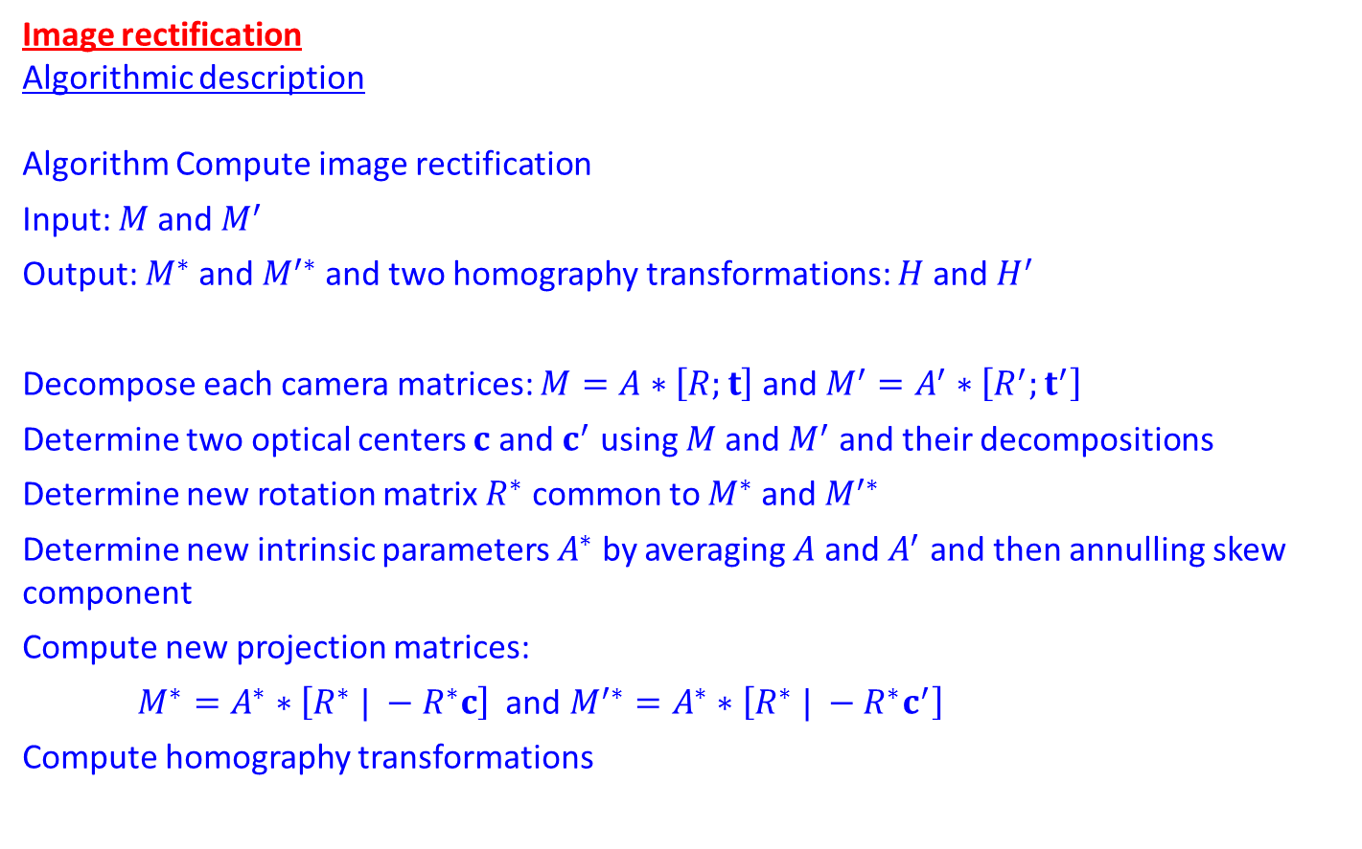
Image rectification
Algorithmic description
Algorithm Compute image rectification
Input: $M$and $M^{′}$
Output: $M^{∗}$and $M^{′∗}$ and two homography transformations: $H$and $H^{′}$
Decompose each camera matrices: $M=A∗\left[R;t\right]$ and $M^{′}=A^{′}∗\left[R^{′};t^{′}\right]$
Determine two optical centers $c$ and $c^{′}$ using $M$and $M^{′}$ and their decompositions
Determine new rotation matrix $R^{∗}$ common to $M^{∗}$and $M^{′∗}$
Determine new intrinsic parameters $A^{∗}$ by averaging $A$ and $A^{′}$ and then annulling skew component
Compute new projection matrices:
$M^{∗}=A^{∗}∗\left[R^{∗} | −R^{∗}c\right]$ and $M^{′∗}=A^{∗}∗\left[R^{∗} | −R^{∗}c^{′}\right]$
Compute homography transformations

Slide 37
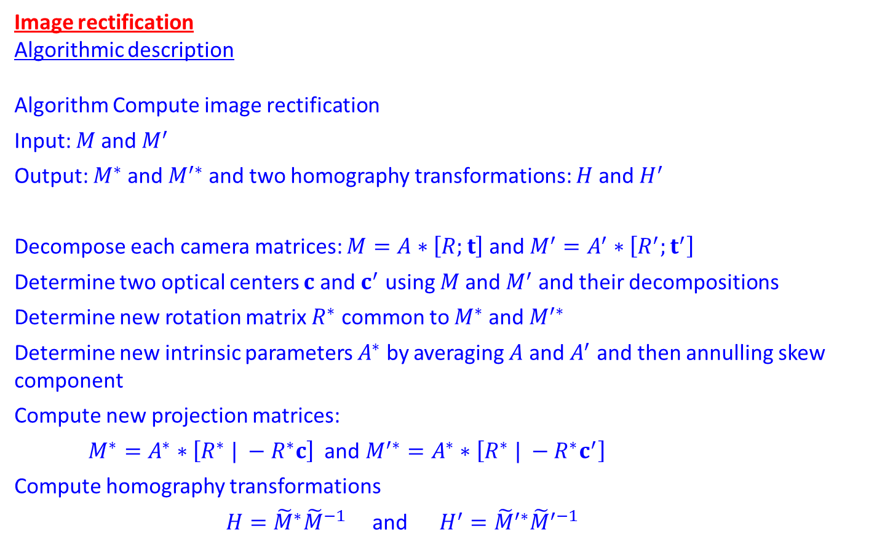
Image rectification
Algorithmic description
Algorithm Compute image rectification
Input: $M$and $M^{′}$
Output: $M^{∗}$and $M^{′∗}$ and two homography transformations: $H$and $H^{′}$
Decompose each camera matrices: $M=A∗\left[R;t\right]$ and $M^{′}=A^{′}∗\left[R^{′};t^{′}\right]$
Determine two optical centers $c$ and $c^{′}$ using $M$and $M^{′}$ and their decompositions
Determine new rotation matrix $R^{∗}$ common to $M^{∗}$and $M^{′∗}$
Determine new intrinsic parameters $A^{∗}$ by averaging $A$ and $A^{′}$ and then annulling skew component
Compute new projection matrices:
$M^{∗}=A^{∗}∗\left[R^{∗} | −R^{∗}c\right]$ and $M^{′∗}=A^{∗}∗\left[R^{∗} | −R^{∗}c^{′}\right]$
Compute homography transformations
$H={\tilde{M}}^{∗}{\tilde{M}}^{−1}$ and $H^{′}={\tilde{M}}^{′∗}{\tilde{M}}^{′−1}$

Slide 38
Image rectification (before)

Slide 39
Image rectification (after)

Slide 40
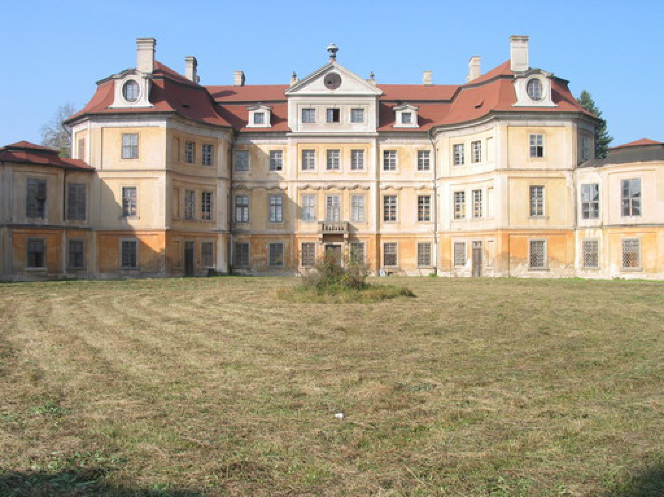
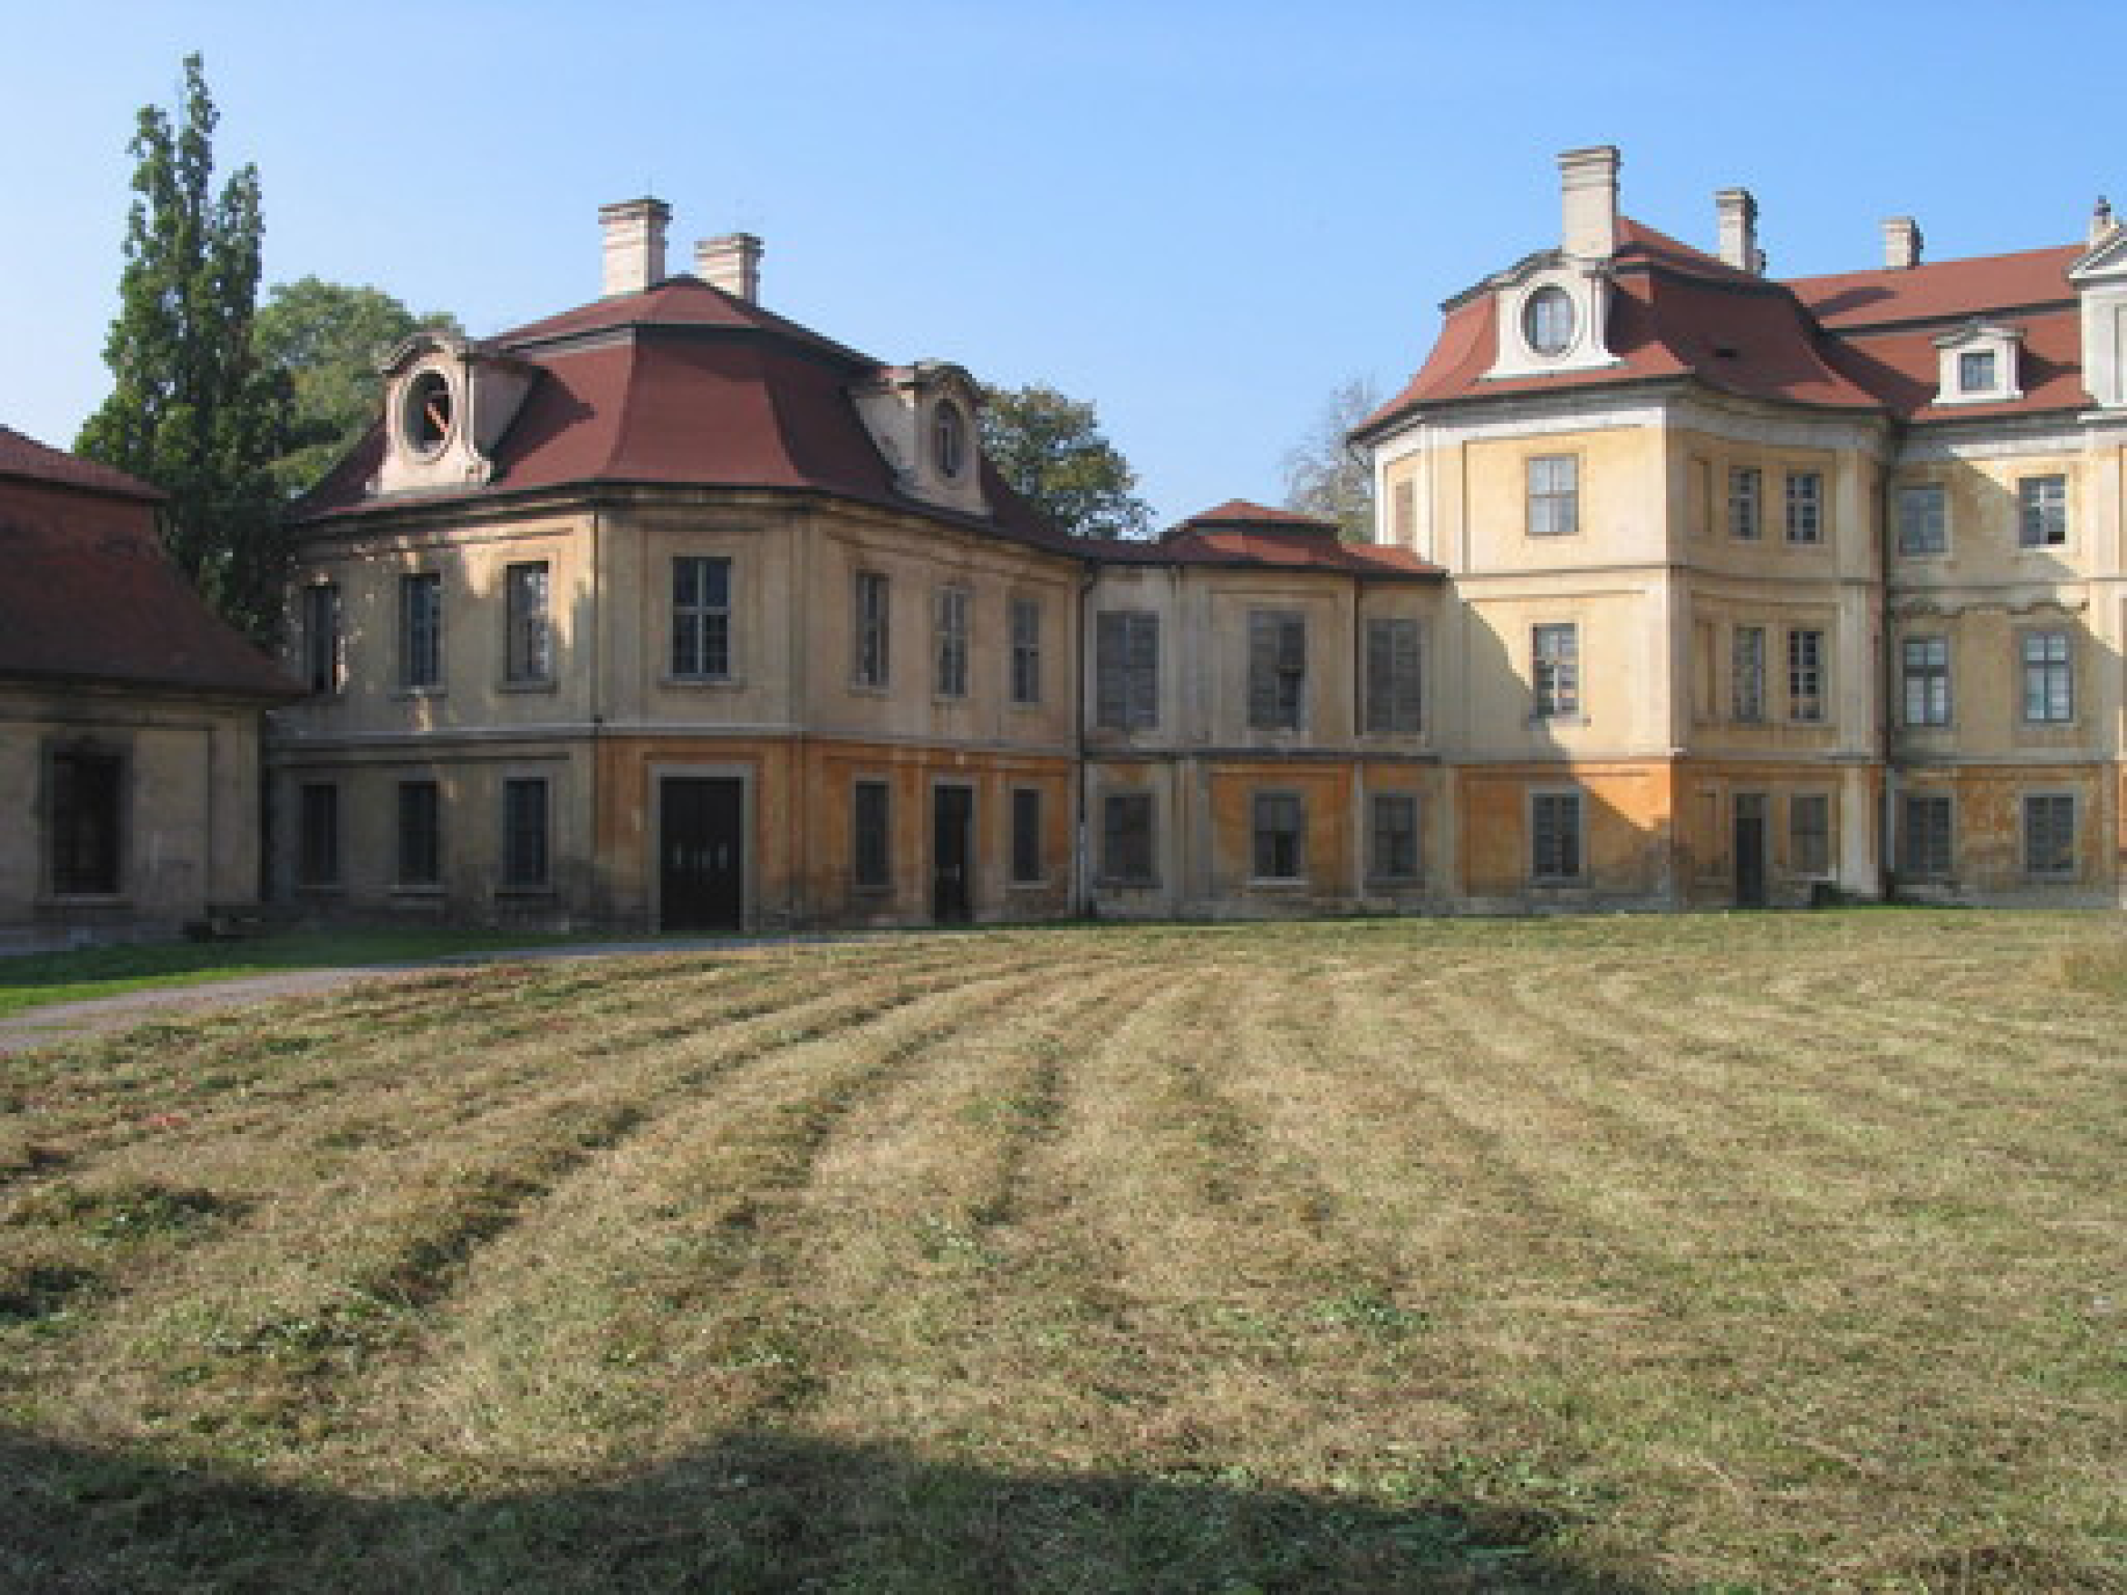
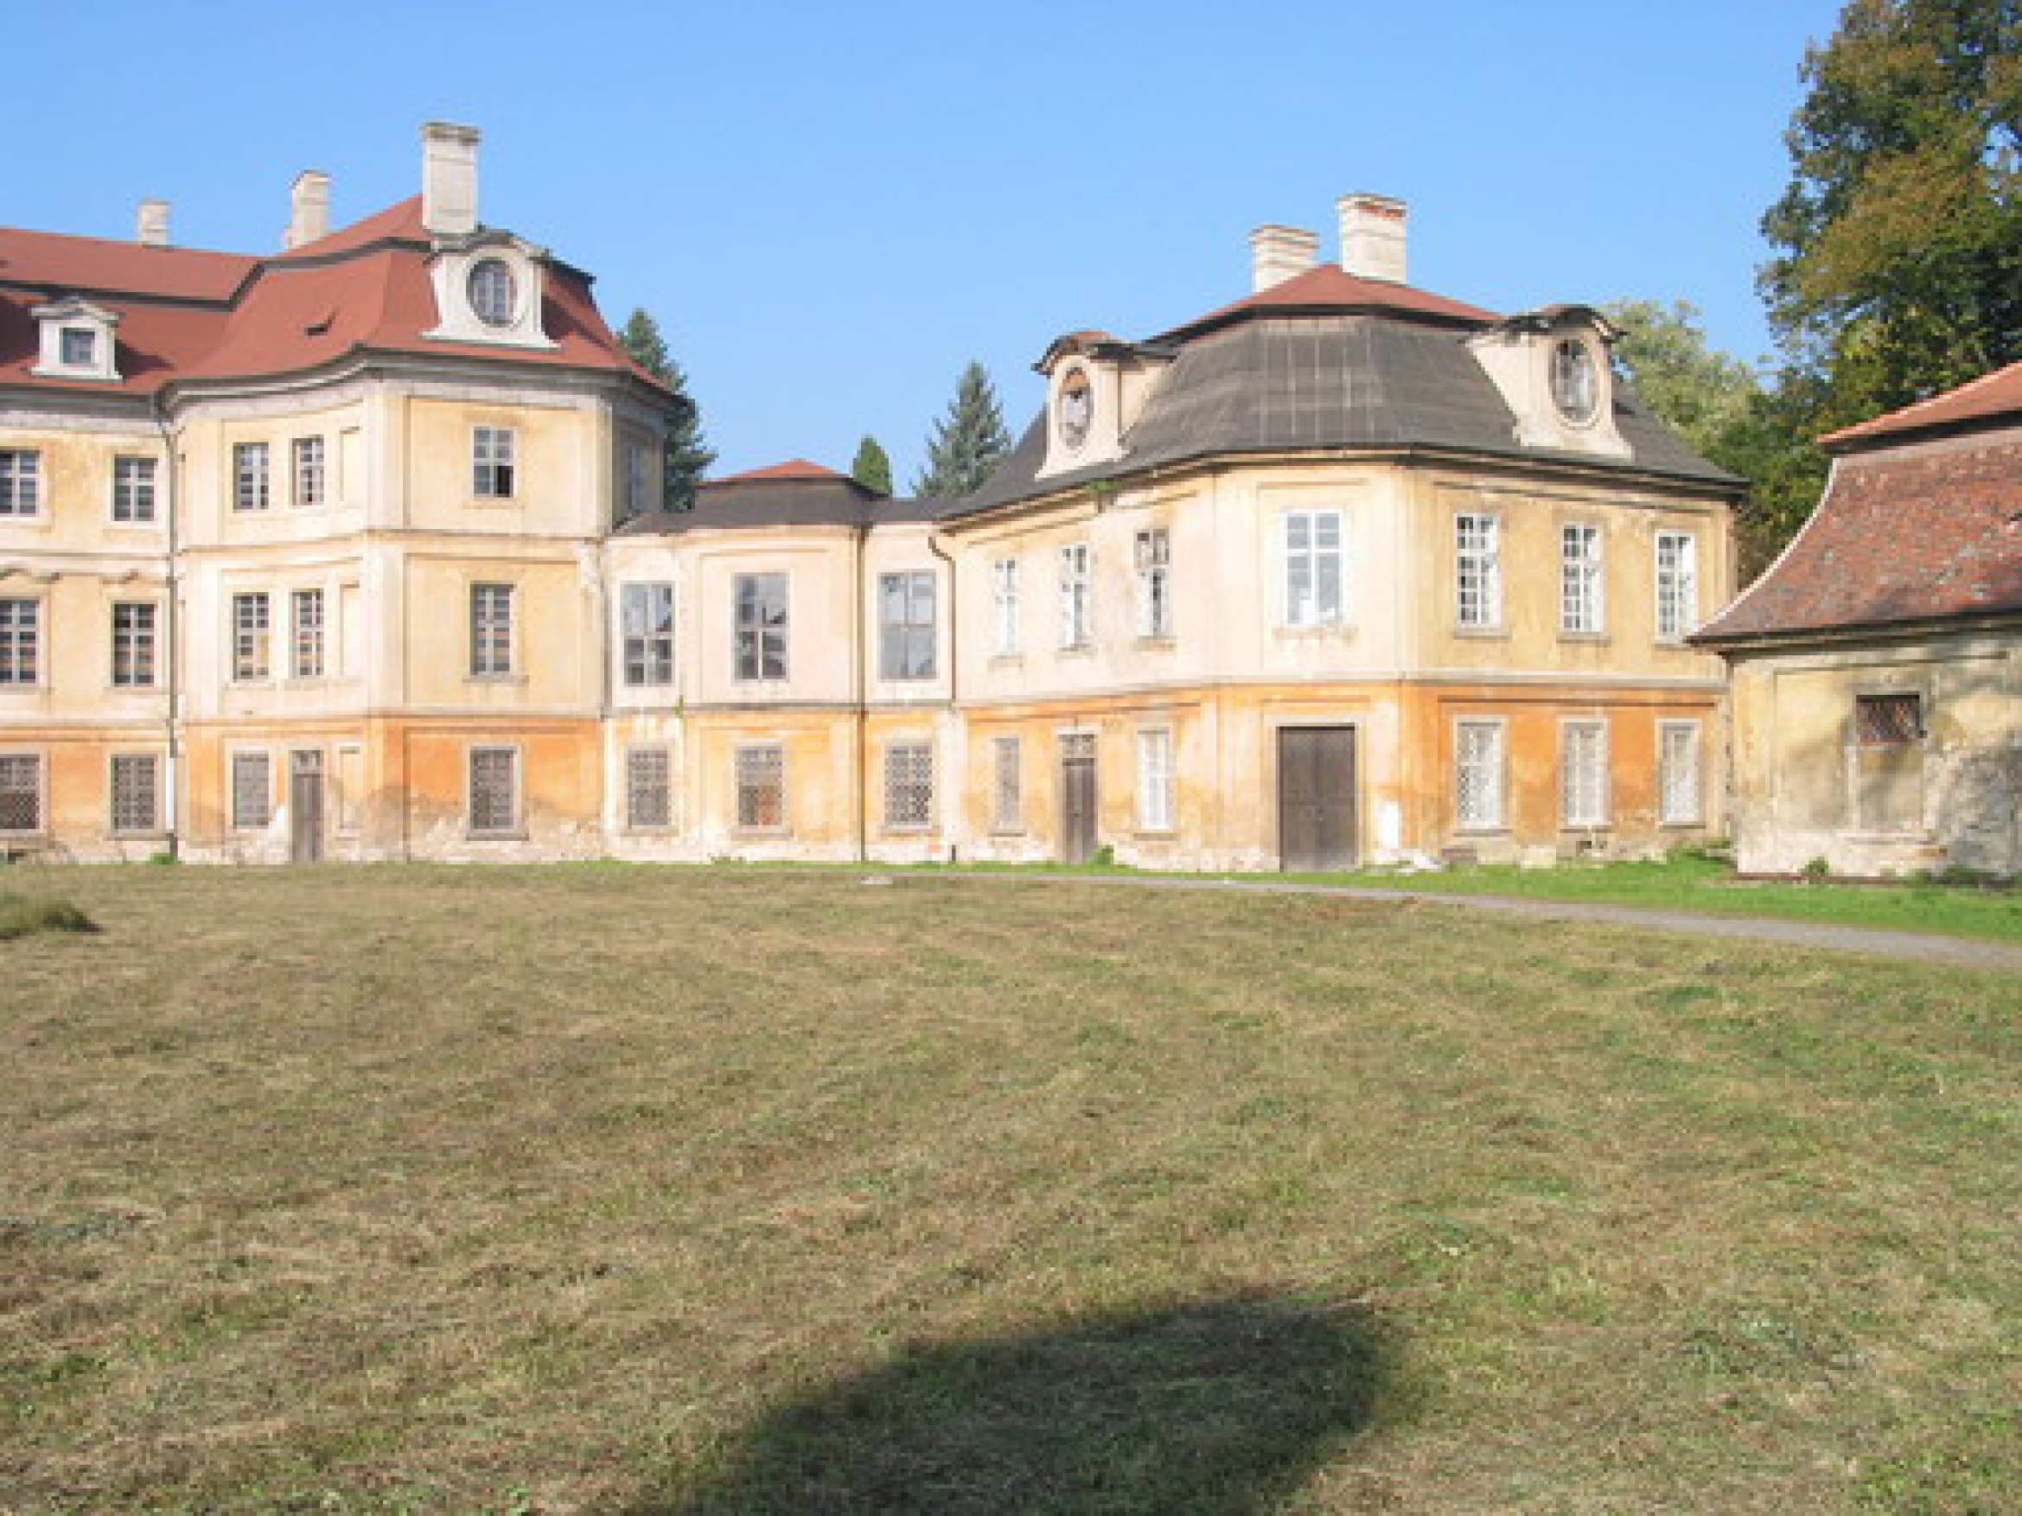
Image rectification: application
3D reconstruction becomes easier
b
a
c

Slide 41
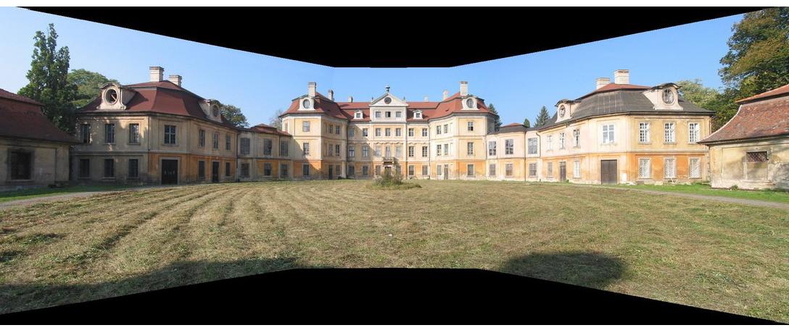
Panoramic view

Slide 42
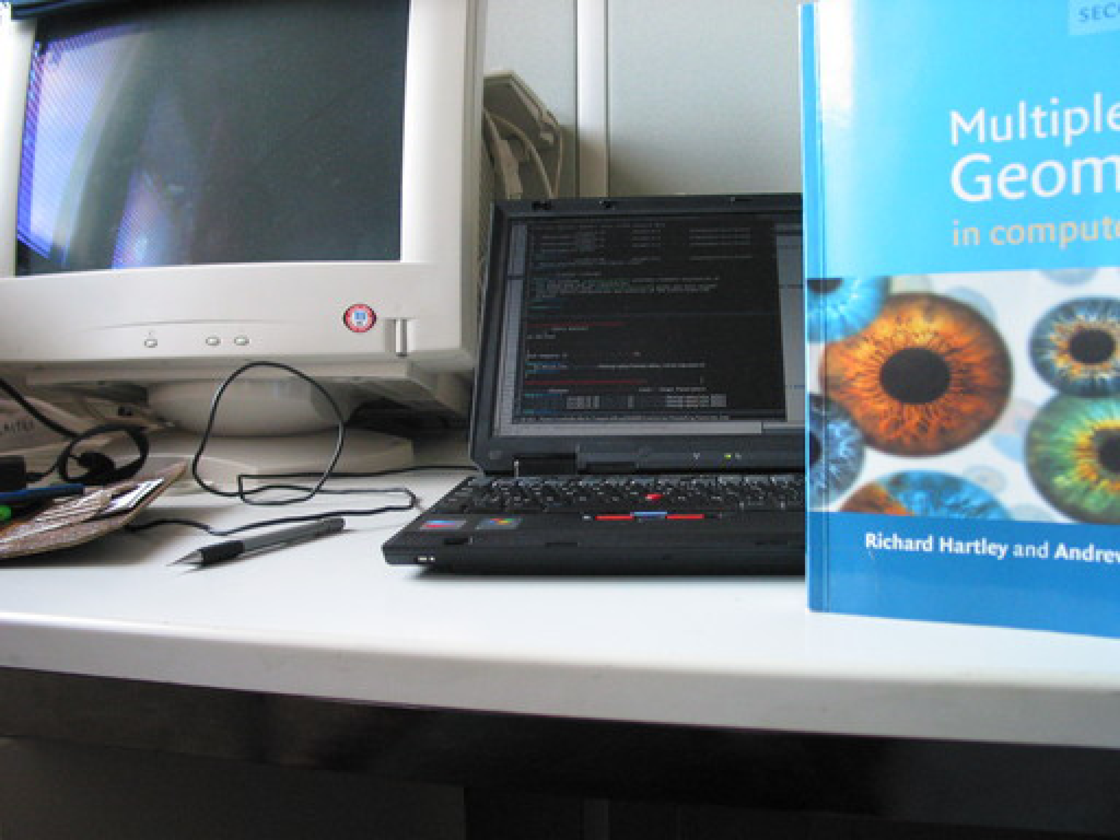
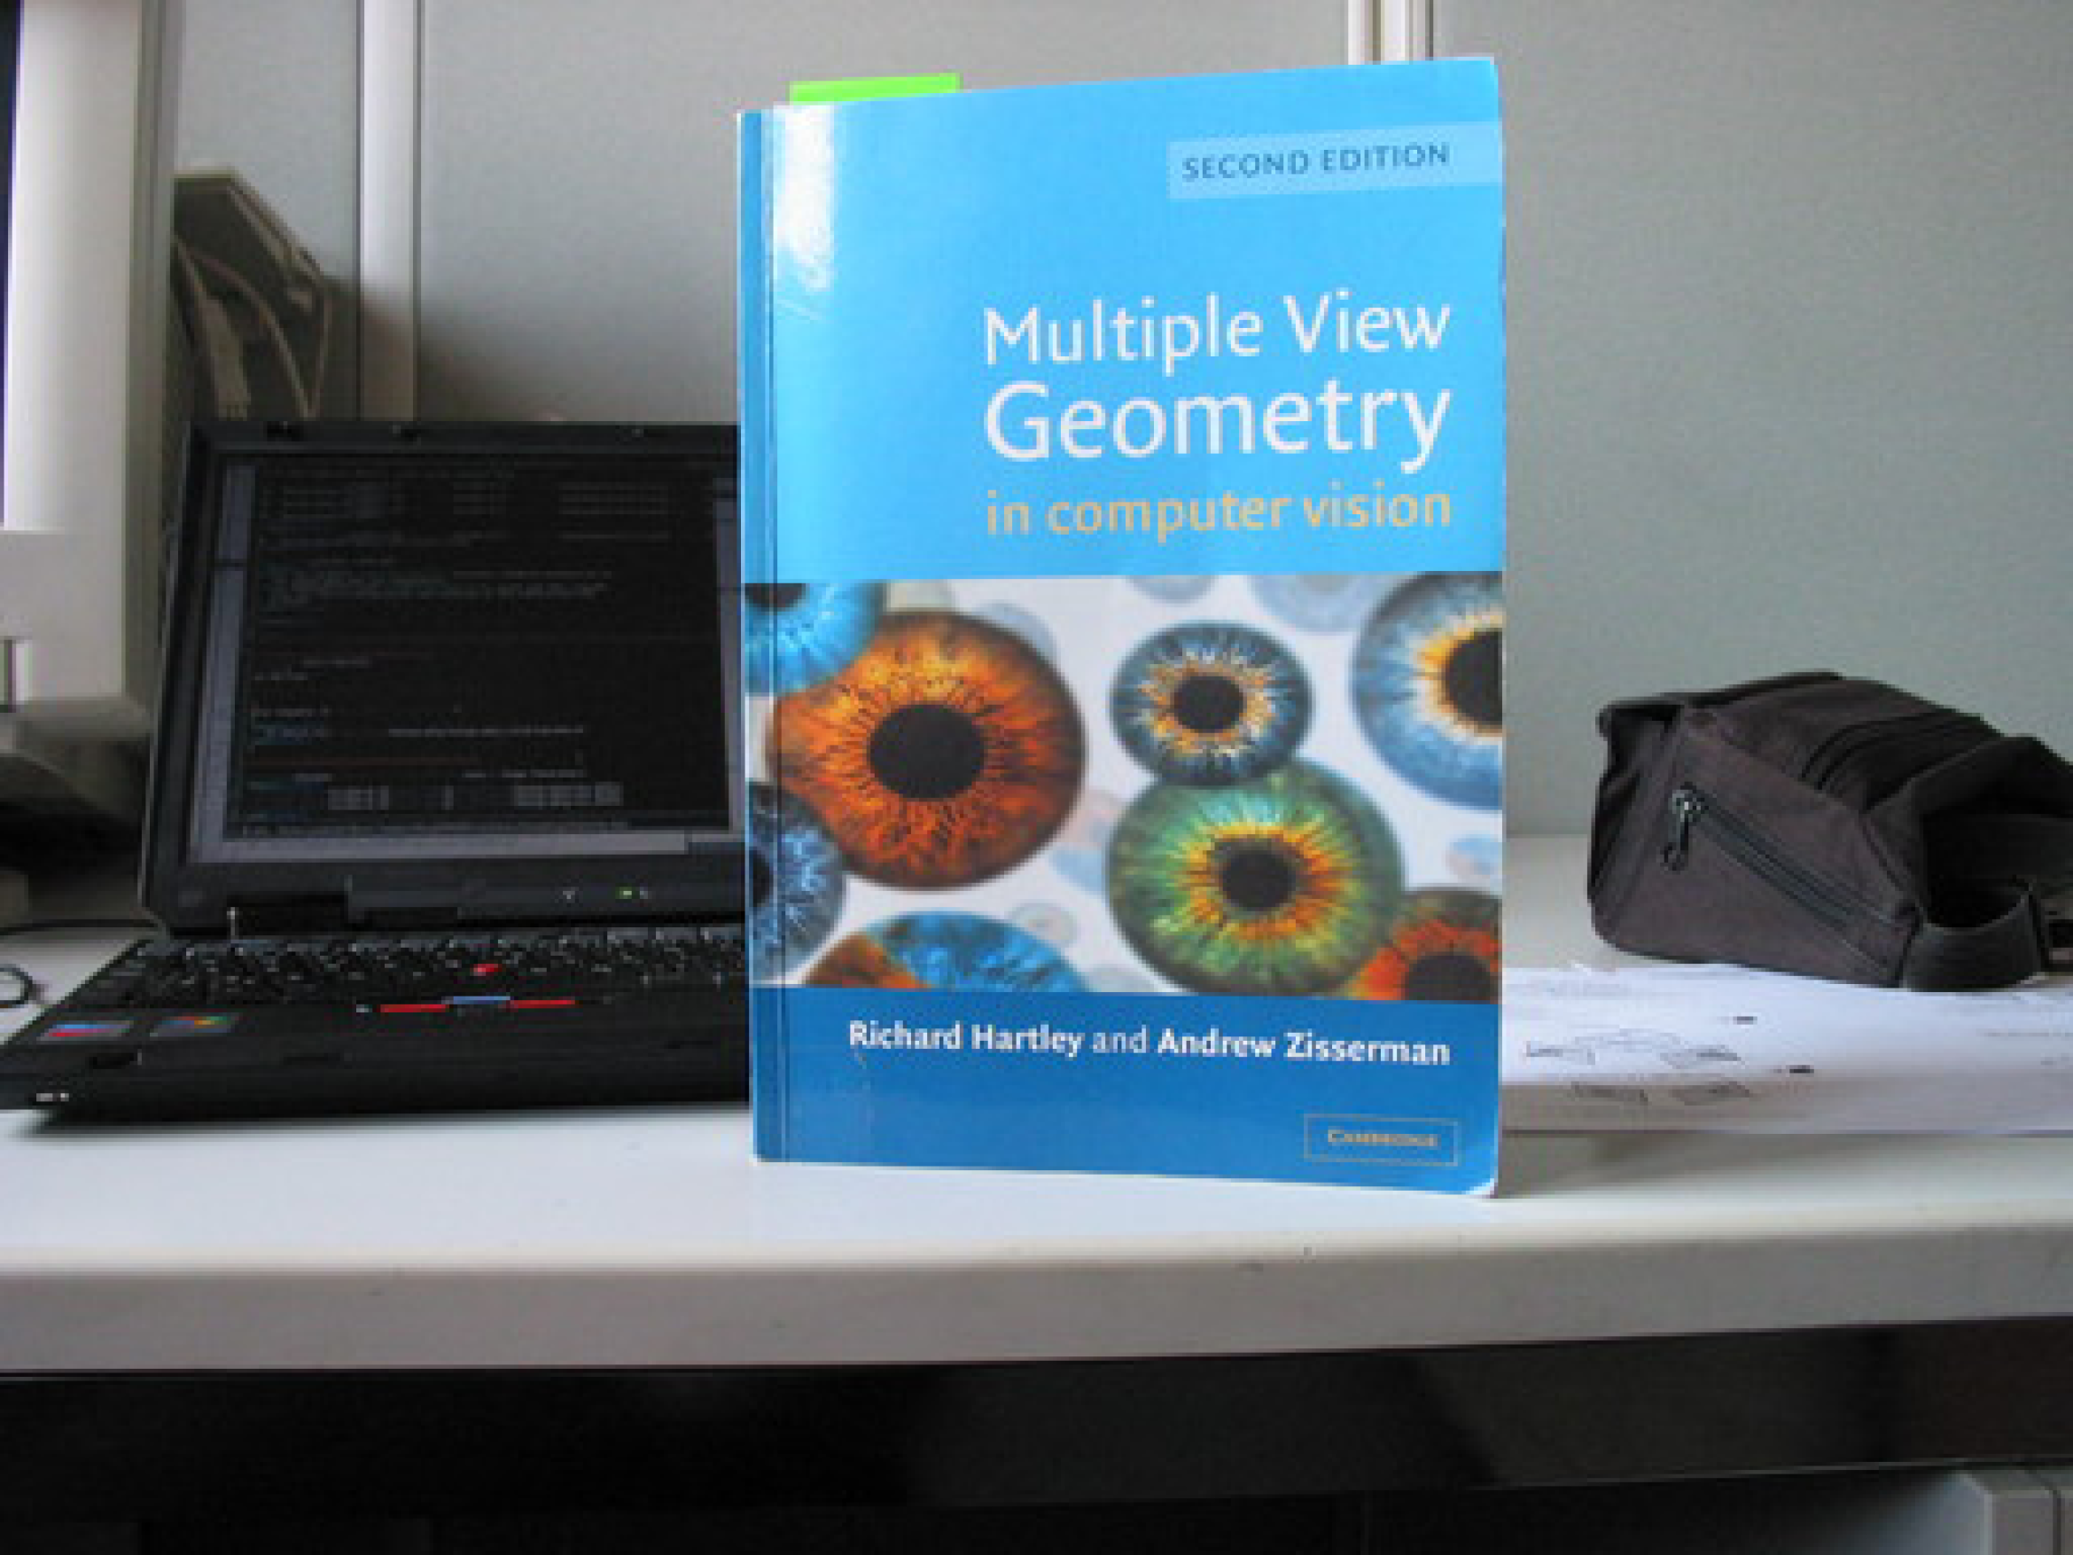
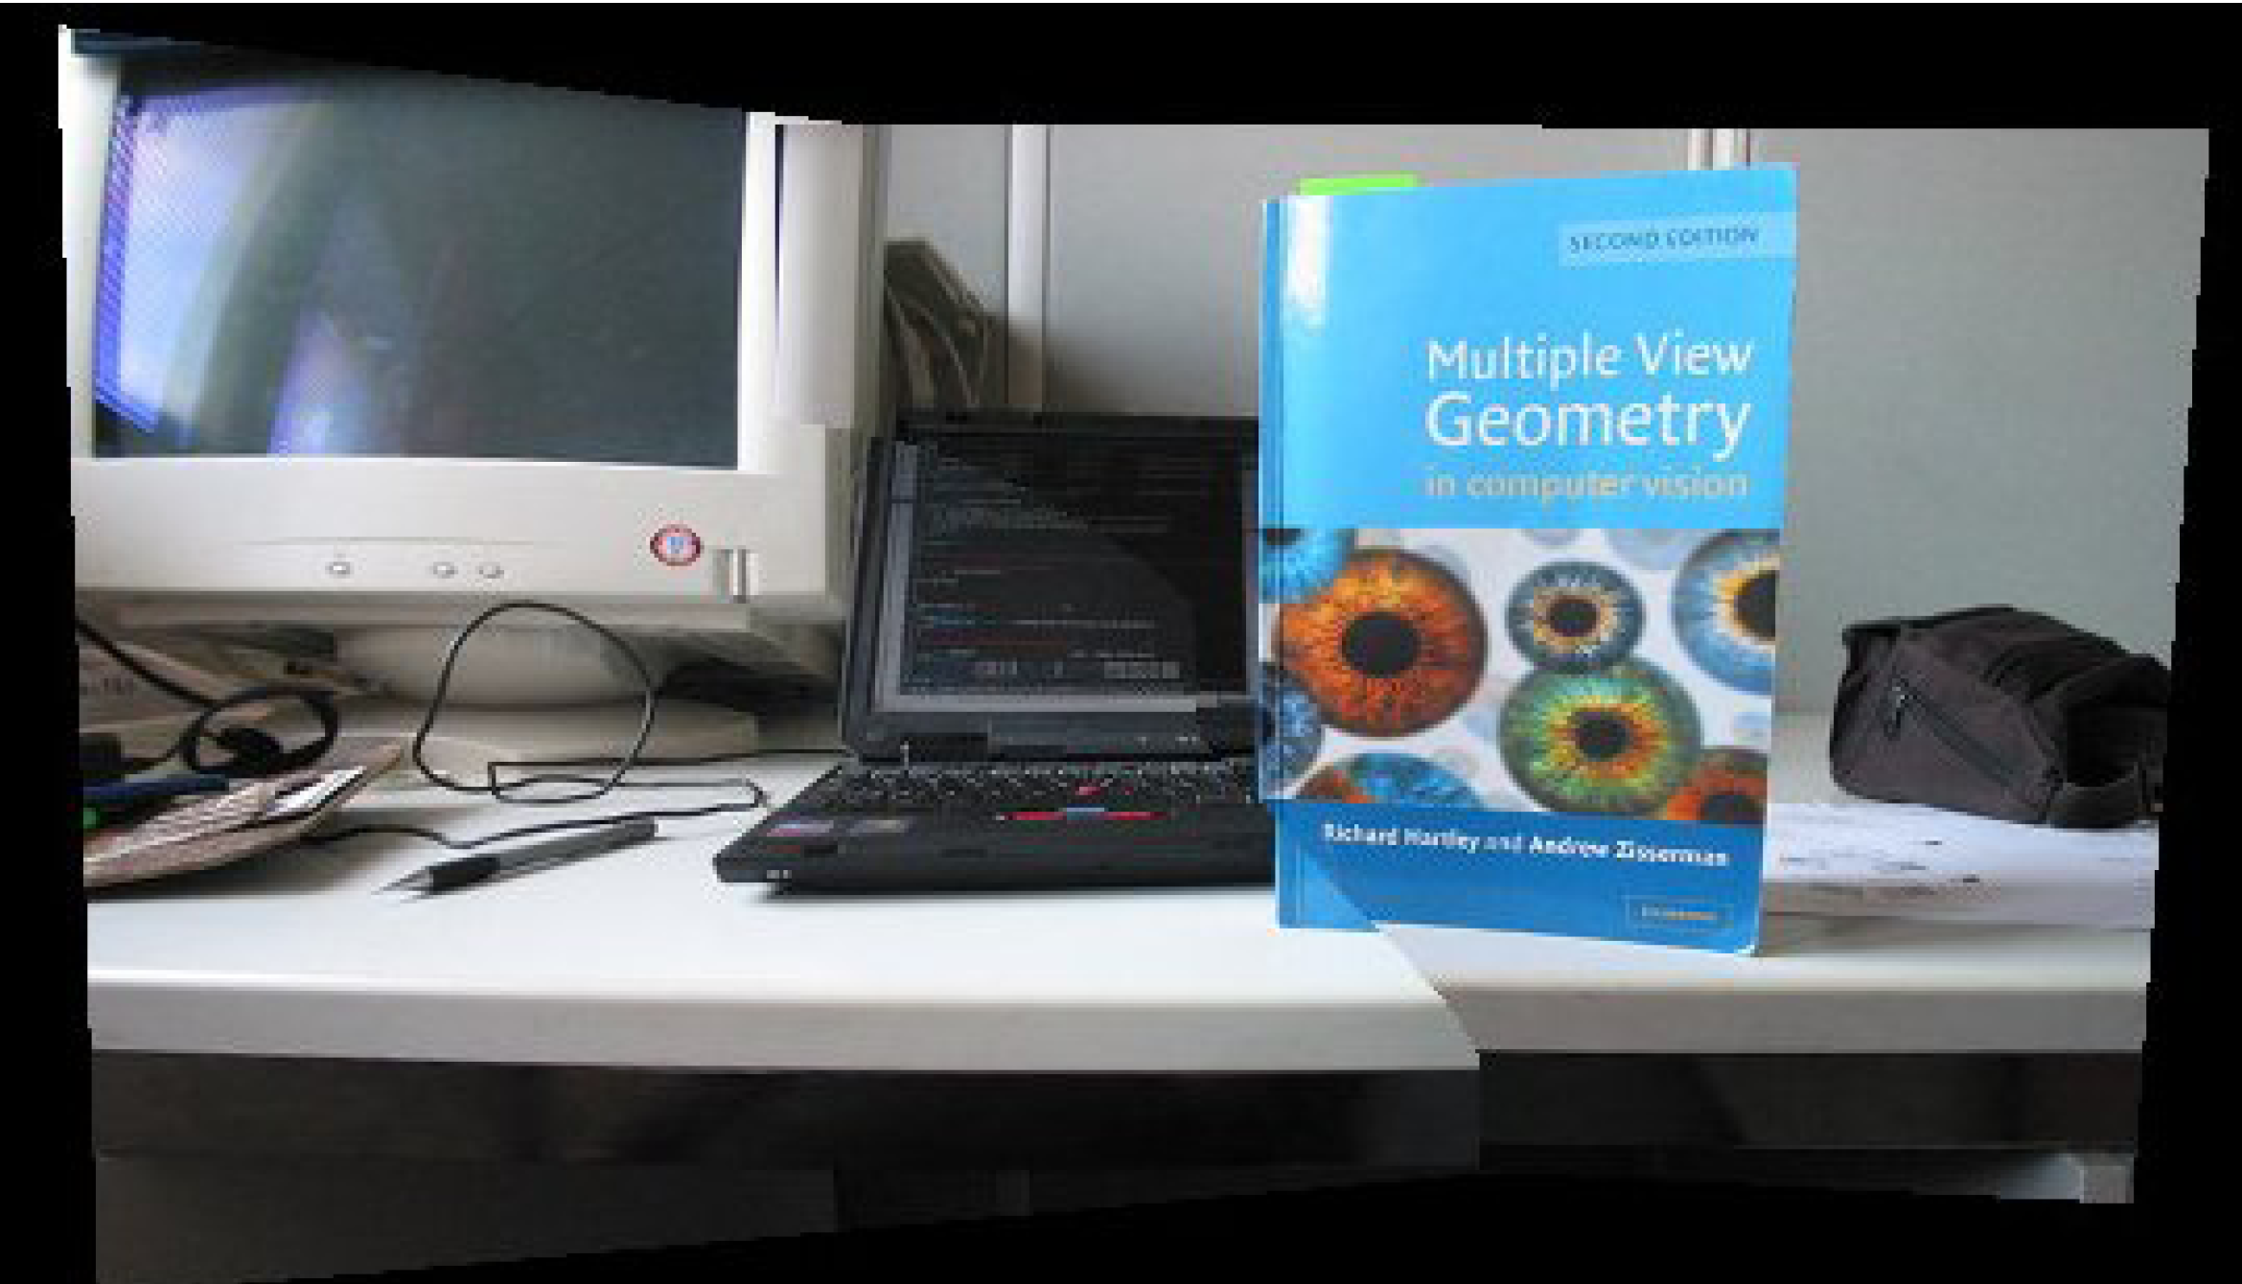
Panoramic view: challenges

Slide 43
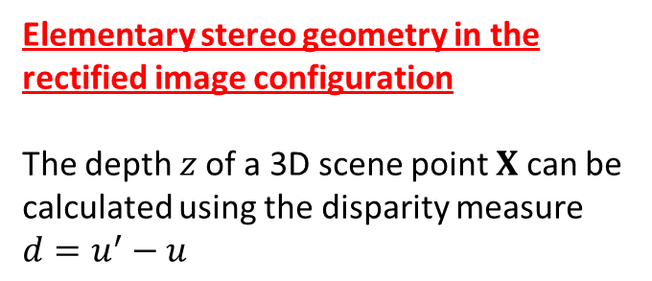
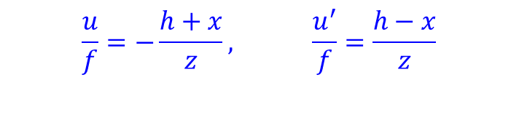
Elementary stereo geometry in the rectified image configuration
The depth $z$of a 3D scene point $X$ can be calculated using the disparity measure $d=u^{′}−u$
$$\frac{u}{f}=−\frac{h+x}{z}, \frac{u^{′}}{f}=\frac{h−x}{z}$$

Slide 44
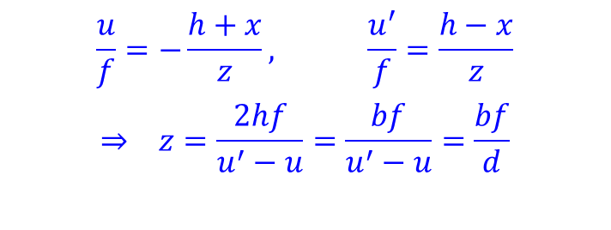
Elementary stereo geometry in the rectified image configuration
The depth $z$of a 3D scene point $X$ can be calculated using the disparity measure $d=u^{′}−u$
$$\frac{u}{f}=−\frac{h+x}{z}, \frac{u^{′}}{f}=\frac{h−x}{z}$$
$$⇒ z=\frac{2hf}{u^{′}−u}=\frac{bf}{u^{′}−u}=\frac{bf}{d}$$

Slide 45
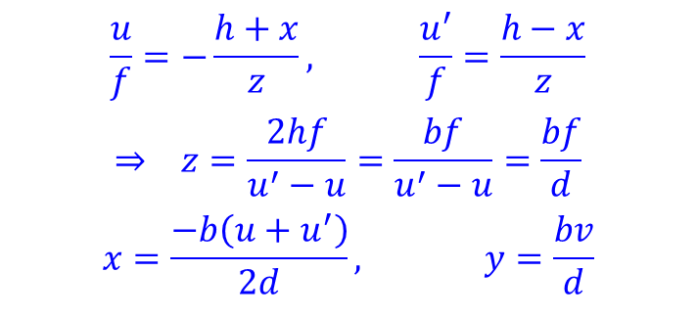
Elementary stereo geometry in the rectified image configuration
The depth $z$of a 3D scene point $X$ can be calculated using the disparity measure $d=u^{′}−u$
$$\frac{u}{f}=−\frac{h+x}{z}, \frac{u^{′}}{f}=\frac{h−x}{z}$$
$$⇒ z=\frac{2hf}{u^{′}−u}=\frac{bf}{u^{′}−u}=\frac{bf}{d}$$
$$x=\frac{−b\left(u+u^{′}\right)}{2d}, y=\frac{bv}{d}$$

Slide 46
Elementary stereo geometry in the rectified image configuration
The depth $z$of a 3D scene point $X$ can be calculated using the disparity measure $d=u^{′}−u$
$$\frac{u}{f}=−\frac{h+x}{z}, \frac{u^{′}}{f}=\frac{h−x}{z}$$
$$⇒ z=\frac{2hf}{u^{′}−u}=\frac{bf}{u^{′}−u}=\frac{bf}{d}$$
$$x=\frac{−b\left(u+u^{′}\right)}{2d}, y=\frac{bv}{d}$$

