Slide 1
55:148 Digital Image Processing
Chapter 11
3D Vision, Geometry
Topics:
  Basics of projective geometry
    Points and hyperplanes in projective space
    Homography
    Estimating homography from point correspondence
  The single perspective camera
    An overview of single camera calibration
    Calibration of one camera from the known scene
  Scene reconstruction from multiple views
  Triangulation
  Projective reconstruction
  Matching constraints
  Bundle adjustment
  Two cameras, stereopsis
    The geometry of two cameras. The fundamental matrix
    Relative motion of the camera; the essential matrix
    Estimation of a fundamental matrix from image point correspondences
    Camera Image rectification
    Applications of the epipolar geometry in vision
  Three and more cameras
    Stereo correspondence algorithms

Slide 2
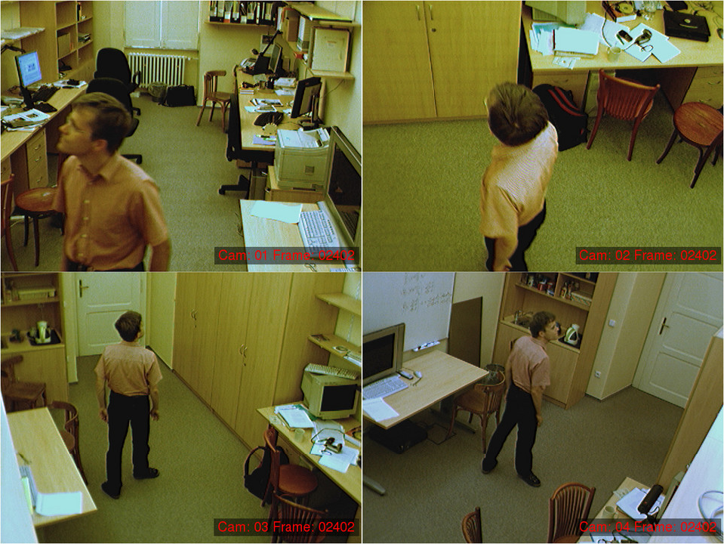
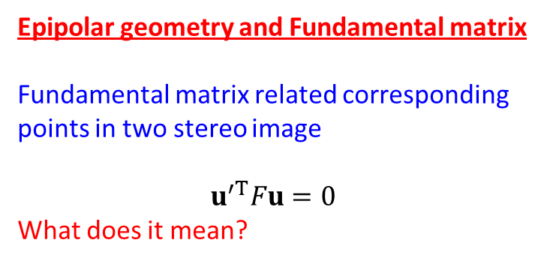
Epipolar geometry and Fundamental matrix
Fundamental matrix related corresponding points in two stereo image
$$u^{′T}Fu=0$$
What does it mean?

Slide 3
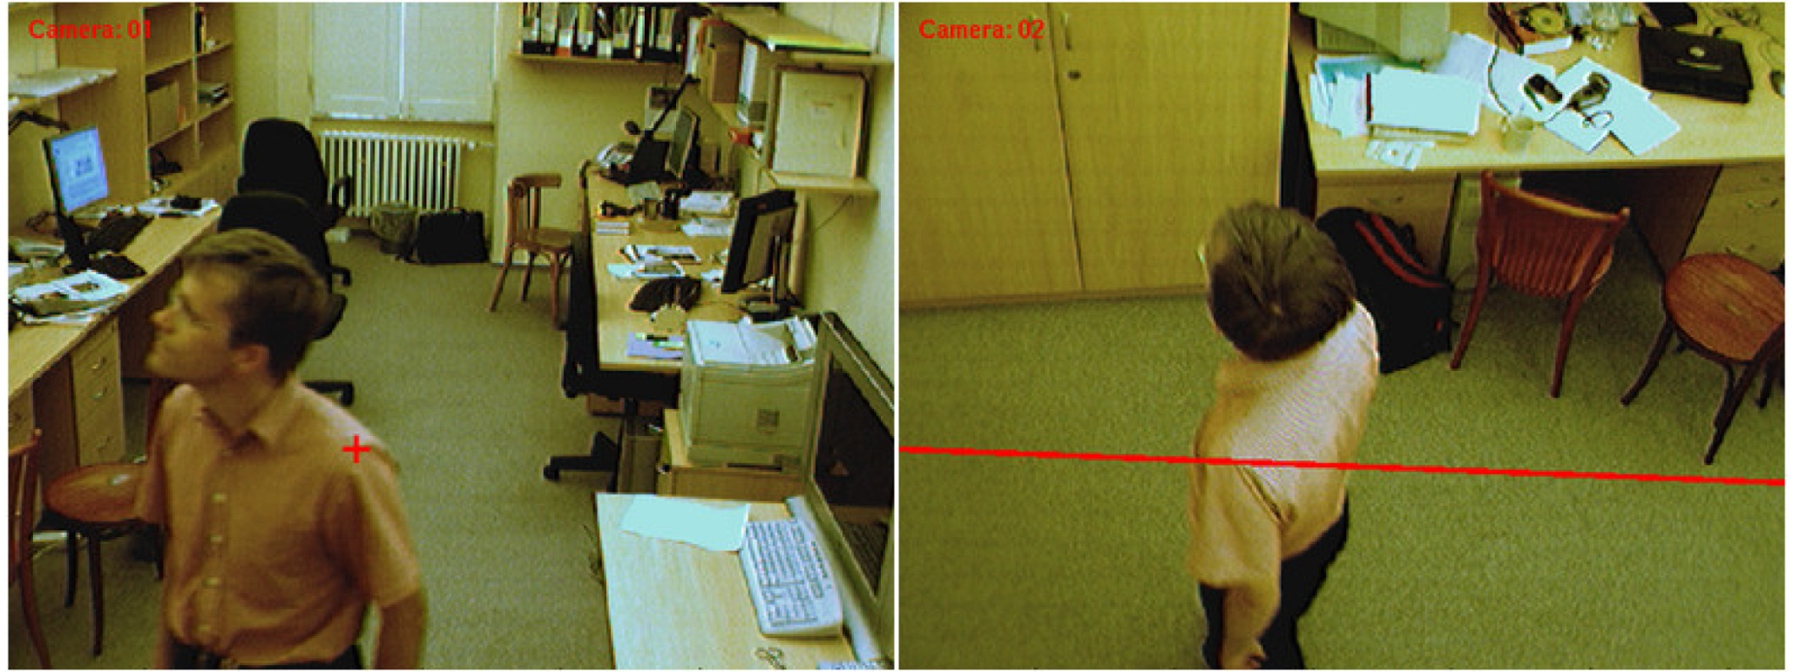
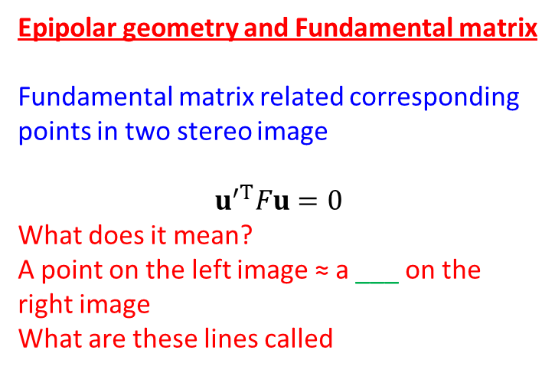
Epipolar geometry and Fundamental matrix
Fundamental matrix related corresponding points in two stereo image
$$u^{′T}Fu=0$$
What does it mean?
A point on the left image ≈ a ___ on the right image
What are these lines called

Slide 4
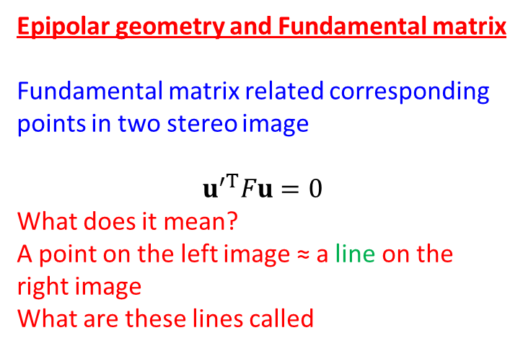
Epipolar geometry and Fundamental matrix
Fundamental matrix related corresponding points in two stereo image
$$u^{′T}Fu=0$$
What does it mean?
A point on the left image ≈ a line on the right image
What are these lines called

Slide 5
Fundamental matrices relating multiple cameras

Slide 6
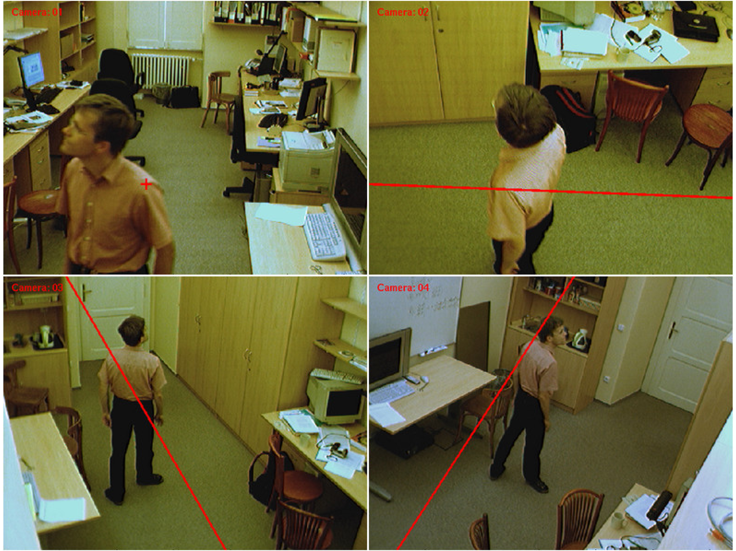
Fundamental matrices relating multiple cameras

Slide 7
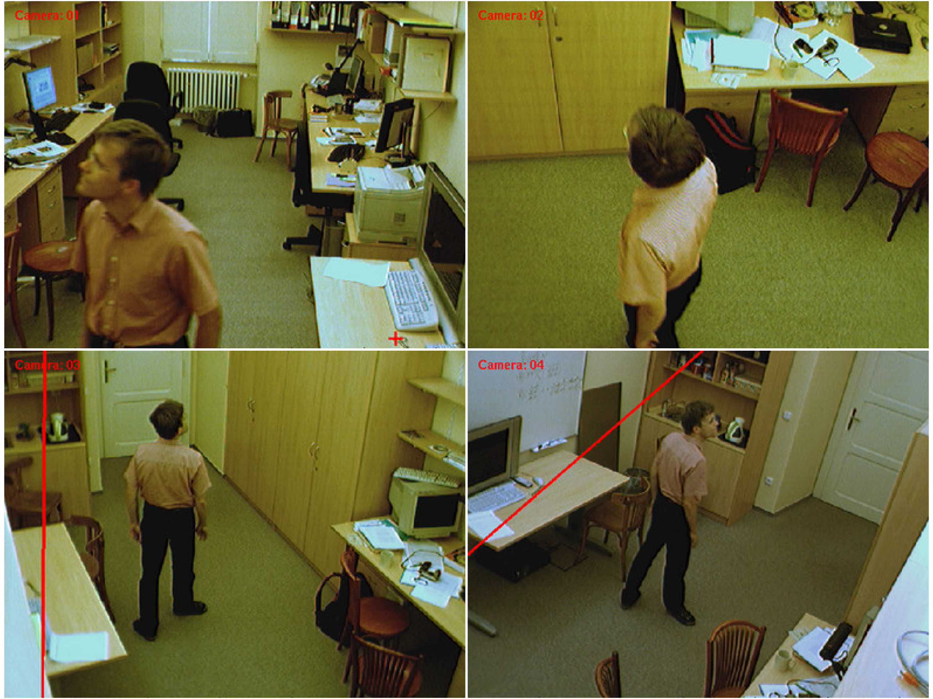
Fundamental matrices relating multiple cameras

Slide 8

Fundamental matrices relating multiple cameras

Slide 9
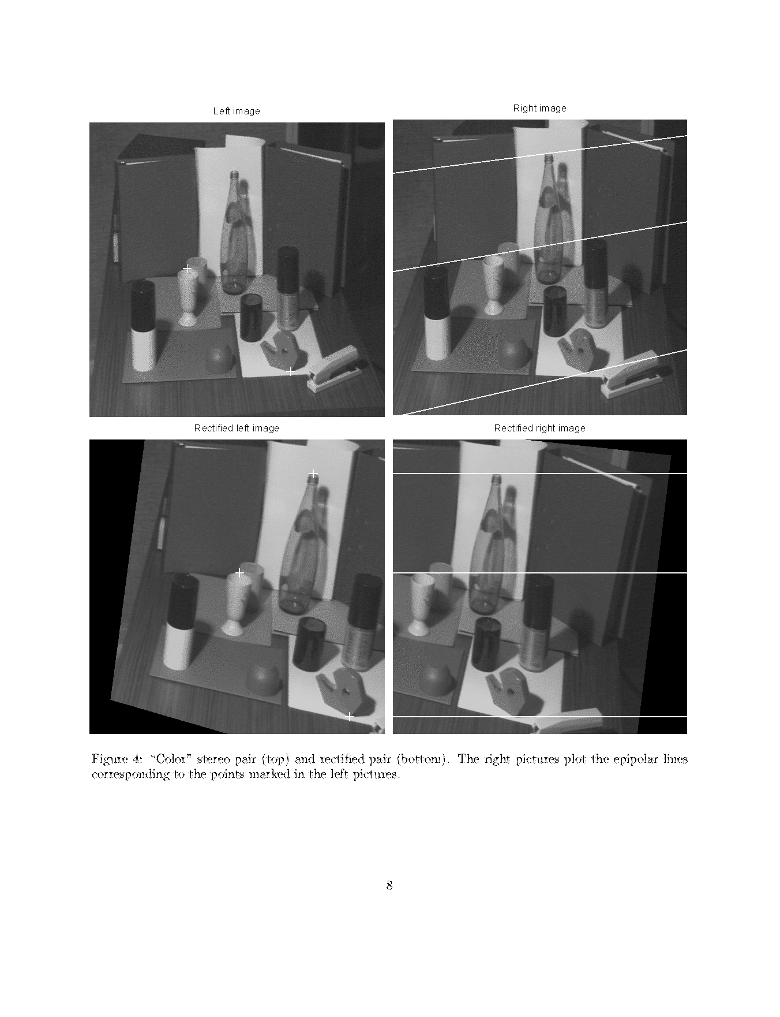
Image rectification (before)

Slide 10
Image rectification (after)

Slide 11
Image rectification
What happens in terms of epipolar geometry?
Where are the two epipoles
What is relation between baseline and image and the camera matrices
Can we solve it using a homographic transformation on each cameral image?

Slide 12
Image rectification
What happens in terms of epipolar geometry?
Where are the two epipoles
What is relation between baseline and image and the camera matrices
Can we solve it using a homographic transformation on each cameral image?

Slide 13
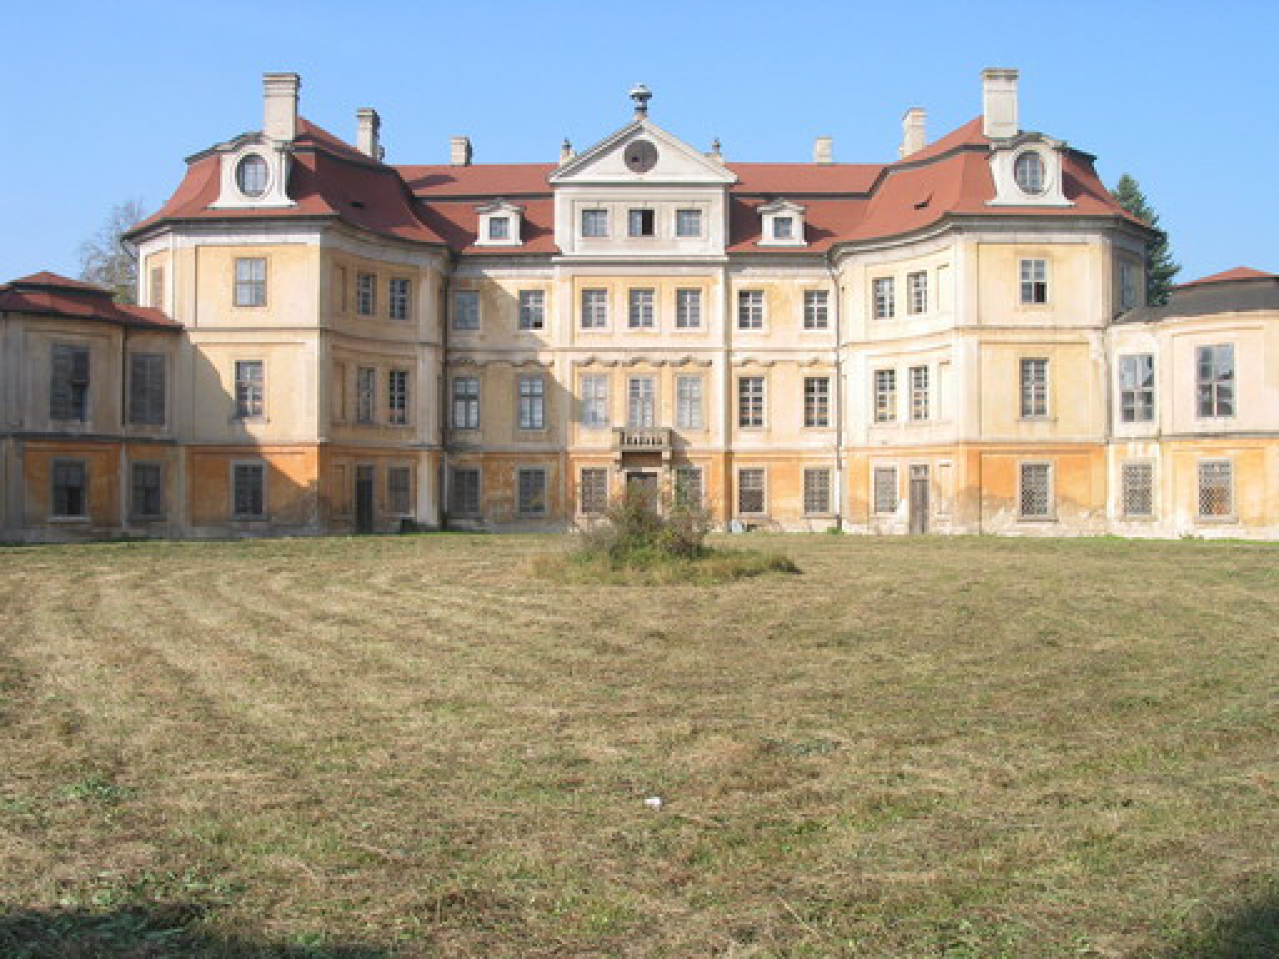
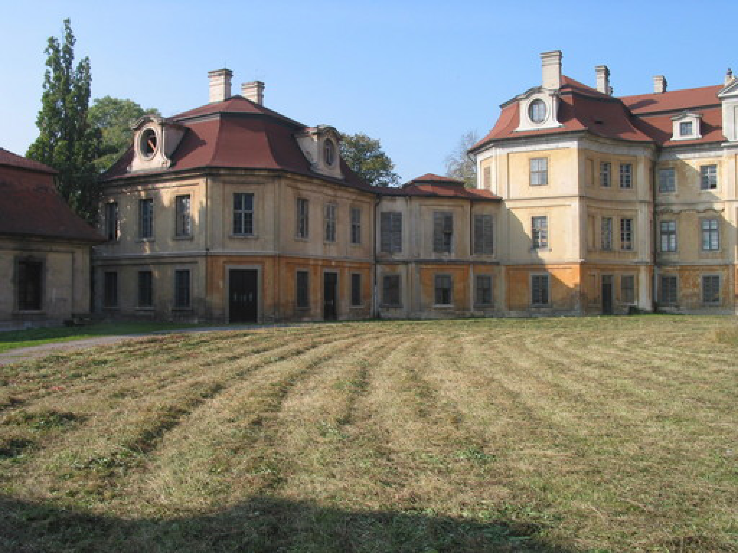
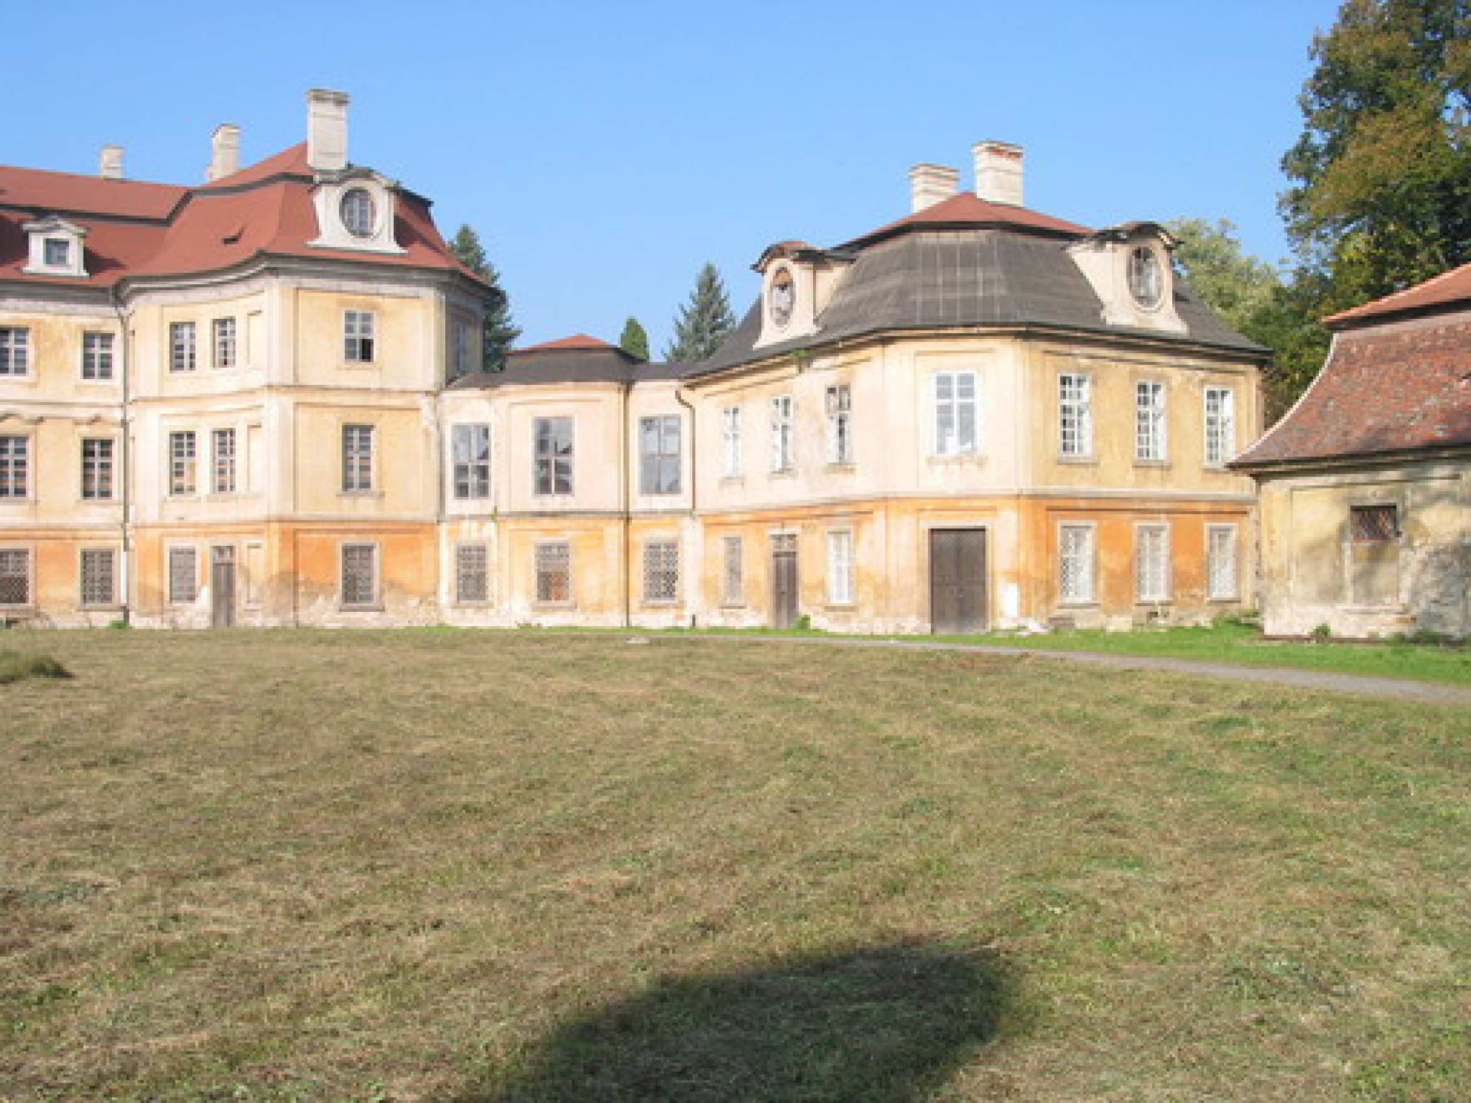
Image rectification: advantages
3D reconstruction becomes easier
Image stitching to generate panoramic views
b
a
c

Slide 14
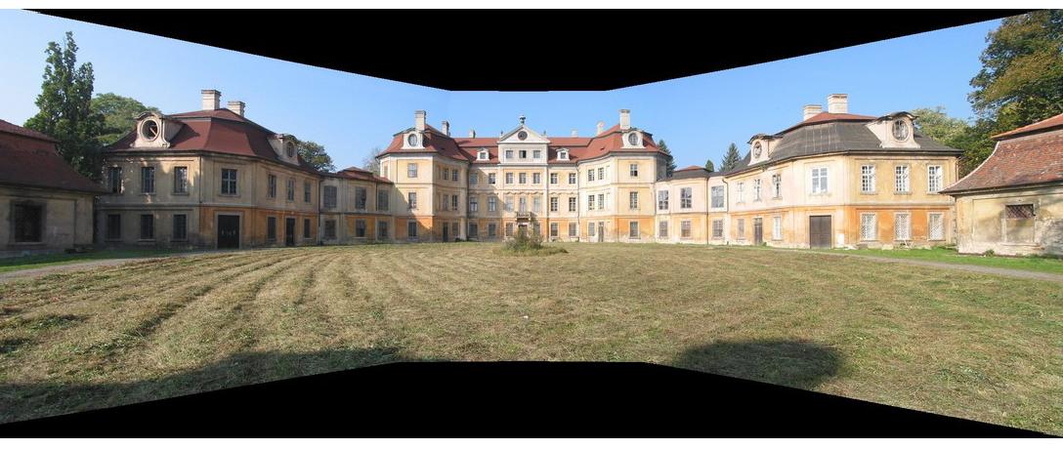
Panoramic view

Slide 15
So, how to accomplish image rectification?
Learn how to determine the fundamental matrix
Relative camera motion and essential matrix
Relation between fundamental matrix and camera matrix
Compute image rectification

Slide 16
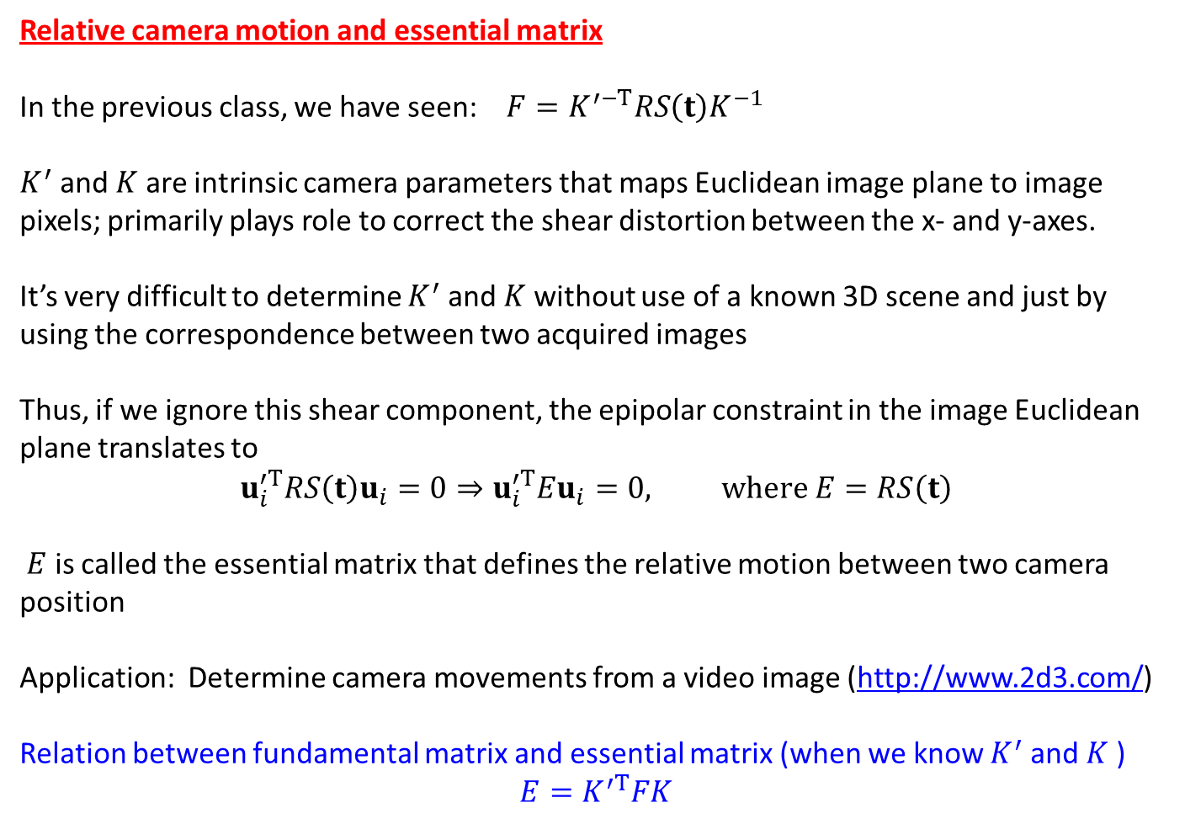
Relative camera motion and essential matrix
In the previous class, we have seen: $F=K^{′−T}RS\left(t\right)K^{−1}$
$K^{′}$ and $K$ are intrinsic camera parameters that maps Euclidean image plane to image pixels; primarily plays role to correct the shear distortion between the x- and y-axes.
It’s very difficult to determine $K^{′}$ and $K$ without use of a known 3D scene and just by using the correspondence between two acquired images
Thus, if we ignore this shear component, the epipolar constraint in the image Euclidean plane translates to
$$u_{i}^{′T}RS\left(t\right)u_{i}=0⇒u_{i}^{′T}Eu_{i}=0, where E=RS\left(t\right)$$
$E$ is called the essential matrix that defines the relative motion between two camera position
Application: Determine camera movements from a video image (http://www.2d3.com/)
Relation between fundamental matrix and essential matrix (when we know $K^{′}$ and $K$ )
$$E=K^{′T}FK$$

Slide 17
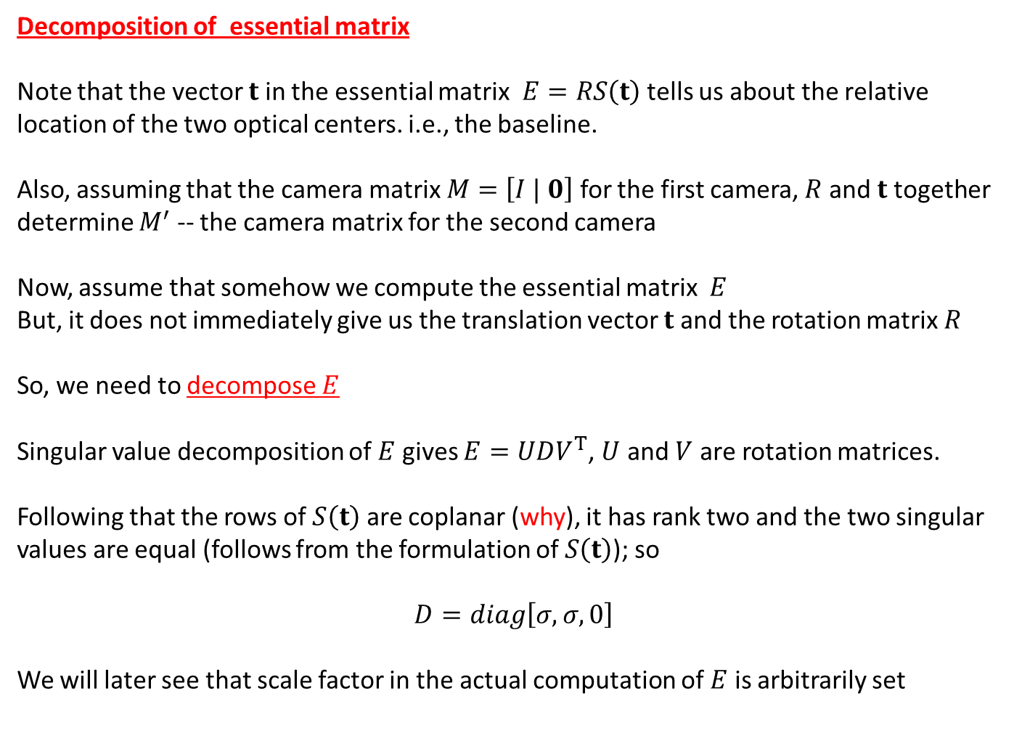
Decomposition of essential matrix
Note that the vector $t$ in the essential matrix $E=RS\left(t\right)$ tells us about the relative location of the two optical centers. i.e., the baseline.
Also, assuming that the camera matrix $M=\left[I | 0\right]$ for the first camera, $R$ and $t$ together determine $M^{′}$ -- the camera matrix for the second camera
Now, assume that somehow we compute the essential matrix $E$
But, it does not immediately give us the translation vector $t$ and the rotation matrix $R$
So, we need to decompose $E$
Singular value decomposition of $E$ gives $E=UDV^{T}$, $U$ and $V$ are rotation matrices.
Following that the rows of $S\left(t\right)$ are coplanar (why), it has rank two and the two singular values are equal (follows from the formulation of $S\left(t\right)$); so
$$D=diag\left[σ,σ,0\right]$$
We will later see that scale factor in the actual computation of $E$ is arbitrarily set

Slide 18
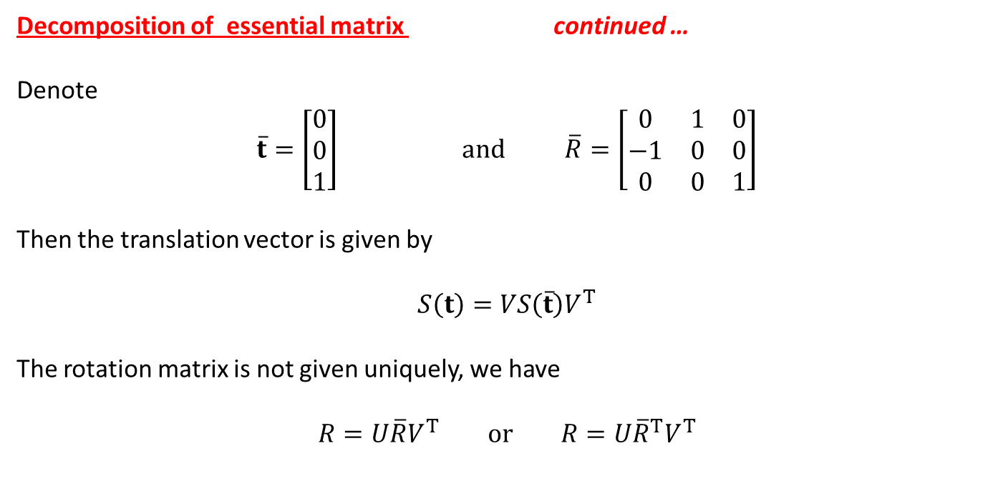
Decomposition of essential matrix continued …
Denote
$$\overline{t}=\left[\begin{matrix}0 \\ 0 \\ 1\end{matrix}\right] and \overline{R}=\left[\begin{matrix}0 & 1 & 0 \\ −1 & 0 & 0 \\ 0 & 0 & 1\end{matrix}\right]$$
Then the translation vector is given by
$$S\left(t\right)=VS\left(\overline{t}\right)V^{T}$$
The rotation matrix is not given uniquely, we have
$$R=U\overline{R}V^{T} or R=U{\overline{R}}^{T}V^{T}$$

Slide 19
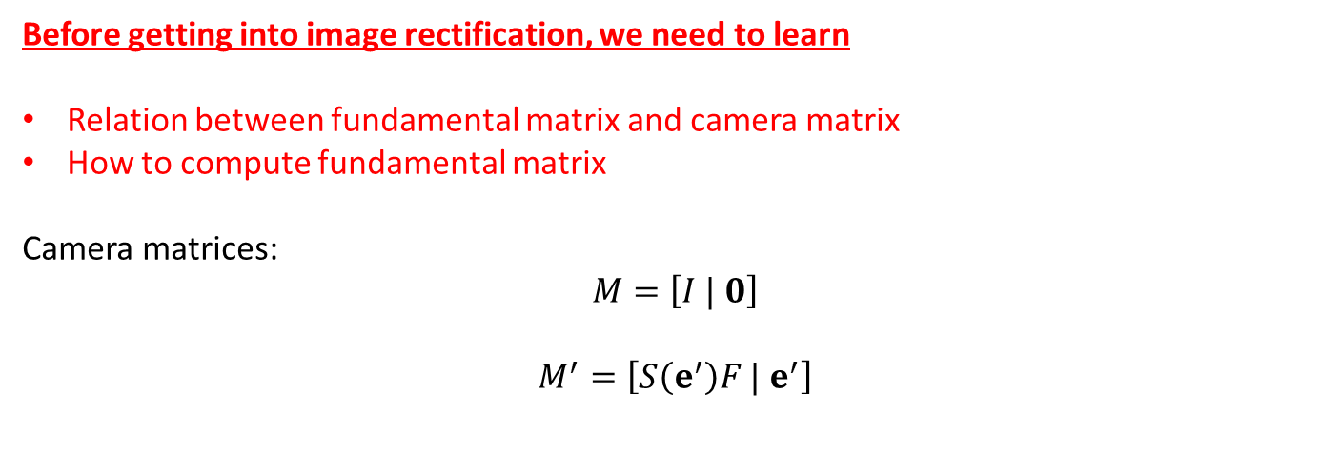
Before getting into image rectification, we need to learn
Relation between fundamental matrix and camera matrix
How to compute fundamental matrix
Camera matrices:
$$M=\left[I | 0\right]$$
$$M^{′}=\left[S\left(e^{′}\right)F | e^{′}\right]$$

Slide 20
Computation of the fundamental matrix using point correspondence
Number of unknowns:

Slide 21
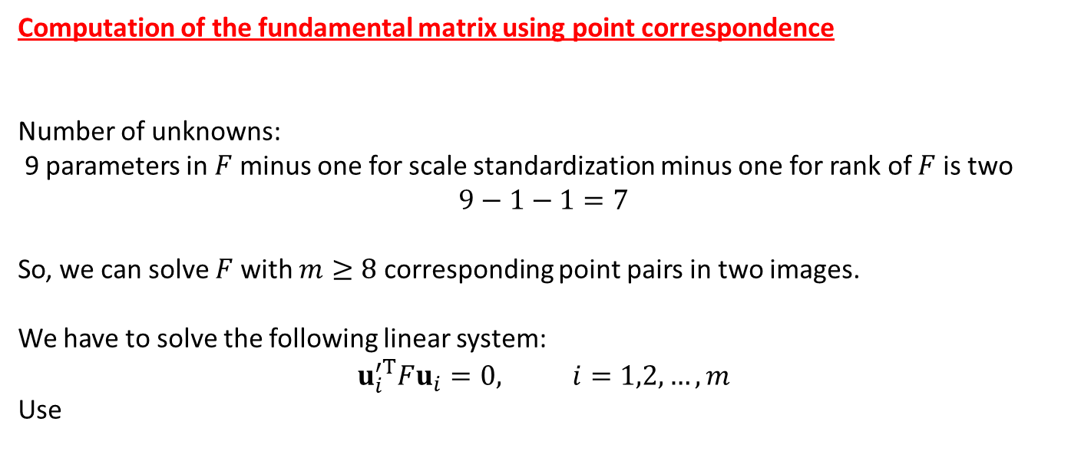
Computation of the fundamental matrix using point correspondence
Number of unknowns:
9 parameters in $F$ minus one for scale standardization minus one for rank of $F$ is two
$$9−1−1=7$$
So, we can solve $F$ with $m≥8$ corresponding point pairs in two images.
We have to solve the following linear system:
$$u_{i}^{′T}Fu_{i}=0, i=1,2,…, m$$
Use

Slide 22
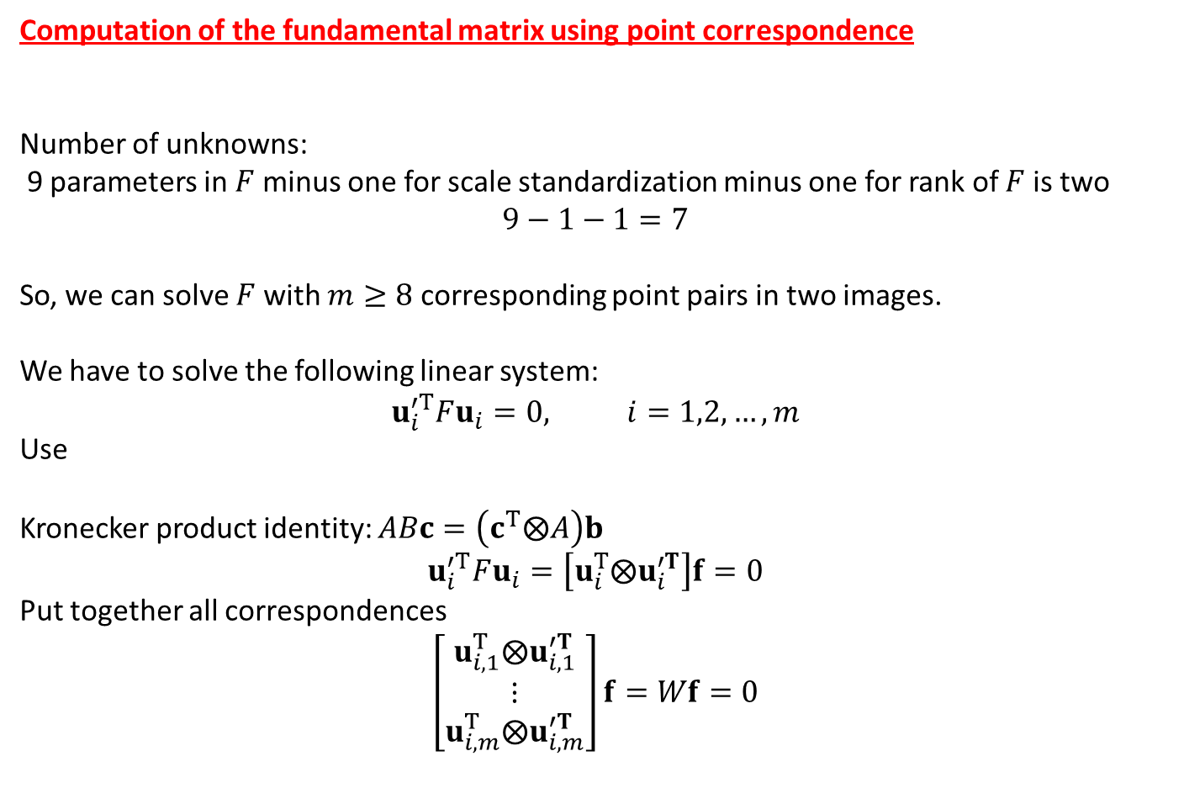
Computation of the fundamental matrix using point correspondence
Number of unknowns:
9 parameters in $F$ minus one for scale standardization minus one for rank of $F$ is two
$$9−1−1=7$$
So, we can solve $F$ with $m≥8$ corresponding point pairs in two images.
We have to solve the following linear system:
$$u_{i}^{′T}Fu_{i}=0, i=1,2,…, m$$
Use
Kronecker product identity: $ABc=\left(c^{T}⨂A\right)b$
$$u_{i}^{′T}Fu_{i}=\left[u_{i}^{T}⨂u_{i}^{′T}\right]f=0$$
Put together all correspondences
$$\left[\begin{matrix}u_{i,1}^{T}⨂u_{i,1}^{′T} \\ ⋮ \\ u_{i,m}^{T}⨂u_{i,m}^{′T}\end{matrix}\right]f=Wf=0$$

Slide 23
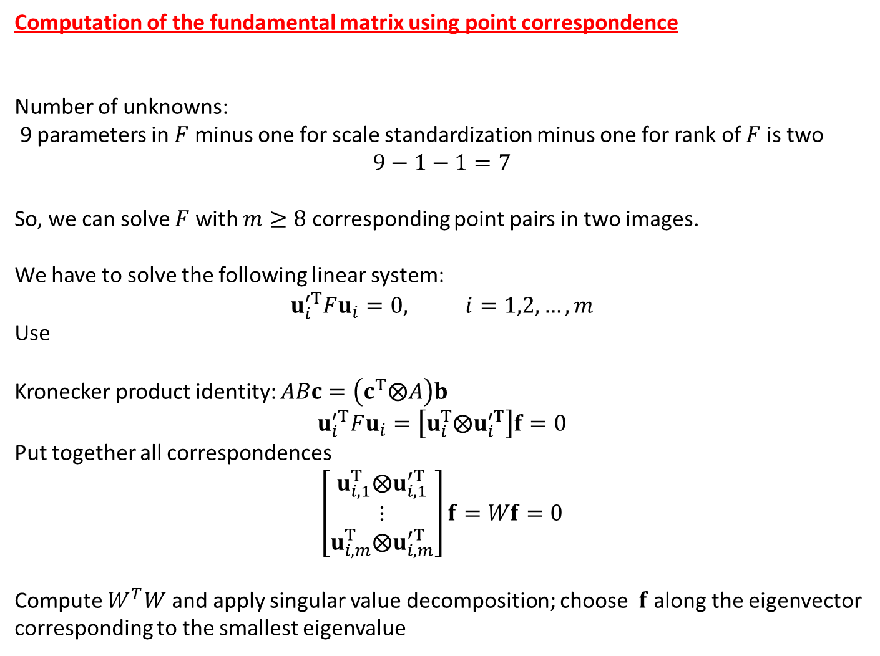
Computation of the fundamental matrix using point correspondence
Number of unknowns:
9 parameters in $F$ minus one for scale standardization minus one for rank of $F$ is two
$$9−1−1=7$$
So, we can solve $F$ with $m≥8$ corresponding point pairs in two images.
We have to solve the following linear system:
$$u_{i}^{′T}Fu_{i}=0, i=1,2,…, m$$
Use
Kronecker product identity: $ABc=\left(c^{T}⨂A\right)b$
$$u_{i}^{′T}Fu_{i}=\left[u_{i}^{T}⨂u_{i}^{′T}\right]f=0$$
Put together all correspondences
$$\left[\begin{matrix}u_{i,1}^{T}⨂u_{i,1}^{′T} \\ ⋮ \\ u_{i,m}^{T}⨂u_{i,m}^{′T}\end{matrix}\right]f=Wf=0$$
Compute $W^{T}W$ and apply singular value decomposition; choose $f$ along the eigenvector corresponding to the smallest eigenvalue

Slide 24
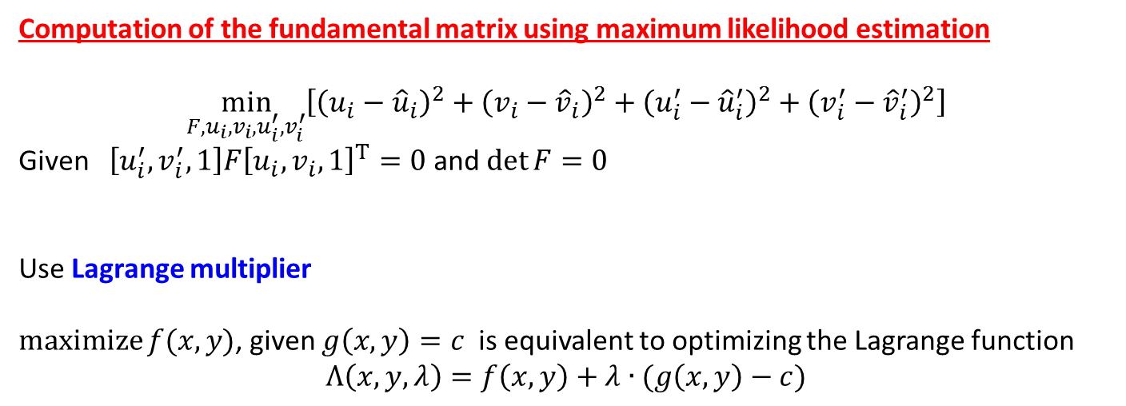
Computation of the fundamental matrix using maximum likelihood estimation
$$\min_{F,u_{i}, v_{i}, u_{i}^{′},v_{i}^{′}}\left[{\left(u_{i}−{\hat{u}}_{i}\right)}^{2}+{\left(v_{i}−{\hat{v}}_{i}\right)}^{2}+{\left(u_{i}^{′}−{\hat{u}}_{i}^{′}\right)}^{2}+{\left(v_{i}^{′}−{\hat{v}}_{i}^{′}\right)}^{2}\right]$$
Given $\left[u_{i}^{′},v_{i}^{′},1\right]F{\left[u_{i},v_{i}, 1\right]}^{T}=0$ and $\det{F}=0$
Use Lagrange multiplier
$\operatorname{maximize}{f(x,y)}$, given $g\left(x,y\right)=c$ is equivalent to optimizing the Lagrange function
$$Λ\left(x,y,λ\right)=f\left(x,y\right)+λ∙(g\left(x,y\right)−c)$$

