Slide 1
55:148 Digital Image Processing
Chapter 11
3D Vision, Geometry
Topics:
  Basics of projective geometry
    Points and hyperplanes in projective space
    Homography
    Estimating homography from point correspondence
  The single perspective camera
    An overview of single camera calibration
    Calibration of one camera from the known scene
  Two cameras, stereopsis
    The geometry of two cameras. The fundamental matrix
    Relative motion of the camera; the essential matrix
    Estimation of a fundamental matrix from image point correspondences
    Applications of the epipolar geometry in vision
  Three and more cameras
    Stereo correspondence algorithms

Slide 2
3D VISION INTRO
Overall Aim:
Marr 1982: From an image (or a series of images) of a scene, derive an accurate three-dimensional geometric description of the scene and quantitatively determine the properties in the scene.
Examples: http://www.2d3.com/
Major challenges
  Perspective projection : All points along a line radiating from the optical center are projected onto a single image point → loss of information → need for additional information to solve the inverse task, i.e., mapping each 2D image point into the 3D scene.
  3D geometry and intensity shading: A complex relation governed multiple variables.
  Mutual occlusion: Further complicates the vision task at conceptual level.
  Noise: Additional complexity to many algorithms reducing their sensitivity and accuracy.

Slide 3
3D VISION INTRO
Three major intertwined modules in a computer-based vision system
  Feature observability in images: Selection of task-relevant features in the original image data (e.g., points, lines, corners etc.)
  Representation: Choice of the models for the observed world (e.g., a triangulated 3D surface representation of the observed scene)
  Interpretation: Extraction of high level knowledge from the mathematical model of stored data (e.g., object detection/recognition, correspondence between two partially overlapping scenes etc.)

Slide 4
Three major building blocks/expertise in a computerized 3D vision system
  Computational theory: Combines analytic and geometric approaches with device-dependent properties to solve the inverse mapping from a 2D captured image to the 3D scene
      primal sketch → 2.5D → full 3D representation
  Representation and algorithms: 3D scene data representation and algorithms manipulating them and extracting knowledge (high level information) from 3D scene representation
  Implementation: Physical realization of the algorithms (programs + hardware)
Different vision paradigms
  Active versus passive vision
  Qualitative versus purposive vision

Slide 5
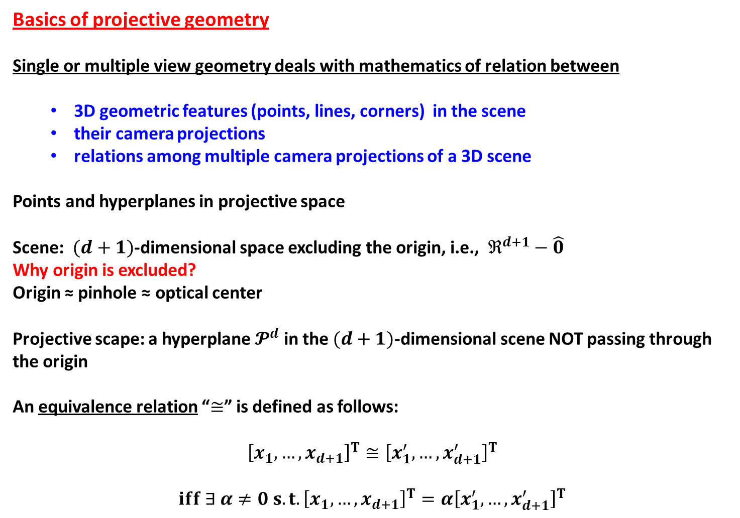
Basics of projective geometry
Single or multiple view geometry deals with mathematics of relation between
  3D geometric features (points, lines, corners) in the scene
  their camera projections
  relations among multiple camera projections of a 3D scene
Points and hyperplanes in projective space
Scene: $(d+1)$-dimensional space excluding the origin, i.e., $ℜ^{d+1}−\hat{0}$
Why origin is excluded?
Origin ≈ pinhole ≈ optical center
Projective scape: a hyperplane $𝓟^{d}$ in the $(d+1)$-dimensional scene NOT passing through the origin
An equivalence relation “$≅$” is defined as follows:
$${\left[x_{1}, …, x_{d+1}\right]}^{T}≅{\left[x_{1}^{′}, …,x_{d+1}^{′}\right]}^{T}$$
$$iff ∃ α≠0 s.t. {\left[x_{1}, …, x_{d+1}\right]}^{T}=α{\left[x_{1}^{′}, …,x_{d+1}^{′}\right]}^{T}$$

Slide 6
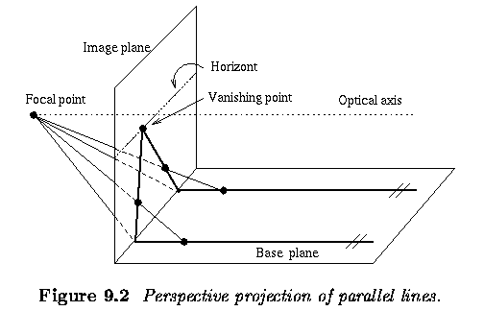
Perspective projection of parallel lines

Slide 7
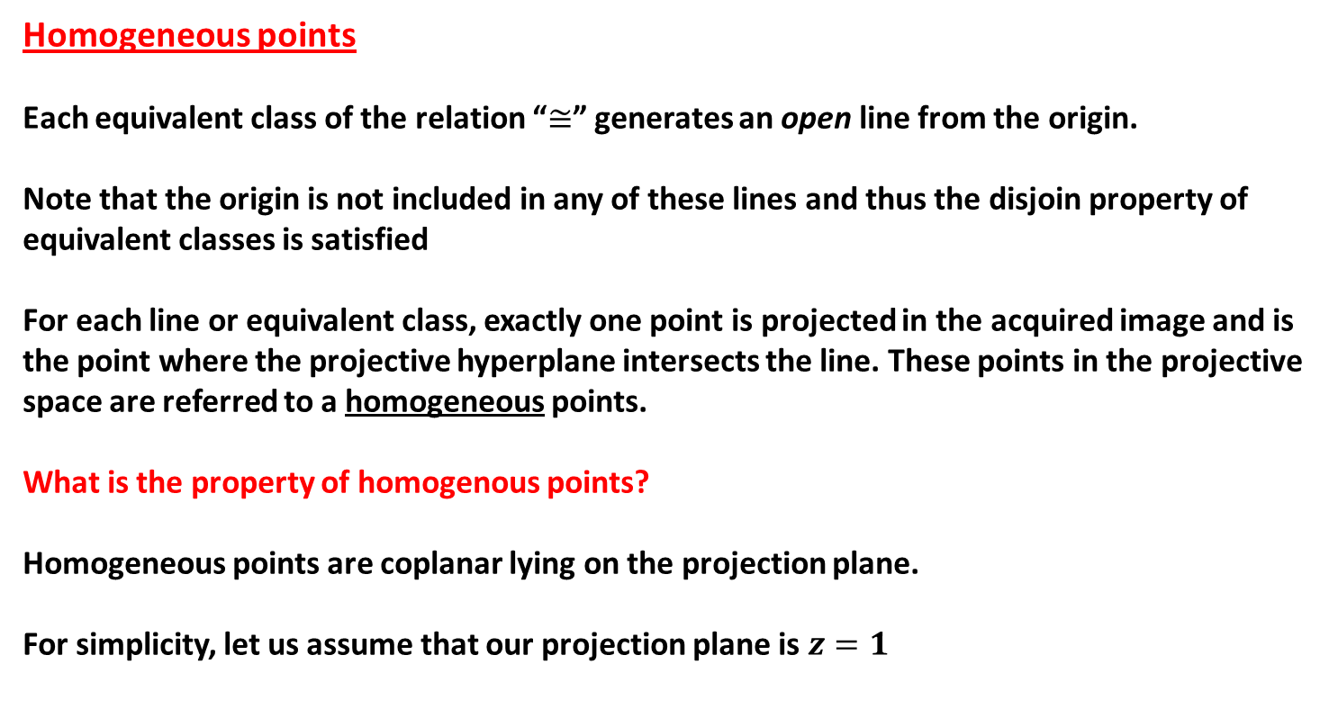
Homogeneous points
Each equivalent class of the relation “$≅$” generates an open line from the origin.
Note that the origin is not included in any of these lines and thus the disjoin property of equivalent classes is satisfied
For each line or equivalent class, exactly one point is projected in the acquired image and is the point where the projective hyperplane intersects the line. These points in the projective space are referred to a homogeneous points.
What is the property of homogenous points?
Homogeneous points are coplanar lying on the projection plane.
For simplicity, let us assume that our projection plane is $z=1$

Slide 8
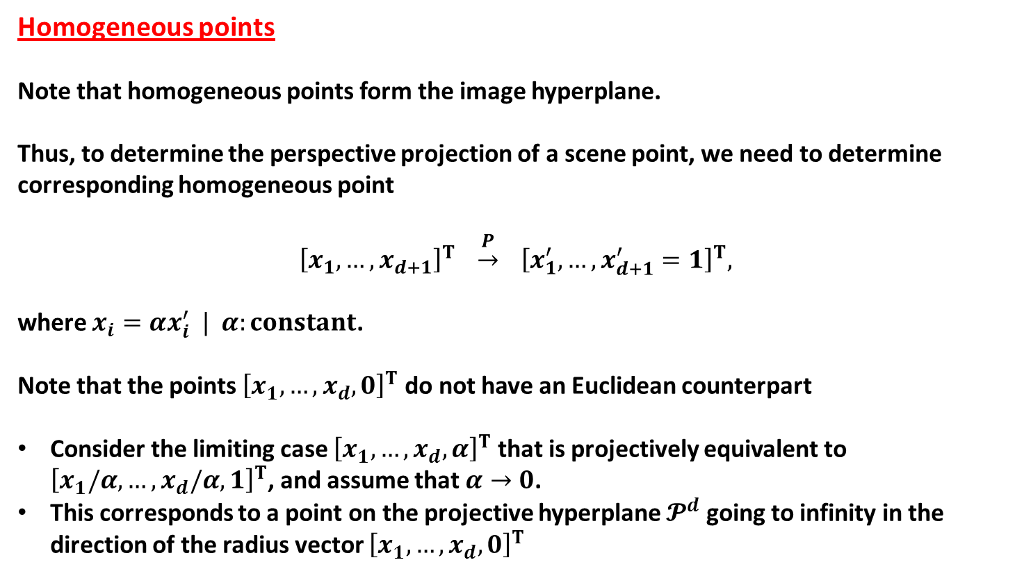
Homogeneous points
Note that homogeneous points form the image hyperplane.
Thus, to determine the perspective projection of a scene point, we need to determine corresponding homogeneous point
$${\left[x_{1}, …, x_{d+1}\right]}^{T} \underset{→}{P} {\left[x_{1}^{′}, …,x_{d+1}^{′}=1\right]}^{T},$$
where $x_{i}=αx_{i}^{′} | α:constant$.
Note that the points ${\left[x_{1}, …,x_{d},0\right]}^{T}$ do not have an Euclidean counterpart
Consider the limiting case ${\left[x_{1}, …,x_{d},α\right]}^{T}$ that is projectively equivalent to ${\left[x_{1}/α, …,x_{d}/α,1\right]}^{T}$, and assume that $α→0$.
This corresponds to a point on the projective hyperplane $𝓟^{d}$going to infinity in the direction of the radius vector ${\left[x_{1}, …,x_{d},0\right]}^{T}$

Slide 9
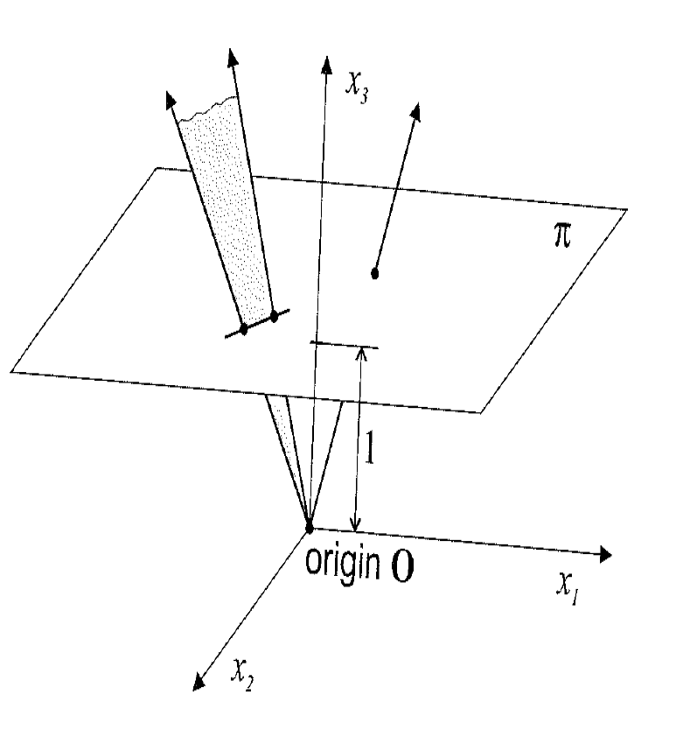
Properties of projection
A line in the scene space through (but not including) the origin is mapped onto a point in the projective plane
A plane in the scene space through the origin (but not including) is mapped to a line on the projection plane

Slide 10
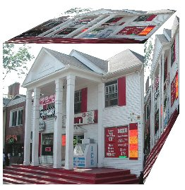
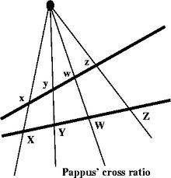
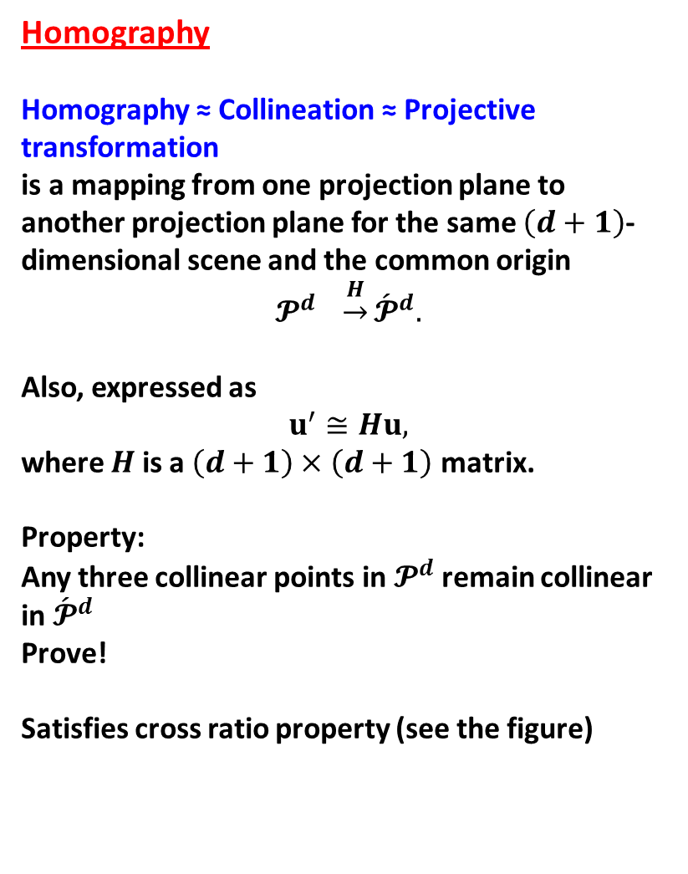
Homography
Homography ≈ Collineation ≈ Projective transformation
is a mapping from one projection plane to another projection plane for the same $\left(d+1\right)$-dimensional scene and the common origin
$$𝓟^{d} \underset{→}{H}{\acute{𝓟}}^{d}.$$
Also, expressed as
$$u^{′}≅Hu,$$
where $H$ is a $\left(d+1\right)×\left(d+1\right)$ matrix.
Property:
Any three collinear points in $𝓟^{d}$ remain collinear in ${\acute{𝓟}}^{d}$
Prove!
Satisfies cross ratio property (see the figure)

Slide 11
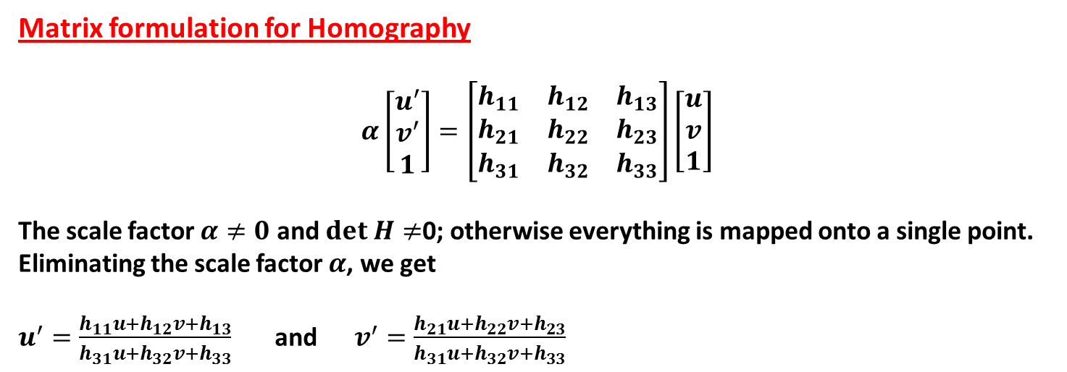
Matrix formulation for Homography
$$α\left[\begin{matrix}u^{′} \\ v^{′} \\ 1\end{matrix}\right]=\left[\begin{matrix}h_{11} & h_{12} & h_{13} \\ h_{21} & h_{22} & h_{23} \\ h_{31} & h_{32} & h_{33}\end{matrix}\right]\left[\begin{matrix}u \\ v \\ 1\end{matrix}\right]$$
The scale factor $α≠0$ and $det H≠$0; otherwise everything is mapped onto a single point.
Eliminating the scale factor $α$, we get
$u^{′}=\frac{h_{11}u+h_{12}v+h_{13}}{h_{31}u+h_{32}v+h_{33}}$ and $v^{′}=\frac{h_{21}u+h_{22}v+h_{23}}{h_{31}u+h_{32}v+h_{33}}$

Slide 12
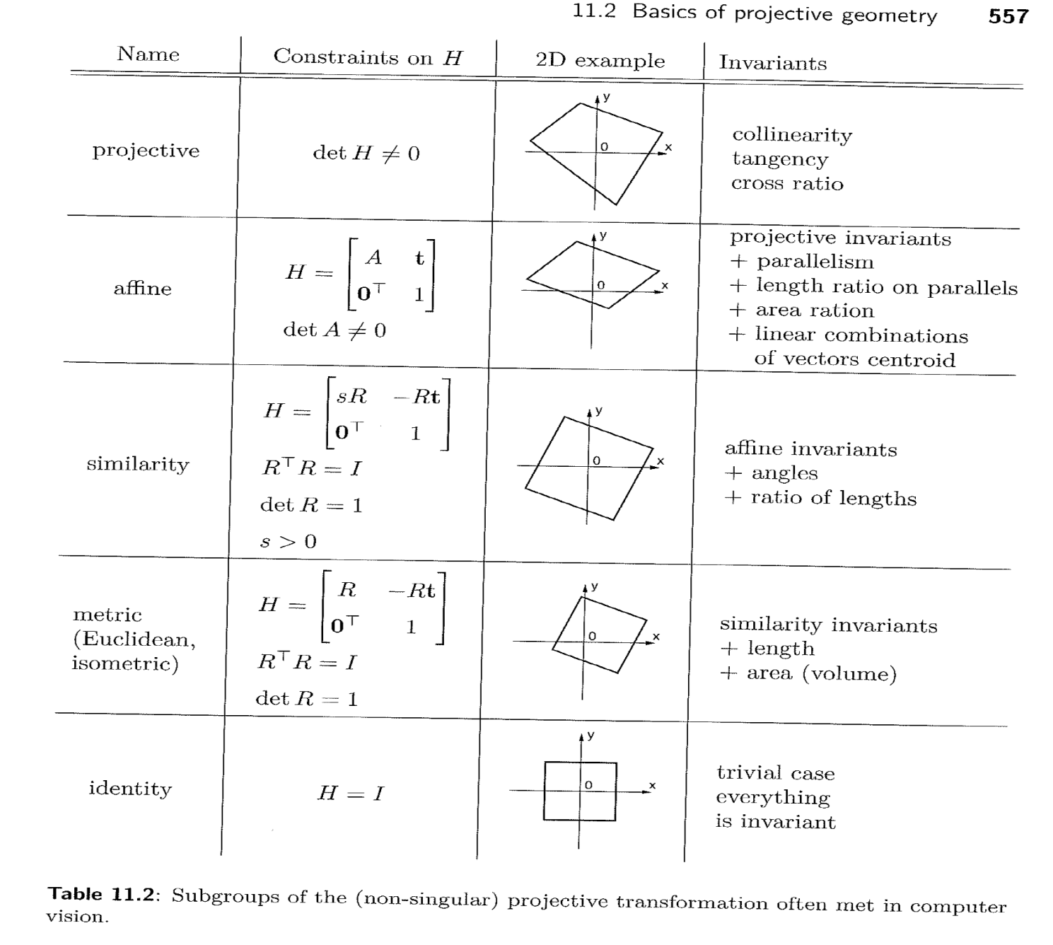
Various linear transformations

Slide 13

Sub groups of homographys
Any homography can be uniquely decomposed as
$$H=H_{P}H_{A}H_{S}$$
where
$H_{P}=\left[\begin{matrix}I & \hat{0} \\ a^{T} & b\end{matrix}\right]$, $H_{A}=\left[\begin{matrix}K & \hat{0} \\ {\hat{0}}^{T} & 1\end{matrix}\right]$, $H_{S}=\left[\begin{matrix}R & −Rt \\ {\hat{0}}^{T} & 1\end{matrix}\right]$

Slide 14
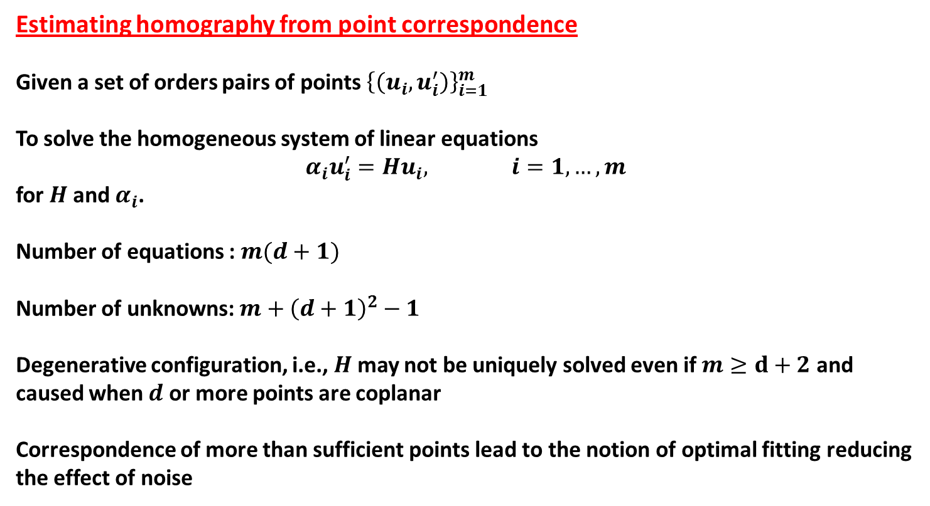
Estimating homography from point correspondence
Given a set of orders pairs of points ${\left\{\left(u_{i},u_{i}^{′}\right)\right\}}_{i=1}^{m}$
To solve the homogeneous system of linear equations
$$α_{i}u_{i}^{′}=Hu_{i}, i=1,…, m$$
for $H$ and $α_{i}$.
Number of equations : $m(d+1)$
Number of unknowns: $m+{\left(d+1\right)}^{2}−1$
Degenerative configuration, i.e., $H$ may not be uniquely solved even if $m≥d+2$ and caused when $d$ or more points are coplanar
Correspondence of more than sufficient points lead to the notion of optimal fitting reducing the effect of noise

Slide 15
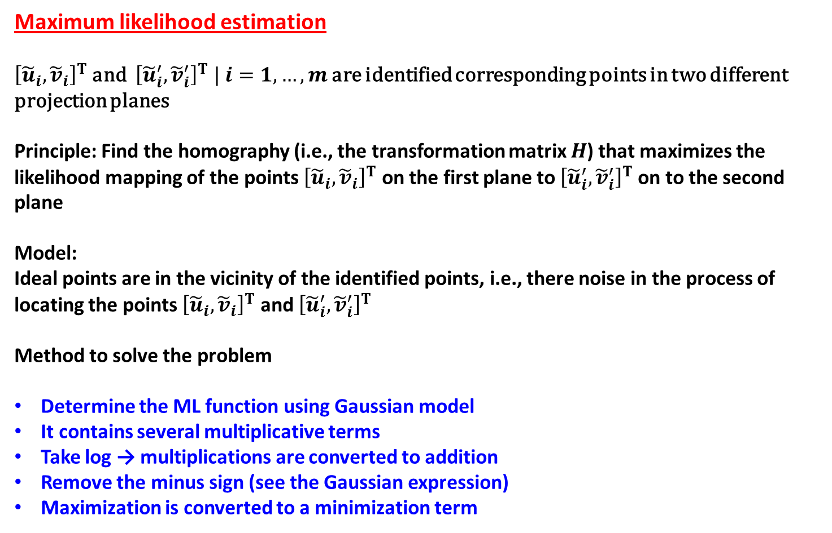
Maximum likelihood estimation
${\left[{\tilde{u}}_{i}, {\tilde{v}}_{i}\right]}^{T}$ and ${\left[{\tilde{u}}_{i}^{′},{\tilde{v}}_{i}^{′}\right]}^{T} | i=1,…,m$ are identified corresponding points in two different projection planes
Principle: Find the homography (i.e., the transformation matrix $H$) that maximizes the likelihood mapping of the points ${\left[{\tilde{u}}_{i}, {\tilde{v}}_{i}\right]}^{T}$ on the first plane to ${\left[{\tilde{u}}_{i}^{′},{\tilde{v}}_{i}^{′}\right]}^{T}$on to the second plane
Model:
Ideal points are in the vicinity of the identified points, i.e., there noise in the process of locating the points ${\left[{\tilde{u}}_{i}, {\tilde{v}}_{i}\right]}^{T}$ and ${\left[{\tilde{u}}_{i}^{′},{\tilde{v}}_{i}^{′}\right]}^{T}$
Method to solve the problem
Determine the ML function using Gaussian model
It contains several multiplicative terms
Take log → multiplications are converted to addition
Remove the minus sign (see the Gaussian expression)
Maximization is converted to a minimization term

Slide 16
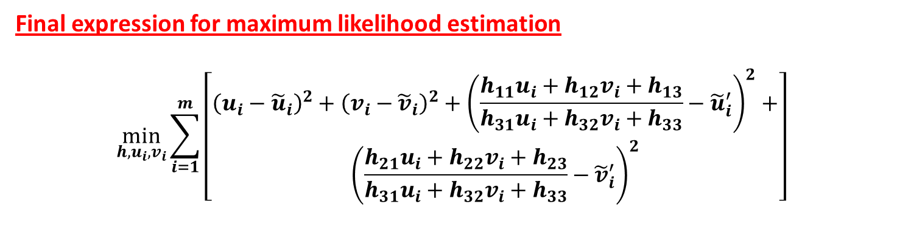
Final expression for maximum likelihood estimation
$$\min_{h,u_{i},v_{i}}{\sum_{i=1}^{m}{\left[\begin{aligned}{\left(u_{i}−{\tilde{u}}_{i}\right)}^{2}+{\left(v_{i}−{\tilde{v}}_{i}\right)}^{2}+{\left(\frac{h_{11}u_{i}+h_{12}v_{i}+h_{13}}{h_{31}u_{i}+h_{32}v_{i}+h_{33}}−{\tilde{u}}_{i}^{′}\right)}^{2}+ \\ {\left(\frac{h_{21}u_{i}+h_{22}v_{i}+h_{23}}{h_{31}u_{i}+h_{32}v_{i}+h_{33}}−{\tilde{v}}_{i}^{′}\right)}^{2}\end{aligned}\right]}}$$

