Slide 1
Course Syllabus
Color
Camera models, camera calibration
Advanced image pre-processing
Line detection
Corner detection
Maximally stable extremal regions
Mathematical Morphology
binary
gray-scale
skeletonization
granulometry
morphological segmentation
Scale in image processing
Wavelet theory in image processing
Image Compression
Texture
Image Registration
rigid
non-rigid
RANSAC

Slide 2
Thinning and thickening often used sequentially
Let $B=\left\{B_{(1)},B_{(2)},B_{(3)},…,B_{(n)}\right\}$ denote a sequence of composite structuring
elements $B_{(i)}=\left(B_{i_{1}},B_{i_{2}}\right)$
Sequential thinning – sequence of n structuring elements
$$X⊘B=\left(\left(\left(X⊘B_{\left(1\right)}\right){⊘B}_{\left(1\right)}\right)…{⊘B}_{(n)}\right)$$
several sequences of structuring elements $\left\{B_{\left(i\right)}\right\}$ are useful in practice
These sequences are called the Golay alphabet
composite structuring element – expressed by a single matrix
“one” means that this element belongs to B1 (it is a subset of objects in the
hit-or-miss transformation)
“zero” belongs to B2 and is a subset of the background
∗ ... element not used in matching process = its value is not significant
Thinning sequential transformations converge to some image — the number of iterations needed depends on the objects in the image and the structuring element used
if two successive images in the sequence are identical, the thinning (or thickening) is stopped

Slide 3
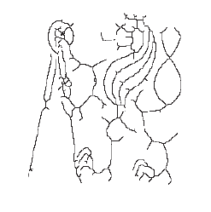
Sequential thinning by structuring element L
thinning by L serves as homotopic substitute of the skeleton;
final thinned image consists only of lines of width one and isolated points
structuring element L from the Golay alphabet is given by
$$L_{1}=\left[\begin{matrix}0 & 0 & 0 \\ d & 1 & d \\ 1 & 1 & 1\end{matrix}\right], L_{1}=\left[\begin{matrix}d & 0 & 0 \\ 1 & 1 & 0 \\ d & 1 & d\end{matrix}\right]$$
(The other six elements are given by rotation).
Original after 5 iteration final result

Slide 4
Sequential thinning by structuring element E
• structuring element E from the Golay alphabet is given by
$$E_{1}=\left[\begin{matrix}d & 1 & d \\ 0 & 1 & 0 \\ 0 & 0 & 0\end{matrix}\right], L_{1}=\left[\begin{matrix}0 & d & d \\ 0 & 1 & 0 \\ 0 & 0 & 0\end{matrix}\right]$$
Less jagged skeletons
Original skeleton

Slide 5
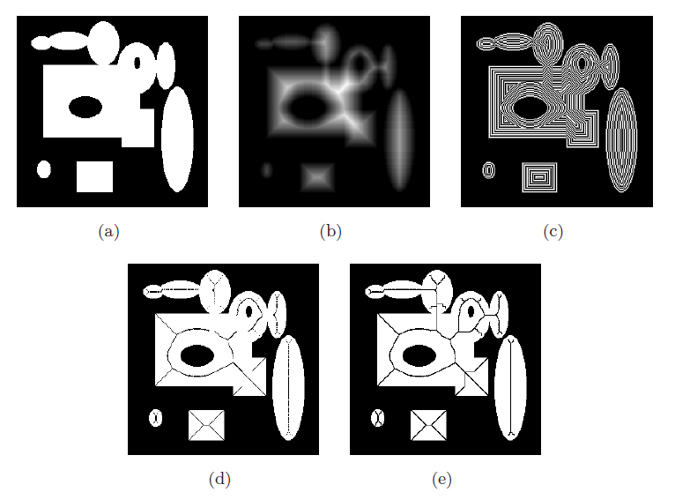

Slide 6
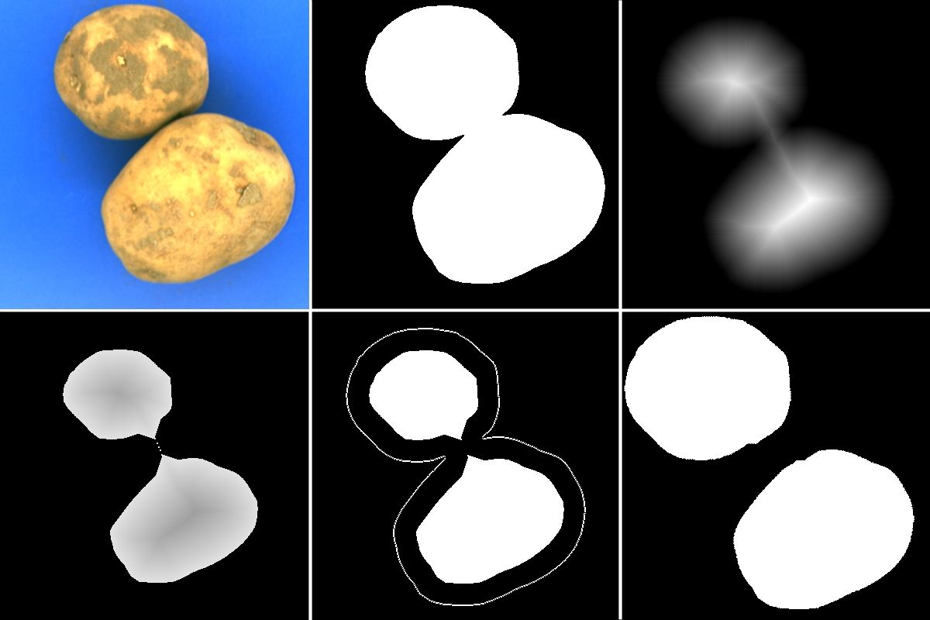
Distance Transform
Binary image: $\left(O,ℤ^{n}\right)$; $O$: set of object pixels/voxels (points)
Distance transform = an images or a function $DT: O⟶ℤ^{n}$ where $DT\left(p\right)$ is the distance between $p$ and the background $\overline{O}$
Distance transform is a measure of “local depth”
---------------------------------------------------------

Slide 7
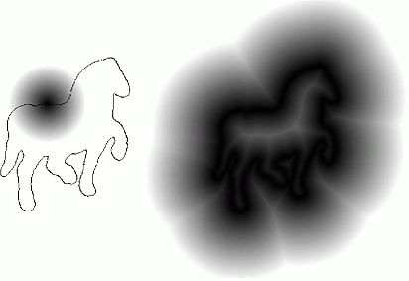
Distance Transform
Another example
---------------------------------------------------------

Slide 8
Distance Transform
Algorithm
---------------------------------------------------------
for all object points $p$
assign $\text{DT}\text{(}\text{p}\text{) = }\text{MAX}$;
for all background points $p$
assign $DT\left(p\right)=0$;
for iteration = 1 and 2
scan the image in slice⁺ row⁺ column⁺ direction and for each p do
if $DT(p)<\min_{\left.q∈N(p\right)}DT(q)+dist(p,q)$
assign $DT\left(p\right)=\min_{\left.q∈N(p\right)}DT(q)+dist(p,q)$
scan the image in slice⁻ row⁻ column⁻ direction and for each p do
if $DT(p)<\min_{\left.q∈N(p\right)}DT(q)+dist(p,q)$
assign $DT\left(p\right)=\min_{\left.q∈N(p\right)}DT(q)+dist(p,q)$

Slide 9
Axial line detection using Distance transform
a point $p$ is an axial point if there is no point $p^{′}$ such that a shortest path from $p^{′}$ to the boundary passes through $p$.
a point $p$ is an axial point if there is no point $q$ in the neighborhood of p such that
$DT\left(q\right)=DT\left(p\right)+\left|p−q\right|$

Slide 10
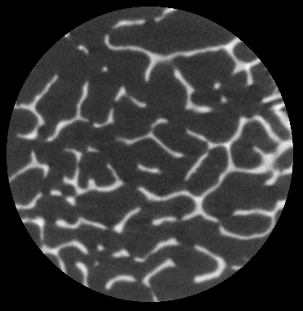
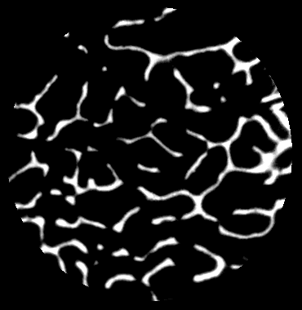
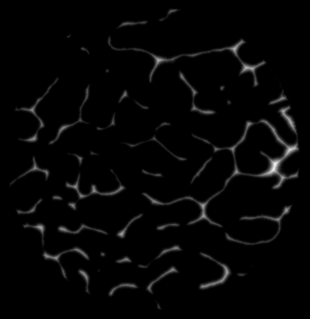
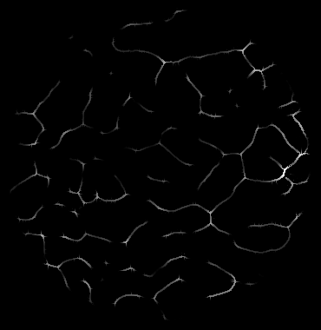
Axial line detection using Distance transform

Slide 11
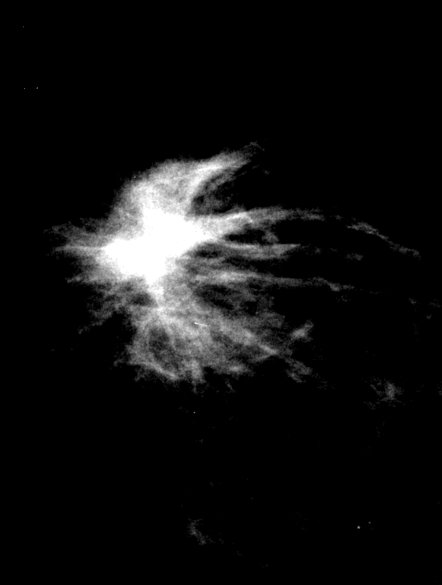
Axial line detection using Distance transform

Slide 12
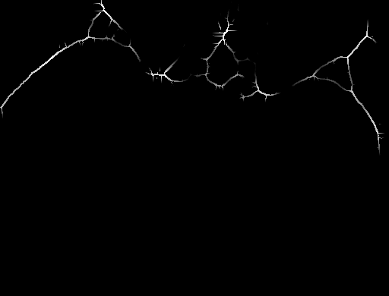
Axial line detection using Distance transform

Slide 13
Simple Points
A points (not necessarily an object point) in a 2D or 3D digital image is a simple point if and only it its binary transformation doesn’t change local image topology
2D simple point characterization is straight forward
A point that doesn’t match with any of the following windows or variations produced by their mirror reflection and/or rotation, is a 2D simple point in (8,4) connectivity
: object : background
: origin
: don’t care
, : At least one in each group is object

Slide 14
3D Simple Points
Included neighborhood
N(p) = set of all 26-adjacent points including p
Excluded neighborhood
N*(p)=N(p) – {p}
Theorem 1. N(p)  B is always a topological ball.
Therefore, p is a simple points if and only if N*(p) is a topological ball.

Slide 15
Local Topological Parameters
ξ(p): number of components in N*(p)  B
η(p): number of tunnels in N*(p)  B
δ(p): number of cavities in N*(p)  B

Slide 16
Cavities in excluded neighborhood
Theorem 2. δ(p) is one if and only if all the 6-neighbors of p are in B.

Slide 17
Tunnels in the excluded neighborhood
Key Observations
N*(p) is a digital topological sphere
All points in N*(p)  B lie on a digital topological sphere

Slide 18
The Continuous Case
If S_{R} –B_{R} is nonempty, the number of tunnels in B_{R} is one less than the number of components in S_{R} –B_{R} , and it is zero when S_{R} –B_{R} is empty.

Slide 19
The Digital Case
A path of N*(p) – B crosses a closed loop of N*(p) ∩ B
A pair of disconnected components of N*(p) – B contributes to a tunnel only when both are adjacent to the interior point p.

Slide 20
Tunnels in excluded neighborhood
X(p): the set of 6-neighbors of p in N*(p) – B
Y(p): the set of 18-neighbors of p in N*(p) – B
Theorem 3. If X(p) is non-empty, η(p) is one less than the number of marrow objects in the intersection of X(p) and Y(p), and η(p) is zero when X(p) is empty.

Slide 21
3D Simple Point Characterization
For any 3D digital image $\left(ℤ^{3},26,6,B\right)$, any point $p∈B$ is a simple point if and only if it satisfies all the four conditions
$ξ\left(p\right)=0$,
$η\left(p\right)=0$
$δ\left(p\right)=0$

Slide 22
3D Simple Point Characterization
For any 3D digital image $\left(ℤ^{3},26,6,B\right)$, any point p ∈ B is a simple point if and only if it satisfies all the four conditions
N*(p)  B is non-empty,
N*(p)  B is 26-connected,
X(p) is non-empty, and
X(p) is 6-connected in Y(p).
X(p): the set of 6-neighbors of p in N*(p) – B
Y(p): the set of 18-neighbors of p in N*(p) – B

