Slide 1
Course Syllabus
Color
Camera models, camera calibration
Advanced image pre-processing
  Line detection
  Corner detection
  Maximally stable extremal regions
Mathematical Morphology
  binary
  gray-scale
  skeletonization
  granulometry
  morphological segmentation
  Scale in image processing
Wavelet theory in image processing
Image Compression
Texture
Image Registration
  rigid
  non-rigid
  RANSAC

Slide 2
Homotopy
  Homotopic tree in 2D
  Challenges in 3D
Sketonization and maximal ball
  Maximal balls
  Skeleton
  Basis relation between maximal ball and skeleton
  Mathematical formulation
  Challenges
Morphological solution to homotopic skeletonization
  Role of his and miss
  Thinning, Thickening, and Duality
  Iterative thinning: structuring element
Distance transform and thinning
  Axial line detection using DT
  Simple point
  Thinning Algorithm

Slide 3



Quiz
Object = black
original
?
?

Slide 4
13.5 Skeletons and object marking
13.5.1 Homotopic transformations
transformation is homotopic if it does not change the continuity relation between regions and holes in the image.
this relation is expressed by homotopic tree
  its root ... image background
  first-level branches ... objects (regions)
  second-level branches ... holes
  etc.
transformation is homotopic if it does not change homotopic tree

Slide 5
Homotopic Tree

Slide 6
Homotopic Tree

Slide 7
Homotopic Tree
r₁
r₂
h₂
h₁
b
r₁
r₂
h₂
h₁

Slide 8
Quitz: Homotopic Transformation
What is the relation between an element in the ith and i+1th levels?

Slide 9
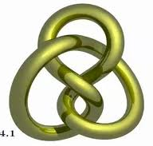
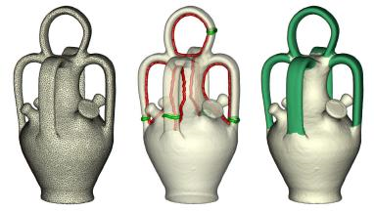
More challenges in 3D
Lot more challenges in 3D
Homotopic tree is not feasible

Slide 10
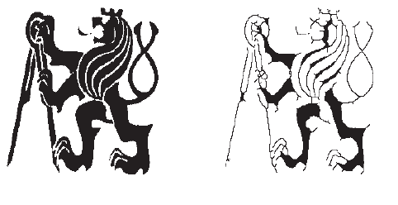
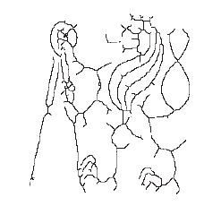
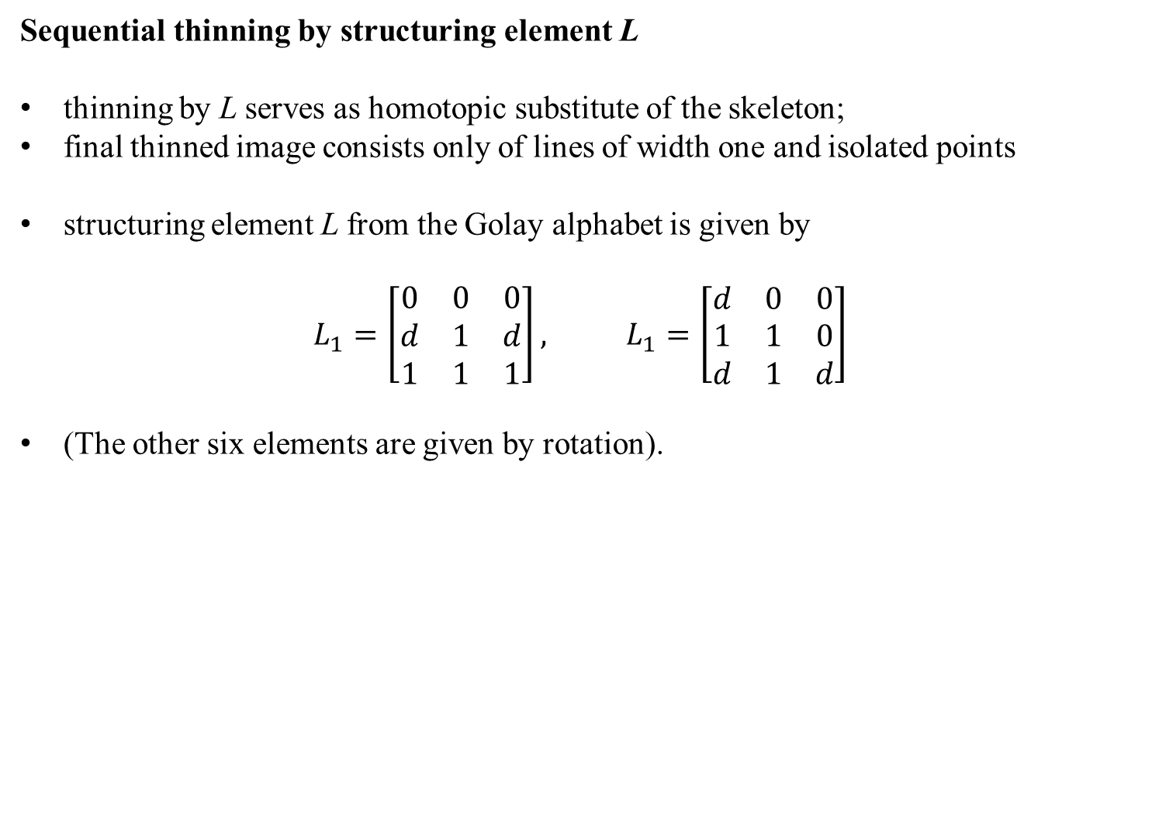
Sequential thinning by structuring element L
thinning by L serves as homotopic substitute of the skeleton;
final thinned image consists only of lines of width one and isolated points
structuring element L from the Golay alphabet is given by
$$L_{1}=\left[\begin{matrix}0 & 0 & 0 \\ d & 1 & d \\ 1 & 1 & 1\end{matrix}\right], L_{1}=\left[\begin{matrix}d & 0 & 0 \\ 1 & 1 & 0 \\ d & 1 & d\end{matrix}\right]$$
(The other six elements are given by rotation).
Original after 5 iteration final result

Slide 11
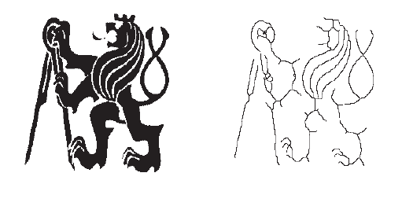

Sequential thinning by structuring element E
• structuring element E from the Golay alphabet is given by
$$E_{1}=\left[\begin{matrix}d & 1 & d \\ 0 & 1 & 0 \\ 0 & 0 & 0\end{matrix}\right], L_{1}=\left[\begin{matrix}0 & d & d \\ 0 & 1 & 0 \\ 0 & 0 & 0\end{matrix}\right]$$
Less jagged skeletons
Original skeleton

Slide 12
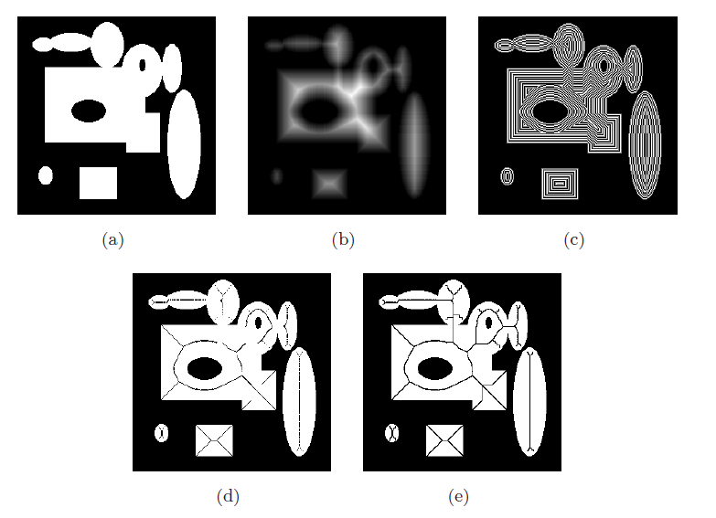

Slide 13
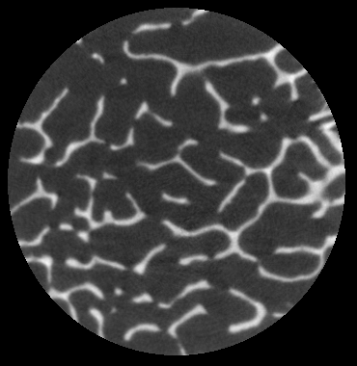
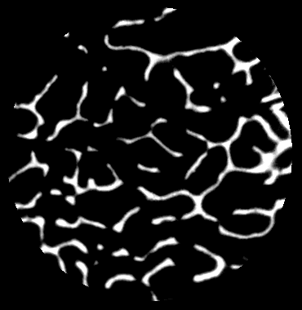
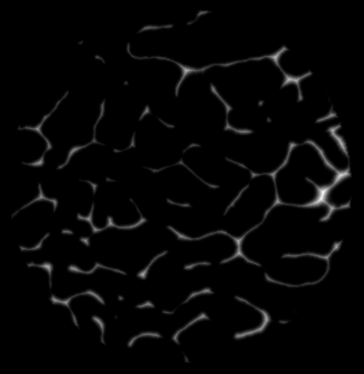
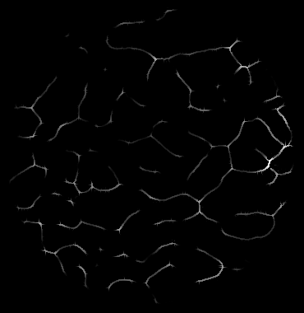
Axial line detection using Distance transform

Slide 14
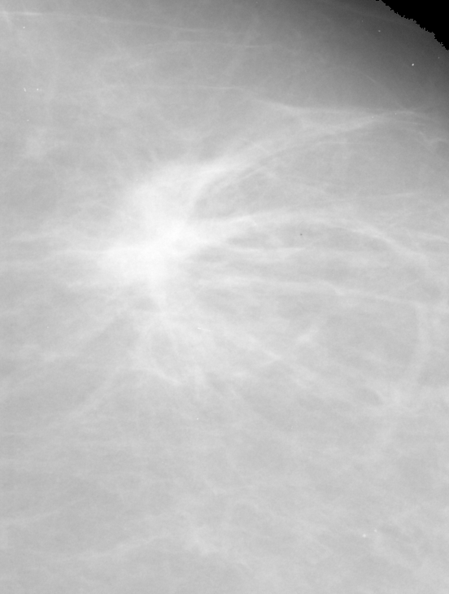
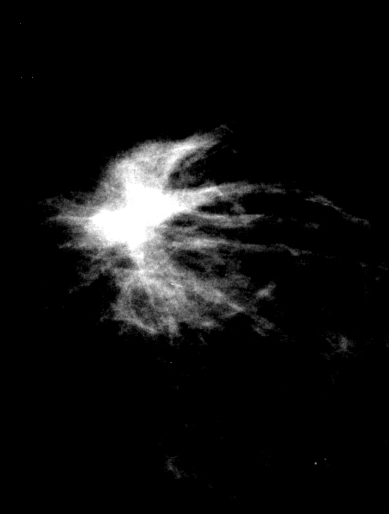
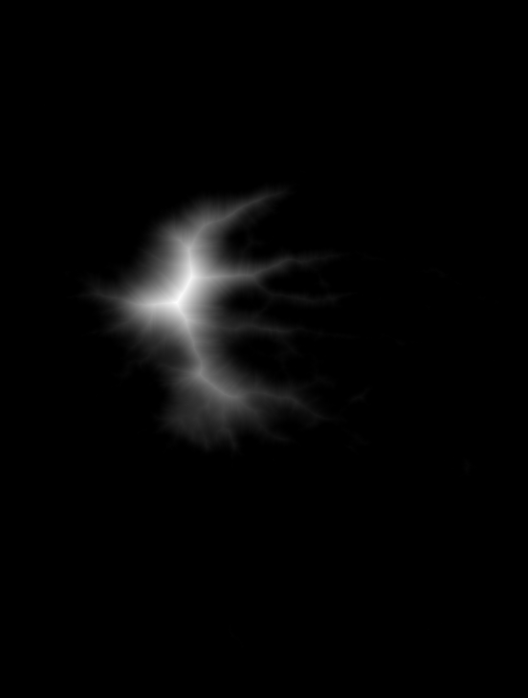
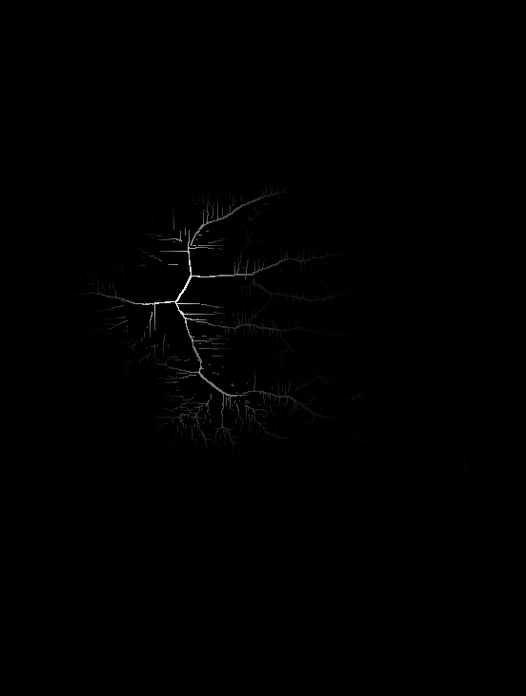
Axial line detection using Distance transform

Slide 15
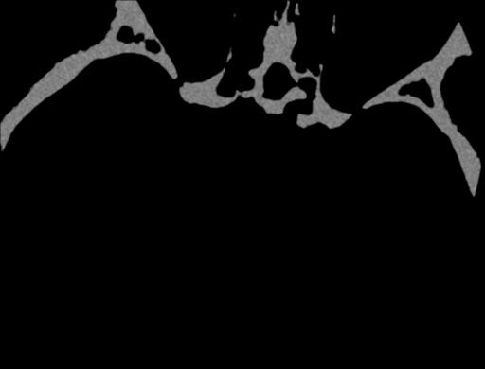
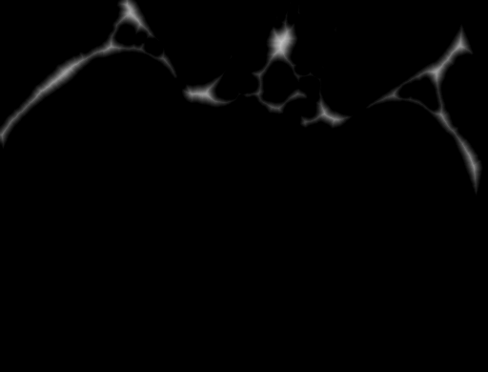
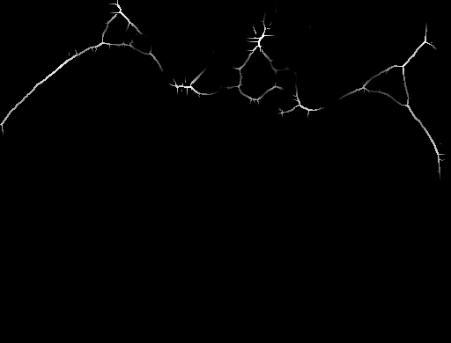
Axial line detection using Distance transform

