Slide 1
Course Syllabus
Color
Camera models, camera calibration
Advanced image pre-processing
  Line detection
  Corner detection
  Maximally stable extremal regions
Mathematical Morphology
  binary
  gray-scale
  skeletonization
  granulometry
  morphological segmentation
  Scale in image processing
Wavelet theory in image processing
Image Compression
Texture
Image Registration
  rigid
  non-rigid
  RANSAC

Slide 2
References
Books:
  Chapter 11, Image Processing, Analysis, and Machine Vision, Sonka et al
  Chapter 9, Digital Image Processing, Gonzalez & Woods

Slide 3
Topics
Basic Morphological concepts
Binary Morphological operations
  Dilation & erosion
  Hit-or-miss transformation
  Opening & closing
Gray scale morphological operations
Some basic morphological operations
  Boundary extraction
  Region filling
  Extraction of connected component
  Convex hull
Skeletonization
Granularity
Morphological segmentation and watersheds

Slide 4
Introduction
Morphological operators often take a binary image and a structuring element as input and combine them using a set operator (intersection, union, inclusion, complement).
The structuring element is shifted over the image and at each pixel of the image its elements are compared with the set of the underlying pixels.
If the two sets of elements match the condition defined by the set operator (e.g. if set of pixels in the structuring element is a subset of the underlying image pixels), the pixel underneath the origin of the structuring element is set to a pre-defined value (0 or 1 for binary images).
A morphological operator is therefore defined by its structuring element and the applied set operator.
Image pre-processing (noise filtering, shape simplification)
Enhancing object structures (skeletonization, thinning, convex hull, object marking)
Segmentation of the object from background
Quantitative descriptors of objects (area, perimeter, projection, Euler-Poincaré characteristics)
binary image
structuring element

Slide 5
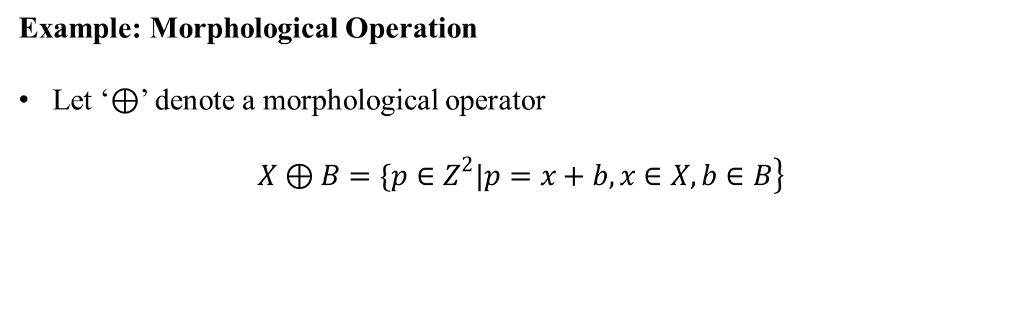
Example: Morphological Operation
Let ‘$⊕$’ denote a morphological operator
$$\left.X⊕B=\{p∈Z^{2}|p=x+b,x∈X,b∈B\right\}$$

Slide 6

Dilation
Morphological dilation ‘$⊕$’ combines two sets using vector of set elements
$$\left.X⊕B=\{p∈Z^{2}|p=x+b,x∈X,b∈B\right\}$$
Commutative: $X⊕B=B⊕X$
Associative: $X⊕\left(B⊕D\right)=\left(X⊕B\right)⊕D$
Invariant of translation: $X_{h}⊕B={\left(X⊕B\right)}_{h}$
$$\text{If} X⊆Y \text{then} X⊕B⊆Y⊕B$$

Slide 7
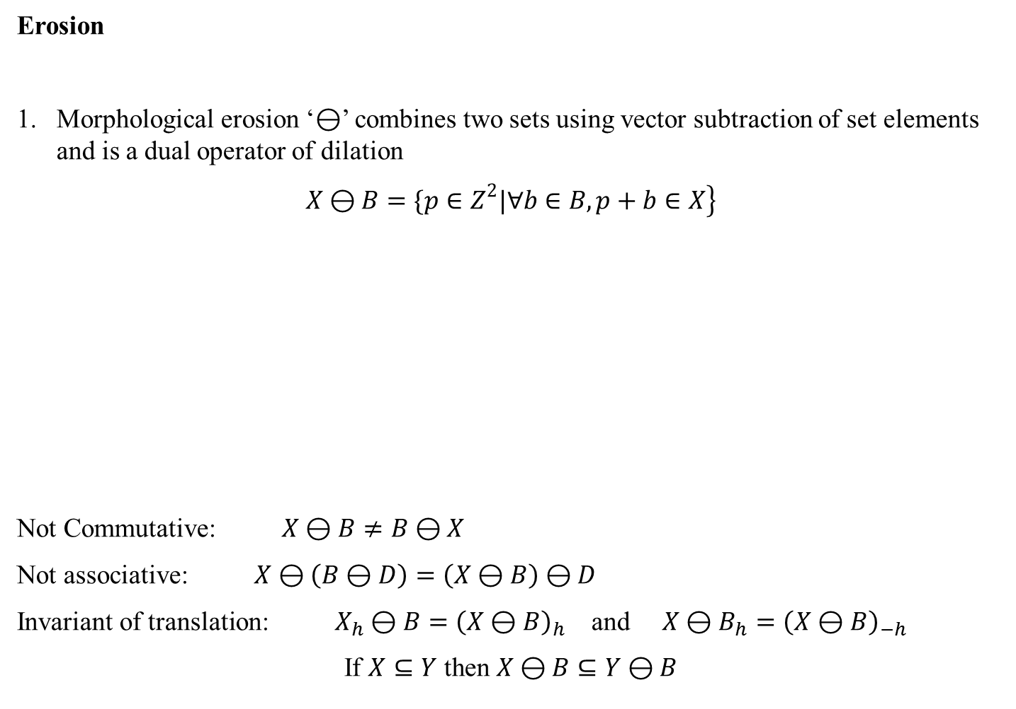
Erosion
Morphological erosion ‘$⊖$’ combines two sets using vector subtraction of set elements and is a dual operator of dilation
$$\left.X⊖B=\{p∈Z^{2}|∀b∈B,p+b∈X\right\}$$
Not Commutative: $X⊖B≠B⊖X$
Not associative: $X⊖\left(B⊖D\right)=\left(X⊖B\right)⊖D$
Invariant of translation: $X_{h}⊖B={\left(X⊖B\right)}_{h}$ and $X⊖B_{h}={\left(X⊖B\right)}_{−h}$
$$\text{If} X⊆Y \text{then} X⊖B⊆Y⊖B$$

Slide 8

Duality: Dilation and Erosion
Transpose Ă of a structuring element A is defined as follows
$$\left.\check{A}=\{−a|a∈A\right\}$$
Duality between morphological dilation and erosion operators
$${\left(X⊖B\right)}^{c}=X^{c}⊕\check{B}$$

Slide 9
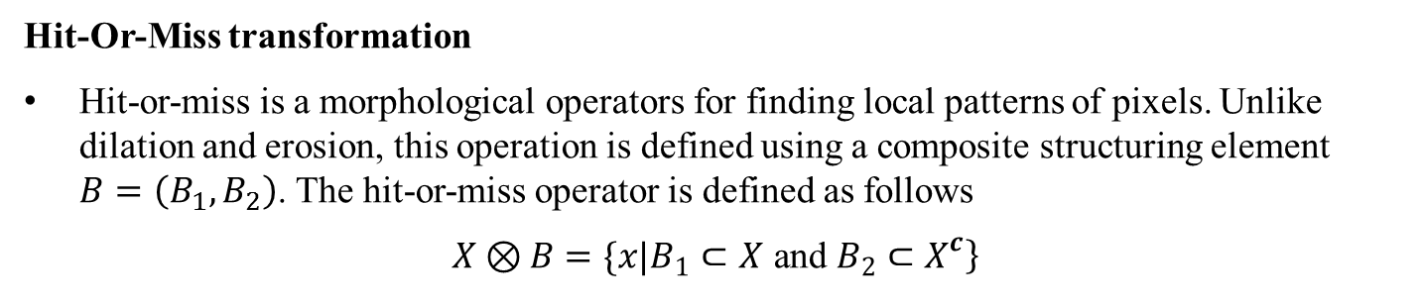
Hit-Or-Miss transformation
Hit-or-miss is a morphological operators for finding local patterns of pixels. Unlike dilation and erosion, this operation is defined using a composite structuring element $B=\left(B_{1},B_{2}\right)$. The hit-or-miss operator is defined as follows
$$\left.X⊗B=\{x|B_{1}⊂X \text{and} B_{2}⊂X^{c}\right\}$$

Slide 10

Hit-Or-Miss transformation: another example
Relation with erosion:
$$X⊗B=\left(X⊖B_{1}\right)∩\left(X^{c}⊖B_{2}\right)$$

Slide 11
Hit-Or-Miss transformation: yet another example

Slide 12
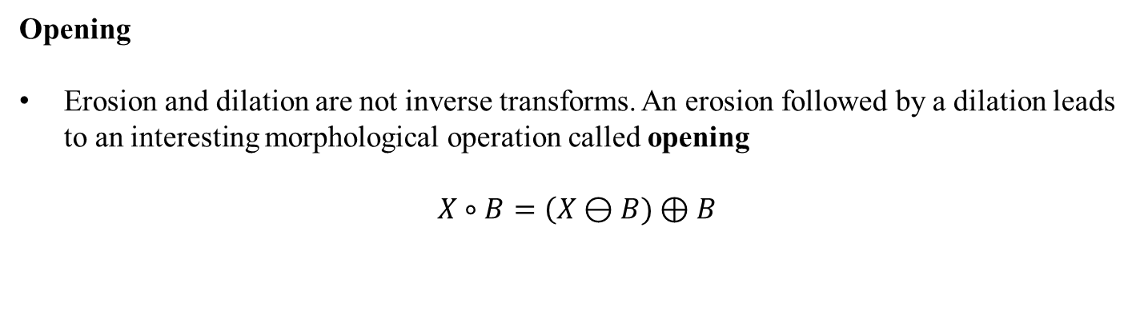
Opening
Erosion and dilation are not inverse transforms. An erosion followed by a dilation leads to an interesting morphological operation called opening
$$X∘B=\left(X⊖B)⊕B\right.$$

Slide 13
Opening
Erosion and dilation are not inverse transforms. An erosion followed by a dilation leads to an interesting morphological operation called opening
$$X∘B=\left(X⊖B)⊕B\right.$$

Slide 14
Opening
Erosion and dilation are not inverse transforms. An erosion followed by a dilation leads to an interesting morphological operation called opening
$$X∘B=\left(X⊖B)⊕B\right.$$

Slide 15
Opening
Erosion and dilation are not inverse transforms. An erosion followed by a dilation leads to an interesting morphological operation called opening
$$X∘B=\left(X⊖B)⊕B\right.$$

Slide 16
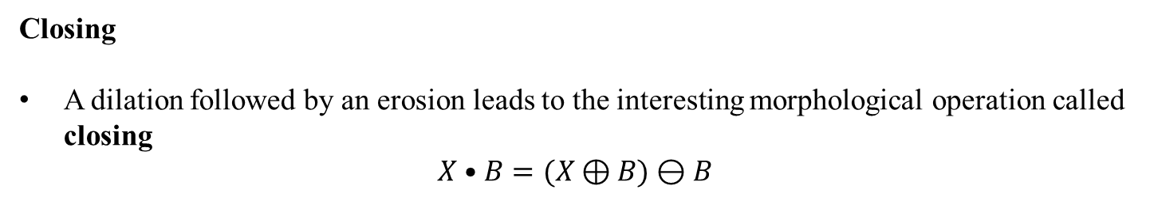
Closing
A dilation followed by an erosion leads to the interesting morphological operation called closing
$$X•B=(X⊕B)⊖B$$

Slide 17
Closing
A dilation followed by an erosion leads to the interesting morphological operation called closing
$$X•B=(X⊕B)⊖B$$

Slide 18
Closing
A dilation followed by an erosion leads to the interesting morphological operation called closing
$$X•B=(X⊕B)⊖B$$

Slide 19
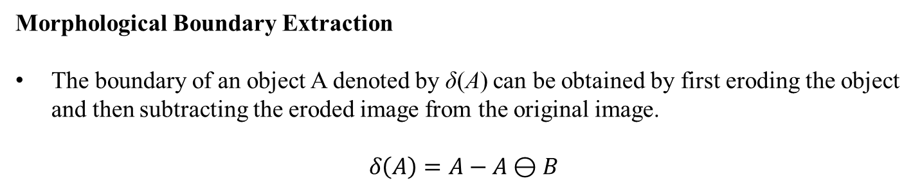
Morphological Boundary Extraction
The boundary of an object A denoted by δ(A) can be obtained by first eroding the object and then subtracting the eroded image from the original image.
$$δ\left(A\right)=A−A⊖B$$

Slide 20
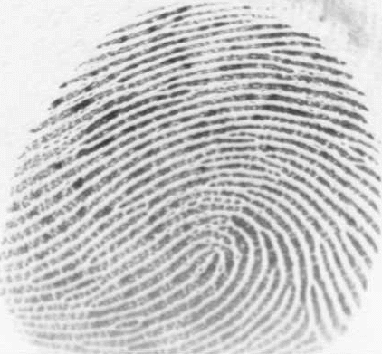
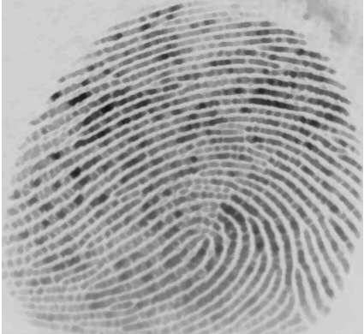
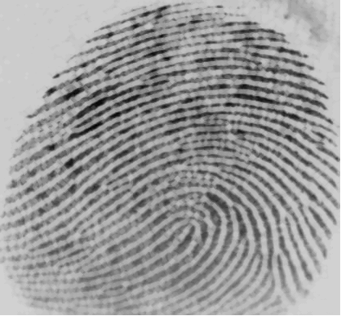
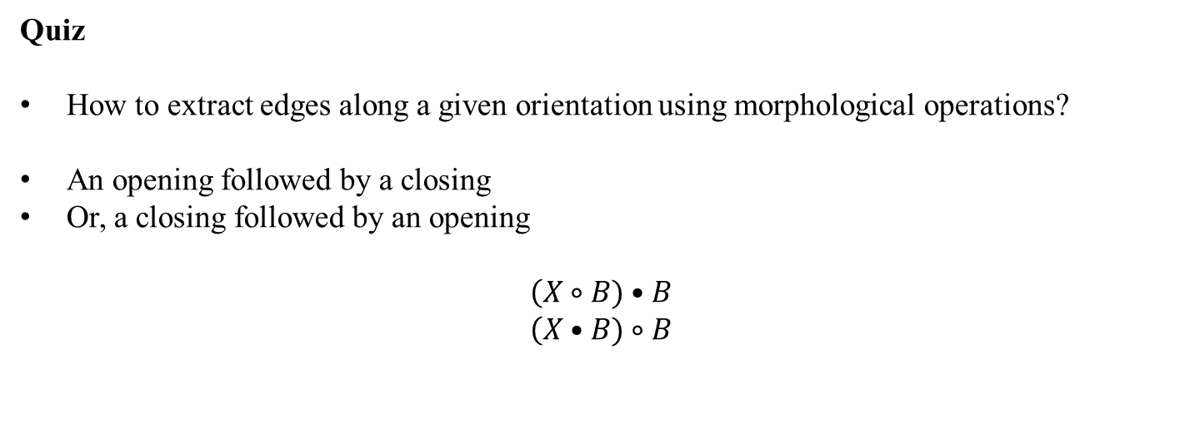
Quiz
How to extract edges along a given orientation using morphological operations?
An opening followed by a closing
Or, a closing followed by an opening
$$\left(X∘B)•B\right.$$
$$\left(X•B)∘B\right.$$

Slide 21
Gray Scale Morphological Operation
top surface T[A]
Set A
Support F

Slide 22
Gray Scale Morphological Operation
A: a subset of n-dimensional Euclidean space, A ⊂ R^{n}
F: support of A
Top hat or surface
A top surface is essentially a gray scale image f : F → R
An umbra U(f) of a gray scale image f : F → R is the whole subspace below the top surface representing the gray scale image f. Thus,

Slide 23
Gray Scale Morphological Operation
top surface T[A]
umbra
Support F

Slide 24
Gray Scale Morphological Operation
top surface T[A]

Slide 25
Gray Scale Morphological Operation
The gray scale dilation between two functions may be defined as the top surface of the dilation of their umbras
More computation-friendly definitions
Commonly, we consider the structure element k as a binary set. Then the definitions of gray-scale morphological operations simplifies to

Slide 26
Morphological Boundary Extraction
The boundary of an object A denoted by δ(A) can be obtained by first eroding the object and then subtracting the eroded image from the original image.

Slide 27
Quiz
How to extract edges along a given orientation using morphological operations?

Slide 28
Morphological noise filtering
An opening followed by a closing
Or, a closing followed by an opening

Slide 29
Morphological noise filtering
MATLAB DEMO

Slide 30
Morphological Region Filling
Task: Given a binary image X and a (seed) point p, fill the region surrounded by the pixels of X and contains p.
A: An image where only the boundary pixels are labeled 1 and others are labeled 0
A^{c}: The Complement of A
We start with an image X₀ where only the seed point p is 1 and others are 0. Then we repeat the following steps until it converges

Slide 31
Morphological Region Filling
A
A^{c}

Slide 32
Morphological Region Filling
The boundary of an object A denoted by δ(A) can be obtained by first eroding the object and then subtracting the eroded image from the original image.
A

Slide 33
Morphological Region Filling

Slide 34
Morphological Region Filling

Slide 35
Homotopic Transformation
Homotopic tree
r1
r2
h2
h1

Slide 36
Quitz: Homotopic Transformation
What is the relation between an element in the ith and i+1th levels?

Slide 37
Skeletonization
Skeleton by maximal balls: locii of the centers of maximal balls completely included by the object

Slide 38
Skeletonization
Matlab Demo
HW: Write an algorithm using morphologic operators to retrieve back the portions of the GOOD curves lost during pruning

Slide 39
Skeletonization and Pruning
Skeletonization preserves both
  End points
  Topology
Pruning preserves only
  Topology
after skeletonization
after pruning
after retrieval

Slide 40
Quench function
Every location p on the skeleton S(X) of a shape X has an associated radius q_{X}(p) of maximal ball; this function is termed as quench function
The set X is recoverable from its skeleton and its quench function

Slide 41
Ultimate Erosion
The ultimate erosion of a set X, denoted by Ult(X), is the set of regional maxima of the quench functions
Morphological reconstruction: Assume two sets A, B such that B ⊂ A. The reconstruction σ_{A}(B) of the set A is the unions of all connected components of A with nonempty intersection with B.
B
A

Slide 42
Ultimate Erosion
The ultimate erosion of a set X, denoted by Ult(X), is the set of regional maxima of the quench functions
Morphological reconstruction: Assume two sets A, B such that B ⊂ A. The reconstruction σ_{A}(B) of the set A is the unions of all connected components of A with nonempty intersection with B.

Slide 43
Convex Hull
A set A is said to be convex if the straight line joining any two points within A lies in A.
Q: Is an empty set convex?
Q: What ar4e the topological properties of a convex set?
A convex hull H of a set X is the minimum convex set containing X.
The set difference H – X is called the convex deficiency of X.

Slide 46
Geodesic Morphological Operations
The geodesic distance D_{X}(x,y) between two points x and y w.r.t. a set X is the length of the shortest path between x and y that entirely lies within X.
??

Slide 47
Geodesic Balls
The geodesic ball B_{X}(p,n) of center p and radius n w.r.t. a set X is a ball constrained by X.

Slide 48
Geodesic Operations
The geodesic dilation δ_{X}^{(n)}(Y) of the set Y by a geodesic ball of radius n w.r.t. a set X is :
The geodesic erosion ε_{X}^{(n)}(Y) of the set Y by a geodesic ball of radius n w.r.t. a set X is :

Slide 49
An example
What happens if we apply geodesic erosion on X – {p} where p is a point in X?

Slide 50
Implementation Issue
An efficient solution: select a ball of radius ‘1’ and then define

Slide 51
Morphological Reconstruction
Assume that we want to reconstruct objects of a given shape from a binary image that was originally obtained by thresholding. All connected components in the input image constitute the set X. However, we are interested only a few connected components marked by a marker set Y.

Slide 52
How?
Successive geodesic dilations of the set Y inside the bigger set X leads to the reconstruction of connected components of X marked by Y.
The geodesic dilation terminates when all connected components of X marked by Y are filled, i.e., an idempotency is reached :
This operation is called reconstruction and is denoted by ρ_{X}(Y).

Slide 53
Geodesic Influence Zone
Let Y, Y₁, Y₂, ..Y_{m} denote m marker sets on a bigger set X such that each of Y and Y_{i}s is a subset of X.

Slide 54
Reconstruction to Gray-Scale Images
This requires the extension of geodesy to gray-scale images.
Any increasing transformation defined for binary images can be extended to gray-level images
A gray level image I is viewed as a stack of binary images obtained by successive thresholding – this process is called threshold decomposition
Threshold decomposition principle

Slide 55
Reconstruction to Gray-Scale Images
Returning to the reconstruction transformation, binary geodesic reconstruction ρ is an increasing transformation
Gray-scale reconstruction: Let J, I be two gray-scale images both over the domain D such that J ⊂ I, the gray-scale reconstruction ρ_{I}(J) of the image I from J is defined as

Slide 56
Reconstruction to Gray-Scale Images

