Slide 1
Course Syllabus
Color
Camera models, camera calibration
Advanced image pre-processing
Line detection
Corner detection
Maximally stable extremal regions
Mathematical Morphology
binary
gray-scale
skeletonization
granulometry
morphological segmentation
Scale in image processing
Wavelet theory in image processing
Image Compression
Texture
Image Registration
rigid
non-rigid
RANSAC

Slide 2
References
Book: Chapter 5, Image Processing, Analysis, and Machine Vision, Sonka et al, latest edition (you may collect a copy of the relevant chapters from my office)
Papers:
Harris and Stephens, 4th Alvey Vision Conference, 147-151, 1988.
Matas et al, Image Vision Geometry, 22:761-767, 2004

Slide 3
Topics
Line detection
Interest points
Corner Detection
Moravec detector
Facet model
Harris corner detection
Maximally stable extremal regions

Slide 4
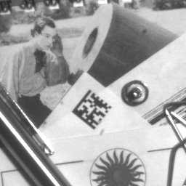
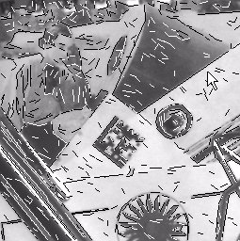
Line detection
Useful in remote sensing, document processing etc.
Edges:
boundaries between regions with relatively distinct gray-levels
the most common type of discontinuity in an image

Slide 5
Line detection
Useful in remote sensing, document processing etc.
Edges:
boundaries between regions with relatively distinct gray-levels
the most common type of discontinuity in an image
Lines:
instances of thin lines in an image occur frequently enough
it is useful to have a separate mechanism for detecting them.

Slide 6
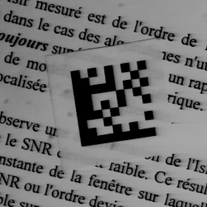
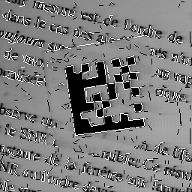
Line detection: How?
Possible approaches: Hough transform

Slide 7
Line detection: How?
Possible approaches: Hough transform (more global analysis and may not be considered as a local pre-processing technique)

Slide 8
Line detection: How?
Possible approaches: Hough transform (more global analysis and may not be considered as a local pre-processing technique)
Convolve with line detection kernels
$$L_{h}=\left[\begin{matrix}−1 & −1 & −1 \\ 2 & 2 & 2 \\ −1 & −1 & −1\end{matrix}\right]$$
$$L_{v}=\left[\begin{matrix}−1 & 2 & −1 \\ −1 & 2 & −1 \\ −1 & 2 & −1\end{matrix}\right]$$

Slide 9
Line detection: How?
Possible approaches: Hough transform (more global analysis and may not be considered as a local pre-processing technique)
Convolve with line detection kernels
$$L_{h}=\left[\begin{matrix}−1 & −1 & −1 \\ 2 & 2 & 2 \\ −1 & −1 & −1\end{matrix}\right]$$
$$L_{v}=\left[\begin{matrix}−1 & 2 & −1 \\ −1 & 2 & −1 \\ −1 & 2 & −1\end{matrix}\right]$$
$$L_{o}=\left[\begin{matrix}2 & −1 & −1 \\ −1 & 2 & −1 \\ −1 & −1 & 2\end{matrix}\right]$$
How to detection lines along other directions?

Slide 10
Lines and corner for correspondence
Interest points for solving correspondence problems in time series data.
Corners are better than lines in solving the above

Slide 11
Lines and corner for correspondence
Interest points for solving correspondence problems in time series data.
Corners are better than lines in solving the above
Consider that we want to solve point matching in two images
?

Slide 12
Lines and corner for correspondence
Interest points for solving correspondence problems in time series data.
Corners are better than lines in solving the above
Consider that we want to solve point matching in two images
A vertex or corner provides better correspondence
?

Slide 13
Corners
Challenges
Gradient computation is less reliable near a corner due to ambiguity of edge orientation
?

Slide 14
Corners
Challenges
Gradient computation is less reliable near a corner due to ambiguity of edge orientation
Corner detector are usually not very robust.
?

Slide 15
Corners
Challenges
Gradient computation is less reliable near a corner due to ambiguity of edge orientation
Corner detector are usually not very robust.
This deficiency is overcome either by manual intervention or large redundancies.
?

Slide 16
Corners
Challenges
Gradient computation is less reliable near a corner due to ambiguity of edge orientation
Corner detector are usually not very robust.
This deficiency is overcome either by manual intervention or large redundancies.
The later approach leads to many more corners than needed to estimate transforms between two images.
?

Slide 17
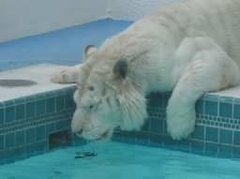
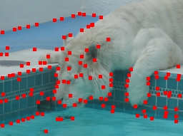
Corner detection
Moravec detector: detects corners as the pixels with locally maximal contrast
$$MO(i,j)=\frac{1}{8}\sum_{Δi = −1}^{1}{\sum_{Δj = −1}^{1}{|\left.f(i+Δi,j+Δj)−f(i,j\right)|}}$$

Slide 18
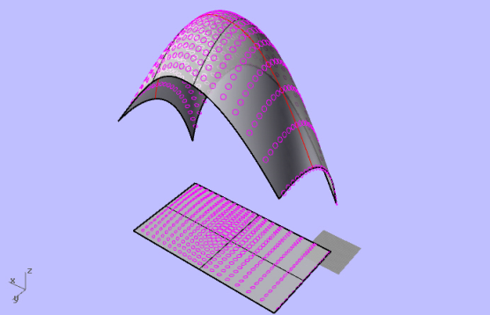
Corner detection
Moravec detector: detects corners as the pixels with locally maximal contrast
$$MO(i,j)=\frac{1}{8}\sum_{Δi = −1}^{1}{\sum_{Δj = −1}^{1}{|\left.f(i+Δi,j+Δj)−f(i,j\right)|}}$$
Differential approaches:
Beaudet’s approach: Corners are measured as the determinant of the Hessian.
Note that the determinant of a Hesian is equivalent to the product of the min & max Gaussian curvatures
$$H=\left[\begin{matrix}\frac{∂^{2}f}{∂x^{2}} & \frac{∂^{2}f}{∂x∂y} \\ \frac{∂^{2}f}{∂x∂y} & \frac{∂^{2}f}{∂y^{2}}\end{matrix}\right]$$
$$\text{Corner} \text{measure} \text{DET}(H)=\frac{∂^{2}f}{∂x^{2}}\frac{∂^{2}f}{∂y^{2}}−{\left(\frac{∂^{2}f}{∂x∂y}\right)}^{2}$$

Slide 19
Continued …
Using a bi-cubic facet model
$$\begin{matrix}f(i,j)=c_{1}+c_{2}x+c_{3}y+c_{4}x^{2}+c_{5}xy \\ +c_{6}y^{2}+c_{7}x^{3}+c_{8}x^{2}y+c_{9}xy^{2}+c_{10}y^{3}\end{matrix}$$
$KR=\frac{\left.2(c_{4}c_{3}^{2}+c_{6}c_{2}^{2}−c_{5}c_{2}c_{3}\right)}{c_{2}^{2}+c_{3}^{2}}$ $ZH=\frac{\left.2(c_{4}c_{3}^{2}+c_{6}c_{2}^{2}−c_{5}c_{2}c_{3}\right)}{{\left(c_{2}^{2}+c_{3}^{2}\right)}^{\frac{3}{2}}}$

Slide 20
Harris corner detector
Key idea: Measure changes over a neighborhood due to a shift and then analyze its dependency on shift orientation

Slide 21
Harris corner detector
Key idea: Measure changes over a neighborhood due to a shift and then analyze its dependency on shift orientation
Orientation dependency of the response for lines
Δ
Δ

Slide 22
Harris corner detector
Key idea: Measure changes over a neighborhood due to a shift and then analyze its dependency on shift orientation
Orientation dependency of the response for lines
Δ
Δ
Δ
Δ

Slide 23
Harris corner detector
Key idea: Measure changes over a neighborhood due to a shift and then analyze its dependency on shift orientation
Orientation dependency of the response for lines
Δ
Δ
Δ
Δ
Δ
High response for shifts along the edge direction; low responses for shifts toward orthogonal direction direction
Anisotropic response
Δ

Slide 24
Key idea: continued …
Orientation dependence of the shift response for corners
Δ
Δ
Δ
Δ
Δ
High response for shifts along all directions
Isotropic response
Δ

Slide 25
Harris corner: mathematical formulation
An image patch or neighborhood W is shifted by a shift vector Δ = [Δx, Δy]^{T}

Slide 26
Harris corner: mathematical formulation
An image patch or neighborhood W is shifted by a shift vector Δ = [Δx, Δy]^{T}
A corner does not have the aperture problem and therefore should show high shift response for all orientation of Δ.

Slide 27
Harris corner: mathematical formulation
An image patch or neighborhood W is shifted by a shift vector Δ = [Δx, Δy]^{T}
A corner does not have the aperture problem and therefore should show high shift response for all orientation of Δ.
The square intensity difference between the original and the shifted image over the neighborhood W is

Slide 28
Harris corner: mathematical formulation
An image patch or neighborhood W is shifted by a shift vector Δ = [Δx, Δy]^{T}
A corner does not have the aperture problem and therefore should show high shift response for all orientation of Δ.
The square intensity difference between the original and the shifted image over the neighborhood W is
$$S_{W}(Δ)=\sum_{\left(x_{i},y_{i})∈W\right.}{{\left(\left.f(x_{i},y_{i})−f(x_{i}+Δx,y_{i}+Δy\right)\right)}^{2}}$$

Slide 29
Harris corner: mathematical formulation
An image patch or neighborhood W is shifted by a shift vector Δ = [Δx, Δy]^{T}
A corner does not have the aperture problem and therefore should show high shift response for all orientation of Δ.
The square intensity difference between the original and the shifted image over the neighborhood W is
$$S_{W}(Δ)=\sum_{\left(x_{i},y_{i})∈W\right.}{{\left(\left.f(x_{i},y_{i})−f(x_{i}+Δx,y_{i}+Δy\right)\right)}^{2}}$$
Apply first-order Taylor expansion

Slide 30
Harris corner: mathematical formulation
An image patch or neighborhood W is shifted by a shift vector Δ = [Δx, Δy]^{T}
A corner does not have the aperture problem and therefore should show high shift response for all orientation of Δ.
The square intensity difference between the original and the shifted image over the neighborhood W is
$$S_{W}(Δ)=\sum_{\left(x_{i},y_{i})∈W\right.}{{\left(\left.f(x_{i},y_{i})−f(x_{i}+Δx,y_{i}+Δy\right)\right)}^{2}}$$
Apply first-order Taylor expansion
$$f(x_{i}+Δx,y_{i}+Δy)≈f(x_{i},y_{i})+\left[\begin{matrix}\frac{\left.∂f(x_{i},y_{i}\right)}{∂x} & \frac{\left.∂f(x_{i},y_{i}\right)}{∂y}\end{matrix}\right]\left[\begin{matrix}Δx \\ Δy\end{matrix}\right]$$

Slide 31
Continued …
$S(x,y,Δ)=\sum_{\left(x_{i},y_{i})∈W\right.}{{\left(f(x_{i},y_{i})−f(x_{i},y_{i})−\left[\begin{matrix}\frac{\left.∂f(x_{i},y_{i}\right)}{∂x} & \frac{\left.∂f(x_{i},y_{i}\right)}{∂y}\end{matrix}\right]\left[\begin{matrix}Δx \\ Δy\end{matrix}\right]\right)}^{2}}$

Slide 32
Continued …
$S(x,y,Δ)=\sum_{\left(x_{i},y_{i})∈W\right.}{{\left(f(x_{i},y_{i})−f(x_{i},y_{i})−\left[\begin{matrix}\frac{\left.∂f(x_{i},y_{i}\right)}{∂x} & \frac{\left.∂f(x_{i},y_{i}\right)}{∂y}\end{matrix}\right]\left[\begin{matrix}Δx \\ Δy\end{matrix}\right]\right)}^{2}}$
$=\sum_{\left(x_{i},y_{i})∈W\right.}{{\left(\left[\begin{matrix}\frac{\left.∂f(x_{i},y_{i}\right)}{∂x} & \frac{\left.∂f(x_{i},y_{i}\right)}{∂y}\end{matrix}\right]\left[\begin{matrix}Δx \\ Δy\end{matrix}\right]\right)}^{2}}$

Slide 33
Continued …
$S(x,y,Δ)=\sum_{\left(x_{i},y_{i})∈W\right.}{{\left(f(x_{i},y_{i})−f(x_{i},y_{i})−\left[\begin{matrix}\frac{\left.∂f(x_{i},y_{i}\right)}{∂x} & \frac{\left.∂f(x_{i},y_{i}\right)}{∂y}\end{matrix}\right]\left[\begin{matrix}Δx \\ Δy\end{matrix}\right]\right)}^{2}}$
$=\sum_{\left(x_{i},y_{i})∈W\right.}{{\left(\left[\begin{matrix}\frac{\left.∂f(x_{i},y_{i}\right)}{∂x} & \frac{\left.∂f(x_{i},y_{i}\right)}{∂y}\end{matrix}\right]\left[\begin{matrix}Δx \\ Δy\end{matrix}\right]\right)}^{2}}$
$=\sum_{\left(x_{i},y_{i})∈W\right.}{{\left(\left[\begin{matrix}\frac{\left.∂f(x_{i},y_{i}\right)}{∂x} & \frac{\left.∂f(x_{i},y_{i}\right)}{∂y}\end{matrix}\right]\left[\begin{matrix}Δx \\ Δy\end{matrix}\right]\right)}^{T}\left(\left[\begin{matrix}\frac{\left.∂f(x_{i},y_{i}\right)}{∂x} & \frac{\left.∂f(x_{i},y_{i}\right)}{∂y}\end{matrix}\right]\left[\begin{matrix}Δx \\ Δy\end{matrix}\right]\right)}$

Slide 34
Continued …
$S(x,y,Δ)=\sum_{\left(x_{i},y_{i})∈W\right.}{{\left(f(x_{i},y_{i})−f(x_{i},y_{i})−\left[\begin{matrix}\frac{\left.∂f(x_{i},y_{i}\right)}{∂x} & \frac{\left.∂f(x_{i},y_{i}\right)}{∂y}\end{matrix}\right]\left[\begin{matrix}Δx \\ Δy\end{matrix}\right]\right)}^{2}}$
$=\sum_{\left(x_{i},y_{i})∈W\right.}{{\left(\left[\begin{matrix}\frac{\left.∂f(x_{i},y_{i}\right)}{∂x} & \frac{\left.∂f(x_{i},y_{i}\right)}{∂y}\end{matrix}\right]\left[\begin{matrix}Δx \\ Δy\end{matrix}\right]\right)}^{2}}$
$=\sum_{\left(x_{i},y_{i})∈W\right.}{{\left(\left[\begin{matrix}\frac{\left.∂f(x_{i},y_{i}\right)}{∂x} & \frac{\left.∂f(x_{i},y_{i}\right)}{∂y}\end{matrix}\right]\left[\begin{matrix}Δx \\ Δy\end{matrix}\right]\right)}^{T}\left(\left[\begin{matrix}\frac{\left.∂f(x_{i},y_{i}\right)}{∂x} & \frac{\left.∂f(x_{i},y_{i}\right)}{∂y}\end{matrix}\right]\left[\begin{matrix}Δx \\ Δy\end{matrix}\right]\right)}$
$=\sum_{\left(x_{i},y_{i})∈W\right.}{\left[\begin{matrix}Δx & Δy\end{matrix}\right]\left[\begin{matrix}\frac{\left.∂f(x_{i},y_{i}\right)}{∂x} \\ \frac{\left.∂f(x_{i},y_{i}\right)}{∂y}\end{matrix}\right]\left[\begin{matrix}\frac{\left.∂f(x_{i},y_{i}\right)}{∂x} & \frac{\left.∂f(x_{i},y_{i}\right)}{∂y}\end{matrix}\right]\left[\begin{matrix}Δx \\ Δy\end{matrix}\right]}$

Slide 35
Continued …
$S(x,y,Δ)=\sum_{\left(x_{i},y_{i})∈W\right.}{{\left(f(x_{i},y_{i})−f(x_{i},y_{i})−\left[\begin{matrix}\frac{\left.∂f(x_{i},y_{i}\right)}{∂x} & \frac{\left.∂f(x_{i},y_{i}\right)}{∂y}\end{matrix}\right]\left[\begin{matrix}Δx \\ Δy\end{matrix}\right]\right)}^{2}}$
$=\sum_{\left(x_{i},y_{i})∈W\right.}{{\left(\left[\begin{matrix}\frac{\left.∂f(x_{i},y_{i}\right)}{∂x} & \frac{\left.∂f(x_{i},y_{i}\right)}{∂y}\end{matrix}\right]\left[\begin{matrix}Δx \\ Δy\end{matrix}\right]\right)}^{2}}$
$=\sum_{\left(x_{i},y_{i})∈W\right.}{{\left(\left[\begin{matrix}\frac{\left.∂f(x_{i},y_{i}\right)}{∂x} & \frac{\left.∂f(x_{i},y_{i}\right)}{∂y}\end{matrix}\right]\left[\begin{matrix}Δx \\ Δy\end{matrix}\right]\right)}^{T}\left(\left[\begin{matrix}\frac{\left.∂f(x_{i},y_{i}\right)}{∂x} & \frac{\left.∂f(x_{i},y_{i}\right)}{∂y}\end{matrix}\right]\left[\begin{matrix}Δx \\ Δy\end{matrix}\right]\right)}$
$=\sum_{\left(x_{i},y_{i})∈W\right.}{\left[\begin{matrix}Δx & Δy\end{matrix}\right]\left[\begin{matrix}\frac{\left.∂f(x_{i},y_{i}\right)}{∂x} \\ \frac{\left.∂f(x_{i},y_{i}\right)}{∂y}\end{matrix}\right]\left[\begin{matrix}\frac{\left.∂f(x_{i},y_{i}\right)}{∂x} & \frac{\left.∂f(x_{i},y_{i}\right)}{∂y}\end{matrix}\right]\left[\begin{matrix}Δx \\ Δy\end{matrix}\right]}$
$$=\sum_{\left(x_{i},y_{i})∈W\right.}{\left[\begin{matrix}Δx & Δy\end{matrix}\right]\left(\left[\begin{matrix}\frac{\left.∂f(x_{i},y_{i}\right)}{∂x} \\ \frac{\left.∂f(x_{i},y_{i}\right)}{∂y}\end{matrix}\right]\left[\begin{matrix}\frac{\left.∂f(x_{i},y_{i}\right)}{∂x} & \frac{\left.∂f(x_{i},y_{i}\right)}{∂y}\end{matrix}\right]\right)\left[\begin{matrix}Δx \\ Δy\end{matrix}\right]}$$

Slide 36
Continued …
$=\sum_{\left(x_{i},y_{i})∈W\right.}{\left[\begin{matrix}Δx & Δy\end{matrix}\right]\left(\left[\begin{matrix}\frac{\left.∂f(x_{i},y_{i}\right)}{∂x} \\ \frac{\left.∂f(x_{i},y_{i}\right)}{∂y}\end{matrix}\right]\left[\begin{matrix}\frac{\left.∂f(x_{i},y_{i}\right)}{∂x} & \frac{\left.∂f(x_{i},y_{i}\right)}{∂y}\end{matrix}\right]\right)\left[\begin{matrix}Δx \\ Δy\end{matrix}\right]}$

Slide 37
Continued …
$=\sum_{\left(x_{i},y_{i})∈W\right.}{\left[\begin{matrix}Δx & Δy\end{matrix}\right]\left(\left[\begin{matrix}\frac{\left.∂f(x_{i},y_{i}\right)}{∂x} \\ \frac{\left.∂f(x_{i},y_{i}\right)}{∂y}\end{matrix}\right]\left[\begin{matrix}\frac{\left.∂f(x_{i},y_{i}\right)}{∂x} & \frac{\left.∂f(x_{i},y_{i}\right)}{∂y}\end{matrix}\right]\right)\left[\begin{matrix}Δx \\ Δy\end{matrix}\right]}$
$=\left[\begin{matrix}Δx & Δy\end{matrix}\right]\left(\sum_{\left(x_{i},y_{i})∈W\right.}{\left[\begin{matrix}\frac{\left.∂f(x_{i},y_{i}\right)}{∂x} \\ \frac{\left.∂f(x_{i},y_{i}\right)}{∂y}\end{matrix}\right]\left[\begin{matrix}\frac{\left.∂f(x_{i},y_{i}\right)}{∂x} & \frac{\left.∂f(x_{i},y_{i}\right)}{∂y}\end{matrix}\right]}\right)\left[\begin{matrix}Δx \\ Δy\end{matrix}\right]$

Slide 38
Continued …
$=\sum_{\left(x_{i},y_{i})∈W\right.}{\left[\begin{matrix}Δx & Δy\end{matrix}\right]\left(\left[\begin{matrix}\frac{\left.∂f(x_{i},y_{i}\right)}{∂x} \\ \frac{\left.∂f(x_{i},y_{i}\right)}{∂y}\end{matrix}\right]\left[\begin{matrix}\frac{\left.∂f(x_{i},y_{i}\right)}{∂x} & \frac{\left.∂f(x_{i},y_{i}\right)}{∂y}\end{matrix}\right]\right)\left[\begin{matrix}Δx \\ Δy\end{matrix}\right]}$
$=\left[\begin{matrix}Δx & Δy\end{matrix}\right]\left(\sum_{\left(x_{i},y_{i})∈W\right.}{\left[\begin{matrix}\frac{\left.∂f(x_{i},y_{i}\right)}{∂x} \\ \frac{\left.∂f(x_{i},y_{i}\right)}{∂y}\end{matrix}\right]\left[\begin{matrix}\frac{\left.∂f(x_{i},y_{i}\right)}{∂x} & \frac{\left.∂f(x_{i},y_{i}\right)}{∂y}\end{matrix}\right]}\right)\left[\begin{matrix}Δx \\ Δy\end{matrix}\right]$
$=\left[\begin{matrix}Δx & Δy\end{matrix}\right]\left[\begin{matrix}\sum_{\left(x_{i},y_{i})∈W\right.}{{\left(\frac{\left.∂f(x_{i},y_{i}\right)}{∂x}\right)}^{2}} & \sum_{\left(x_{i},y_{i})∈W\right.}{\frac{\left.∂f(x_{i},y_{i}\right)}{∂x}\frac{\left.∂f(x_{i},y_{i}\right)}{∂y}} \\ \sum_{\left(x_{i},y_{i})∈W\right.}{\frac{\left.∂f(x_{i},y_{i}\right)}{∂x}\frac{\left.∂f(x_{i},y_{i}\right)}{∂y}} & \sum_{\left(x_{i},y_{i})∈W\right.}{{\left(\frac{\left.∂f(x_{i},y_{i}\right)}{∂y}\right)}^{2}}\end{matrix}\right]\left[\begin{matrix}Δx \\ Δy\end{matrix}\right]$

Slide 39
Continued …
$=\sum_{\left(x_{i},y_{i})∈W\right.}{\left[\begin{matrix}Δx & Δy\end{matrix}\right]\left(\left[\begin{matrix}\frac{\left.∂f(x_{i},y_{i}\right)}{∂x} \\ \frac{\left.∂f(x_{i},y_{i}\right)}{∂y}\end{matrix}\right]\left[\begin{matrix}\frac{\left.∂f(x_{i},y_{i}\right)}{∂x} & \frac{\left.∂f(x_{i},y_{i}\right)}{∂y}\end{matrix}\right]\right)\left[\begin{matrix}Δx \\ Δy\end{matrix}\right]}$
$=\left[\begin{matrix}Δx & Δy\end{matrix}\right]\left(\sum_{\left(x_{i},y_{i})∈W\right.}{\left[\begin{matrix}\frac{\left.∂f(x_{i},y_{i}\right)}{∂x} \\ \frac{\left.∂f(x_{i},y_{i}\right)}{∂y}\end{matrix}\right]\left[\begin{matrix}\frac{\left.∂f(x_{i},y_{i}\right)}{∂x} & \frac{\left.∂f(x_{i},y_{i}\right)}{∂y}\end{matrix}\right]}\right)\left[\begin{matrix}Δx \\ Δy\end{matrix}\right]$
$=\left[\begin{matrix}Δx & Δy\end{matrix}\right]\left[\begin{matrix}\sum_{\left(x_{i},y_{i})∈W\right.}{{\left(\frac{\left.∂f(x_{i},y_{i}\right)}{∂x}\right)}^{2}} & \sum_{\left(x_{i},y_{i})∈W\right.}{\frac{\left.∂f(x_{i},y_{i}\right)}{∂x}\frac{\left.∂f(x_{i},y_{i}\right)}{∂y}} \\ \sum_{\left(x_{i},y_{i})∈W\right.}{\frac{\left.∂f(x_{i},y_{i}\right)}{∂x}\frac{\left.∂f(x_{i},y_{i}\right)}{∂y}} & \sum_{\left(x_{i},y_{i})∈W\right.}{{\left(\frac{\left.∂f(x_{i},y_{i}\right)}{∂y}\right)}^{2}}\end{matrix}\right]\left[\begin{matrix}Δx \\ Δy\end{matrix}\right]$
$=Δ^{T}A_{w}(x,y)Δ$

Slide 40
Harris matrix
The matrix A_{W} is called the Harris matrix and its symmetric and positive semi-definite.

Slide 41
Harris matrix
The matrix A_{W} is called the Harris matrix and its symmetric and positive semi-definite.
Eigen-value decomposition of of A_{W} gives eigenvectors and eigenvalues (λ₁, λ₂) of the response matrix.
.

Slide 42
Harris matrix
The matrix A_{W} is called the Harris matrix and its symmetric and positive semi-definite.
Eigen-value decomposition of of A_{W} gives eigenvectors and eigenvalues (λ₁, λ₂) of the response matrix.
Three distinct situations:
Both λ₁ and λ₂ are small ⇒ no edge or corner; a flat region

Slide 43
Harris matrix
The matrix A_{W} is called the Harris matrix and its symmetric and positive semi-definite.
Eigen-value decomposition of of A_{W} gives eigenvectors and eigenvalues (λ₁, λ₂) of the response matrix.
Three distinct situations:
Both λ₁ and λ₂ are small ⇒ no edge or corner; a flat region
λ_{i} is large but λ_{ji} is small ⇒ existence of an edge; no corner

Slide 44
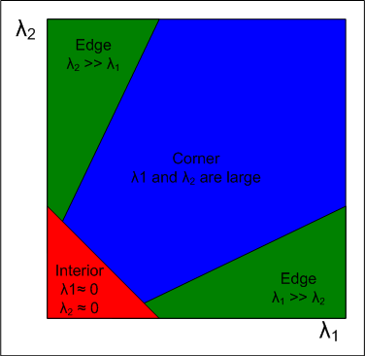
Harris matrix
The matrix A_{W} is called the Harris matrix and its symmetric and positive semi-definite.
Eigen-value decomposition of of A_{W} gives eigenvectors and eigenvalues (λ₁, λ₂) of the response matrix.
Three distinct situations:
Both λ₁ and λ₂ are small ⇒ no edge or corner; a flat region
λ_{i} is large but λ_{ji} is small ⇒ existence of an edge; no corner
Both λ₁ and λ₂ are large ⇒ existence of a corner

Slide 45
Harris matrix
The matrix A_{W} is called the Harris matrix and its symmetric and positive semi-definite.
Eigen-value decomposition of of A_{W} gives eigenvectors and eigenvalues (λ₁, λ₂) of the response matrix.
Three distinct situations:
Both λ₁ and λ₂ are small ⇒ no edge or corner; a flat region
λ_{i} is large but λ_{ji} is small ⇒ existence of an edge; no corner
Both λ₁ and λ₂ are large ⇒ existence of a corner
Avoid eigenvalue decomposition and compute a single response measure
Harris response function
$R(A)=det(A)−κ∗{\text{trace}}^{2}(A)$
A value of κ between 0.04 and 0.15 has be used in literature.

Slide 46
Algorithm: Harris corner detection
Filter the image with a Gaussian

Slide 47
Algorithm: Harris corner detection
Filter the image with a Gaussian
Estimate intensity gradient in two coordinate directions

Slide 48
Algorithm: Harris corner detection
Filter the image with a Gaussian
Estimate intensity gradient in two coordinate directions
For each pixel c and a neighborhood window W
Calculate the local Harris matrix A

Slide 49
Algorithm: Harris corner detection
Filter the image with a Gaussian
Estimate intensity gradient in two coordinate directions
For each pixel c and a neighborhood window W
Calculate the local Harris matrix A
Compute the response function R(A)

Slide 50
Algorithm: Harris corner detection
Filter the image with a Gaussian
Estimate intensity gradient in two coordinate directions
For each pixel c and a neighborhood window W
Calculate the local Harris matrix A
Compute the response function R(A)
Choose the best candidates for corners by selecting thresholds on the response function R(A)

Slide 51
Algorithm: Harris corner detection
Filter the image with a Gaussian
Estimate intensity gradient in two coordinate directions
For each pixel c and a neighborhood window W
Calculate the local Harris matrix A
Compute the response function R(A)
Choose the best candidates for corners by selecting thresholds on the response function R(A)
Apply non-maximal suppression

Slide 52
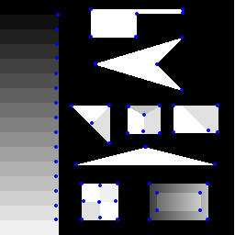
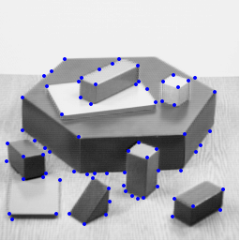
Examples

Slide 53
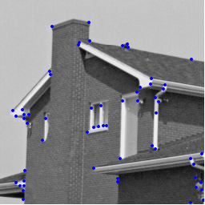
Examples

Slide 54
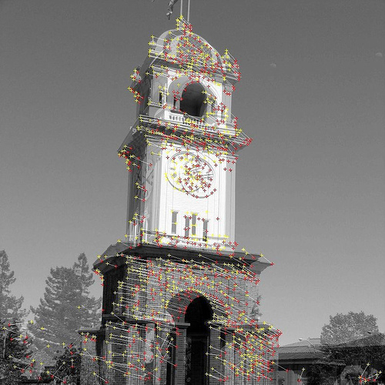
Examples

Slide 55
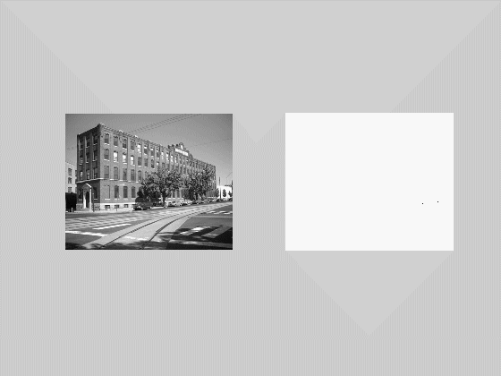
Maximally Stable Extremal Regions (MSER)
Key idea: Consider a movie generated by thresholding a gray level image (intensity values [0,1,…,255]) at all possible thresholds starting from 0 and ending at 255. building

Slide 56
Maximally Stable Extremal Regions (MSER)
Key idea: Consider a movie generated by thresholding a gray level image (intensity values [0,1,…,255]) at all possible thresholds starting from 0 and ending at 255.
Initially it’s an empty image and then some dots (local minima) appear and starts growing

Slide 57
Maximally Stable Extremal Regions (MSER)
Key idea: Consider a movie generated by thresholding a gray level image (intensity values [0,1,…,255]) at all possible thresholds starting from 0 and ending at 255.
Initially it’s an empty image and then some dots (local minima) appear and starts growing
New dots appear and starts growing and so on

Slide 58
Maximally Stable Extremal Regions (MSER)
Key idea: Consider a movie generated by thresholding a gray level image (intensity values [0,1,…,255]) at all possible thresholds starting from 0 and ending at 255.
Initially it’s an empty image and then some dots (local minima) appear and starts growing
New dots appear and starts growing and so on
From time to time two disconnected regions get merged

Slide 59
Maximally Stable Extremal Regions (MSER)
Key idea: Consider a movie generated by thresholding a gray level image (intensity values [0,1,…,255]) at all possible thresholds starting from 0 and ending at 255.
Initially it’s an empty image and then some dots (local minima) appear and starts growing
New dots appear and starts growing and so on
From time to time two disconnected regions get merged
Finally, all regions get merged into a single component.

Slide 60
Maximally Stable Extremal Regions (MSER)
Key idea: Consider a movie generated by thresholding a gray level image (intensity values [0,1,…,255]) at all possible thresholds starting from 0 and ending at 255.
BUT, the important observation here is that

Slide 61
Maximally Stable Extremal Regions (MSER)
Key idea: Consider a movie generated by thresholding a gray level image (intensity values [0,1,…,255]) at all possible thresholds starting from 0 and ending at 255.
BUT, the important observation here is that
Starting from a tiny seed area (one or a few pixels), a region continues growing till it fills the object containing the initial seed area

Slide 62
Maximally Stable Extremal Regions (MSER)
Key idea: Consider a movie generated by thresholding a gray level image (intensity values [0,1,…,255]) at all possible thresholds starting from 0 and ending at 255.
BUT, the important observation here is that
Starting from a tiny seed area (one or a few pixels), a region continues growing till it fills the object containing the initial seed area
Then remains (almost) unchanged for quite sometime in the threshold movie until it get merged with the bigger (generally, parent) object to which it belongs

Slide 63
Maximally Stable Extremal Regions (MSER)
Key idea: Consider a movie generated by thresholding a gray level image (intensity values [0,1,…,255]) at all possible thresholds starting from 0 and ending at 255.
BUT, the important observation here is that
Starting from a tiny seed area (one or a few pixels), a region continues growing till it fills the object containing the initial seed area
Then remains (almost) unchanged for quite sometime in the threshold movie until it get merged with the bigger (generally, parent) object to which it belongs
MSER intends to capture these stable regions

Slide 64
Maximally Stable Extremal Regions (MSER)
Key idea: Consider a movie generated by thresholding a gray level image (intensity values [0,1,…,255]) at all possible thresholds starting from 0 and ending at 255. building

Slide 65
MSER: mathematical formulation
Image $I:D⊂ℤ^{2}→ℱ$
Assumption: $ℱ$ is fully ordered i.e., $∃$ a reflexive, anti-symmetric and transitive relation on $ℱ$ Trivially satisfied in a scalar image

Slide 66
MSER: mathematical formulation
Image $I:D⊂ℤ^{2}→ℱ$
Assumption: $ℱ$ is fully ordered i.e., $∃$ a reflexive, anti-symmetric and transitive relation on $ℱ$ Trivially satisfied in a scalar image
There exists an adjacency relation $A⊂D×D$, e.g., 26-adjacency

Slide 67
MSER: mathematical formulation
Image $I:D⊂ℤ^{2}→ℱ$
Assumption: $ℱ$ is fully ordered i.e., $∃$ a reflexive, anti-symmetric and transitive relation on $ℱ$ Trivially satisfied in a scalar image
There exists an adjacency relation $A⊂D×D$, e.g., 26-adjacency Path: a sequence of points $p_{1},p_{2},…,p_{n}$ where $p_{i}Ap_{i+1}$ for all $i$

Slide 68
MSER: mathematical formulation
Image $I:D⊂ℤ^{2}→ℱ$
Assumption: $ℱ$ is fully ordered i.e., $∃$ a reflexive, anti-symmetric and transitive relation on $ℱ$ Trivially satisfied in a scalar image
There exists an adjacency relation $A⊂D×D$, e.g., 26-adjacency Path: a sequence of points $p_{1},p_{2},…,p_{n}$ where $p_{i}Ap_{i+1}$ for all $i$ Connected region: a maximal subset $R$ of $D$ where every two points $p,q∈R$ are connected by a path entirely contained by $R$

Slide 69
MSER: mathematical formulation
Image $I:D⊂ℤ^{2}→ℱ$
Assumption: $ℱ$ is fully ordered i.e., $∃$ a reflexive, anti-symmetric and transitive relation on $ℱ$ Trivially satisfied in a scalar image
There exists an adjacency relation $A⊂D×D$, e.g., 26-adjacency Path: a sequence of points $p_{1},p_{2},…,p_{n}$ where $p_{i}Ap_{i+1}$ for all $i$ Connected region: a maximal subset $R$ of $D$ where every two points $p,q∈R$ are connected by a path entirely contained by $R$ Boundary $∂R=\left\{p|p∈D−R and ∃q s.t. pAq\right\}$

Slide 70
MSER: mathematical formulation
Image $I:D⊂ℤ^{2}→ℱ$
Assumption: $ℱ$ is fully ordered i.e., $∃$ a reflexive, anti-symmetric and transitive relation on $ℱ$ Trivially satisfied in a scalar image
There exists an adjacency relation $A⊂D×D$, e.g., 26-adjacency Path: a sequence of points $p_{1},p_{2},…,p_{n}$ where $p_{i}Ap_{i+1}$ for all $i$ Connected region: a maximal subset $R$ of $D$ where every two points $p,q∈R$ are connected by a path entirely contained by $R$ Boundary $∂R=\left\{p|p∈D−R and ∃q s.t. pAq\right\}$

Slide 71
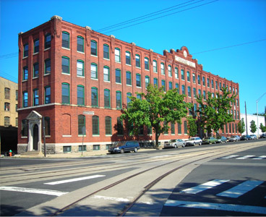
MSER: mathematical formulation
Extremal region: $Q⊂D$ is a connected region for some threshold,

Slide 72
MSER: mathematical formulation
Extremal region: $Q⊂D$ is a connected region for some threshold, i.e., $p∈Q$ and $p∈∂Q$ implies that $I\left(p\right)<I(q)$

Slide 73
MSER: mathematical formulation
Extremal region: $Q⊂D$ is a connected region for some threshold, i.e., $p∈Q$ and $p∈∂Q$ implies that $I\left(p\right)<I(q)$
Maximally stable extremal region (MSER) An extremal region that is most stable on the threshold video HOW TO FORMULATE:

Slide 74
MSER: mathematical formulation
Extremal region: $Q⊂D$ is a connected region for some threshold, i.e., $p∈Q$ and $p∈∂Q$ implies that $I\left(p\right)<I(q)$
Maximally stable extremal region (MSER) An extremal region that is most stable on the threshold video HOW TO FORMULATE: Consider a nested sequence of extremal regions $Q_{0},Q_{1}, …, Q_{max}$, subscript → threshold Relative speed at threshold $i$ on the nested chain $speed_{i}=\frac{\left|Q_{i+∆}−Q_{i+∆}\right|}{2∆∗\left|Q_{i}\right|}$ $∆$ is a parameter to the method

Slide 75
MSER: mathematical formulation
Extremal region: $Q⊂D$ is a connected region for some threshold, i.e., $p∈Q$ and $p∈∂Q$ implies that $I\left(p\right)<I(q)$
Maximally stable extremal region (MSER) An extremal region that is most stable on the threshold video HOW TO FORMULATE: Consider a nested sequence of extremal regions $Q_{0},Q_{1}, …, Q_{max}$, subscript → threshold Relative speed at threshold $i$ on the nested chain $speed_{i}=\frac{\left|Q_{i+∆}−Q_{i+∆}\right|}{2∆∗\left|Q_{i}\right|}$ $∆$ is a parameter to the method

Slide 76
MSER: mathematical formulation
Extremal region: $Q⊂D$ is a connected region for some threshold, i.e., $p∈Q$ and $p∈∂Q$ implies that $I\left(p\right)<I(q)$
Maximally stable extremal region (MSER) An extremal region that is most stable on the threshold video HOW TO FORMULATE: Consider a nested sequence of extremal regions $Q_{0},Q_{1}, …, Q_{max}$, subscript → threshold Relative speed at threshold $i$ on the nested chain $speed_{i}=\frac{\left|Q_{i+∆}−Q_{i+∆}\right|}{2∆∗\left|Q_{i}\right|}$ $∆$ is a parameter to the method Finally, $Q_{i^{∗}}$ is a MSER is $speed_{i^{∗}}$ produces a local minima on the nested chain $Q_{0},Q_{1}, …, Q_{max}$ along the threshold variable

Slide 77
MSER: properties
Invariance under monotonic transforms M : I→I of image intensities

Slide 78
MSER: properties
Invariance under monotonic transforms M : I→I of image intensities
Invariance under homeomorphic transformations (adjacency preserving) T: C→C of the image space

Slide 79
MSER: properties
Invariance under monotonic transforms M : I→I of image intensities
Invariance under homeomorphic transformations (adjacency preserving) T: C→C of the image space
Stability: extremal regions that remain virtually unchanged over a threshold range are selected

Slide 80
MSER: properties
Invariance under monotonic transforms M : I→I of image intensities
Invariance under homeomorphic transformations (adjacency preserving) T: C→C of the image space
Stability: extremal regions that remain virtually unchanged over a threshold range are selected
Multi-scale detection: Extremal regions of all scales are detected simultaneously

Slide 81
MSER: properties
Invariance under monotonic transforms M : I→I of image intensities
Invariance under homeomorphic transformations (adjacency preserving) T: C→C of the image space
Stability: extremal regions that remain virtually unchanged over a threshold range are selected
Multi-scale detection: Extremal regions of all scales are detected simultaneously
The set of all MSERs are enumerated in O(n*log log n) time, where n is the number of image pixels

Slide 82
Algorithm: MSER enumeration
Input: Image I and the Δ parameter
Output: List of nested extremal regions

Slide 83
Algorithm: MSER enumeration
Input: Image I and the Δ parameter
Output: List of nested extremal regions
For all pixels shorted by intensity
Place a pixel in the image as its tern come
Update the connected component structure
Update the area for the effected connected components

Slide 84
Algorithm: MSER enumeration
Input: Image I and the Δ parameter
Output: List of nested extremal regions
For all pixels shorted by intensity
Place a pixel in the image as its tern come
Update the connected component structure
Update the area for the effected connected components
For all connected components
Detect regions with local minima w.r.t. rate of change of connected component area with threshold; define each such region as a MSER

Slide 85
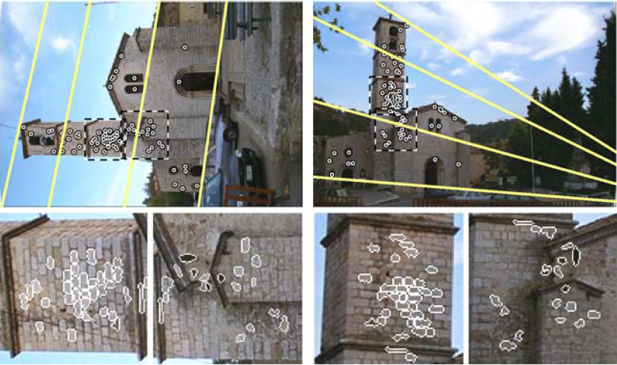
Examples

Slide 86
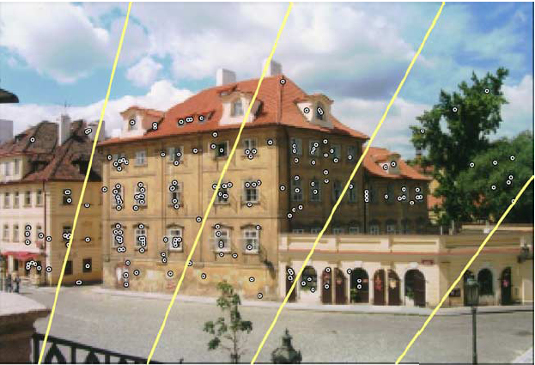
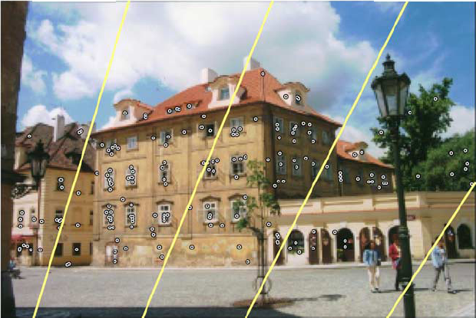
Examples

