Slide 1
Course Syllabus
Color
Camera models, camera calibration
Advanced image pre-processing
  Line detection
  Corner detection
  Maximally stable extremal regions
Mathematical Morphology
  binary
  gray-scale
  skeletonization
  granulometry
  morphological segmentation
  Scale in image processing
Wavelet theory in image processing
Image Compression
Texture
Image Registration
  rigid
  non-rigid
  RANSAC

Slide 2
References
Book: Chapter 5, Image Processing, Analysis, and Machine Vision, Sonka et al, latest edition (you may collect a copy of the relevant chapters from my office)
Papers:
  Harris and Stephens, 4th Alvey Vision Conference, 147-151, 1988.
  Matas et al, Image Vision Geometry, 22:761-767, 2004

Slide 3
Topics
Line detection
Interest points
  Corner Detection
    Moravec detector
    Facet model
    Harris corner detection
  Maximally stable extremal regions

Slide 4
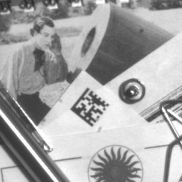
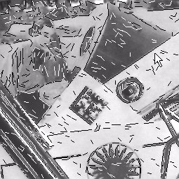
Line detection
Useful in remote sensing, document processing etc.
Edges:
  boundaries between regions with relatively distinct gray-levels
  the most common type of discontinuity in an image
Lines:
  instances of thin lines in an image occur frequently enough
  it is useful to have a separate mechanism for detecting them.

Slide 5
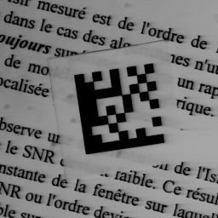
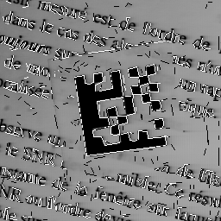
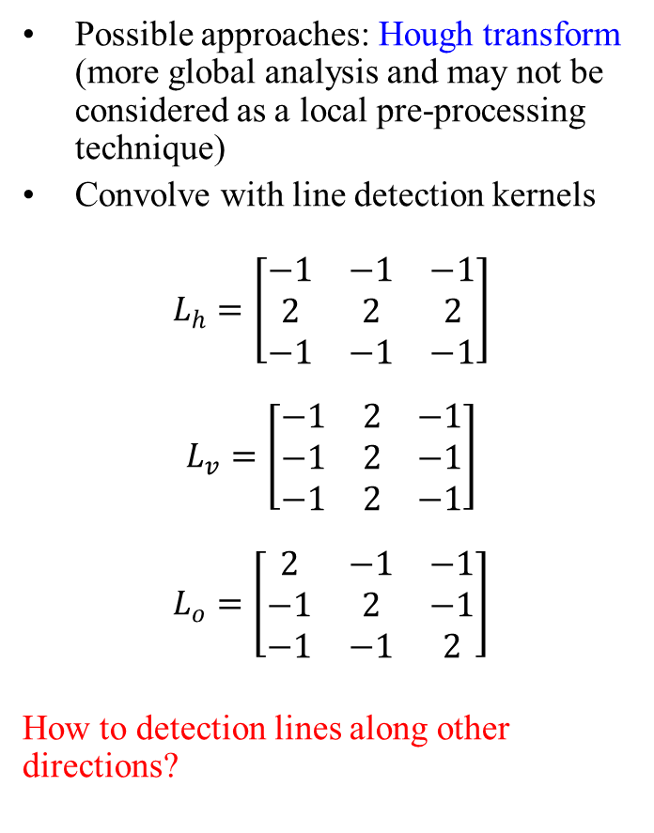
Line detection: How?
Possible approaches: Hough transform (more global analysis and may not be considered as a local pre-processing technique)
Convolve with line detection kernels
$$L_{h}=\left[\begin{matrix}−1 & −1 & −1 \\ 2 & 2 & 2 \\ −1 & −1 & −1\end{matrix}\right]$$
$$L_{v}=\left[\begin{matrix}−1 & 2 & −1 \\ −1 & 2 & −1 \\ −1 & 2 & −1\end{matrix}\right]$$
$$L_{o}=\left[\begin{matrix}2 & −1 & −1 \\ −1 & 2 & −1 \\ −1 & −1 & 2\end{matrix}\right]$$
How to detection lines along other directions?

Slide 6
Lines and corner for correspondence
Interest points for solving correspondence problems in time series data.
Corners are better than lines in solving the above problem due to the aperture problem
  Consider that we want to solve point matching in two images
  A vertex or corner provides better correspondence
?

Slide 7
Corners
Challenges
  Gradient computation is less reliable near a corner due to ambiguity of edge orientation
  Corner detector are usually not very robust.
  This deficiency is overcome either by manual intervention or large redundancies.
  The later approach leads to many more corners than needed to estimate transforms between two images.
?

Slide 8
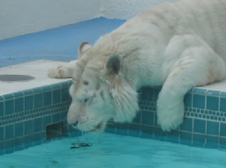
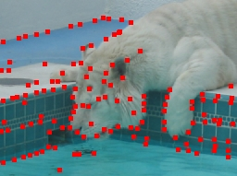
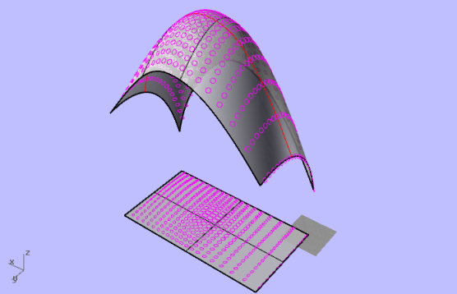
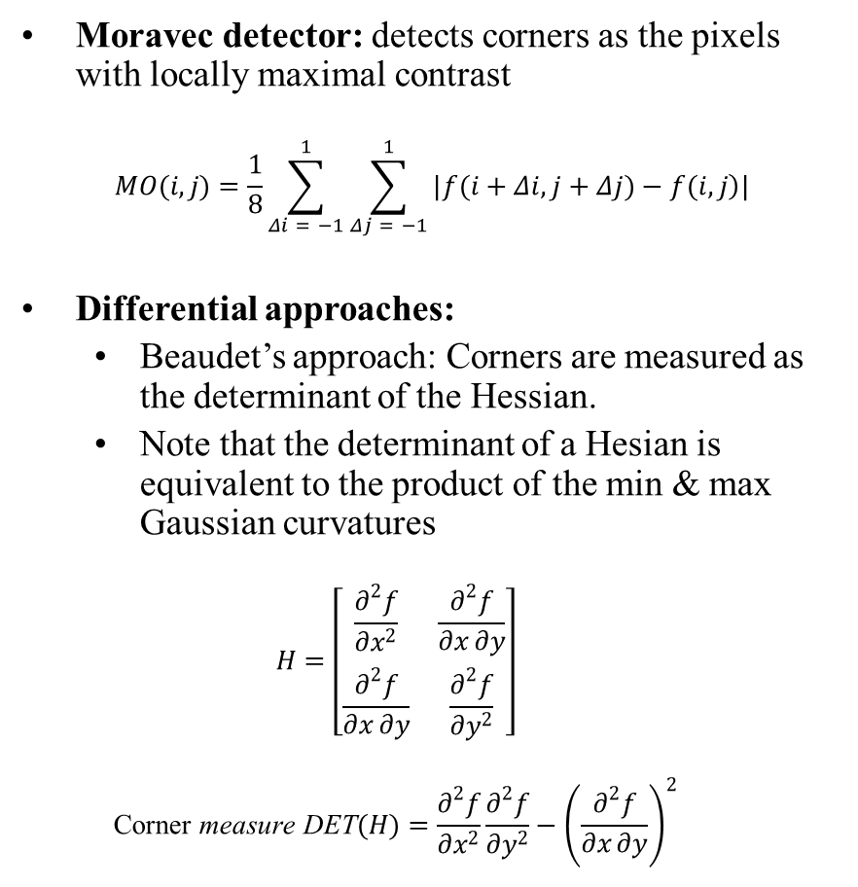
Corner detection
Moravec detector: detects corners as the pixels with locally maximal contrast
$$MO(i,j)=\frac{1}{8}\sum_{Δi = −1}^{1}{\sum_{Δj = −1}^{1}{|\left.f(i+Δi,j+Δj)−f(i,j\right)|}}$$
Differential approaches:
  Beaudet’s approach: Corners are measured as the determinant of the Hessian.
  Note that the determinant of a Hesian is equivalent to the product of the min & max Gaussian curvatures
  $$H=\left[\begin{matrix}\frac{∂^{2}f}{∂x^{2}} & \frac{∂^{2}f}{∂x∂y} \\ \frac{∂^{2}f}{∂x∂y} & \frac{∂^{2}f}{∂y^{2}}\end{matrix}\right]$$
  $$\text{Corner} \text{measure} \text{DET}(H)=\frac{∂^{2}f}{∂x^{2}}\frac{∂^{2}f}{∂y^{2}}−{\left(\frac{∂^{2}f}{∂x∂y}\right)}^{2}$$

Slide 9

Continued …
Using a bi-cubic facet model
$$\begin{matrix}f(i,j)=c_{1}+c_{2}x+c_{3}y+c_{4}x^{2}+c_{5}xy \\ +c_{6}y^{2}+c_{7}x^{3}+c_{8}x^{2}y+c_{9}xy^{2}+c_{10}y^{3}\end{matrix}$$
$KR=\frac{\left.2(c_{4}c_{3}^{2}+c_{6}c_{2}^{2}−c_{5}c_{2}c_{3}\right)}{c_{2}^{2}+c_{3}^{2}}$ $ZH=\frac{\left.2(c_{4}c_{3}^{2}+c_{6}c_{2}^{2}−c_{5}c_{2}c_{3}\right)}{{\left(c_{2}^{2}+c_{3}^{2}\right)}^{\frac{3}{2}}}$

Slide 10
Harris corner detector
Key idea: Measure changes over a neighborhood due to a shift and then analyze its dependency on shift orientation
Orientation dependency of the response for lines
Δ
Δ
Δ
Δ
Δ
High response for shifts along the edge direction; low responses for shifts toward orthogonal direction direction
Anisotropic response
Δ

Slide 11
Key idea: continued …
Orientation dependence of the shift response for corners
Δ
Δ
Δ
Δ
Δ
High response for shifts along all directions
Isotropic response
Δ

Slide 12
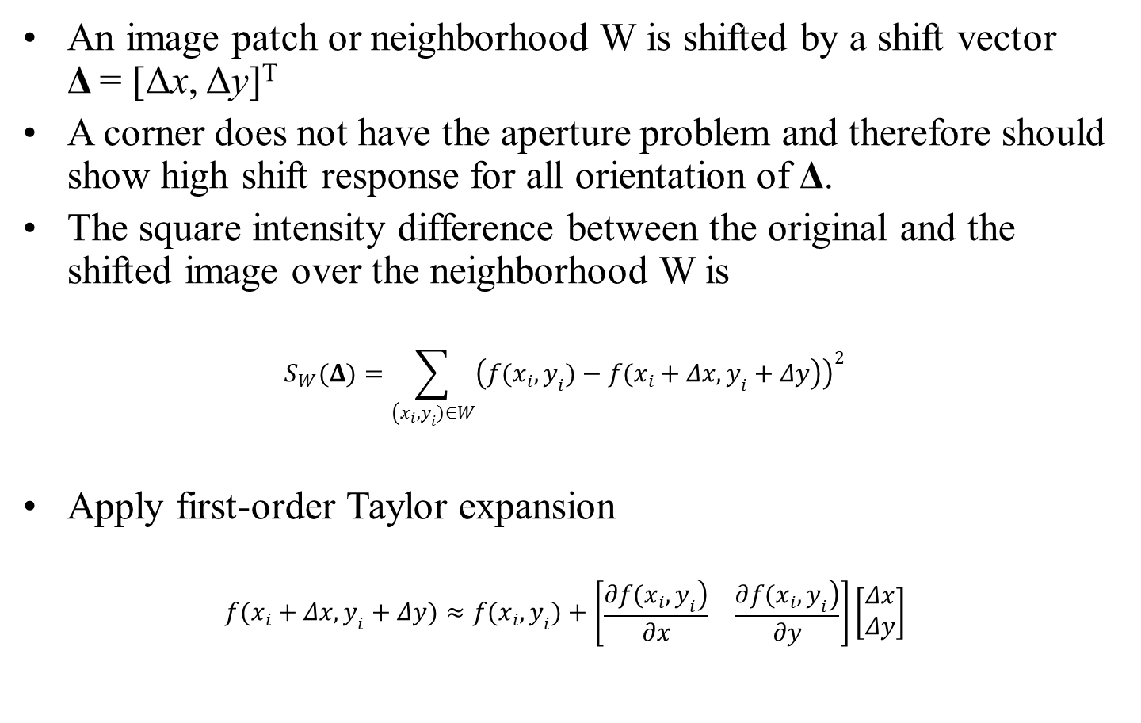
Harris corner: mathematical formulation
An image patch or neighborhood W is shifted by a shift vector Δ = [Δx, Δy]^{T}
A corner does not have the aperture problem and therefore should show high shift response for all orientation of Δ.
The square intensity difference between the original and the shifted image over the neighborhood W is
$$S_{W}(Δ)=\sum_{\left(x_{i},y_{i})∈W\right.}{{\left(\left.f(x_{i},y_{i})−f(x_{i}+Δx,y_{i}+Δy\right)\right)}^{2}}$$
Apply first-order Taylor expansion
$$f(x_{i}+Δx,y_{i}+Δy)≈f(x_{i},y_{i})+\left[\begin{matrix}\frac{\left.∂f(x_{i},y_{i}\right)}{∂x} & \frac{\left.∂f(x_{i},y_{i}\right)}{∂y}\end{matrix}\right]\left[\begin{matrix}Δx \\ Δy\end{matrix}\right]$$

Slide 13
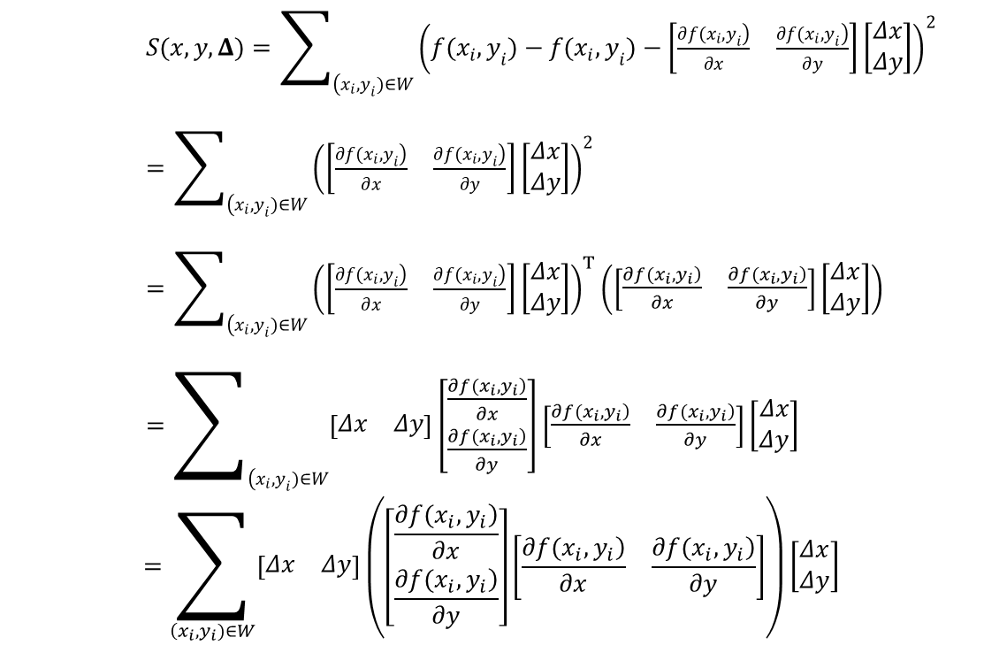
Continued …
$S(x,y,Δ)=\sum_{\left(x_{i},y_{i})∈W\right.}{{\left(f(x_{i},y_{i})−f(x_{i},y_{i})−\left[\begin{matrix}\frac{\left.∂f(x_{i},y_{i}\right)}{∂x} & \frac{\left.∂f(x_{i},y_{i}\right)}{∂y}\end{matrix}\right]\left[\begin{matrix}Δx \\ Δy\end{matrix}\right]\right)}^{2}}$
$=\sum_{\left(x_{i},y_{i})∈W\right.}{{\left(\left[\begin{matrix}\frac{\left.∂f(x_{i},y_{i}\right)}{∂x} & \frac{\left.∂f(x_{i},y_{i}\right)}{∂y}\end{matrix}\right]\left[\begin{matrix}Δx \\ Δy\end{matrix}\right]\right)}^{2}}$
$=\sum_{\left(x_{i},y_{i})∈W\right.}{{\left(\left[\begin{matrix}\frac{\left.∂f(x_{i},y_{i}\right)}{∂x} & \frac{\left.∂f(x_{i},y_{i}\right)}{∂y}\end{matrix}\right]\left[\begin{matrix}Δx \\ Δy\end{matrix}\right]\right)}^{T}\left(\left[\begin{matrix}\frac{\left.∂f(x_{i},y_{i}\right)}{∂x} & \frac{\left.∂f(x_{i},y_{i}\right)}{∂y}\end{matrix}\right]\left[\begin{matrix}Δx \\ Δy\end{matrix}\right]\right)}$
$=\sum_{\left(x_{i},y_{i})∈W\right.}{\left[\begin{matrix}Δx & Δy\end{matrix}\right]\left[\begin{matrix}\frac{\left.∂f(x_{i},y_{i}\right)}{∂x} \\ \frac{\left.∂f(x_{i},y_{i}\right)}{∂y}\end{matrix}\right]\left[\begin{matrix}\frac{\left.∂f(x_{i},y_{i}\right)}{∂x} & \frac{\left.∂f(x_{i},y_{i}\right)}{∂y}\end{matrix}\right]\left[\begin{matrix}Δx \\ Δy\end{matrix}\right]}$
$$=\sum_{\left(x_{i},y_{i})∈W\right.}{\left[\begin{matrix}Δx & Δy\end{matrix}\right]\left(\left[\begin{matrix}\frac{\left.∂f(x_{i},y_{i}\right)}{∂x} \\ \frac{\left.∂f(x_{i},y_{i}\right)}{∂y}\end{matrix}\right]\left[\begin{matrix}\frac{\left.∂f(x_{i},y_{i}\right)}{∂x} & \frac{\left.∂f(x_{i},y_{i}\right)}{∂y}\end{matrix}\right]\right)\left[\begin{matrix}Δx \\ Δy\end{matrix}\right]}$$

Slide 14
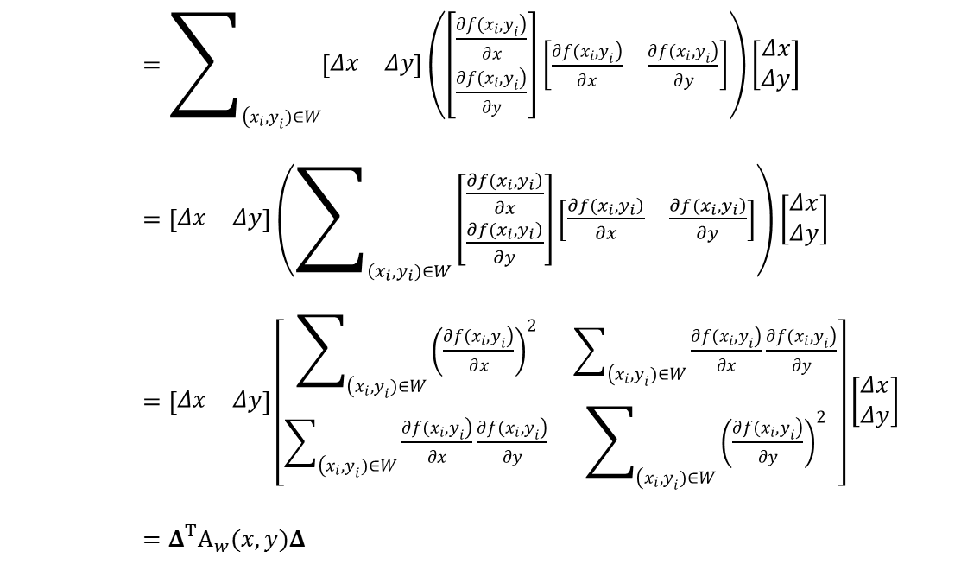
Continued …
$=\sum_{\left(x_{i},y_{i})∈W\right.}{\left[\begin{matrix}Δx & Δy\end{matrix}\right]\left(\left[\begin{matrix}\frac{\left.∂f(x_{i},y_{i}\right)}{∂x} \\ \frac{\left.∂f(x_{i},y_{i}\right)}{∂y}\end{matrix}\right]\left[\begin{matrix}\frac{\left.∂f(x_{i},y_{i}\right)}{∂x} & \frac{\left.∂f(x_{i},y_{i}\right)}{∂y}\end{matrix}\right]\right)\left[\begin{matrix}Δx \\ Δy\end{matrix}\right]}$
$=\left[\begin{matrix}Δx & Δy\end{matrix}\right]\left(\sum_{\left(x_{i},y_{i})∈W\right.}{\left[\begin{matrix}\frac{\left.∂f(x_{i},y_{i}\right)}{∂x} \\ \frac{\left.∂f(x_{i},y_{i}\right)}{∂y}\end{matrix}\right]\left[\begin{matrix}\frac{\left.∂f(x_{i},y_{i}\right)}{∂x} & \frac{\left.∂f(x_{i},y_{i}\right)}{∂y}\end{matrix}\right]}\right)\left[\begin{matrix}Δx \\ Δy\end{matrix}\right]$
$=\left[\begin{matrix}Δx & Δy\end{matrix}\right]\left[\begin{matrix}\sum_{\left(x_{i},y_{i})∈W\right.}{{\left(\frac{\left.∂f(x_{i},y_{i}\right)}{∂x}\right)}^{2}} & \sum_{\left(x_{i},y_{i})∈W\right.}{\frac{\left.∂f(x_{i},y_{i}\right)}{∂x}\frac{\left.∂f(x_{i},y_{i}\right)}{∂y}} \\ \sum_{\left(x_{i},y_{i})∈W\right.}{\frac{\left.∂f(x_{i},y_{i}\right)}{∂x}\frac{\left.∂f(x_{i},y_{i}\right)}{∂y}} & \sum_{\left(x_{i},y_{i})∈W\right.}{{\left(\frac{\left.∂f(x_{i},y_{i}\right)}{∂y}\right)}^{2}}\end{matrix}\right]\left[\begin{matrix}Δx \\ Δy\end{matrix}\right]$
$=Δ^{T}A_{w}(x,y)Δ$

Slide 15
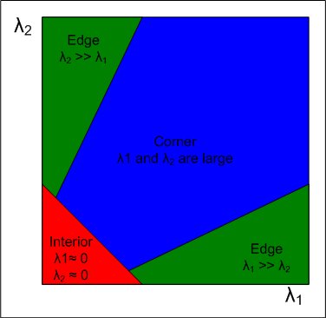
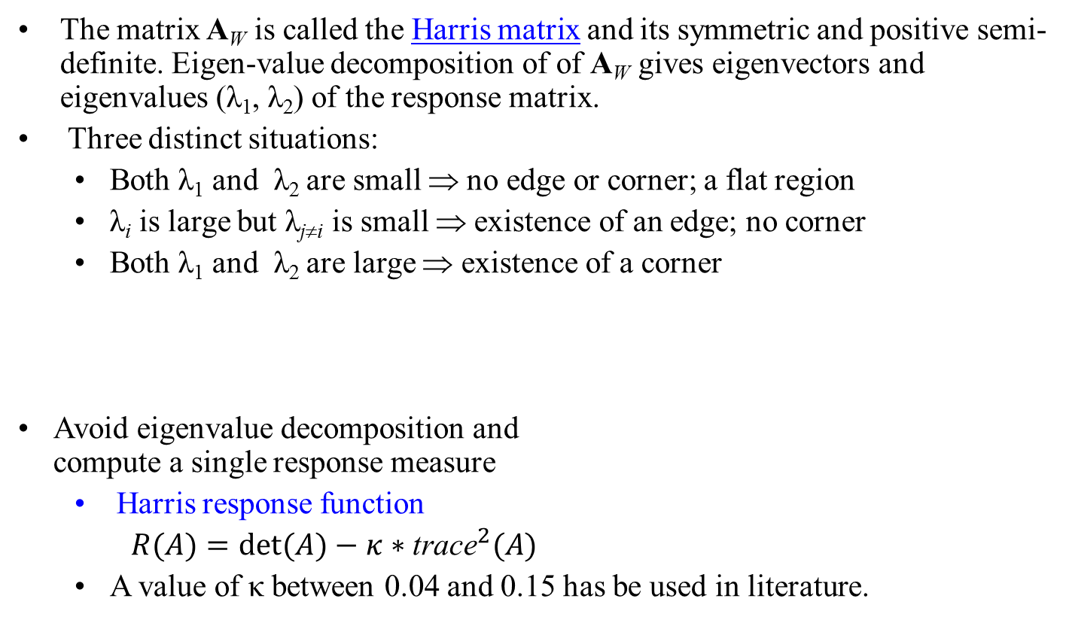
Harris matrix
The matrix A_{W} is called the Harris matrix and its symmetric and positive semi-definite. Eigen-value decomposition of of A_{W} gives eigenvectors and eigenvalues (λ₁, λ₂) of the response matrix.
Three distinct situations:
  Both λ₁ and λ₂ are small ⇒ no edge or corner; a flat region
  λ_{i} is large but λ_{ji} is small ⇒ existence of an edge; no corner
  Both λ₁ and λ₂ are large ⇒ existence of a corner
Avoid eigenvalue decomposition and
compute a single response measure
  Harris response function
  $R(A)=det(A)−κ∗{\text{trace}}^{2}(A)$
  A value of κ between 0.04 and 0.15 has be used in literature.

Slide 16
Algorithm: Harris corner detection
Filter the image with a Gaussian
Estimate intensity gradient in two coordinate directions
For each pixel c and a neighborhood window W
  Calculate the local Harris matrix A
  Compute the response function R(A)
Choose the best candidates for corners by selecting thresholds on the response function R(A)
Apply non-maximal suppression

Slide 17
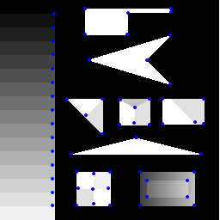
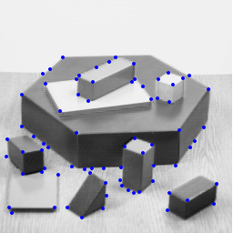
Examples

Slide 18
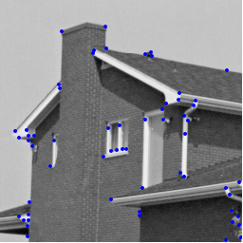
Examples

Slide 19
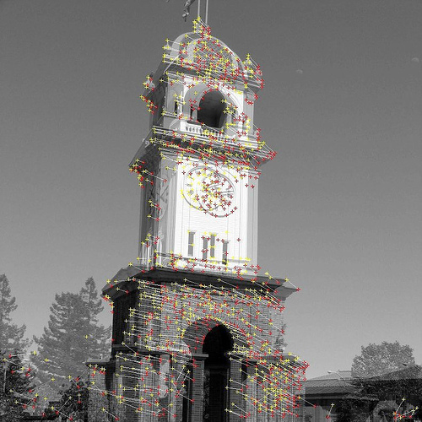
Examples

Slide 20
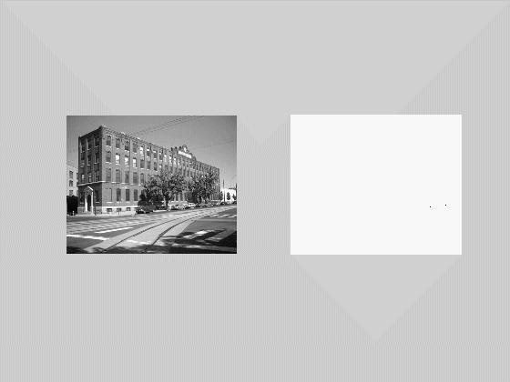
Maximally Stable Extremal Regions (MSER)
Key idea: Consider a movie generated by thresholding a gray level image (intensity values [0,1,…,255]) at all possible thresholds starting from 0 and ending at 255. building

Slide 21
Maximally Stable Extremal Regions (MSER)
Key idea: Consider a movie generated by thresholding a gray level image (intensity values [0,1,…,255]) at all possible thresholds starting from 0 and ending at 255.
  Initially it’s an empty image and then some dots (local minima) appear and starts growing
  New dots appear and starts growing and so on
  From time to time two disconnected regions get merged
  Finally, all regions get merged into a single component.
  BUT, the important observation here is that – starting from a tiny seed area (one or a few pixels), a region continues growing till it fills the object containing the initial seed area and then remains (almost) unchanged for quite sometime in the threshold movie until it get merged with the bigger (generally, parent) object to which it belongs
  MSER intends to capture these stable regions

Slide 22
Maximally Stable Extremal Regions (MSER)
Key idea: Consider a movie generated by thresholding a gray level image (intensity values [0,1,…,255]) at all possible thresholds starting from 0 and ending at 255.
  BUT, the important observation here is that
  Starting from a tiny seed area (one or a few pixels), a region continues growing till it fills the object containing the initial seed area
  Then remains (almost) unchanged for quite sometime in the threshold movie until it get merged with the bigger (generally, parent) object to which it belongs
  MSER intends to capture these stable regions

Slide 23
Maximally Stable Extremal Regions (MSER)
Key idea: Consider a movie generated by thresholding a gray level image (intensity values [0,1,…,255]) at all possible thresholds starting from 0 and ending at 255. building

Slide 24
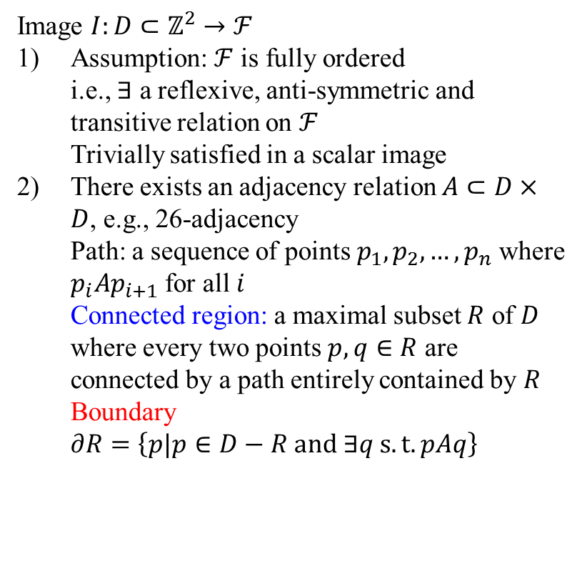
MSER: mathematical formulation
Image $I:D⊂ℤ^{2}→ℱ$
Assumption: $ℱ$ is fully ordered
i.e., $∃$ a reflexive, anti-symmetric and transitive relation on $ℱ$
Trivially satisfied in a scalar image
There exists an adjacency relation $A⊂D×D$, e.g., 26-adjacency
Path: a sequence of points $p_{1},p_{2},…,p_{n}$ where $p_{i}Ap_{i+1}$ for all $i$
Connected region: a maximal subset $R$ of $D$ where every two points $p,q∈R$ are connected by a path entirely contained by $R$
Boundary $∂R=\left\{p|p∈D−R and ∃q s.t. pAq\right\}$

Slide 25
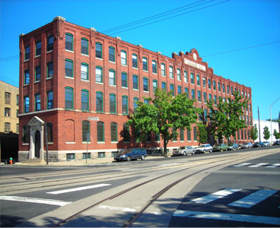
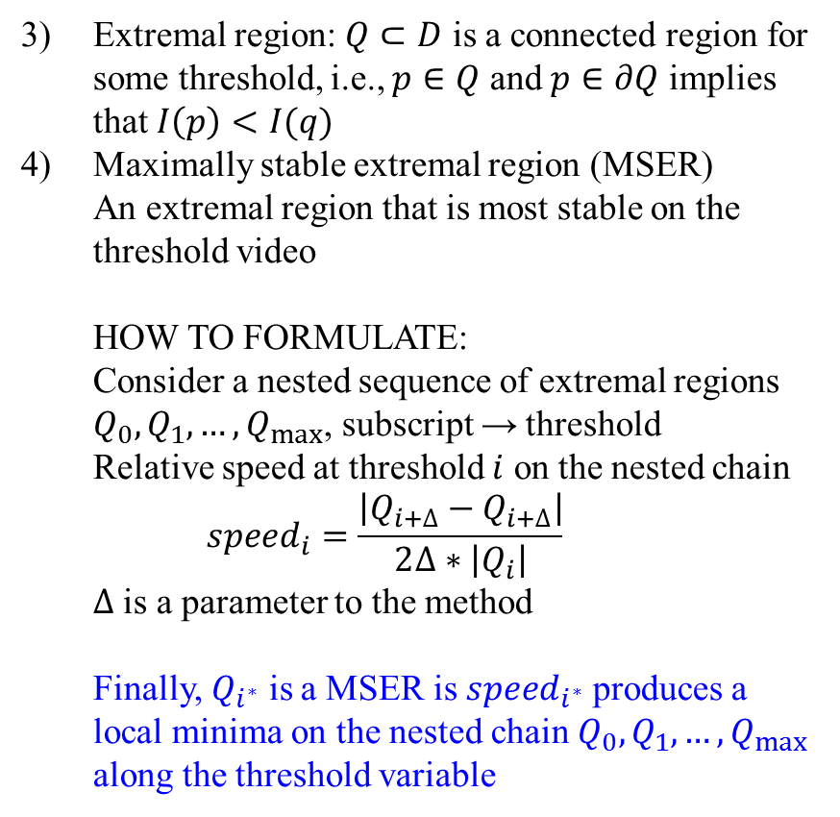
MSER: mathematical formulation
Extremal region: $Q⊂D$ is a connected region for some threshold, i.e., $p∈Q$ and $p∈∂Q$ implies that $I\left(p\right)<I(q)$
Maximally stable extremal region (MSER)
An extremal region that is most stable on the threshold video
HOW TO FORMULATE:
Consider a nested sequence of extremal regions $Q_{0},Q_{1}, …, Q_{max}$, subscript → threshold
Relative speed at threshold $i$ on the nested chain
$speed_{i}=\frac{\left|Q_{i+∆}−Q_{i+∆}\right|}{2∆∗\left|Q_{i}\right|}$
$∆$ is a parameter to the method
Finally, $Q_{i^{∗}}$ is a MSER is $speed_{i^{∗}}$ produces a local minima on the nested chain $Q_{0},Q_{1}, …, Q_{max}$ along the threshold variable

Slide 26
MSER: properties
Invariance under monotonic transforms M : I→I of image intensities
Invariance under homeomorphic transformations (adjacency preserving) T: C→C of the image space
Stability: extremal regions that remain virtually unchanged over a threshold range are selected
Multi-scale detection: Extremal regions of all scales are detected simultaneously
The set of all MSERs are enumerated in O(n*log log n) time, where n is the number of image pixels

Slide 27
Algorithm: MSER enumeration
Input: Image I and the Δ parameter
Output: List of nested extremal regions
For all pixels shorted by intensity
  Place a pixel in the image as its tern come
  Update the connected component structure
  Update the area for the effected connected components
For all connected components
  Detect regions with local minima w.r.t. rate of change of connected component area with threshold; define each such region as a MSER

Slide 28
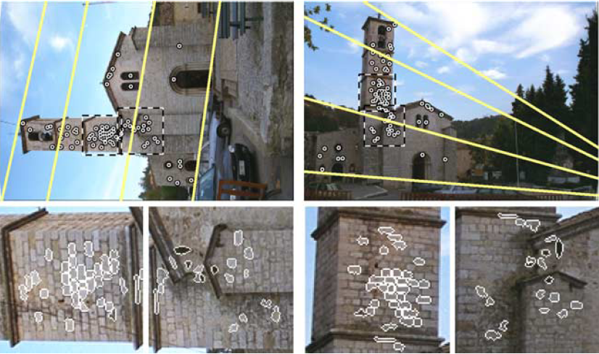
Examples

Slide 29
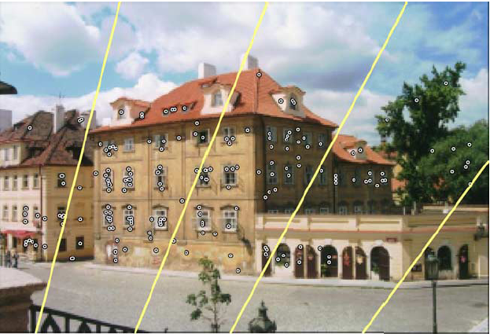
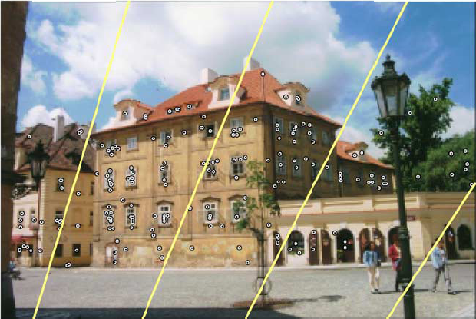
Examples

