Slide 1
55:148 Digital Image Processing
Chapter 11
3D Vision, Geometry
Topics:
  Basics of projective geometry
    Points and hyperplanes in projective space
    Homography
    Estimating homography from point correspondence
  The single perspective camera
    An overview of single camera calibration
    Calibration of one camera from the known scene
  Scene reconstruction from multiple views
  Triangulation
  Projective reconstruction
  Matching constraints
  Bundle adjustment
  Two cameras, stereopsis
    The geometry of two cameras. The fundamental matrix
    Relative motion of the camera; the essential matrix
    Estimation of a fundamental matrix from image point correspondences
    Camera Image rectification
    Applications of the epipolar geometry in vision
  Three and more cameras
    Stereo correspondence algorithms

Slide 2
Image epipolar rectification
Illustrative description
Both image planes being coplanar
Baseline along the horizontal axis (x-axis) of the image plane
Two epipoles at infinity along the horizontal direction
Horizontal epipolar lines
Method: Apply suitable homographic transformation on each image
Before
After

Slide 3
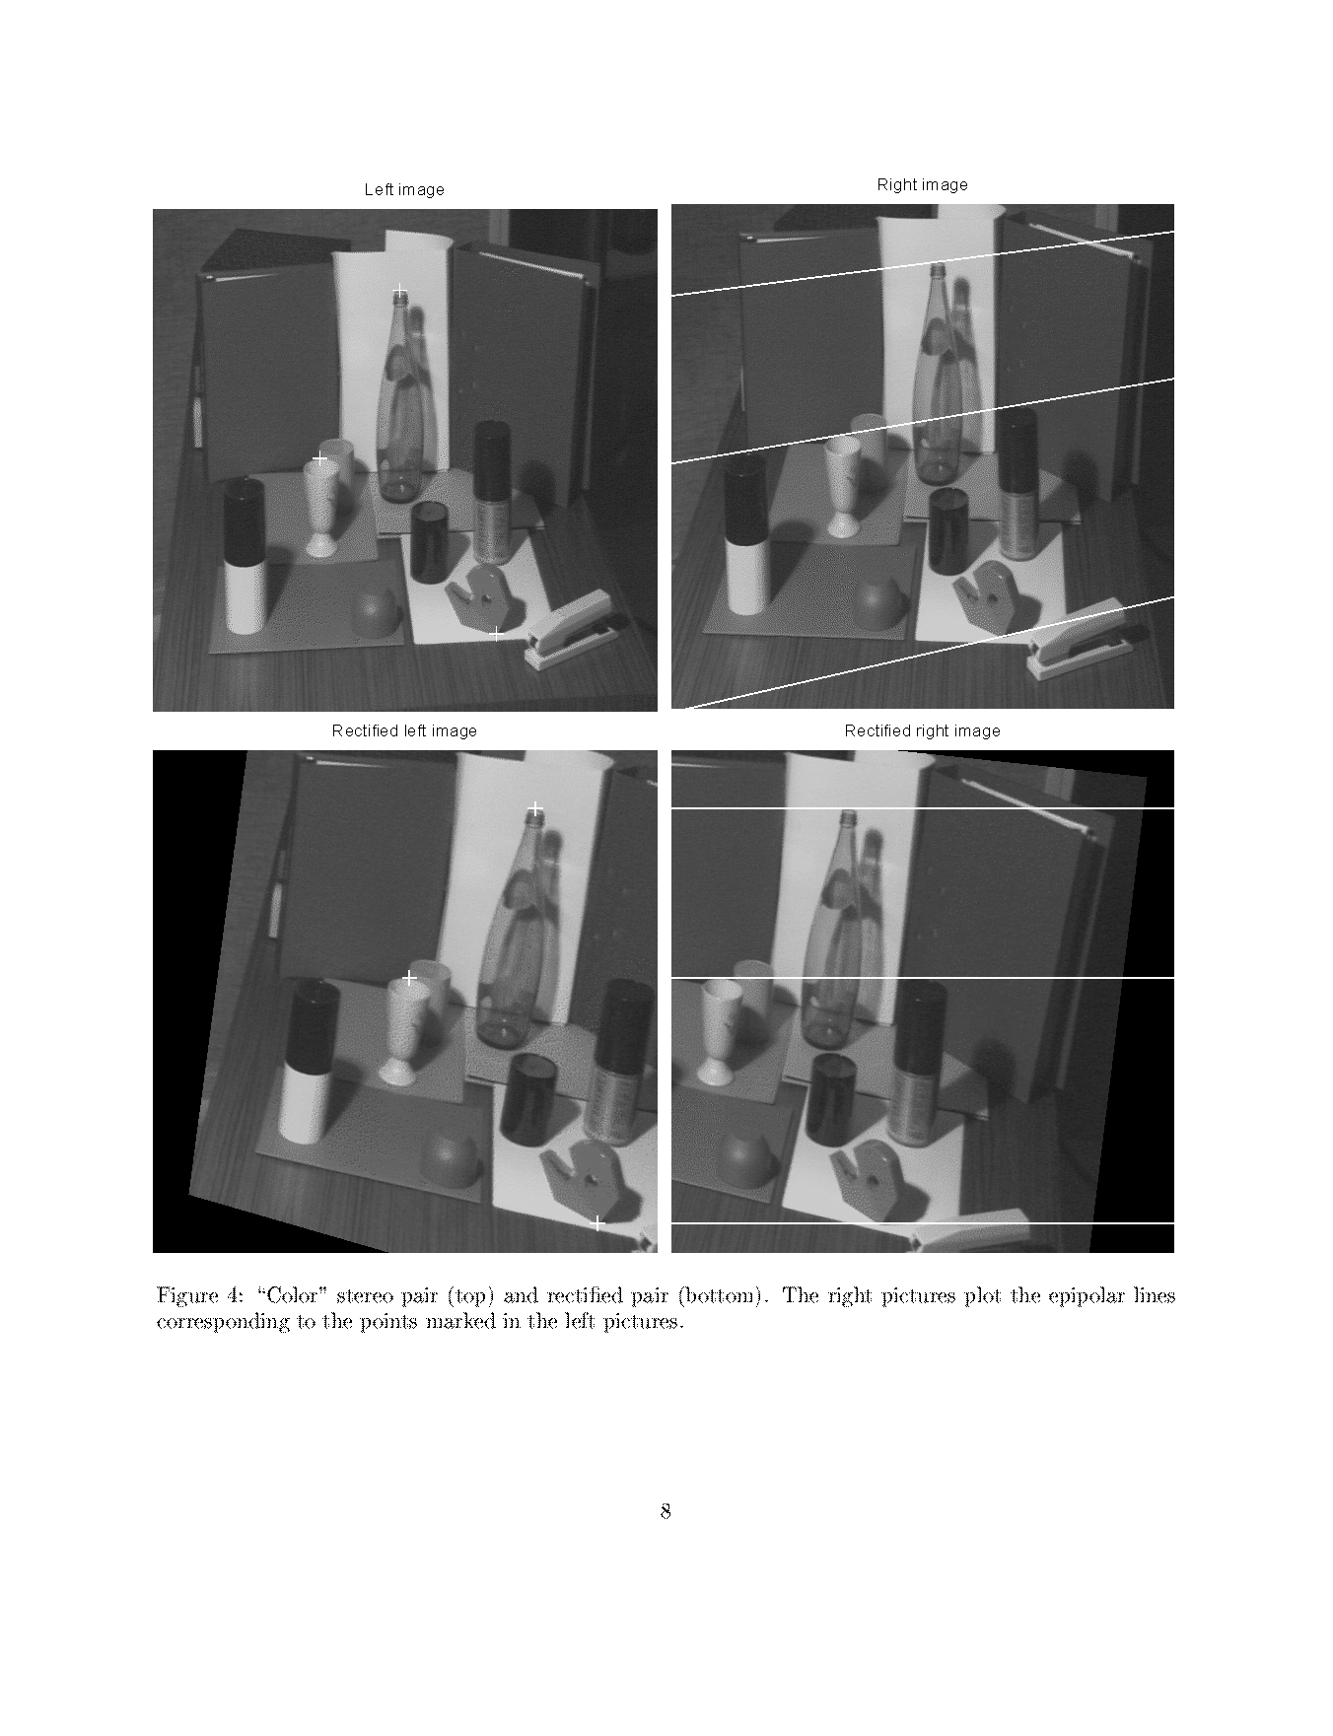
Image rectification (before)

Slide 4
Image rectification (after)

Slide 5
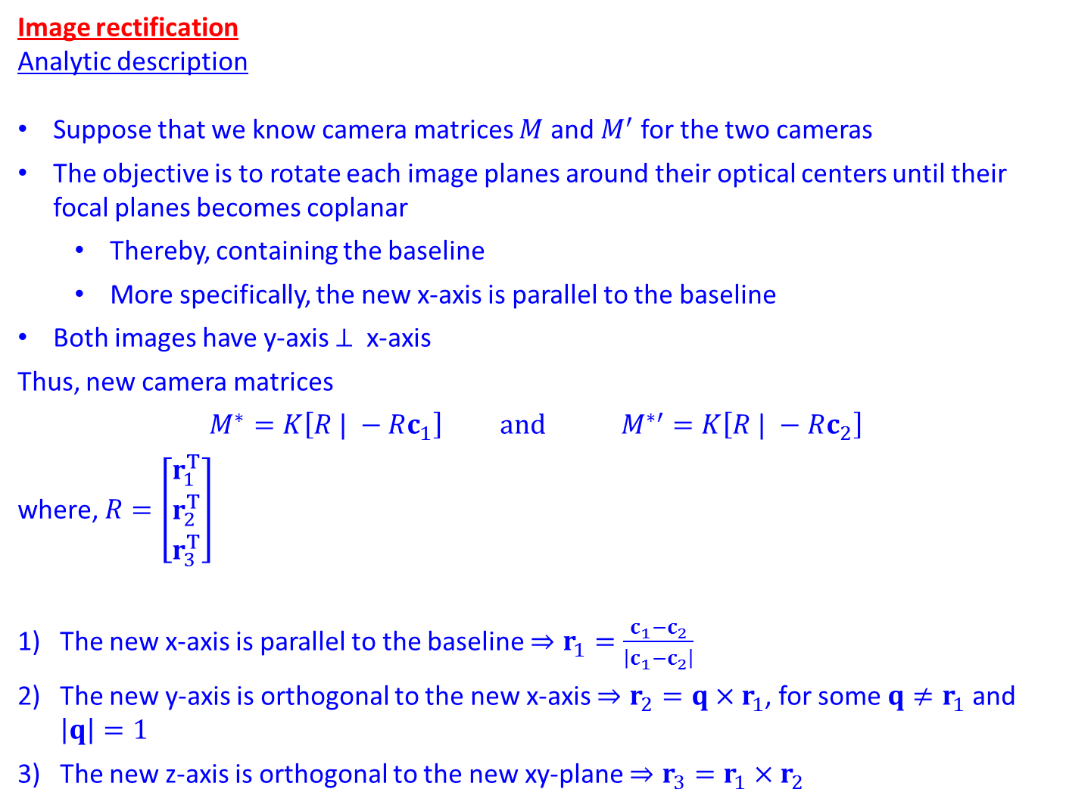
Image rectification
Analytic description
Suppose that we know camera matrices $M$ and $M^{′}$ for the two cameras
The objective is to rotate each image planes around their optical centers until their focal planes becomes coplanar
  Thereby, containing the baseline
  More specifically, the new x-axis is parallel to the baseline
Both images have y-axis $⊥$ x-axis
Thus, new camera matrices
$$M^{∗}=K\left[R | −Rc_{1}\right] and M^{∗′}=K\left[R | −Rc_{2}\right]$$
where, $R=\left[\begin{matrix}r_{1}^{T} \\ r_{2}^{T} \\ r_{3}^{T}\end{matrix}\right]$
The new x-axis is parallel to the baseline $⇒r_{1}=\frac{c_{1}−c_{2}}{\left|c_{1}−c_{2}\right|}$
The new y-axis is orthogonal to the new x-axis $⇒r_{2}=q×r_{1}$, for some $q≠r_{1}$ and $\left|q\right|=1$
The new z-axis is orthogonal to the new xy-plane $⇒r_{3}=r_{1}×r_{2}$

Slide 6
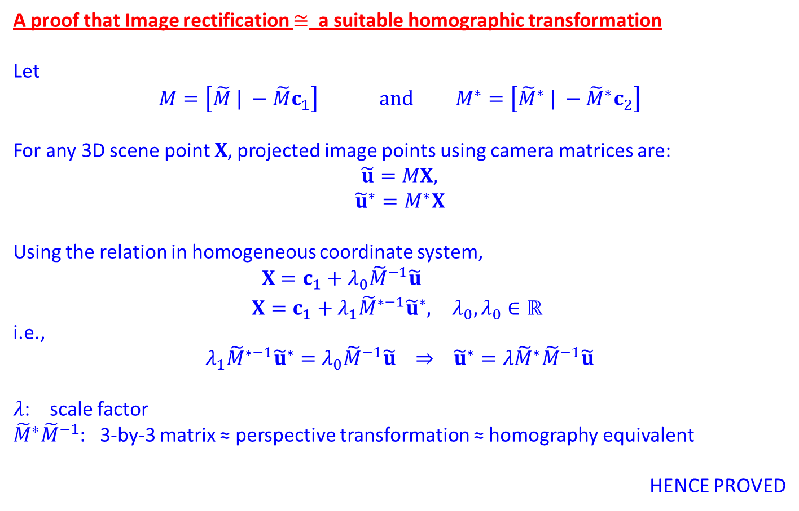
A proof that Image rectification $≅$ a suitable homographic transformation
Let
$$M=\left[\tilde{M} | −\tilde{M}c_{1}\right] and M^{∗}=\left[{\tilde{M}}^{∗} | −{\tilde{M}}^{∗}c_{2}\right]$$
For any 3D scene point $X$, projected image points using camera matrices are:
$$\tilde{u}=MX,$$
$${\tilde{u}}^{∗}=M^{∗}X$$
Using the relation in homogeneous coordinate system,
$$\begin{matrix}X=c_{1}+λ_{0}{\tilde{M}}^{−1}\tilde{u} & \\ X=c_{1}+λ_{1}{\tilde{M}}^{∗−1}{\tilde{u}}^{∗}, & λ_{0},λ_{0}∈ℝ \end{matrix}$$
i.e.,
$$λ_{1}{\tilde{M}}^{∗−1}{\tilde{u}}^{∗}=λ_{0}{\tilde{M}}^{−1}\tilde{u} ⇒ {\tilde{u}}^{∗}=λ{\tilde{M}}^{∗}{\tilde{M}}^{−1}\tilde{u}$$
$λ$: scale factor
${\tilde{M}}^{∗}{\tilde{M}}^{−1}$: 3-by-3 matrix ≈ perspective transformation ≈ homography equivalent
HENCE PROVED

Slide 7
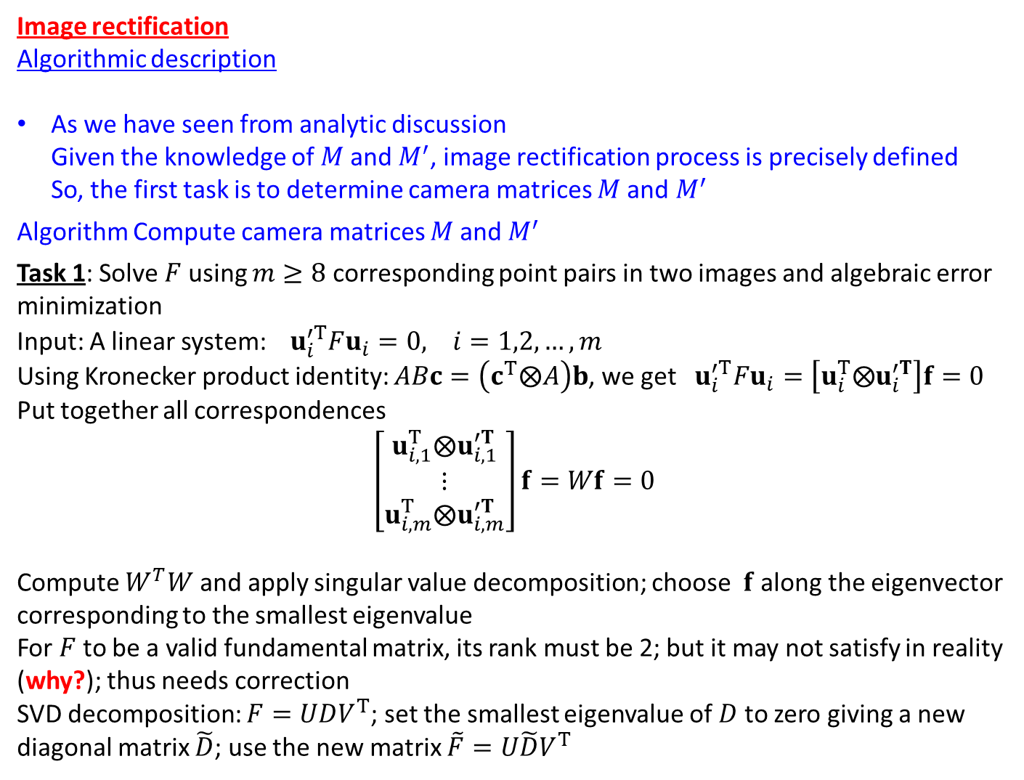
Image rectification
Algorithmic description
As we have seen from analytic discussion
Given the knowledge of $M$and $M^{′}$, image rectification process is precisely defined
So, the first task is to determine camera matrices $M$and $M^{′}$
Algorithm Compute camera matrices $M$and $M^{′}$
Task 1: Solve $F$ using $m≥8$ corresponding point pairs in two images and algebraic error minimization
Input: A linear system: $u_{i}^{′T}Fu_{i}=0, i=1,2,…, m$
Using Kronecker product identity: $ABc=\left(c^{T}⨂A\right)b$, we get $u_{i}^{′T}Fu_{i}=\left[u_{i}^{T}⨂u_{i}^{′T}\right]f=0$
Put together all correspondences
$$\left[\begin{matrix}u_{i,1}^{T}⨂u_{i,1}^{′T} \\ ⋮ \\ u_{i,m}^{T}⨂u_{i,m}^{′T}\end{matrix}\right]f=Wf=0$$
Compute $W^{T}W$ and apply singular value decomposition; choose $f$ along the eigenvector corresponding to the smallest eigenvalue
For $F$ to be a valid fundamental matrix, its rank must be 2; but it may not satisfy in reality (why?); thus needs correction
SVD decomposition: $F=UDV^{T}$; set the smallest eigenvalue of $D$ to zero giving a new diagonal matrix $\tilde{D}$; use the new matrix $\tilde{F}=U\tilde{D}V^{T}$
Note that ML estimation method incorporate the validity condition of F into the optimization process

Slide 8
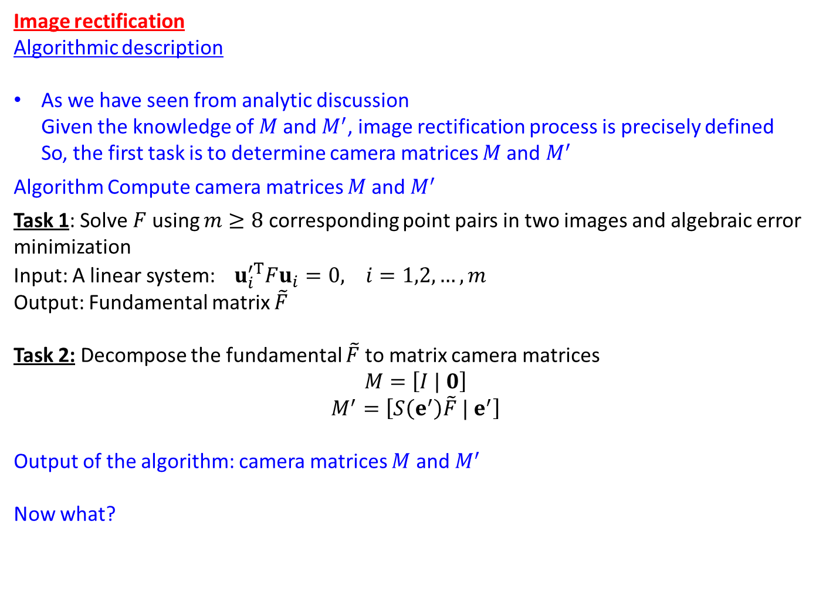
Image rectification
Algorithmic description
As we have seen from analytic discussion
Given the knowledge of $M$and $M^{′}$, image rectification process is precisely defined
So, the first task is to determine camera matrices $M$and $M^{′}$
Algorithm Compute camera matrices $M$and $M^{′}$
Task 1: Solve $F$ using $m≥8$ corresponding point pairs in two images and algebraic error minimization
Input: A linear system: $u_{i}^{′T}Fu_{i}=0, i=1,2,…, m$
Output: Fundamental matrix $\tilde{F}$
Task 2: Decompose the fundamental $\tilde{F}$to matrix camera matrices
$$M=\left[I | 0\right]$$
$$M^{′}=\left[S\left(e^{′}\right)\tilde{F} | e^{′}\right]$$
Output of the algorithm: camera matrices $M$ and $M^{′}$
Now what?

Slide 9
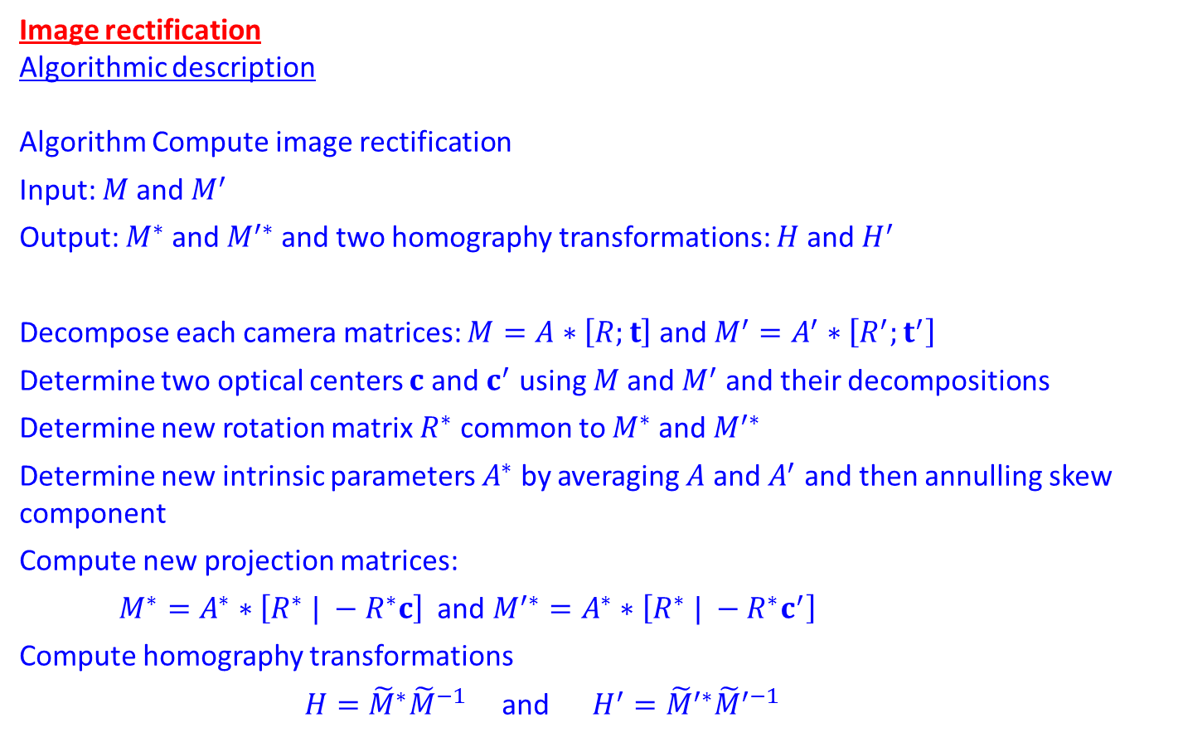
Image rectification
Algorithmic description
Algorithm Compute image rectification
Input: $M$and $M^{′}$
Output: $M^{∗}$and $M^{′∗}$ and two homography transformations: $H$and $H^{′}$
Decompose each camera matrices: $M=A∗\left[R;t\right]$ and $M^{′}=A^{′}∗\left[R^{′};t^{′}\right]$
Determine two optical centers $c$ and $c^{′}$ using $M$and $M^{′}$ and their decompositions
Determine new rotation matrix $R^{∗}$ common to $M^{∗}$and $M^{′∗}$
Determine new intrinsic parameters $A^{∗}$ by averaging $A$ and $A^{′}$ and then annulling skew component
Compute new projection matrices:
$M^{∗}=A^{∗}∗\left[R^{∗} | −R^{∗}c\right]$ and $M^{′∗}=A^{∗}∗\left[R^{∗} | −R^{∗}c^{′}\right]$
Compute homography transformations
$H={\tilde{M}}^{∗}{\tilde{M}}^{−1}$ and $H^{′}={\tilde{M}}^{′∗}{\tilde{M}}^{′−1}$

Slide 10
Image rectification (before)

Slide 11
Image rectification (after)

Slide 12
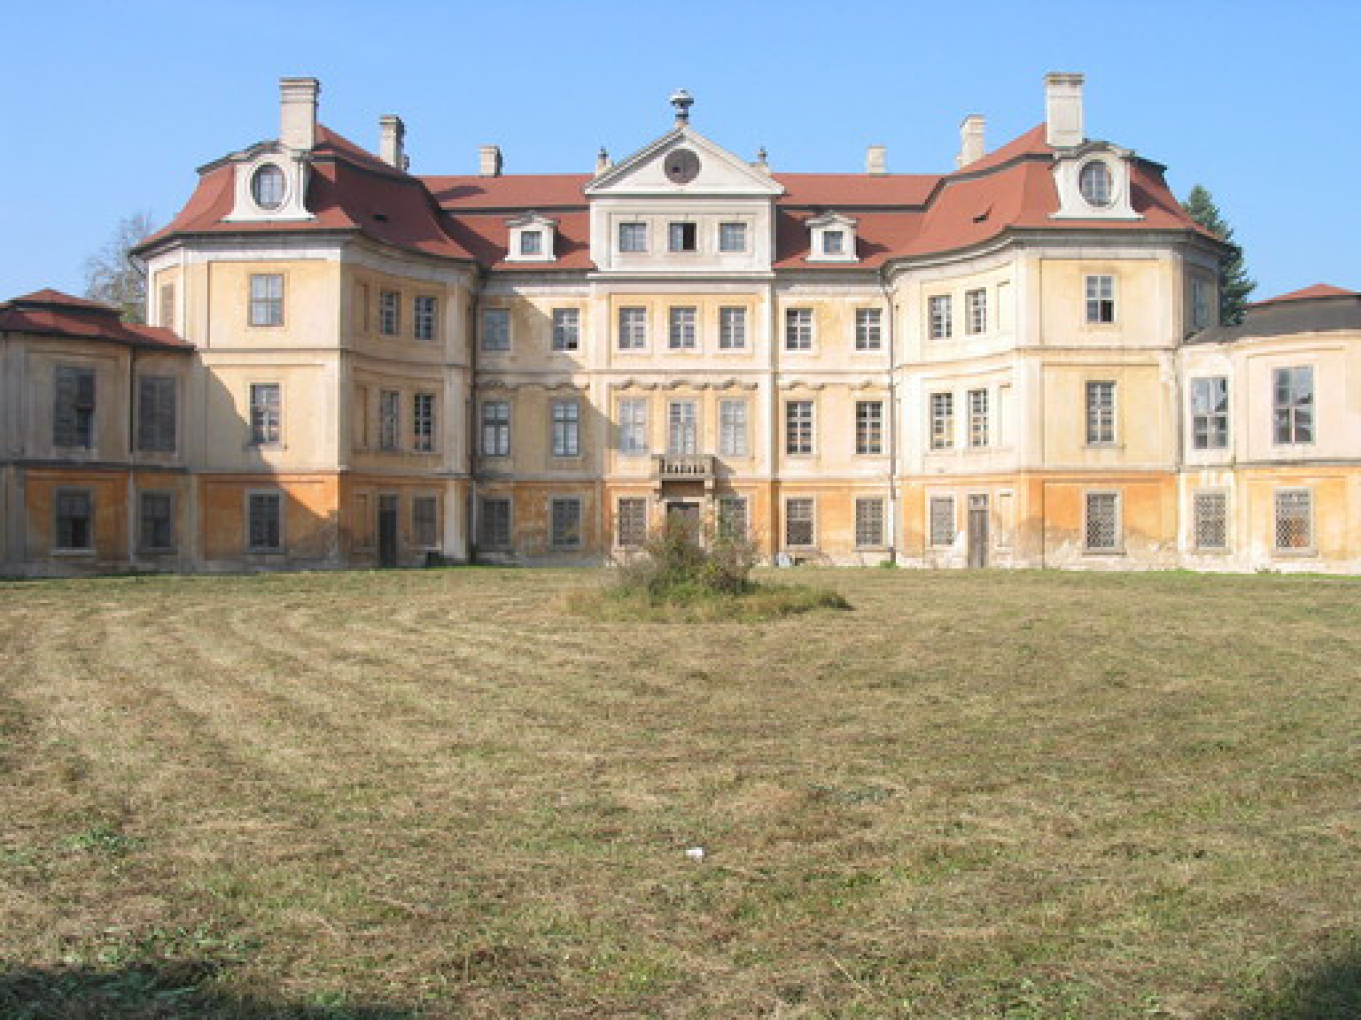
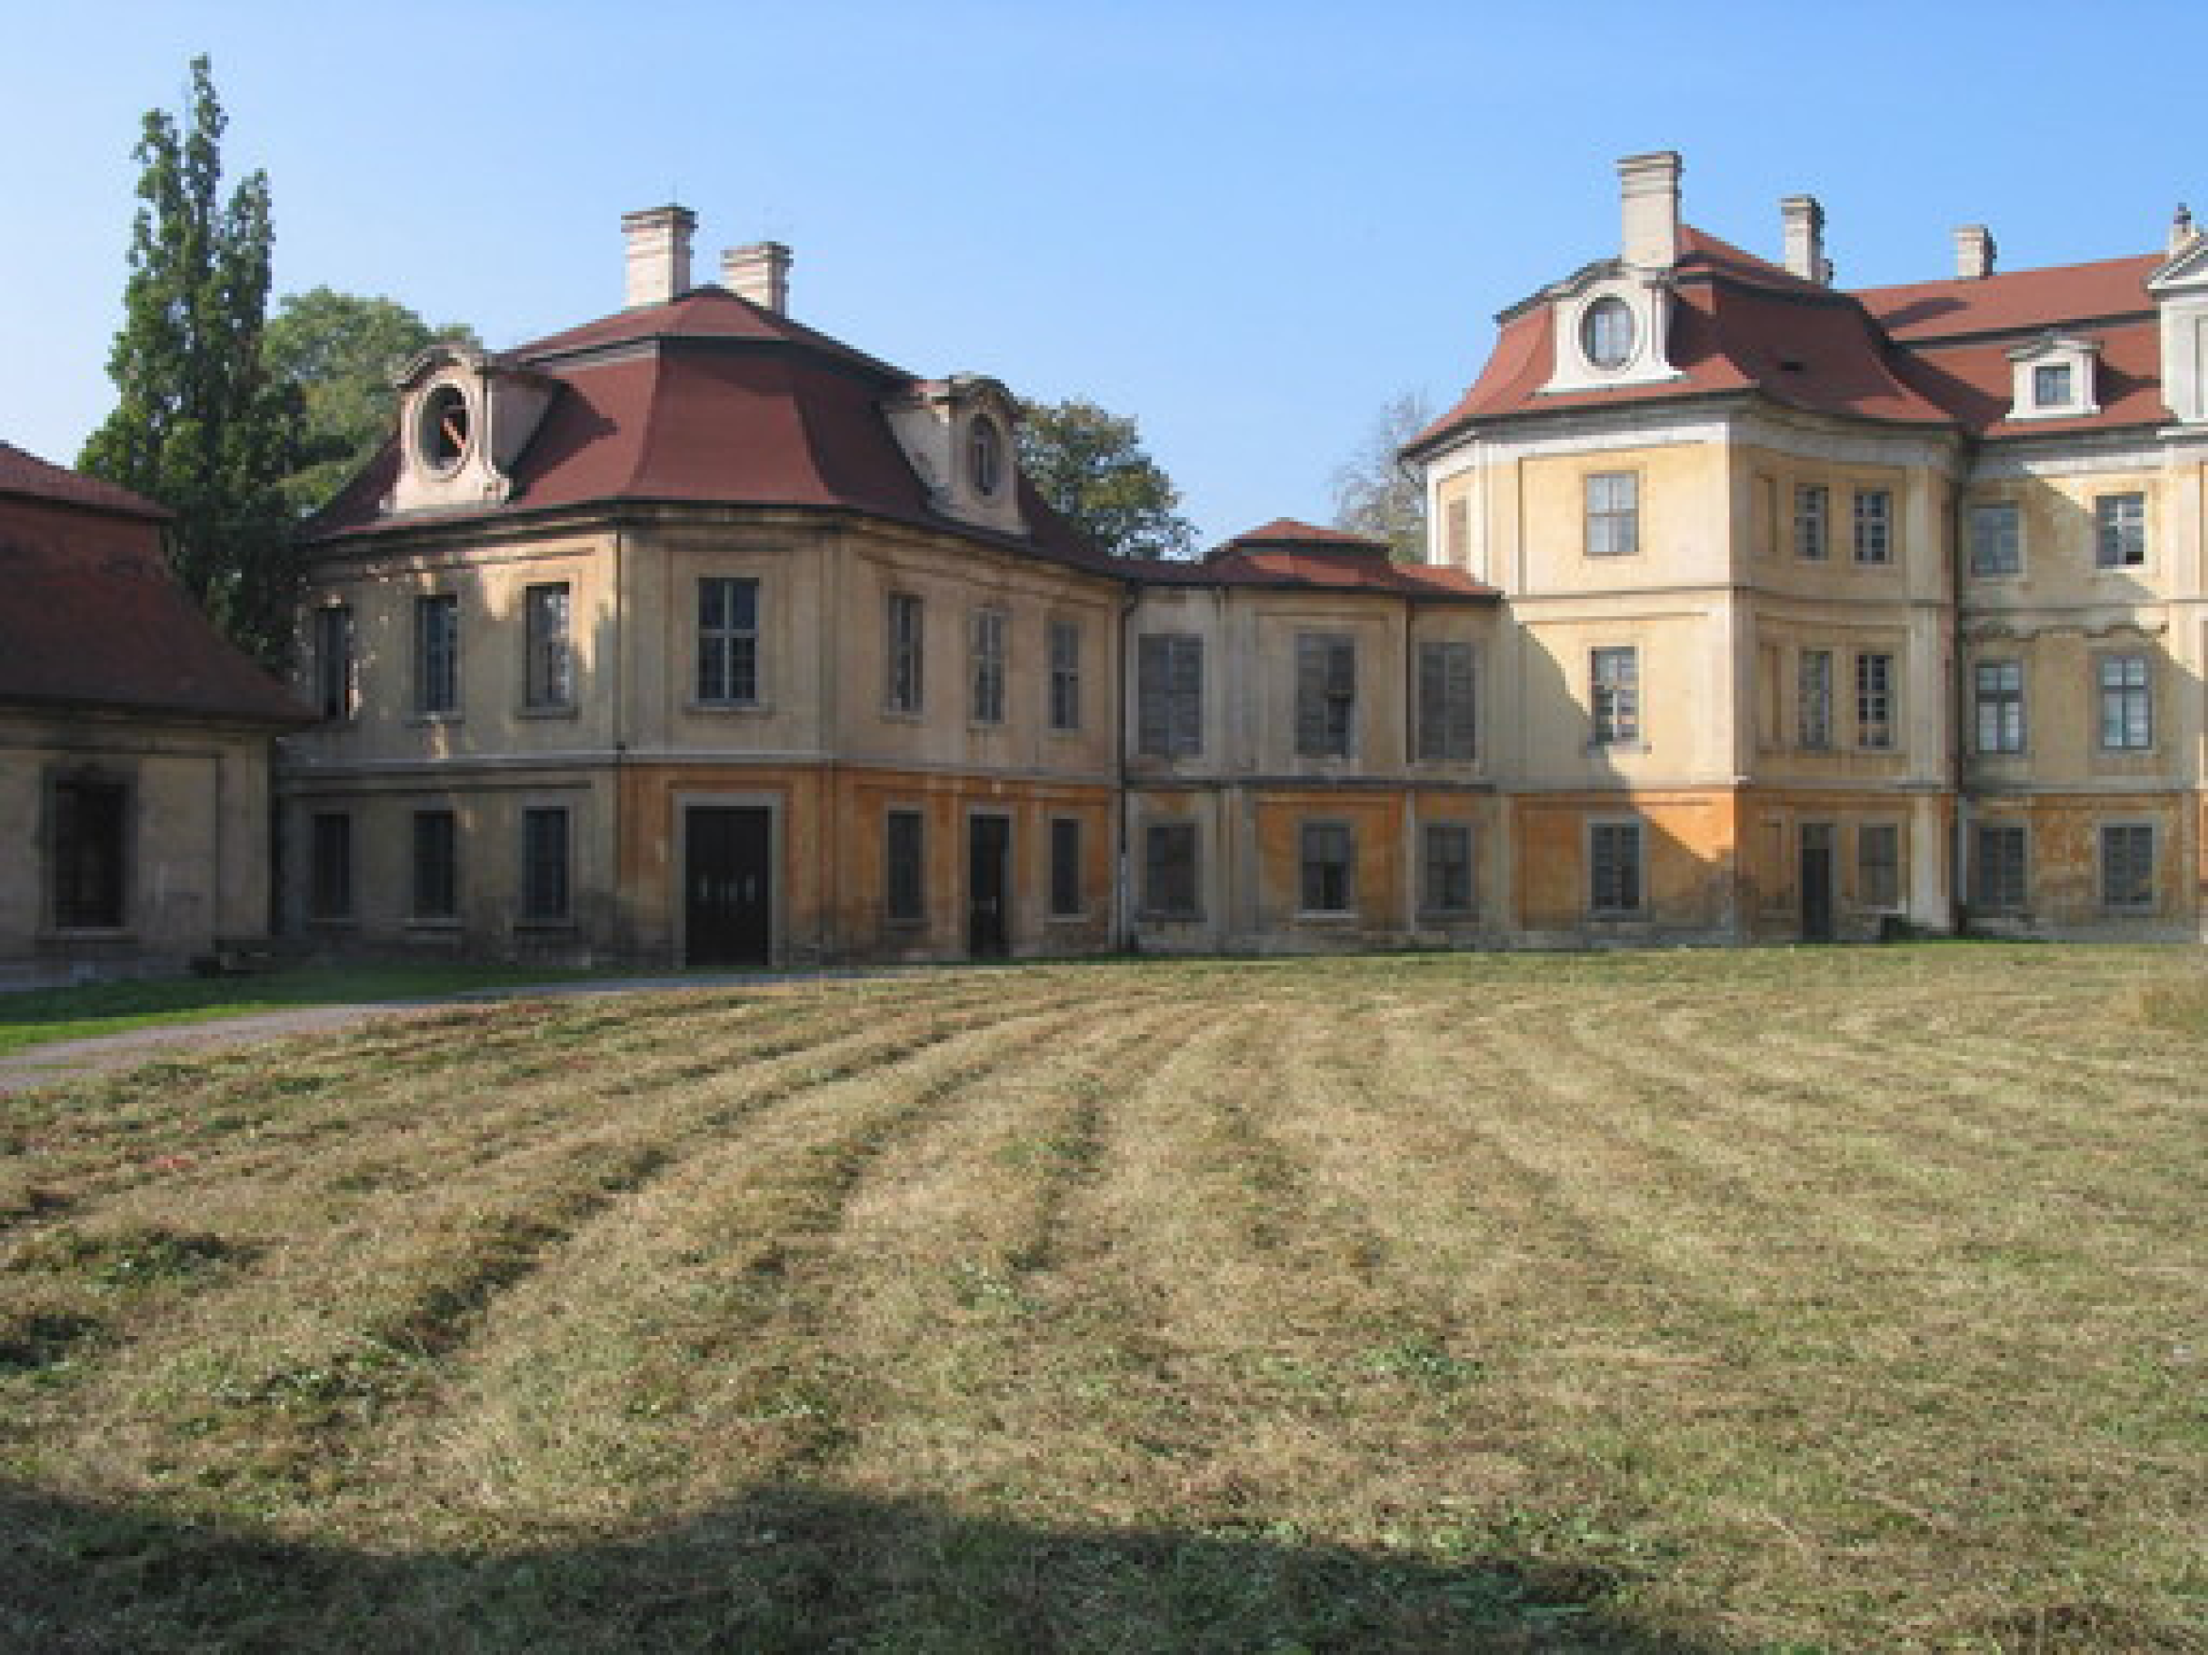
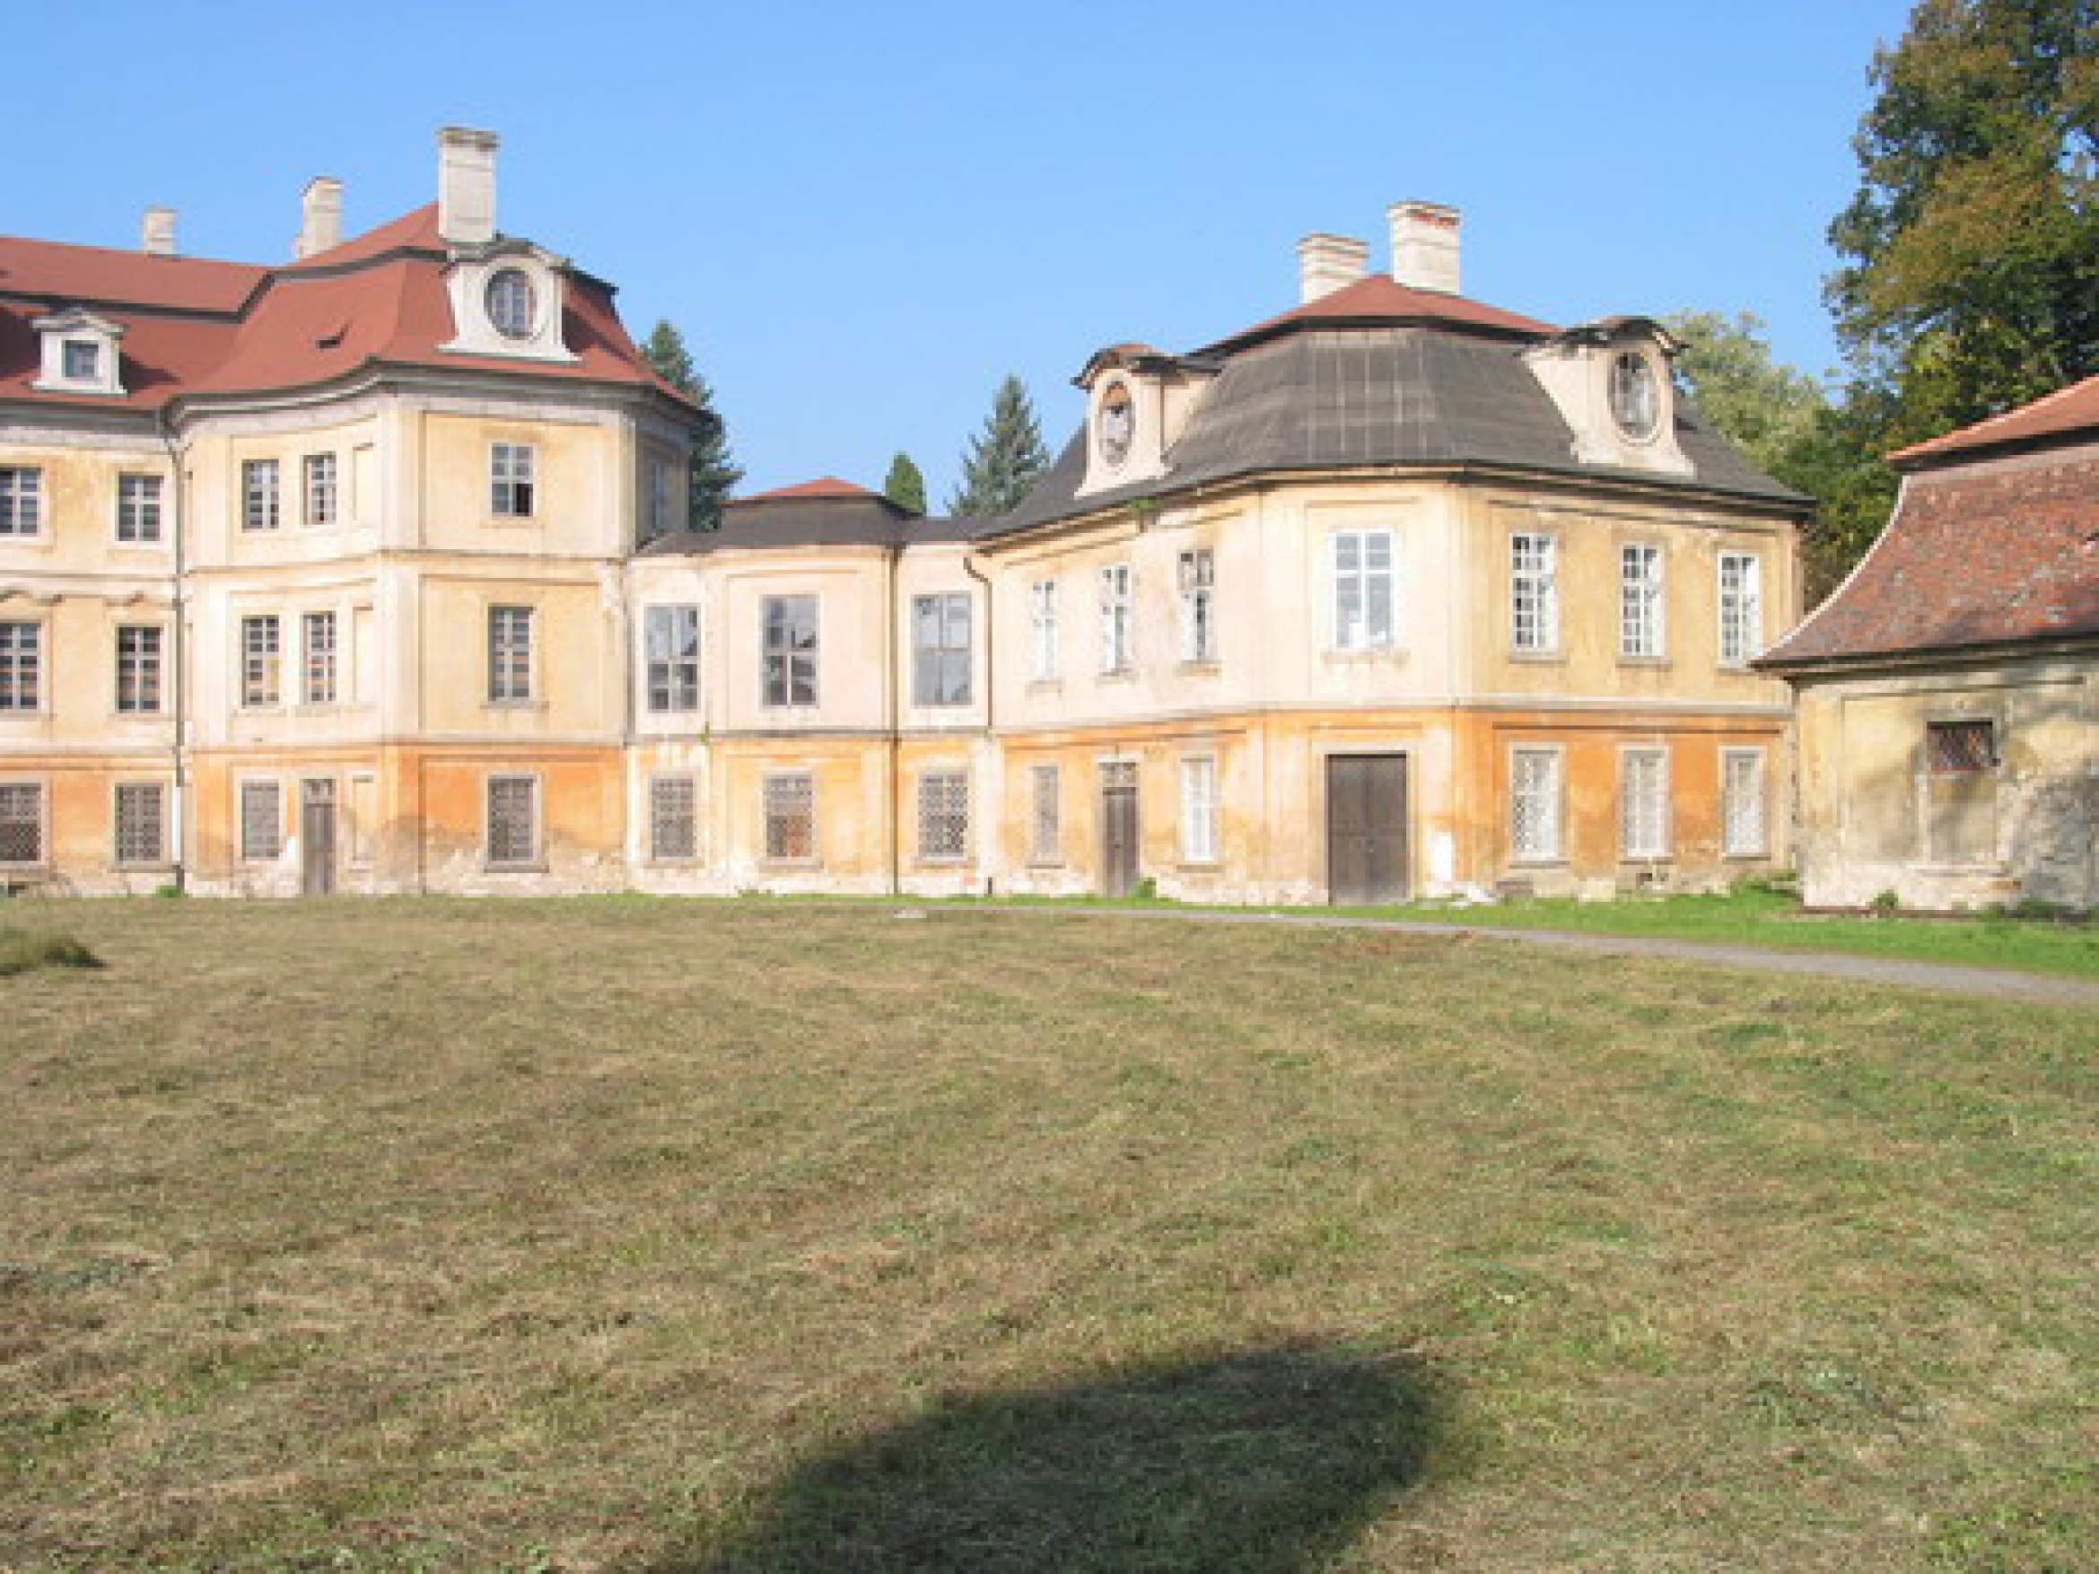
Image rectification: application
3D reconstruction becomes easier
b
a
c

Slide 13
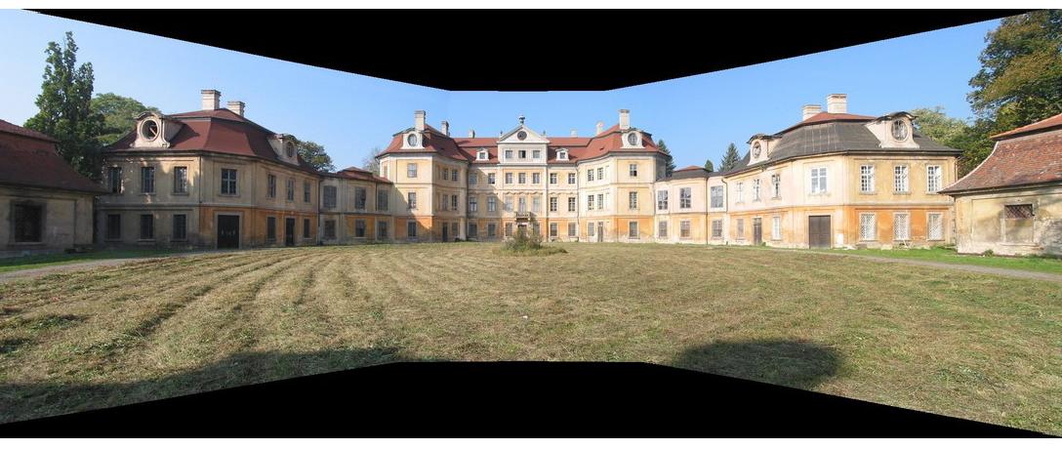
Panoramic view

Slide 14
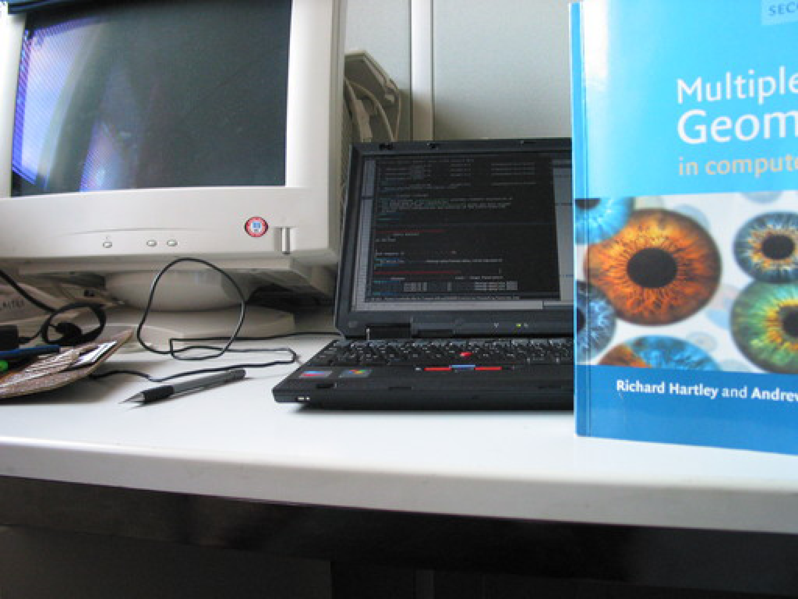
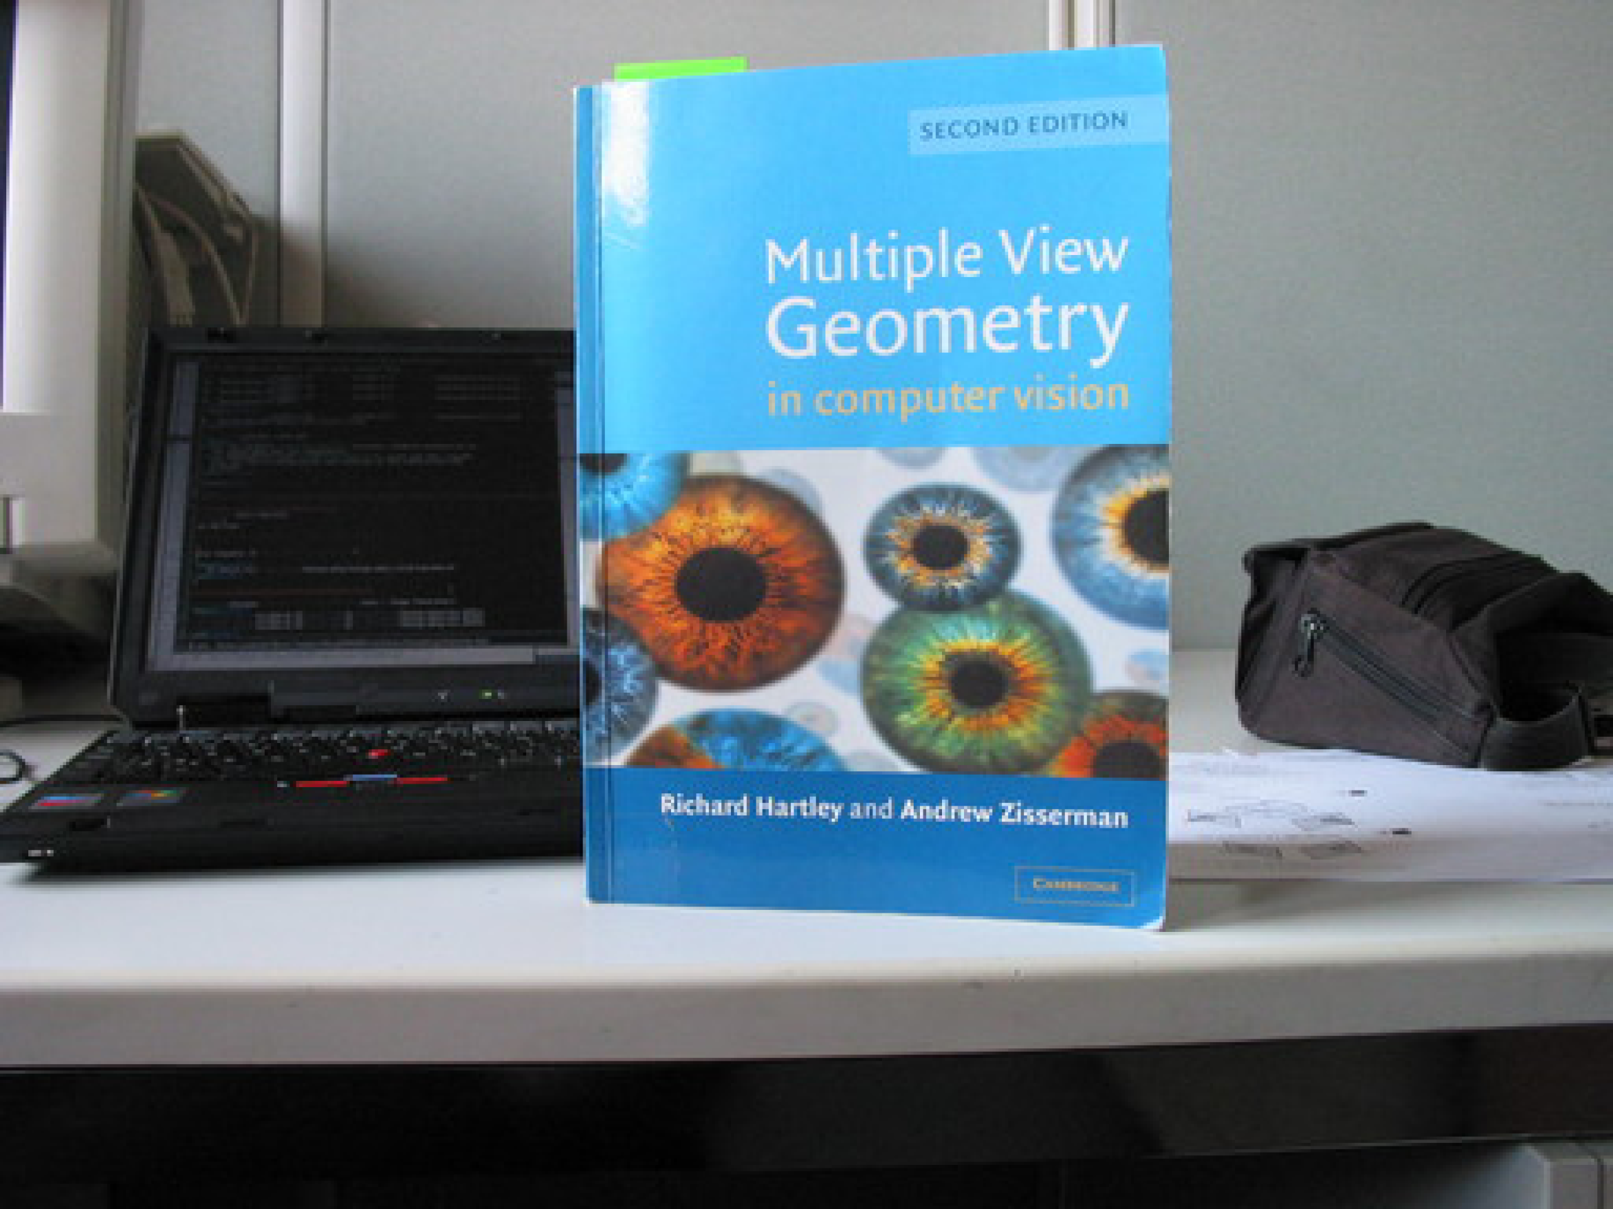
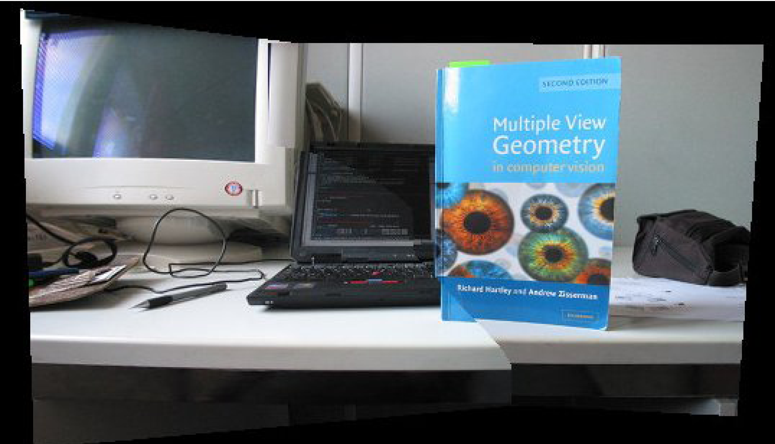
Panoramic view: challenges

Slide 15
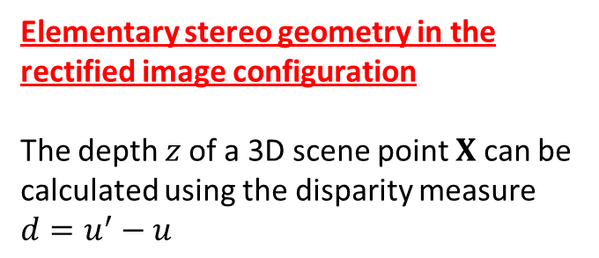
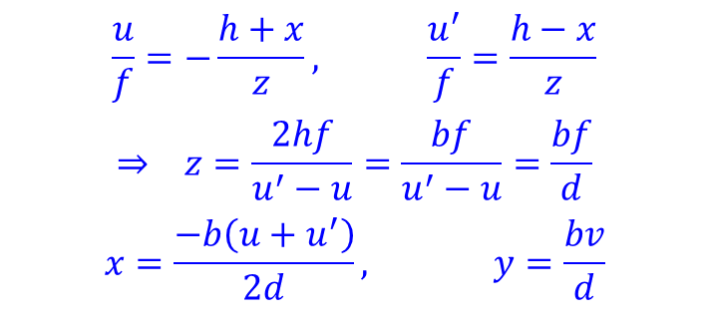
Elementary stereo geometry in the rectified image configuration
The depth $z$of a 3D scene point $X$ can be calculated using the disparity measure $d=u^{′}−u$
$$\frac{u}{f}=−\frac{h+x}{z}, \frac{u^{′}}{f}=\frac{h−x}{z}$$
$$⇒ z=\frac{2hf}{u^{′}−u}=\frac{bf}{u^{′}−u}=\frac{bf}{d}$$
$$x=\frac{−b\left(u+u^{′}\right)}{2d}, y=\frac{bv}{d}$$

