Slide 1
55:148 Digital Image Processing
Chapter 11
3D Vision, Geometry
Topics:
  Basics of projective geometry
    Points and hyperplanes in projective space
    Homography
    Estimating homography from point correspondence
  The single perspective camera
    An overview of single camera calibration
    Calibration of one camera from the known scene
  Scene reconstruction from multiple views
  Triangulation
  Projective reconstruction
  Matching constraints
  Bundle adjustment
  Two cameras, stereopsis
    The geometry of two cameras. The fundamental matrix
    Relative motion of the camera; the essential matrix
    Estimation of a fundamental matrix from image point correspondences
    Applications of the epipolar geometry in vision
  Three and more cameras
    Stereo correspondence algorithms

Slide 2
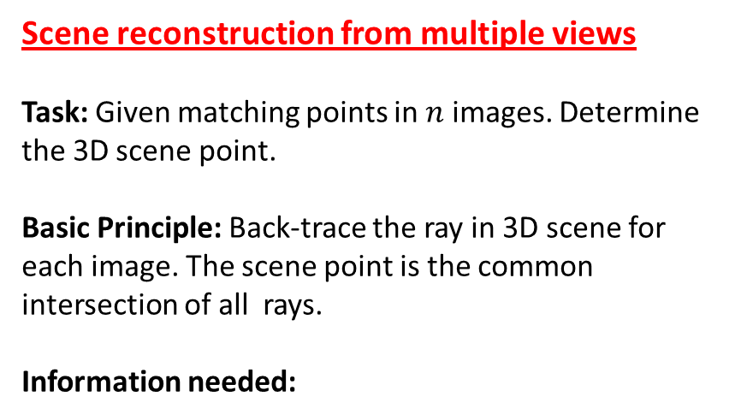
Scene reconstruction from multiple views
Task: Given matching points in $n$ images. Determine the 3D scene point.
Basic Principle: Back-trace the ray in 3D scene for each image. The scene point is the common intersection of all rays.
Information needed:

Slide 3
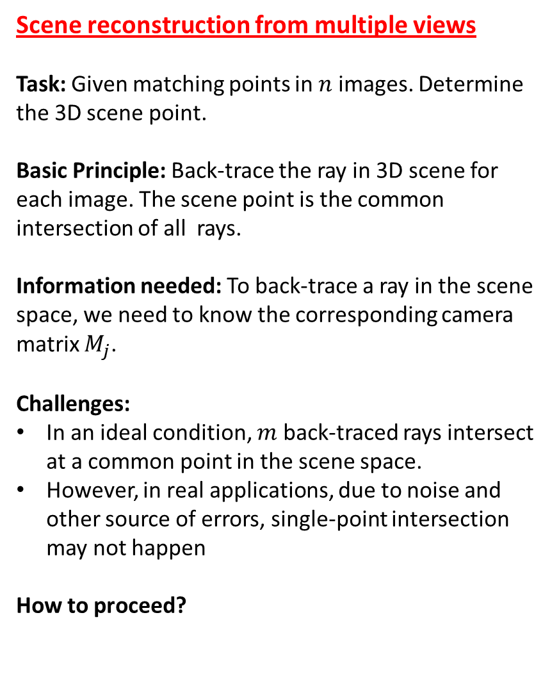
Scene reconstruction from multiple views
Task: Given matching points in $n$ images. Determine the 3D scene point.
Basic Principle: Back-trace the ray in 3D scene for each image. The scene point is the common intersection of all rays.
Information needed: To back-trace a ray in the scene space, we need to know the corresponding camera matrix $M_{j}$.
Challenges:
In an ideal condition, $m$ back-traced rays intersect at a common point in the scene space.
However, in real applications, due to noise and other source of errors, single-point intersection may not happen
How to proceed?

Slide 4
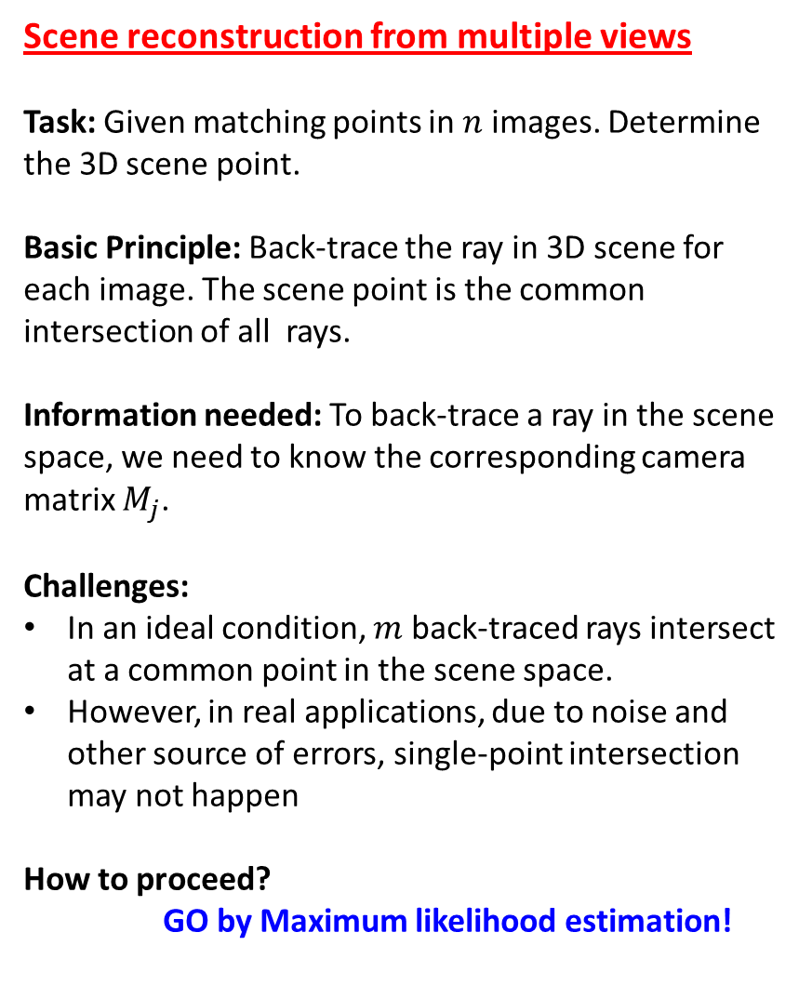
Scene reconstruction from multiple views
Task: Given matching points in $n$ images. Determine the 3D scene point.
Basic Principle: Back-trace the ray in 3D scene for each image. The scene point is the common intersection of all rays.
Information needed: To back-trace a ray in the scene space, we need to know the corresponding camera matrix $M_{j}$.
Challenges:
In an ideal condition, $m$ back-traced rays intersect at a common point in the scene space.
However, in real applications, due to noise and other source of errors, single-point intersection may not happen
How to proceed?
GO by Maximum likelihood estimation!

Slide 5
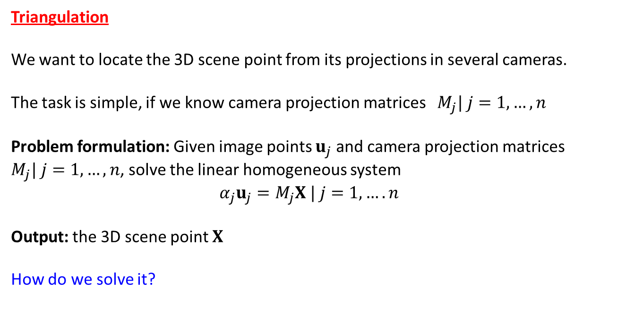
Triangulation
We want to locate the 3D scene point from its projections in several cameras.
The task is simple, if we know camera projection matrices $M_{j}| j=1, …, n$
Problem formulation: Given image points $u_{j}$ and camera projection matrices $M_{j}| j=1, …, n$, solve the linear homogeneous system
$$α_{j}u_{j}=M_{j}X | j=1, …. n$$
Output: the 3D scene point $X$
How do we solve it?

Slide 6
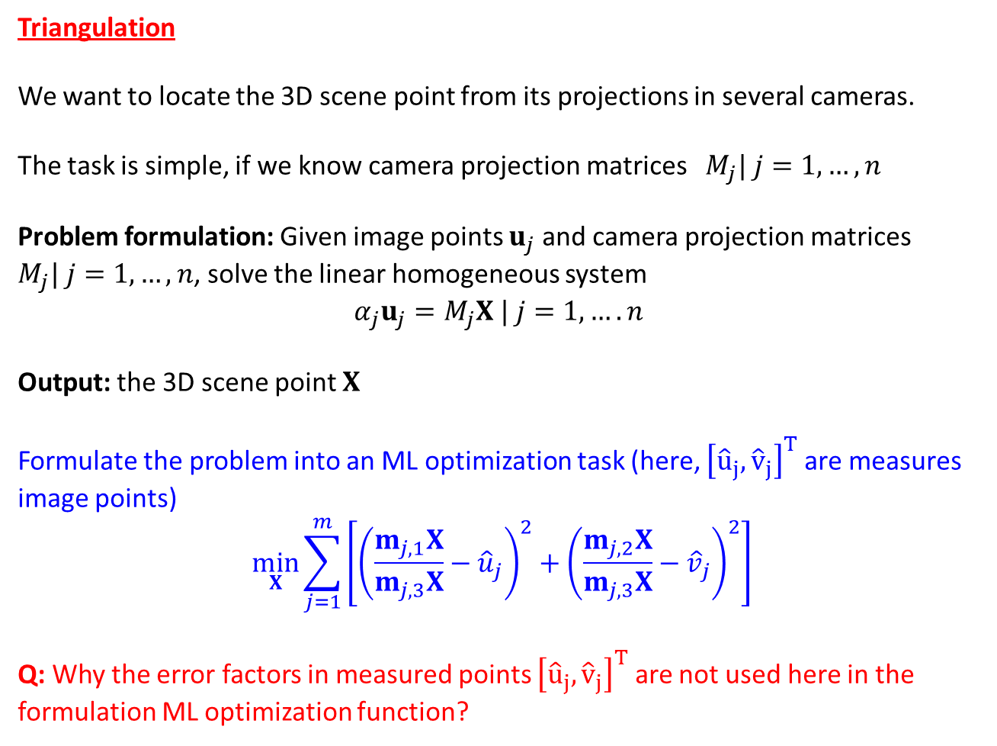
Triangulation
We want to locate the 3D scene point from its projections in several cameras.
The task is simple, if we know camera projection matrices $M_{j}| j=1, …, n$
Problem formulation: Given image points $u_{j}$ and camera projection matrices $M_{j}| j=1, …, n$, solve the linear homogeneous system
$$α_{j}u_{j}=M_{j}X | j=1, …. n$$
Output: the 3D scene point $X$
Formulate the problem into an ML optimization task (here, ${\left[{\hat{u}}_{j},{\hat{v}}_{j}\right]}^{T}$ are measures image points)
$$\min_{X}{\sum_{j=1}^{m}{\left[{\left(\frac{m_{j,1}X}{m_{j,3}X}−{\hat{u}}_{j}\right)}^{2}+{\left(\frac{m_{j,2}X}{m_{j,3}X}−{\hat{v}}_{j}\right)}^{2}\right]}}$$
Q: Why the error factors in measured points ${\left[{\hat{u}}_{j},{\hat{v}}_{j}\right]}^{T}$ are not used here in the formulation ML optimization function?

Slide 7
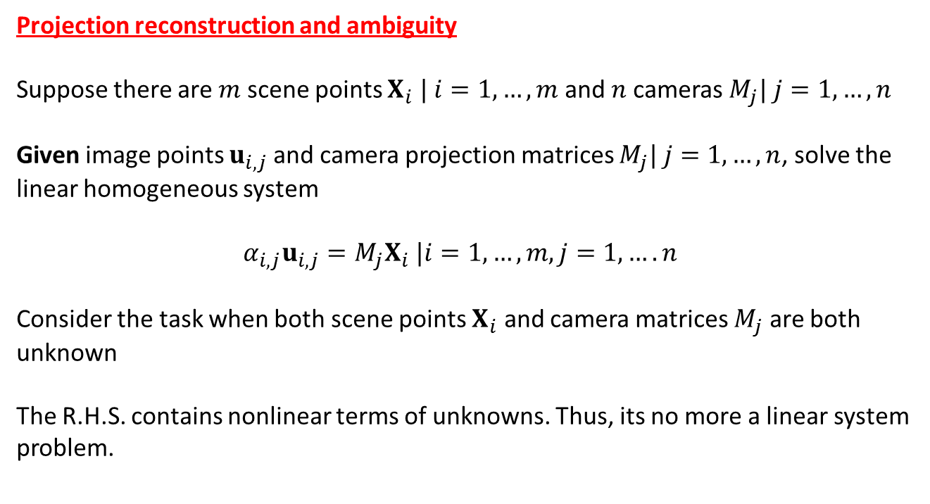
Projection reconstruction and ambiguity
Suppose there are $m$ scene points $X_{i} | i=1, …, m$ and $n$cameras $M_{j}| j=1, …, n$
Given image points $u_{i,j}$ and camera projection matrices $M_{j}| j=1, …, n$, solve the linear homogeneous system
$$α_{i,j}u_{i,j}=M_{j}X_{i} |i=1, …, m, j=1, …. n$$
Consider the task when both scene points $X_{i}$ and camera matrices $M_{j}$ are both unknown
The R.H.S. contains nonlinear terms of unknowns. Thus, its no more a linear system problem.

Slide 8
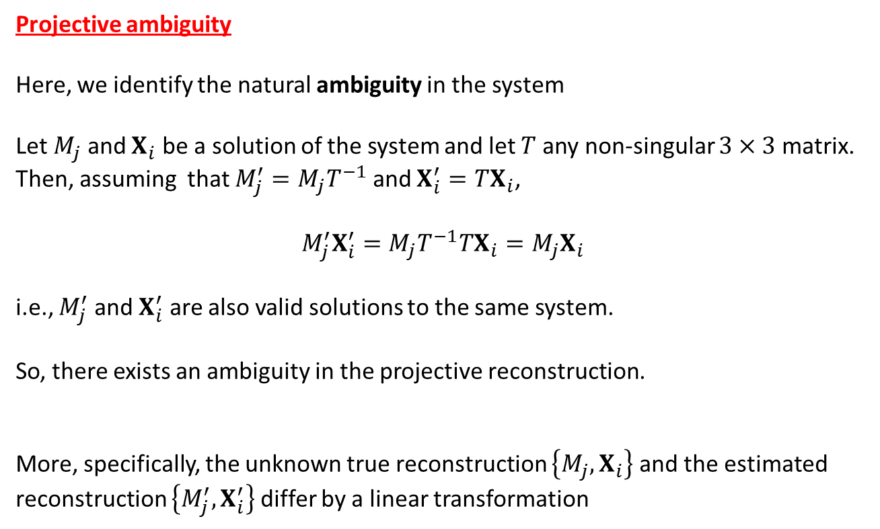
Projective ambiguity
Here, we identify the natural ambiguity in the system
Let $M_{j}$ and $X_{i}$ be a solution of the system and let $T$ any non-singular $3×3$ matrix.
Then, assuming that $M_{j}^{′}=M_{j}T^{−1}$ and $X_{i}^{′}=TX_{i}$,
$$M_{j}^{′}X_{i}^{′}=M_{j}T^{−1}TX_{i}=M_{j}X_{i}$$
i.e., $M_{j}^{′}$ and $X_{i}^{′}$ are also valid solutions to the same system.
So, there exists an ambiguity in the projective reconstruction.
More, specifically, the unknown true reconstruction $\left\{M_{j},X_{i}\right\}$ and the estimated reconstruction $\left\{M_{j}^{′},X_{i}^{′}\right\}$ differ by a linear transformation

Slide 9
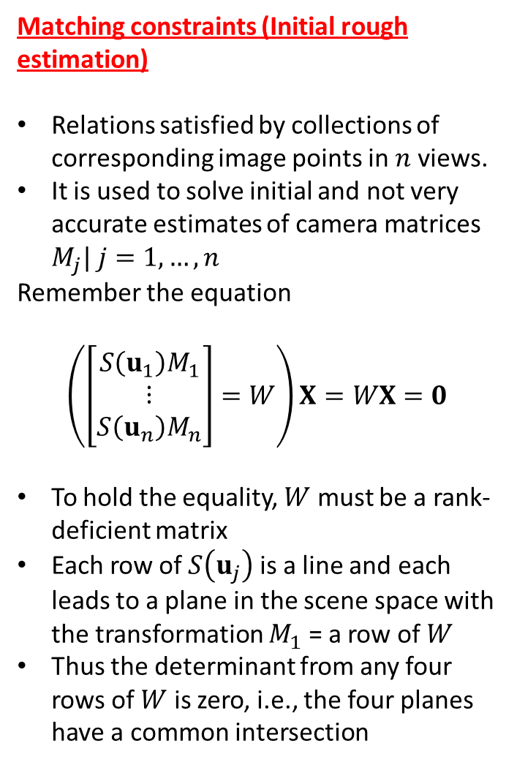
Matching constraints (Initial rough estimation)
Relations satisfied by collections of corresponding image points in $n$ views.
It is used to solve initial and not very accurate estimates of camera matrices $M_{j}| j=1, …, n$
Remember the equation
$$\left(\left[\begin{matrix}S\left(u_{1}\right)M_{1} \\ ⋮ \\ S\left(u_{n}\right)M_{n}\end{matrix}\right]=W\right)X=WX=0$$
To hold the equality, $W$ must be a rank-deficient matrix
Each row of $S\left(u_{j}\right)$ is a line and each leads to a plane in the scene space with the transformation $M_{1}$ = a row of $W$
Thus the determinant from any four rows of $W$ is zero, i.e., the four planes have a common intersection

Slide 10
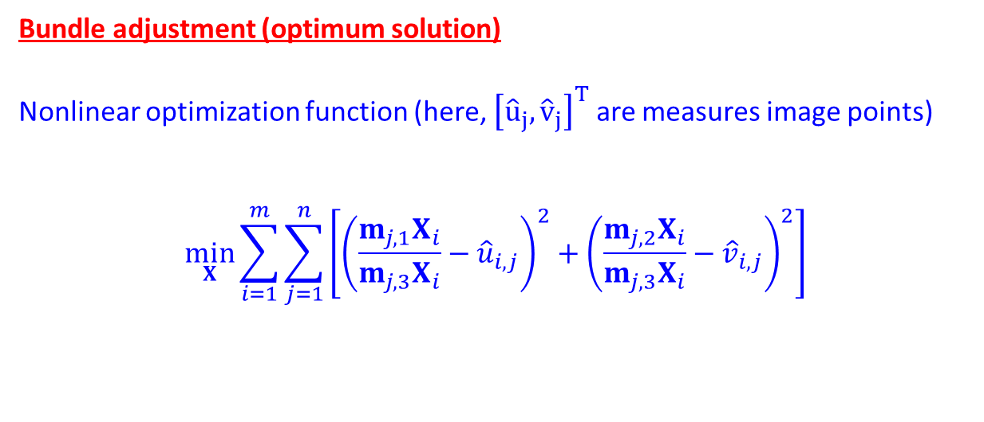
Bundle adjustment (optimum solution)
Nonlinear optimization function (here, ${\left[{\hat{u}}_{j},{\hat{v}}_{j}\right]}^{T}$ are measures image points)
$$\min_{X}{\sum_{i=1}^{m}{\sum_{j=1}^{n}{\left[{\left(\frac{m_{j,1}X_{i}}{m_{j,3}X_{i}}−{\hat{u}}_{i,j}\right)}^{2}+{\left(\frac{m_{j,2}X_{i}}{m_{j,3}X_{i}}−{\hat{v}}_{i,j}\right)}^{2}\right]}}}$$

Slide 11
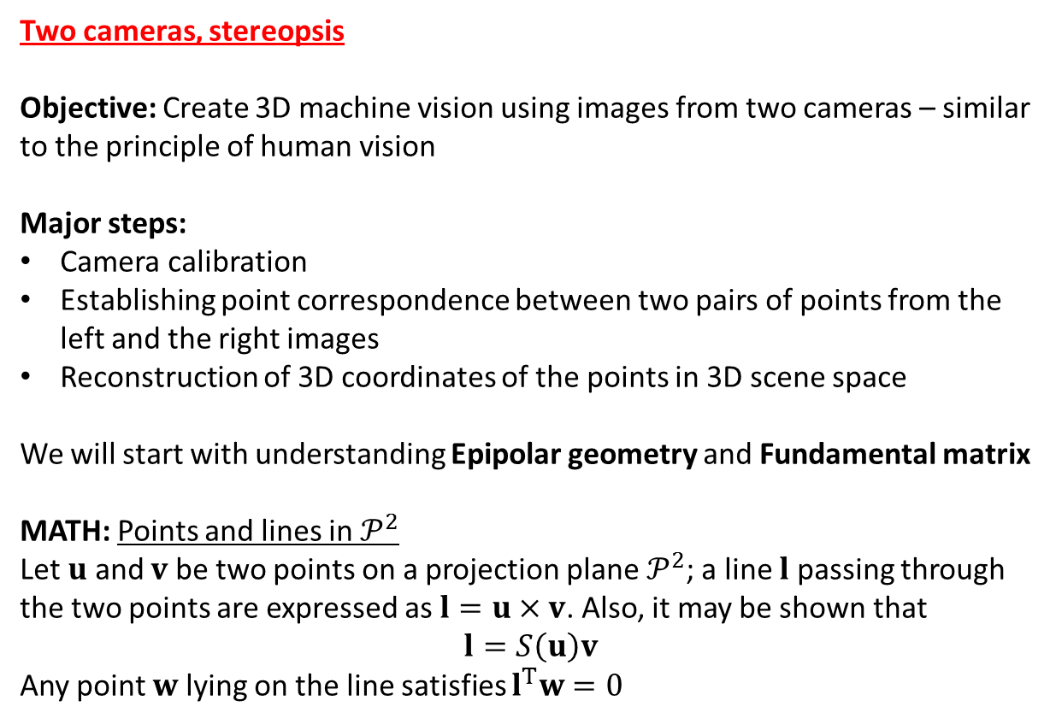
Two cameras, stereopsis
Objective: Create 3D machine vision using images from two cameras – similar to the principle of human vision
Major steps:
Camera calibration
Establishing point correspondence between two pairs of points from the left and the right images
Reconstruction of 3D coordinates of the points in 3D scene space
We will start with understanding Epipolar geometry and Fundamental matrix
MATH: Points and lines in $𝒫^{2}$
Let $u$ and $v$ be two points on a projection plane $𝒫^{2}$; a line $l$ passing through the two points are expressed as $l=u×v$. Also, it may be shown that
$$l=S\left(u\right)v$$
Any point $w$ lying on the line satisfies $l^{T}w=0$

Slide 12
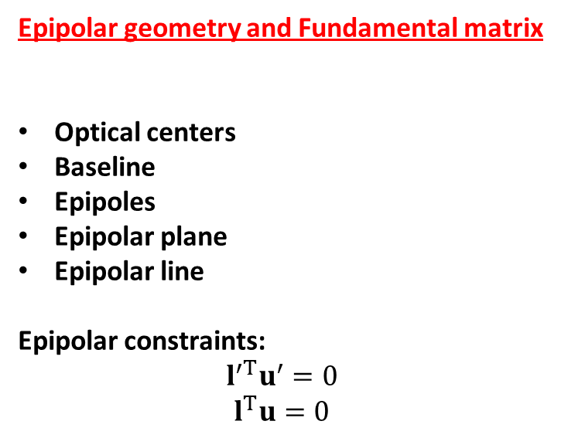
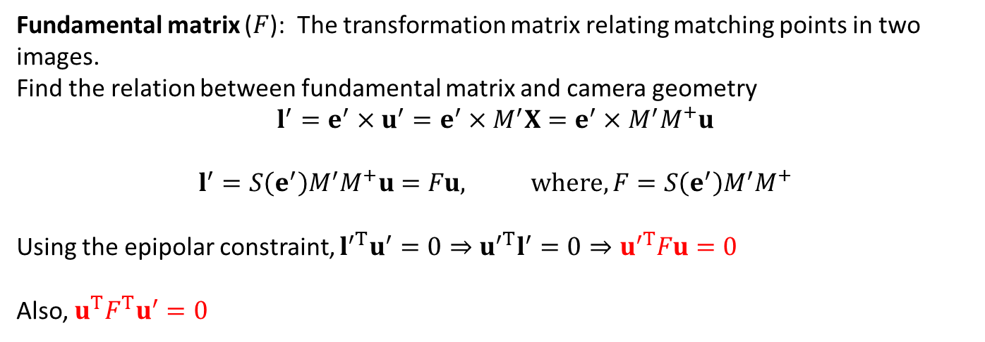
Epipolar geometry and Fundamental matrix
Optical centers
Baseline
Epipoles
Epipolar plane
Epipolar line
Epipolar constraints:
$$l^{′T}u^{′}=0$$
$$l^{T}u=0$$
Fundamental matrix ($F$): The transformation matrix relating matching points in two images.
Find the relation between fundamental matrix and camera geometry
$$l^{′}=e^{′}×u^{′}=e^{′}×M^{′}X=e^{′}×M^{′}M^{+}u$$
$$l^{′}=S\left(e^{′}\right)M^{′}M^{+}u=Fu, where, F=S\left(e^{′}\right)M^{′}M^{+}$$
Using the epipolar constraint, $l^{′T}u^{′}=0⇒u^{′T}l^{′}=0⇒u^{′T}Fu=0$
Also, $u^{T}F^{T}u^{′}=0$

Slide 13
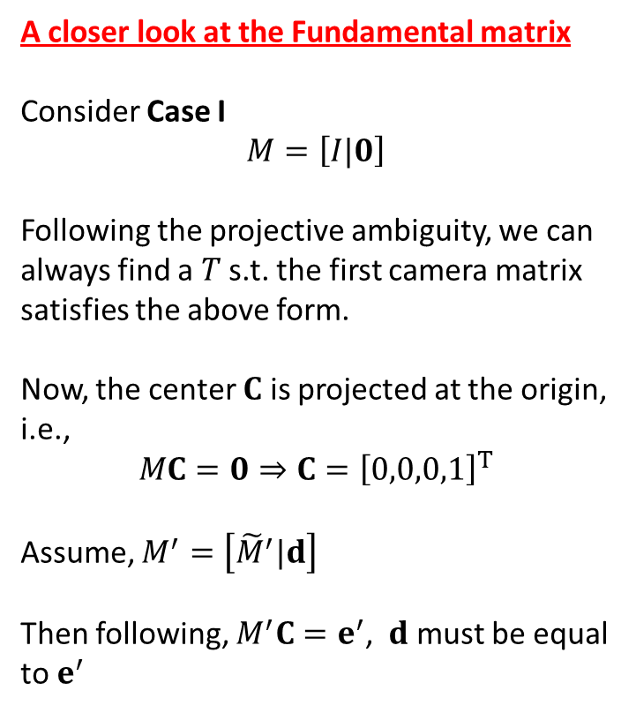
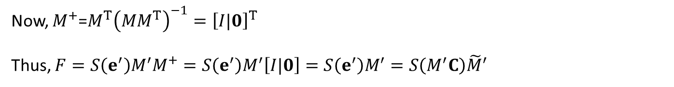
A closer look at the Fundamental matrix
Consider Case I
$$M=\left[I|0\right]$$
Following the projective ambiguity, we can always find a $T$ s.t. the first camera matrix satisfies the above form.
Now, the center $C$ is projected at the origin, i.e.,
$$MC=0⇒C={\left[0,0,0,1\right]}^{T}$$
Assume, $M^{′}=\left[{\tilde{M}}^{′}|d\right]$
Then following, $M^{′}C=e^{′}$, $d$ must be equal to $e^{′}$
Now, $M^{+}$=$M^{T}{\left(MM^{T}\right)}^{−1}={\left[I|0\right]}^{T}$
Thus, $F=S\left(e^{′}\right)M^{′}M^{+}=S\left(e^{′}\right)M^{′}\left[I|0\right]=S\left(e^{′}\right)M^{′}=S\left(M^{′}C\right){\tilde{M}}^{′}$

Slide 14
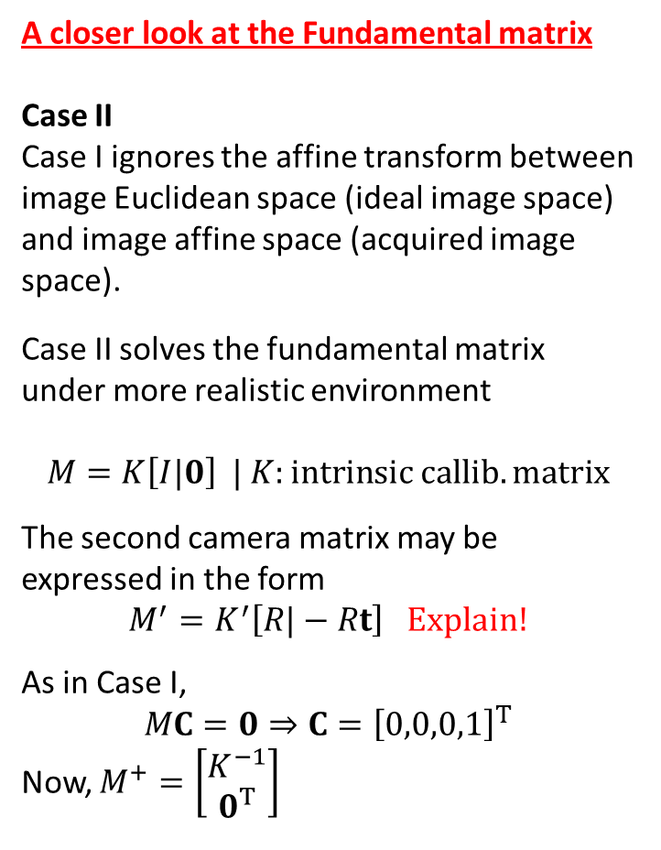
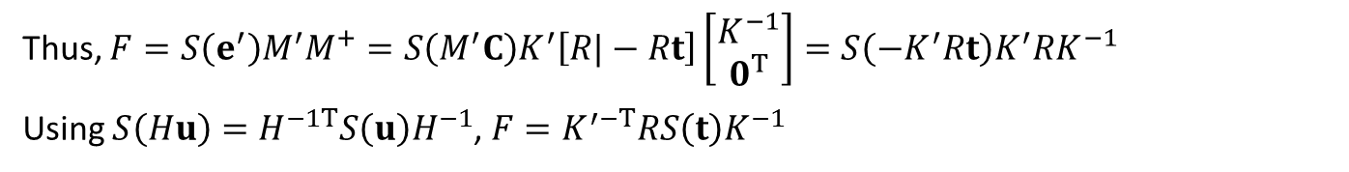
A closer look at the Fundamental matrix
Case II
Case I ignores the affine transform between image Euclidean space (ideal image space) and image affine space (acquired image space).
Case II solves the fundamental matrix under more realistic environment
$$M=K\left[I|0\right] | K:intrinsic callib. matrix$$
The second camera matrix may be expressed in the form
$$M^{′}=K^{′}\left[R|−Rt\right] Explain!$$
As in Case I,
$$MC=0⇒C={\left[0,0,0,1\right]}^{T}$$
Now, $M^{+}=\left[\begin{matrix}K^{−1} \\ 0^{T}\end{matrix}\right]$
Thus, $F=S\left(e^{′}\right)M^{′}M^{+}=S\left(M^{′}C\right)K^{′}\left[R|−Rt\right]\left[\begin{matrix}K^{−1} \\ 0^{T}\end{matrix}\right]=S\left(−K^{′}Rt\right)K^{′}RK^{−1}$
Using $S\left(Hu\right)=H^{−1T}S\left(u\right)H^{−1}$, $F=K^{′−T}RS\left(t\right)K^{−1}$

