Slide 1
55:148 Digital Image Processing
Chapter 11
3D Vision, Geometry
Topics:
  Basics of projective geometry
    Points and hyperplanes in projective space
    Homography
    Estimating homography from point correspondence
  The single perspective camera
    An overview of single camera calibration
    Calibration of one camera from the known scene
  Two cameras, stereopsis
    The geometry of two cameras. The fundamental matrix
    Relative motion of the camera; the essential matrix
    Estimation of a fundamental matrix from image point correspondences
    Applications of the epipolar geometry in vision
  Three and more cameras
    Stereo correspondence algorithms
Green = To be discussed today

Slide 2
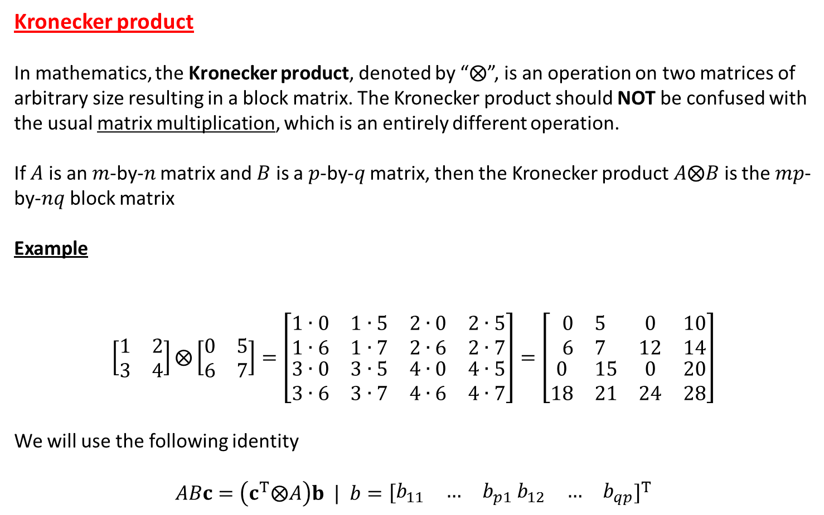
Kronecker product
In mathematics, the Kronecker product, denoted by “$⨂$”, is an operation on two matrices of arbitrary size resulting in a block matrix. The Kronecker product should NOT be confused with the usual matrix multiplication, which is an entirely different operation.
If $A$ is an $m$-by-$n$ matrix and $B$ is a $p$-by-$q$ matrix, then the Kronecker product $A⨂B$ is the $mp$-by-$nq$ block matrix
Example
$$\left[\begin{matrix}1 & 2 \\ 3 & 4\end{matrix}\right]⨂\left[\begin{matrix}0 & 5 \\ 6 & 7\end{matrix}\right]=\left[\begin{matrix}\begin{matrix}1∙0 & 1∙5 \\ 1∙6 & 1∙7\end{matrix} & \begin{matrix}2∙0 & 2∙5 \\ 2∙6 & 2∙7\end{matrix} \\ \begin{matrix}3∙0 & 3∙5 \\ 3∙6 & 3∙7\end{matrix} & \begin{matrix}4∙0 & 4∙5 \\ 4∙6 & 4∙7\end{matrix}\end{matrix}\right]=\left[\begin{matrix}\begin{matrix}0 & 5 \\ 6 & 7\end{matrix} & \begin{matrix}0 & 10 \\ 12 & 14\end{matrix} \\ \begin{matrix}0 & 15 \\ 18 & 21\end{matrix} & \begin{matrix}0 & 20 \\ 24 & 28\end{matrix}\end{matrix}\right]$$
We will use the following identity
$$ABc=\left(c^{T}⨂A\right)b | b={\left[\begin{matrix}b_{11} & … & b_{p1}\end{matrix} \begin{matrix}b_{12} & … & b_{qp}\end{matrix}\right]}^{T}$$

Slide 3
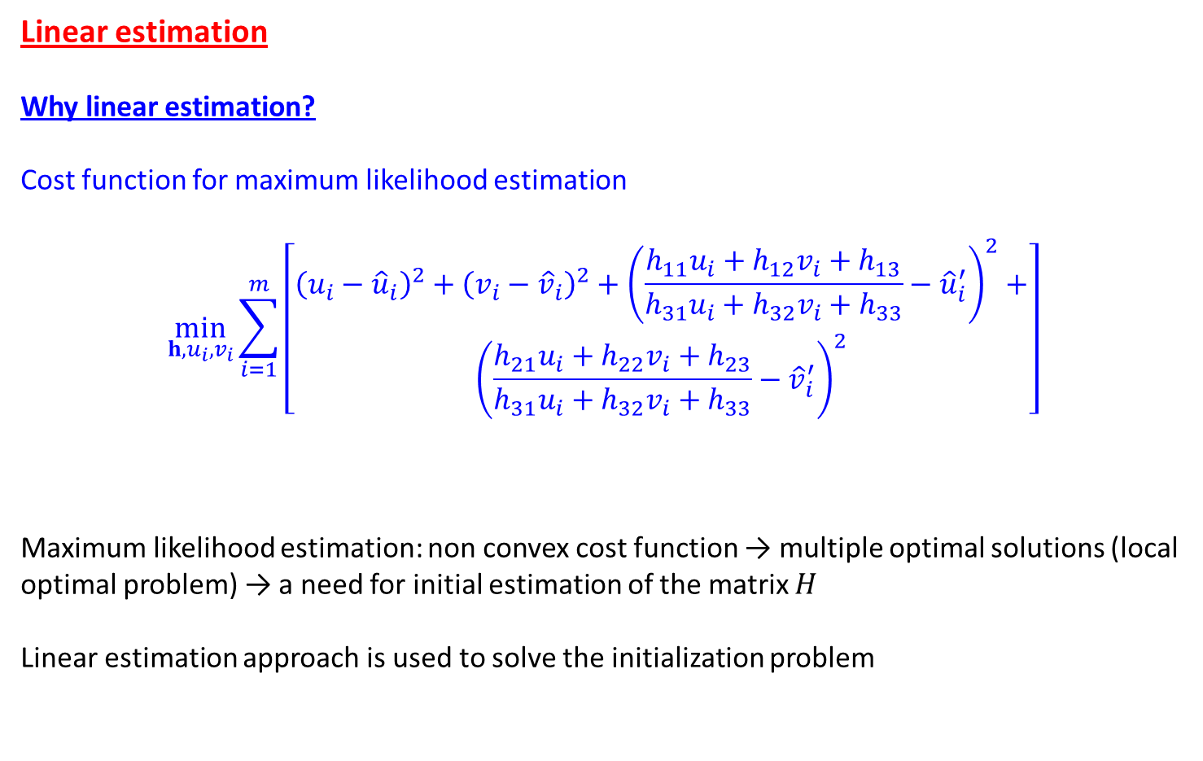
Linear estimation
Why linear estimation?
Cost function for maximum likelihood estimation
$$\min_{h,u_{i},v_{i}}{\sum_{i=1}^{m}{\left[\begin{aligned}{\left(u_{i}−{\hat{u}}_{i}\right)}^{2}+{\left(v_{i}−{\hat{v}}_{i}\right)}^{2}+{\left(\frac{h_{11}u_{i}+h_{12}v_{i}+h_{13}}{h_{31}u_{i}+h_{32}v_{i}+h_{33}}−{\hat{u}}_{i}^{′}\right)}^{2}+ \\ {\left(\frac{h_{21}u_{i}+h_{22}v_{i}+h_{23}}{h_{31}u_{i}+h_{32}v_{i}+h_{33}}−{\hat{v}}_{i}^{′}\right)}^{2}\end{aligned}\right]}}$$
Maximum likelihood estimation: non convex cost function → multiple optimal solutions (local optimal problem) → a need for initial estimation of the matrix $H$
Linear estimation approach is used to solve the initialization problem

Slide 4
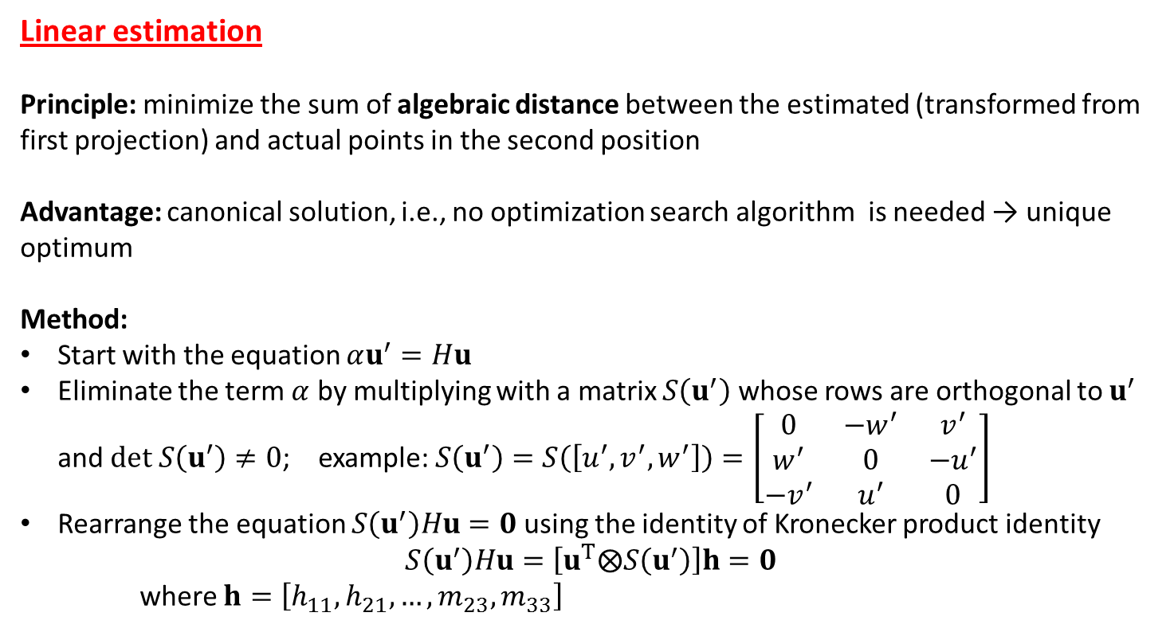
Linear estimation
Principle: minimize the sum of algebraic distance between the estimated (transformed from first projection) and actual points in the second position
Advantage: canonical solution, i.e., no optimization search algorithm is needed → unique optimum
Method:
Start with the equation $αu^{′}=Hu$
Eliminate the term $α$ by multiplying with a matrix $S\left(u^{′}\right)$ whose rows are orthogonal to $u^{′}$ and $det S\left(u^{′}\right)≠0$; example: $S\left(u^{′}\right)=S\left(\left[u^{′},v^{′},w^{′}\right]\right)=\left[\begin{matrix}0 & {−w}^{′} & v^{′} \\ w^{′} & 0 & −u^{′} \\ −v^{′} & u^{′} & 0\end{matrix}\right]$
Rearrange the equation $S\left(u^{′}\right)Hu=0$ using the identity of Kronecker product identity
$$S\left(u^{′}\right)Hu=\left[u^{T}⨂S\left(u^{′}\right)\right]h=0$$
where $h=\left[h_{11}, h_{21}, …, m_{23},m_{33}\right]$

Slide 5
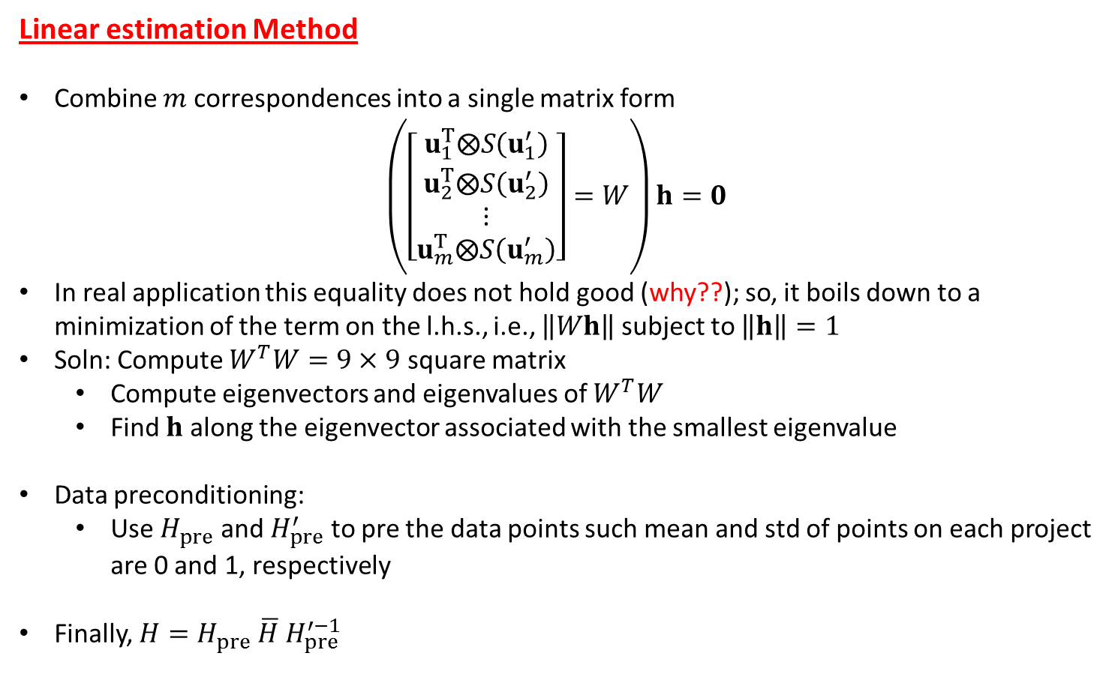
Linear estimation Method
Combine $m$ correspondences into a single matrix form
$\left(\left[\begin{matrix}u_{1}^{T}⨂S\left(u_{1}^{′}\right) \\ \begin{matrix}u_{2}^{T}⨂S\left(u_{2}^{′}\right) \\ ⋮\end{matrix} \\ u_{m}^{T}⨂S\left(u_{m}^{′}\right)\end{matrix}\right]=W\right)h=0$
In real application this equality does not hold good (why??); so, it boils down to a minimization of the term on the l.h.s., i.e., $\left\|Wh\right\|$ subject to $\left\|h\right\|=1$
Soln: Compute $W^{T}W=9×9$ square matrix
  Compute eigenvectors and eigenvalues of $W^{T}W$
  Find $h$ along the eigenvector associated with the smallest eigenvalue
Data preconditioning:
  Use $H_{pre}$ and $H_{pre}^{′}$ to pre the data points such mean and std of points on each project are 0 and 1, respectively
Finally, $H=H_{pre} \overline{H} H_{pre}^{′−1}$

Slide 6
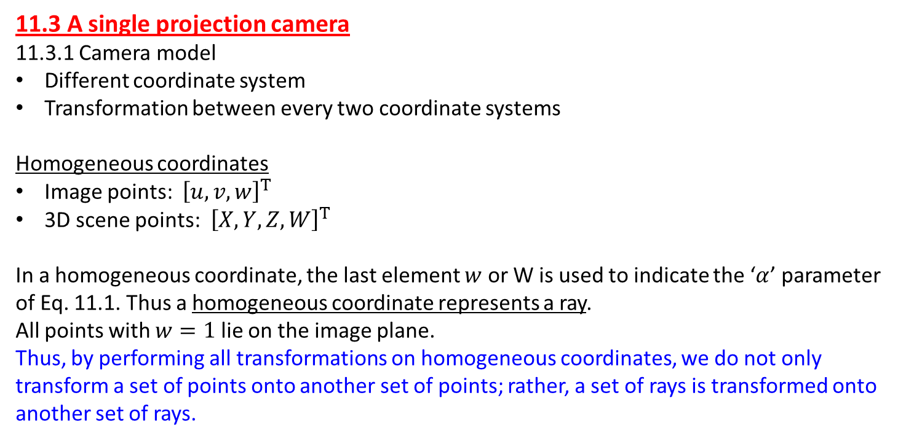
11.3 A single projection camera
11.3.1 Camera model
Different coordinate system
Transformation between every two coordinate systems
Homogeneous coordinates
Image points: ${\left[u,v,w\right]}^{T}$
3D scene points: ${\left[X, Y, Z, W\right]}^{T}$
In a homogeneous coordinate, the last element $w$ or W is used to indicate the ‘$α$’ parameter of Eq. 11.1. Thus a homogeneous coordinate represents a ray.
All points with $w=1$ lie on the image plane.
Thus, by performing all transformations on homogeneous coordinates, we do not only transform a set of points onto another set of points; rather, a set of rays is transformed onto another set of rays.

Slide 7
Camera model
Important parameters
Image plane
Optical axis
Focal point/optical center/center of projection
Different coordinate systems
World/scene coordinate system
Camera coordinate system
Image Euclidean coordinate system
Image affine coordinate system

Slide 8
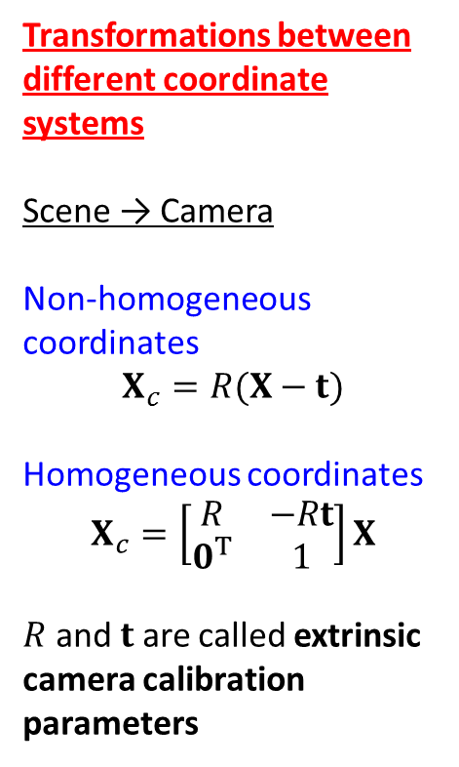
Transformations between different coordinate systems
Scene → Camera
Non-homogeneous coordinates
$$X_{c}=R(X−t)$$
Homogeneous coordinates
$$X_{c}=\left[\begin{matrix}R & −Rt \\ 0^{T} & 1\end{matrix}\right]X$$
$R$ and $t$ are called extrinsic camera calibration parameters

Slide 9
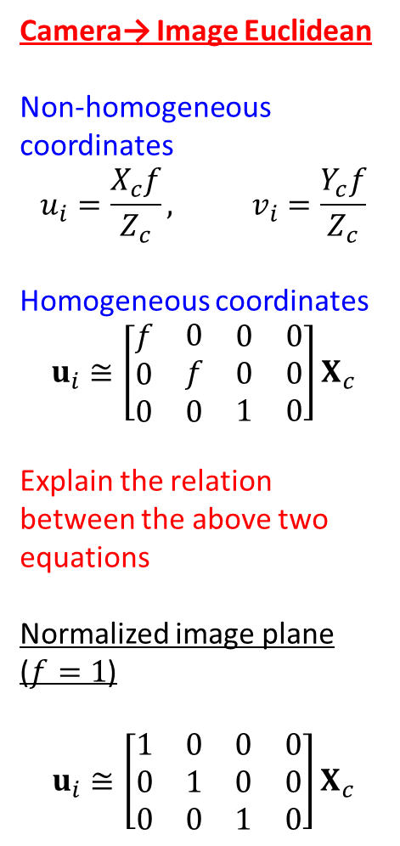
Camera→ Image Euclidean
Non-homogeneous coordinates
$$u_{i}=\frac{X_{c}f}{Z_{c}}, v_{i}=\frac{Y_{c}f}{Z_{c}}$$
Homogeneous coordinates
$$u_{i}≅\left[\begin{matrix}\begin{matrix}f \\ 0 \\ 0\end{matrix} & \begin{matrix}0 \\ f \\ 0\end{matrix} & \begin{matrix}\begin{matrix}0 \\ 0 \\ 1\end{matrix} & \begin{matrix}0 \\ 0 \\ 0\end{matrix}\end{matrix}\end{matrix}\right]X_{c}$$
Explain the relation between the above two equations
Normalized image plane ($f=1$)
$$u_{i}≅\left[\begin{matrix}\begin{matrix}1 \\ 0 \\ 0\end{matrix} & \begin{matrix}0 \\ 1 \\ 0\end{matrix} & \begin{matrix}\begin{matrix}0 \\ 0 \\ 1\end{matrix} & \begin{matrix}0 \\ 0 \\ 0\end{matrix}\end{matrix}\end{matrix}\right]X_{c}$$

Slide 10
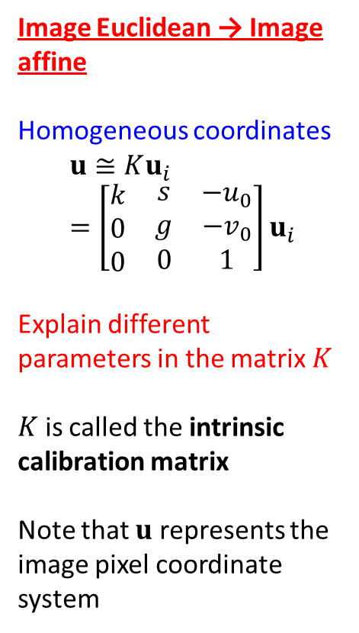
Image Euclidean → Image affine
Homogeneous coordinates
$$u≅Ku_{i}=\left[\begin{matrix}\begin{matrix}k \\ 0 \\ 0\end{matrix} & \begin{matrix}s \\ g \\ 0\end{matrix} & \begin{matrix}−u_{0} \\ −v_{0} \\ 1\end{matrix}\end{matrix}\right]u_{i}$$
Explain different parameters in the matrix $K$
$K$ is called the intrinsic calibration matrix
Note that $u$ represents the image pixel coordinate system

Slide 11
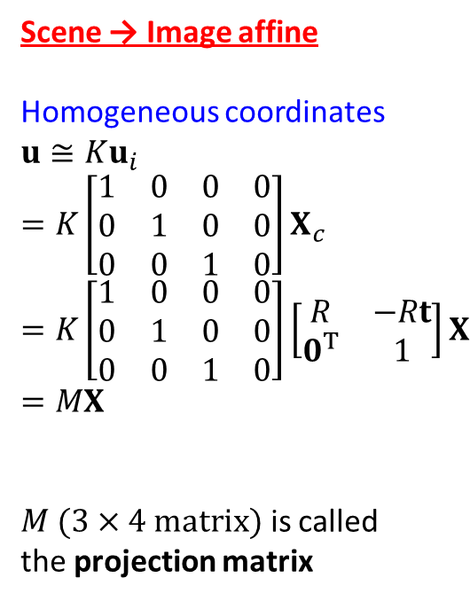
Scene → Image affine
Homogeneous coordinates
$$u≅Ku_{i}=K\left[\begin{matrix}\begin{matrix}1 \\ 0 \\ 0\end{matrix} & \begin{matrix}0 \\ 1 \\ 0\end{matrix} & \begin{matrix}\begin{matrix}0 \\ 0 \\ 1\end{matrix} & \begin{matrix}0 \\ 0 \\ 0\end{matrix}\end{matrix}\end{matrix}\right]X_{c}=K\left[\begin{matrix}\begin{matrix}1 \\ 0 \\ 0\end{matrix} & \begin{matrix}0 \\ 1 \\ 0\end{matrix} & \begin{matrix}\begin{matrix}0 \\ 0 \\ 1\end{matrix} & \begin{matrix}0 \\ 0 \\ 0\end{matrix}\end{matrix}\end{matrix}\right]\left[\begin{matrix}R & −Rt \\ 0^{T} & 1\end{matrix}\right]X=MX$$
$M (3×4 matrix)$ is called the projection matrix

Slide 12
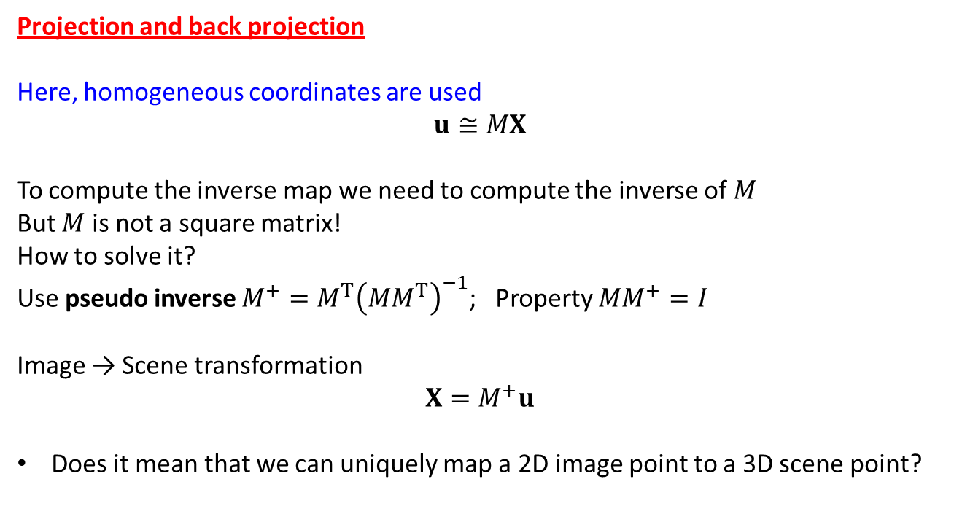
Projection and back projection
Here, homogeneous coordinates are used
$$u≅MX$$
To compute the inverse map we need to compute the inverse of $M$
But $M$ is not a square matrix!
How to solve it?
Use pseudo inverse $M^{+}=M^{T}{\left(MM^{T}\right)}^{−1}$; Property ${MM}^{+}=I$
Image → Scene transformation
$$X=M^{+}u$$
Does it mean that we can uniquely map a 2D image point to a 3D scene point?

Slide 13
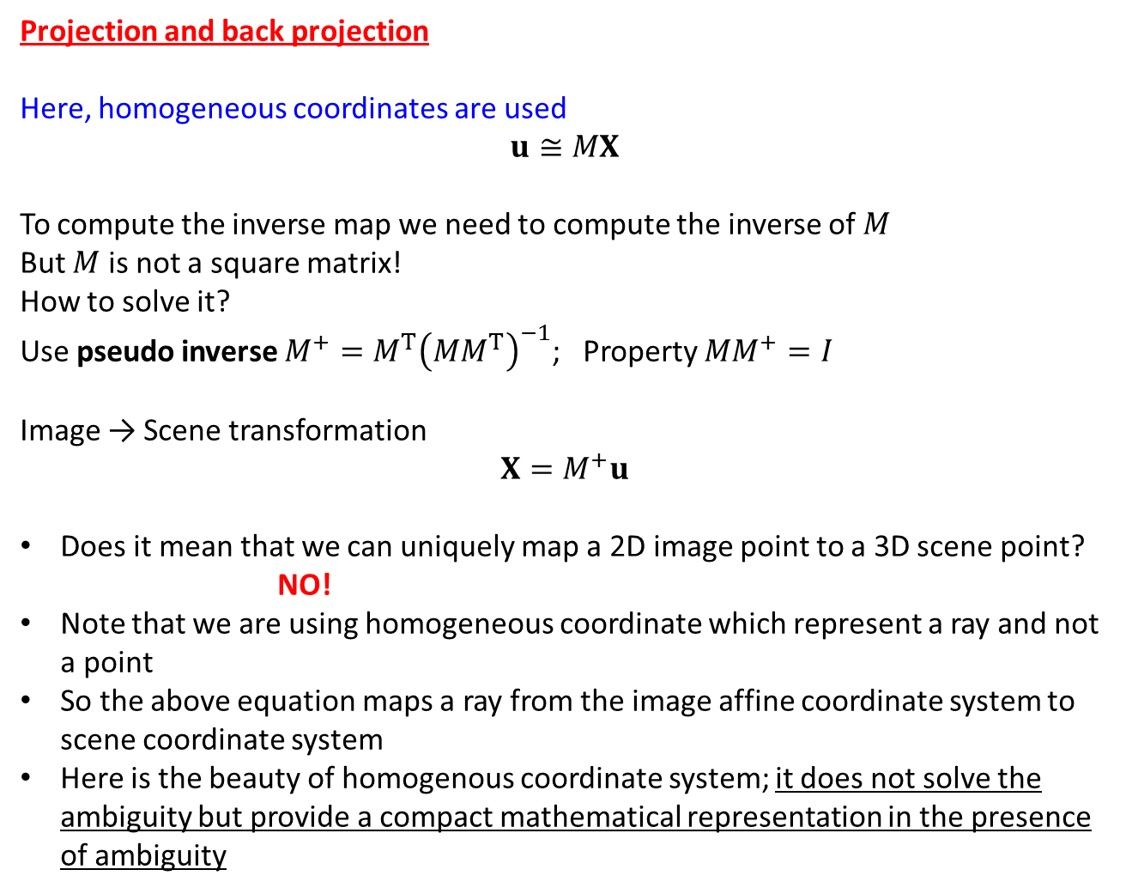
Projection and back projection
Here, homogeneous coordinates are used
$$u≅MX$$
To compute the inverse map we need to compute the inverse of $M$
But $M$ is not a square matrix!
How to solve it?
Use pseudo inverse $M^{+}=M^{T}{\left(MM^{T}\right)}^{−1}$; Property ${MM}^{+}=I$
Image → Scene transformation
$$X=M^{+}u$$
Does it mean that we can uniquely map a 2D image point to a 3D scene point?
NO!
Note that we are using homogeneous coordinate which represent a ray and not a point
So the above equation maps a ray from the image affine coordinate system to scene coordinate system
Here is the beauty of homogenous coordinate system; it does not solve the ambiguity but provide a compact mathematical representation in the presence of ambiguity

Slide 14
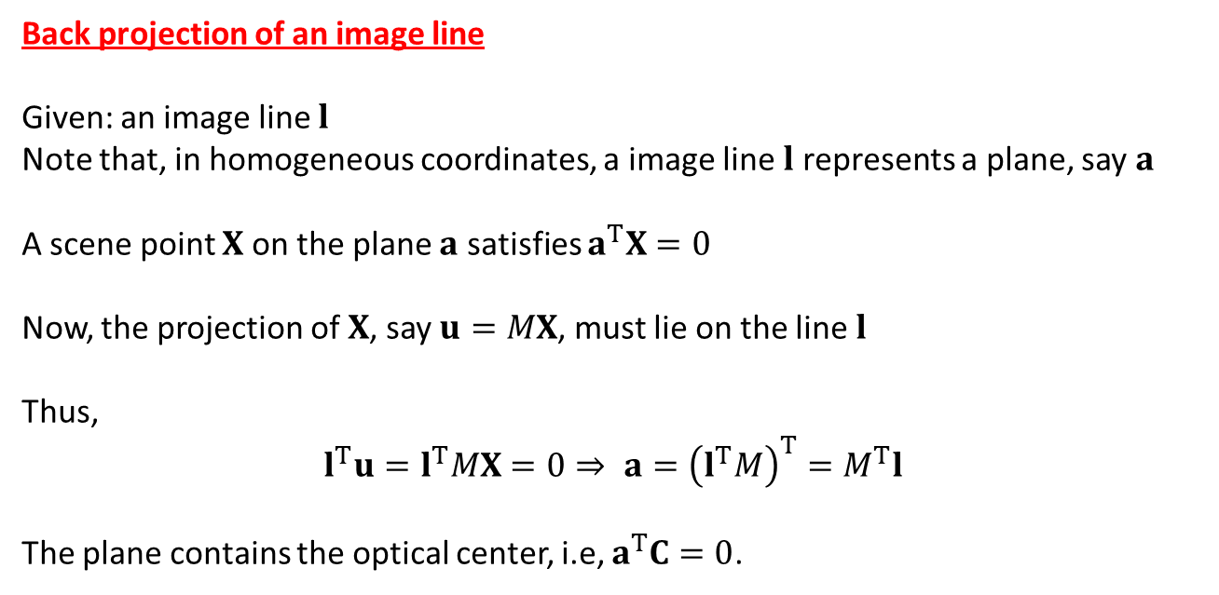
Back projection of an image line
Given: an image line $l$
Note that, in homogeneous coordinates, a image line $l$ represents a plane, say $a$
A scene point $X$ on the plane $a$ satisfies $a^{T}X=0$
Now, the projection of $X$, say $u=MX$, must lie on the line $l$
Thus,
$$l^{T}u=l^{T}MX=0⇒ a={\left(l^{T}M\right)}^{T}=M^{T}l$$
The plane contains the optical center, i.e, $a^{T}C=0$.

Slide 15
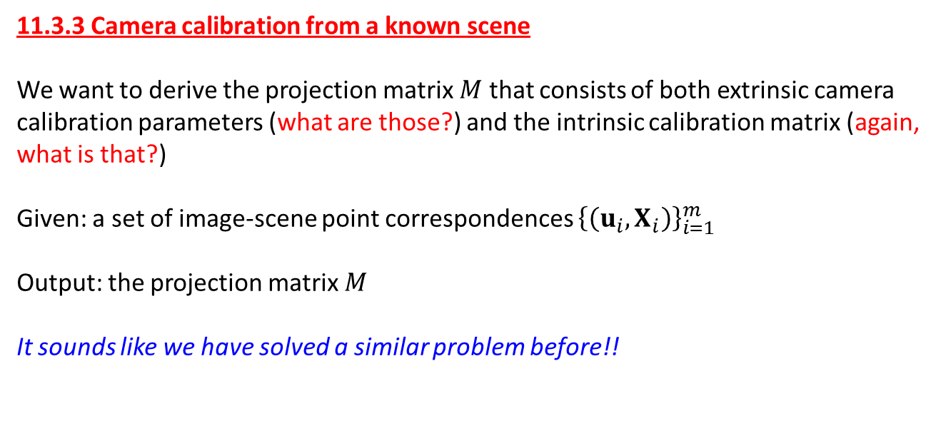
11.3.3 Camera calibration from a known scene
We want to derive the projection matrix $M$ that consists of both extrinsic camera calibration parameters (what are those?) and the intrinsic calibration matrix (again, what is that?)
Given: a set of image-scene point correspondences ${\left\{\left(u_{i},X_{i}\right)\right\}}_{i=1}^{m}$
Output: the projection matrix $M$
It sounds like we have solved a similar problem before!!

Slide 16
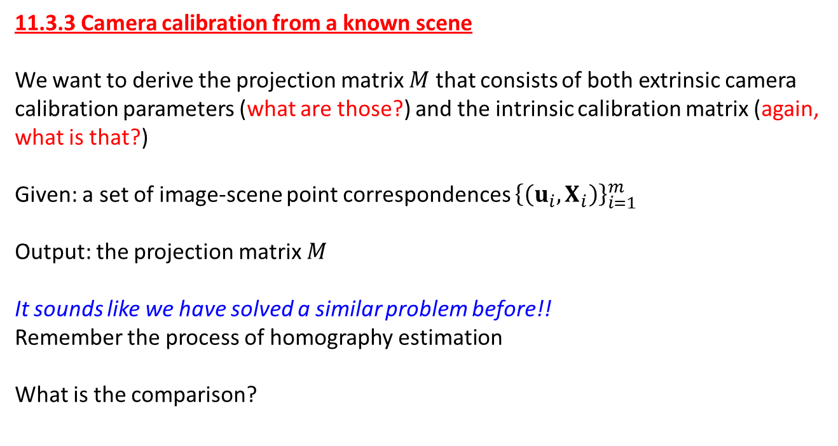
11.3.3 Camera calibration from a known scene
We want to derive the projection matrix $M$ that consists of both extrinsic camera calibration parameters (what are those?) and the intrinsic calibration matrix (again, what is that?)
Given: a set of image-scene point correspondences ${\left\{\left(u_{i},X_{i}\right)\right\}}_{i=1}^{m}$
Output: the projection matrix $M$
It sounds like we have solved a similar problem before!!
Remember the process of homography estimation
What is the comparison?

Slide 17
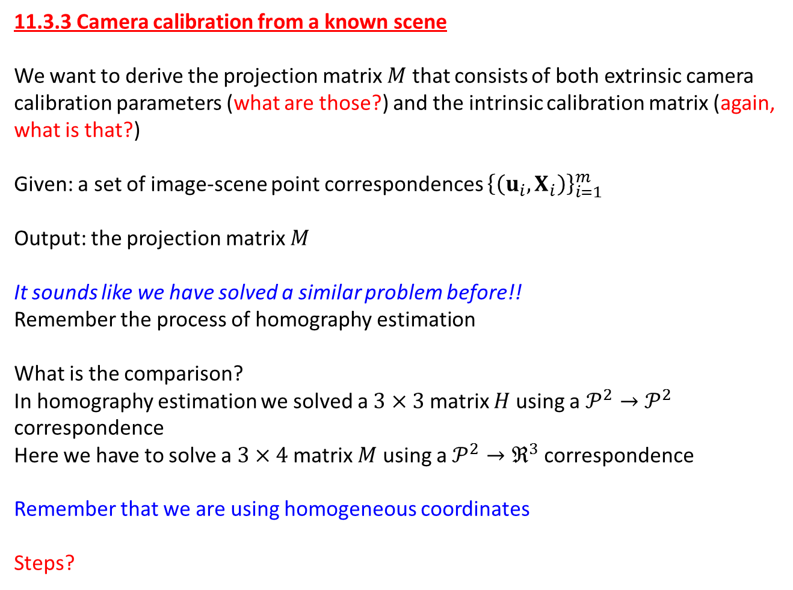
11.3.3 Camera calibration from a known scene
We want to derive the projection matrix $M$ that consists of both extrinsic camera calibration parameters (what are those?) and the intrinsic calibration matrix (again, what is that?)
Given: a set of image-scene point correspondences ${\left\{\left(u_{i},X_{i}\right)\right\}}_{i=1}^{m}$
Output: the projection matrix $M$
It sounds like we have solved a similar problem before!!
Remember the process of homography estimation
What is the comparison?
In homography estimation we solved a $3×3$ matrix $H$ using a $𝒫^{2}→𝒫^{2}$ correspondence
Here we have to solve a $3×4$ matrix $M$ using a $𝒫^{2}→ℜ^{3}$ correspondence
Remember that we are using homogeneous coordinates
Steps?

Slide 18
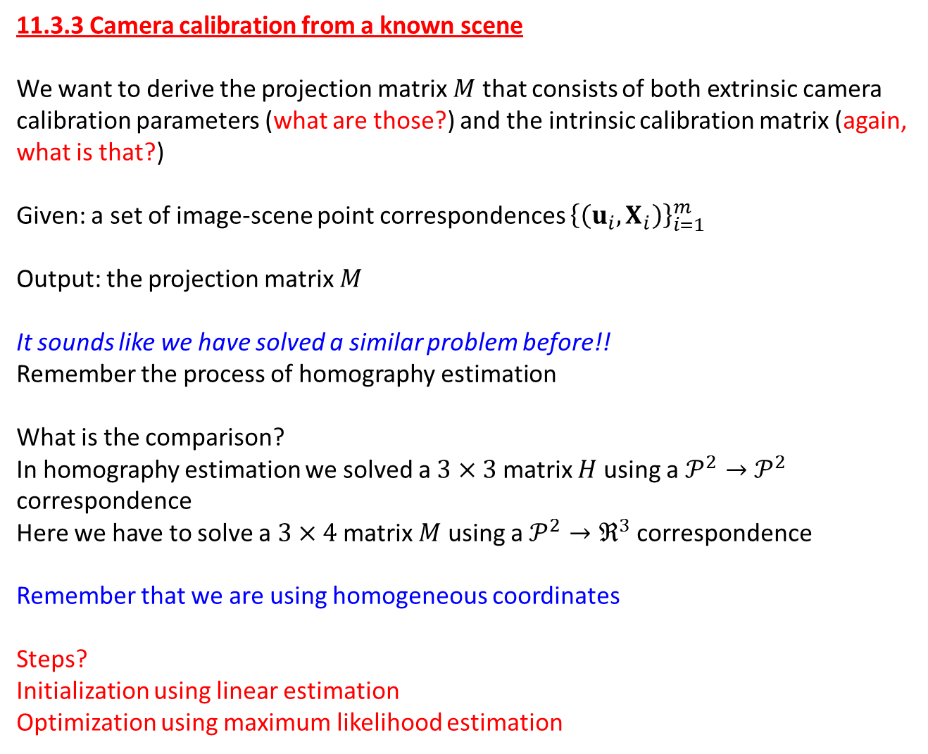
11.3.3 Camera calibration from a known scene
We want to derive the projection matrix $M$ that consists of both extrinsic camera calibration parameters (what are those?) and the intrinsic calibration matrix (again, what is that?)
Given: a set of image-scene point correspondences ${\left\{\left(u_{i},X_{i}\right)\right\}}_{i=1}^{m}$
Output: the projection matrix $M$
It sounds like we have solved a similar problem before!!
Remember the process of homography estimation
What is the comparison?
In homography estimation we solved a $3×3$ matrix $H$ using a $𝒫^{2}→𝒫^{2}$ correspondence
Here we have to solve a $3×4$ matrix $M$ using a $𝒫^{2}→ℜ^{3}$ correspondence
Remember that we are using homogeneous coordinates
Steps?
Initialization using linear estimation
Optimization using maximum likelihood estimation

Slide 19
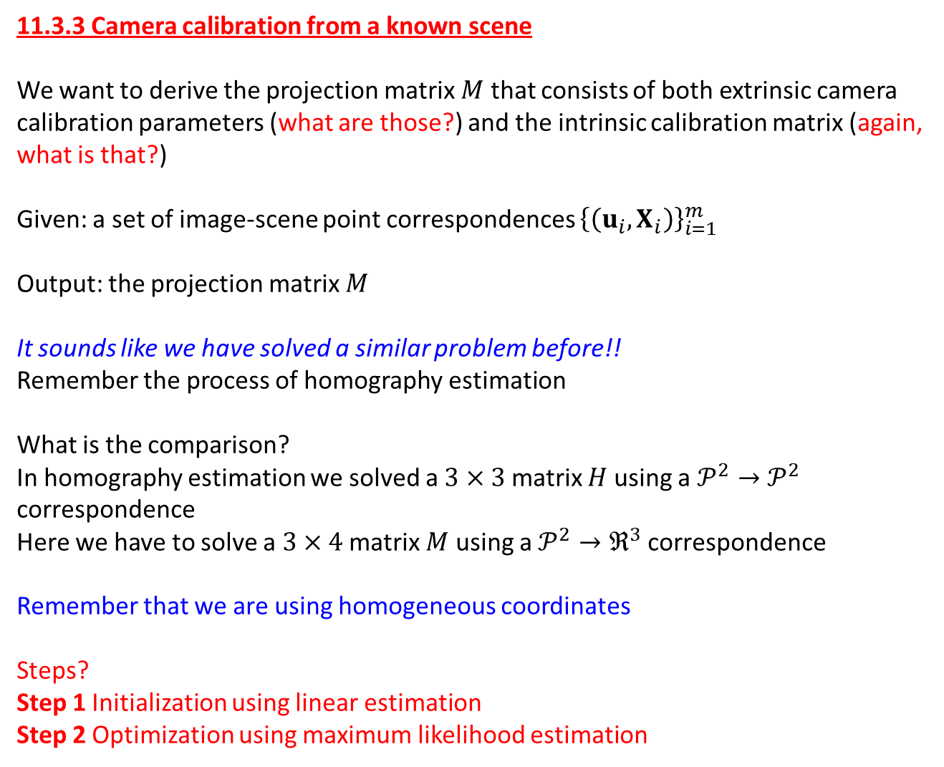
11.3.3 Camera calibration from a known scene
We want to derive the projection matrix $M$ that consists of both extrinsic camera calibration parameters (what are those?) and the intrinsic calibration matrix (again, what is that?)
Given: a set of image-scene point correspondences ${\left\{\left(u_{i},X_{i}\right)\right\}}_{i=1}^{m}$
Output: the projection matrix $M$
It sounds like we have solved a similar problem before!!
Remember the process of homography estimation
What is the comparison?
In homography estimation we solved a $3×3$ matrix $H$ using a $𝒫^{2}→𝒫^{2}$ correspondence
Here we have to solve a $3×4$ matrix $M$ using a $𝒫^{2}→ℜ^{3}$ correspondence
Remember that we are using homogeneous coordinates
Steps?
Step 1 Initialization using linear estimation
Step 2 Optimization using maximum likelihood estimation

Slide 20
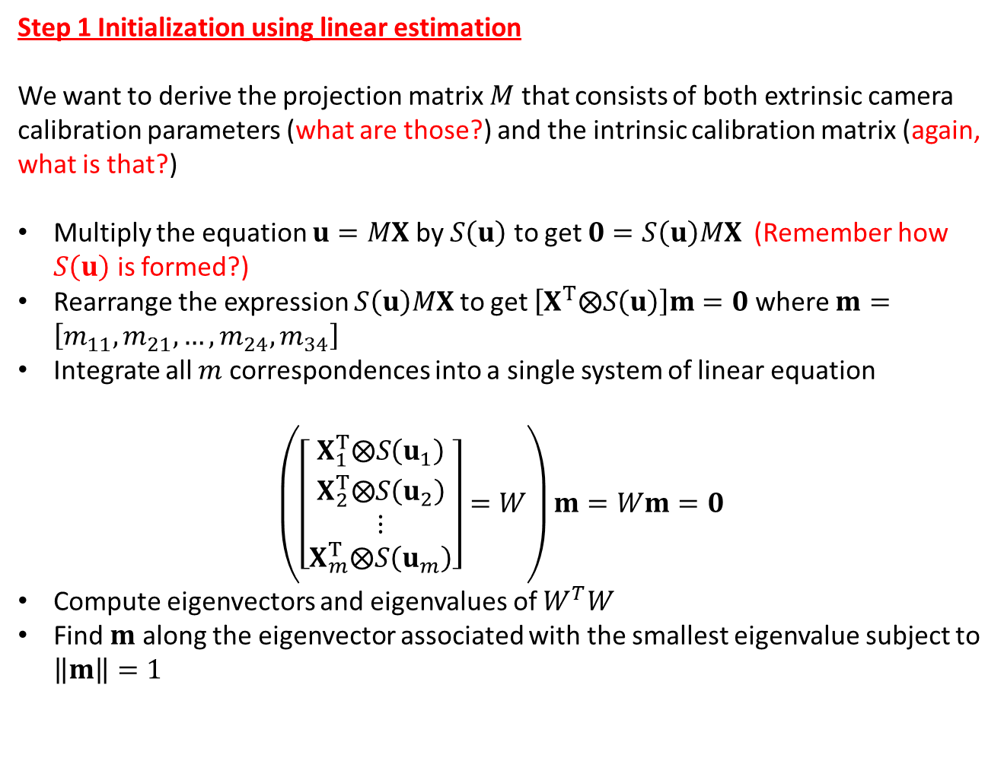
Step 1 Initialization using linear estimation
We want to derive the projection matrix $M$ that consists of both extrinsic camera calibration parameters (what are those?) and the intrinsic calibration matrix (again, what is that?)
Multiply the equation $u=MX$ by $S\left(u\right)$ to get $0=S\left(u\right)MX$ (Remember how $S\left(u\right)$ is formed?)
Rearrange the expression $S\left(u\right)MX$ to get $\left[X^{T}⨂S\left(u\right)\right]m=0$ where $m=\left[m_{11}, m_{21}, …, m_{24},m_{34}\right]$
Integrate all $m$ correspondences into a single system of linear equation
$$\left(\left[\begin{matrix}X_{1}^{T}⨂S\left(u_{1}\right) \\ \begin{matrix}X_{2}^{T}⨂S\left(u_{2}\right) \\ ⋮\end{matrix} \\ X_{m}^{T}⨂S\left(u_{m}\right)\end{matrix}\right]=W\right)m=Wm=0$$
Compute eigenvectors and eigenvalues of $W^{T}W$
Find $m$ along the eigenvector associated with the smallest eigenvalue subject to $\left\|m\right\|=1$

Slide 21

Step 2 Maximum Likelihood Estimation
Cost function :
$$\min_{m,X_{i},Y_{i},Z_{i}}{\sum_{i=1}^{m}{\left[{\left(X_{i}−{\hat{X}}_{i}\right)}^{2}+{\left(Y_{i}−{\hat{Y}}_{i}\right)}^{2}+{\left(Z_{i}−{\hat{Z}}_{i}\right)}^{2}+{\left(Proj_{u}(m,X) −{\hat{u}}_{i}\right)}^{2}+{\left(Proj_{v}(m,X) −{\hat{v}}_{i}\right)}^{2}\right]}}$$

