Slide 1
University of Iowa USLI
FRR

Slide 2
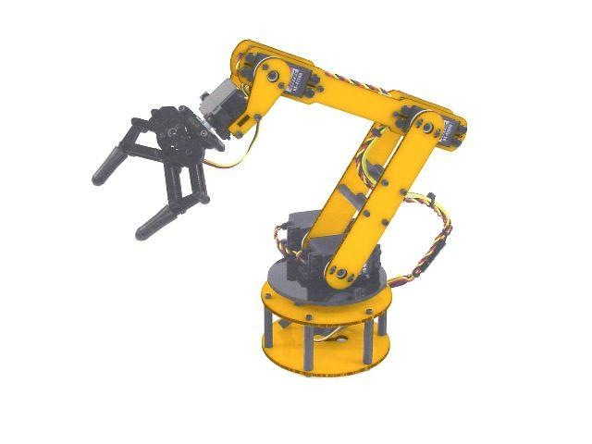
AGSE Design/Dimension
Packed Dimensions 3.5’ X 6’ X 3-9’
Rail Size 1”
Weight 100lbs

Slide 3
AGSE Key features
Robotic Arm 360 Degree Rotation
20” Reach
11 oz Grip Strength
Program Language with Computer
Communication with Launch Vehicle
Stop Switch on computer interface of automated program

Slide 4
AGSE/Launch Vehicle Integration
Contact Sensor
Ignitor Placement via servo linear actuator

Slide 5
Requirement Verification for AGSE
Robotic arm testing and code verification
Logic integration with servo winch and servo linear stage
Safety Stop switch test on computer code

Slide 6
Launch Vehicle Design/Dimensions
Height: 2.38m
Diameter: 10.2cm
Weight: 6.23kg

Slide 7
Key Launch Vehicle Design Features
Dual Deployment system
Rotating Payload Bay
No Drag System

Slide 8
Motor Description
Motor tested: K570
Final Motor: K630
Thrust-Weight Ratio:
Test: 13.95
Final: 12.89

Slide 9
Flight Statistics
Motor: Cesaroni K630
Thrust-to-Weight Ratio: 12.89
Rail Exit Velocity: 77.1 ft/s (23.5 m/s)
Streamers
Manufacturer: Sunward Group Ltd.
Size: 5 x 50 in (12.7 x 127 cm)
Parachute
Manufacturer: Angel Chute
Size: 52 in diameter (132.1 cm diameter)
Terminal Velocity: 21.4 ft/s (6.52 m/s)
Mass: 13.7 lbs (6.2 kg)
Mass margin: 2 lbs (0.91 kg)
Stability: 2.41 cal
Kinetic Energy
Section 1: 19.8 ft-lbs (26.8 N-m)
Section 2: 12.8 ft-lbs (17.4 N-m)
Section 3: 51 ft-lbs (69 N-m)

Slide 10
Altitude and Drift
Max altitude tested: 6053 ft (1845 m)
Max Predicted: 5274.4 ft (1608 m)
Drift tested: 3710.6 ft(1131 m)
Drift Predicted

Slide 11
Test Plan/Procedure
Electronic Testing- recovery, payloadbay interface
Drag System Testing- low torque, high risk
Payload Bay Testing- rotation test passed

Slide 12
Full Scale Test
Flight Data
Recovery hand test
Recovery ground test
Recovery full test

Slide 13
Requirements Verification
Strength- Material specs and full test
Stability- Simulation and full test
Recovery- Ground and full test
Payload Secured- Payload test

Slide 14
Questions

