Slide 1
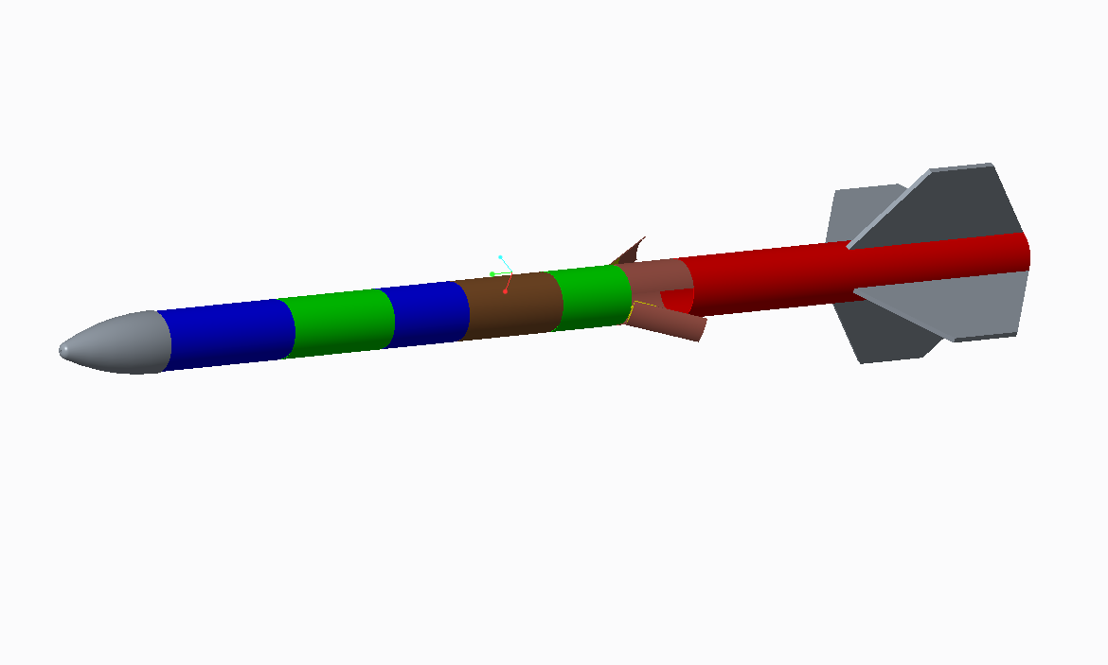
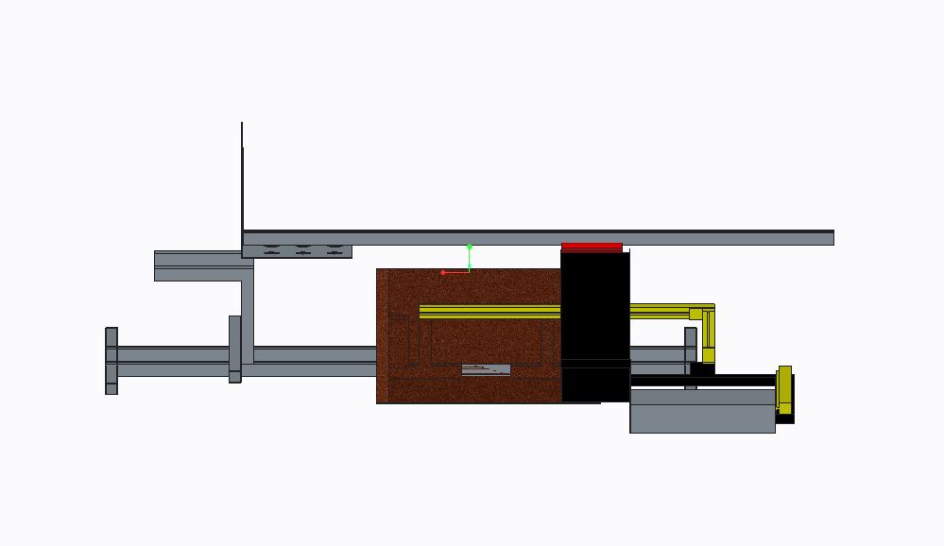
UIowa AIAA MAV Team
Project Lead: Austin Brenner

Slide 2
Team Roster
Advisor: Kevin Trojanowski
Members: Vicki, Ryan, Alec, Andrew, Matt, Austin, and Frank

Slide 3
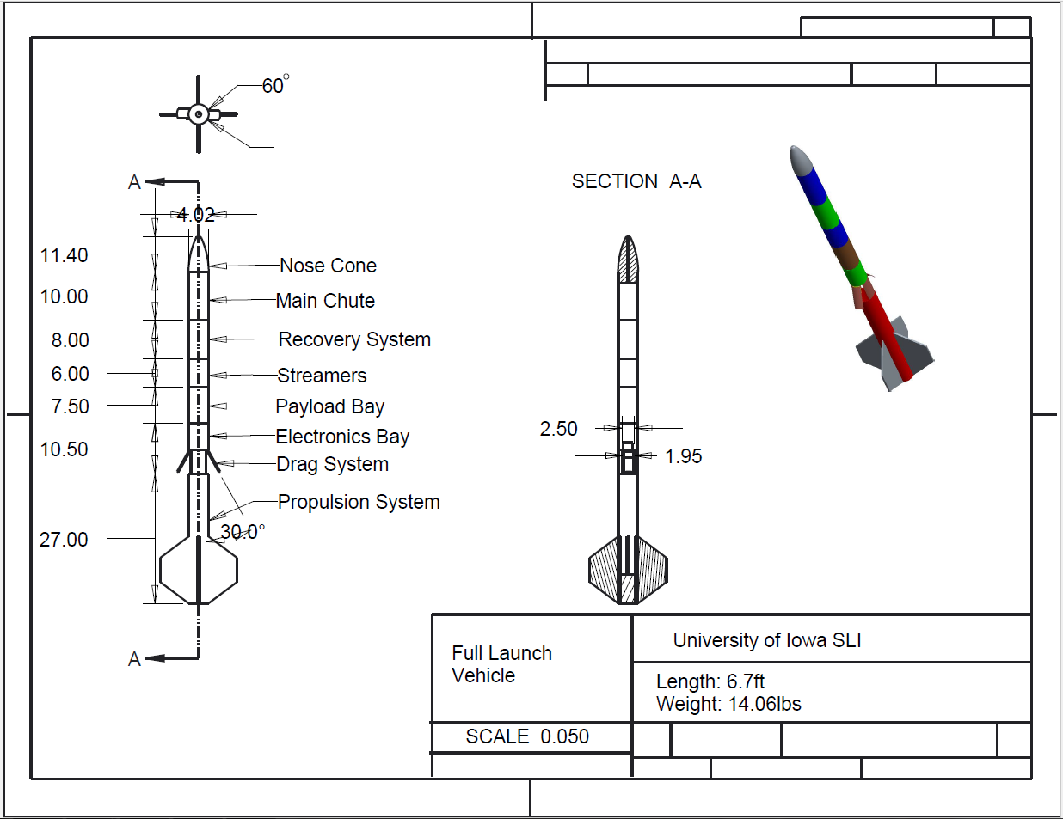
Final launch vehicle and payload dimensions
AGSE: Packed: 8x3x3ft (2.44x.91x.91m)
Rail: 6ft (1.83m)
Total Height: 9ft (2.74m)
Launch Vehicle:2.04m Length, 10.2cm Diameter
6.38kg

Slide 4
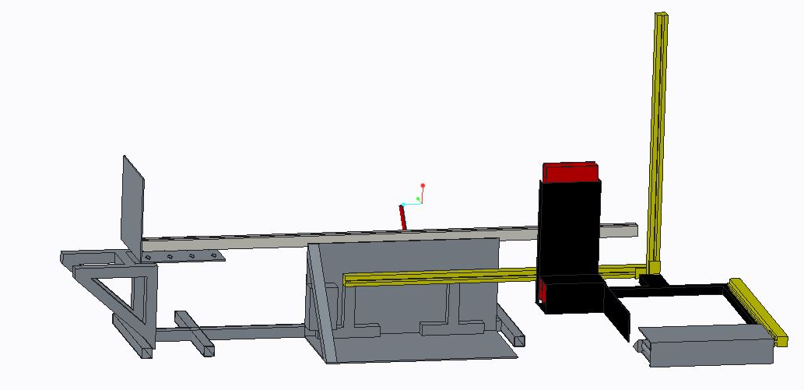
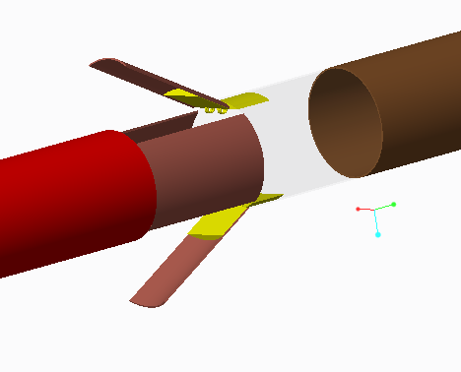
Key design features
Active Drag System
Rotating Payload Bay
AGSE Linear Actuators
AGSE Conveyor

Slide 5
Flight Characteristics
Motor: Cesaroni K490
Thrust-to-Weight Ratio: 10.2
Rail Exit Velocity: 41.01 ft/s (12.5 m/s)
Streamers
Manufacturer: Sunward Group Ltd.
Size: 5 x 50 in (12.7 x 127 cm)
Parachute
Manufacturer: Angel Chute
Size: 52 in diameter (132.1 cm diameter)
Terminal Velocity: 30.2 ft/s (9.2 m/s)
Mass: 13.04 lbs (5.9 kg)
Mass margin: 2 lbs (0.91 kg)
Stability: 0.944 cal
Kinetic Energy
Section 1: 13.7 ft-lbs (18.6 N-m)
Section 2: 9.12 ft-lbs (12.4 N-m)
Section 3: 132.2 ft-lbs (179.2 N-m)

Slide 6
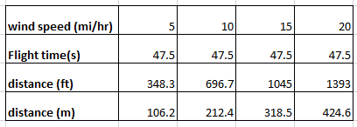
Launch pad drift with varying
wind speed
Drift Calculation

Slide 7
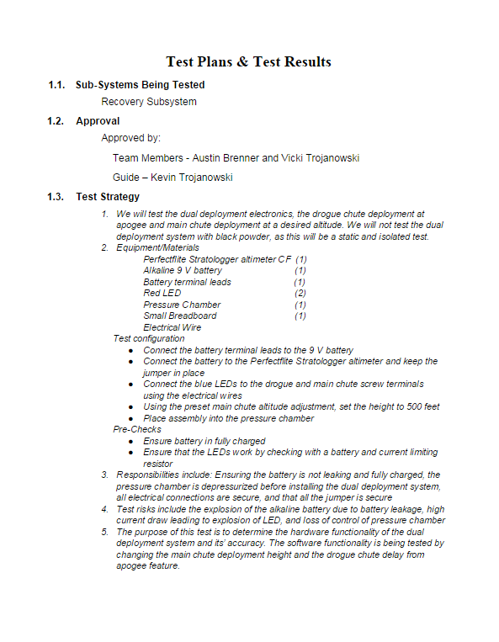
Test plans and procedure
Recovery
Control
Subscale flight
Payload
Drag

Slide 8
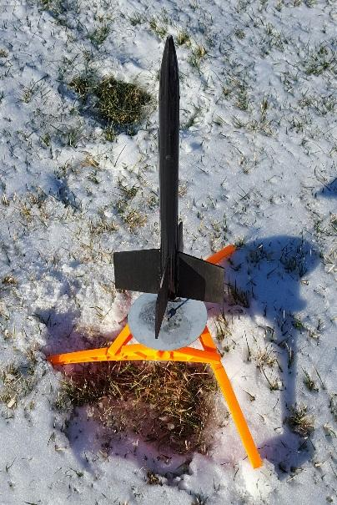
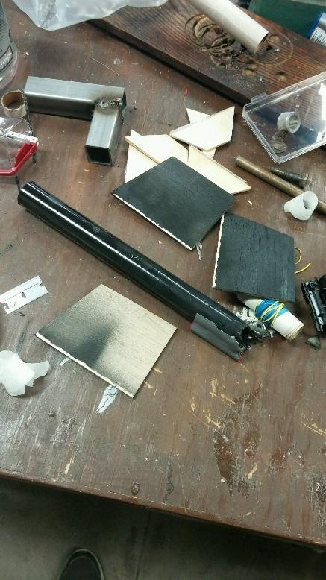
Scale model flight test

Slide 9
Tests of staged recovery system
Hand Test
LED test
Pressure/Black powder test

Slide 10
Final payload design overview

Slide 11
Integration/ Interfaces
IR Sensor
Light Sensor
Contact Sensors in AGSE
Altimeters

Slide 12
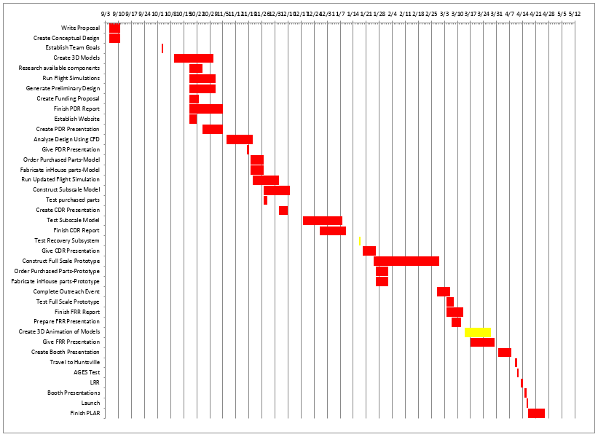
Status of requirements verification

Slide 13
Thank you

