Slide 1



Punam Kumar Saha Professor Departments of ECE and Radiology University of Iowa pksaha@engineering.uiowa.edu
3D Simple Point, Topology Preservation, and Skeletonization

Slide 2
References
[1] P. K. Saha, B. Chanda, and D. D. Majumder, "Principles and algorithms for 2D and 3D shrinking," NCKBCS Library, Indian Statistical Institute Calcutta, India, Technical Report TR/KBCS/2/91, 1991.
[2] P. K. Saha, B. B. Chaudhuri, B. Chanda, and D. D. Majumder, "Topology preservation in 3D digital space," Pattern Recognition, vol. 27, pp. 295-300, 1994.
[3] P. K. Saha and B. B. Chaudhuri, "Detection of 3-D simple points for topology preserving transformations with application to thinning," IEEE Transactions on Pattern Analysis and Machine Intelligence, vol. 16, pp. 1028-1032, 1994.
[4] P. K. Saha, B. B. Chaudhuri, and D. D. Majumder, "A new shape preserving parallel thinning algorithm for 3D digital images," Pattern Recognition, vol. 30, pp. 1939-1955, 1997.
[5] D. Jin and P. K. Saha, "A new fuzzy skeletonization algorithm and its applications to medical imaging," Proc of the Image Analysis and Processing–ICIAP, pp. 662-671, 2013.
[6] P. K. Saha, G. Borgefors, and G. Sanniti di Baja, "A survey on skeletonization algorithms and their applications," Pattern Recognition Letters, 2015.
[7] P. K. Saha and B. B. Chaudhuri, "3D digital topology under binary transformation with applications," Computer vision and image understanding, vol. 63, pp. 418-429, 1996.
[8] D. Jin, C. Chen, and P. K. Saha, "Filtering Non-Significant Quench Points Using Collision Impact in Grassfire Propagation," in Image Analysis and Processing—ICIAP 2015, Springer International Publishing, pp. 432-443, 2015.
[9] D. Jin, K. S. Iyer, C. Chen, E. A. Hoffman, and P. K. Saha, "A robust and efficient curve skeletonization algorithm for tree-like objects using minimum cost paths," Pattern Recognition Letters, 2015.
[10] C. Chen, D. Jin, and P. K. Saha, "Fuzzy Skeletonization Improves the Performance of Characterizing Trabecular Bone Micro-architecture," in Advances in Visual Computing, Springer International Publishing, pp. 14-24, 2015.

Slide 3
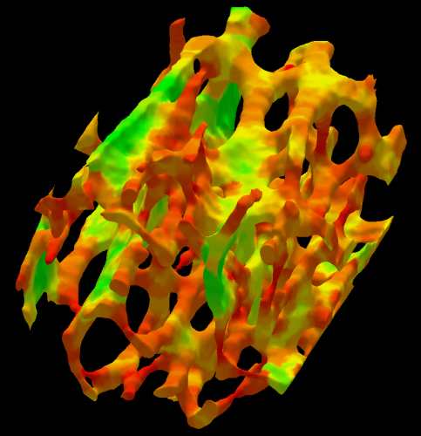
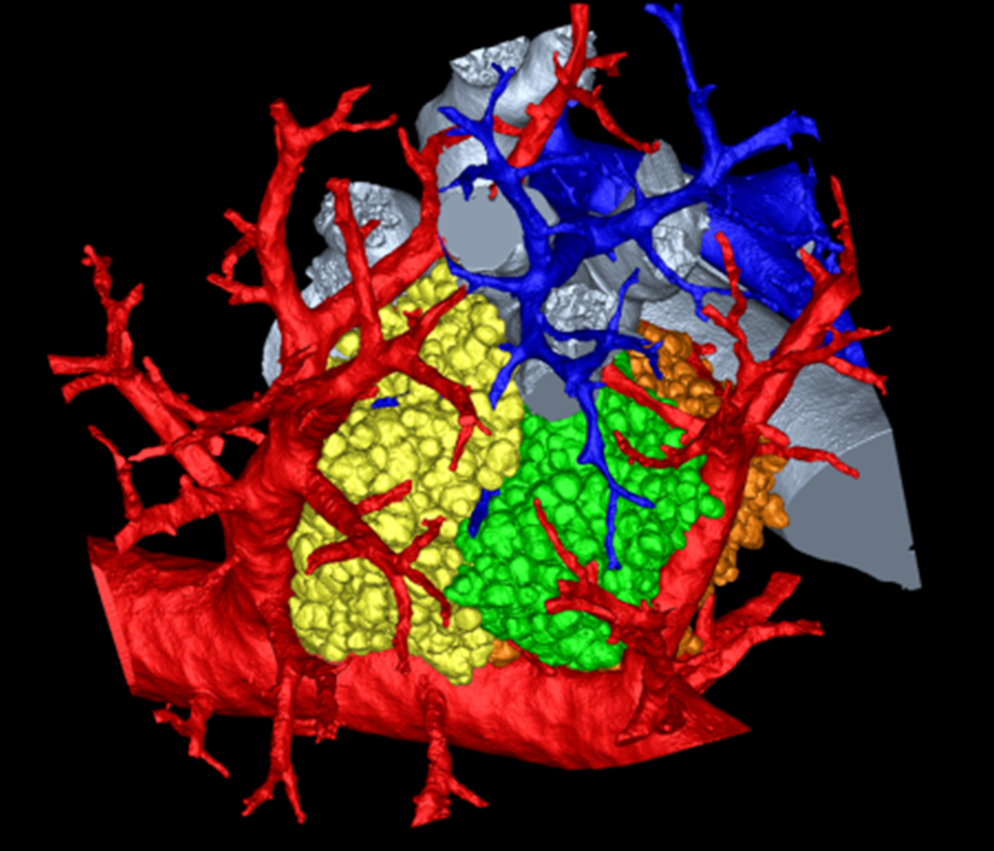
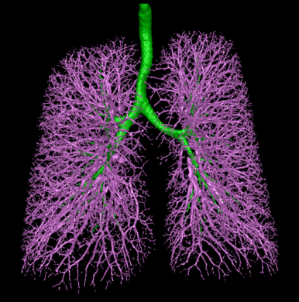
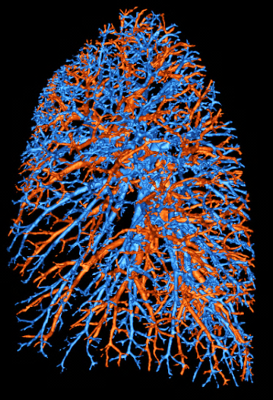

Outline
Introduction to topological transformation and topological equivalence
Basic notions of digital topology
Euler characteristic
Simple point
A simple point characterization in 3-D
Number of tunnels in $3×3×3$ neighborhood
Local topological numbers
Efficient algorithms
Fuzzy Skeletonization

Slide 4
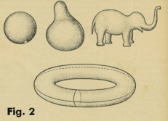
Continuous Deformation
Topology. The study of those properties of geometric figures or solid bodies that remain invariant under certain transformations.
Continuous deformation. A transformation which shrinks, stretches, bents, twists, etc. in any way without tearing
Envision a figure drawn on a rubber sheet
A deformation of the sheet by stretching, twisting, bending, etc. which doesn’t tear the sheet will change the figure into some other shape

Slide 5
Topological Transformation and Equivalence
Topology. The study of those properties of geometric figures or solid bodies that remain invariant under certain transformations.
Topological transformation. A transformation that carries one geometric figure into another figure is a topological transformation if the following conditions are met:
1) the transformation is one-to-one
2) the transformation is bicontinuous (i.e. continuous in both directions)
Topologically equivalent. Two different shapes are topologically equivalent if one can be changed to the other by a topological transformation

Slide 6
Basic Definitions in 3-D
A cubic grid constitutes the set $Z^{3}$
An element of $Z^{3}$ is referred to as a point represented by its x-, y-, z-coordinates
Each cube centered at an element in $Z^{3}$ is referred to as a voxel
26-adjacency
18-adjacency
6-adjacency

Slide 7
Basic Definitions in 3-D
An $α$-path $π$, where $α∈\{6, 18, 26\}$, is a nonempty sequence $〈p_{0},⋯, p_{l−1}〉$ of voxels where every two successive voxels are $α$-adjacent
26-path
6-path
An $α$-component of a set of voxels $S$ is a maximal subset of $S$ where every two voxels are $α$-connected in $S$

Slide 8
Basic Definitions in 3-D
An $α$-path $π$, where $α∈\{6, 18, 26\}$, is a nonempty sequence $〈p_{0},⋯, p_{l−1}〉$ of voxels where every two successive voxels are $α$-adjacent
26-path
6-path
An $α$-component of a set of voxels $S$ is a maximal subset of $S$ where every two voxels are $α$-connected in $S$

Slide 9
Adjacency Pairs in Digital Topology
Digital topology loosely refers to the use of mathematical topological properties and features such as connectedness, topology preservation, boundary etc., for images defined in digital grids
Jordan curve

Slide 10
Adjacency Pairs in Digital Topology
Digital topology loosely refers to the use of mathematical topological properties and features such as connectedness, topology preservation, boundary etc., for images defined in digital grids
Adjacency pairs. Rosenfeld’s approach to digital topology is to use a pair of adjacency relations $\left(κ_{1}, κ_{0}\right)$ where $κ_{1}$ is used for object points while $κ_{0}$ is used for background points
Jordan curve
Theorem. Jordan curve partitions of a plane into inside and outside

Slide 11
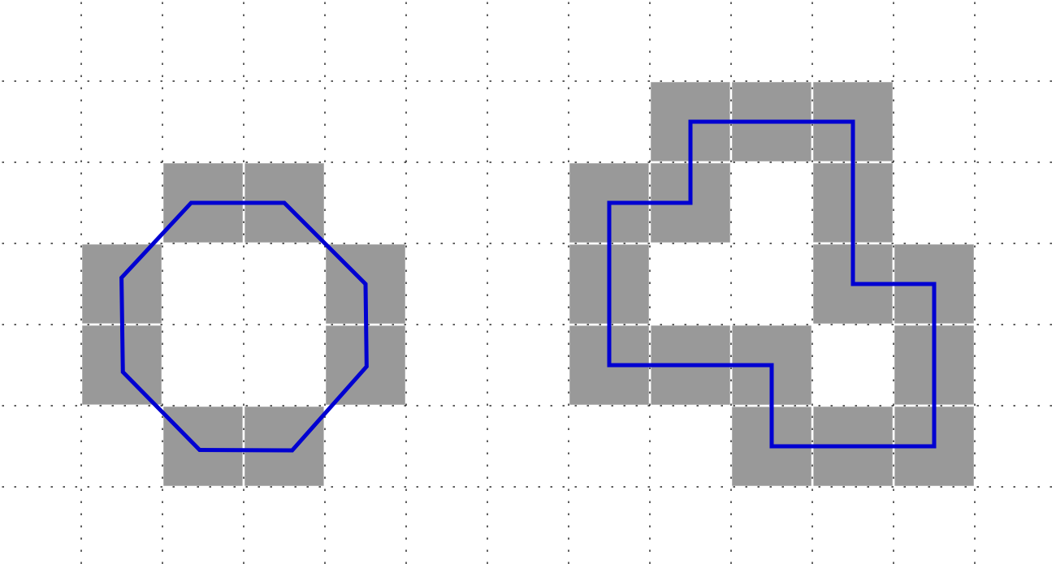
Why the Adjacency Pair?
Rosenfeld convincingly demonstrated that use of a proper adjacency pair leads to workable framework of digital topology, which holds several important mathematical topological properties, including the Jordan curve theorem
One proper adjacency pair is (26,6)
(26,6) is the most popular adjacency pairs in 3-D
The modern trend is to use the cubicial complex representation of digital images to define topological transformation

Slide 12
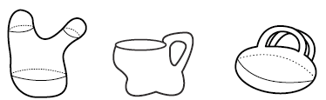
Cavities and Tunnels in 3-D
Cavity. A background or white component surrounded by an object component
Tunnel. Difficult to define a tunnel. However, the number of tunnels in an object is well-defined - the rank of the first homology group of the object.
Intuitively, a tunnel would be the opening in the handle of a coffee mug, formed by bending a cylinder to connect the two ends to each other or to another connected object
A hollow torus has two tunnels: the first arises from the cavity inside the ring and the second from the ring itself

Slide 13
Euler Characteristic
The Euler characteristic of a polyhedral set $X$, denoted by $χ(X)$, is defined as follows
$χ\left(φ\right)=0$
$χ\left(X\right)=1$, if $X$ is non-empty and convex
for any two polyhedral $X$, $Y$, $χ\left(X∪Y\right)=χ\left(X\right)+χ\left(Y\right)−χ(X∩Y)$

Slide 14
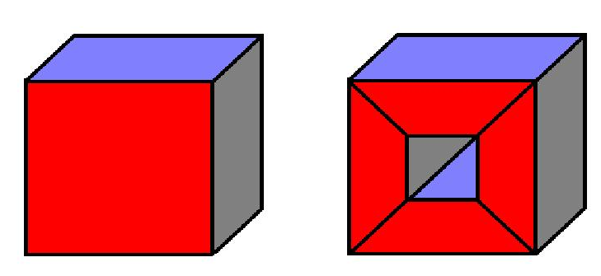
Euler Characteristic: Alternative Definitions
The Euler characteristic of a polyhedron with each element being convex
$χ\left(X\right)=\#points−\#edges+\#faces−\#volumes,$
and
$χ\left(X\right)=\#components−\#tunnels+\#cavities$
8 ‒ 12 + 6 ‒ 1 = 1
16 ‒ 32 + 20 ‒ 4 = 0
1 ‒ 0 + 0 = 1
1 ‒ 1 + 0 = 0

Slide 15


3-D Simple Point
Simple Point. A point whose deletion or addition preserves the topology in the local neighborhood in terms of components, tunnels, and cavities
$$p$$
$$p$$
$$p$$
$$p$$
$$p$$
The major challenge. Presence of tunnels in 3-D that is not there in 2-D

Slide 16
3-D Simple Point Characterization by Morgenthaler (1981)
A point $p∈Z^{3}$ is a (26,6) simple point in a 3-D binary image $\left(Z^{3},26,6,B\right)$ if and only if the following conditions are satisfied
In $N_{26}^{∗}\left(p\right)$, the point $p$ is 26-adjacent to exactly one black (object) component
In $N_{26}^{∗}\left(p\right)$, the point $p$ is 6-adjacent to exactly one white (background) component
$χ\left(\left(Z^{3},26,6,\left(B∩N\left(p\right)\right)∪\left\{p\right\}\right)\right)=χ\left(\left(Z^{3},26,6,\left(B∩N\left(p\right)\right)−\left\{p\right\}\right)\right)$
$$χ\left(X\right)=\#components−\#tunnels+\#cavities$$

Slide 17
Tunnels on the Surface of a Topological Sphere
$$B$$
$$B$$
$$𝒮$$
$$𝒮$$
Saha, Chanda, Dutta Majumder, "Principles and algorithms for 2D and 3D shrinking," Indian Statistical Institute, Calcutta, India, TR/KBCS/2/91, 1991.
Saha, Chaudhuri, Chanda, Dutta Majumder, "Topology preservation in 3D digital space," Pat Recog, 27:295-300, 1994.
Saha and Chaudhuri, "Detection of 3-D simple points … with application to thinning," IEEE Trans Pat Anal Mach Intel, 16:1028-1032, 1994.
Saha and Chaudhuri, "3D digital topology under binary transformation with applications," Comp Vis Imag Und, 63:418-429, 1996

Slide 18
Tunnels on the Surface of 3x3x3 Neighborhood (Digital Case)
In a $3×3×3$ neighborhood, if the central voxel is white, all black voxels lie on its outer surface
For computation of tunnels, a white component must be 6-adjacent to the central voxel
Ooops still there is some problem!!

Slide 19
Tunnels on the Surface of 3x3x3 Neighborhood (Digital Case)

Slide 20
Tunnels on the Surface of 3x3x3 Neighborhood (Digital Case)

Slide 21
Tunnels on the Surface of 3x3x3 Neighborhood (Digital Case)
Saha, Chanda, Dutta Majumder, "Principles and algorithms for 2D and 3D shrinking," Indian Statistical Institute, Calcutta, India, TR/KBCS/2/91, 1991.
Saha, Chaudhuri, Chanda, Dutta Majumder, "Topology preservation in 3D digital space," Pat Recog, 27:295-300, 1994.
Saha and Chaudhuri, "Detection of 3-D simple points … with application to thinning," IEEE Trans Pat Anal Mach Intel, 16:1028-1032, 1994.
Saha and Chaudhuri, "3D digital topology under binary transformation with applications," Comp Vis Imag Und, 63:418-429, 1996

Slide 22
Tunnels on the Surface of 3x3x3 Neighborhood (Digital Case)
Saha, Chanda, Dutta Majumder, "Principles and algorithms for 2D and 3D shrinking," Indian Statistical Institute, Calcutta, India, TR/KBCS/2/91, 1991.
Saha, Chaudhuri, Chanda, Dutta Majumder, "Topology preservation in 3D digital space," Pat Recog, 27:295-300, 1994.
Saha and Chaudhuri, "Detection of 3-D simple points … with application to thinning," IEEE Trans Pat Anal Mach Intel, 16:1028-1032, 1994.
Saha and Chaudhuri, "3D digital topology under binary transformation with applications," Comp Vis Imag Und, 63:418-429, 1996

Slide 23
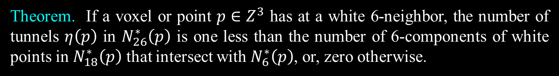
Tunnels on the Surface of 3x3x3 Neighborhood (Digital Case)
Theorem. If a voxel or point $p∈Z^{3}$ has at a white 6-neighbor, the number of tunnels $η\left(p\right)$ in $N_{26}^{∗}\left(p\right)$ is one less than the number of 6-components of white points in $N_{18}^{∗}\left(p\right)$ that intersect with $N_{6}^{∗}\left(p\right)$, or, zero otherwise.
Saha, Chanda, Dutta Majumder, "Principles and algorithms for 2D and 3D shrinking," Indian Statistical Institute, Calcutta, India, TR/KBCS/2/91, 1991.
Saha, Chaudhuri, Chanda, Dutta Majumder, "Topology preservation in 3D digital space," Pat Recog, 27:295-300, 1994.
Saha and Chaudhuri, "Detection of 3-D simple points … with application to thinning," IEEE Trans Pat Anal Mach Intel, 16:1028-1032, 1994.
Saha and Chaudhuri, "3D digital topology under binary transformation with applications," Comp Vis Imag Und, 63:418-429, 1996

Slide 24

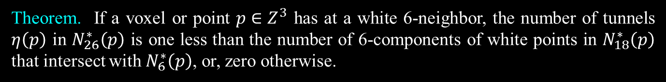
3-D Simple Point Characterization by Saha et al. (1991, 1994)
Theorem. If a voxel or point $p∈Z^{3}$ has at a white 6-neighbor, the number of tunnels $η\left(p\right)$ in $N_{26}^{∗}\left(p\right)$ is one less than the number of 6-components of white points in $N_{18}^{∗}\left(p\right)$ that intersect with $N_{6}^{∗}\left(p\right)$, or, zero otherwise.
A point $p∈Z^{3}$ is a (26,6) simple point in a 3-D binary image $\left(Z^{3},26,6,B\right)$ if and only if the following conditions are satisfied
$p$ has a white (background) 6-neighbor, i.e., $N_{6}^{∗}\left(p\right)−B≠φ$
$p$ has a black (object) 26-neighbor, i.e., $N_{26}^{∗}\left(p\right)∩B≠φ$
The set of black 26-neighbors of $p$ is 26-connected, i.e., $N_{26}^{∗}\left(p\right)∩B$ is 26-connected
The set of white 6-neighbors of $p$ is 6-connected in the set of white 18-neighbors, i.e., $N_{6}^{∗}\left(p\right)−B$ is 6-connected in $N_{18}^{∗}\left(p\right)−B$
Saha, Chanda, Dutta Majumder, "Principles and algorithms for 2D and 3D shrinking," Indian Statistical Institute, Calcutta, India, TR/KBCS/2/91, 1991.
Saha, Chaudhuri, Chanda, Dutta Majumder, "Topology preservation in 3D digital space," Pat Recog, 27:295-300, 1994.
Saha and Chaudhuri, "Detection of 3-D simple points … with application to thinning," IEEE Trans Pat Anal Mach Intel, 16:1028-1032, 1994.
Saha and Chaudhuri, "3D digital topology under binary transformation with applications," Comp Vis Imag Und, 63:418-429, 1996

Slide 25
Local Topological Numbers
$ξ\left(p\right)$: the number of objects components in the $3×3×3$ neighborhood after deletion of $p$
$η\left(p\right)$: the number of tunnels in the $3×3×3$ neighborhood after deletion of $p$
$δ\left(p\right)$: the number of cavities in the $3×3×3$ neighborhood after deletion of $p$
Saha, Chanda, Dutta Majumder, "Principles and algorithms for 2D and 3D shrinking," Indian Statistical Institute, Calcutta, India, TR/KBCS/2/91, 1991.
Saha and Chaudhuri, "3D digital topology under binary transformation with applications," Comp Vis Imag Und, 63:418-429, 1996

Slide 26
Efficient Computation of 3-D Simple Point and Local Topological Numbers
Dead surface
Dead edge
Theorem. 3-D simplicity and local topological numbers of a point is independent of its dead points.
Saha, Chanda, Dutta Majumder, "Principles and algorithms for 2D and 3D shrinking," Indian Statistical Institute, Calcutta, India, TR/KBCS/2/91, 1991.
Saha, Chaudhuri, Chanda, Dutta Majumder, "Topology preservation in 3D digital space," Pat Recog, 27:295-300, 1994.
Saha and Chaudhuri, "Detection of 3-D simple points … with application to thinning," IEEE Trans Pat Anal Mach Intel, 16:1028-1032, 1994.
Saha and Chaudhuri, "3D digital topology under binary transformation with applications," Comp Vis Imag Und, 63:418-429, 1996

Slide 27
Effective Neighbors
p
p
e (edge)-neighbor: 18-adjacent but not 6-adjacent, i.e., share an edge with $p$
Effective e-neighbor: An e-neighbor not belonging to a dead surface
v (vertex)-neighbor: 26-adjacent but not 18-adjacent, i.e., share a vertex with $p$
Effective v-neighbor: A v-neighbor not belonging to a dead surface or a dead edge
Theorem. Object/background configuration 6-neighbors, effective e- and v-neighbors is the necessary and sufficient information to decide on 3-D simplicity and local topological numbers of a point.

Slide 28
Efficient Algorithm
Determine the object/background configuration of 6-neighbors
Determine the object/background configuration of effective e-neighbors
Determine the object/background configuration of effective v-neighbors
Use look up table to determine 3-D simplicity and the local topological numbers $ξ\left(p\right)$, $η(p)$, and $δ\left(p\right)$
Saha, Chanda, Dutta Majumder, "Principles and algorithms for 2D and 3D shrinking," Indian Statistical Institute, Calcutta, India, TR/KBCS/2/91, 1991.
Saha, Chaudhuri, Chanda, Dutta Majumder, "Topology preservation in 3D digital space," Pat Recog, 27:295-300, 1994.
Saha and Chaudhuri, "Detection of 3-D simple points … with application to thinning," IEEE Trans Pat Anal Mach Intel, 16:1028-1032, 1994.
Saha and Chaudhuri, "3D digital topology under binary transformation with applications," Comp Vis Imag Und, 63:418-429, 1996

Slide 29
Topology Preservation in Parallel Skeletonization
The principal challenge in topology preservation for parallel skeletonization
a characterization of simple point guarantees topology preservation when one simple point is deleted at a time
however, these characterizations fail to ensure topology preservation when a set of simple points are deleted in parallel

Slide 30
Our Approach
Sub-iterative scheme. Divide an iteration into subiterations based on 2 × 2 × 2 subfield partitioning of the image grid
Saha, Chaudhuri, and Dutta Majumder, "A new shape preserving parallel thinning algorithm for 3D digital images," Patt Recog, 30:1939-1955, 1997

Slide 31
Fuzzy Skeletonization, and its Applications

Slide 32
Outline
Fuzzy Skeletonization
Applications of Digital Topology and Geometry in Object Characterization

Slide 33
Outline
Fuzzy Skeletonization
Applications of Digital Topology and Geometry in Object Characterization

Slide 34

Principle of Skeletonization
Object: A closed and bounded subset of R³
Maximal Included Ball: A ball included in the object that cannot be cannot be fully included by another ball inside the object
Skeleton: Loci of the centers of maximal included balls
Blum’s Grassfire Transform: A process that yields the skeleton of a binary objects

Slide 35
Blum’s Grassfire Propagation
Blum’s grassfire transform is defined by fire propagation on a grass field, where the field resembles a binary object.
grassfire is simultaneously initiated at all boundary points
grassfire propagates inwardly at a uniform speed
the skeleton is defined as the set of quench points where two or more opposite fire fronts meet

Slide 36
Fuzzy Grassfire Propagation
Fuzzy Object: A membership value is assigned at each voxel
The membership value is interpreted as the fraction of object occupancy in a given voxel or local material density
Fuzzy Grassfire Propagation
grassfire is simultaneously initiated at the boundary of the support of a fuzzy object
the speed of fire-front at at given voxel is inversely proportion to its material density, i.e., membership value
grassfire stops at quench voxels when its natural speed of propagation is interrupted by colliding impulse from opposing fire-fronts

Slide 37
Outline of the Algorithm
Primary skeletonization
Locate fuzzy quench voxels in the decreasing order of FDT values and filter those using local shape factor
Sequentially remove simple points that are not necessary for topology preservation in the increasing order of FDT values
Final skeletonization
Convert two-voxel thick structures into single-voxel structures
Remove voxels with conflicting topological and geometric properties
Skeleton pruning
Compute global shape factor to detect spurious branches
Delete spurious branches

Slide 38
Simple Points: Topology Preservation
Theorem: A point p is a 3-D simple point if and only if it satisfies the following four conditions:
p has a black 26-neighbor
p has a white 6-neighbore
The set of black 26-neighbors of p is26-connected
The set of white 6-neighbors of p is 6-connected in the set of white 18-neighbors of p

Slide 39
Simple Points: Examples
✔
✔
✗
✗
✗
✗

Slide 40
Fuzzy Quench or Axial Points
During fuzzy grassfire propagation, the speed of a fire-front at a given voxel equates to the inverse of local material density
Fuzzy distance transform defines the time when the fire-front reaches at a given voxel
This process is violated only at quench or axial points where the propagation is interrupted by colliding impulse from opposite fire-fronts

Slide 41
How to Locate an Axial Point
1. Consider a shape and its axial line
b₂
5. Now, consider
an axial point $a_{1}$
2. Consider a non-axial point $p_{1}$
a₂
3. Find the shortest
path $p_{1}b_{1}$ to
boundary
a₁
p₂
6. If extend the
shortest path $a_{1}b_{1}$
to $a_{2}$, the shortest
path from $a_{2}$ to the
boundary does not
passes through $a_{1}$
p₁
4. If we extend the
path $p_{1}b_{1}$ to $p_{2}$
the shortest path
$p_{2}b_{1}$ passes
through $p_{1}$
b₁
A point $a$ is an axial point if there is no point $a^{′}$ such that a shortest path from $a^{′}$ to the boundary passes through $a$

Slide 42
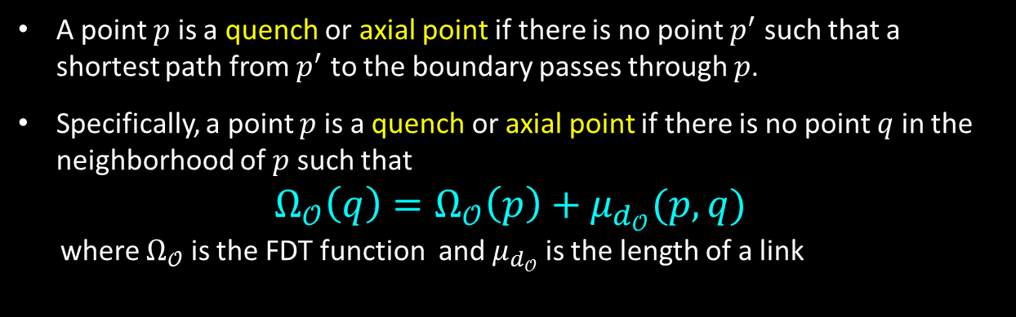
Fuzzy Quench or Axial Points
A point $p$ is a quench or axial point if there is no point $p^{′}$ such that a shortest path from $p^{′}$ to the boundary passes through $p$.
Specifically, a point $p$ is a quench or axial point if there is no point $q$ in the neighborhood of $p$ such that
$$Ω_{𝒪}\left(q\right)=Ω_{𝒪}\left(p\right)+μ_{d_{𝒪}}(p,q)$$
where $Ω_{𝒪}$ is the FDT function and $μ_{d_{𝒪}}$ is the length of a link
Arcelli and Sanniti di Baja introduced a criterion to detect the centers of maximal balls (CMBs) in a binary digital image using $3×3$ weighted distance transform
Borgefors extended it to $5×5$ weighted distances
This concept was generalized to fuzzy sets by Saha and Wehrli, Svensson, and Jin and Saha
Arcelli, Sanniti di Baja, “Finding local maxima in a pseudo-Euclidean distance transform”, Comput Vis Graph Imag Proc, 43: 361-367, 1988
Borgefors, “Centres of maximal discs in the 5-7-11 distance transform”, Proc of the Scandinavian Conf on Imag Anal ,1: 105-105), 1993
Saha, Wehrli, “Fuzzy distance transform in general digital grids and its applications”, Proc of 7th Joint Conf Info Sc, Research Triangular Park, NC, 201-213, 2003
Svensson, “Aspects on the reverse fuzzy distance transform”, Patt Recog Lett 29: 888-896, 2008
Jin, Saha. "A new fuzzy skeletonization algorithm and its applications to medical imaging." Proc. of 17th Int Conf on Imag Anal Proc (ICIAP), 662-671, 2013.

Slide 43
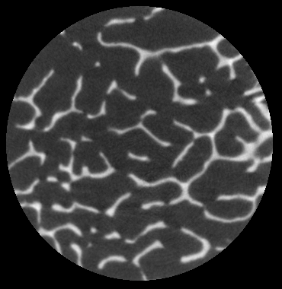
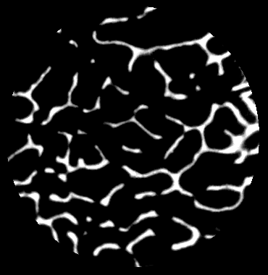
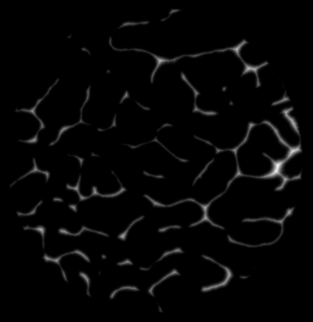
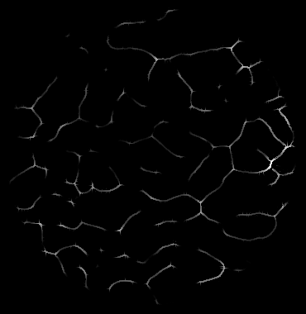
Examples

Slide 44
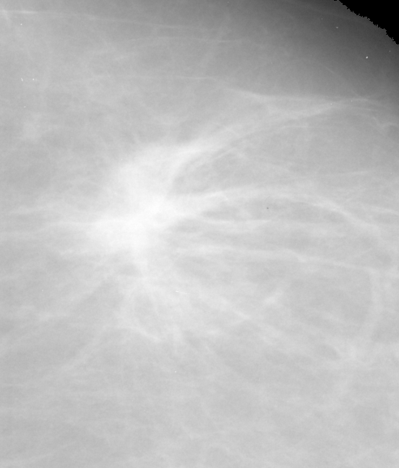
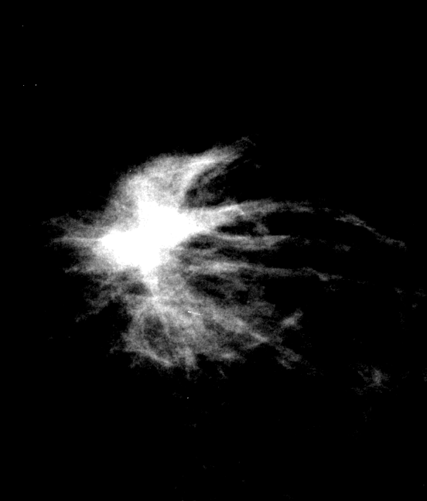
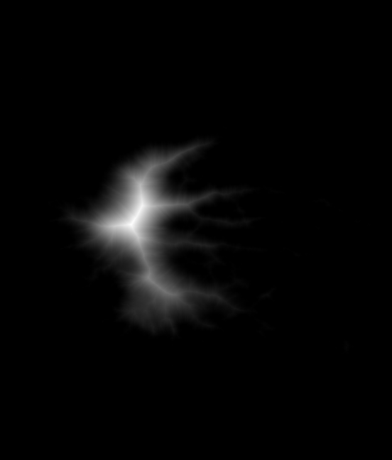
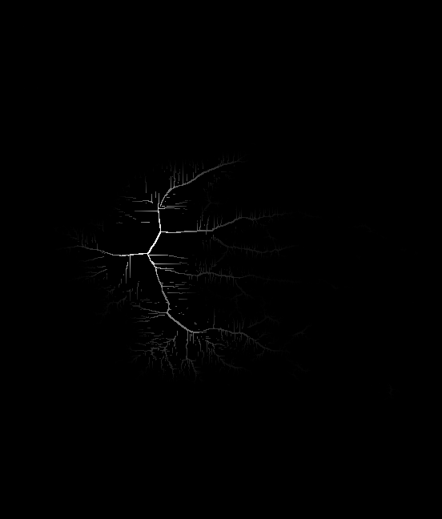
Examples

Slide 45
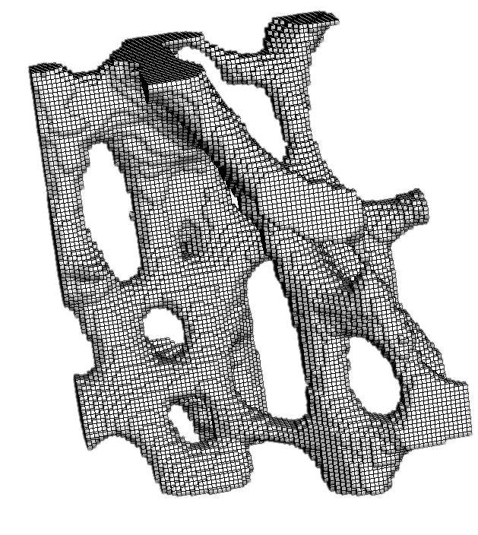

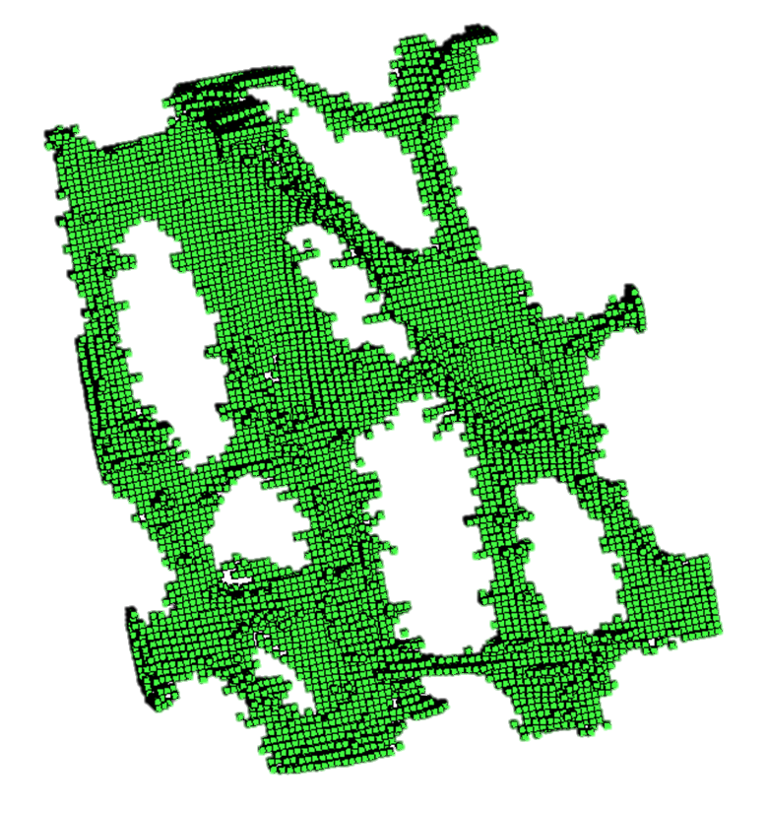
Filtering Quench or Axial Voxels
Too many spurious quench voxels
Support of the fuzzy object
An image slice of the fuzzy object
All quench voxels

Slide 46

Local Shape Factor for Quench Voxels
At quench voxels, natural speed of fire-front propagation is interrupted by colliding impulse from opposite fire-fronts
Local Shape Factor is defined as the measure of this “degree of colliding impulse”
$$LSF\left(p\right)=1−f_{+}\left(\max_{q∈N^{∗}\left(p\right)}{\frac{Ω_{𝒪}\left(q\right)−Ω_{𝒪}\left(p\right)}{μ_{d_{𝒪}}\left(p,q\right) }}\right)$$
Local shape factor determines the significance of individual quench voxels

Slide 47
Surface and Curve Quench Voxels
Surface Quench Voxels
two opposite fire fronts meet
Curve Quench Voxels
fire fronts meet from all directions on a plane

Slide 48
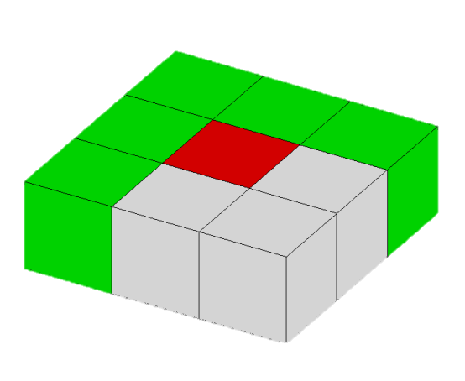
Filtering Quench Voxels
Define a suitable support mask that fits the geometric type of the quench voxel
Determine the significance in terms of LSF over the support mask
Support mask for a surface quench voxel
p
p
Overall significance
compute minimum LSF over the support mask
or
compute the average LSF over the support mask

Slide 49
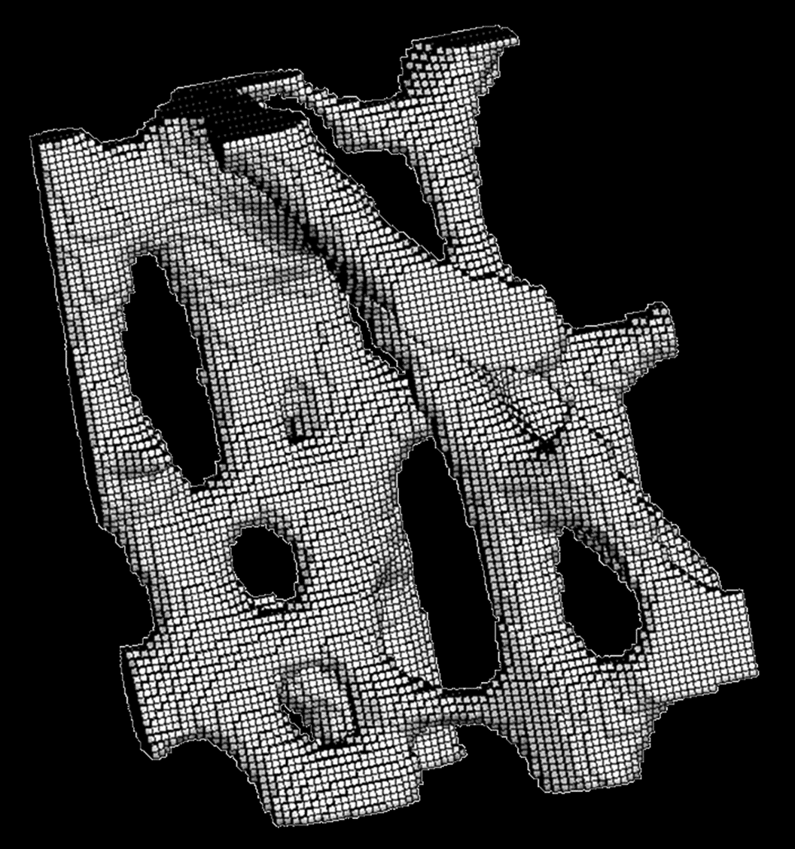
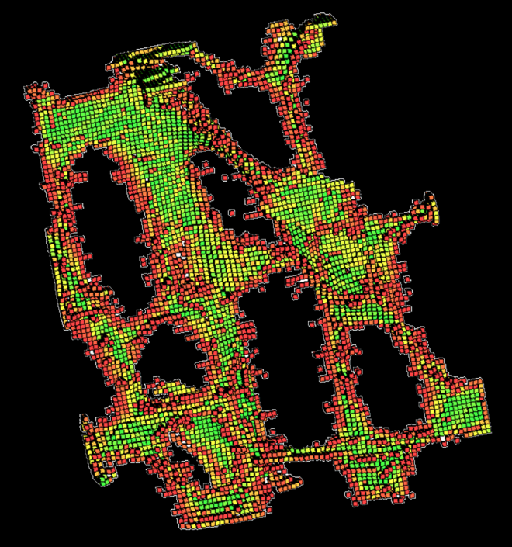
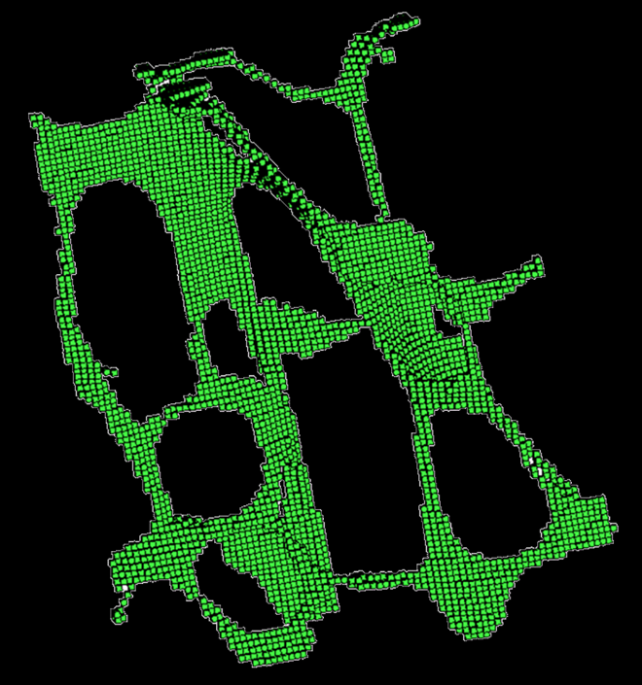
Filtered Axial Voxels
0
1
Local shape factor (LSF)
Support of the fuzzy object
Initial quench voxels; red voxels have lower LSF values representing noisy quench voxels
Filtered quench voxels

Slide 50
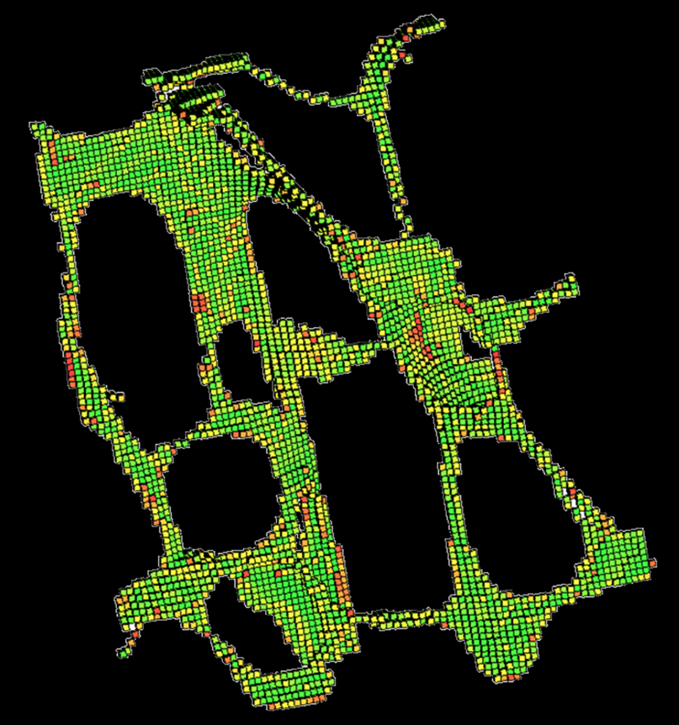
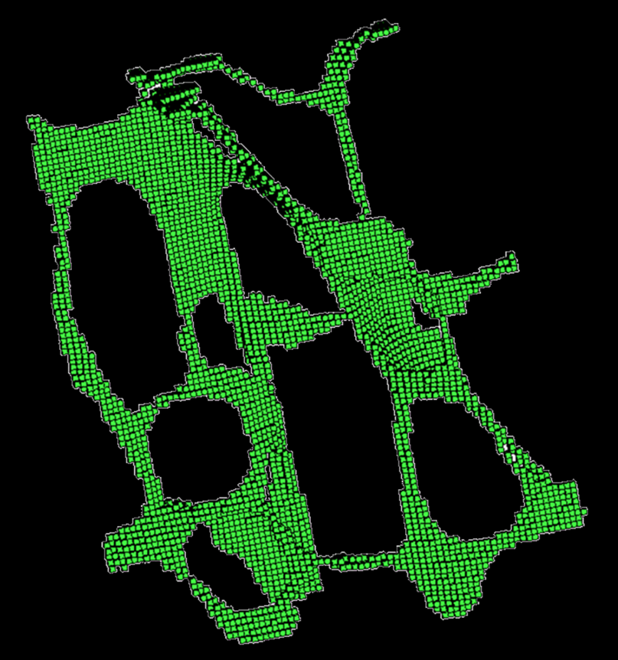
Skeletal Pruning
Compute global shape factor of each branch by adding LSF values of individual voxels and prune spurious branches
before
after

Slide 51
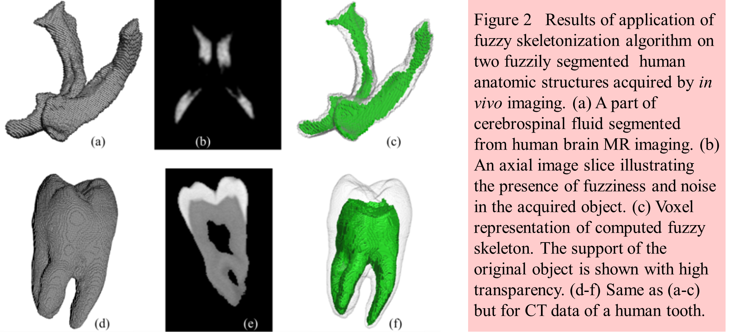
A Few Examples

Slide 52
A Few Examples

Slide 53
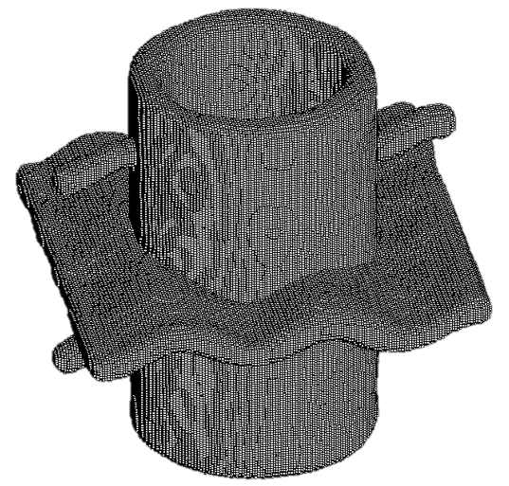
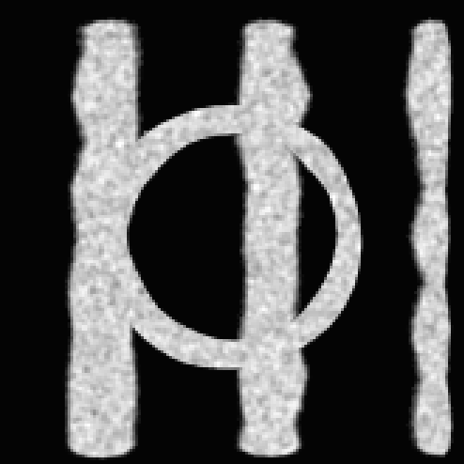

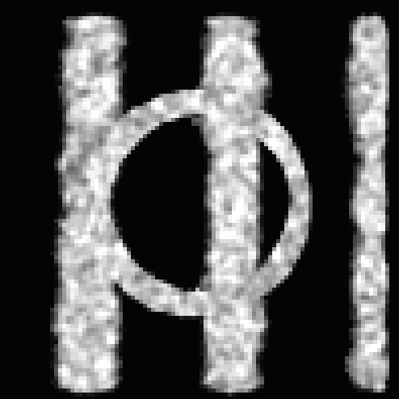
Evaluation
Ground truth: High resolution 3-D binary objects with known skeletons
Test phantoms: Down-sampling binary objects and addition of white Gaussian noise to generate fuzzy objects
low noise/blur
medium noise/blur
high noise/blur

Slide 54
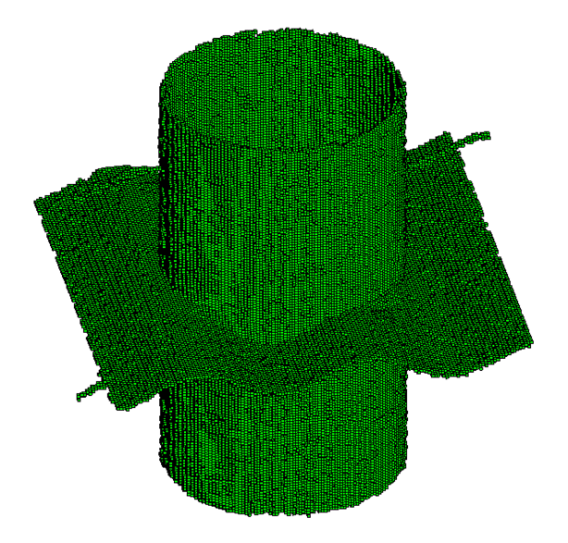
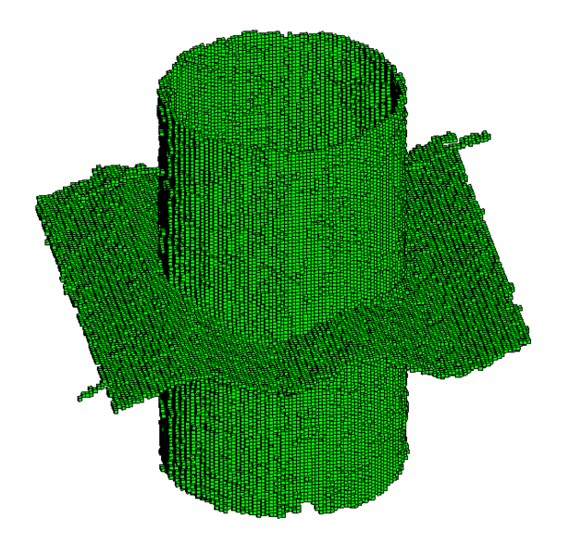
Results
Skeletons at low, medium, and high noise/blur
Fuzzy skeletonization errors in voxel unit
Downsampling | No noise | SNR 24 | SNR 12 | SNR 6
3×3×3 | 0.49 | 0.52 | 0.54 | 0.58
4×4×4 | 0.52 | 0.53 | 0.54 | 0.58
5×5×5 | 0.57 | 0.58 | 0.59 | 0.60

Slide 55
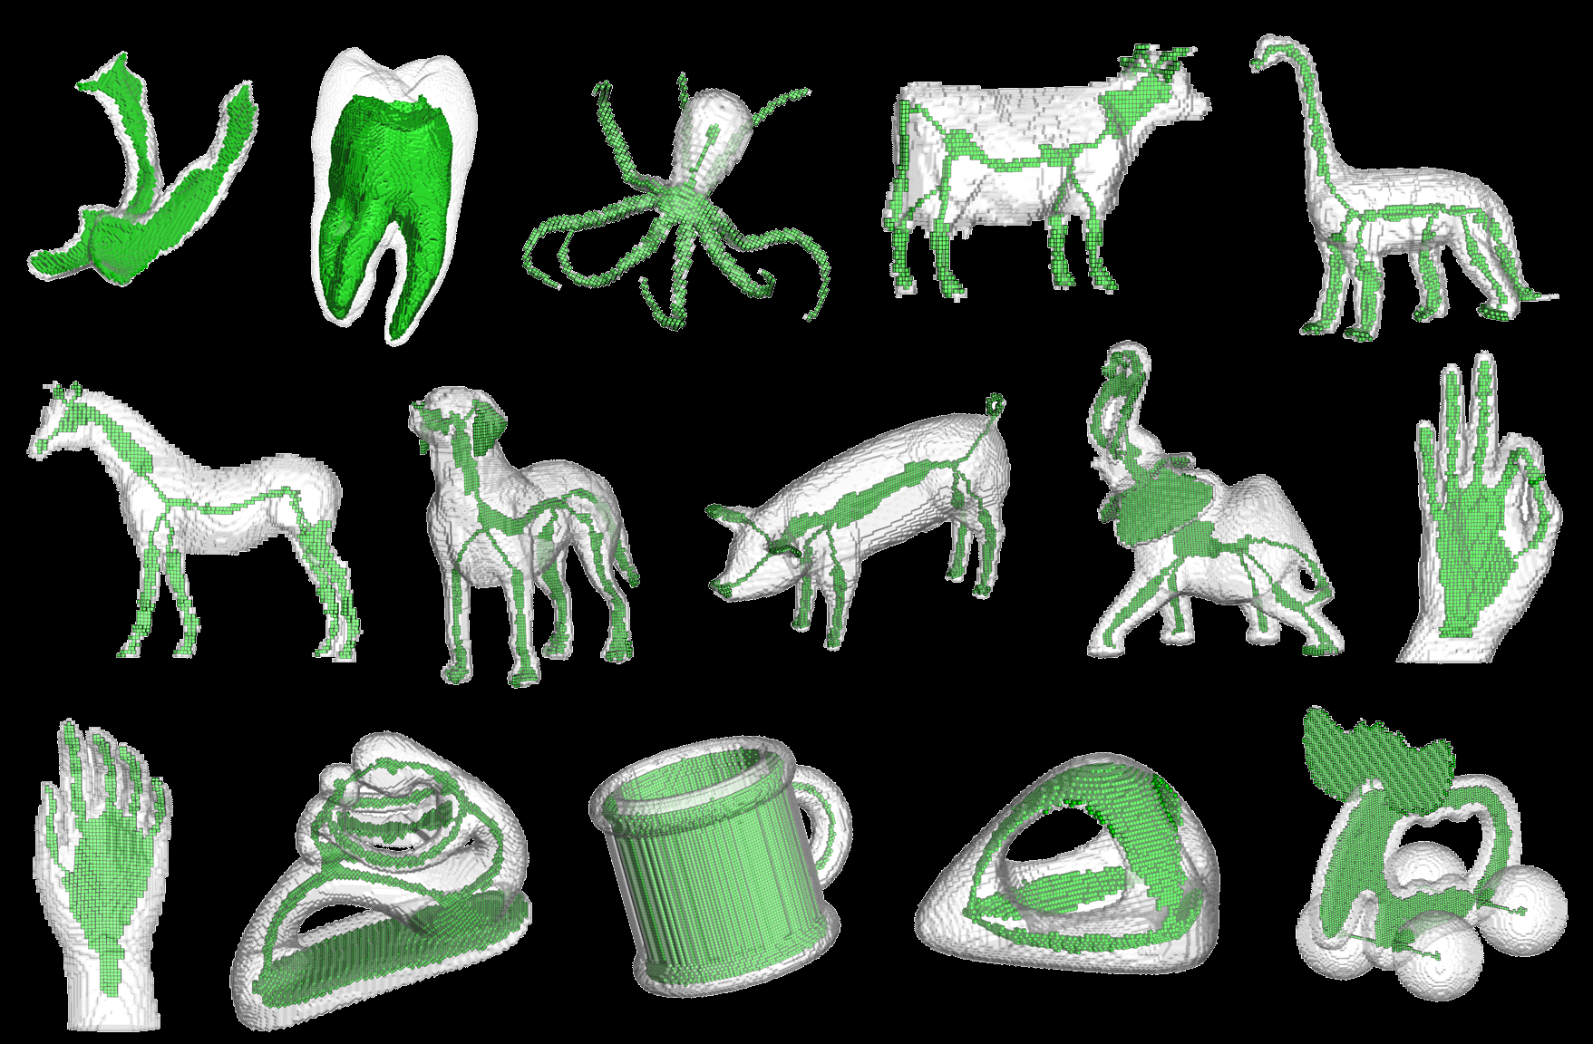
Results of Application on Online 3D Figures

Slide 56
Applications

Slide 57
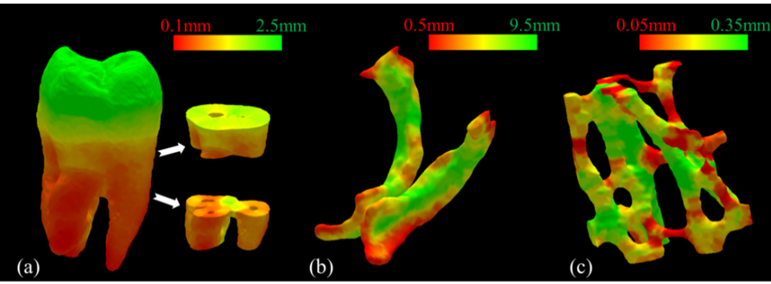
Local Thickness Computation for Fuzzy Objects

Slide 58
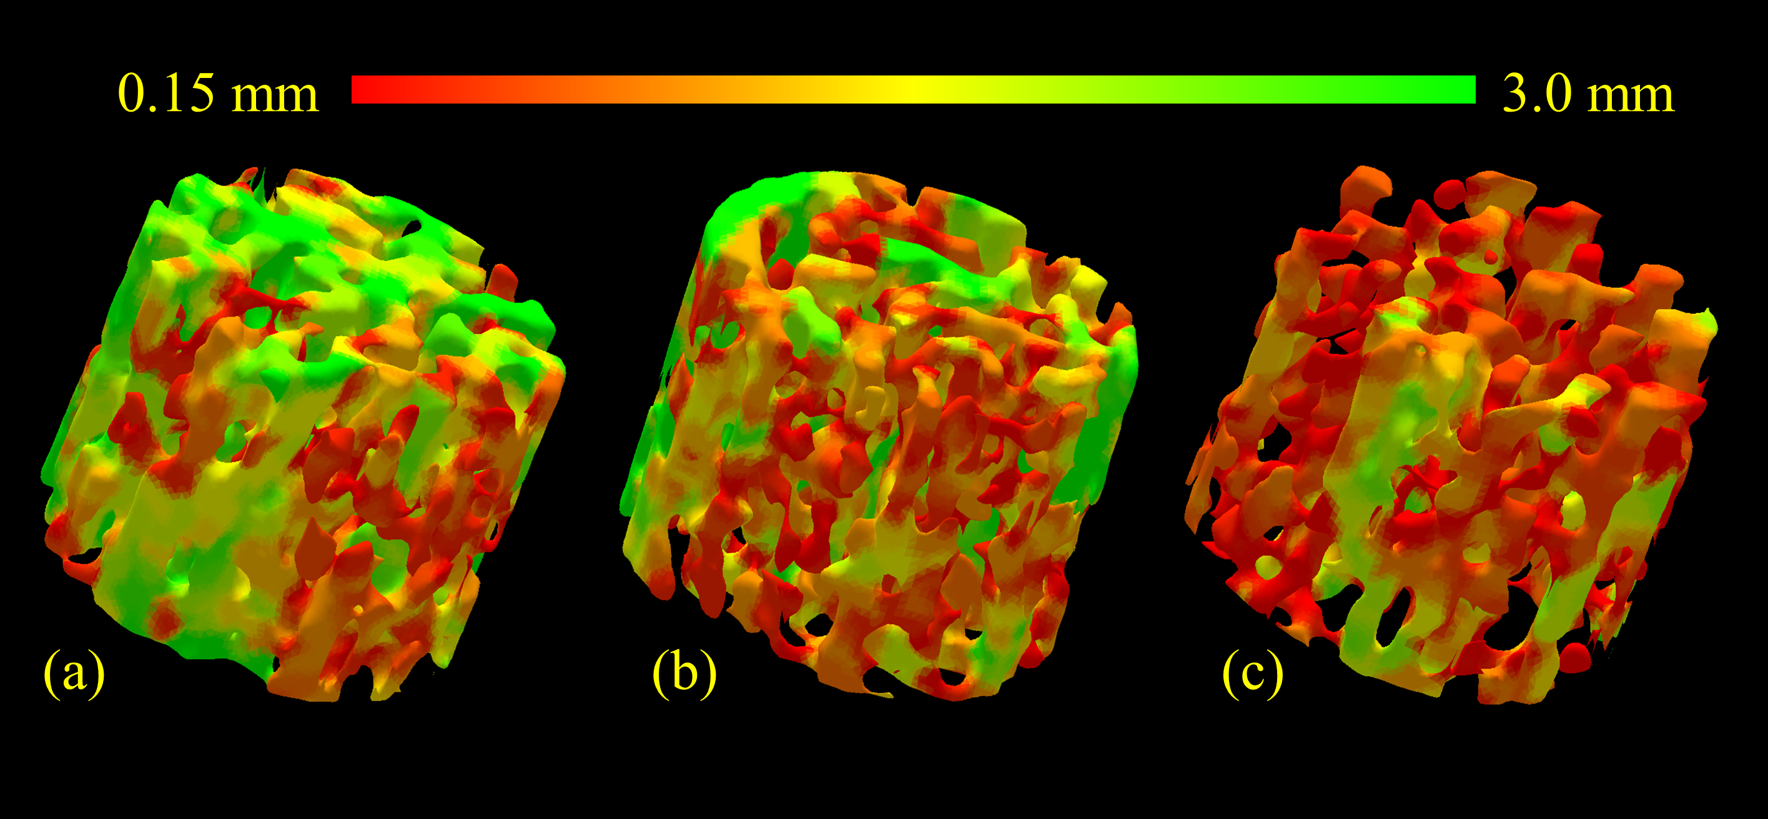
Local Width Computation for Fuzzy Objects

Slide 59
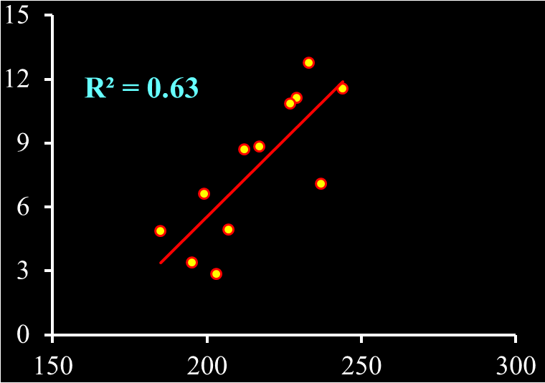
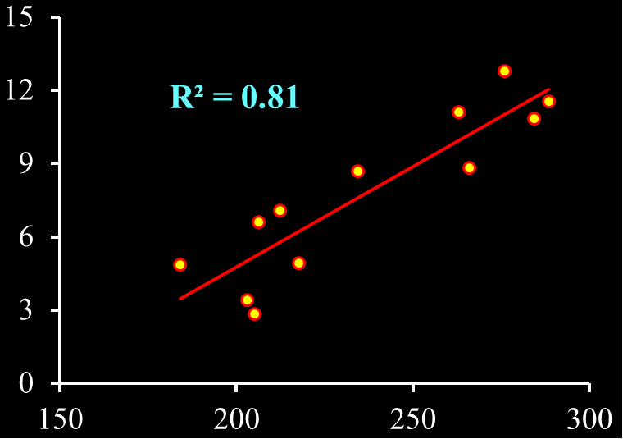
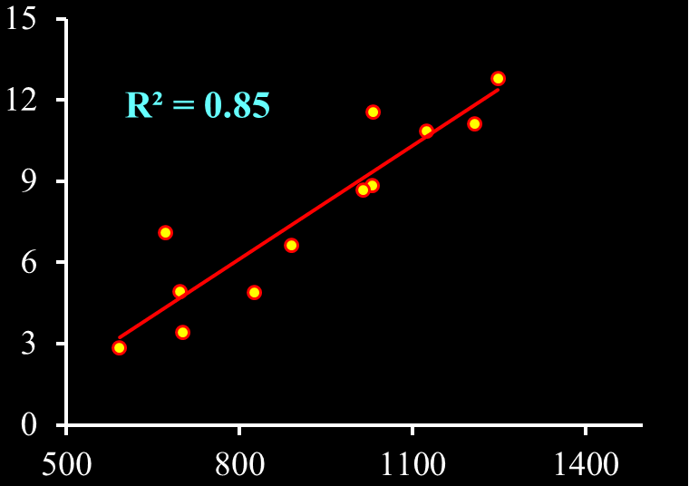
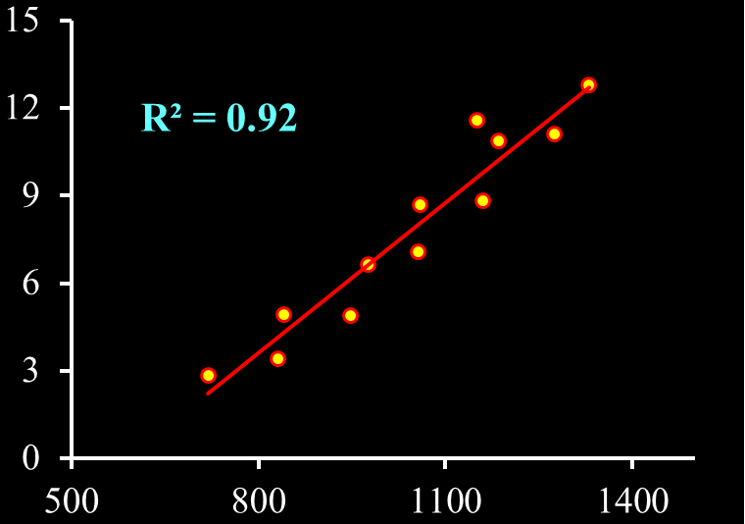
Fuzzy Skeletonization Improves the Sensitivity of Derived Measures
Yield Stress (MPa)
Yield Stress (MPa)
Thickness_{BSK} (micron)
Thickness_{FSK} (micron)
Yield Stress (MPa)
Yield Stress (MPa)
Surface-Width_{BSK} (micron)
Surface-Width_{FSK} (micron)

Slide 60
Summary
The issues of sequential topological transformation in 3-D cubic grid (3-D simple point) are solved
Local topological properties introduced by Saha et al. are useful to characterize 1-D and 2-D digital manifolds and their junctions embedded in a 3-D digital space
Topology preservation in parallel skeletonization is effectively solved using a subfield approach
Digital topology and geometry play important roles in medical image processing
solves several classical problems of medical imaging
expands the scope of target information
provides a strong theoretical foundation to a process enhancing its stability, fidelity, and efficiency
A comprehensive framework for fuzzy skeletonization is developed along the spirit of fuzzy grassfire propagation
Experimental results show that the fuzzy skeletons are computed with sub-voxel accuracies under various levels of SNR and downsampling rates
Fuzzy skeletonization improves the performance of individual trabecular thickness and width computation at in vivo CT imaging

