Slide 1

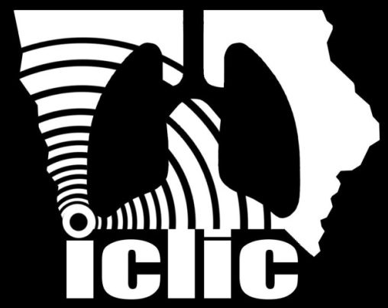
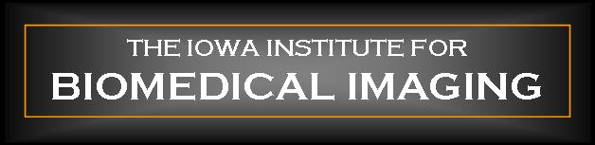
Punam Kumar Saha
Professor
Departments of ECE and Radiology
University of Iowa pksaha@engineering.uiowa.edu
Multi-Scale Opening of Conjoined Structures with Applications

Slide 2
References
[1] P. K. Saha, Z. Gao, S. K. Alford, M. Sonka, and E. Hoffman, "Topomorphologic separation of fused isointensity objects via multiscale opening: Separating arteries and veins in 3-D pulmonary CT," IEEE Transactions on Medical Imaging, vol. 29, pp. 840-851, 2010.
[2] D. M. Vasilescu, Z. Gao, P. K. Saha, L. Yin, G. Wang, B. Haefeli-Bleuer, M. Ochs, E. R. Weibel, and E. A. Hoffman, "Assessment of morphometry of pulmonary acini in mouse lungs by nondestructive imaging using multiscale microcomputed tomography," Proceedings of the National Academy of Sciences, vol. 109, pp. 17105-17110, 2012.
[3] Z. Xu, Z. Gao, E. Hoffman, and P. K. Saha, "Tensor scale-based anisotropic region growing for segmentation of elongated biological structures," Proc of 9th IEEE International Symposium on Biomedical Imaging (ISBI), pp. 1032-1035, 2012.
[4] Z. Gao, R. W. Grout, C. Holtze, E. A. Hoffman, and P. K. Saha, "A New Paradigm of Interactive Artery/Vein Separation in Noncontrast Pulmonary CT Imaging Using Multiscale Topomorphologic Opening," IEEE Transactions on Biomedical Engineering, vol. 59, pp. 3016-3027, 2012.
[5] S. Basu, E. Hoffman, and P. K. Saha, "Multi-scale Opening–A New Morphological Operator," in Image Analysis and Processing—ICIAP 2015, Springer, pp. 417-427, 2015.
[6] P. K. Saha, S. Basu, and E. A. Hoffman, "Multi-scale opening of conjoined fuzzy objects: theory and applications," IEEE Transactions of Fuzzy Systems, in press.

Slide 3
Motivation
Quantification of vascular geometry
  pulmonary hypertension
  pulmonary emboli
Use of arterial tree as a prior knowledge for airway segmentation
Use as landmarks for intra- and inter-subject pulmonary image registration
Notes:
Segmenting pulmonary A/V trees via CT imaging is a critical first step in the quantification of vascular geometry for purposes of determining, for instance, pulmonary hypertension, using vascular dimensions as a comparator for assessment of airway size, detection of pulmonary emboli and more.
Segmentation of A/V trees may also be useful to enhance airway tree segmentation based on the relationship of artery and airway, and to provide landmarks for intra- and inter- subject pulmonary data registration.

Slide 4
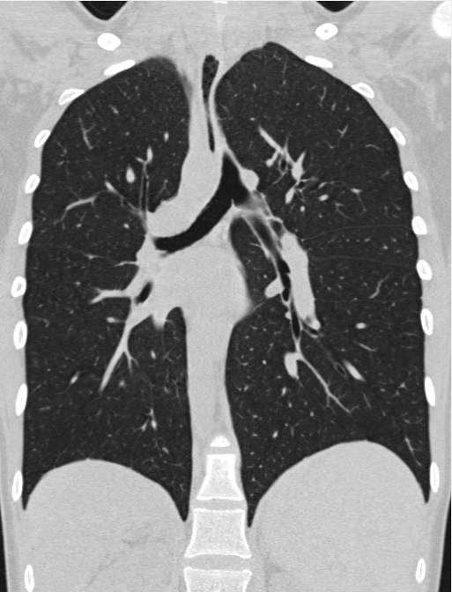
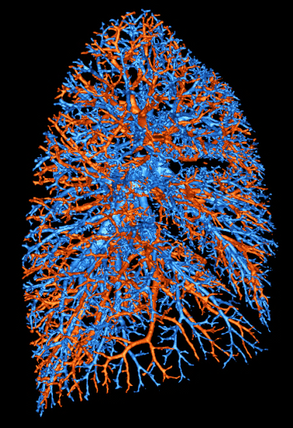
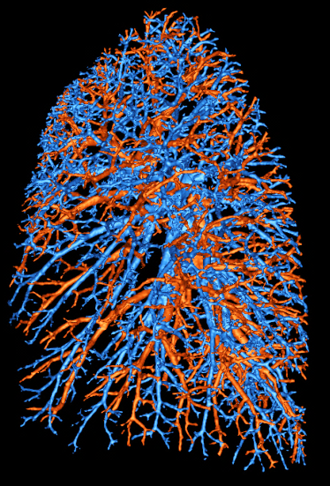
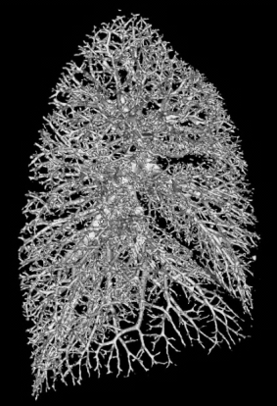
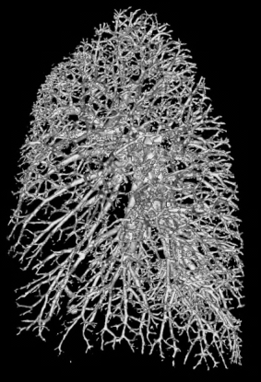
Introduction to A/V Separation via Non-Contrast Pulmonary CT Imaging
Task 1. Segmentation of complete pulmonary vasculature
Task 2. Separation of arteries and veins

Slide 5
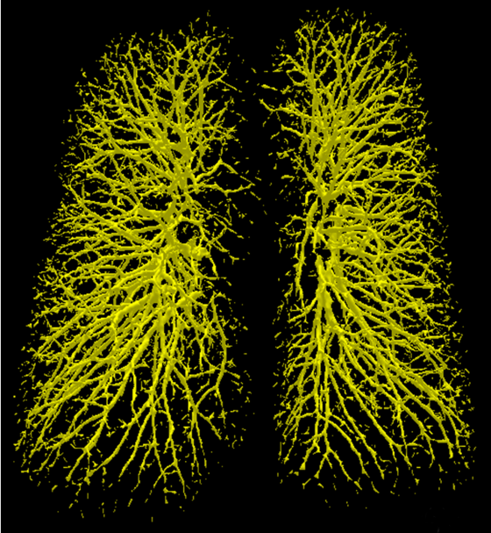
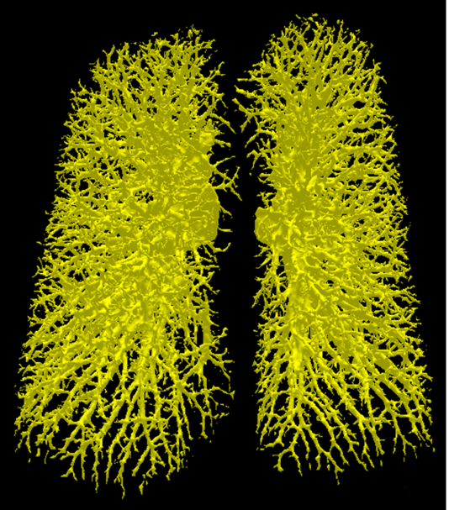
Segmentation of Complete Pulmonary Vasculature
Fuzzy connectivity based region growing using tensor scale
  Facilitates growth along structure, arrest leaking
  across structure
 | Vesselness | T-scale
True Positive | 84.0% | 97.9%
True Negative | 99.8% | 97.3%
False Positive | 0.2% | 2.7%
False Negative | 16.0% | 2.1%
Accuracy | 91.5% | 97.6
Error | 8.5% | 2.4%
Vesselness based
Tensor scale
Xu, Gao, Hoffman, Saha, "Tensor scale-based anisotropic region growing for … elongated biological structures," Proc of 9th IEEE Int Symp Biomed Imag (ISBI), 1032-1035, 2012
Notes:
Clearly, when we say “tensor scale”, there are two parts, tensor and scale, lets first talk about scale. As we know, in many image processing applications, we often break down the task to several levels using the idea of multi resolution, or we can say, multi scale, so the idea of scale is related to structure size, as what we need here is to deal with structures of difference sizes at different levels. That’s “hierarchical processing”

Slide 6

Basic Challenges in A/V Separation
In CT images, arteries and veins appear as two iso-intensity objects with fusions at various locations and scales
Trace of intensity variation not reliable at locations of fusions
Relatively low SNR and resolution
Complex geometric coupling at bifurcations
Notes:
Artery/Vein (A/V) are indistinguishable by intensities in non-contrast pulmonary CT images
no trace of intensity variation at locations of fusions between A/V
Limited SNR and resolution of in vivo imaging
Complex and tight coupling and fusion between A/V with arbitrary and multi-scale geometry, especially, at branching locations
Patient-specific structural abnormalities of vascular trees

Slide 7
A/V Separation Model
Artery/vein (A/V) are modeled as two tubular tree-like structures
A/V are not separable using intensity or gradient like features
A/V are mutually fused at different locations and scales
Often, A/V are locally separable using a morphological opening operation with a suitable scale
Notes:
Artery/Vein (A/V) are indistinguishable by intensities in non-contrast pulmonary CT images
no trace of intensity variation at locations of fusions between A/V
Limited SNR and resolution of in vivo imaging
Complex and tight coupling and fusion between A/V with arbitrary and multi-scale geometry, especially, at branching locations
Patient-specific structural abnormalities of vascular trees

Slide 8
Key Ideas of Our Approach
A/V are locally separable using morphologic traces
Cross-sectional profile
Separable using morphologic opening operator
Q: How to determine the structure size?
Notes:
A/v are modeled as tow iso-intensity structures fused various locations and scales .

Slide 9
Multi-Scale Fusion
Q: How to account for multi-scale fusions?
Q: How to combine locally separated regions?

Slide 10
Key Ideas of Our Approach
Determine optimum scale for opening using morphological connectivity through fuzzy distance transform model
Iterative progression to finer scale
  Freeze the separation at current scale
    Fill undecided annular holes
    Stop paths from an object to enter into its rival object
Saha, Gao, Alford, Sonka, Hoffman, "Topomorphologic separation of fused isointensity objects via multiscale opening," IEEE Trans Medi Imag, 29: 840-851, 2010.
Gao, Grout, Holtze, Hoffman, Saha, "A New Paradigm of Interactive Artery/Vein Separation ...," IEEE Trans Biomed Eng, 59: 3016-3027, 2012.
Saha, Basu, Hoffman, "Multi-scale opening of conjoined fuzzy objects: theory and applications," IEEE Transactions of Fuzzy Systems, in press.

Slide 11
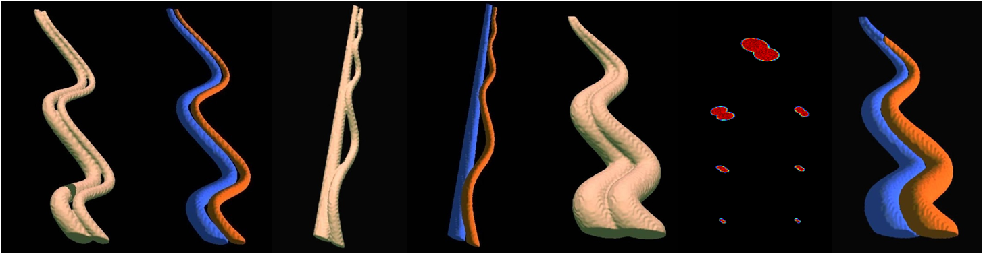
Computer Generated Phantoms
Resolutions:
4×4×4, 5×5×5
Varying overlap and scales
Different geometry of coupling

Slide 12
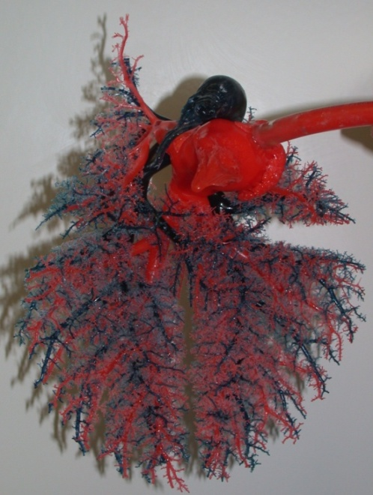
Vessel Casting of Pig Lung
Pulmonary vasculature of an exsanguinated animal was flushed with 2% Dextran solution
Pneumonectomy was performed.
Vascular cast was created using a rapid-hardening compound (methyl methacrylate)
Vascular casting compounds
  Venous(oxygenated): red oil paint .
  Arterial (deoxygenated): blue oil paint and Ethiodol (contrast-enhance)
Provides the ground truth for separated A/V tree

Slide 13
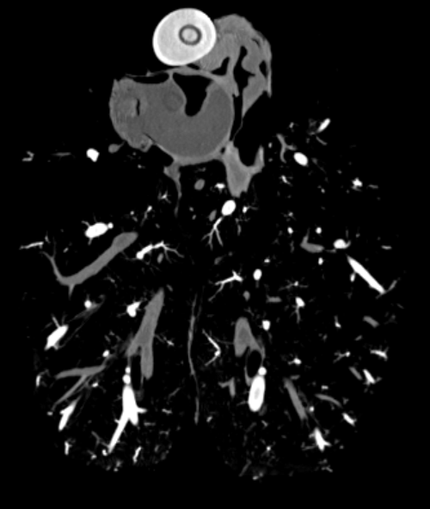
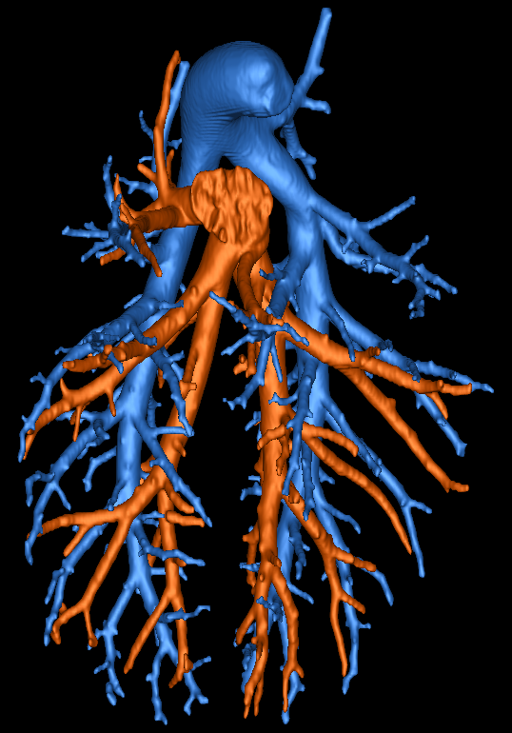
Ground Truth of A/V Trees
Threshold cast CT image at high value ➔ artery
Threshold cast CT image at low value ➔ vein + outer arterial boundary
Eliminate outer arterial boundary using a region constrained dilation ➔ vein

Slide 14
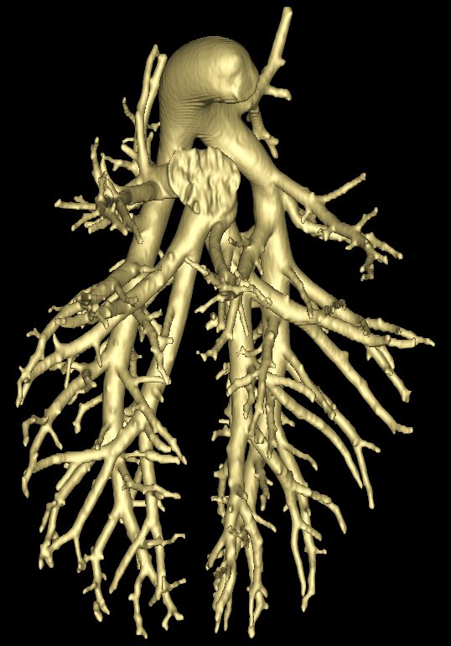
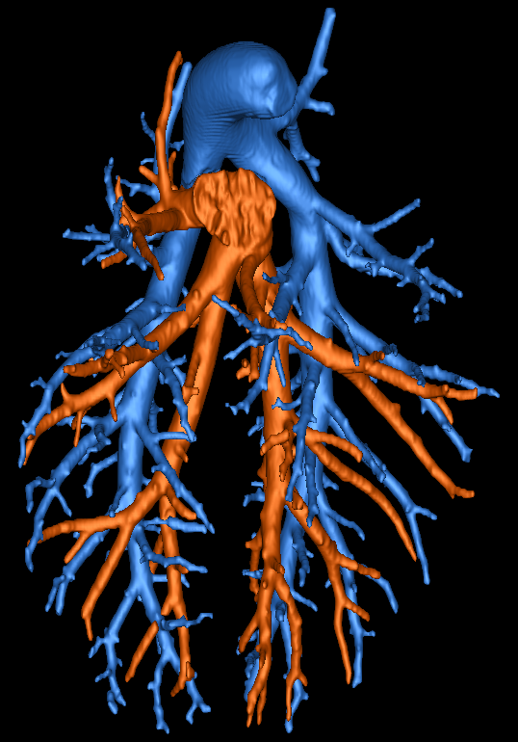
Results on Vessel Cast Images
contrast separated A/V
contrast eliminated
vascular tree
computed A/V separation

Slide 15
Results on Vessel Cast Images
True Positive =94.4 %
False Negative = 1.6%

Slide 16
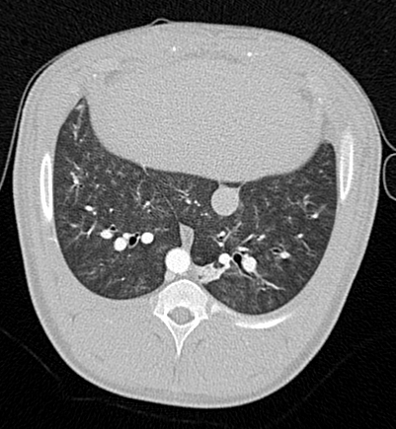
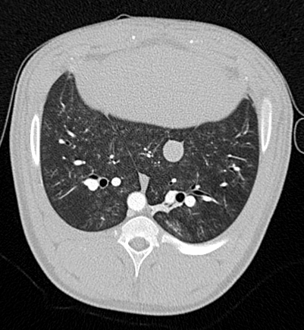
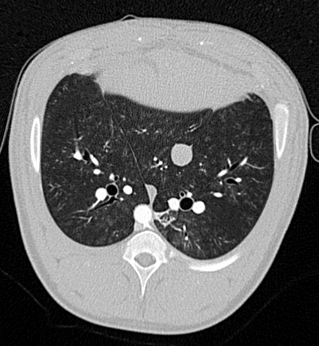
In Vivo Pig CT Imaging
Artery/Vein separation on contrast-enhanced in vivo CT images of a pig’s lung at three different positive end-expiratory pressures (PEEPs)
CT scan images at 7.5 cm, 12 cm and 18 cm H₂O PEEPs

Slide 17
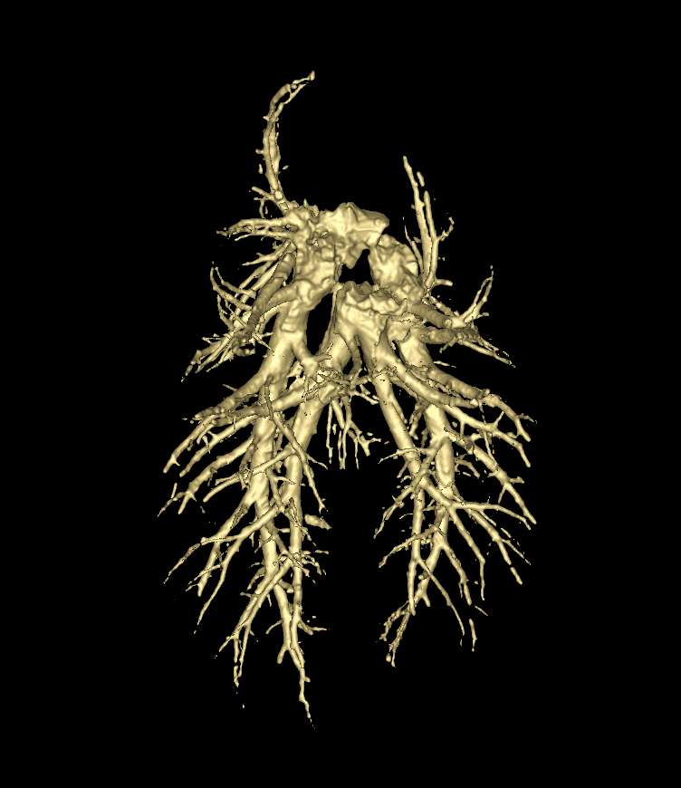
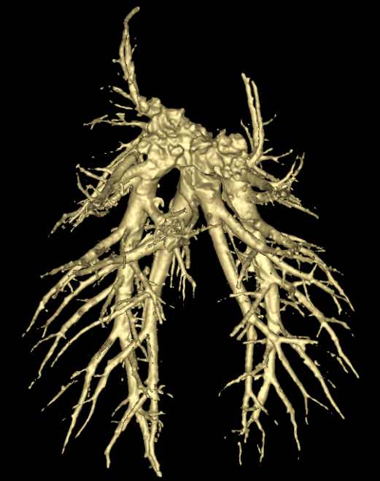
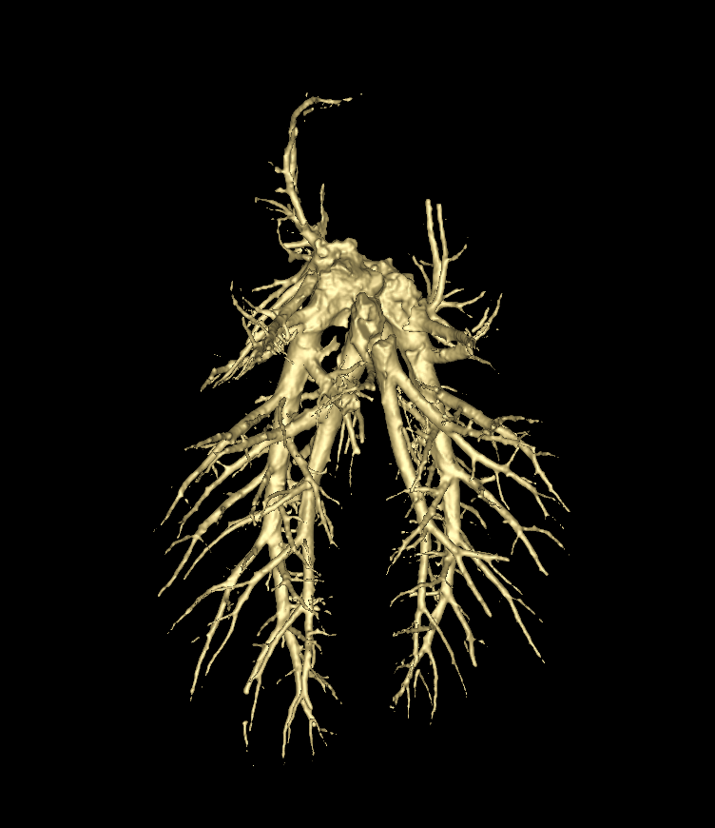
In Vivo Pig CT Imaging
Artery/Vein separation on contrast-enhanced in vivo CT images of a pig’s lung at three different positive end-expiratory pressures (PEEPs)
Pulmonary vasculature at 7.5 cm, 12 cm and 18 cm H₂O PEEPs

Slide 18
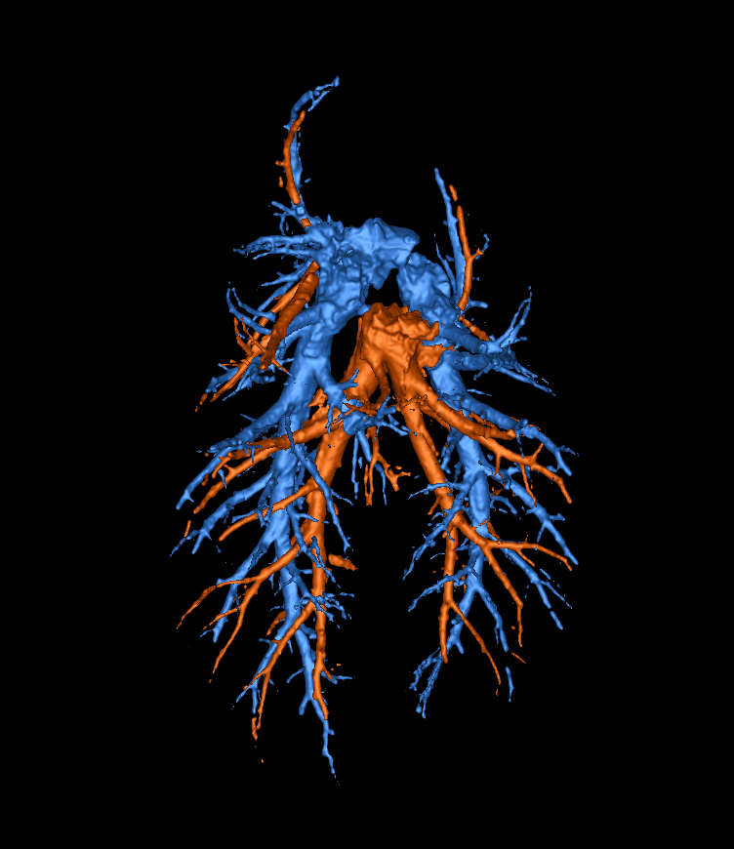
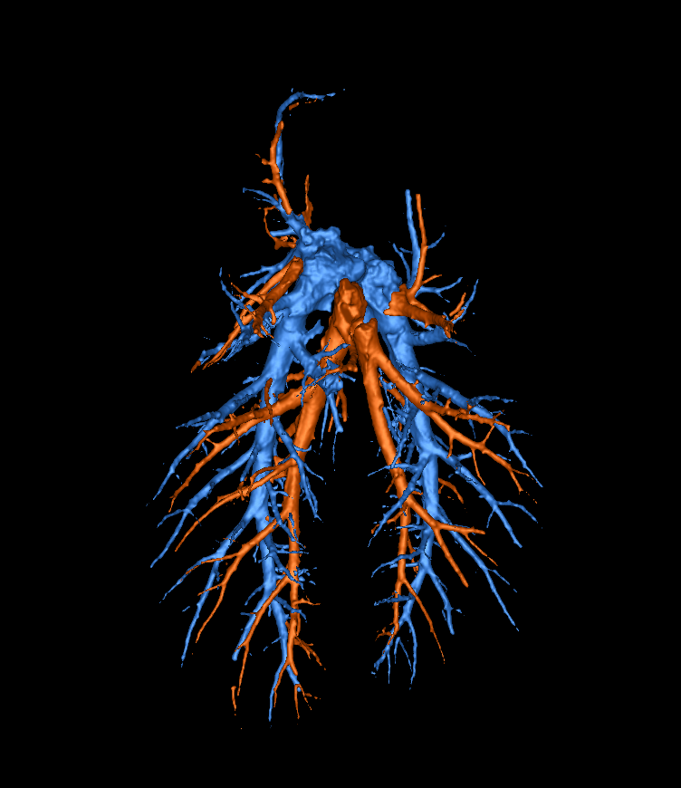
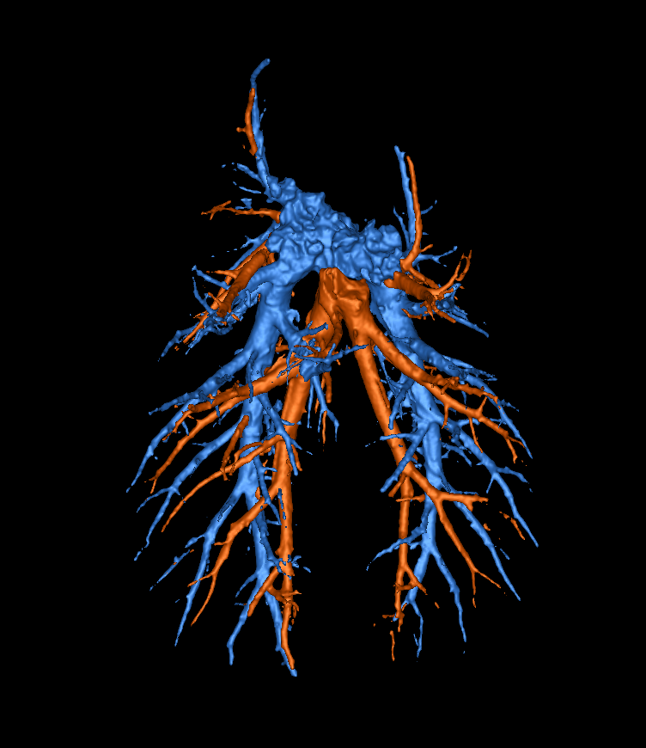
In Vivo Pig CT Imaging
Artery/Vein separation on contrast-enhanced in vivo CT images of a pig’s lung at three different positive end-expiratory pressures (PEEPs)
Artert/vein separation at 7.5 cm, 12 cm and 18 cm H₂O PEEPs

Slide 19
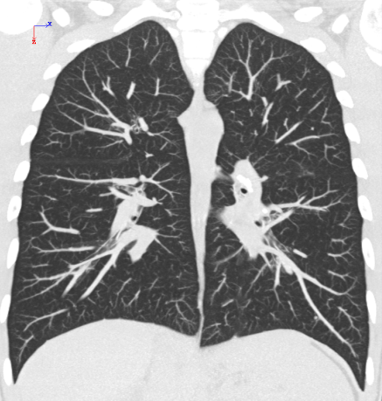
Human Pulmonary CT Imaging
Scanner: Siemens Sensation 64 MDCT scanner
CT Parameters: 120 kVp and 100 mAs.
Scanned at 0.75 mm slice thickness
Reconstructed at 0.5 mm slice-thickness and 0.6x0.6mm² in-plane resolution.

Slide 20
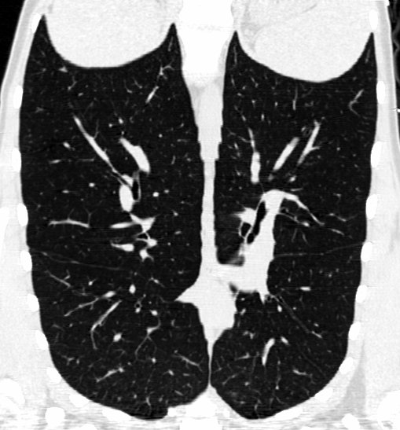



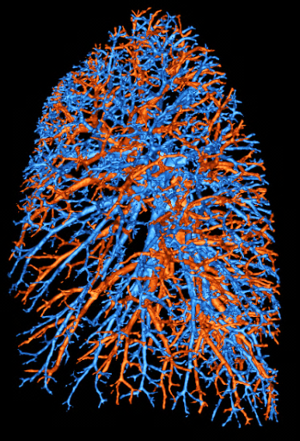

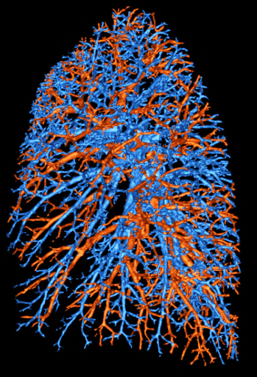
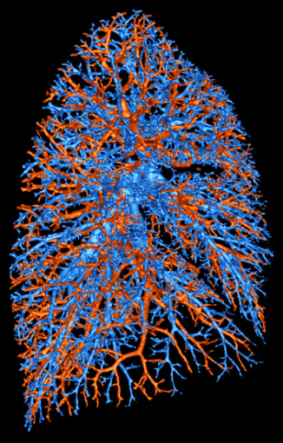
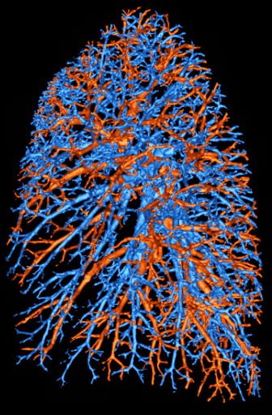
Human Pulmonary CT Imaging
Mutually blinded inter-user reproducibility
Agreement: 95.3±1.6%
Disagreement: 3.2±1.5%

Slide 21
Human Pulmonary CT Imaging
Mutually blinded inter-user reproducibility
Agreement: 95.3±1.6%
Disagreement: 3.2±1.5%

Slide 22
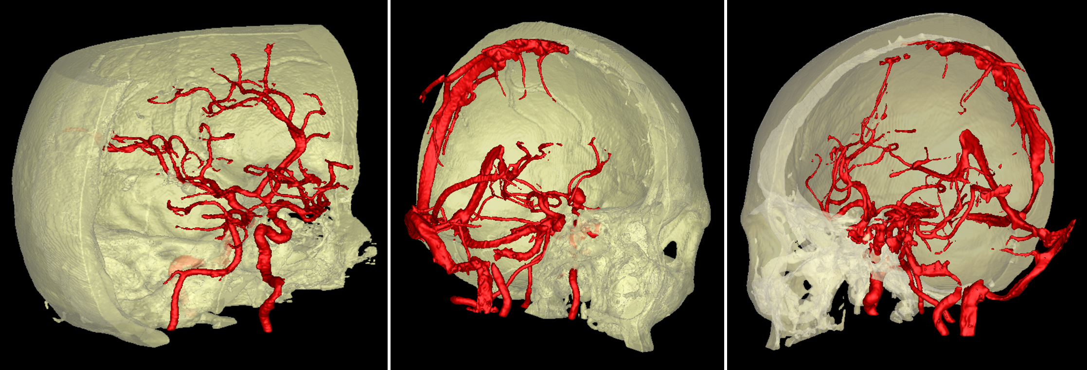
Bone Removed Segmentation of Vasculature in CT Angiography
Error: 3.9±1.1%
Mutually blinded inter-user reproducibility
Agreement: 94.2±3.8%
Saha, Basu, Hoffman, "Multi-scale opening of conjoined fuzzy objects: theory and applications," IEEE Transactions of Fuzzy Systems, in press.

Slide 23
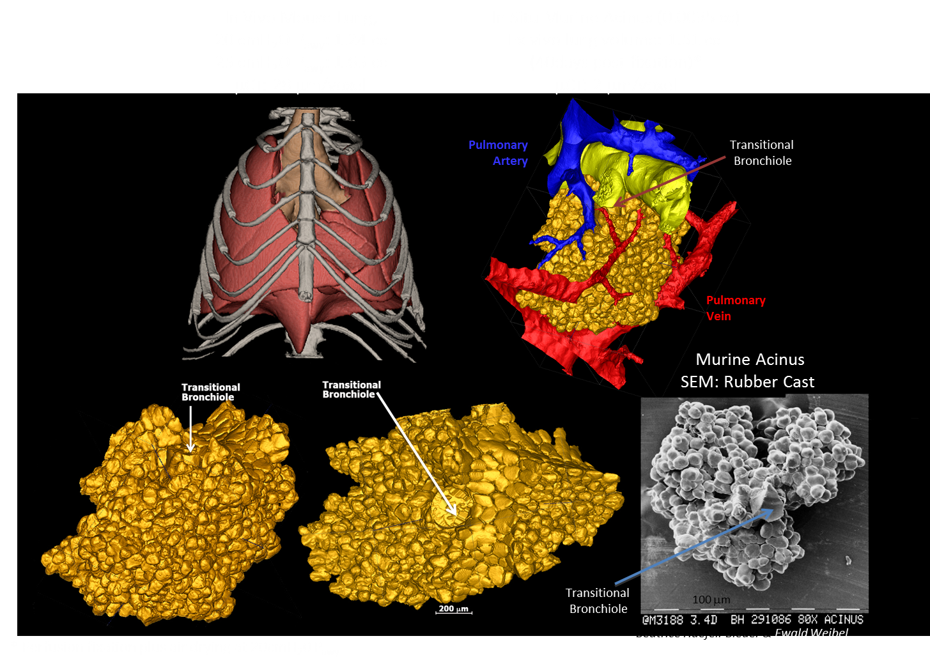
Imaging the Murine Lung Micro-structure
Vasilescu, Gao, Saha, Yin, Wang, Haefeli-Bleuer, Ochs, Weibel, Hoffman, "Assessment of morphometry of pulmonary acini ….," Proc Nation Acad Sci, 109: 17105-17110, 2012

Slide 24
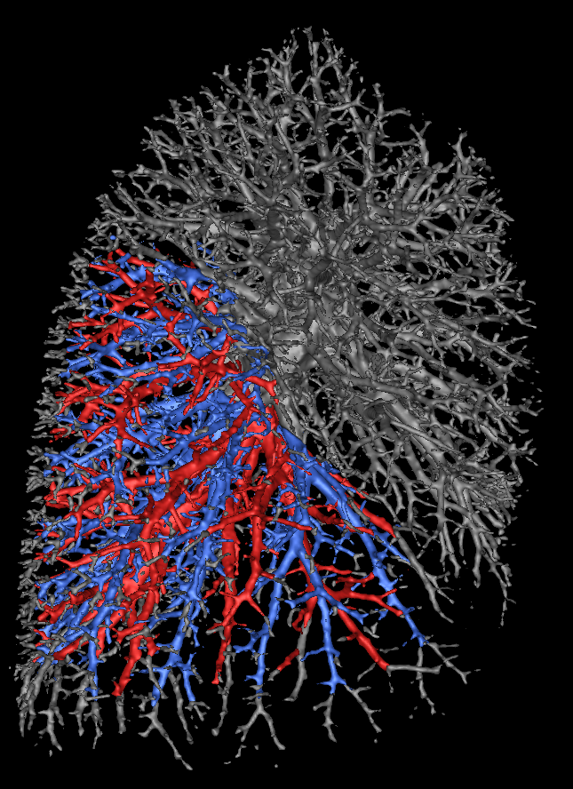
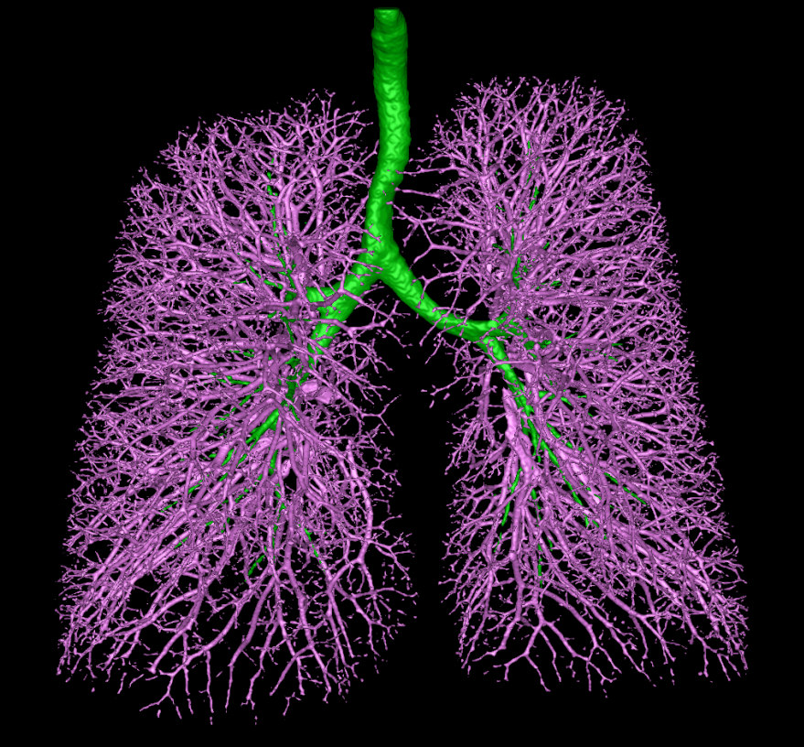
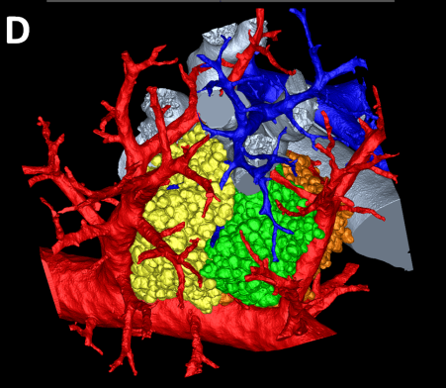
Multi-Scale Opening of
Conjoined Structures
Separation of conjoined biological structures in non-contrast imaging
Left: Separation pulmonary arterial and venous trees via in vivo CT imaging.
Right: Separation of adjacent acini, transitional bronchiole and supplying vasculature inside a mice lung scanned with high resolution (2 micron) micro-CT imaging.

Slide 25
Summary
A novel multi-scale topo-morphologic opening algorithm can separate to structures conjoined at various scales and locations
Separation of pulmonary artery/vein trees in non-contrast in vivo imaging may be performed using the multi-scale topo-morphologic opening
Results of computer-generated and pulmonary cast phantom experiments show high accuracy
Promising results on pulmonary human CT data with no contrast agents

