Slide 1
Punam Kumar Saha Professor Departments of ECE and Radiology University of Iowa pksaha@engineering.uiowa.edu
Fuzzy Connectivity, Distance Transform, and their Applications

Slide 2
References
[1] P. K. Saha, J. K. Udupa, and D. Odhner, "Scale-based fuzzy connected image segmentation: theory, algorithms, and validation," Computer Vision and Image Understanding, vol. 77, pp. 145-174, 2000.
[2] P. K. Saha and J. K. Udupa, "Iterative relative fuzzy connectedness and object definition: theory, algorithms, and applications in image segmentation," Proc of the IEEE Workshop on Mathematical Methods in Biomedical Image Analysis (MMBIA), pp. 28-35, 2000.
[3] PK Saha, JK Udupa, “Fuzzy connected object delineation: axiomatic path strength definition and the case of multiple seeds”, Computer Vision and Image Understanding, vol. 83, 275-295, 2001.
[4] P. K. Saha and J. K. Udupa, "Relative fuzzy connectedness among multiple objects: theory, algorithms, and applications in image segmentation," Computer Vision and Image Understanding, vol. 82, pp. 42-56, 2001.
[5] J. K. Udupa, P. K. Saha, and R. d. A. Lotufo, "Relative fuzzy connectedness and object definition: theory, algorithms, and applications in image segmentation," IEEE Transactions on Pattern Analysis and Machine Intelligence, vol. 24, pp. I485-1500, 2002.
[6] J. K. Udupa and P. K. Saha, "Fuzzy connectedness and image segmentation," Proceedings of the IEEE, vol. 91, pp. 1649-1669, 2003.
[7] T. Lei, J. K. Udupa, P. K. Saha, and D. Odhner, "Artery-vein separation via MRA-an image processing approach," IEEE Transactions on Medical Imaging, vol. 20, pp. 689-703, 2001.
[8] P. K. Saha, J. K. Udupa, E. F. Conant, D. P. Chakraborty, and D. Sullivan, "Breast tissue density quantification via digitized mammograms," IEEE Transactions on Medical Imaging, vol. 20, pp. 792-803, 2001.

Slide 3
References (Contd.)
[9] P. K. Saha, F. W. Wehrli, and B. R. Gomberg, "Fuzzy distance transform: theory, algorithms, and applications," Computer Vision and Image Understanding, vol. 86, pp. 171-190, 2002.
[10] PK Saha, FW Wehrli, Fuzzy distance transform in general digital grids and its applications”, in Proceedings of 7th Joint Conference on Information Sciences, Research Triangular Park, NC, 201-213, 2003.
[11] P. K. Saha and F. W. Wehrli, "Measurement of trabecular bone thickness in the limited resolution regime of in vivo MRI by fuzzy distance transform," IEEE Transactions on Medical Imaging, vol. 23, pp. 53-62, 2004.
[12] Y. Zhuge, J. K. Udupa, and P. K. Saha, "Vectorial scale-based fuzzy-connected image segmentation," Computer Vision and Image Understanding, vol. 101, pp. 177-193, 2006.
[13] K. C. Ciesielski, J. K. Udupa, P. K. Saha, and Y. Zhuge, "Iterative relative fuzzy connectedness for multiple objects with multiple seeds," Computer Vision and Image Understanding, vol. 107, pp. 160-182, 2007.
[14] R. Strand, K. C. Ciesielski, F. Malmberg, and P. K. Saha, "The minimum barrier distance," Computer Vision and Image Understanding, vol. 117, pp. 429-437, 2013.
[15] C. Li, D. Jin, C. Chen, E. M. Letuchy, K. F. Janz, T. L. Burns, J. C. Torner, S. M. Levy, and P. K. Saha, "Automated cortical bone segmentation for multirow-detector CT imaging with validation and application to human studies," Medical physics, vol. 42, pp. 4553-4565, 2015.

Slide 4
Fuzzy Connectivity and Image Segmentation
Homogeneity-based affinity
Object-feature-based affinity
Object scale: neighborhood size
Scale-based fuzzy affinity and connectivity
Evaluation
qualitative
quantitative
Conclusion

Slide 5
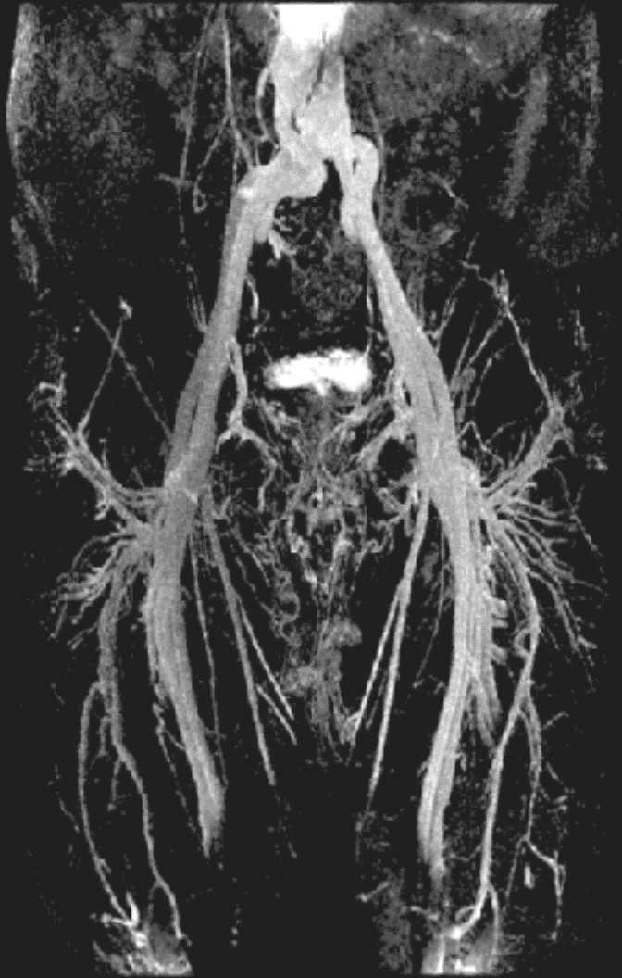
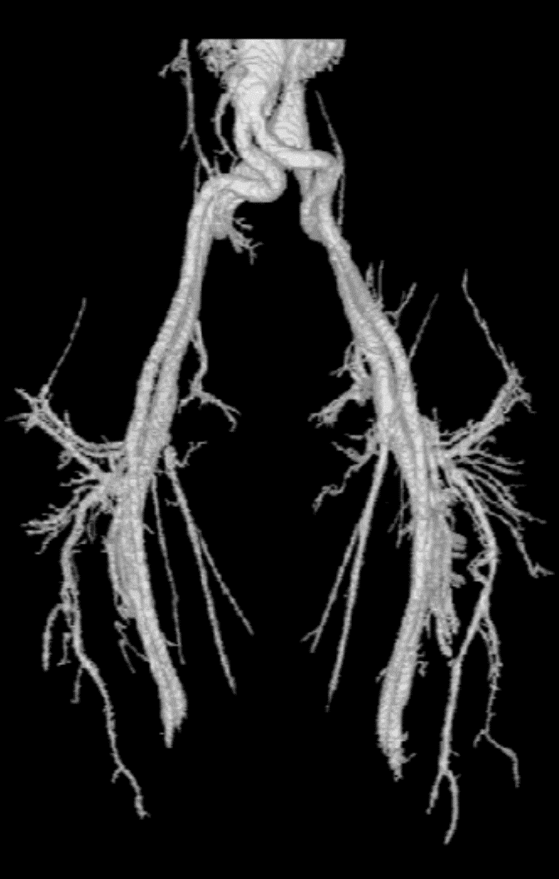
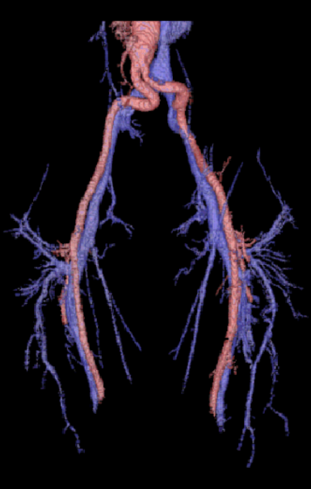
Motivation
Connectivity: a popularly used tool for region growing
Applications: image segmentation, object tracking, object separation
A fuzzy model for connectivity analysis is essential to capture the global extent of an object using local hanging togetherness and path connectivity
CE-MRA
Image data
Segmented
vasculature
Separated
arteries/veins
Separation of arteries and veins in a contrast-enhanced magnetic resonance angiographic (CE-MRA) image data using iterative relative fuzzy connectivity

Slide 6
Image, Adjacency, and Paths
Image grid: An 𝑛-dimensional (𝑛D) cubic grid represented by $Z^{3}$ | $Z$ is the set of integers
Spel: An element of the image grid represented by integer coordinates
Adjacency: Spatial nearness between two spels
Image: An n-dimensional grid with image feature value(s) associated with every spel
Path: A sequence $π$ of spels $\left\langle p_{1}, p_{2}, ⋯p_{l}\right\rangle$ where every two successive spels $p_{i}$, $p_{i+1}$ are adjacent
$$p_{2}$$
$$p_{i}$$
$$p_{1}$$
$$p_{i+1}$$
$$p_{l}$$
A path $π$

Slide 7
Affinity and Strength of a Path
Fuzzy Affinity ($κ$): local hanging-togetherness between two spels
$κ\left(p,q\right)∈[0,1]$
$κ\left(p,q\right)$ is zero if $p$, $q$ are non-adjacent
$κ\left(p,p\right)=1$, i.e., reflexive
$κ\left(p,q\right)=κ\left(q,p\right)$, i.e. symmetric
Strength ( $Π$ ) of a path ( $π$ = $\left\langle p_{1}, p_{2}, ⋯p_{l}\right\rangle$ )
$Π\left(π\right)$ = the affinity of the weakest link on the path, i.e., $Π\left(π\right)=\min_{1≤i<l}{κ\left(p_{i},p_{i+1}\right)}$

Slide 8
Fuzzy Connectivity
$$p$$
$$q$$
Fuzzy Connectivity ($K$): Strength of the strongest path between two spels
$K\left(p,q\right)$ = strength of the strongest path between two spel, i.e., $K\left(p,q\right)=\max_{π∈𝒫_{p,q}}{Π\left(π\right)}$
$𝒫_{p,q}$ is the set of all possible paths between $p$ and $q$.

Slide 9
Fuzzy Connectivity: Properties
Theorem 1. For any image $𝒞=(C,f)$ over $\left(Z^{n},α\right)$, and for any affinity $κ$, fuzzy connectivity $K$ in $𝒞$ is a similitude relation in $C$ if and only if
$$K\left(p,q\right)=\max_{π∈𝒫_{p,q}}\left[\min_{1≤i<l}{μ_{κ}(p_{i},p_{i+1}}\right],$$
where $π$ is the path $\left\langle p_{1}, p_{2}, ⋯p_{l}\right\rangle .$
Theorem 2. For any image $𝒞=(C,f)$ over $\left(Z^{n},α\right)$, and for any affinity $κ$, and for any $θ∈\left[0,1\right]$, the $κθ$-object $O_{Kθ}\left(S\right)$ of $𝒞$ containing $S$ is
$$O_{Kθ}\left(S\right)=\left\{c | c∈C \text{and} \max_{s∈S}\left[K\left(s,c\right)\right]≥θ\right\}.$$
Theorem 3. For any image $𝒞=(C,f)$ over $\left(Z^{n},α\right)$, and for any affinity $κ$, for any $θ∈\left[0,1\right]$, and for any two no-empty sets $S_{1},S_{2}∈C$, the $κθ$-objects $O_{Kθ}\left(S_{1}\right)$ and $O_{Kθ}\left(S_{2}\right)$ are equal if and only if $S_{1}⊂O_{Kθ}\left(S_{2}\right)$ and $S_{2}⊂O_{Kθ}\left(S_{1}\right)$.
Saha, Udupa, Odhner, "Scale-based fuzzy connected image segmentation: theory, algorithms, and validation," Comp Vis Imag Und, 77: 145-174, 2000
Saha, Udupa, “Fuzzy connected object delineation: axiomatic path strength definition and the case of multiple seeds”, Comp Vis Imag Und, 83: 275-295, 2001.
Udupa, Saha, "Fuzzy connectedness and image segmentation," Proceedings of the IEEE, 91: 1649-1669, 2003

Slide 10
Scale-Based Fuzzy Affinity and Connectivity

Slide 11
Notion of Local Scale in Fuzzy Affinity
$$\sum_{r∈N_{p}}{f\left(I\left(r\right),I\left(r+\vec{pq}\right)\right)}$$
A generic approach of computing the affinity or local hanging-togetherness between two nearby points $p$, $q$.
Q. What is the size of neighborhood $N_{p}$ at a point $p$?
$$N_{p}$$
$$r$$
$$p$$
$$q$$
Scale: size of the largest hyper-sphere entirely contained in the object region determines the local scale or the neighborhood size.
Saha, Udupa, Odhner, "Scale-based fuzzy connected image segmentation: theory, algorithms, and validation," Comp Vis Imag Und, 77: 145-174, 2000

Slide 12
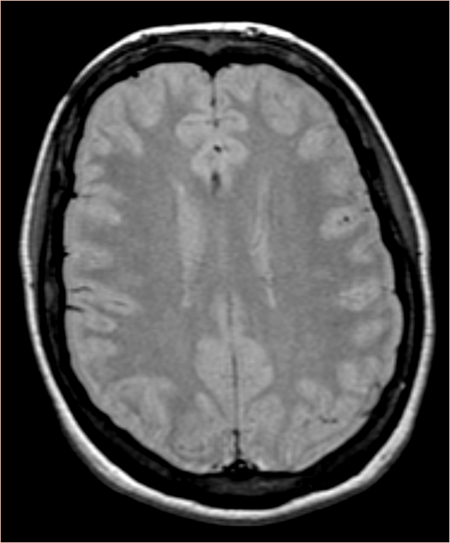
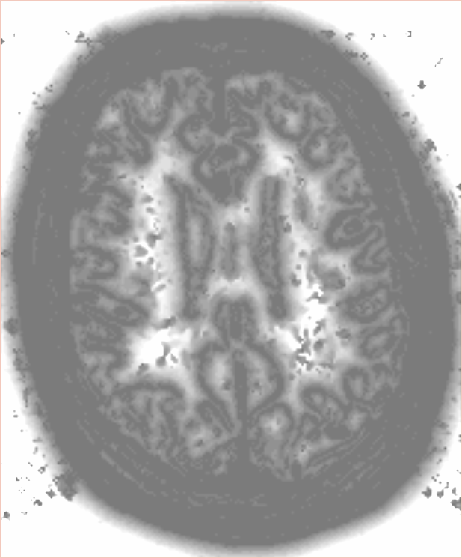
Computation of Scale
A method is developed for computing scale at every location without image segmentation.
original
scale

Slide 13
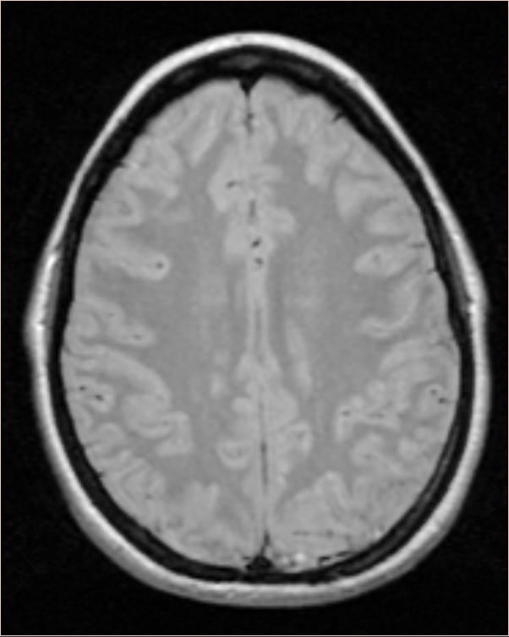
Scale-Based Affinity
Aspects
Spatial nearness ($μ_{α}$)
Homogeneity-based affinity ( $μ_{h}$)
Object-feature-based affinity ( $μ_{o}$)
Combined affinity
$$μ_{κ}=μ_{α}\sqrt{μ_{h}μ_{o}}$$
Saha, Udupa, Odhner, "Scale-based fuzzy connected image segmentation: theory, algorithms, and validation," Comp Vis Imag Und, 77: 145-174, 2000

Slide 14
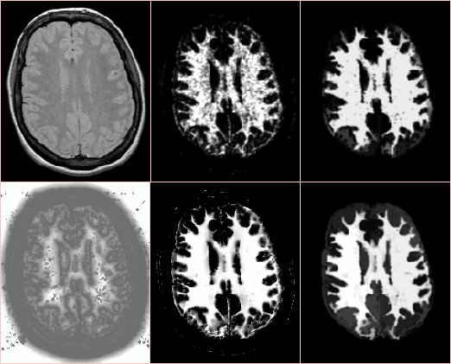
Results of Scale-Based Affinity
original
fuzzy affinity
fuzzy connectivity
non scale-based
scale-based
scale
fuzzy affinity
fuzzy connectivity

Slide 15
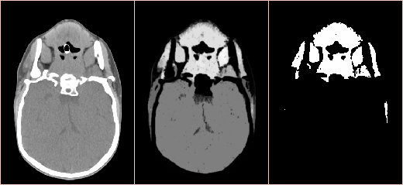
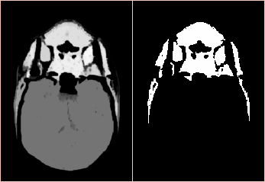
Results of Scale-Based Affinity
original
fuzzy connectivity
fuzzy object
non scale-based
scale-based
fuzzy connectivity
fuzzy object

Slide 16
Relative Fuzzy Connectivity
The key idea of relative fuzzy connectedness is to consider all co-objects of importance that are present in an image and to let them to compete among themselves in having image locations as their members.
$$o$$
$$O$$
$$c$$
$$a$$
$$B$$
$$b$$
Let $o$ and $b$ represent the seed of two different objects.
A point $c$ is assigned to the object whose seed is more strongly connected to $c$.
The object $P_{ob_{κ}}$ represented by the seed $o$ relative to the object represented by the seed $b$ is
$$P_{ob_{κ}}=\left\{c | c∈C \text{and} K(o,c)>K(b,c)\right\}$$
Saha, Udupa, "Relative fuzzy connectedness among multiple objects ….. in image segmentation," Comp Vis Imag Und, 82: 42-56, 2001.
Udupa, Saha, Lotufo, "Relative fuzzy connectedness and …….. in image segmentation," IEEE Trans Pat Anal Mach Intel, 24: I485-1500, 2002.

Slide 17
Iterative Relative Fuzzy Connectivity
The principle behind this strategy is to iteratively refine the competition rules for different objects depending upon the results of the previous iteration.
Due to blurring where the two objects $O_{1}$, $O_{2}$ come close, it is likely that a point $c$ has $K\left(o,c\right)=K\left(b,c\right)$.
In such a situation, the best path from $b$ to $c$ need to pass through the core of $a$.
$$o$$
$$O_{1}$$
$$b$$
$$O_{2}$$
$$O_{3}$$
$$c$$
Iterative relative fuzzy connectivity
$$∀p,q∈C, {μ_{κ}}_{ob}^{0}(p,q)=μ_{κ}(p,q)$$
$$P_{ob_{κ}}^{0}=\left\{c | c∈C \text{and} K^{0}(o,c) >K^{0}(b,c)\right\}$$
Initial rules
$$∀p,q∈C, {μ_{κ}}_{ob}^{0}(p,q)=\left\{\begin{matrix}0, & \text{if} p \text{or} q∈P_{ob_{κ}}^{i−1}, \\ μ_{κ}\left(p,q\right), & \text{otherwise}.\end{matrix}\right.$$
Iterative refinement
$$P_{ob_{κ}}^{i}=\left\{c | c∈C \text{and} K^{i}(o,c) >K^{i}(b,c)\right\}$$
Saha, Udupa, "Iterative relative fuzzy connectedness …… in image segmentation," Proc of the IEEE Workshop on Math Meth Biomed Imag Anal (MMBIA), 28-35, 2000.
Udupa, Saha, Lotufo, "Relative fuzzy connectedness and …….. in image segmentation," IEEE Trans Pat Anal Mach Intel, 24: I485-1500, 2002.
Ciesielski, Udupa, Saha, Zhuge, "Iterative relative fuzzy connectedness for multiple objects with multiple seeds," Comp Vis Imag Und, 107: 160-182, 2007

Slide 18
Summary
Interpretation of object scale as neighborhood size.
Computation of scale without explicit object segmentation
A new class of scale-based fuzzy affinity relations considering both homogeneity and object-features
Relative fuzzy connectedness simultaneously grows multiple objects
Iterative relative fuzzy connectedness refines the rules of competition to iteratively separate multiple objects starting a large scale and iteratively progressing to finer details

Slide 19
Fuzzy Distance Transform

Slide 20
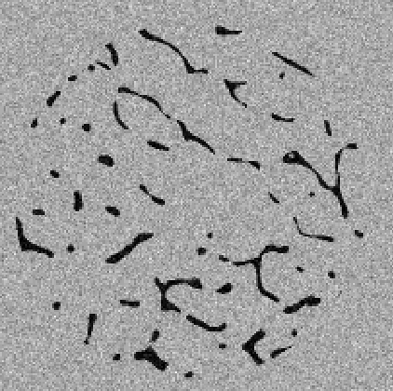
Motivation
Distance transform is a popularly used tool for object shape analysis
44µm
Applications: feature extraction, local thickness or scale computation, skeletonization, morphological and shape-based object analysis
144µm
A fuzzy model for distance-based analysis is essential in a limited resolution regime.
288µm
MR image of human trabecular bone at different resolution regimes

Slide 21
Fuzzy Subsets, Objects, and Paths
A fuzzy subset: a set of pairs
location, membership value ($μ$)
Support of an object: locations with non zero membership
$$π(t)$$
A path $$ is a continuous function (an walk) of time $t[0,1]$
$$π(0)$$
$$π(1)$$

Slide 22
Length of a Path
Distance. The minimum material that has to be traversed through to proceed from one point to the other
$$π(t)$$
$$π(t+Δt)$$
$$π(0)$$
Δfuzzy length(t) = material(π(t)) × Δarc length(t)
$$π(1)$$
Δarc length(t) = speed(t) × Δt
Fuzzy length of a path
$$Π\left(π\right)=\int_{0}^{1}{μ\left(π\left(t \right)\right)\left|\frac{dπ\left(t\right)}{dt}\right|dt}$$
Saha, Wehrli, Gomberg, "Fuzzy distance transform: theory, algorithms, and applications," Comp Vis Imag Und, 86: 171-190, 2002

Slide 23
Properties of the Shortest Path
x
y
x
y
low membership
high membership
Existence of the shortest path is not guaranteed
There may be multiple shortest path
The shortest path may not be a straight line segment even for a convex fuzzy subset set

Slide 24
Fuzzy Distance Transform
Fuzzy distance between two points is the infimum of fuzzy lengths of all paths between them.
$$p$$
$$q$$
Fuzzy distance transform (FDT) at a point is the infimum of the distances the candidate point and a point in the inverse of the support.
Saha, Wehrli, Gomberg, "Fuzzy distance transform: theory, algorithms, and applications," Comp Vis Imag Und, 86: 171-190, 2002

Slide 25
Metric Properties of Fuzzy Distance
Theorem 1. For any fuzzy subset of ℜ^{n}, fuzzy distance is a metric for interior of the support of the fuzzy subset.
Saha, Wehrli, Gomberg, "Fuzzy distance transform: theory, algorithms, and applications," Comp Vis Imag Und, 86: 171-190, 2002

Slide 26
Fuzzy Distance in Generalized Digital Space
Digital grid $G$ in $ℜ^{n}$ is a locally finite set of points over $ℜ^{n}$
The distance between any two points $p,q  G$ is bounded by $Δ_{min}$ and $Δ_{max}$
A Digital space $D$ is an ordered pair $\left(G,α\right)$, where
$α$ is a binary adjacency relation on $G$
For all $p∈G$, $α\left(p,q\right)$ is nonzero for finitely many $q$s, only.
A Digital object $𝒪$ a fuzzy subset of $G$
$μ_{𝒪}:G→\left[0,1\right]$ is the membership function of $𝒪$
$Θ\left(𝒪\right)=\left\{p | p∈G \text{and} μ_{𝒪}≠0\right\}$ is the support of $𝒪$
Saha, Wehrli, “Fuzzy distance transform in general digital grids and its applications”, Proc of 7th Joint Conf Info Sc, Research Triangular Park, NC, 201-213, 2003

Slide 27
Digital Paths and Links
A digital path $π = \left\langle p1,p2,⋯,pl\right\rangle$ is a sequence of adjacent points, i.e., $∀1≤i<l, μ_{α}\left(p_{i},p_{i+1}\right)=1$
A link $\left\langle p,q\right\rangle$ is an digital path of exactly two points
Length $μ_{d_{𝒪}}\left(\left\langle p,q\right\rangle \right)$ of a link $\left\langle p,q\right\rangle$
length of any link $\left\langle p,q\right\rangle$ is nonnegative
the length of a link $\left\langle p,p\right\rangle$is always 0;
the lengths of the links $\left\langle p,q\right\rangle$ and $\left\langle q,p\right\rangle$ are equal;
the length of the link is nonzero if $p∈Θ\left(𝒪\right)$ and $p≠q$
$$μ_{d_{𝒪}}\left(\left\langle p,q\right\rangle \right)=\frac{1}{2}\left(μ_{𝒪}\left(p\right)+μ_{𝒪}(p)\right)×\left\|p−q\right\|$$
Saha, Wehrli, Gomberg, "Fuzzy distance transform: theory, algorithms, and applications," Comp Vis Imag Und, 86: 171-190, 2002
Saha, Wehrli, “Fuzzy distance transform in general digital grids and its applications”, Proc of 7th Joint Conf Info Sc, Research Triangular Park, NC, 201-213, 2003

Slide 28
Path Length
Length $Π_{𝒪}\left(π\right)$ of a path $π = \left\langle p1,p2,⋯,pl\right\rangle$ in is the sum of the lengths of all links along the path, i.e.
$$Π_{𝒪}\left(π\right)=\sum_{i=1}^{l−1}{μ_{d_{𝒪}}\left(\left\langle p_{i},p_{i+1}\right\rangle \right)}$$
Theorem 1. For any digital space $D=\left(G,α\right)$, for any fuzzy object $𝒪$ on $D$ with a bounded support, for any two points $p, q  G$, there exists a shortest path between them.
Saha, Wehrli, Gomberg, "Fuzzy distance transform: theory, algorithms, and applications," Comp Vis Imag Und, 86: 171-190, 2002
Saha, Wehrli, “Fuzzy distance transform in general digital grids and its applications”, Proc of 7th Joint Conf Info Sc, Research Triangular Park, NC, 201-213, 2003

Slide 29
Fuzzy Distance
Fuzzy distance $ω_{𝒪}\left(p,q\right)$ between two grid points $p,q,∈G$ is the length of the shortest path from $p$ to $q$, i.e.,
$$ω_{𝒪}\left(p,q\right)=\min_{π∈𝒫_{p,q}}{Π_{𝒪}\left(π\right)},$$
where, $𝒫_{p,q}$ is the set of all paths from $p$ to $q$
Theorem 2. For any digital space $D=\left(G,α\right)$, for any fuzzy object $𝒪$ on $D$ with a bounded support, for valid link-length function $μ_{d_{𝒪}}$, fuzzy distance $ω_{𝒪}$ is a metric for the support $Θ\left(𝒪\right)$ of $𝒪$.
Saha, Wehrli, Gomberg, "Fuzzy distance transform: theory, algorithms, and applications," Comp Vis Imag Und, 86: 171-190, 2002
Saha, Wehrli, “Fuzzy distance transform in general digital grids and its applications”, Proc of 7th Joint Conf Info Sc, Research Triangular Park, NC, 201-213, 2003

Slide 30
Fuzzy Distance Transform
Fuzzy distance transform (FDT) $Ω_{𝒪}\left(p\right)$ at any point $p∈G$ the fuzzy distance between $p$ and a nearest points in the complement of the support $Θ\left(𝒪\right)$ of $𝒪$, i.e.,
$$Ω_{𝒪}\left(p\right)=\min_{q∈Θ\left(𝒪\right)}{ω_{𝒪}\left(p,q\right)}$$
Saha, Wehrli, Gomberg, "Fuzzy distance transform: theory, algorithms, and applications," Comp Vis Imag Und, 86: 171-190, 2002
Saha, Wehrli, “Fuzzy distance transform in general digital grids and its applications”, Proc of 7th Joint Conf Info Sc, Research Triangular Park, NC, 201-213, 2003

Slide 31
Algorithmic Solution for FDT
FDT is computed using a dynamic programming based method (DP).
DP for computing FDT terminates in a finite number of steps.
On termination, DP accurately computes FDT.

Slide 32
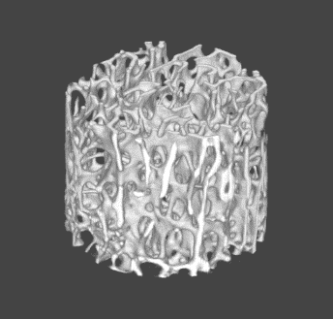
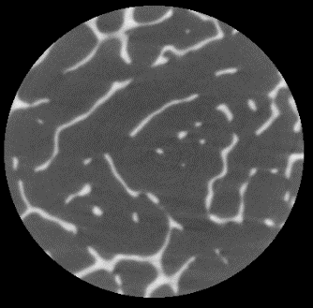
FDT-Based Thickness Computation
Performance under varying image resolution: trabecular bone model
Image acquisition
Two cadaveric distal radius samples
Cylindrical cores of 9 mm height and 9 mm diameter with the cylinder axis parallel to the direction of the radius
SANCO Medical μ-CT 20 scanner
22 µm isotropic voxel
Preprocessing
BVF Mapping
FDT computation
Thickness computation
3D skeletonization
Sampling FDT values along skeleton
Saha, Wehrli, "Measurement of trabecular bone thickness …… in vivo MRI by fuzzy distance transform," IEEE Trans Med Imag, 23: 53-62, 2004

Slide 33
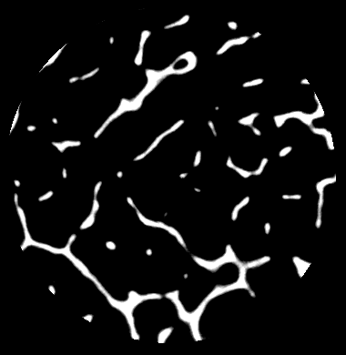
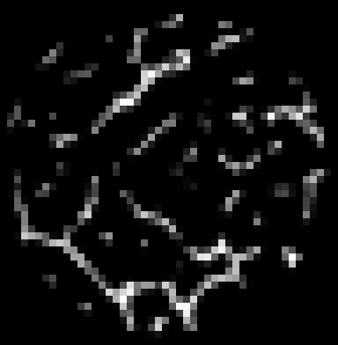
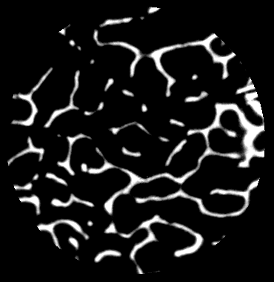
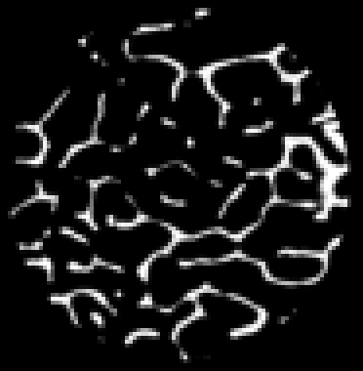
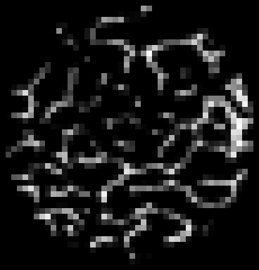
Images at Different Resolutions
22 μm
88 μm
176 μm

Slide 34
Results
Saha, Wehrli, "Measurement of trabecular bone thickness …… in vivo MRI by fuzzy distance transform," IEEE Trans Med Imag, 23: 53-62, 2004

Slide 35
Longitudinal Study Showing Effects of Treatment: A Rabbit Model
NZW Rabbit (3.5-4 Mo. Old; N=12)
Sham Operation (n=6)
0.4 mg/kg/day Dexamethazone (n=6)
MR image acquisition (Voxel size 98x98x300 μm³)
Baseline
2 weeks
4 weeks

Slide 36
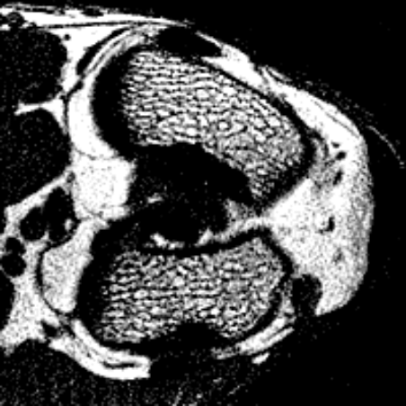
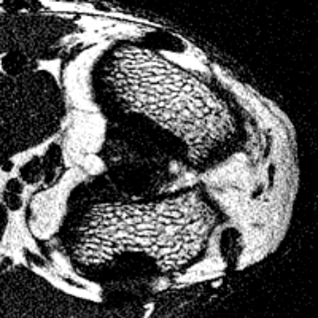
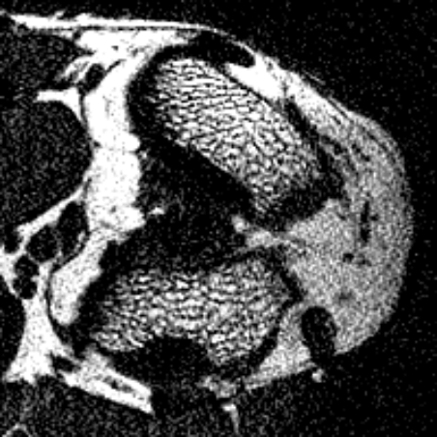
Results
Treatment effects are not visually apparent! 98x98x300 μm³
baseline
2 weeks
4 weeks
Effect of dexamethasone on rabbit trabecular thickness.
Saha, Wehrli, "Measurement of trabecular bone thickness …… in vivo MRI by fuzzy distance transform," IEEE Trans Med Imag, 23: 53-62, 2004

Slide 37
FDT-Based Detection of Axial Points
Fuzzy skeletonization yields a compact representation directly from the fuzzy representation of an object
A major challenge in fuzzy skeletonization is to recognize the axial points (often referred to as shape points or representative points) that in some sense describes the shape of the skeleton (but not the topology)

Slide 38
How to Locate an Axial Point
1. Consider a shape and its axial line
b₂
5. Now, consider
an axial point $a_{1}$
2. Consider a non-axial point $p_{1}$
a₂
3. Find the shortest
path $p_{1}b_{1}$ to
boundary
a₁
p₂
6. If extend the
shortest path $a_{1}b_{1}$
to $a_{2}$, the shortest
path from $a_{2}$ to the
boundary does not
passes through $a_{1}$
p₁
4. If we extend the
path $p_{1}b_{1}$ to $p_{2}$
the shortest path
$p_{2}b_{1}$ passes
through $p_{1}$
b₁
A point $a$ is an axial point if there is no point $a^{′}$ such that a shortest path from $a^{′}$ to the boundary passes through $a$

Slide 39
Fuzzy Axial Points
A point $p$ is an axial point if there is no point $p^{′}$ such that a shortest path from $p^{′}$ to the boundary passes through $p$.
Specifically, a point $p$ is an axial point if there is no point $q$ in the neighborhood of $p$ such that
$$Ω_{𝒪}\left(q\right)=Ω_{𝒪}\left(p\right)+μ_{d_{𝒪}}(p,q)$$
Arcelli and Sanniti di Baja introduced a criterion to detect the centers of maximal balls (CMBs) in a binary digital image using $3×3$ weighted distance transform
Borgefors extended it to $5×5$ weighted distances
This concept was generalized to fuzzy sets by Saha and Wehrli, Svensson, and Jin and Saha
Arcelli, Sanniti di Baja, “Finding local maxima in a pseudo-Euclidean distance transform”, Comput Vis Graph Imag Proc, 43: 361-367, 1988
Borgefors, “Centres of maximal discs in the 5-7-11 distance transform”, Proc of the Scandinavian Conf on Imag Anal ,1: 105-105), 1993
Saha, Wehrli, “Fuzzy distance transform in general digital grids and its applications”, Proc of 7th Joint Conf Info Sc, Research Triangular Park, NC, 201-213, 2003
Svensson, “Aspects on the reverse fuzzy distance transform”, Patt Recog Lett 29: 888-896, 2008
Jin, Saha. "A new fuzzy skeletonization algorithm and its applications to medical imaging." Proc. of 17th Int Conf on Imag Anal Proc (ICIAP), 662-671, 2013.

Slide 40
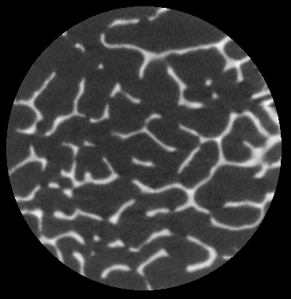
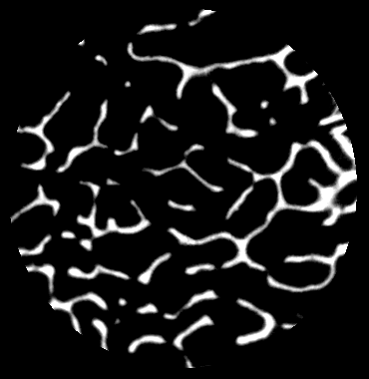
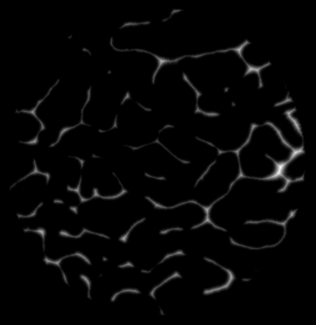
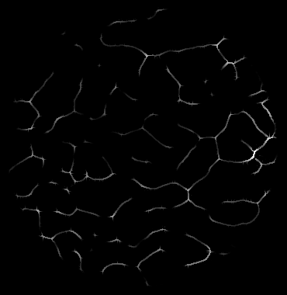
Results

Slide 41
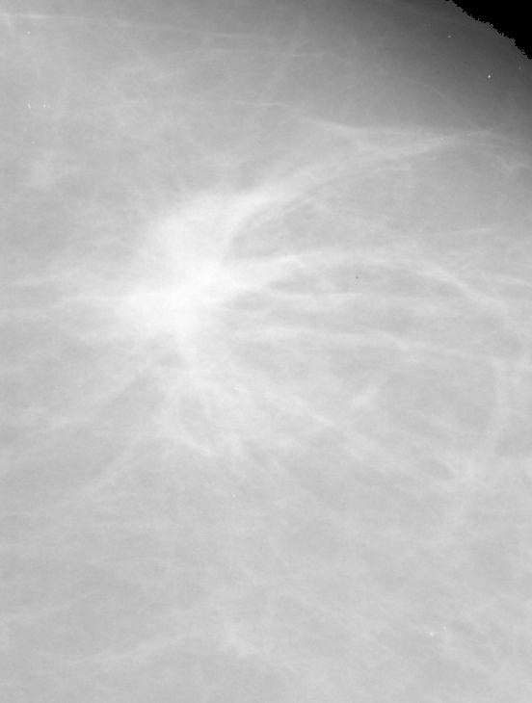
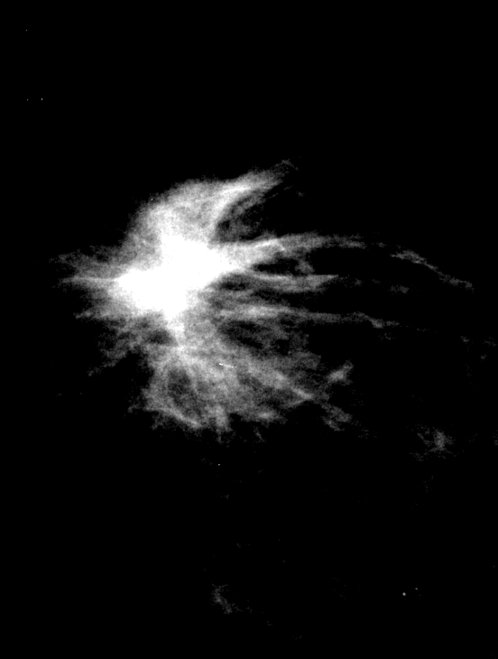
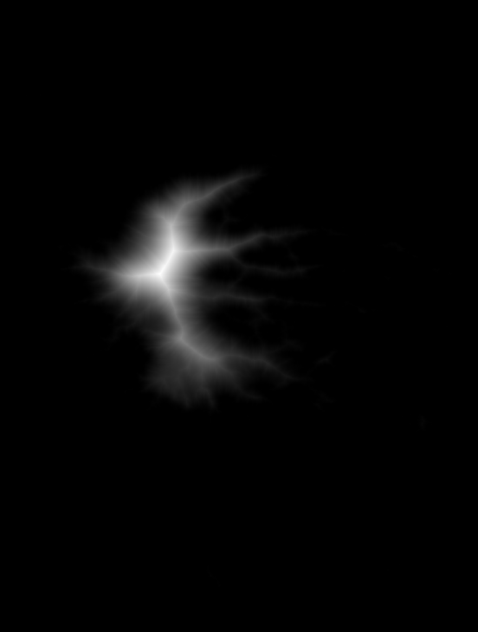
Results

Slide 42
Results

Slide 43
Summary
The theory of fuzzy distance has been extended to a more general grid
The conditions for valid length functions for links have been established
Accuracy of FDT-based thickness computation has been studied and its superiority over the hard DT-based method at various resolutions has been experimentally observed.
A new FDT-based method is presented to directly recognize axial points in the fuzzy representation of an object and the results of different applications have been presented

