Slide 1



Punam Kumar Saha
Professor
Departments of ECE and Radiology
University of Iowa pksaha@engineering.uiowa.edu
Theory of Object Class Uncertainty and its Application

Slide 2
References
[1] P. K. Saha and J. K. Udupa, "Optimum image thresholding via class uncertainty and region homogeneity," IEEE Transactions on Pattern Analysis and Machine Intelligence, vol. 23, pp. 689-706, 2001.
[2] P. K. Saha, B. Das, and F. W. Wehrli, "An object class-uncertainty induced adaptive force and its application to a new hybrid snake," Pattern Recognition, vol. 40, pp. 2656-2671, 2007.
[3] Y. Liu, G. Liang, and P. K. Saha, "A new multi-object image thresholding method based on correlation between object class uncertainty and intensity gradient," Medical physics, vol. 39, pp. 514-532, 2012.

Slide 3
Outline
Theory Of Object Class Uncertainty
Applications To Optimum Thresholding
Applications To Snake

Slide 4
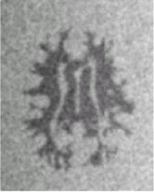
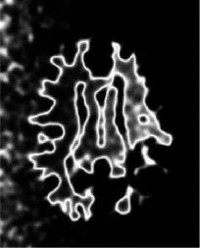
Object Class Uncertainty
threshold yielding minimum “classification error”
background intensity distribution
class uncertainty
object intensity distribution
Postulate. In an image with fuzzy boundaries, at optimum partitioning of object classes, voxels with high class uncertainty appear in the vicinity of object boundaries.
Gray-scale image
Class uncertainty image at optimum thresholding
Saha, Udupa, "Optimum image thresholding via class uncertainty and region homogeneity," IEEE Trans Patt Anal Mach Intell, 23: 689-706, 2001

Slide 5


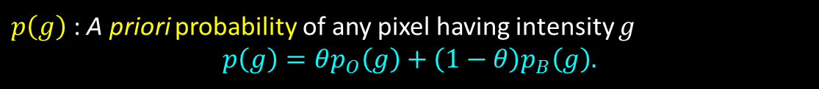
Computation of Object Class Uncertainty
A priori probability an object pixel having intensity $g$
$$p_{O}\left(g\right)=P\left(f\left(c\right)=g | c∈F_{O}\right),$$
where $P$ represents “probability,” and $F_{O}$ represents the true object class
A priori probability a background pixel having intensity $g$
$$p_{B}\left(g\right)=P\left(f\left(c\right)=g | c∈F_{B}\right),$$
where $F_{B}$ represents the true object class
$θ$ : A priori probability of any pixel belonging to object
$p\left(g\right)$ : A priori probability of any pixel having intensity $g$
$$p\left(g\right)=θp_{O}\left(g\right)+\left(1−θ\right)p_{B}\left(g\right).$$

Slide 6
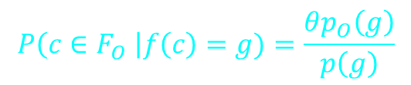

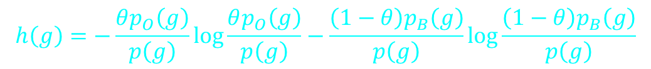
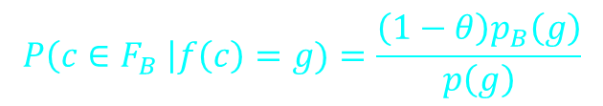
Computation of Object Class Uncertainty
A posteriori probability:
$$P\left(c∈F_{O} \right|f\left(c\right)=g)=\frac{θp_{O}\left(g\right)}{p\left(g\right)}$$
$$P\left(c∈F_{B} \right|f\left(c\right)=g)=\frac{\left(1−θ\right)p_{B}\left(g\right)}{p\left(g\right)}$$
$h\left(g\right)$ : “object class uncertainty” at intensity $g$
$$h\left(g\right)=−\frac{θp_{O}\left(g\right)}{p\left(g\right)}\log{\frac{θp_{O}\left(g\right)}{p\left(g\right)}}−\frac{\left(1−θ\right)p_{B}\left(g\right)}{p\left(g\right)}\log{\frac{\left(1−θ\right)p_{B}\left(g\right)}{p\left(g\right)}}$$

Slide 7
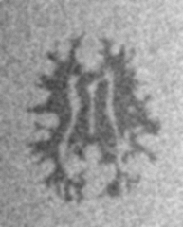
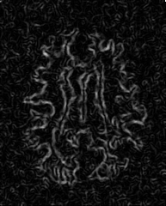
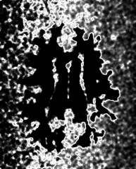
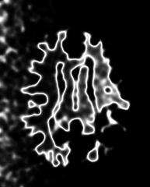

Optimum Thresholding
Postulate. In an image with fuzzy boundaries, at optimum partitioning of object classes, voxels with high class uncertainty appear in the vicinity of object boundaries.
$$E\left(t\right)=\sum_{c∈C}{H_{t}\left(f\left(c\right)\right)\left(1−Δ_{rank}\left(c\right)\right)+\left(1−H_{t}\left(f\left(c\right)\right)\right)Δ_{rank}\left(c\right)},$$
$H_{t}$ is the uncertainty map at a threshold $t$ and $Δ_{rank}$ is a rank-normalized gradient operator
optimal threshold
E
t
original image
gradient image
uncertainty image at a non-optimal threshold
uncertainty image at an optimal threshold
A theory to combine information theoretic measures with image gradient features
Saha, Udupa, "Optimum image thresholding via class uncertainty and region homogeneity," IEEE Trans Patt Anal Mach Intell, 23: 689-706, 2001

Slide 8
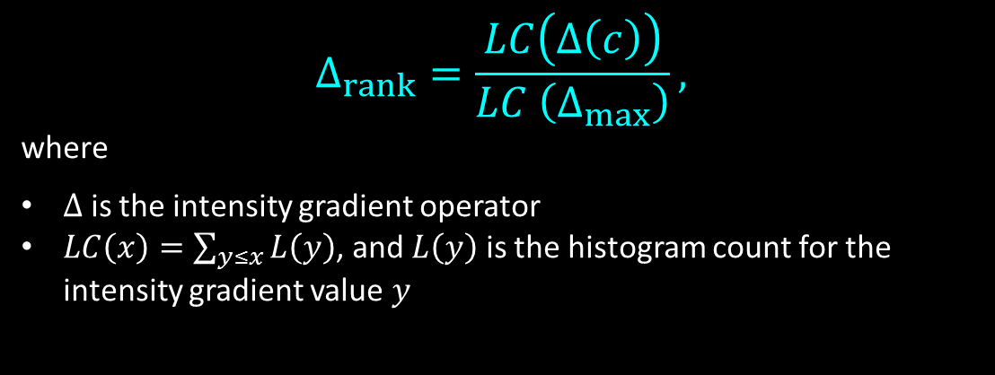
Rank-Normalized Gradient
DoG measures are sensitive to the standard deviation parameter of the normalizing Gaussian function
Rank-based normalization of the gradient parameter
  A parameter-free approach of normalization
$$Δ_{rank}=\frac{LC\left(Δ\left(c\right)\right)}{LC \left(Δ_{max}\right)},$$
where
$Δ$ is the intensity gradient operator
$LC\left(x\right)=\sum_{y≤x}{L\left(y\right)}$, and $L\left(y\right)$ is the histogram count for the intensity gradient value $y$
Saha, Udupa, "Optimum image thresholding via class uncertainty and region homogeneity," IEEE Trans Patt Anal Mach Intell, 23: 689-706, 2001

Slide 9



Optimum Thresholding Algorithm
Principle. Minimization of Uncertainty Homogeneity Energy (MHUE) $E(t)$
$$t_{opt}=\underset{t}{arg min}{E\left(t\right)}$$
An efficient computation of the Energy function $E\left(t\right)$
$$E\left(t\right)=\sum_{c∈C}{H_{t}\left(f\left(c\right)\right)\left(1−Δ_{rank}\left(c\right)\right)+\left(1−H_{t}\left(f\left(c\right)\right)\right)Δ_{rank}\left(c\right)}$$
$∀$ intensity value $i$,
$$X\left(i\right)=\sum_{c∈C | f\left(c\right)=i}{1−Δ_{rank}},$$
$$Y\left(i\right)=\sum_{c∈C | f\left(c\right)=i}{Δ_{rank}},$$
Efficient formulation of $E\left(t\right)$
$$E\left(t\right)=\sum_{i}{H_{t}\left(i\right)X\left(i\right)+\left(1−H_{t}\left(i\right)\right)Y\left(i\right)}$$
Note: Number of possible intensity values in an image is far less than the number of pixels/voxels in the image
Saha, Udupa, "Optimum image thresholding via class uncertainty and region homogeneity," IEEE Trans Patt Anal Mach Intell, 23: 689-706, 2001

Slide 10
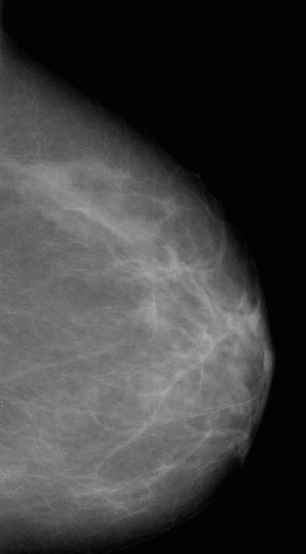

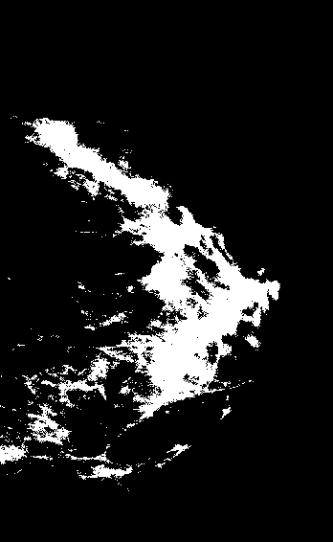
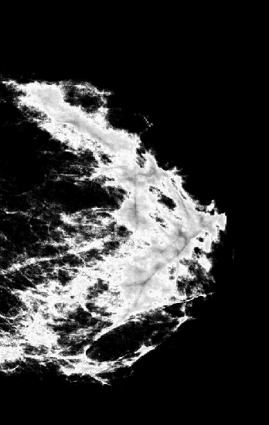
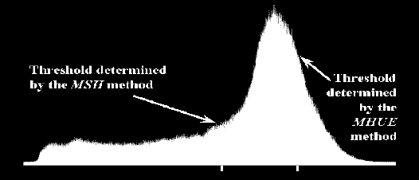
Results
MSII†
MHUE
optimum uncertainty (OU) map
Digitized Mammogram
†Leung, Lam, “Maximum segmented image information thresholding,” Graph Mod Imag Proc, 60: 57-76, 1998

Slide 11
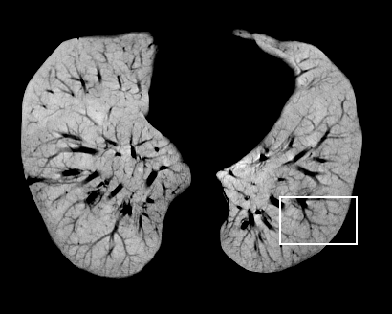
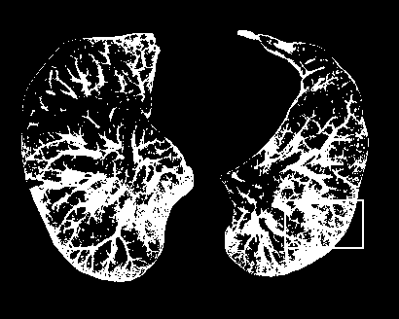
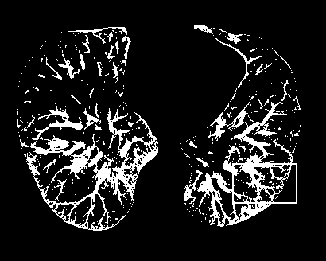
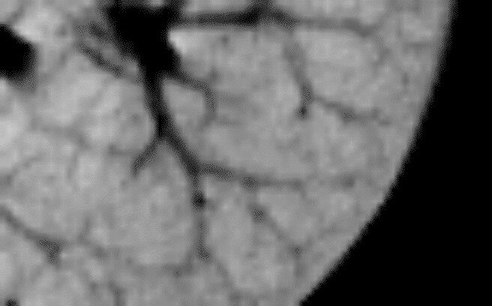
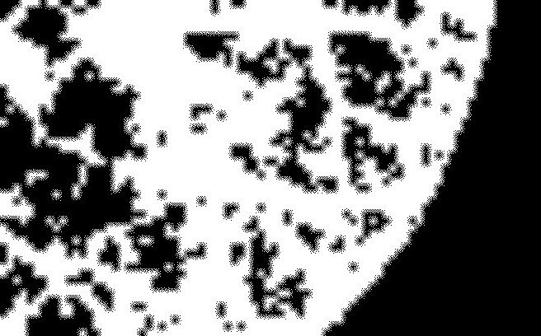
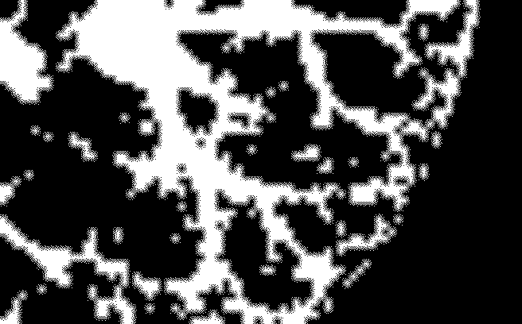
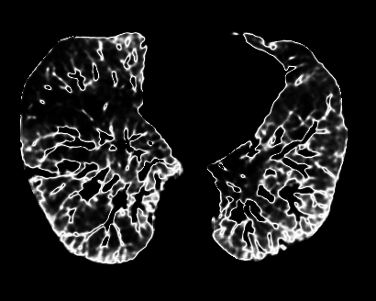
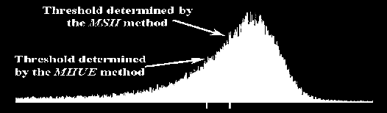
Results
Inverted CT
MSII
MHUE
OU Map

Slide 12
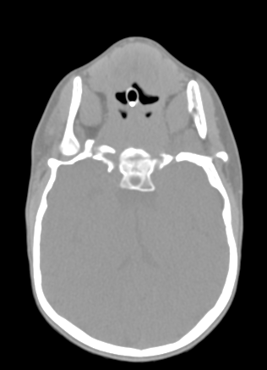
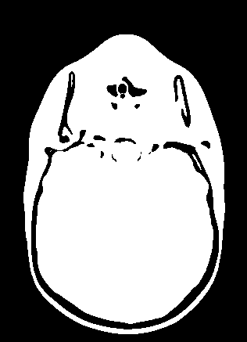
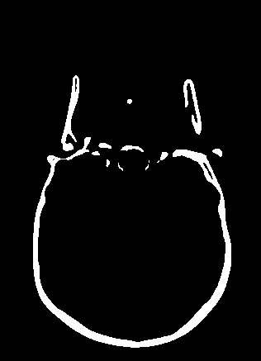
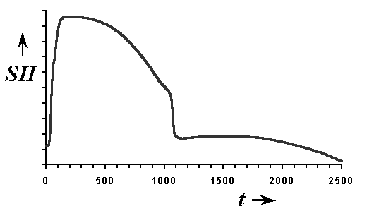
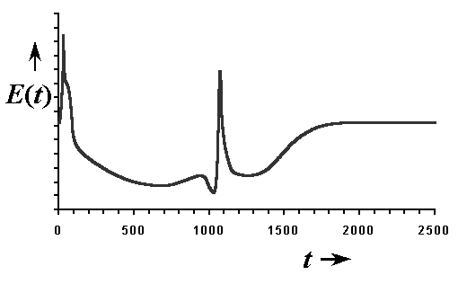
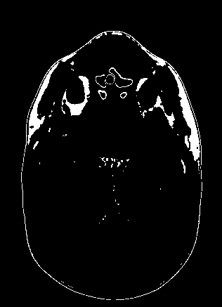
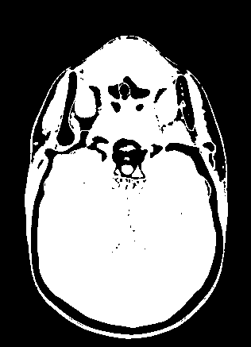
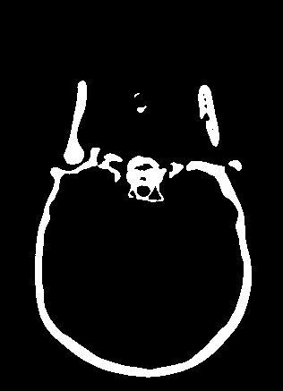
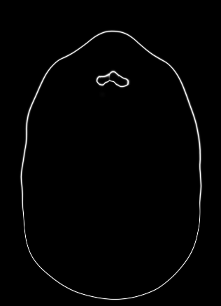
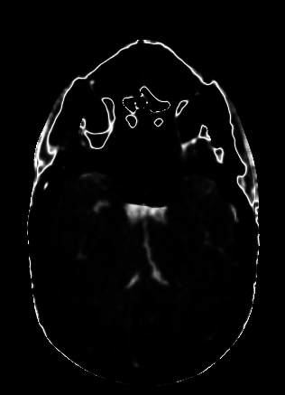
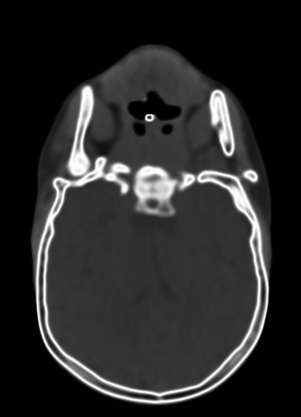
Multiple Object Segmentation
CT Slice
MSII
MHUE
OU Map

Slide 13
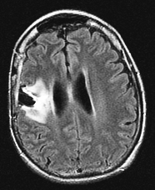

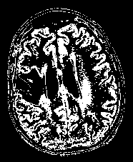
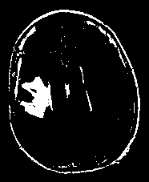
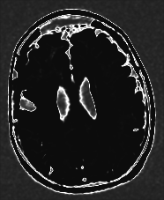
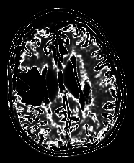
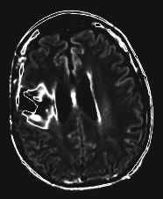
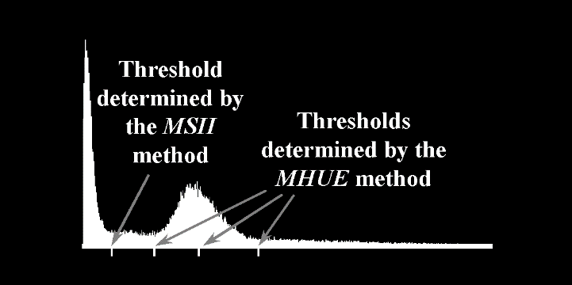
Application on MR Slice Data
Flair
MHUE segmentation
CT Slice
MSII
OU Map

Slide 14
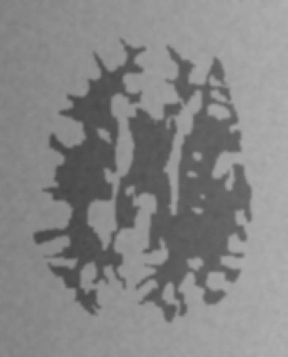
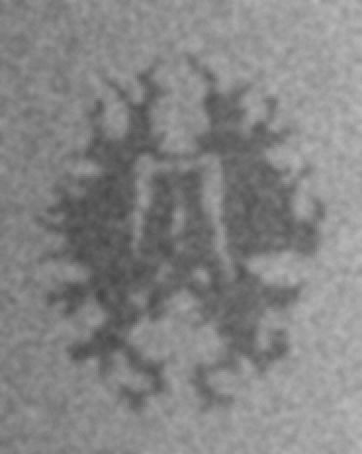
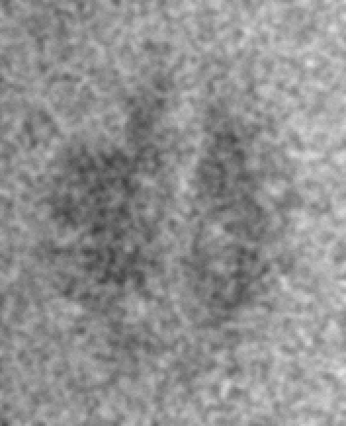
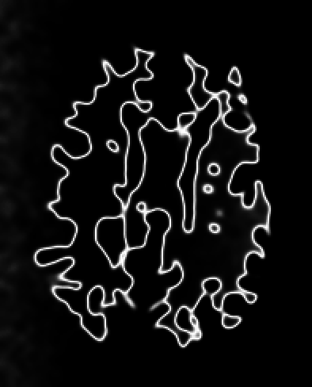
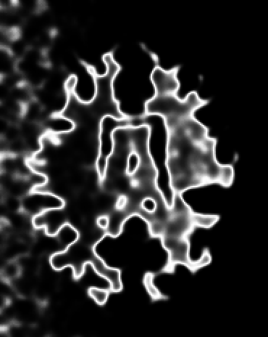


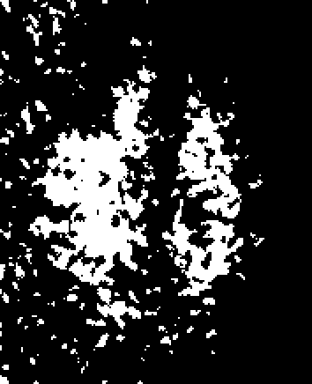
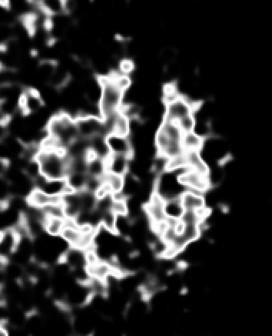
Phantom Experiment
Phantoms
MHUE
OU Map

Slide 15

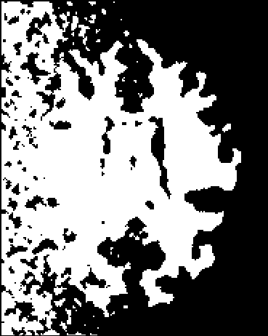
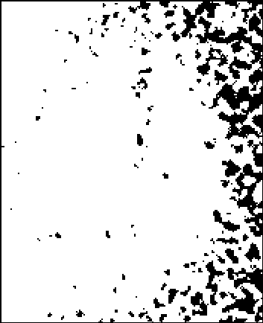

Phantom Experiment
Phantoms
MSII

Slide 16
Application of Object Class Uncertainty to Snake
Saha, Das, Wehrli, "An object class-uncertainty induced adaptive force and its application to a new hybrid snake," Patt Recog, 40: 2656-2671, 2007

Slide 17
Outline
Brief Overview of Snake
Basic Challenges
Object Feature Force
Object Class Uncertainty
Smart Force
Smart Snake – Methods and Design
Experimental Results

Slide 18


Curves in Motion
Initialization
  Squeezing Snake: Object contained
  entirely inside the region enclosed by the initial contour
  Expanding Snake: Object entirely includes the region enclosed by the initial contour
  Automatic
    Expand from a seed point using balloon force
    Converge from the boundary of image frame

Slide 19


Internal Energy
The spline properties
An elastic rubber band possessing elastic potential energy
  Responsible for shrinking of the contour
Behaves like a thin metal strip giving rise to bending energy
  Bending energy is minimum for a circle.
Total internal energy of the snake $ν$ can be defined as
$$E_{int}=α\left(s\right)\left\|\frac{∂ν\left(s\right)}{∂s}\right\|+β\left(s\right){\left\|\frac{∂^{2}ν\left(s\right)}{∂s^{2}}\right\|}^{2}$$

Slide 20



Snake: Basic Formulation
Snake: a deformable spline $ν$†
Basic Snake Equation
$$E_{snake}=E_{int}+E_{image}+E_{con}$$
Internal Energy
  String (elastic) Force
  Rigidity Force
$$E_{int}=α\left(s\right)\left\|\frac{∂ν\left(s\right)}{∂s}\right\|+β\left(s\right){\left\|\frac{∂^{2}ν\left(s\right)}{∂s^{2}}\right\|}^{2}$$
Image Energy
  Gradient
  Intensity
† Kass, Witkin, and Terzopoulos, “Snakes: Active Contour Models”, Int. J. Comput. Vis., 1, 321-331, 1988

Slide 21

An Overlooked Territory
Theory and algorithms to optimally fit in a priori object/background feature information
Attempts to overcome this limitation
A blind balloon force† to move the snake in homogeneous regions
Failure to arrest uncontrolled snake propagation once leaked through a weak boundary zone
Sub optimal performance near boundaries with narrow concavities
Result using balloon snake
† Cohen and Cohen, IEEE Trans. PAMI, 15, 1131-1147, 1993

Slide 22
Main Contribution
Introduction of object/background feature based SMART FORCE into snake
Spline
Nature of smart force
  Expanding within the object
  Compressing inside the background
  Weakens at the vicinity of the object-background interface
Object
Background

Slide 23


Design of the Smart Force
Probably, we need…
  Optimum object-background classification
  Confidence level of the classification
We have used …
  Object Class Uncertainty† Based Smart Force
Gray-scale image
Smart force
expanding
contracting
weak
† Saha, Udupa, "Optimum image thresholding via class uncertainty and region homogeneity," IEEE Trans Patt Anal Mach Intell, 23: 689-706, 2001

Slide 24


Object Class Uncertainty Induced Smart Force
$τ_{ν}\left(p\right)$ : unit vector radially outward at the location $p$ on the contour $ν$
Smart force
$$F_{smart,ν}\left(p\right)=\left\{\begin{matrix}1−h\left(f\left(p\right)\right)τ_{ν}\left(p\right), & \text{if} p∈O, \\ −1+h\left(f\left(p\right)\right)τ_{ν}\left(p\right), & \text{otherwise}\text{.}\end{matrix}\right.$$
original image
$$p$$
Object
Spline
Type of Smart Forces
Expanding (inside object)
Contracting (inside background)
Background
Weak force (at interface)
smart force
Saha, Das, Wehrli, "An object class-uncertainty induced adaptive force and its application to a new hybrid snake," Patt Recog, 40: 2656-2671, 2007

Slide 25

Properties of Smart Force
Direction adaptive
  Expands inside the object
  Compresses within background
  Resists uncontrolled post-leaking propagation
Optimal response to the chaos in acquired signal
Complementary with Image Gradient force
  stronger inside homogeneous regions
  weak near boundaries
smart force

Slide 26






Estimation of Uncertainty Force
Prior Information about object and background intensity distribution acquired
$m_{O}$ : Object mean
$σ_{O}$ : Object standard deviation
$m_{B}$ : Background mean
$σ_{B}$ : Background standard deviation
background intensity distribution
object intensity distribution
threshold
smart force
Expanding (inside object)
Contracting (inside background)
Weak force (at interface)
$$m_{B}$$
$$m_{O}$$

Slide 27





Image Force Field and Snake
phantom
Gradient Force
Smart snake (SS)
Balloon snake (BS)
Smart force
SS
BS
BS

Slide 28



Comparative Results
SS
BS
SS
BS
Phantom with high object-background contrast at different levels of noise and blurring

Slide 29





Comparative Results
phantom
Smart force
SS
BS
phantom
Smart force
SS
BS

Slide 30




Comparative Results
phantom
Smart force
SS
BS
SS
BS

Slide 31


Object Class Uncertainty Induced Smart Snake

Slide 32
Comparison with Balloon Snake
Segmentation result (red) smart snake
Segmentation result (red) using balloon snake

Slide 33
Comparison with Balloon Snake
Result (red) using balloon snake
Results (red) using smart snake

Slide 34


Carotid Data Segmentation using Smart Snake

Slide 35
Summary
Introduced object class uncertainty theory
  Combines information theoretic measure with image features
A fundamental postulate is stated
  In most real life imaging applications, under optimum classification, image elements with the maximum class uncertainty appear in the vicinity of object boundaries.
  Supported by results of application on several real images and 250 computer generated realistic phantoms
  Potential application in multiple image and data classification tasks

Slide 36
Summary (Contd.)
Application to optimum thresholding
  Potential application in local threshold selection
  Results of application using both real and phantom data
Introduced object class uncertainty based smart force into snake model
  Direction adaptive
  Strength adaptive to fit with the inherent chaos in signal
  Acts in complementary fashion with image gradient information
Preliminary results of application of class uncertainty based smart snake on several natural and medical data

