Slide 1



Punam Kumar Saha Professor Departments of ECE and Radiology University of Iowa pksaha@engineering.uiowa.edu
In Vivo Characterization of Trabecular Bone Micro-architecture

Slide 2
References
[1] P. K. Saha and B. B. Chaudhuri, "3D digital topology under binary transformation with applications," Computer vision and image understanding, vol. 63, pp. 418-429, 1996.
[2] B. R. Gomberg, P. K. Saha, H. K. Song, S. N. Hwang, and F. W. Wehrli, "Topological analysis of trabecular bone MR images," IEEE Transactions on Medical Imaging, vol. 19, pp. 166-174, 2000.
[3] P. K. Saha, B. R. Gomberg, and F. W. Wehrli, "Three-dimensional digital topological characterization of cancellous bone architecture," International Journal of Imaging Systems and Technology, vol. 11, pp. 81-90, 2000.
[4] F. W. Wehrli, B. R. Gomberg, P. K. Saha, H. K. Song, S. N. Hwang, and P. J. Snyder, "Digital topological analysis of in vivo magnetic resonance microimages of trabecular bone reveals structural implications of osteoporosis," Journal of Bone and Mineral Research, vol. 16, pp. 1520-1531, 2001.
[5] F. W. Wehrli, P. K. Saha, B. R. Gomberg, H. K. Song, P. J. Snyder, M. Benito, A. Wright, and R. Weening, "Role of magnetic resonance for assessing structure and function of trabecular bone," Topics in Magnetic Resonance Imaging, vol. 13, pp. 335-355, 2002.
[6] P. K. Saha and F. W. Wehrli, "Measurement of trabecular bone thickness in the limited resolution regime of in vivo MRI by fuzzy distance transform," IEEE Transactions on Medical Imaging, vol. 23, pp. 53-62, 2004.
[7] X. S. Liu, P. Sajda, P. K. Saha, F. W. Wehrli, and X. E. Guo, "Quantification of the roles of trabecular microarchitecture and trabecular type in determining the elastic modulus of human trabecular bone," Journal of Bone and Mineral Research, vol. 21, pp. 1608-1617, 2006.

Slide 3
References (Contd.)
[8] X. S. Liu, P. Sajda, P. K. Saha, F. W. Wehrli, G. Bevill, T. M. Keaveny, and X. E. Guo, "Complete volumetric decomposition of individual trabecular plates and rods and its morphological correlations with anisotropic elastic moduli in human trabecular bone," Journal of Bone and Mineral Research, vol. 23, pp. 223-235, 2008.
[9] G. Chang, S. K. Pakin, M. E. Schweitzer, P. K. Saha, and R. R. Regatte, "Adaptations in trabecular bone microarchitecture in Olympic athletes determined by 7T MRI," Journal of Magnetic Resonance Imaging, vol. 27, pp. 1089-1095, 2008.
[10] P. K. Saha, Y. Xu, H. Duan, A. Heiner, and G. Liang, "Volumetric topological analysis: a novel approach for trabecular bone classification on the continuum between plates and rods," IEEE Transactions on Medical Imaging, vol. 29, pp. 1821-1838, 2010.
[11] S. Dudley-Javoroski, P. Saha, G. Liang, C. Li, Z. Gao, and R. Shields, "High dose compressive loads attenuate bone mineral loss in humans with spinal cord injury," Osteoporosis International, vol. 23, pp. 2335-2346, 2012.
[12] P. K. Saha, Y. Liu, C. Chen, D. Jin, E. M. Letuchy, Z. Xu, R. E. Amelon, T. L. Burns, J. C. Torner, and S. M. Levy, "Characterization of trabecular bone plate-rod microarchitecture using multirow detector CT and the tensor scale: Algorithms, validation, and applications to pilot human studies," Medical physics, vol. 42, pp. 5410-5425, 2015.

Slide 4
Osteoporosis, Trabecular Bone Micro-Architecture, and Plate-Rod Distribution
Trabecular bone: network of interconnected plates and rods
Wolff’s law (1892): bone grows/remodels in response to the applied stresses
Osteoporosis: low bone mineral density and architectural deterioration
At risk in USA: >40 million
US health care cost: ~$17B/Y
Trabecular bone
Cortical bone
There is histologic evidence confirming the relationship between the gradual conversion of trabeculae from plates to rods and low-trauma fracture risk

Slide 5
Bone Mineral Density (BMD) and Miro-Architecture
How Predictive is BMD of the Bone’s Mechanical Behavior?
Meta analysis
N=38 (1985-2000)
Various parameters of “strength”
Mean r² = 0.64±0.17
Clinical studies have confirmed the role of plate/rod bone micro-architecture to determine bone strength
Quantifying Architecture via Bone Biopsy
Iliac crest or rib
Painful, risky, and limited retests
Not suitable for controls or time-series analysis

Slide 6
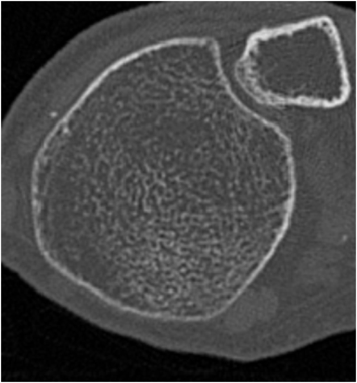
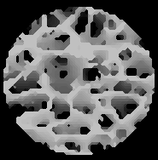
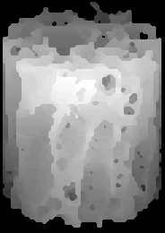
In Vivo Imaging Offers an Opportunity for Virtual Bone Biopsy
Virtual core
Topology, Scale, Orientation
Distal tibia
Features
Challenges
Analogous to bone biopsy
Virtual core is isolated from 3D image data sets.
Core is subjected to analysis
Reduced resolution
Limited signal-to-noise ratio

Slide 7
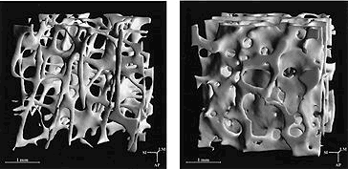
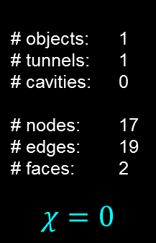

Topology of Trabecular Networks
Topological analysis of line skeletonized structure
Structure-Model Index (SMI)
SMI µ (∂S/∂r)
r
3D Euler Poincaré Formula:
$χ$ = objects - tunnels + cavities
= nodes - edges + faces
Connectivity Index = $1−χ$
SMI=relative change in surface area (S) upon radial (r) expansion
S
calcaneus
# objects: 1
# tunnels: 1
# cavities: 0
# nodes: 17
# edges: 19
# faces: 2
$$χ=0$$
SMI = 2.3
SMI = 1.1
Hildebrand et al, J Bone Miner Res, 1999

Slide 8
Topological Analysis
Topological class (curve, surface junctions) at any location may be unambiguously determined from the topological numbers (#objects (ξ), #tunnels (η), and #cavities (δ))
Edge: ξ = 1; η = 0; δ = 0
Curve Interior: ξ = 2; η = 0; δ = 0
Surface Interior: ξ = 1; η = 1; δ = 0
Curve-Curve junction: ξ > 2; η = 0; δ = 0
Surface-Curve junction: ξ > 1; η = 1; δ = 0
Surface-Surface junction: ξ = 1; η > 1; δ = 0
Saha and Chaudhuri, "3D digital topology under binary transformation with applications," Comp Vis Imag Und, 63:418-429, 1996

Slide 9
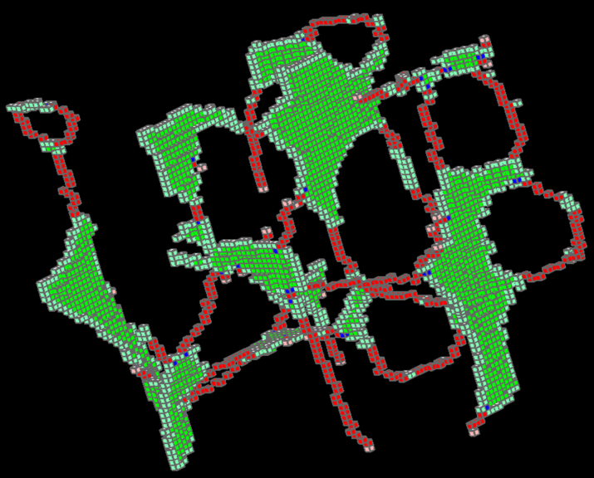
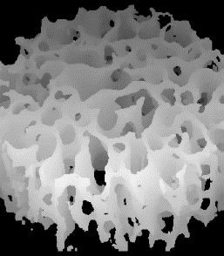
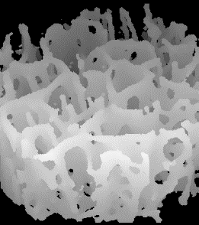
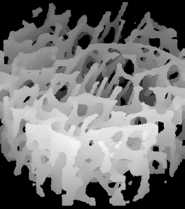
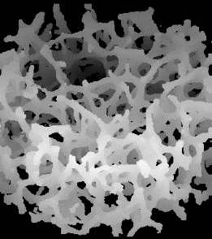
Digital Topological Analysis
Identifies plates/rods and other topological entities
Able to distinguish between fracture/ non-fracture groups via in vivo MRI
Being used by several leading research groups
young adult
osteoporotic
old age
Surface = plate
Rod = curve
Junction
plate-like
rod-like
Surface/Curve(Plate/Rod) Ratio
Age and disease-related topological changes
58.1
15.7
9.8
3.5
Saha, Gomberg, Wehrli, "Three-dimensional digital topological characterization of cancellous bone architecture," Int J Imag Syst Tech, 11:81-90, 2000
Gomberg, Saha, Song, Hwang, Wehrli, "Topological analysis of trabecular bone MR images," IEEE Trans Med Imag, 19:166-174, 2000
Wehrli, Gomberg, Saha, Song, Hwang, Snyder, "Digital topological analysis of in vivo ….. of trabecular bone ……..," J Bone Min Res, 16:1520-1531, 2001

Slide 10
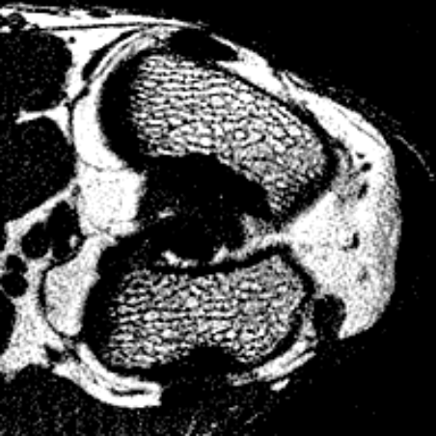
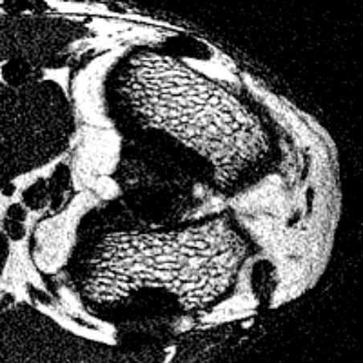
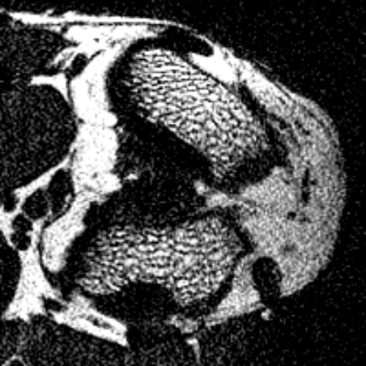
Measures TB thickness/Spacing at In Vivo Resolution using Fuzzy Distance Transform
In vivo evidence of Dexamethasone on trabecular bone thickness
98x98x300 μm³
Baseline
2 weeks
4 weeks
Treatment effect is not visually apparent!
Saha and Wehrli, "Measurement of trabecular bone thickness in the limited resolution regime of in vivo MRI by fuzzy distance transform," IEEE Trans Med Imag, 23: 53-62, 2004

Slide 11
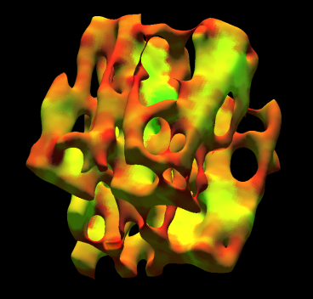
Recent Works: Volumetric Topological Analysis
DTA
VTA
Quantify trabecular bone architecture via clinical CT imaging
Plateness and rodness on the continuum between perfect plates and perfect rods
Local trabecular bone width in the unit of microns
Saha, Xu, Duan, Heiner, Liang, "Volumetric topological analysis: a novel approach for trabecular bone classification ……….," IEEE Trans Med Imag, 29:1821-1838, 2010

Slide 12
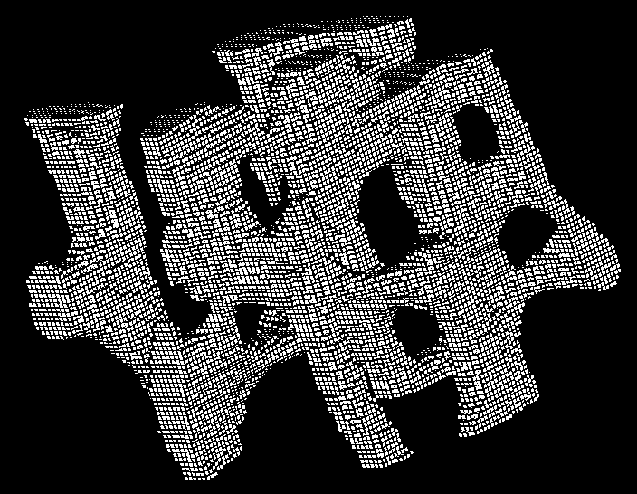
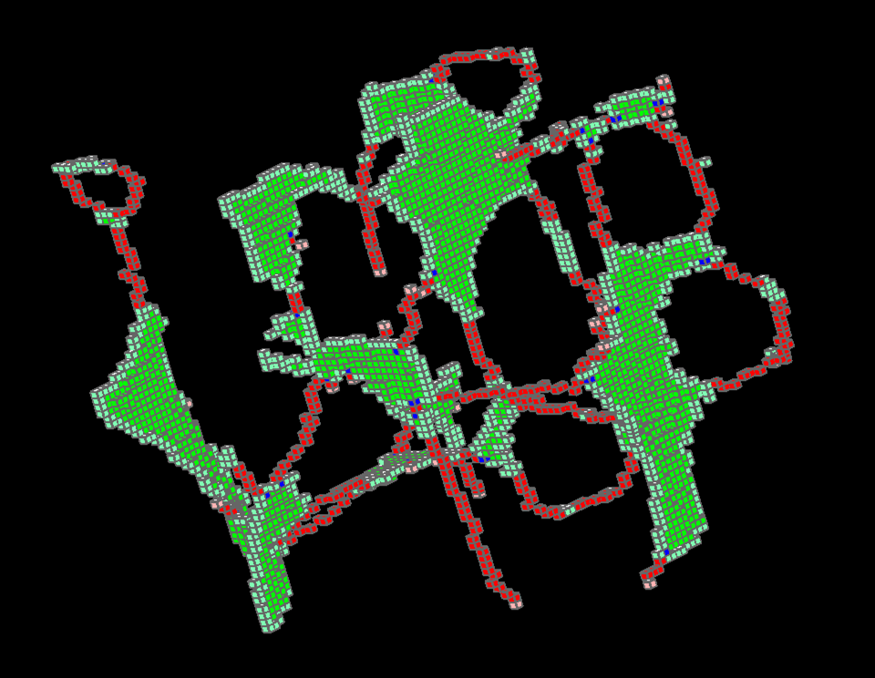
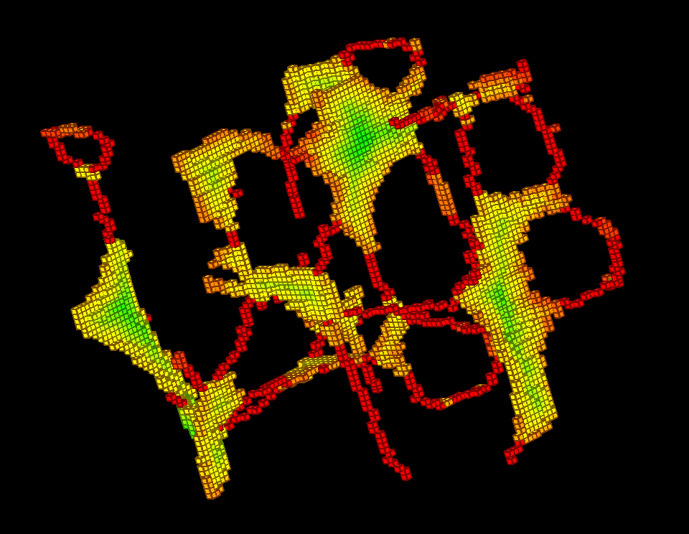
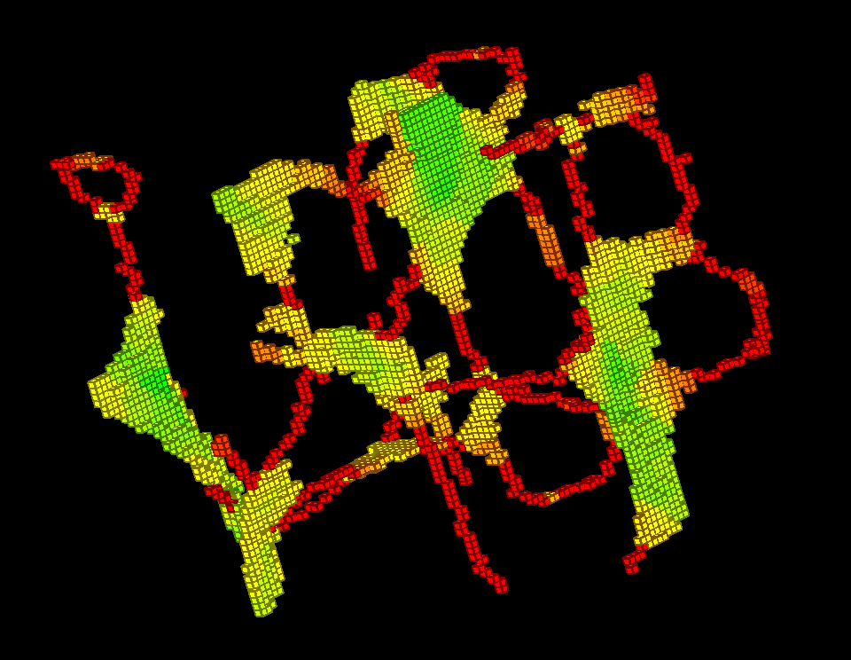
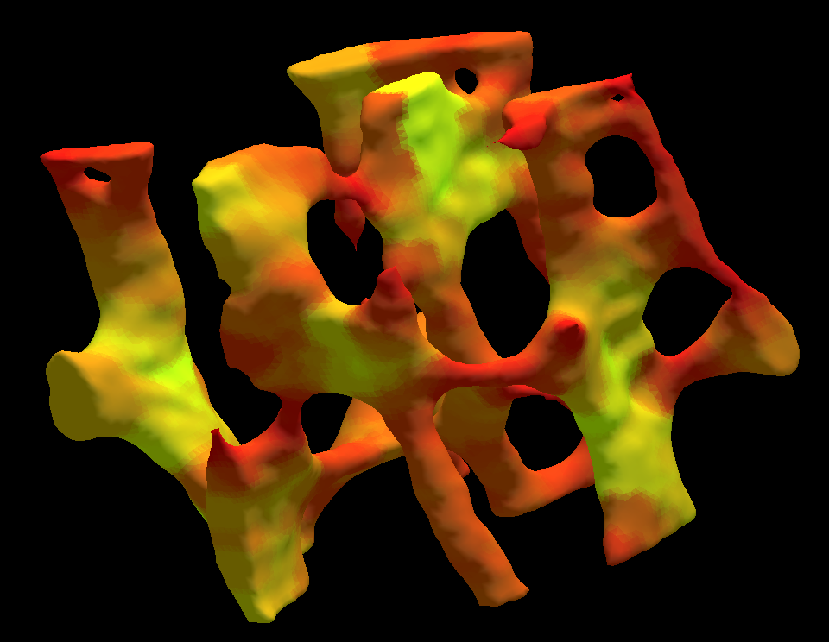
Intermediate Steps

Slide 13
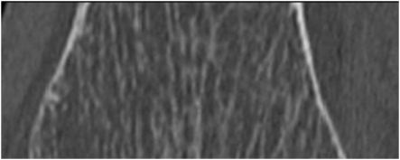
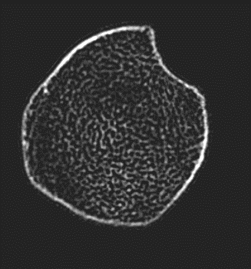
CT Imaging
128 slice SOMATOM Definition Siemens Flash scanner
120 kV, 200 mAs, pitch: 1.0
nominal collimation: 16x0.3mm
scan length: 10 cm
slice thickness: 300 μm
Axial
Sagittal
Scan1
Scan2
Scan3

Slide 14
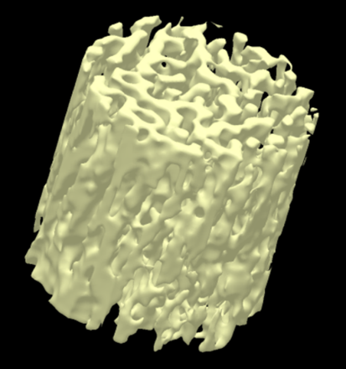
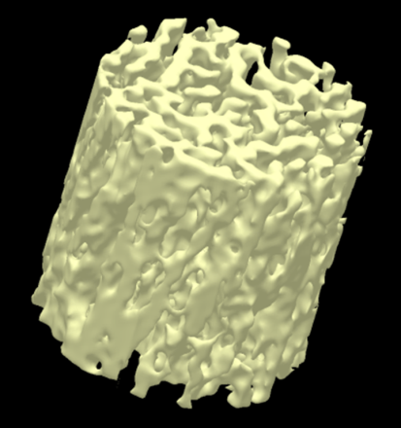
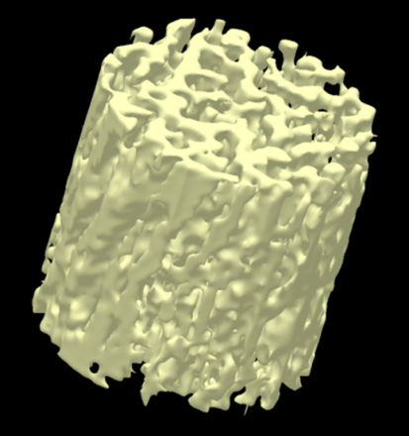
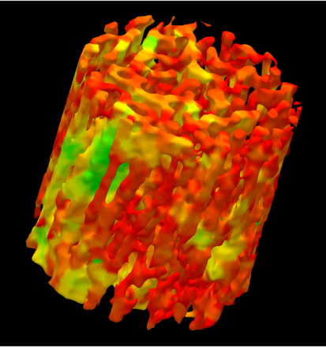
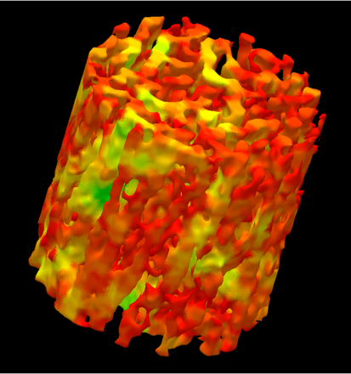
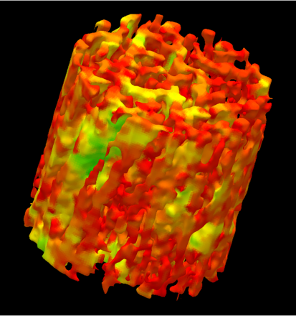
High Intra- and Inter-Modality Reproducibility
Three repeat CT scans
Color-coded results of volumetric topological analysis
Repeat CT scan ICC: 0.97

Slide 15
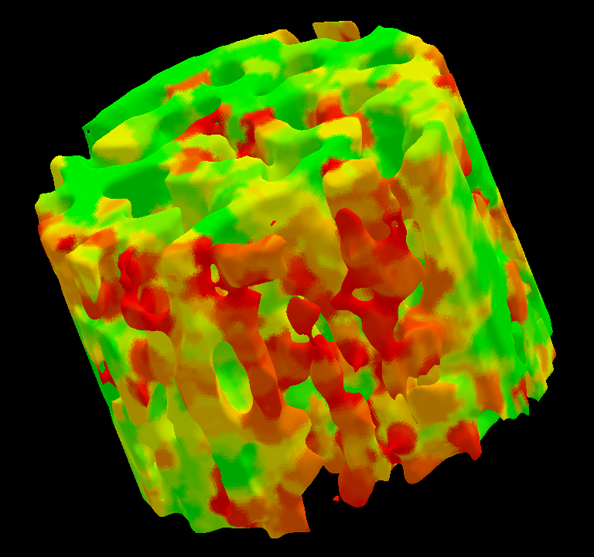
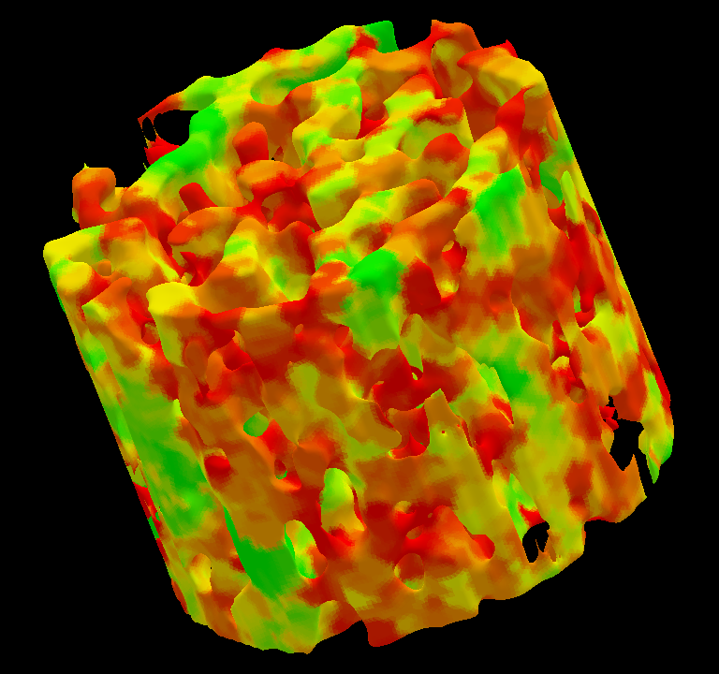
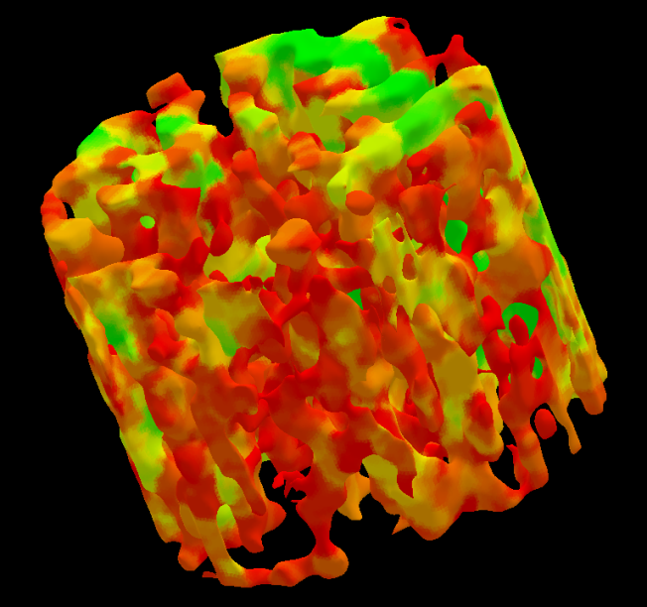
VTA Measure for TB with Distinctively Different Strengths
Modulus: 2.2 GPa BMD: 1.27 gm/cm³
SW_{VTA}: 385 µm
SCR_{VTA}: 0.38
Modulus: 3.3 GPa BMD: 1.31 gm/cm³
SW_{VTA}: 464 µm
SCR_{VTA}: 0.58
8% reduction in BMD reduced bone strength to half and manifest a 50% alteration in micro-architecture
Modulus: 1.5 GPa BMD: 1.20 gm/cm³
SW_{VTA}: 340 µm
SCR_{VTA}: 0.26

Slide 16
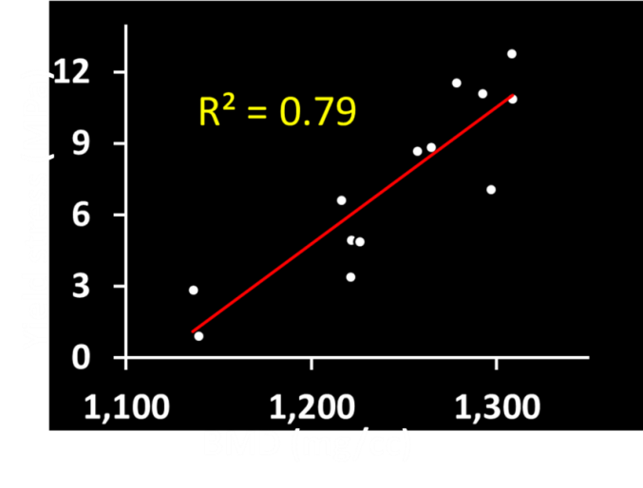
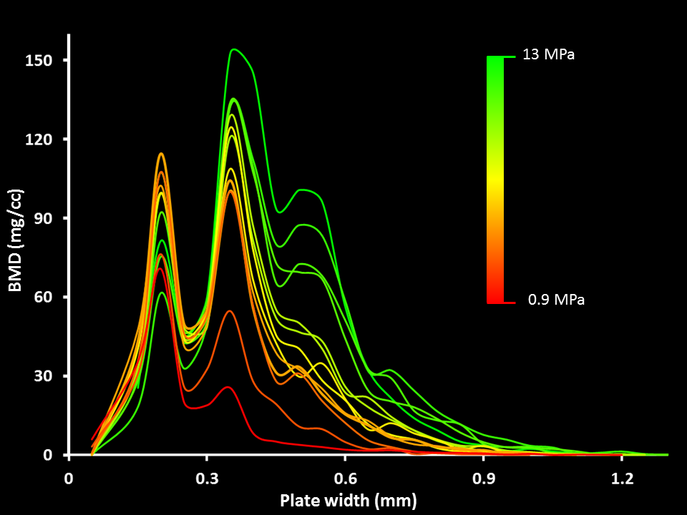
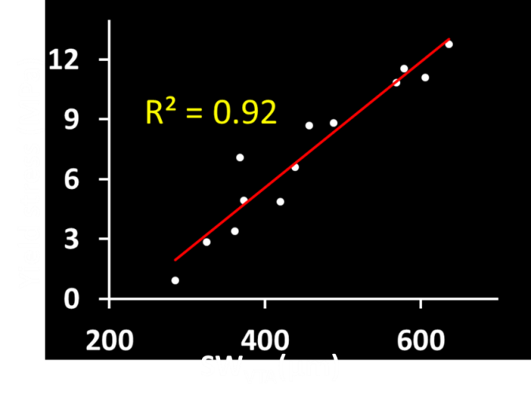
Ability To Predict Mechanical Properties
Bone mass distribution at different plate width: a new class of information
High predictability of experimental biomechanical properties.

Slide 17
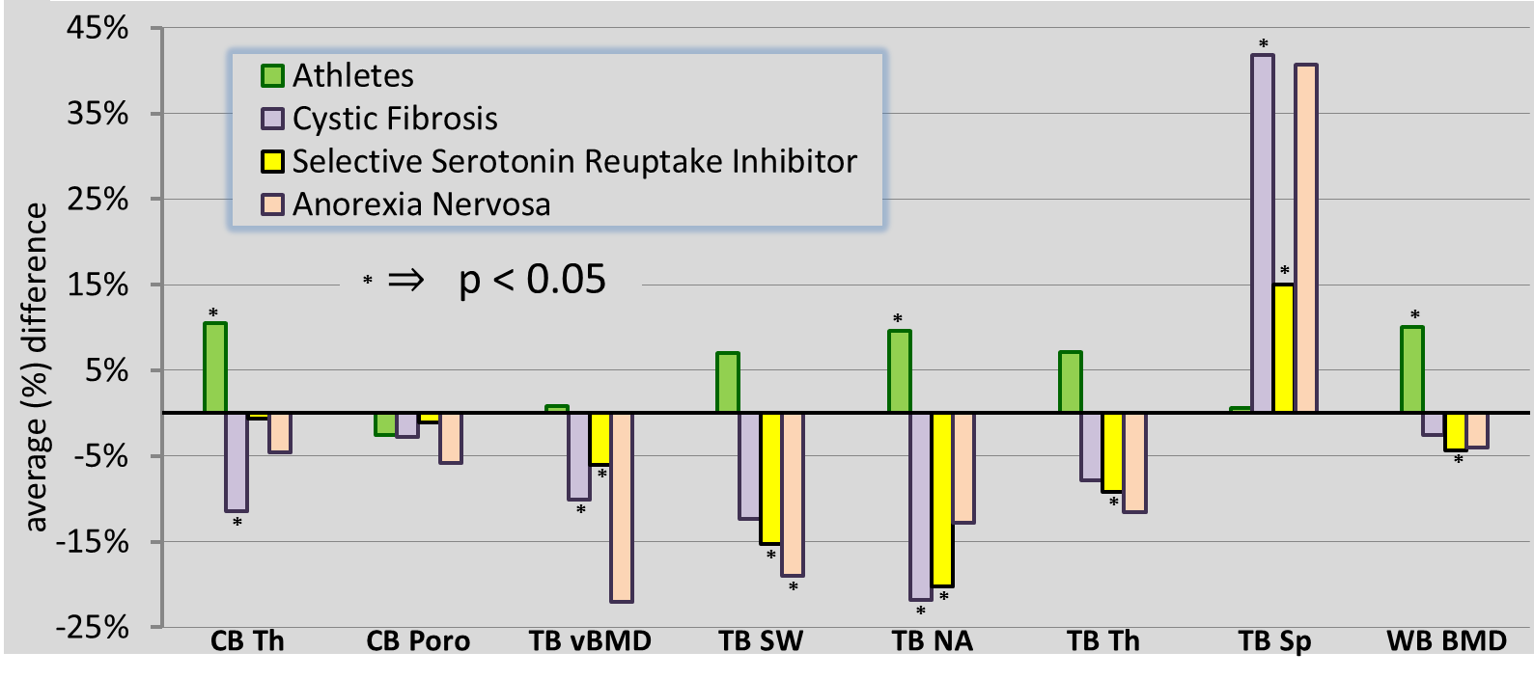
Results of a Human Pilot Study
Average differences of bone measures in athlete (N=10), cystic fibrosis (N=11), selective serotonin reuptake inhibitor (N=12), and anorexia nervosa (N=4) groups as compared to age-sex-BMI-similar healthy controls from the Iowa Bone Development Study (N=102). Age-sex-height matching was used for the anorexia nervosa group.

Slide 18
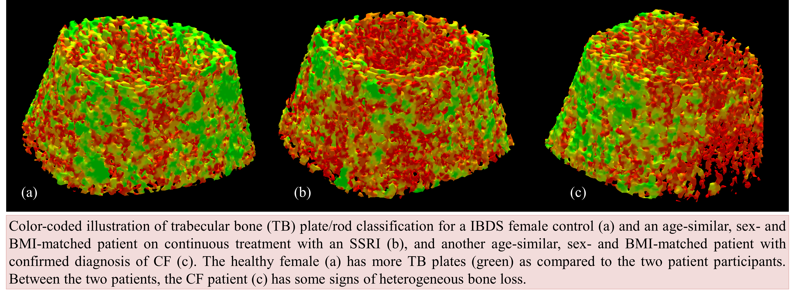
Bone Characterization in Different Human Groups
Saha, Liu, Chen, Jin, Letuchy, Xu, Amelon, Burns, Torner, Levy, "Characterization of trabecular bone plate-rod microarchitecture ….," Med Phy, 42:5410-5425, 2015

Slide 19
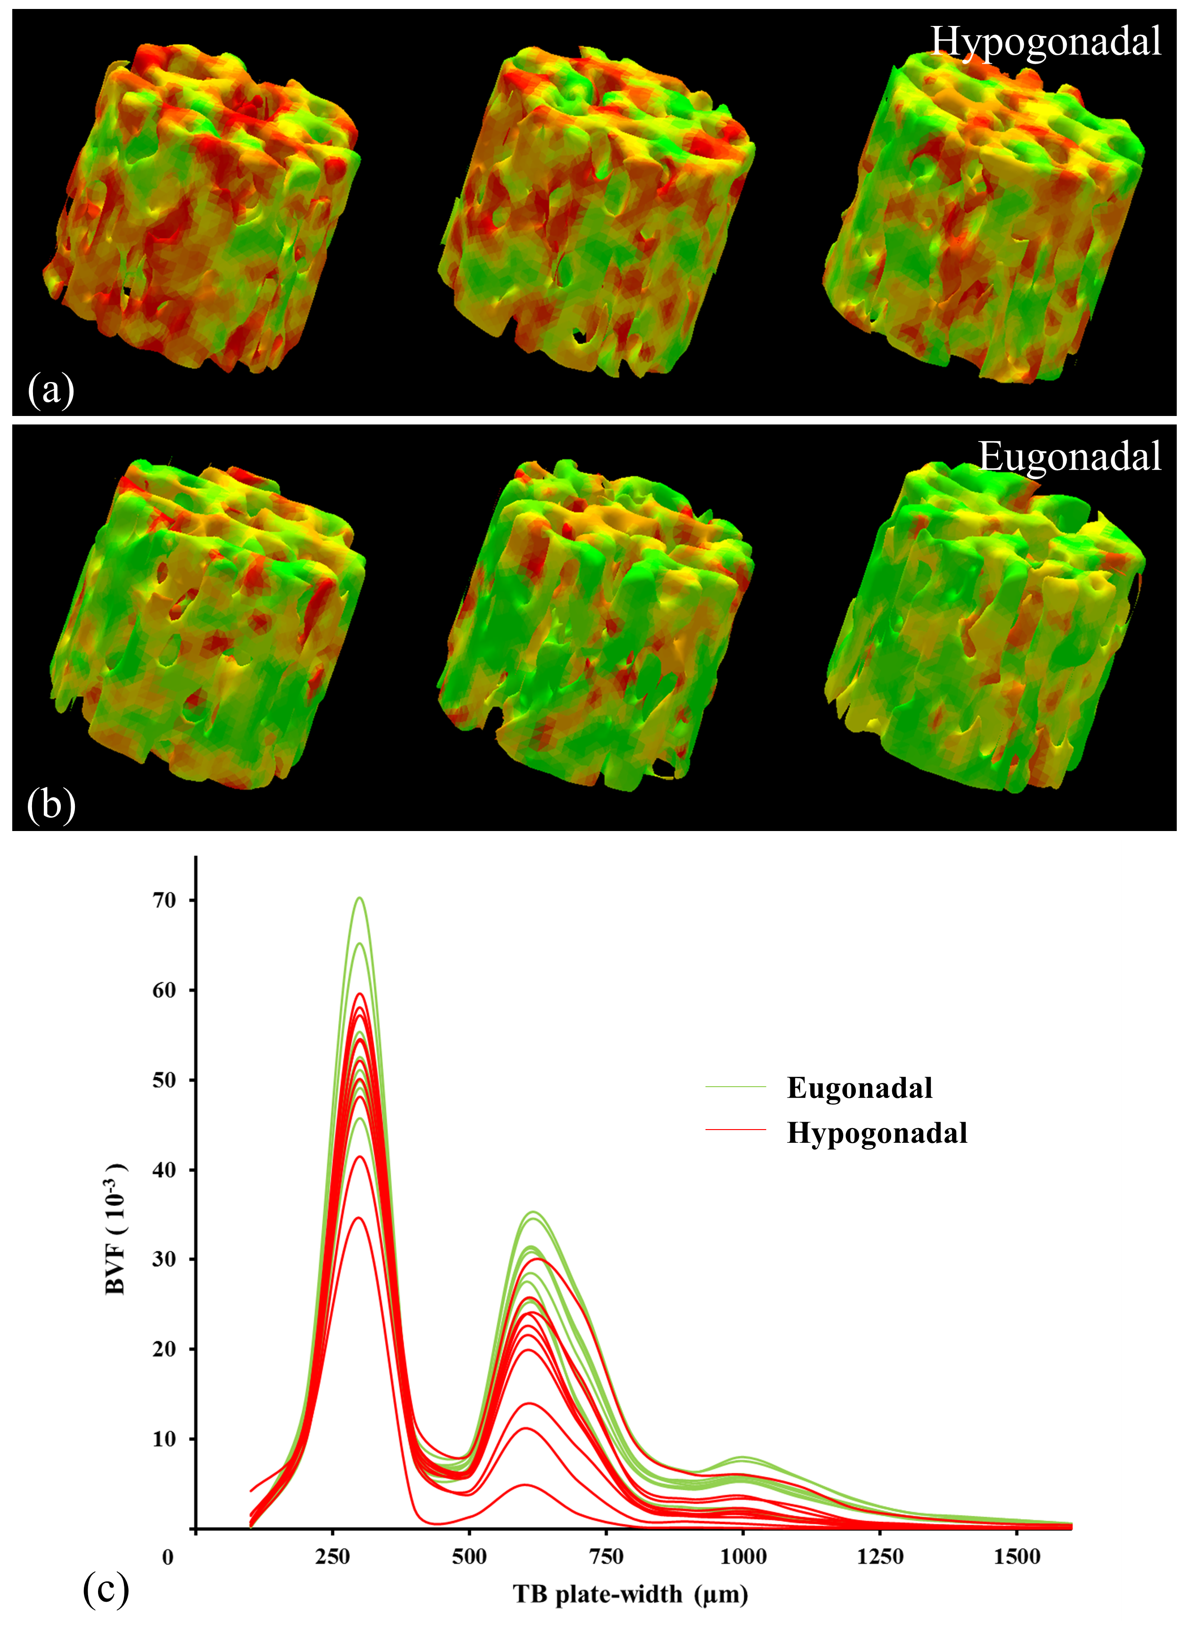
Bone Micro-Architecture among Eugonadal and Hypogonadal Men
N = 20 MRI Study
Trabecular bone plate-rod micro-architecture among hypogonadal and eugonadal men
Bone mass distribution at different plate width: a new class of information
44 % (p = 0.001) reduction in trabecular bone plate volume
No significant difference in rod volume

Slide 20
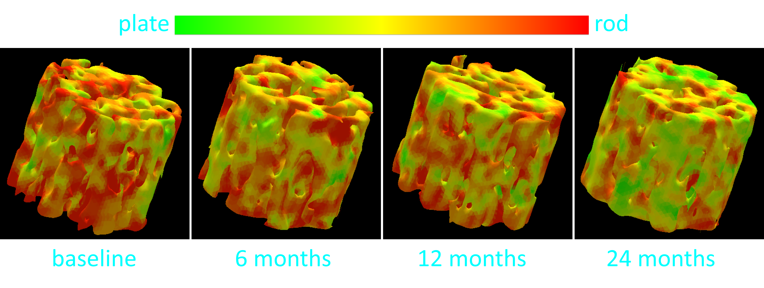
Treatment Effects Hypogonadal Men
N = 10 Two year follow-up MRI study
Treatment effects in trabecular bone plate-rod micro-architecture in hypogonadal men
6.5 % (p = 0.06) increase in trabecular bone plate volume after 6 months
16.2 % (p = 0.003) increase in trabecular bone plate volume after 24 months
No significant difference in rod volume even after 24 months of treatment

Slide 21
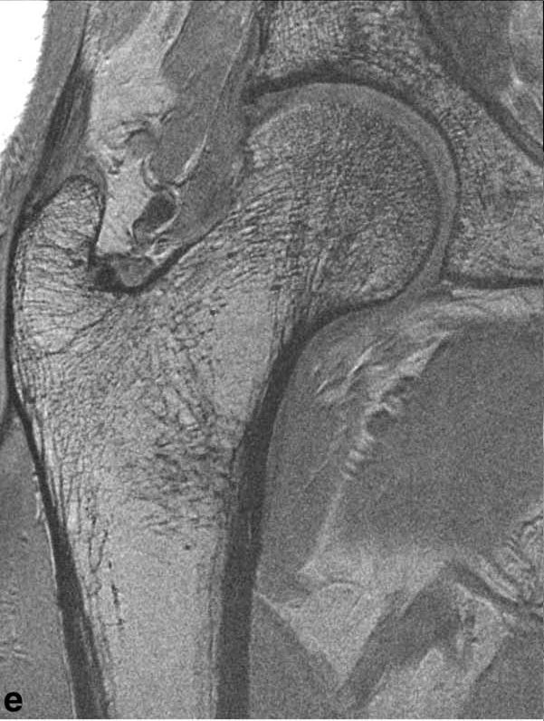
MRI of Proximal Femur Microarchitecture as a Biomarker of Bone Quality
Periosteal border = green (already drawn)
The trabecular analysis (orange and yellow lines) should capture the subregional variation in microarchitecture in the common fracture sites:
FH = femoral head
FN = femoral neck
Divided into different subregions
GT = greater trochanter
IT = intertrochanteric
D = diaphysis
Because the cortex can be very thin at the femoral head, I would err on the side of slightly overestimating the femoral head cortical thickness.
FN
FH
GT
IT
D

Slide 22
Summary
CT-based Virtual Bone Biopsy (VBB) is a new method that provides detailed quantitative information on cortical and trabecular bone architecture noninvasively.
Applicable to various anatomic sites, including load-bearing sites.
VBB structural parameters are highly reproducible and are strongly associated with bone strength.
Method provides a sensitive tool to assess effects of diseases and therapeutic intervention.
Technology is more demanding than bone densitometry.
Method has potential to supplant Dual Energy X-ray Absorptiometry (DAX) based bone densitometry.
Notes:
Read or paraphrase from slide.

