Slide 1
Turbulence Modeling in Computational Fluid Dynamics (CFD)
Maysam Mousaviraad, Jun Shao, Shanti Bhushan, Tao Xing and Fred Stern
IIHR—Hydroscience & Engineering
C. Maxwell Stanley Hydraulics Laboratory
The University of Iowa
58:160 Intermediate Mechanics of Fluids
http://css.engineering.uiowa.edu/~me_160/
Oct. 9, 2015

Slide 2
Outline
Characteristics of turbulence
Approaches to predicting turbulent flows
Reynolds averaging
RANS equations and unknowns
The Reynolds-Stress Equations
The closure problem of turbulence
Characteristics of wall-bound turbulent flows
Turbulence models and ranges of applicability
7.1. RANS
7.2. LES/DES
7.3. DNS
Example: diffuser

Slide 3
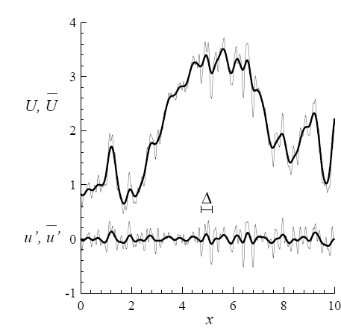
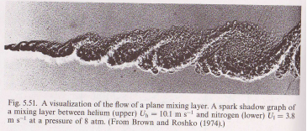
Characteristics of turbulence
Randomness and fluctuation:
Nonlinearity: Reynolds stresses from the nonlinear convective terms
Diffusion: enhanced diffusion of momentum, energy etc.
Vorticity/eddies/energy cascade: vortex stretching

Slide 4
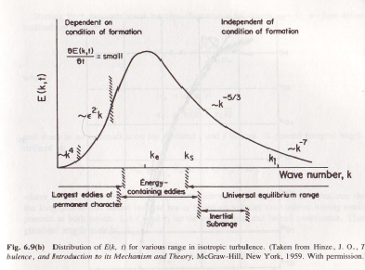
Characteristics of turbulence
Dissipation: occurs at smallest scales
Three-dimensional: fluctuations are always 3D
Coherent structures: responsible for a large part of
the mixing
A broad range of length and time scales: making
DNS very difficult

Slide 5
Approaches to predicting turbulent flows
AFD, EFD and CFD:
AFD: No analytical solutions exist
EFD: Expensive, time-consuming, and sometimes impossible (e.g. fluctuating pressure within a flow)
CFD: Promising, the need for turbulence modeling
Another classification scheme for the approaches
The use of correlations:
Integral equations: reduce PDE to ODE for simple cases
One-point closure: RANS equations + turbulent models
Two-point closure: rarely used, FFT of Two-point equations
LES: solve for large eddies while model small eddies
DNS: solve NS equations directly without any model

Slide 6
Deeper insights on RANS/URANS/LES
RANS
URANS
LES

Slide 7
Reynolds Averaging
Time averaging: for stationary turbulence
Spatial averaging: for homogenous turbulence
Ensemble averaging: for any turbulence
Phase averaging: for turbulence with periodic motion

Slide 8
RANS equations and unknowns
RANS equation
RANS equation in conservative form
Numbers of unknowns and equations
Unknowns: 10 = P (1) + U (3) + (6)
Equations: 4 = Continuity (1) + Momentum (3)

Slide 9
The Reynolds-Stress Equation
Derivation: Taking moments of the NS equation.
Multiply the NS equation by a fluctuating property and time average the product. Using this procedure, one can derive a differential equation for the Reynolds-stress tensor.
NEW Equations: 6 = 6 equation for the Reynolds stress tensor
NEW Unknowns: 22 = 6 + 6 + 10

Slide 10
The closure problem of turbulence
Because of the non-linearity of the Navier-Stokes equation, as we take higher and higher moments, we generate additional unknowns at each level.
In essence, Reynolds averaging is a brutal simplification that loses much of the information contained in the Navier-Stokes equation.
The function of turbulence modeling is to devise approximations for the unknown correlations in terms of flow properties that are known so that a sufficient number of equations exist.
In making such approximations, we close the system.

Slide 11
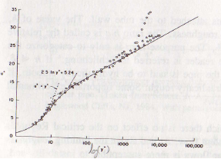
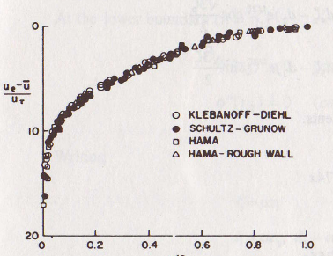
Characteristics of Wall-Bound Turbulent Flows
The turbulent boundary layer (zero-pressure gradient) has universal velocity distribution near the wall (inner-layer) (Clauser 1951)
The velocity defect when plotted vs. y/δ collapse on a single curve (outer-layer)

Slide 12
Turbulent models (RANS)
Boussinesq eddy-viscosity approximation
Algebraic (zero-equation) models
Mixing length
Cebeci-Smith Model
Baldwin-Lomax Model
One-equation models
Baldwin-Barth model
Spalart-Allmaras model
Two-equation models
k-ε model
k-ω model
Four-equation (v2f) models
Reynolds-stress (seven-equation) models

Slide 13
Turbulent models (RANS)
Boussinesq eddy-viscosity approximation
Dimensional analysis shows: , where q is a turbulence velocity scale and L is a turbulence length scale. Usually where is the turbulent kinetic energy. Models that do not provide a length scale are called incomplete.

Slide 14
Turbulent models (0-eqn RANS)
Mixing length model:
Assume for free shear flow, then
α=0.180 for far wake
α=0.071 for mixing layer
α=0.098 for plane jet
α=0.080 for round jet
Comments:
Reliable only for free shear flows with different α values
Not applicable to wall-bounded flows

Slide 15
Turbulent models (0-eqn RANS)
Cebeci-Smith Model (Two-layer model)
Where is the smallest value of for
Inner layer:
Outer layer:
Closure coefficients:
Comments:
Three key modifications to mixing length model; Applicable to wall-bounded flows; Applicable to 2D flows only; Not reliable for separated flows;
difficult to determine in some cases;

Slide 16
Turbulent models (0-eqn RANS)
Baldwin-Lomax Model (Two-layer model)
Where is the smallest value of for
Inner layer:
Outer layer:
Closure coefficients:
Comments:
Applicable to 3D flows; Not reliable for separated flows; No need to determine

Slide 17
Turbulent models (1-eqn RANS)
Baldwin-Barth model
Kinematic eddy viscosity :
Turbulence Reynolds number :
Closure coefficients and auxiliary relations:

Slide 18
Turbulent models (1-eqn RANS)
Spalart-Allmaras model
Kinematic eddy viscosity :
Eddy viscosity equation:
Closure coefficients and auxiliary relations:

Slide 19
Turbulent models (1-eqn RANS)
Comments on one-equation models: 1.One-equation models based on turbulence kinetic energy are incomplete as they relate the turbulence length scales to some typical flow dimension. They are rarely used. 2.One-equation models based on an equation for the eddy viscosity are complete such as Baldwin-Barth model and Spalart-Allmaras model.
3.They circumvent the need to specify a dissipation length by expressing the decay, or dissipation, of the eddy viscosity in terms of spatial gradients.
4 Spalart-Allmaras model can predicts better results than Baldwin-Barth model, and much better results for separated flow than Baldwin-Barth model and algebraic models. 5 Also most of DES simulations are based on the Spalart-Allmaras model.

Slide 20
Turbulent models (2-eqn RANS)
k-ε model:
,
,
k-ω model:
,
,

Slide 21
Turbulent models (2-eqn RANS)
Comments on two-equation models: 1. Two-equation models are complete; 2. k-ε and k-ω models are the most widely used two-equation models and a lot of versions exist. For example, a popular variant of k-ω model introduced by Menter has been used in our research code CFDSHIP-IOWA. There are also a lot of low-Reynolds-number versions with different damping functions.
3. k-ω model shows better results than k-ε model for flows with adverse pressure gradient and separated flows as well as better numerical stability.
,

Slide 22
Turbulent models (4-eqn RANS)
v2f-kε model:
,
,
,
v2f-kω model:
,

Slide 23
Turbulent models (4-eqn RANS)
Comments on four-equation models: 1. For two-equation models a major problem is that it is hard to specify the proper conditions to be applied near walls.
2. Durbin suggested that the problem is that the Reynolds number is low near a wall and that the impermeability condition (zero normal velocity) is far more important. That is the motivation for the equation for the normal velocity fluctuation.
3. It was found that the model also required a damping function f, hence the name v2f model.
4. They appear to give improved results at essentially the same cost as the k-ε and k-ω models especially for separated flows. Hopefully the v2f-kω model can have better numerical stability than v2f-kε model as their counterparts behave in two-equation models.
,

Slide 24
Turbulent models (7-eqn RANS)
Some of the most noteworthy types of applications for which models based on the Boussinesq approximation fail are:
1. Flows with sudden changes in mean strain rate
2. Flow over curved surfaces
3. Flow in ducts with secondary motions
4. Flow in rotating fluids
5. Three-dimensional flows
6. Flows with boundary-layer separation
In Reynolds-stress models, the equations for the Reynolds stress tensor are modeled and solved along with the ε-equation:

Slide 25
Turbulent models (7-eqn RANS)
These are some versions of Reynolds stress models:
1. LRR rapid pressure-strain model
2. Lumley pressure-strain model
3. SSG pressure-strain model
4. Wilcox stress- model
Comments on Reynolds stress models:
1.Reynolds stress models require the solution of seven additional PDEs and those equation are even harder to solve than the two-equation models.
2. Although Reynolds stress models have greater potential to represent turbulent flow more correctly, their success so far has been moderate.
3. There is a lot of current research in this field, and new models are often proposed. Which model is best for which kind of flow is not clear due to the fact that in many attempts to answer this question numerical errors were too large to allow clear conclusions to be reached.

Slide 26
Turbulent models (LES)
Large scale motions are generally much more energetic than the small scale ones.
The size and strength of large scale motions make them to be the most effective transporters of the conserved properties.
LES treats the large eddies more exactly than the small ones may make sense
LES is 3D, time dependent and expensive but much less costly than DNS.

Slide 27
Turbulent models (LES, filtering)
LES needs a velocity field that contains only the large scale components of the total field, which is achieved by filtering the velocity field (Leonard, 1974)
G(x-ξ) is the filter kernel, is a localized function, which includes a Gaussian, a box filter (a simple local average) and a cutoff (a filter which eliminates all Fourier coefficients belonging to wavenumbers above a cutoff)
Each filter has a length scale associated with it, Δ.
Eddies of size large than Δ are large eddies while those smaller than Δ are small eddies and need to be modeled.
if
otherwise
Box or top-hat filter
Gaussian filter
Cutoff filter

Slide 28
Turbulent models (LES, Governing Equations)
Filtered Navier-Stokes equations (constant density, incompressible):
Note that:
Introducing Subgrid-scale Reynolds Stress
The filter width Δ> grid size h
The models used to approximate the SGS Reynolds stress are called subgrid-scale (SGS) or subfilter-scale models.

Slide 29
Turbulent models (LES, Smagorinsky model)
The earliest and most commonly used subgrid scale model is one proposed by Smagorinsky (1963), which is an eddy viscosity model.
As the increased transport and dissipation are due to the viscosity in laminar flow, it seems reasonable to assume that
Strain rate of the large scale or resolved field
Eddy viscosity
Model constant
Drawbacks: 1. Cs is not constant
2. Changes of Cs are required in all shear flows
3. Need to be reduced near the wall.
4. Not accurate for complex and/or higher
Reynolds number flows.

Slide 30
Turbulent models (LES, Scale-similarity model and Dynamic model)
Dynamic model:
1. filtered LES solutions can be filtered again using a filter broader than the previous filter to obtain a very large scale field.
2. An effective subgrid-scale field can be obtained by subtraction of the two fields.
3. model parameter can then be computed.
Advantages: 1. model parameter computed at every spatial grid point and every time step from the results of LES
2. Self-consistent subgrid-scale model
3. Automatically change the parameter near the wall and in shear flows
Disadvantages: backscatter (eddy viscosity<0) may cause instability.

Slide 31
Turbulent models (DES)
Massively separated flows at high Re usually involve
both large and small scale vortical structures and very
thin turbulent boundary layer near the wall
RANS approaches are efficient inside the boundary
layer but predict very excessive diffusion in the separated
regions
LES is accurate in the separated regions but is unaffordable
for resolving thin near-wall turbulent boundary layers at
industrial Reynolds numbers
Motivation for DES: combination of LES and RANS. RANS
inside attached boundary layer and LES in the separated
regions

Slide 32
DES Formulation
Modification to RANS models was straightforward by substituting the length scale , which is the distance to the closest wall, with the new DES length scale, defined as:
where is the DES constant, is the grid spacing and is based on the largest dimensions of the local grid cell, and are the grid spacing in x, y and z coordinates respectively
Applying the above modification will result in S-A Based, standard k-ε (or k-ω) based and Menter’s SST based DES models, etc.

Slide 33
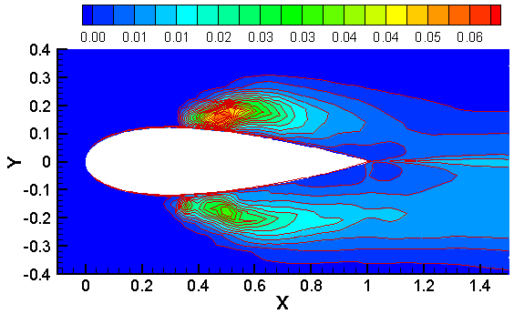
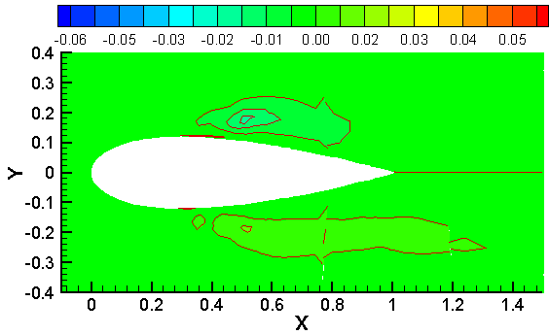
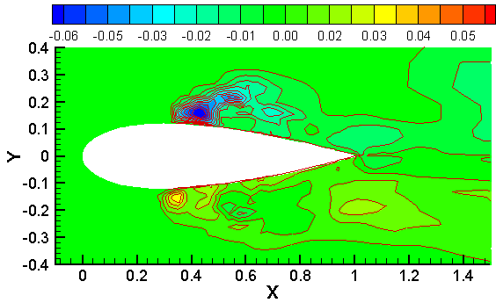
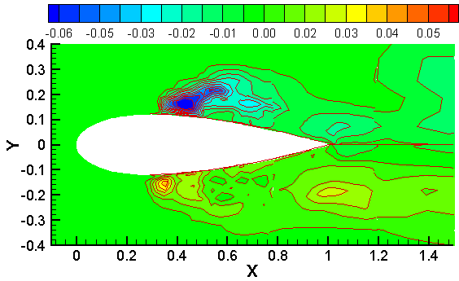
Resolved/Modeled/Total Reynolds stress (DES)
TKE
Modeled
Resolved
Total
Modeled Reynolds stress:

Slide 34
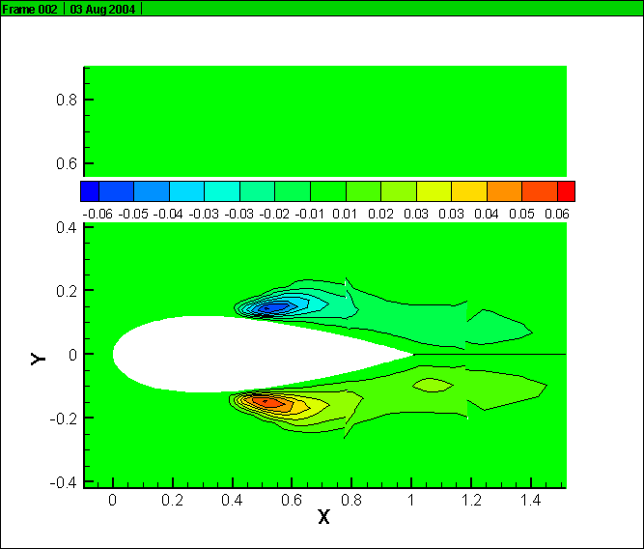
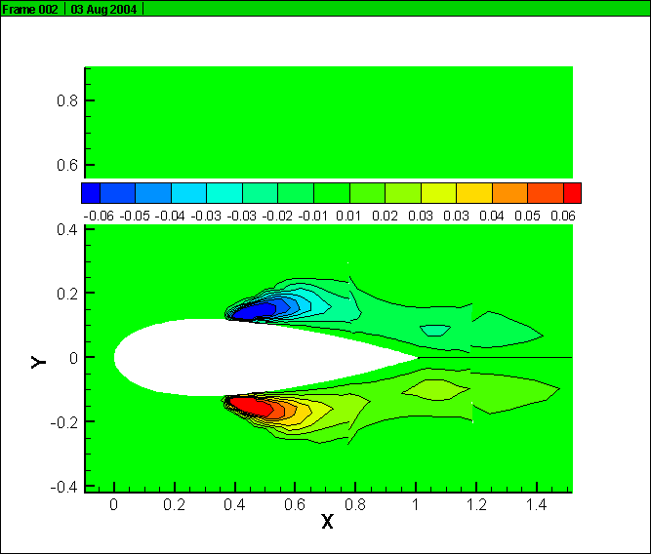
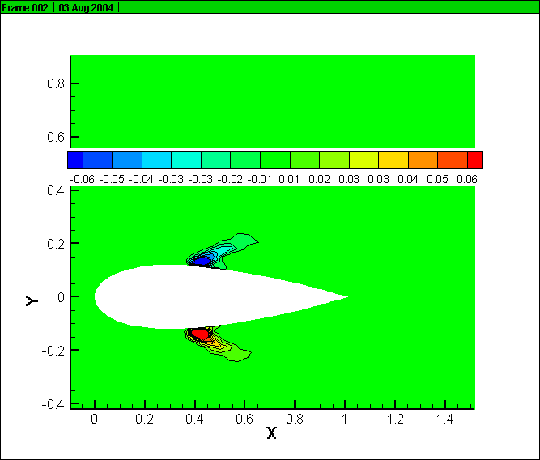
Resolved/Modeled/Total Reynolds stress (URANS)
Modeled
Total
Resolved

Slide 35
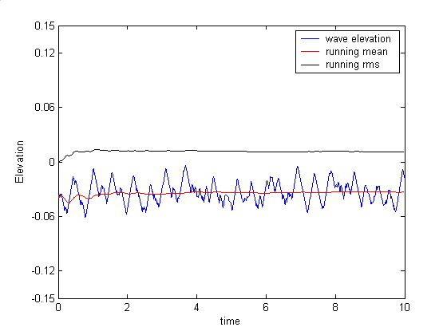
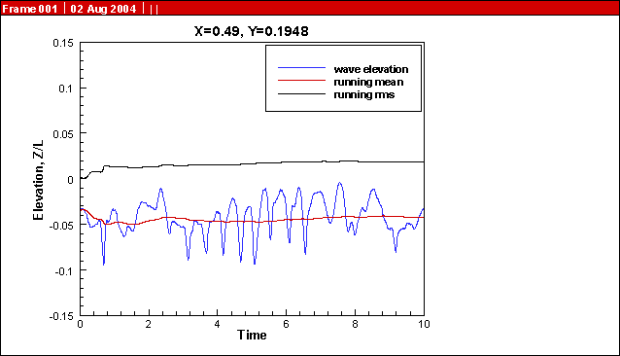
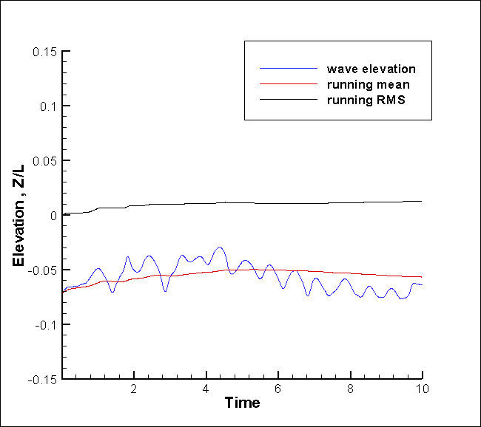
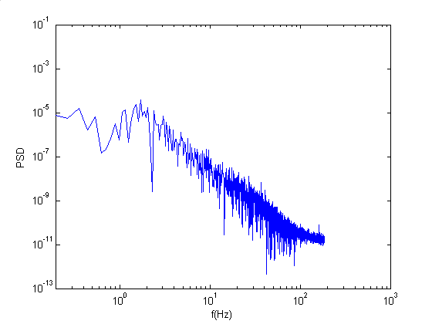
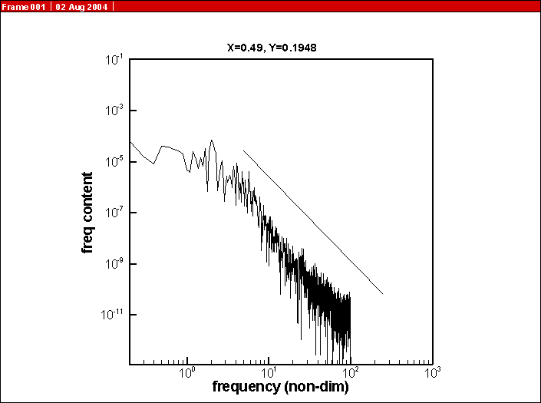
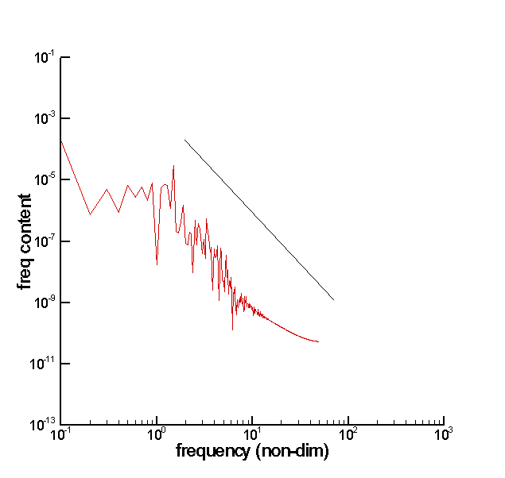
Deep insight into RANS/DES (Point oscillation on free surface with power spectral analysis)
EFD
DES
URANS
-5/3
2HZ

Slide 36
Direct Numerical Simulation (DNS)
DNS is to solve the Navier-Stokes equation directly without averaging or approximation other than numerical discretizations whose errors can be estimated (V&V) and controlled.
The domain of DNS must be at least as large as the physical domain or the largest turbulent eddy (scale L)
The size of the grid must be no larger than a viscously determined scale, Kolmogoroff scale, η
The number of grid points in each direction must be at least L/ η
The computational cost is proportional to
Provide detailed information on flow field
Due to the computational cost, DNS is more likely to be a research tool, not a design tool.

Slide 37
Examples (Diffuser)
Asymmetric diffuser with separation is a good test case for turbulence models.
A inlet channel was added at the diffuser inlet to generate fully developed velocity profile
Boundary layer in the lower diffuser wall will separate due to the adverse pressure gradient.
Results shown next include comparisons between V2f and k-ε
LES simulation of this geometry can be found in:
M. Fatica, H. J. Kaltenbach, and R. Mittal, “Validation of LES in a Plain Asymmetric Diffuser”, center for turbulence research, annual research briefs, 1997

Slide 38
Examples (Diffuser)
Mean velocity predicted by V2f agreed very well with EFD data, particular the separation region is captured.
K-ε model fails to predict the separation caused by adverse pressure gradient.

Slide 39
Examples (Diffuser)
v2f
k-ε
TKE predicted by V2f agreed better with EFD data than k- ε model, particular the asymmetric distribution.
Right column is for the skin friction coefficient on the lower wall, from which the separation and reattachment point can be found.
2x/H

Slide 40
References
J. H. Ferziger, M. Peric, “Computational Methods for Fluid
Dynamics,” 3rd edition, Springer, 2002.
D. C. Wilcox, “Turbulence Modeling for CFD”, 1998.
S.B.Pope, “Turbulent Flows,” Cambridge, 2000
P. A. Durbin and B. A. Pettersson Reif, “Statistical Theory and
Modeling for Turbulent Flows,” John Wiley & Sons, LTD, 2001.
P.A. Davidson, “Turbulence: An Introduction for Scientists
and Engineers,” Oxford, 2004.

