Slide 1
Introduction to Computational Fluid Dynamics (CFD)
Zhaoyuan Wang, Maysam Mousaviraad, Shanti Bhushan, Tao Xing, Timur K. Dogan, and Fred Stern
IIHR—Hydroscience & Engineering
C. Maxwell Stanley Hydraulics Laboratory
The University of Iowa
ME:5160 Intermediate Mechanics of Fluids
http://css.engineering.uiowa.edu/~me_160/
Sep. 03, 2019

Slide 2
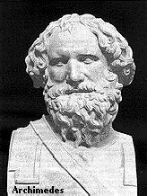
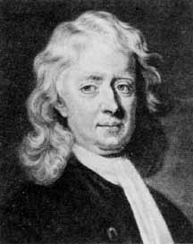
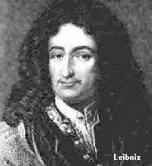
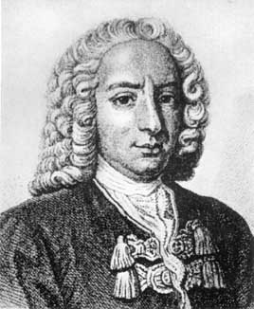
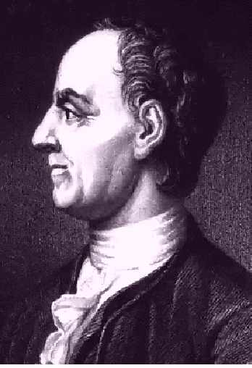
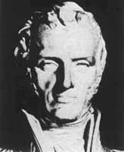
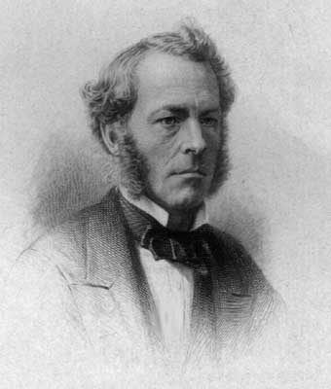
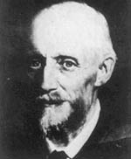
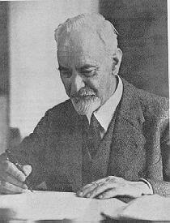

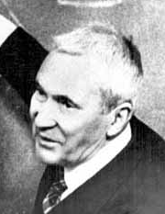
Faces of Fluid Mechanics
Archimedes
(C. 287-212 BC)
Newton
(1642-1727)
Leibniz
(1646-1716)
Bernoulli
(1667-1748)
Euler
(1707-1783)
Navier
(1785-1836)
Stokes
(1819-1903)
Reynolds
(1842-1912)
Prandtl
(1875-1953)
Taylor
(1886-1975)
Kolmogorov
(1903-1987)

Slide 3
Outline
1. What, why and where of CFD?
2. Modeling
3. Numerical methods
4. Types of CFD codes
5. ANSYS CFD Interface
6. CFD Process
7. Example of CFD Process
8. ME:5160 CFD Labs

Slide 4
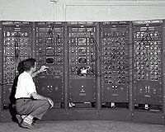

What is CFD?
CFD is the simulation of fluids engineering systems using modeling (mathematical physical problem formulation) and numerical methods (discretization methods, solvers, numerical parameters, and grid generations, etc.)
Historically only Analytical Fluid Dynamics (AFD) and Experimental Fluid Dynamics (EFD).
CFD made possible by the advent of digital computer and advancing with improvements of computer resources
(500 flops, 1947→20 teraflops, 2003 →1.3 pentaflops, 2009 →200 petaflops, Oak Ridge National Laboratory,2019)
Summit, Peak Compute: 200,795 TFlop/s,
TOP500: 1st, June 2019

Slide 5
Why use CFD?
Analysis and Design
    1. Simulation-based design instead of “build & test”
      More cost effective and more rapid than EFD
      CFD provides high-fidelity database for diagnosing flow field
      Provides guidance for planning experiments
    2. Simulation of physical fluid phenomena that are difficult for experiments
      Full scale simulations (e.g., ships and airplanes)
      Environmental effects (wind, weather, etc.)
      Hazards (e.g., explosions, radiation, pollution)
      Physics (e.g., planetary boundary layer, stellar evolution)
Knowledge and exploration of flow physics

Slide 6
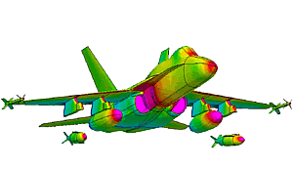
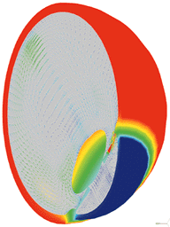
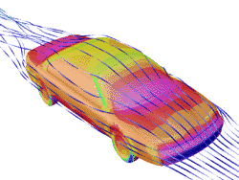
Where is CFD used?
Where is CFD used?
  Aerospace
  Automotive
  Biomedical
  Chemical Processing
  HVAC
  Hydraulics
  Marine
  Oil & Gas
  Power Generation
  Sports
Aerospace
Biomedical
F18 Store Separation
Automotive
Temperature and natural convection currents in the eye following laser heating.

Slide 7
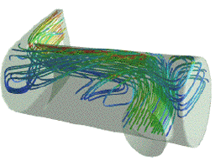
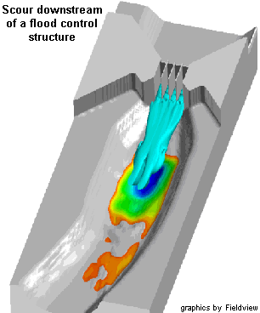
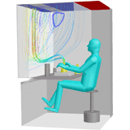
Where is CFD used?
Chemical Processing
Where is CFD used?
  Aerospacee
  Automotive
  Biomedical
  Chemical Processing
  HVAC
  Hydraulics
  Marine
  Oil & Gas
  Power Generation
  Sports
Polymerization reactor vessel - prediction of flow separation and residence time effects.
Hydraulics
HVAC
Streamlines for workstation ventilation

Slide 8
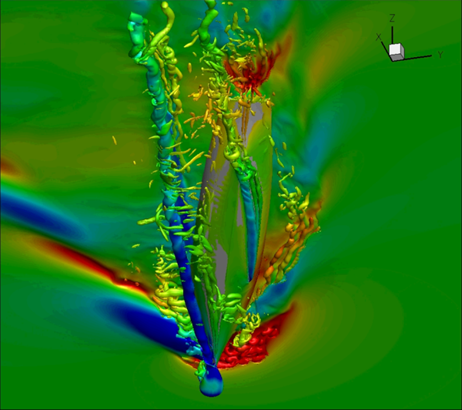
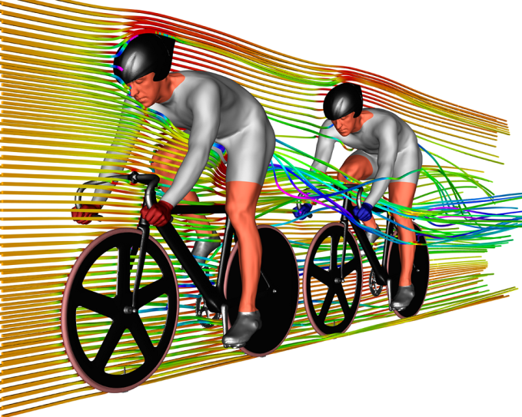
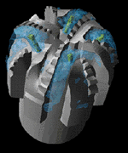
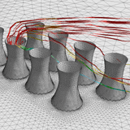
Where is CFD used?
Marine
Sports
Where is CFD used?
  Aerospace
  Automotive
  Biomedical
  Chemical Processing
  HVAC
  Hydraulics
  Marine
  Oil & Gas
  Power Generation
  Sports
http://gallery.ensight.com/keyword/sport/1/701168838_KVnHn#!i=701168838&k=KVnHn
Oil & Gas
Power Generation
Flow of lubricating mud over drill bit
Flow around cooling towers

Slide 9
Modeling
Modeling is the mathematical physics problem formulation in terms of a continuous initial boundary value problem (IBVP)
IBVP is in the form of Partial Differential Equations (PDEs) with appropriate boundary conditions and initial conditions.
Modeling includes:
1. Geometry and domain
2. Coordinates
3. Governing equations
4. Flow conditions
5. Initial and boundary conditions
6. Selection of models for different applications

Slide 10
Modeling (geometry and domain)
Simple geometries can be easily created by few geometric parameters (e.g. circular pipe)
Complex geometries must be created by the partial differential equations or importing the database of the geometry(e.g. airfoil) into commercial software
Domain: size and shape
Typical approaches
  Geometry approximation
  CAD/CAE integration: use of industry standards such as Parasolid, ACIS, STEP, or IGES, etc.
  The three coordinates: Cartesian system (x,y,z), cylindrical system (r, θ, z), and spherical system(r, θ, Φ) should be appropriately chosen for a better resolution of the geometry (e.g. cylindrical for circular pipe).

Slide 11
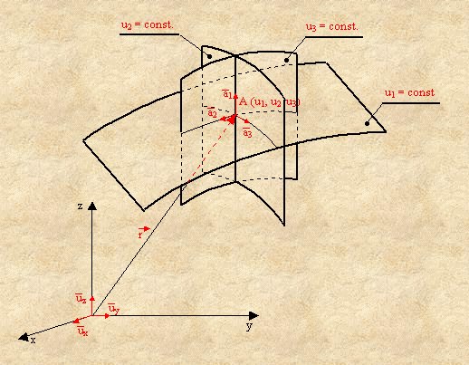
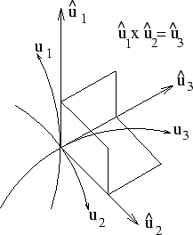
Modeling (coordinates)
z
Cartesian
z
Cylindrical
z
Spherical
(x,y,z)
(r,θ,z)
(r,θ,φ)
φ
z
y
y
y
θ
r
θ
r
x
x
x
General Curvilinear Coordinates
General orthogonal
Coordinates

Slide 12
Modeling (governing equations)
Navier-Stokes equations (3D in Cartesian coordinates)
Local
acceleration
Convection
Piezometric pressure gradient
Viscous terms
Continuity equation
Equation of state
Rayleigh Equation

Slide 13
Modeling (flow conditions)
Based on the physics of the fluids phenomena, CFD can be distinguished into different categories using different criteria
  Viscous vs. inviscid (Re: Reynolds No.)
  External flow or internal flow (wall bounded or not)
  Turbulent vs. laminar (Re)
  Incompressible vs. compressible (Ma: Mach No.)
  Single- vs. multi-phase (Ca: Cavitation No.)
  Thermal/density effects (Pr: Prandtl No., γ, Gr: Grashof No., Ec)
  Free-surface flow (Fr) and surface tension (We)
  Chemical reactions and combustion (Pe, Da)
  etc…

Slide 14
Modeling (initial conditions)
Initial conditions (ICS, steady/unsteady flows)
  ICs should not affect final results and only affect convergence path, i.e. number of iterations (steady) or time steps (unsteady) need to reach converged solutions.
  More reasonable guess can speed up the convergence
  For complicated unsteady flow problems, CFD codes are usually run in the steady mode for a few iterations for getting a better initial conditions

Slide 15
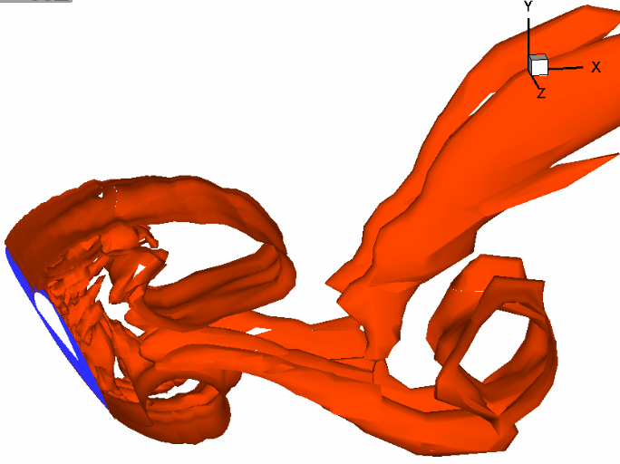
Modeling(boundary conditions)
Boundary conditions: No-slip or slip-free on walls, periodic, inlet (velocity inlet, mass flow rate, constant pressure, etc.), outlet (constant pressure, velocity convective, numerical beach, zero-gradient), and non-reflecting (for compressible flows, such as acoustics), etc.
No-slip walls: u=0,v=0
Inlet ,u=c,v=0
Outlet, p=c
r
Periodic boundary condition in spanwise direction of an airfoil
o
x
v=0, dp/dr=0,du/dr=0
Axisymmetric

Slide 16
Modeling (selection of models)
CFD codes typically designed for solving certain fluid
phenomenon by applying different models
  Viscous vs. inviscid (Re)
  Turbulent vs. laminar (Re, Turbulent models)
  Incompressible vs. compressible (Ma, equation of state)
  Single- vs. multi-phase (Ca, cavitation model, two-fluid
  model)
  Thermal/density effects and energy equation
  (Pr, γ, Gr, Ec, conservation of energy)
  Free-surface flow (Fr, level-set & surface tracking model) and
  surface tension (We, bubble dynamic model)
  Chemical reactions and combustion (Chemical reaction
  model)
  etc…

Slide 17
Modeling (Turbulence and free surface models)
Turbulent flows at high Re usually involve both large and small scale
vortical structures and very thin turbulent boundary layer (BL) near the wall
Turbulent models:
  DNS: most accurately solve NS equations, but too expensive
  for turbulent flows
  RANS: predict mean flow structures, efficient inside BL but excessive
  diffusion in the separated region.
  LES: accurate in separation region and unaffordable for resolving BL
  DES: RANS inside BL, LES in separated regions.
Free-surface models:
  Surface-tracking method: mesh moving to capture free surface,
  limited to small and medium wave slopes
  Single/two phase level-set and volume-of-fluid (VOF) methods:
  mesh fixed and level-set/VOF functions used to capture the gas/liquid
  interface, capable of studying steep or breaking waves.

Slide 18
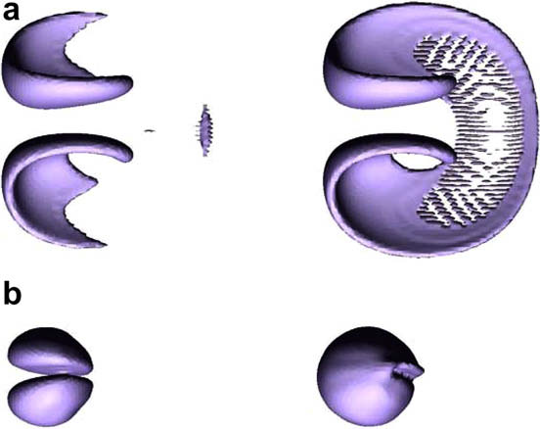
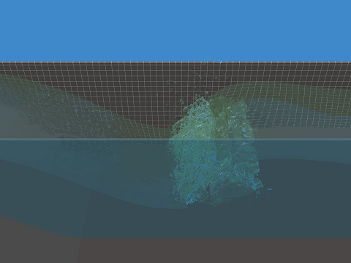
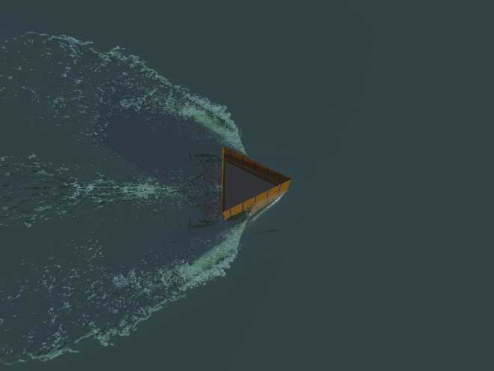
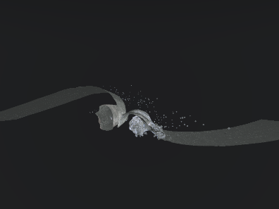
Modeling (examples)
Wave breaking in bump flow simulation: 2.2 billion grid points
Deformation of a sphere.(a)maximum stretching; (b) recovered shape. Left: LS; right: VOF.
Movie
Stokes wave breaking: 3.2-12 Billion Grid Points
Wedge flow simulation, 1 billion grid points
Movie
Movie

Slide 19
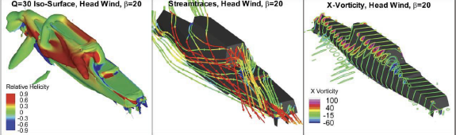
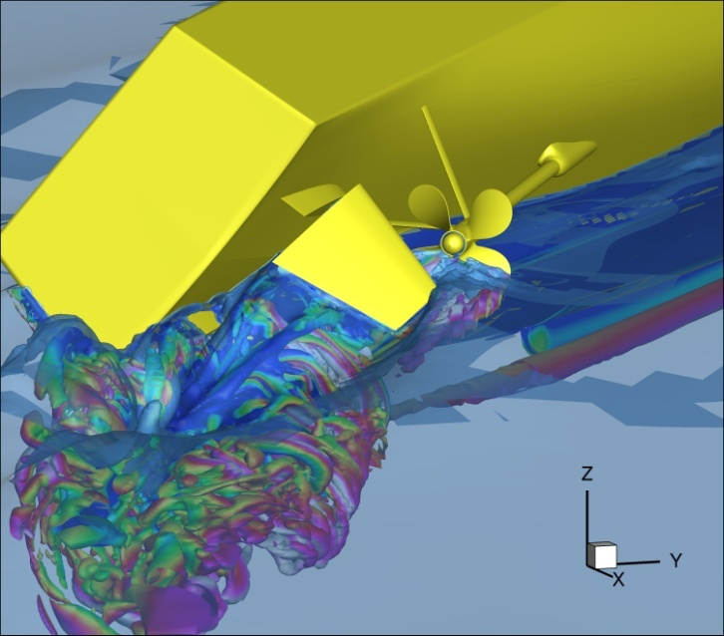
Modeling (examples, cont’d)
Simulation of Numerette Planing Hull
Movie
Air flow for ONR Tumblehome in Planar motion mechanism (PMM) maneuvers
Movie
Broaching of ONR Tumblehome with rotating propellers
Waterjet flow modeling for JHSS and Delft catamaran
Movie

Slide 20
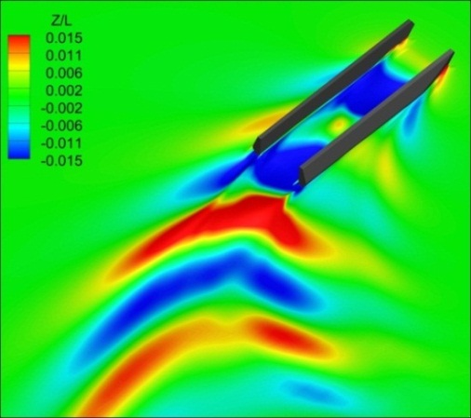
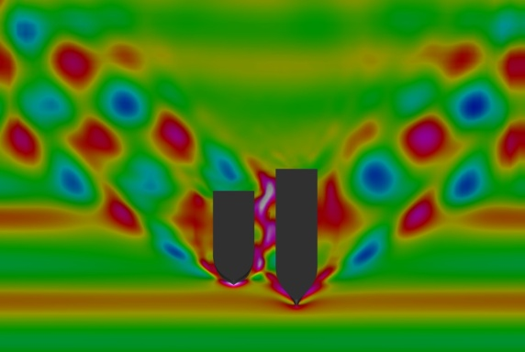
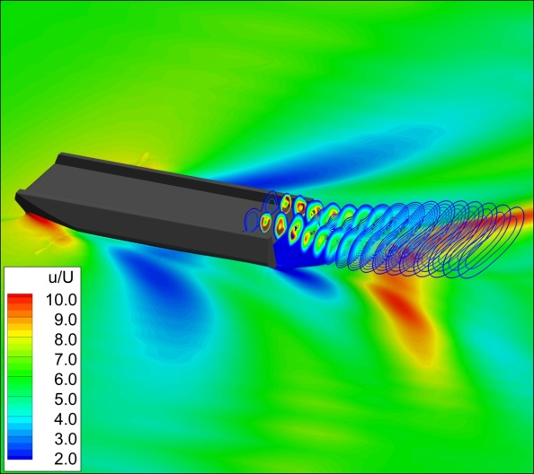
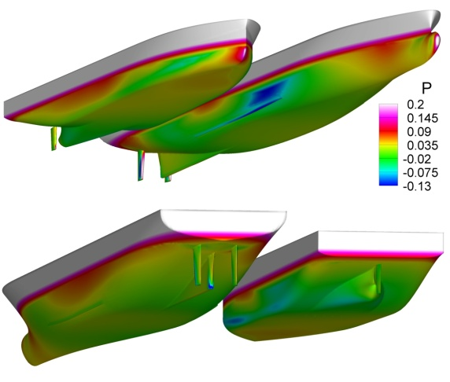
Modeling (examples, cont’d)
T-Craft (SES/ACV) turning circle in calm water with water jet propulsion (top) and straight ahead with air-fan propulsion (bottom)
Regular head wave simulation for side by side ship-ship interactions
Movie
Movie

Slide 21
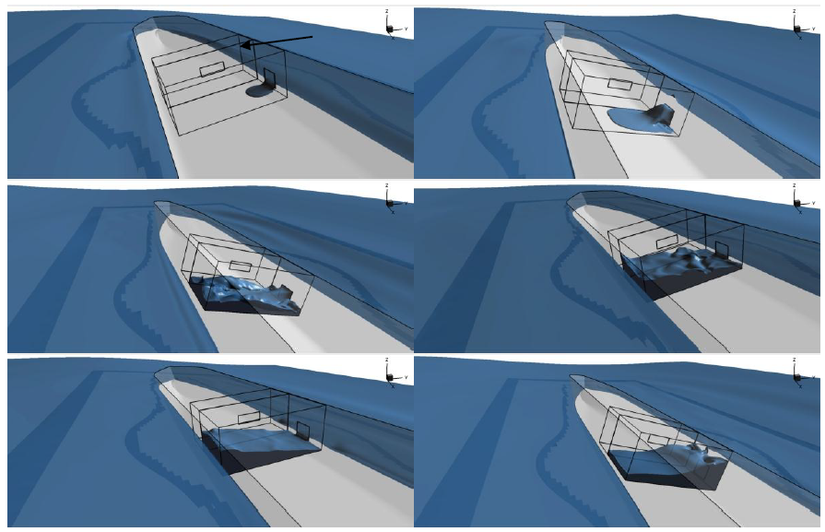
Modeling (examples, cont’d)
Movie
Ship in three-sisters rogue (freak) waves
Damaged stability for SSRC cruiser with two-room compartment in beam waves
Movie

Slide 22
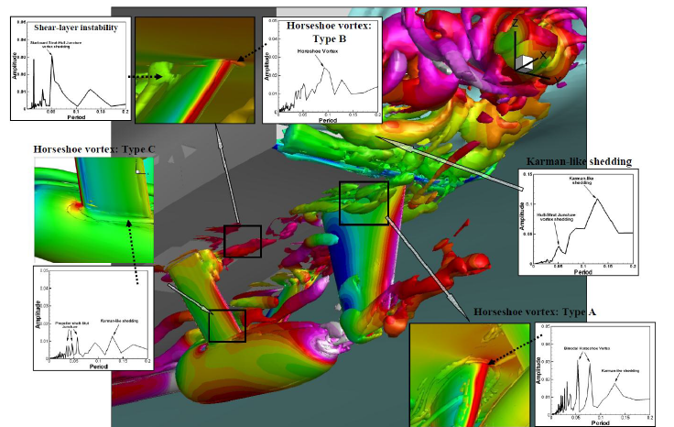
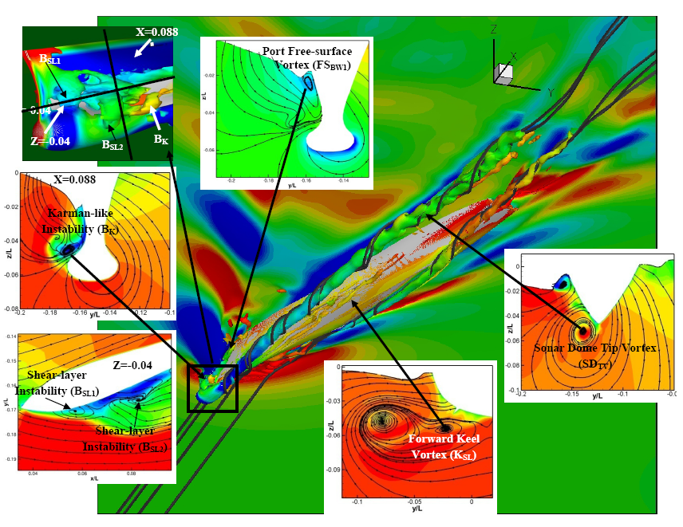
Vortical Structures and Instability Analysis
Fully appended Athena DES Computation
Re=2.9×10⁸, Fr=0.25
Isosurface of Q=300 colored using piezometric pressure
Karman-like shedding from Transom Corner
Horse-shoe vortices from hull-rudder (Case A) and
strut-hull (Case B) junction flow.
- Shear layer instability at hull-strut intersection
DTMB 5415 at β=20° DES Computation
Re=4.85×10⁶,Fr=0.28
Isosurface of Q=300 colored using piezometric pressure
The sonar dome (SD_{TV}) and bilge keel (BK_{TV})
vortices exhibits helical instability breakdown.
Shear-layer instabilities: port bow (B_{SL1}, B_{SL2}) and
fore-body keel (K_{SL}).
Karman-like instabilities on port side bow (B_{K}) .
Wave breaking vortices on port (FS_{BW1}) and starboard
(FS_{BW2}). Latter exhibits horse shoe type instability.
Movie

Slide 23
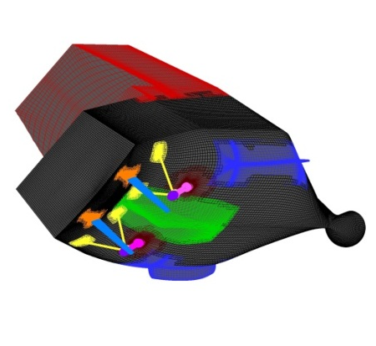
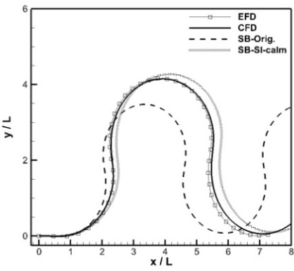
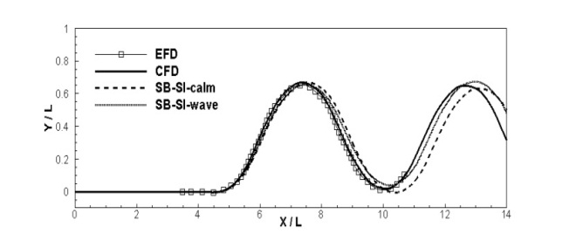
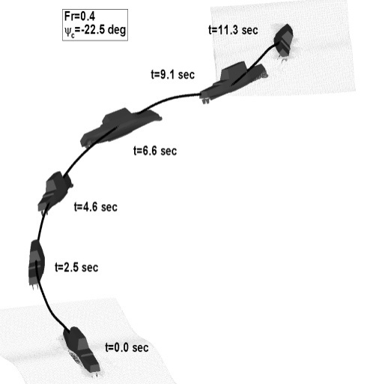
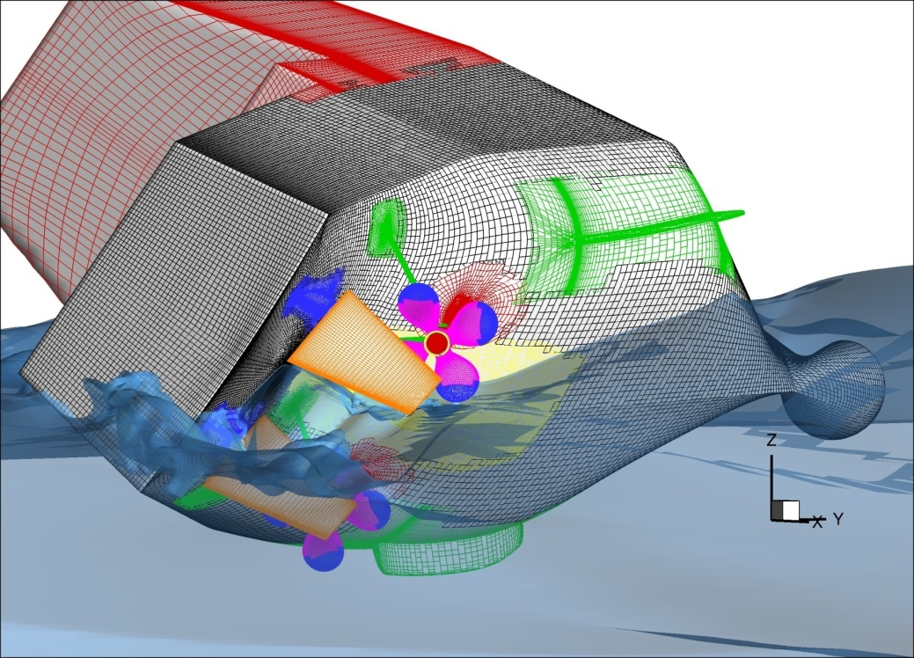
Modeling (examples, cont’d)
Movie (CFD)
Movie (EFD
at Iowa wave basin)
CFD simulations to improve system identification (SI) technique
Broaching simulation of free running ONR Tumblehome
Movie (CFD)
Movie (EFD)

Slide 24
Numerical methods
The continuous Initial Boundary Value Problems (IBVPs) are discretized into algebraic equations using numerical methods. Assemble the system of algebraic equations and solve the system to get approximate solutions
Numerical methods include:
1. Discretization methods
2. Solvers and numerical parameters
3. Grid generation and transformation
4. High Performance Computation (HPC) and post-
processing

Slide 25
Discretization methods
Finite difference methods (straightforward to apply, usually for regular grid) and finite volumes and finite element methods (usually for irregular meshes)
Each type of methods above yields the same solution if the grid is fine enough. However, some methods are more suitable to some cases than others
Finite difference methods for spatial derivatives with different order of accuracies can be derived using Taylor expansions, such as 2nd order upwind scheme, central differences schemes, etc.
Higher order numerical methods usually predict higher order of accuracy for CFD, but more likely unstable due to less numerical dissipation
Temporal derivatives can be integrated either by the explicit method (Euler, Runge-Kutta, etc.) or implicit method (e.g. Beam-Warming method)

Slide 26
Discretization methods (Cont’d)
Explicit methods can be easily applied but yield conditionally stable Finite Different Equations (FDEs), which are restricted by the time step; Implicit methods are unconditionally stable, but need efforts on efficiency.
Usually, higher-order temporal discretization is used when the spatial discretization is also of higher order.
Stability: A discretization method is said to be stable if it does not magnify the errors that appear in the course of numerical solution process.
Pre-conditioning method is used when the matrix of the linear algebraic system is ill-posed, such as multi-phase flows, flows with a broad range of Mach numbers, etc.
Selection of discretization methods should consider efficiency, accuracy and special requirements, such as shock wave tracking.

Slide 27
Discretization methods (example)
2D incompressible laminar flow boundary layer
(L,m+1)
y
m=MM+1
(L-1,m)
(L,m)
m=MM
m=1
m=0
(L,m-1)
L-1
L
x
FD Sign( )<0
2nd order central difference
i.e., theoretical order of accuracy
P_{kest}= 2.
BD Sign( )>0
1st order upwind scheme, i.e., theoretical order of accuracy P_{kest}= 1

Slide 28
Discretization methods (example)
B₂
B₃
B₁
B₄
Solve it using
Thomas algorithm
To be stable, Matrix has to be Diagonally dominant.

Slide 29
Solvers and numerical parameters
Solvers include: tridiagonal, pentadiagonal solvers, PETSC solver, solution-adaptive solver, multi-grid solvers, etc.
Solvers can be either direct (Cramer’s rule, Gauss elimination, LU decomposition) or iterative (Jacobi method, Gauss-Seidel method, SOR method)
Numerical parameters need to be specified to control the calculation.
  Under relaxation factor, convergence limit, etc.
  Different numerical schemes
  Monitor residuals (change of results between iterations)
  Number of iterations for steady flow or number of time steps for unsteady flow
  Single/double precisions

Slide 30
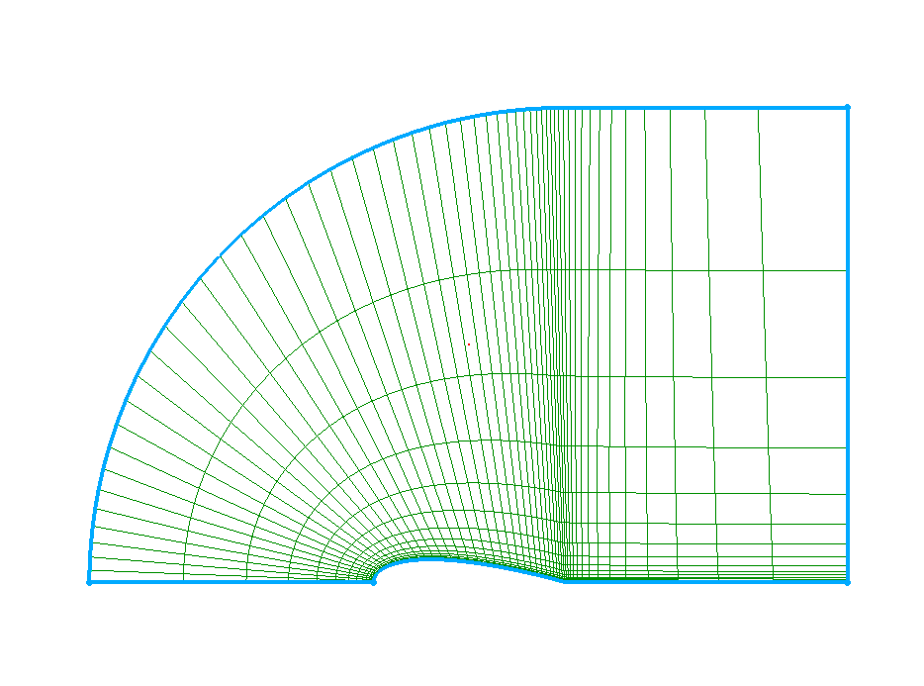
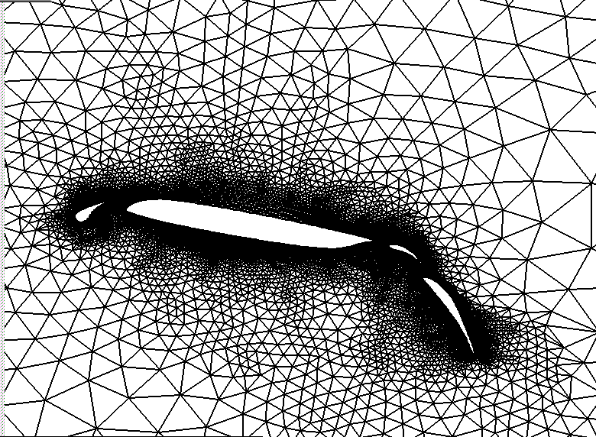
Numerical methods (grid generation)
Grids can either be structured (hexahedral) or unstructured (tetrahedral). Depends upon type of discretization scheme and application
  Scheme
    Finite differences: structured
    Finite volume or finite element: structured or unstructured
  Application
    Thin boundary layers best resolved with highly-stretched structured grids
    Unstructured grids useful for complex geometries
    Unstructured grids permit automatic adaptive refinement based on the pressure gradient, or regions interested (FLUENT)
structured
unstructured

Slide 31
Numerical methods (grid transformation)
y
Transform
o
x
o
Physical domain
Computational domain
Transformation between physical (x,y,z) and computational (ξ,η,ζ) domains, important for body-fitted grids. The partial derivatives at these two domains have the relationship (2D as an example)

Slide 32
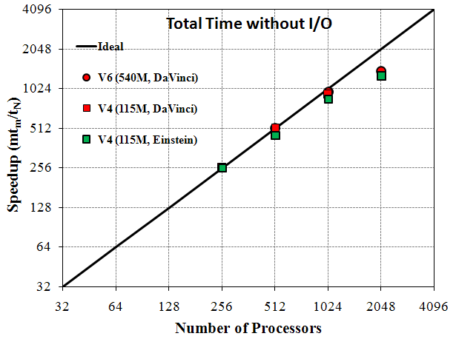
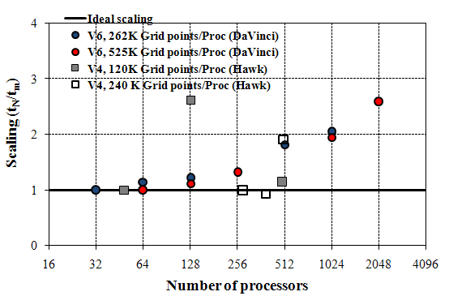
High performance computing
CFD computations (e.g. 3D unsteady flows) are usually very expensive which requires parallel high performance supercomputers with the use of multi-block technique.
As required by the multi-block technique, CFD codes need to be developed using the Massage Passing Interface (MPI) Standard to transfer data between different blocks.
Emphasis on improving:
  Strong scalability, main bottleneck pressure Poisson solver for incompressible flow.
  Weak scalability, limited by the memory requirements.
Figure: Strong scalability of total times without I/O for CFDShip-Iowa V6 and V4 on NAVO Cray XT5 (Einstein) and IBM P6 (DaVinci) are compared with ideal scaling.
Figure: Weak scalability of total times without I/O for CFDShip-Iowa V6 and V4 on IBM P6 (DaVinci) and SGI Altix (Hawk) are compared with ideal scaling.

Slide 33
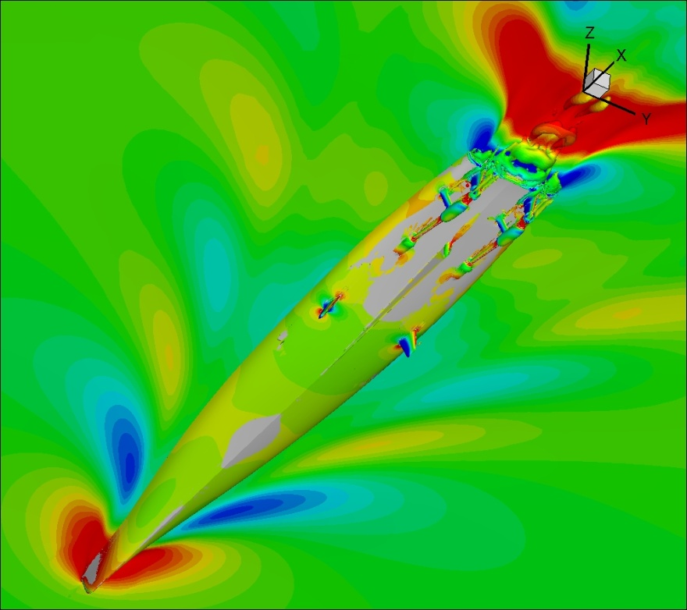
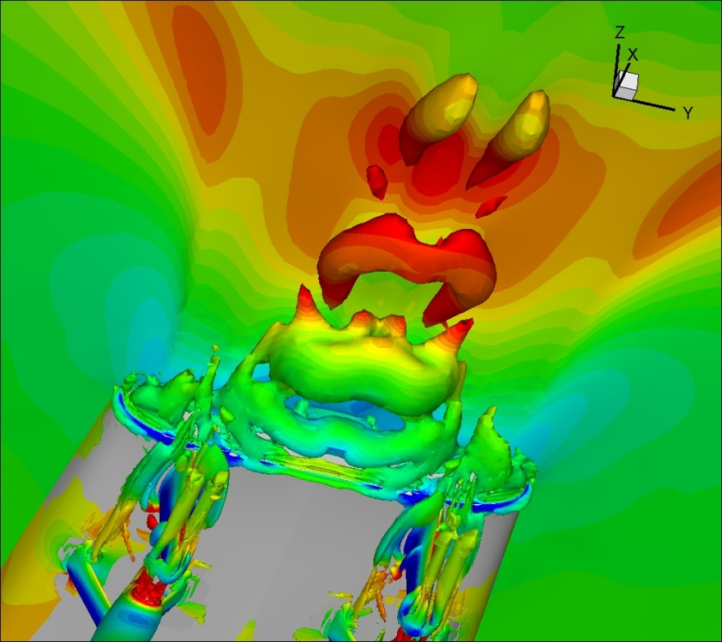
Post-Processing
Post-processing: 1. Visualize the CFD results (contour, velocity vectors, streamlines, pathlines, streak lines, and iso-surface in 3D, etc.), and 2. CFD UA: verification and validation using EFD data (more details later)
Post-processing usually through using commercial software
Figure: Isosurface of Q=300 colored using piezometric pressure, free=surface colored using z for fully appended Athena, Fr=0.25, Re=2.9×10⁸. Tecplot360 is used for visualization.

Slide 34



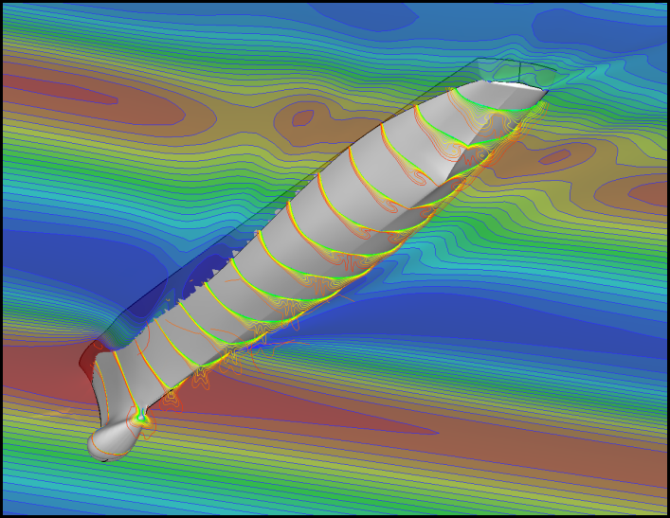


Types of CFD codes
Commercial CFD code: ANSYS FLUENT, Star-CCM+, CFDRC, CFX/AEA, etc.
Research CFD code: CFDSHIP-IOWA
Public domain software (PHI3D, HYDRO, and WinpipeD, etc.)
Other CFD software includes the Grid generation software (e.g. Pointwise (gridgen), Gambit) and flow visualization software (e.g. Tecplot, Paraview, ANSYS EnSight, FieldView)
CFDSHIPIOWA

Slide 35
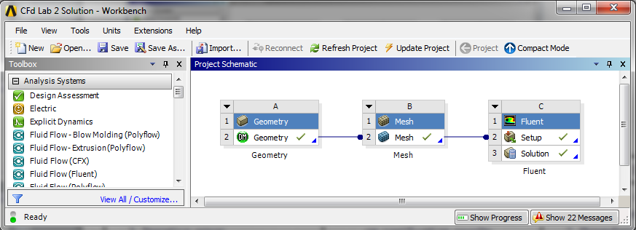


ANSYS Interface
Lab1: Pipe Flow | Lab 2: Airfoil Flow | Lab3: Diffuser | Lab4: Ahmed car
1. Definition of “CFD Process” 2. Boundary conditions 3. Iterative error 4. Grid error 5. Developing length of laminar and turbulent pipe flows. 6. Verification using AFD 7. Validation using EFD | 1. Boundary conditions 2. Effect of order of accuracy on verification results 3. Effect of grid generation topology, “C” and “O” Meshes 4. Effect of angle of attack/turbulent models on flow field 5. Verification and Validation using EFD | 1. Meshing and iterative convergence 2. Boundary layer separation 3. Axial velocity profile 4. Streamlines 5. Effect of turbulence models 6. Effect of expansion angle and comparison with LES, EFD, and RANS. | 1. Meshing and iterative convergence 2. Boundary layer separation 3. Axial velocity profile 4. Streamlines 5. Effect of slant angle and comparison with LES, EFD, and RANS.

Slide 36
CFD process
Purposes of CFD codes will be different for different applications: investigation of bubble-fluid interactions for bubbly flows, study of wave induced massively separated flows for free-surface, etc.
Depend on the specific purpose and flow conditions of the problem, different CFD codes can be chosen for different applications (aerospace, marines, combustion, multi-phase flows, etc.)
Once purposes and CFD codes chosen, “CFD process” is the steps to set up the IBVP problem and run the code:
1. Geometry
2. Physics (Setup)
3. Mesh
4. Solve
5. Results

Slide 37
CFD Process
Geometry
Physics
Mesh
Solution
Results
Geometry Parameters
(ANSYS Design Modeler)
Flow properties
(ANSYS Fluent-Setup)
Unstructured
(ANSYS Mesh)
Steady/
Unsteady
(ANSYS Fluent-Setup)
Forces Report
(ANSYS Fluent-Results)
Domain Shape and Size
(ANSYS Design Modeler)
Viscous Model
(ANSYS Fluent-Setup)
Structured
(ANSYS Mesh)
Iterations/
Steps
(ANSYS Fluent-Solution)
XY Plot
(ANSYS Fluent-Results)
Boundary Conditions
(ANSYS Fluent-Setup)
Convergent Limit
(ANSYS Fluent-Solution)
Verification & Validation
(ANSYS Fluent-Results)
Initial Conditions
(ANSYS Fluent-Solution)
Precisions
(ANSYS Fluent-Solution)
Contours, Vectors, and Streamlines
(ANSYS Fluent-Results)
Numerical Scheme
(ANSYS Fluent-Solution)
Green regions indicate ANSYS modules

Slide 38
Geometry
Selection of an appropriate coordinate
Determine the domain size and shape
Any simplifications needed?
What kinds of shapes needed to be used to best resolve the geometry? (lines, circular, ovals, etc.)
For commercial code, geometry is usually created using commercial software (either separated from the commercial code itself, like Gambit)
For research code, commercial software (e.g. pointwise) is used.

Slide 39
Physics (Setup)
Flow conditions and fluid properties
1. Flow conditions: inviscid, viscous, laminar, or
turbulent, etc.
2. Fluid properties: density, viscosity, and
thermal conductivity, etc.
  3. Flow conditions and properties usually presented in dimensional form in industrial commercial CFD software, whereas in non-dimensional variables for research codes.
Selection of models: different models usually fixed by codes, options for user to choose
Initial and Boundary Conditions: not fixed by codes, user needs specify them for different applications.

Slide 40
Mesh
Meshes should be well designed to resolve important flow features which are dependent upon flow condition parameters (e.g., Re), such as the grid refinement inside the wall boundary layer
Mesh can be generated by either commercial codes (Pointwise/Gridgen, Gambit, etc.) or research code (using algebraic vs. PDE based, conformal mapping, etc.)
The mesh, together with the boundary conditions need to be exported from commercial software in a certain format that can be recognized by the research CFD code or other commercial CFD software.

Slide 41
Solve
Setup appropriate numerical parameters
Choose appropriate Solvers
Solution procedure (e.g. incompressible flows)
Solve the momentum, pressure Poisson equations and get flow field quantities, such as velocity, turbulence intensity, pressure and integral quantities (lift, drag forces)

Slide 42
Results
Reports the saved time history of the residuals of the velocity, pressure and temperature, etc.
Report the integral quantities, such as total pressure drop, friction factor (pipe flow), lift and drag coefficients (airfoil flow), etc.
XY plots could present the centerline velocity/pressure distribution, friction factor distribution (pipe flow), pressure coefficient distribution (airfoil flow).
AFD or EFD data can be imported and put on top of the XY plots for validation

Slide 43


Results
Analysis and visualization
  Calculation of derived variables
    Vorticity
    Wall shear stress
  Calculation of integral parameters: forces, moments
  Visualization (usually with commercial software)
    Simple 2D contours
    3D contour isosurface plots
    Vector plots and streamlines (streamlines are the lines whose tangent direction is the same as the velocity vectors)
    Animations

Slide 44
Results (Uncertainty Assessment)
Simulation error: the difference between a simulation result S and the truth T (objective reality), assumed composed of additive modeling δ_{SM} and numerical δ_{SN} errors:
Error: Uncertainty:
Verification: process for assessing simulation numerical uncertainties U_{SN} and, when conditions permit, estimating the sign and magnitude Delta δ*_{SN} of the simulation numerical error itself and the uncertainties in that error estimate U_{SN}
I: Iterative, G : Grid, T: Time step, P: Input parameters
Iterative convergence requires U_{I} to be at least one order of magnitude smaller than U_{G} and U_{T}.
Validation: process for assessing simulation modeling uncertainty U_{SM} by using benchmark experimental data and, when conditions permit, estimating the sign and magnitude of the modeling error δ_{SM} itself.
D: EFD Data; U_{V}: Validation Uncertainty
Validation achieved

Slide 45



Results (UA, Verification)
Convergence studies: Convergence studies require a minimum of m=3 solutions to evaluate convergence with respective to input parameters. Consider the solutions corresponding to fine , medium ,and coarse meshes
Monotonic Convergence
(i). Monotonic convergence: 0<R_{k}<1
(ii). Oscillatory Convergence: R_{k}<0; | R_{k}|<1
(iii). Monotonic divergence: R_{k}>1
(iv). Oscillatory divergence: R_{k}<0; | R_{k}|>1
Monotonic Divergence
Oscillatory Convergence
Grid refinement ratio: uniform ratio of grid spacing between meshes.

Slide 46
Results (Verification, RE)
Generalized Richardson Extrapolation (RE): For monotonic convergence, generalized RE is used to estimate the error δ*_{k} and order of accuracy p_{k} due to the selection of the kth input parameter.
The error is expanded in a power series expansion with integer powers of Δx_{k} as a finite sum.
The accuracy of the estimates depends on how many terms are retained in the expansion, the magnitude (importance) of the higher-order terms, and the validity of the assumptions made in RE theory

Slide 47
Results (Verification, RE)
ε_{SN} is the error in the estimate
S_{C} is the numerical benchmark
Finite sum for the kth parameter and mth solution
Power series expansion
order of accuracy for the ith term
Three equations with three unknowns

Slide 48
Results (UA, Verification, cont’d)
Monotonic Convergence: Generalized Richardson Extrapolation
1. Correction
factors
is the theoretical order of accuracy, 2 for 2nd order and 1 for 1st order schemes
is the uncertainties based on fine mesh solution, is the uncertainties based on numerical benchmark S_{C}
is the correction factor
2. GCI approach
F_{S}: Factor of Safety
3. FS approach
Oscillatory Convergence: Uncertainties can be estimated, but without
signs and magnitudes of the errors.
Divergence
In this course, only grid uncertainties studied. So, all the variables with subscribe symbol k will be replaced by g, such as “U_{k}” will be “U_{g}”

Slide 49
Results (Verification, Asymptotic Range)
Asymptotic Range: For sufficiently small Δx_{k}, the solutions are in the asymptotic range such that higher-order terms are negligible and the assumption that and are independent of Δx_{k} is valid.
When Asymptotic Range reached, P_{g} will be close to the theoretical value P_{gest} , and the ratio P of accuracy of grid and theoretical accuracy, will be close to 1.
To achieve the asymptotic range for practical geometry and conditions is usually not possible and number of grids m>3 is undesirable from a resources point of view

Slide 50


Results (UA, Verification, cont’d)
Verification for velocity profile using AFD: To avoid ill-defined ratios, L2 norm of the ε_{G21} and ε_{G32} are used to define R_{G} and P_{G}
Where <> and || ||₂ are used to denote a profile-averaged quantity (with ratio of solution changes based on L2 norms) and L2 norm, respectively.
NOTE: For verification using AFD for axial velocity profile in laminar pipe flow (CFD Lab1), there is no modeling error, only grid errors. So, the difference between CFD and AFD, E, can be plot with +Ug and –Ug to see if solution was verified.

Slide 51


Results (Verification: Iterative Convergence)
Typical CFD solution techniques for obtaining steady state solutions involve beginning with an initial guess and performing time marching or iteration until a steady state solution is achieved.
The number of order magnitude drop and final level of solution residual can be used to determine stopping criteria for iterative solution techniques
(1) Oscillatory (2) Convergent (3) Mixed oscillatory/convergent
(a)
(b)
Iteration history for series 60: (a). Solution change (b) magnified view of total resistance over last two periods of oscillation (Oscillatory iterative convergence)

Slide 52

Results (UA, Validation)
Validation procedure: simulation modeling uncertainties
was presented where for successful validation, the comparison
error, E, is less than the validation uncertainty, Uv.
Interpretation of the results of a validation effort
Validation achieved
Validation not achieved
Validation example
Example: Grid study
and validation of
wave profile for
series 60

Slide 53


ANSYS Workbench
Design project schematics with ANSYS Workbench

Slide 54

ANSYS Design Modeler
Create geometry using ANSYS Design Modeler

Slide 55

ANSYS Mesh
Create mesh using ANSYS Mesh

Slide 56



ANSYS Fluent
Setup and solve problem, and analyze results using ANSYS Fluent

Slide 57
ME:5160 CFD Labs
Schedule
CFD Lab | Lab1: Pipe Flow | Lab 2: Airfoil Flow | Lab3: Diffuser | Lab4: Ahmed car
Due Date | Oct 11 | Oct. 25 | Nov. 8 | Dec. 2
CFD lectures by Zhaoyuan-Wang (zhaoyuan-wang@uiowa.edu)
You can use any computer lab in SC for accessing ANSYS software
Refer to V&V Papers (Ref1, Ref2) and instruction (V&V Instruction) on class website
Use the lab report instructions for preparing your reports
Visit class website for more information http://css.engineering.uiowa.edu/~me_160

