Slide 1
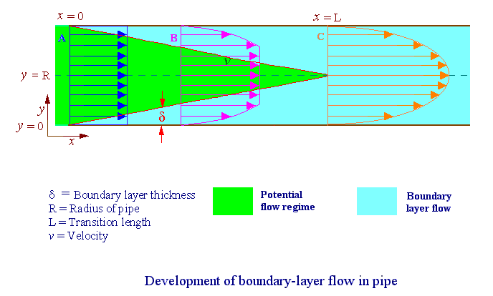
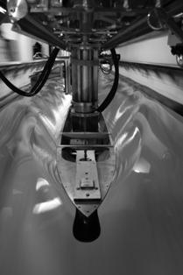
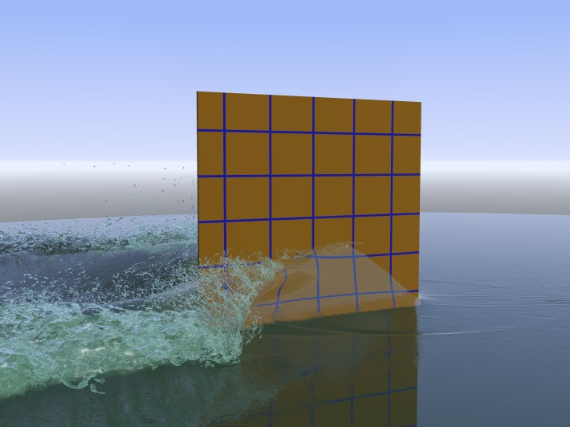
Introduction to Fluid Mechanics
Frederick Stern, Maysam Mousaviraad, Hyunse Yoon
8/27/2012
AFD
EFD
CFD
Acknowledgment: Tao Xing, Jun Shao, Surajeet Ghosh, Shanti Bhushan

Slide 2
Fluid Mechanics
Fluids essential to life
  Human body 65% water
  Earth’s surface is 2/3 water
  Atmosphere extends 17km above the earth’s surface
History shaped by fluid mechanics
  Geomorphology
  Human migration and civilization
  Modern scientific and mathematical theories and methods
  Warfare
Affects every part of our lives

Slide 3
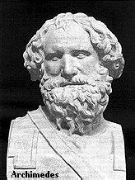
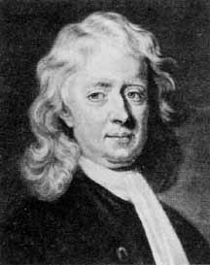
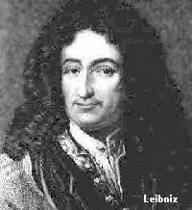
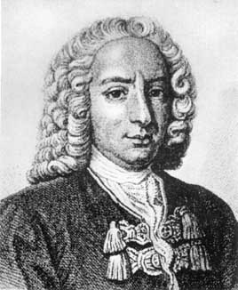
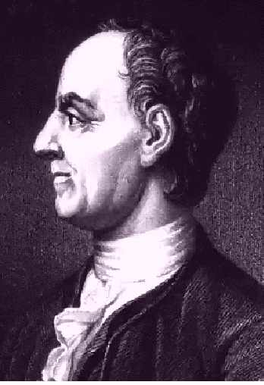
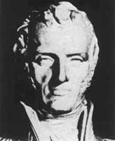
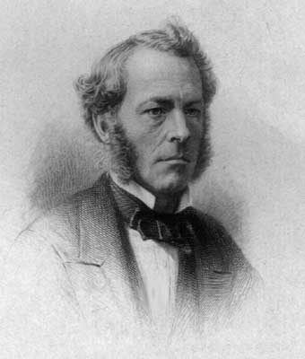
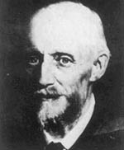
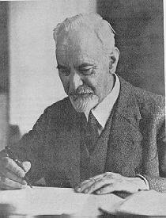

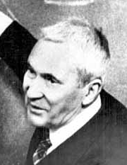
History
Faces of Fluid Mechanics
Archimedes
(C. 287-212 BC)
Newton
(1642-1727)
Leibniz
(1646-1716)
Bernoulli
(1667-1748)
Euler
(1707-1783)
Navier
(1785-1836)
Stokes
(1819-1903)
Reynolds
(1842-1912)
Prandtl
(1875-1953)
Taylor
(1886-1975)
Kolmogorov
(1903-1987)

Slide 4
Significance
Fluids omnipresent
  Weather & climate
  Vehicles: automobiles, trains, ships, and planes, etc.
  Environment
  Physiology and medicine
  Sports & recreation
  Many other examples!

Slide 5
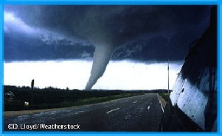
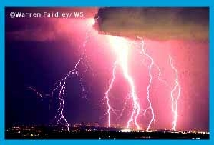
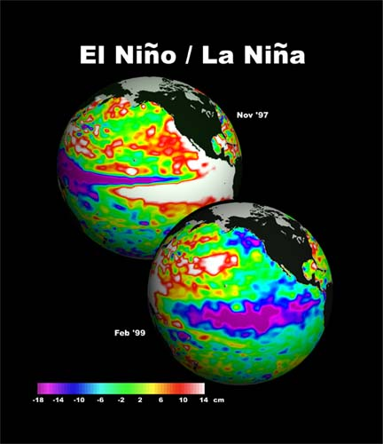
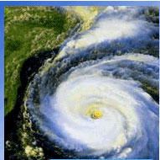
Weather & Climate
Tornadoes
Thunderstorm
Global Climate
Hurricanes

Slide 6
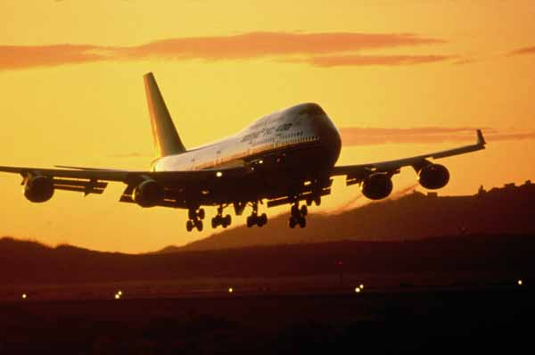
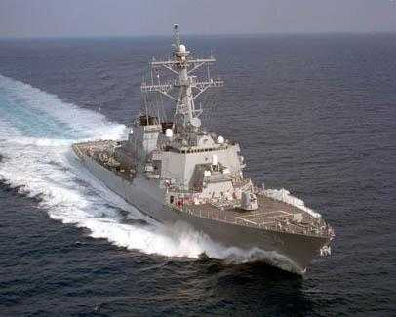
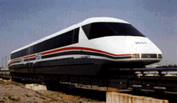
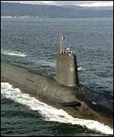
Vehicles
Aircraft
Surface ships
High-speed rail
Submarines

Slide 7
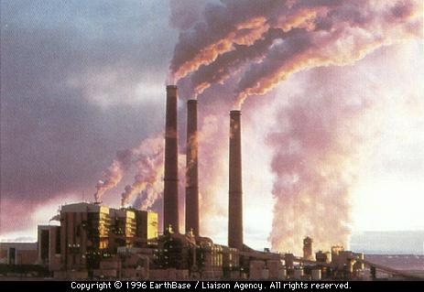
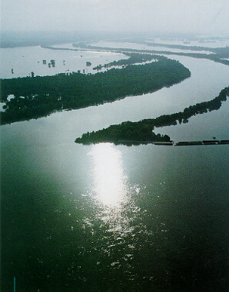
Environment
Air pollution
River hydraulics

Slide 8
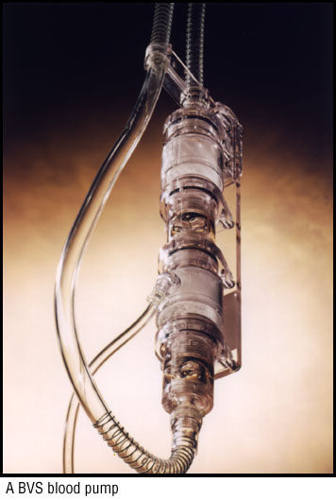
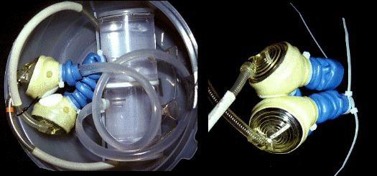
Physiology and Medicine
Blood pump
Ventricular assist device

Slide 9
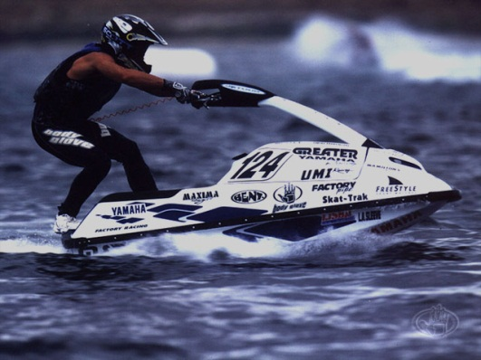
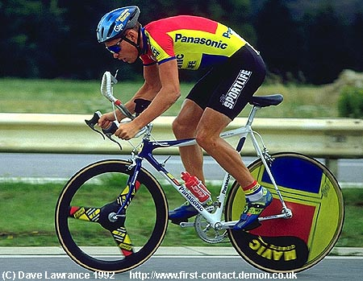
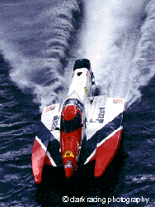
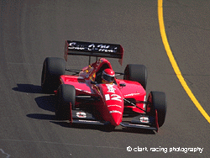
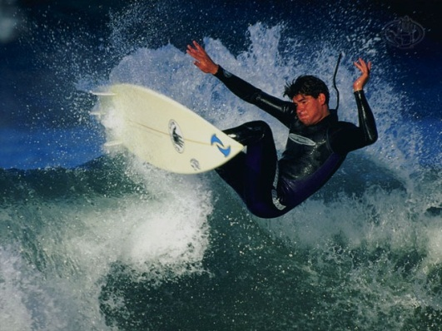
Sports & Recreation
Water sports
Cycling
Offshore racing
Auto racing
Surfing

Slide 10
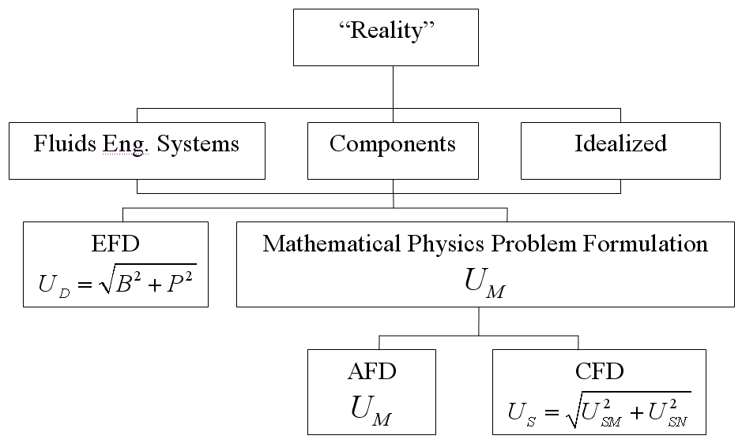
Fluids Engineering

Slide 11
Analytical Fluid Dynamics
The theory of mathematical physics problem formulation
Control volume & differential analysis
Exact solutions only exist for simple geometry and conditions
Approximate solutions for practical applications
  Linear
  Empirical relations using EFD data

Slide 12
Analytical Fluid Dynamics
Lecture Part of Fluid Class
  Definition and fluids properties
  Fluid statics
  Fluids in motion
  Continuity, momentum, and energy principles
  Dimensional analysis and similitude
  Surface resistance
  Flow in conduits
  Drag and lift

Slide 13
Analytical Fluid Dynamics
Example: laminar pipe flow
Assumptions: Fully developed, Low
Approach: Simplify momentum equation, integrate, apply boundary conditions to determine integration constants and use energy equation to calculate head loss
Schematic
0
0
0
Exact solution :
Friction factor:
Head loss:

Slide 14
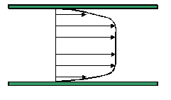
Analytical Fluid Dynamics
Example: turbulent flow in smooth pipe( )
Three layer concept (using dimensional analysis)
Laminar sub-layer (viscous shear dominates)
Overlap layer (viscous and turbulent shear important)
3. Outer layer (turbulent shear dominates)
(κ=0.41, B=5.5)
Assume log-law is valid across entire pipe:
Integration for average velocity and using EFD data to adjust constants:

Slide 15
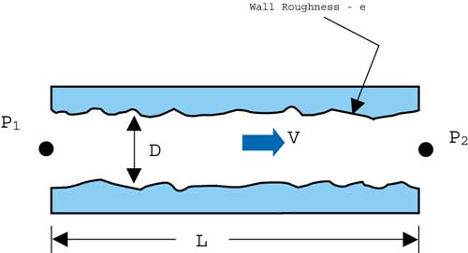
Analytical Fluid Dynamics
Example: turbulent flow in rough pipe
Both laminar sublayer and overlap layer
are affected by roughness
Inner layer:
Outer layer: unaffected
Overlap layer:
constant
Three regimes of flow depending on k⁺
K⁺<5, hydraulically smooth (no effect of roughness)
5 < K⁺< 70, transitional roughness (Re dependent)
K⁺> 70, fully rough (independent Re)
For 3, using EFD data to adjust constants:
Friction factor:

Slide 16
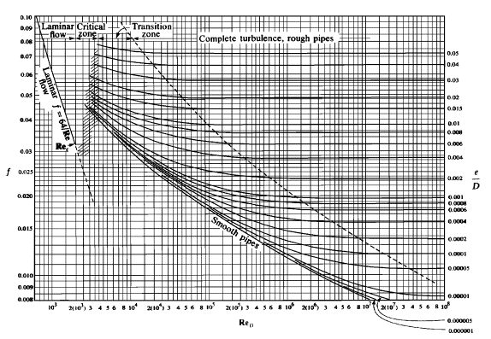
Analytical Fluid Dynamics
Example: Moody diagram for turbulent pipe flow
Composite Log-Law for smooth and rough pipes is given by the Moody diagram:

Slide 17
Experimental Fluid Dynamics (EFD)
Definition:
Use of experimental methodology and procedures for solving fluids engineering systems, including full and model scales, large and table top facilities, measurement systems (instrumentation, data acquisition and data reduction), uncertainty analysis, and dimensional analysis and similarity.
EFD philosophy:
Decisions on conducting experiments are governed by the ability of the expected test outcome, to achieve the test objectives within allowable uncertainties.
Integration of UA into all test phases should be a key part of entire experimental program
  test design
  determination of error sources
  estimation of uncertainty
  documentation of the results

Slide 18
Purpose
  Science & Technology: understand and investigate a phenomenon/process, substantiate and validate a theory (hypothesis)
  Research & Development: document a process/system, provide benchmark data (standard procedures, validations), calibrate instruments, equipment, and facilities
  Industry: design optimization and analysis, provide data for direct use, product liability, and acceptance
  Teaching: instruction/demonstration

Slide 19
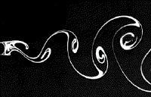
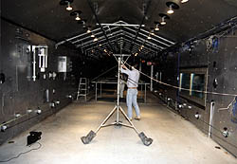
Applications of EFD
Application in science & technology
Picture of Karman vortex shedding
Application in research & development
Tropic Wind Tunnel has the ability to create
temperatures ranging from 0 to 165 degrees
Fahrenheit and simulate rain

Slide 20
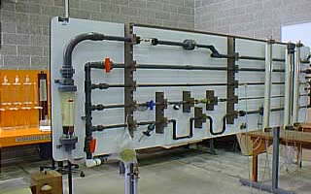
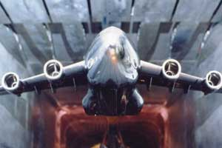
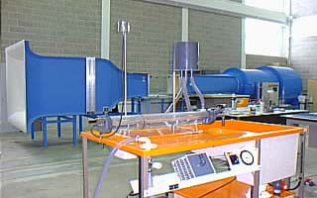
Applications of EFD (cont’d)
Example of industrial application
NASA's cryogenic wind tunnel simulates flight
conditions for scale models--a critical tool in
designing airplanes.
Application in teaching
Fluid dynamics laboratory

Slide 21
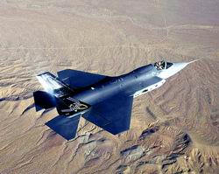
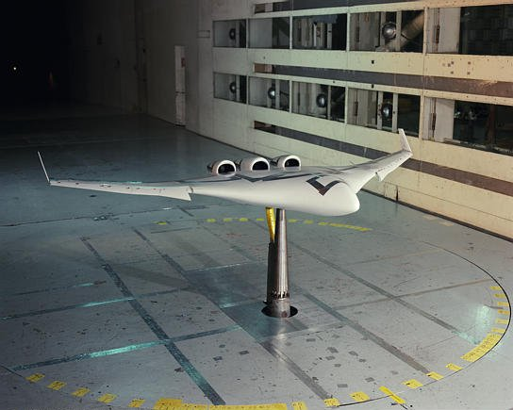
Full and model scale
  Scales: model, and full-scale
  Selection of the model scale: governed by dimensional analysis and similarity

Slide 22
Measurement systems
Instrumentation
  Load cell to measure forces and moments
  Pressure transducers
  Pitot tubes
  Hotwire anemometry
  PIV, LDV
Data acquisition
  Serial port devices
  Desktop PC’s
  Plug-in data acquisition boards
  Data Acquisition software - Labview
Data analysis and data reduction
  Data reduction equations
  Spectral analysis

Slide 23
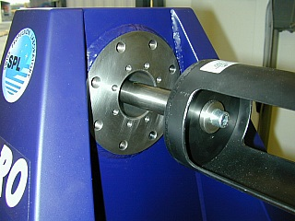
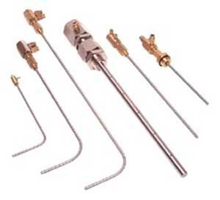
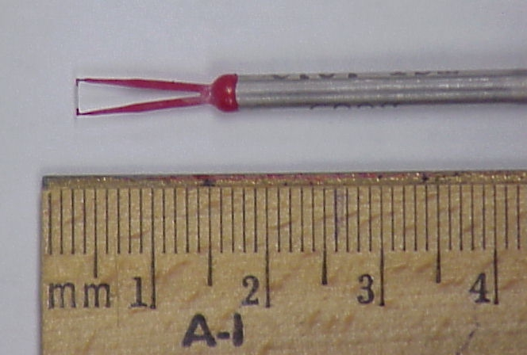
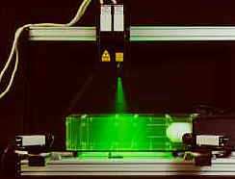
Instrumentation
Pitot tube
Load cell
Hotwire
3D - PIV

Slide 24
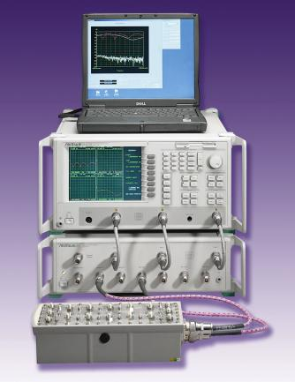
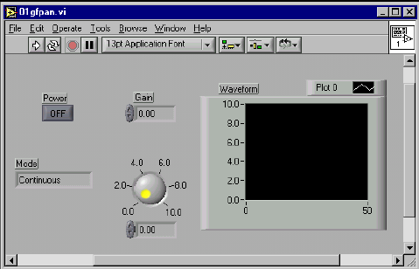
Data acquisition system
Hardware
Software - Labview

Slide 25
Data reduction methods
Data reduction equations
Spectral analysis
Example of data reduction equations

Slide 26
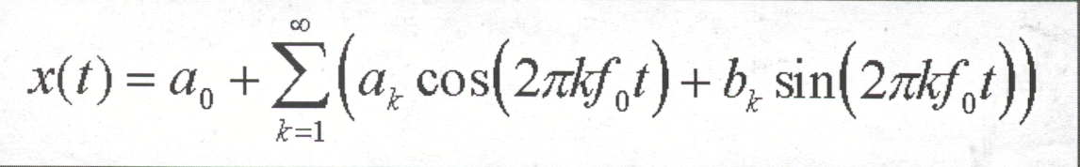
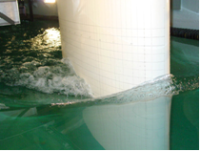
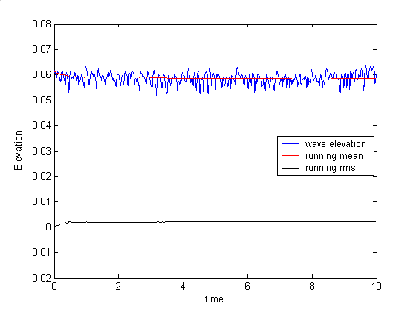

Spectral analysis
Aim: To analyze the natural unsteadiness of the separated flow, around a surface piercing
strut, using FFT.
FFT: Converts a function from amplitude as function
of time to amplitude as function of frequency
Fast Fourier Transform
Free-surface wave elevation contours
Time history of wave elevation
Surface piercing strut
FFT of wave elevation
Power spectral density
of wave elevation

Slide 27
Uncertainty analysis
Rigorous methodology for uncertainty assessment using statistical and engineering concepts

Slide 28



Dimensional analysis
Definition : Dimensional analysis is a process of formulating fluid mechanics problems in
in terms of non-dimensional variables and parameters.
Why is it used :
  Reduction in variables ( If F(A1, A2, … , An) = 0, then f(Π1, Π2, … Πr < n) = 0,
  where, F = functional form, Ai = dimensional variables, Πj = non-dimensional
  parameters, m = number of important dimensions, n = number of dimensional variables, r
  = n – m ). Thereby the number of experiments required to determine f vs. F is reduced.
  Helps in understanding physics
  Useful in data analysis and modeling
  Enables scaling of different physical dimensions and fluid properties
Example
Drag = f(V, L, r, m, c, t, e, T, etc.)
From dimensional analysis,
Vortex shedding behind cylinder
Examples of dimensionless quantities : Reynolds number, Froude
Number, Strouhal number, Euler number, etc.

Slide 29


Similarity and model testing
Definition : Flow conditions for a model test are completely similar if all relevant dimensionless parameters have the same corresponding values for model and prototype.
  Πi model = Πi prototype i = 1
  Enables extrapolation from model to full scale
  However, complete similarity usually not possible. Therefore, often it is necessary to
  use Re, or Fr, or Ma scaling, i.e., select most important Π and accommodate others
  as best possible.
Types of similarity:
  Geometric Similarity : all body dimensions in all three coordinates have the same
  linear-scale ratios.
  Kinematic Similarity : homologous (same relative position) particles lie at homologous
  points at homologous times.
  Dynamic Similarity : in addition to the requirements for kinematic similarity the model
  and prototype forces must be in a constant ratio.

Slide 30



Particle Image Velocimetry (PIV)
Definition : PIV measures whole velocity fields by taking two images shortly after each other and calculating the distance individual particles travelled within this time. From the known time difference and the measured displacement the velocity is calculated.
  Seeding: The flow medium must be seeded with particles.
  Double Pulsed Laser: Two laser pulses illuminate these particles with short time difference.
  Light Sheet Optics: Laser light is formed into a thin light plane guided into the flow medium.
  CCD Camera: A fast frame-transfer CCD captures two frames exposed by laser pulses.
  Timing Controller: Highly accurate electronics control the laser and camera(s).
  Software: Particle image capture, evaluation and display.
57:020 Fluid Mechanics
30

Slide 31




EFD at UI: IIHR Flume, Towing Tank, Wave Basin Facilities
Idealized/Practical Geometries; Small/Large Facilities:
  Development of measurement systems for small/large facilities
  Global/local flow measurements including physics/modeling;
  EFD benchmark data with UA for CFD validation
(K. Hokusai, 1832)
Flume (30 m × 0.91 m × 0.45 m)
  Free surface instability (Free surface, 2D-PIV, Borescopic-PIV)
  Plunging wave breaking span-wise structures
2) Towing Tank (100 m × 3 m × 3 m)
  Ship propulsion/maneuvering/sea-keeping/environmental tests (CFD whole field, Tomographic-PIV)
  Flat plate; NACA0024
Free surface instability in flume
3) Wave Basin (40 m × 20 m × 4.2 m)
  Non-contacting photo-tracking system
  Trajectory/6DOF motions/local flow field
  Free-running ONR Tumblehome model
  (T35-calm, Z20-wave)
  Maneuvering/sea-keeping tests
  System Identification (SI) approach
IIHR Towing Tank
IIHR Wave Basin

Slide 32


Centrifugal Instability Experiment at Flume (Borescopic PIV)
Movie clips:
  Flume flow over bump (h/H=0.222)
  Free surface deformation (h/H=0.111)
  Stream-wise flow (h/H=0.111; 8 Hz)
  Instantaneous flow
  Secondary flow
  Cross-stream (secondary) flow (h/H=0.167; 9 Hz)
  Past Bump Top
  Near Trough
  Near Crest
Numerical simulation of a bump flow
Marquillie and Ehrenstein (2003)
Spectrum of free
surface fluctuations
(Gui et al.)
http://lfmi.epfl.ch/page-78671-en.html
Spectrum of
velocity fluctuations
measured with PIV
(Gui et al.)

Slide 33



Turbulent Vortex Breakdown Experiment at Towing Tank (Tomographic PIV)
Vortex | Onset | Progression
Sonar dome tip (SDTV) | Side of sonar dome at x=0.045 | Cross flow pattern induces helical circulation
Fore body keel (FBKV) | Concave section of sonar dome at x=0.055 | Moves towards the hull due to lifting by SDTV
Bilge keel (BKV) | Vortex separation behind blunt body | Advected by free stream
Bilge keel tip (BKTV) | Vortex separation behind blunt body | Cross flow pattern induces helical circulation
CFDShip-Iowa V4 (DES) simulation for β=20°
(Bhushan et al.)  Movie clip
x=0.2
x=0.12
x=0.1
x=0.06
EFD measurements for β=20° : Cross-plane streamlines and nearby volumetric iso-surfaces of Q = 100 at the fore body (Yoon et al.)  Movie clip
EFD measurements for β=10°: Iso-surfaces of Q=100
(Yoon et al.)

Slide 34


Free-running Model Test at Wave Basin (Stereoscopic PIV)
IIHR Wave Basin Facility:
  Free-running ONR Tumblehome model
  Carriage Tracking System
  6DOF Visual Motion Capture System
  Wi-Fi Integrated Controller Release/Captive Mount
  Stereo PIV Mount/Traverse
Mean trajectory of 35° turning test in head waves
(Sanada et al.)
Movie clip: T35-wave
Definitions of $H_{D}$ and $μ_{D}$ at encounter angle χ= -90°
 Movie clip
(Turning in calm water)
(Turning)
 Movie clip
(Pull out)
(Zigzag)
(Turning in waves)
Maneuvering results (BSHC)

Slide 35
EFD process
“EFD process” is the steps to set up an experiment and
take data

Slide 36




EFD – “hands on” experience
Lab1: Measurement of density and kinematic viscosity of a fluid and visualization of flow around a cylinder.
Lab2: Measurement of flow rate, friction factor and velocity profiles in smooth and rough pipes, and measurement of flow rate through a nozzle using PIV technique.
Lab3: Measurement of surface pressure distribution, lift and drag coefficient for an airfoil, and measurement of flow velocity field around an airfoil using PIV technique.
Lab 1, 2, 3: PIV based flow measurement and visualization

Slide 37


Computational Fluid Dynamics
CFD is use of computational methods for solving fluid engineering systems, including modeling (mathematical & Physics) and numerical methods (solvers, finite differences, and grid generations, etc.).
Rapid growth in CFD technology since advent of computer
ENIAC 1, 1946
IBM WorkStation

Slide 38
Purpose
The objective of CFD is to model the continuous fluids with Partial Differential Equations (PDEs) and discretize PDEs into an algebra problem, solve it, validate it and achieve simulation based design instead of “build & test”
Simulation of physical fluid phenomena that are difficult to be measured by experiments: scale simulations (full-scale ships, airplanes), hazards (explosions,radiations,pollution), physics (weather prediction, planetary boundary layer, stellar evolution).

Slide 39
Modeling
Mathematical physics problem formulation of fluid engineering system
Governing equations: Navier-Stokes equations (momentum), continuity equation, pressure Poisson equation, energy equation, ideal gas law, combustions (chemical reaction equation), multi-phase flows(e.g. Rayleigh equation), and turbulent models (RANS, LES, DES).
Coordinates: Cartesian, cylindrical and spherical coordinates result in different form of governing equations
Initial conditions(initial guess of the solution) and Boundary Conditions (no-slip wall, free-surface, zero-gradient, symmetry, velocity/pressure inlet/outlet)
Flow conditions: Geometry approximation, domain, Reynolds Number, and Mach Number, etc.

Slide 40




Modeling (examples)
Wave breaking in bump flow simulation
Deformation of a sphere.(a)maximum stretching; (b) recovered shape. Left: LS; right: VOF.
Movie
Two-phase flow past a surface-piercing cylinder showing vortical structures colored by pressure
Movie
Wedge flow simulation
Movie

Slide 41


Modeling (examples, cont’d)
Air flow for ONR Tumblehome in PMM maneuvers
Movie
Waterjet flow modeling for JHSS and Delft catamaran
Broaching of ONR Tumblehome with rotating propellers
Movie

Slide 42




Modeling (examples, cont’d)
T-Craft (SES/ACV) turning circle in calm water with water jet propulsion (top) and straight ahead with air-fan propulsion (bottom)
Regular head wave simulation for side by side ship-ship interactions
Movie
Movie

Slide 43

Modeling (examples, cont’d)
Movie
Ship in three-sisters rogue (freak) waves
Damaged stability for SSRC cruiser with two-room compartment in beam waves
Movie

Slide 44


Vortical Structures and Instability Analysis
Fully appended Athena DES Computation
Re=2.9×10⁸, Fr=0.25
Isosurface of Q=300 colored using piezometric pressure
Karman-like shedding from Transom Corner
Horse-shoe vortices from hull-rudder (Case A) and
strut-hull (Case B) junction flow.
- Shear layer instability at hull-strut intersection
DTMB 5415 at β=20° DES Computation
Re=4.85×10⁶,Fr=0.28
Isosurface of Q=300 colored using piezometric pressure
The sonar dome (SD_{TV}) and bilge keel (BK_{TV})
vortices exhibits helical instability breakdown.
Shear-layer instabilities: port bow (B_{SL1}, B_{SL2}) and
fore-body keel (K_{SL}).
Karman-like instabilities on port side bow (B_{K}) .
Wave breaking vortices on port (FS_{BW1}) and starboard
(FS_{BW2}). Latter exhibits horse shoe type instability.
Movie

Slide 45





Modeling (examples, cont’d)
Movie (CFD)
Movie (EFD
at Iowa wave basin)
CFD simulations to improve system identification (SI) technique
Broaching simulation of free running ONR Tumblehome
Movie (CFD)
Movie (EFD)

Slide 46

Numerical methods
y
Finite difference methods: using numerical scheme to approximate the exact derivatives in the PDEs
Finite volume methods
Grid generation: conformal mapping, algebraic methods and differential equation methods
Grid types: structured, unstructured
Solvers: direct methods (Cramer’s rule, Gauss elimination, LU decomposition) and iterative methods (Jacobi, Gauss-Seidel, SOR)
jmax
j+1
j
j-1
o
i-1
i
i+1
imax
x
Slice of 3D mesh of a fighter aircraft

Slide 47
CFD process
Geometry
Physics
Mesh
Solve
Reports
Post-Processing
Select Geometry
Heat Transfer ON/OFF
Unstructured
(automatic/
manual)
Steady/
Unsteady
Forces Report
(lift/drag, shear stress, etc)
Contours
Geometry Parameters
Compressible
ON/OFF
Structured
(automatic/
manual)
Iterations/
Steps
XY Plot
Vectors
Domain Shape and Size
Flow properties
Convergent Limit
Verification
Streamlines
Viscous Model
Precisions
(single/
double)
Validation
Boundary Conditions
Numerical Scheme
Initial Conditions

Slide 48





Commercial software
CFD software
1. FLUENT: http://www.fluent.com
2. FLOWLAB: http://www.flowlab.fluent.com
3. CFDRC: http://www.cfdrc.com
4. STAR-CD: http://www.cd-adapco.com
5. CFX/AEA: http://www.software.aeat.com/cfx
Grid Generation software
1. Gridgen: http://www.pointwise.com
2. GridPro: http://www.gridpro.com
Visualization software
1. Tecplot: http://www.amtec.com
2. Fieldview: http://www.ilight.com

Slide 49


ANSYS Workbench

Slide 50

ANSYS Design Modeler

Slide 51

ANSYS Mesh

Slide 52

ANSYS Fluent

Slide 53


“Hands-on” experience using CFD Educational Interface (pipe template)

Slide 54


“Hands-on” experience using CFD Educational Interface (airfoil template)

Slide 55
57:020 Fluid Mechanics
Lectures cover basic concepts in fluid statics, kinematics, and dynamics, control-volume, and differential-equation analysis methods. Homework assignments, tests, and complementary EFD/CFD labs
This class provides an introduction to all three tools: AFD through lecture and CFD and EFD through labs
ISTUE Teaching Modules (http://www.iihr.uiowa.edu/~istue) (next two slides)

Slide 56
TM Descriptions
Table 1: ISTUE Teaching Modules for Introductory Level Fluid Mechanics at Iowa
Teaching Modules | TM for Fluid Property | TM for Pipe Flow | TM for Airfoil Flow
Overall Purpose | Hands-on student experience with table-top facility and simple MS for fluid property measurement, including comparison manufacturer values and rigorous implementation standard EFD UA | Hands-on student experience with complementary EFD, CFD, and UA for Introductory Pipe Flow, including friction factor and mean velocity measurements and comparisons benchmark data, laminar and turbulent flow CFD simulations, modeling and verification studies, and validation using AFD and EFD. | Hands-on student experience with complementary EFD, CFD, and UA for Introductory Airfoil Flow, including lift and drag, surface pressure, and mean and turbulent wake velocity profile measurements and comparisons benchmark data, inviscid and turbulent flow simulations, modeling and verification studies, and validation using AFD and EFD.
Educational Materials | FM and EFD lecture; lab report instructions; pre lab questions, and EFD exercise notes. | FM, EFD and CFD lectures; lab report instructions; pre lab questions, and EFD and CFD exercise notes. | FM, EFD and CFD lectures; lab report instructions; pre lab questions, and EFD and CFD exercise notes.
ISTUE ASEE papers | Paper 1 Paper2 Paper 3
FM Lecture | Introduction to Fluid Mechanics
Lab Report Instructions | EFD lab report Instructions CFD lab report Instructions
Continued in next slide…
http://css.engineering.uiowa.edu/~fluids

Slide 57
TM Descriptions, cont’d
Teaching Modules |  | TM for Fluid Property | TM for Pipe Flow | TM for Airfoil Flow
CFD | CFD Lecture | Introduction to CFD
 | Exercise Notes | None | CFD Prelab1 PreLab1 Questions CFD Lab 1 Lab1 Concepts CFDLab1-template.doc EFD Data | CFD Prelab2 PreLab 2 Questions CFD Lab2 Lab2 Concepts CFDLab2-template.doc EFD Data
EFD | EFD Lecture | EFD and UA
 | Exercise Notes | PreLab1 Questions Lab1 Lecture Lab 1 exercise notes Lab 1 data reduction sheet Lab1 concepts | PreLab2 Questions Lab2 Lecture Lab 2 exercise notes Lab2 data reduction sheet (smooth & rough) EFDlab2-template.doc Lab2 concepts | PreLab3 Questions Lab3 Lecture Lab 3 exercise notes Lab 3 data reduction sheet Lab3 concepts
UA(EFD) | References: EFD UA Report; EFD UA Summary; EFD UA Example
UA(CFD)

