Slide 1
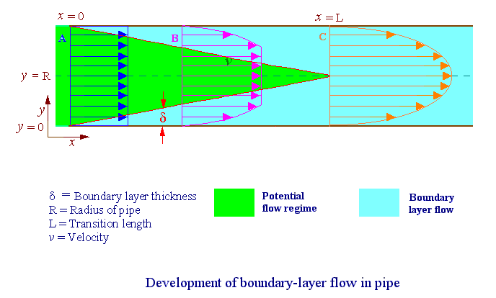
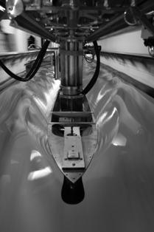
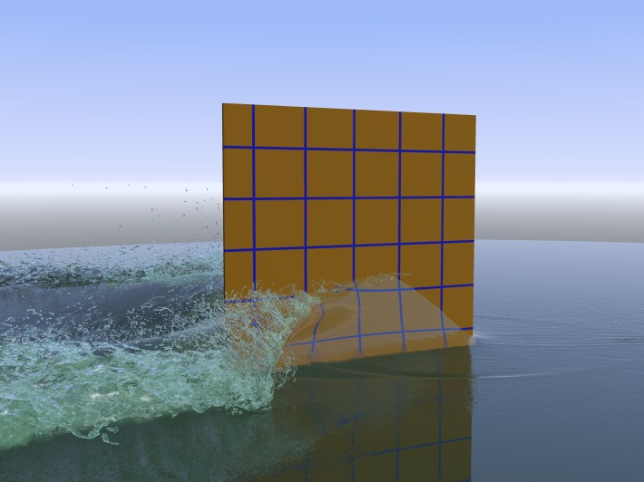
Introduction to Fluid Mechanics
Frederick Stern, Maysam Mousaviraad, Hyunse Yoon, Zhaoyuan Wang, Timur K. Dogan
8/27/2015
AFD
EFD
CFD
Acknowledgment: Tao Xing, Jun Shao, Surajeet Ghosh, Shanti Bhushan

Slide 2
Fluid Mechanics
Fluids essential to life
  Human body 65% water
  Earth’s surface is 2/3 water
  Atmosphere extends 17km above the earth’s surface
History shaped by fluid mechanics
  Geomorphology
  Human migration and civilization
  Modern scientific and mathematical theories and methods
  Warfare
Affects every part of our lives

Slide 3
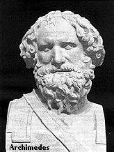
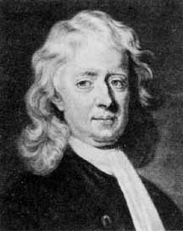
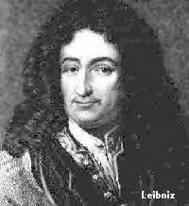
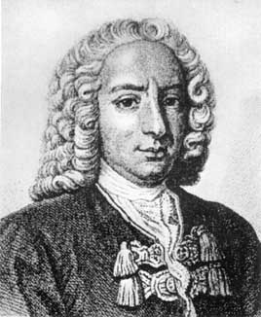
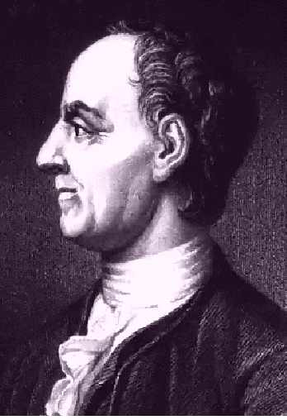
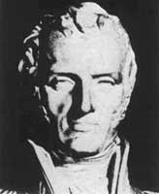
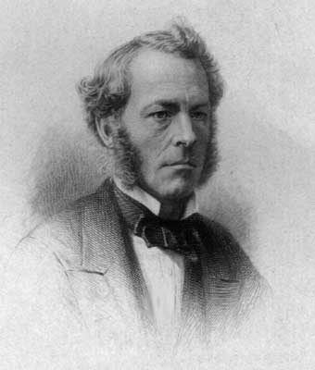
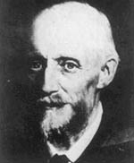
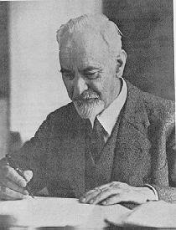

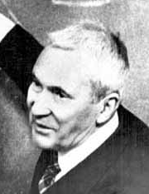
History
Faces of Fluid Mechanics
Archimedes
(C. 287-212 BC)
Newton
(1642-1727)
Leibniz
(1646-1716)
Bernoulli
(1667-1748)
Euler
(1707-1783)
Navier
(1785-1836)
Stokes
(1819-1903)
Reynolds
(1842-1912)
Prandtl
(1875-1953)
Taylor
(1886-1975)
Kolmogorov
(1903-1987)

Slide 4
Significance
Fluids omnipresent
  Weather & climate
  Vehicles: automobiles, trains, ships, and planes, etc.
  Environment
  Physiology and medicine
  Sports & recreation
  Many other examples!

Slide 5
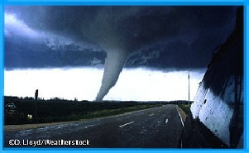
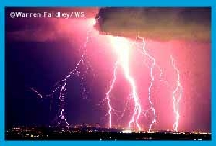
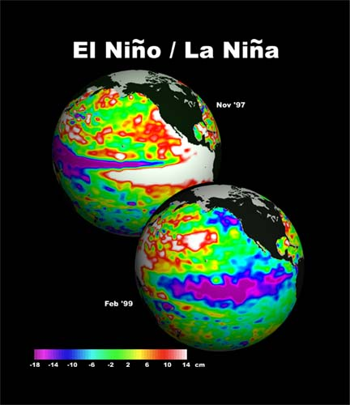
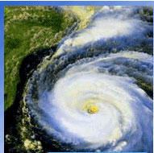
Weather & Climate
Tornadoes
Thunderstorm
Global Climate
Hurricanes

Slide 6
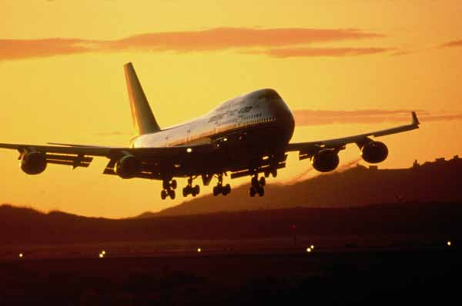
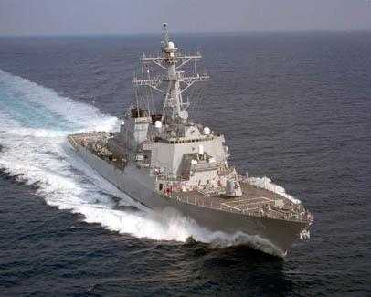
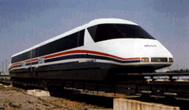
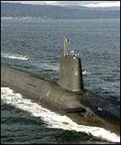
Vehicles
Aircraft
Surface ships
High-speed rail
Submarines

Slide 7
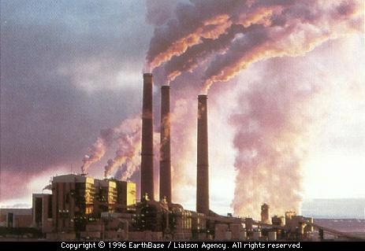
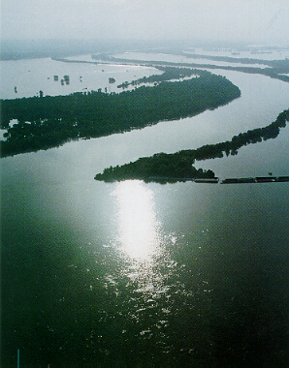
Environment
Air pollution
River hydraulics

Slide 8
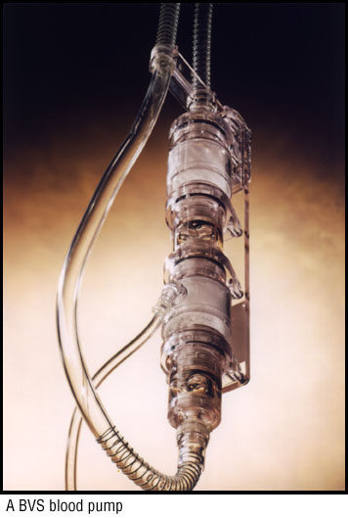
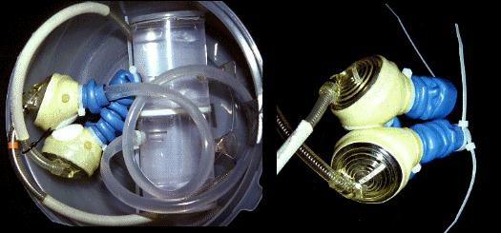
Physiology and Medicine
Blood pump
Ventricular assist device

Slide 9
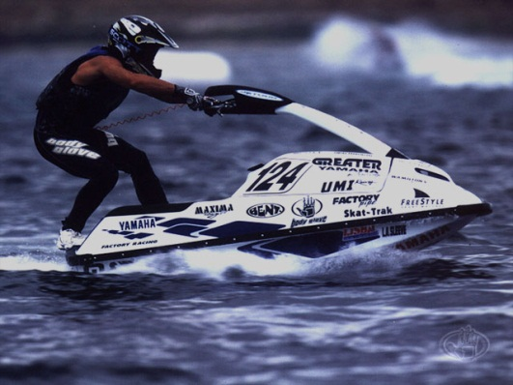
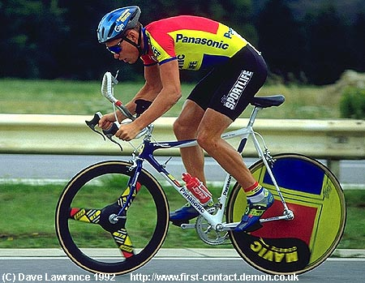
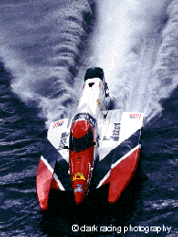
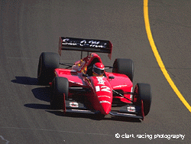
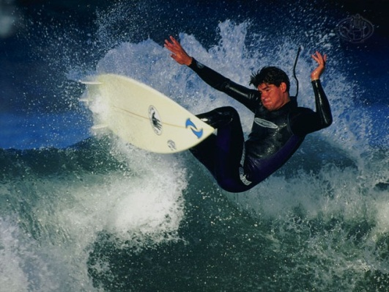
Sports & Recreation
Water sports
Cycling
Offshore racing
Auto racing
Surfing

Slide 10
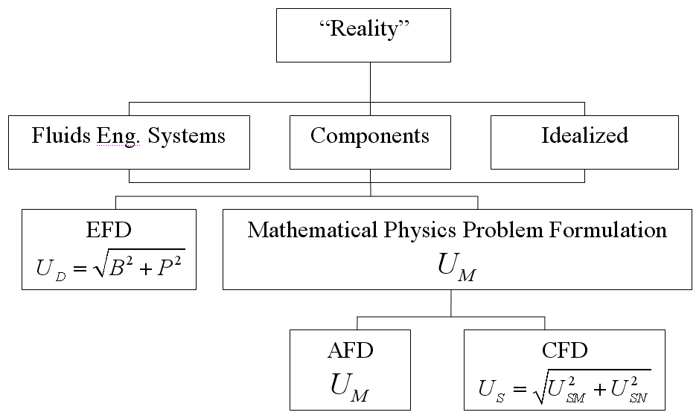
Fluids Engineering

Slide 11
Analytical Fluid Dynamics
The theory of mathematical physics problem formulation
Control volume & differential analysis
Exact solutions only exist for simple geometry and conditions
Approximate solutions for practical applications
  Linear
  Empirical relations using EFD data

Slide 12
Analytical Fluid Dynamics
Lecture Part of Fluid Class
  Definition and fluids properties
  Fluid statics
  Fluids in motion
  Continuity, momentum, and energy principles
  Dimensional analysis and similitude
  Surface resistance
  Flow in conduits
  Drag and lift

Slide 13
Analytical Fluid Dynamics
Example: laminar pipe flow
Assumptions: Fully developed, Low
Approach: Simplify momentum equation, integrate, apply boundary conditions to determine integration constants and use energy equation to calculate head loss
Schematic
0
0
0
Exact solution :
Friction factor:
Head loss:

Slide 14
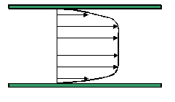
Analytical Fluid Dynamics
Example: turbulent flow in smooth pipe( )
Three layer concept (using dimensional analysis)
Laminar sub-layer (viscous shear dominates)
Overlap layer (viscous and turbulent shear important)
3. Outer layer (turbulent shear dominates)
(κ=0.41, B=5.5)
Assume log-law is valid across entire pipe:
Integration for average velocity and using EFD data to adjust constants:

Slide 15
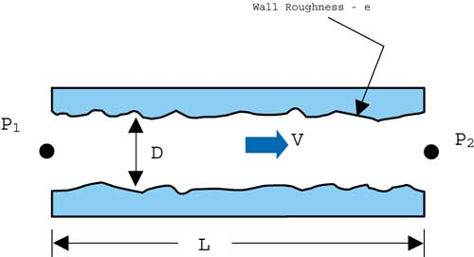
Analytical Fluid Dynamics
Example: turbulent flow in rough pipe
Both laminar sublayer and overlap layer
are affected by roughness
Inner layer:
Outer layer: unaffected
Overlap layer:
constant
Three regimes of flow depending on k⁺
K⁺<5, hydraulically smooth (no effect of roughness)
5 < K⁺< 70, transitional roughness (Re dependent)
K⁺> 70, fully rough (independent Re)
For 3, using EFD data to adjust constants:
Friction factor:

Slide 16
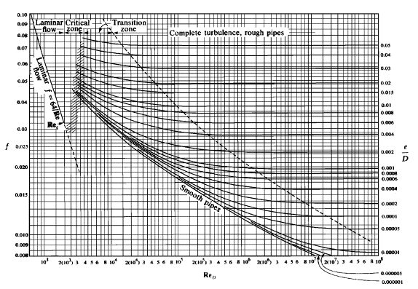
Analytical Fluid Dynamics
Example: Moody diagram for turbulent pipe flow
Composite Log-Law for smooth and rough pipes is given by the Moody diagram:

Slide 17
Experimental Fluid Dynamics (EFD)
Definition:
Use of experimental methodology and procedures for solving fluids engineering systems, including full and model scales, large and table top facilities, measurement systems (instrumentation, data acquisition and data reduction), uncertainty analysis, and dimensional analysis and similarity.
EFD philosophy:
Decisions on conducting experiments are governed by the ability of the expected test outcome, to achieve the test objectives within allowable uncertainties.
Integration of UA into all test phases should be a key part of entire experimental program
  test design
  determination of error sources
  estimation of uncertainty
  documentation of the results

Slide 18
Purpose
  Science & Technology: understand and investigate a phenomenon/process, substantiate and validate a theory (hypothesis)
  Research & Development: document a process/system, provide benchmark data (standard procedures, validations), calibrate instruments, equipment, and facilities
  Industry: design optimization and analysis, provide data for direct use, product liability, and acceptance
  Teaching: instruction/demonstration

Slide 19
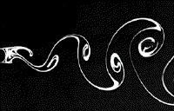
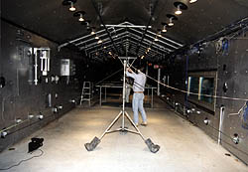
Applications of EFD
Application in science & technology
Picture of Karman vortex shedding
Application in research & development
Tropic Wind Tunnel has the ability to create
temperatures ranging from 0 to 165 degrees
Fahrenheit and simulate rain

Slide 20
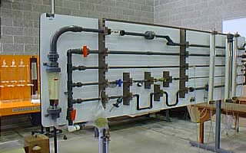
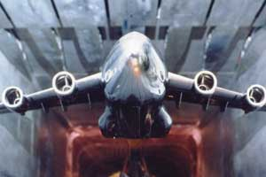
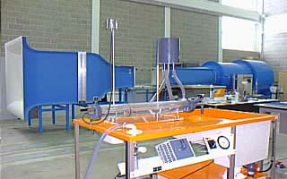
Applications of EFD (cont’d)
Example of industrial application
NASA's cryogenic wind tunnel simulates flight
conditions for scale models--a critical tool in
designing airplanes.
Application in teaching
Fluid dynamics laboratory

Slide 21
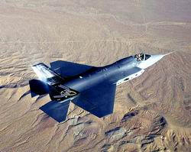
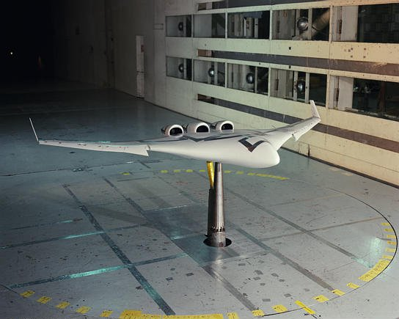
Full and model scale
  Scales: model, and full-scale
  Selection of the model scale: governed by dimensional analysis and similarity

Slide 22
Measurement systems
Instrumentation
  Load cell to measure forces and moments
  Pressure transducers
  Pitot tubes
  Hotwire anemometry
  PIV, LDV
Data acquisition
  Serial port devices
  Desktop PC’s
  Plug-in data acquisition boards
  Data Acquisition software - Labview
Data analysis and data reduction
  Data reduction equations
  Spectral analysis

Slide 23
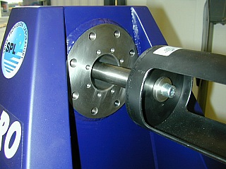
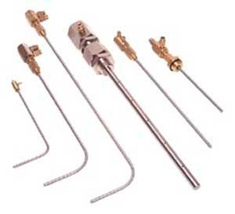
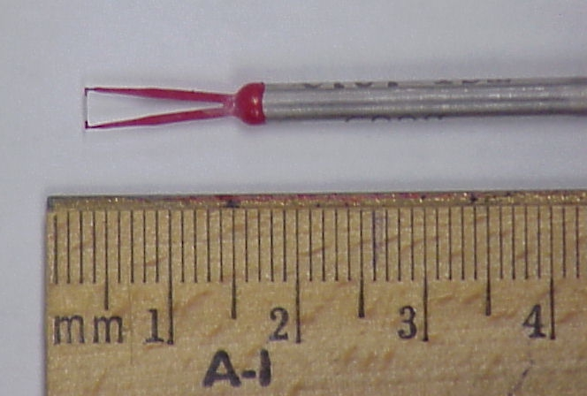
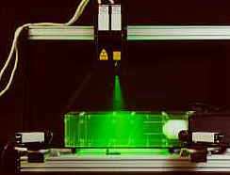
Instrumentation
Pitot tube
Load cell
Hotwire
3D - PIV

Slide 24
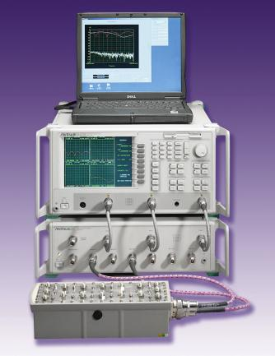
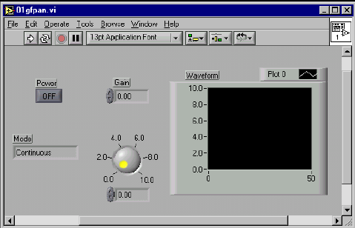
Data acquisition system
Hardware
Software - Labview

Slide 25
Data reduction methods
Data reduction equations
Spectral analysis
Example of data reduction equations

Slide 26
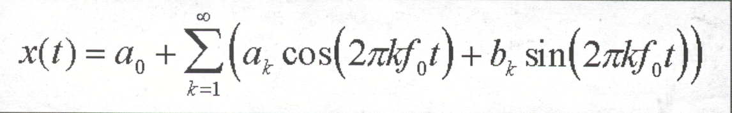
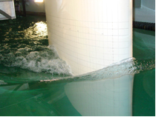
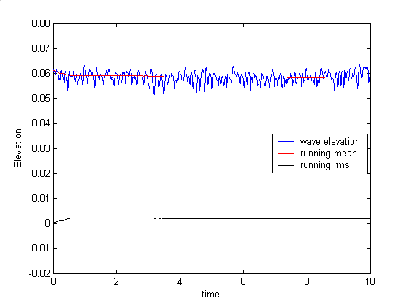

Spectral analysis
Aim: To analyze the natural unsteadiness of the separated flow, around a surface piercing
strut, using FFT.
FFT: Converts a function from amplitude as function
of time to amplitude as function of frequency
Fast Fourier Transform
Free-surface wave elevation contours
Time history of wave elevation
Surface piercing strut
FFT of wave elevation
Power spectral density
of wave elevation

Slide 27
Uncertainty analysis
Rigorous methodology for uncertainty assessment using statistical and engineering concepts

Slide 28



Dimensional analysis
Definition : Dimensional analysis is a process of formulating fluid mechanics problems in
in terms of non-dimensional variables and parameters.
Why is it used :
  Reduction in variables ( If F(A1, A2, … , An) = 0, then f(Π1, Π2, … Πr < n) = 0,
  where, F = functional form, Ai = dimensional variables, Πj = non-dimensional
  parameters, m = number of important dimensions, n = number of dimensional variables, r
  = n – m ). Thereby the number of experiments required to determine f vs. F is reduced.
  Helps in understanding physics
  Useful in data analysis and modeling
  Enables scaling of different physical dimensions and fluid properties
Example
Drag = f(V, L, r, m, c, t, e, T, etc.)
From dimensional analysis,
Vortex shedding behind cylinder
Examples of dimensionless quantities : Reynolds number, Froude
Number, Strouhal number, Euler number, etc.

Slide 29


Similarity and model testing
Definition : Flow conditions for a model test are completely similar if all relevant dimensionless parameters have the same corresponding values for model and prototype.
  Πi model = Πi prototype i = 1
  Enables extrapolation from model to full scale
  However, complete similarity usually not possible. Therefore, often it is necessary to
  use Re, or Fr, or Ma scaling, i.e., select most important Π and accommodate others
  as best possible.
Types of similarity:
  Geometric Similarity : all body dimensions in all three coordinates have the same
  linear-scale ratios.
  Kinematic Similarity : homologous (same relative position) particles lie at homologous
  points at homologous times.
  Dynamic Similarity : in addition to the requirements for kinematic similarity the model
  and prototype forces must be in a constant ratio.

Slide 30



Particle Image Velocimetry (PIV)
Definition : PIV measures whole velocity fields by taking two images shortly after each other and calculating the distance individual particles travelled within this time. From the known time difference and the measured displacement the velocity is calculated.
  Seeding: The flow medium must be seeded with particles.
  Double Pulsed Laser: Two laser pulses illuminate these particles with short time difference.
  Light Sheet Optics: Laser light is formed into a thin light plane guided into the flow medium.
  CCD Camera: A fast frame-transfer CCD captures two frames exposed by laser pulses.
  Timing Controller: Highly accurate electronics control the laser and camera(s).
  Software: Particle image capture, evaluation and display.
57:020 Fluid Mechanics
30

Slide 31




EFD at UI: IIHR Flume, Towing Tank, Wave Basin Facilities
Idealized/Practical Geometries; Small/Large Facilities:
  Development of measurement systems for small/large facilities
  Global/local flow measurements including physics/modeling;
  EFD benchmark data with UA for CFD validation
(K. Hokusai, 1832)
Flume (30 m × 0.91 m × 0.45 m)
  Free surface instability (Free surface, 2D-PIV, Borescopic-PIV)
  Plunging wave breaking span-wise structures
2) Towing Tank (100 m × 3 m × 3 m)
  Ship propulsion/maneuvering/sea-keeping/environmental tests (CFD whole field, Tomographic-PIV)
  Flat plate; NACA0024
  Circular cylinder
Free surface instability in flume
3) Wave Basin (40 m × 20 m × 4.2 m)
  Non-contacting photo-tracking system
  Trajectory/6DOF motions/local flow field
  Free-running ONR Tumblehome model
  (T35-calm, Z20-wave)
  Maneuvering/sea-keeping tests
  System Identification (SI) approach
IIHR Towing Tank
IIHR Wave Basin

Slide 32
EFD process
“EFD process” is the steps to set up an experiment and
take data

Slide 33




EFD – “hands on” experience
Lab1: Measurement of density and kinematic viscosity of a fluid and visualization of flow around a cylinder.
Lab2: Measurement of flow rate, friction factor and velocity profiles in smooth and rough pipes, and measurement of flow rate through a nozzle using PIV technique.
Lab3: Measurement of surface pressure distribution, lift and drag coefficient for an airfoil, and measurement of flow velocity field around an airfoil using PIV technique.
Lab 1, 2, 3: PIV based flow measurement and visualization

Slide 34


Computational Fluid Dynamics
CFD is use of computational methods for solving fluid engineering systems, including modeling (mathematical & Physics) and numerical methods (solvers, finite differences, and grid generations, etc.).
Rapid growth in CFD technology since advent of computer
ENIAC 1, 1946
IBM WorkStation

Slide 35
Purpose
The objective of CFD is to model the continuous fluids with Partial Differential Equations (PDEs) and discretize PDEs into an algebra problem, solve it, validate it and achieve simulation based design instead of “build & test”
Simulation of physical fluid phenomena that are difficult to be measured by experiments: scale simulations (full-scale ships, airplanes), hazards (explosions,radiations,pollution), physics (weather prediction, planetary boundary layer, stellar evolution).

Slide 36
Modeling
Mathematical physics problem formulation of fluid engineering system
Governing equations: Navier-Stokes equations (momentum), continuity equation, pressure Poisson equation, energy equation, ideal gas law, combustions (chemical reaction equation), multi-phase flows(e.g. Rayleigh equation), and turbulent models (RANS, LES, DES).
Coordinates: Cartesian, cylindrical and spherical coordinates result in different form of governing equations
Initial conditions(initial guess of the solution) and Boundary Conditions (no-slip wall, free-surface, zero-gradient, symmetry, velocity/pressure inlet/outlet)
Flow conditions: Geometry approximation, domain, Reynolds Number, and Mach Number, etc.

Slide 37

Numerical Methods
y
Finite difference methods: using numerical scheme to approximate the exact derivatives in the PDEs
Finite volume methods
Grid generation: conformal mapping, algebraic methods and differential equation methods
Grid types: structured, unstructured
Solvers: direct methods (Cramer’s rule, Gauss elimination, LU decomposition) and iterative methods (Jacobi, Gauss-Seidel, SOR)
jmax
j+1
j
j-1
o
i-1
i
i+1
imax
x
Slice of 3D mesh of a fighter aircraft

Slide 38



CFD at UI: CFDShip-Iowa
CFDSHIP-IOWA V4.5
  Propulsion (Movie: ONRT Propellers)
  Maneuvering
  (Movie: ONRT Air Flow, T-Craft, ONRT SI , ONRT Broaching)
  Ship-ship interaction (Movie: Regular Head Waves)
  Damaged ship stability and rouge waves
  (Movie: Rouge Wave, Damaged SSRC)
  Vortical Structures and Instability Analysis (Movie: DTMB)
2) CFDSHIP-IOWA V6
  Wave breaking around a wedge-shaped bow (1 billion grid points) (Movie)
  Plunging wave breaking over a bump (2.2 billion grid points) (Movie)
  Stokes wave breaking (12 billion grid points) (Movie)
  Free surface instability over a bump (Movie)
  Two-phase flow past a surface-piercing cylinder showing vortical structures colored by pressure (Movie)

Slide 39
CFD Process
Geometry
Physics
Mesh
Solution
Results
Geometry Parameters
(ANSYS Design Modeler)
Flow properties
(ANSYS Fluent-Setup)
Unstructured
(ANSYS Mesh)
Steady/
Unsteady
(ANSYS Fluent-Setup)
Forces Report
(ANSYS Fluent-Results)
Domain Shape and Size
(ANSYS Design Modeler)
Viscous Model
(ANSYS Fluent-Setup)
Structured
(ANSYS Mesh)
Iterations/
Steps
(ANSYS Fluent-Solution)
XY Plot
(ANSYS Fluent-Results)
Boundary Conditions
(ANSYS Fluent-Setup)
Convergent Limit
(ANSYS Fluent-Solution)
Verification & Validation
(ANSYS Fluent-Results)
Initial Conditions
(ANSYS Fluent-Solution)
Precisions
(ANSYS Fluent-Solution)
Contours, Vectors, and Streamlines
(ANSYS Fluent-Results)
Numerical Scheme
(ANSYS Fluent-Solution)
Green regions indicate ANSYS modules

Slide 40




Commercial Software
CFD software
1. ANSYS: http://www.ansys.com
2. CFDRC: http://www.cfdrc.com
3. STAR-CD: http://www.cd-adapco.com
Grid Generation software
1. Gridgen: http://www.pointwise.com
2. GridPro: http://www.gridpro.com
Visualization software
1. Tecplot: http://www.amtec.com
2. Fieldview: http://www.ilight.com
3. EnSight: http://www.ceisoftware.com/

Slide 41


ANSYS Workbench
Design project schematics with ANSYS Workbench

Slide 42

ANSYS Design Modeler
Create geometry using ANSYS Design Modeler

Slide 43

ANSYS Mesh
Create mesh using ANSYS Mesh

Slide 44



ANSYS Fluent
Setup and solve problem, and analyze results using ANSYS Fluent

Slide 45
57:020 Fluid Mechanics
Lectures cover basic concepts in fluid statics, kinematics, and dynamics, control-volume, and differential-equation analysis methods. Homework assignments, tests, and complementary EFD/CFD labs
This class provides an introduction to all three tools: AFD through lecture and CFD and EFD through labs
ISTUE Teaching Modules (http://www.iihr.uiowa.edu/~istue) (next two slides)

Slide 46
TM Descriptions
Table 1: ISTUE Teaching Modules for Introductory Level Fluid Mechanics at Iowa
Teaching Modules | TM for Fluid Property | TM for Pipe Flow | TM for Airfoil Flow
Overall Purpose | Hands-on student experience with table-top facility and simple MS for fluid property measurement, including comparison manufacturer values and rigorous implementation standard EFD UA | Hands-on student experience with complementary EFD, CFD, and UA for Introductory Pipe Flow, including friction factor and mean velocity measurements and comparisons benchmark data, laminar and turbulent flow CFD simulations, modeling and verification studies, and validation using AFD and EFD. | Hands-on student experience with complementary EFD, CFD, and UA for Introductory Airfoil Flow, including lift and drag, surface pressure, and mean and turbulent wake velocity profile measurements and comparisons benchmark data, inviscid and turbulent flow simulations, modeling and verification studies, and validation using AFD and EFD.
Educational Materials | FM and EFD lecture; lab report instructions; pre lab questions, and EFD exercise notes. | FM, EFD and CFD lectures; lab report instructions; pre lab questions, and EFD and CFD exercise notes. | FM, EFD and CFD lectures; lab report instructions; pre lab questions, and EFD and CFD exercise notes.
ISTUE ASEE papers | Paper 1 Paper2 Paper 3
FM Lecture | Introduction to Fluid Mechanics
Lab Report Instructions | EFD lab report Instructions CFD lab report Instructions
Continued in next slide…
http://css.engineering.uiowa.edu/~fluids

Slide 47
TM Descriptions, cont’d
Teaching Modules |  | TM for Fluid Property | TM for Pipe Flow | TM for Airfoil Flow
CFD | CFD Lecture | Introduction to CFD
 | Exercise Notes | None | CFD Prelab1 PreLab1 Questions CFD Lab 1 Lab1 Concepts CFDLab1-template.doc EFD Data | CFD Prelab2 PreLab 2 Questions CFD Lab2 Lab2 Concepts CFDLab2-template.doc EFD Data
EFD | EFD Lecture | EFD and UA
 | Exercise Notes | PreLab1 Questions Lab1 Lecture Lab 1 exercise notes Lab 1 data reduction sheet Lab1 concepts | PreLab2 Questions Lab2 Lecture Lab 2 exercise notes Lab2 data reduction sheet (smooth & rough) EFDlab2-template.doc Lab2 concepts | PreLab3 Questions Lab3 Lecture Lab 3 exercise notes Lab 3 data reduction sheet Lab3 concepts
UA(EFD) | References: EFD UA Report; EFD UA Summary; EFD UA Example
UA(CFD)

Slide 48


APPENDIX
Centrifugal Instability Experiment at Flume (Borescopic PIV)
Movie clips:
  Flume flow over bump (h/H=0.222)
  Free surface deformation (h/H=0.111)
  Stream-wise flow (h/H=0.111; 8 Hz)
  Instantaneous flow
  Secondary flow
  Cross-stream (secondary) flow (h/H=0.167; 9 Hz)
  Past Bump Top
  Near Trough
  Near Crest
Numerical simulation of a bump flow
Marquillie and Ehrenstein (2003)
Spectrum of free
surface fluctuations
(Gui et al.)
http://lfmi.epfl.ch/page-78671-en.html
Spectrum of
velocity fluctuations
measured with PIV
(Gui et al.)

Slide 49



Turbulent Vortex Breakdown Experiment at Towing Tank (Tomographic PIV)
Vortex | Onset | Progression
Sonar dome tip (SDTV) | Side of sonar dome at x=0.045 | Cross flow pattern induces helical circulation
Fore body keel (FBKV) | Concave section of sonar dome at x=0.055 | Moves towards the hull due to lifting by SDTV
Bilge keel (BKV) | Vortex separation behind blunt body | Advected by free stream
Bilge keel tip (BKTV) | Vortex separation behind blunt body | Cross flow pattern induces helical circulation
CFDShip-Iowa V4 (DES) simulation for β=20°
(Bhushan et al.)  Movie clip
x=0.2
x=0.12
x=0.1
x=0.06
EFD measurements for β=20° : Cross-plane streamlines and nearby volumetric iso-surfaces of Q = 100 at the fore body (Yoon et al.)  Movie clip
EFD measurements for β=10°: Iso-surfaces of Q=100
(Yoon et al.)

Slide 50


Free-running Model Test at Wave Basin (Stereoscopic PIV)
IIHR Wave Basin Facility:
  Free-running ONR Tumblehome model
  Carriage Tracking System
  6DOF Visual Motion Capture System
  Wi-Fi Integrated Controller Release/Captive Mount
  Stereo PIV Mount/Traverse
Mean trajectory of 35° turning test in head waves
(Sanada et al.)
Movie clip: T35-wave
Definitions of $H_{D}$ and $μ_{D}$ at encounter angle χ= -90°
 Movie clip
(Turning in calm water)
(Turning)
 Movie clip
(Pull out)
(Zigzag)
(Turning in waves)
Maneuvering results (BSHC)

Slide 51
CFDShip-Iowa V4.5
Semi-coupled two-phase level-set solver
Absolute earth fixed or relative inertial coordinates
Node centered finite difference scheme on curvilinear body fitted grids
Multi-block dynamic overset grid interpolation using SUGGAR
2nd/3rd/4th order upwind, linear or TVD convection
URANS/DES Turbulence models with WF option
6DoF ship motions including several bodies
PISO or projection using PETSc
MPI based domain decomposition
Optimization of serial and parallel performance
SBD functional areas:
  Structures integration
  Propeller modeling
  Shape optimization
  Environmental effects

Slide 52

Propulsion
Movie
Broaching of ONR Tumblehome with rotating propellers
Waterjet flow modeling for JHSS and Delft catamaran

Slide 53



Maneuvering
Air flow for ONR Tumblehome in PMM maneuvers
Movie
T-Craft (SES/ACV) turning circle in calm water with water jet propulsion (top) and straight ahead with air-fan propulsion (bottom)
Movie

Slide 54




Maneuvering
Movie (CFD)
Movie (EFD
at Iowa wave basin)
CFD simulations to improve system identification (SI) technique
Broaching simulation of free running ONR Tumblehome
Movie (CFD)
Movie (EFD)

Slide 55


Ship-Ship Interactions
Regular head wave simulation for side by side ship-ship interactions
Movie

Slide 56

Damaged Ship Stability and Rouge Waves
Movie
Ship in three-sisters rogue (freak) waves
Damaged stability for SSRC cruiser with two-room compartment in beam waves
Movie

Slide 57


Vortical Structures and Instability Analysis
Fully appended Athena DES Computation
Re=2.9×10⁸, Fr=0.25
Isosurface of Q=300 colored using piezometric pressure
Karman-like shedding from Transom Corner
Horse-shoe vortices from hull-rudder (Case A) and
strut-hull (Case B) junction flow.
- Shear layer instability at hull-strut intersection
DTMB 5415 at β=20° DES Computation
Re=4.85×10⁶,Fr=0.28
Isosurface of Q=300 colored using piezometric pressure
The sonar dome (SD_{TV}) and bilge keel (BK_{TV})
vortices exhibits helical instability breakdown.
Shear-layer instabilities: port bow (B_{SL1}, B_{SL2}) and
fore-body keel (K_{SL}).
Karman-like instabilities on port side bow (B_{K}) .
Wave breaking vortices on port (FS_{BW1}) and starboard
(FS_{BW2}). Latter exhibits horse shoe type instability.
Movie

Slide 58
CFDShip-Iowa V6
Version 6.2
Orthogonal curvilinear, non-uniform staggered grid
3rd order QUICK/5th order WENO for convection\
Semi-Lagrangian advection
Four-step fractional step for velocity-pressure coupling
Hypre multigrid pressure Poisson solver
MPI based domain decomposition and MPI2-I/O
Force distribution on wall surface
Turbulence modeling using URANS, DES and LES
Wall-layer modeling using wall function
Interface modeling using VOF and level set methods
Two-phase using sharp interface (ghost fluid) method
Functional areas: small-scale physics, wave breaking, and hybrid RANS/LES

Slide 59


Wave breaking around a wedge-shaped bow
Left: Experiment (Noblesse et. al, 2008); Right: simulation, image rendered using POV-ray.
1.0 billion grid points was used, first on Navy DSRC Einstein (Cray XT5) then on ERDC Diamond (SGI Altix Ice).
1024 cores was used, and it was also able to run on 512 cores (64 nodes) on Einstein.
Top view of wave breaking around a wedge, image rendered using POV-ray.
Wave breakings around of a Wedge-shaped Bow
(Movie)

Slide 60



Plunging wave breaking over a bump
Top view of the wave breaking behind a submerged bump, grid 768×256×64.
Wave breaking over a submerged bump.
Left: Experiment; right: Simulation, grid 768×256×64.
Close-up view of the wave breaking region for the bump flow, grid 2.2 billion.
Movie
Notes:
Plunging wave breaking is one of the most violent phenomena of air-water interface interactions, producing strong turbulence with large amounts of air bubbles, water droplets, jets and sprays. These phenomena commonly occur in ship flows and are one of the main sources of the underwater sounds and white-water wakes, which are of great importance for signature of ships.
The plunging wave breaking is generated by impulsive flow over a submerged bump fixed in a shallow water flume using the exact experimental initial and boundary conditions provided by Kang et al. (2010).
The overall plunging wave breaking process is described with major wave breaking events identified: jet plunging, oblique splash, and vertical jet. These major events repeat up to four times before entering the chaotic breakings.

Slide 61





Stokes wave breaking
Wave breaking process
t = 1.20
t = 1.44
t = 1.76
t = 2.08
t = 2.96
Movie
3D interface structure
Wave profile of simulation 1 at t =1.76. Grid: 2048×1024×1536 (≈3.22 billion). (a) Side view;
(b) front view; (c) perspective view: red line shows the cross section slices locations at x/λ = -0.25, -0.05, and 0.05.
Velocity profiles in the jet at y/ = 0.25. (a) Gortler inviscid instabilities; (b) Rayleigh/Taylor instabilities.
Red: stable; blue: unstable.
Notes:
1. The observed wavy gap flow exhibits jet-like velocity profiles, which is most relevant to the G¨ortler type centrifugal instability for convex curvature.
The G¨ortler inviscid instability theory for convex curvature and Rayleigh instability theory are applied to flow field in the stream-wise central plane which are shown in figure .
2. It should be noted that it is the first time to be able to sufficiently resolve the detailed velocity profiles in the jet of plunging wave breaking due to the high spatial resolution.
3. In the upstream at x/λ = −0.25, the flow is stable, whereas in the wave breaking region, G¨ortler stability criterion is violated in most locations and Rayleigh stability criterion is
broken only in small regions. These results support the idea that breaking wave instabilities are mainly due to G¨ortler type centrifugal instability.

Slide 62


Instabilities for Free Surface Flow
The computed free surface is the same as EFD over the bump and upstream.
The flow is separated earlier in the downstream of the bump without a turbulence model.
Secondary flow pattern and large recirculation zone observed in the simulation.
The Bulge-scar is not observed in the simulation.
Similar patterns for velocity and Reynolds stresses are observed for EFD and CFD.
The velocity components and Reynolds stresses are under predicted for CFD.
A turbulence model and finer grid will be used to improve simulation results.
The flow rate Q will be increased for the bulge-scar pattern.
Contour of TKE and streamlines of mean velocity
Instantaneous secondary flow patterns
Movie

Slide 63

Two-phase Cylinder Flow
Two-phase flow past a surface-piercing cylinder showing vortical structures colored by pressure
Movie

