Slide 1
Experimental Fluid Dynamics and Uncertainty Assessment Methodology
H. Elshiekh, H. Yoon, M. Muste, F. Stern
Acknowledgements: S. Ghosh, M. Marquardt, S. Cook

Slide 2
Table of Contents
What is EFD
EFD philosophy
EFD Process
  Test Setup
  Data Acquisition
  Data Reduction
  Uncertainty analysis
  Data Analysis
57:020 EFD Labs

Slide 3
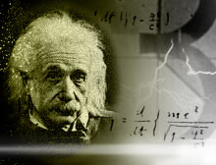
1. What is EFD
Experimental Fluid Dynamics (EFD): Use of experimental methodology and procedures for solving fluids engineering systems, including full and model scales, large and table top facilities, measurement systems (instrumentation, data acquisition and data reduction), dimensional analysis and similarity and uncertainty analysis.
  Purpose:
  Science & Technology: understand and investigate a phenomenon/process, substantiate and validate a theory (hypothesis)
  Research & Development: document a process/system, provide benchmark data (standard procedures, validations), calibrate instruments, equipment, and facilities
  Industry: design optimization and analysis, provide data for direct use, product liability, and acceptance
  Teaching: Instruction/demonstration
A pretty experiment is in itself often more valuable than twenty formulae extracted from our minds."
- Albert Einstein
Notes:
5)Implementation of standard procedures (tests): refers to a particular testing method that aims to provide consistency in the conduct of a measurement from one test facility to another. Test standards often make avail;able tabulated coefficients, the values of which have been accepted by the international community. Test standards instruct the user to place the measurement system into a reference configuration such that the outcome of a measurement in this configuration can be compared to data already well estabilshed and accepted. UA can be best conducted in this manner.

Slide 4
2. EFD Philosophy
Decisions on conducting experiments are governed by the ability of the expected test outcome to achieve the experiment objectives within allowable uncertainties.
Integration of UA into all test phases should be a key part of entire experimental program
  test design
  determination of error sources
  estimation of uncertainty
  documentation of the results

Slide 5
3. EFD Process
EFD labs provide “hands on” experience with modern measurement systems, understanding and implementation of EFD in practical application and focus on “EFD process”:
Notes:
See Coleman and Steele, 1989- Chapter I

Slide 6
1) Test Setup
Types of measurements and instrumentation

Slide 7
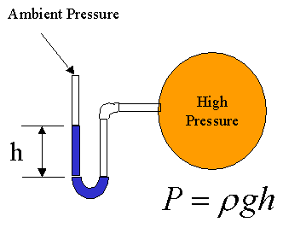
Manometers
Principle of operation: Manometers are devices in which columns of suitable liquid are used to measure the difference in pressure between two points, or between a certain point and the atmosphere (p_{atm}).
Applying fundamental equations of hydrostatics the pressure difference, P, between the two liquid columns can be calculated.
Manometers are frequently used to measure pressure differences sensed by Pitot tubes to determine velocities in various flows.
Types of manometers: simple, differential (U-tube), inclined tube, high precision (Rouse manometer).
U-tube manometer

Slide 8
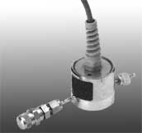
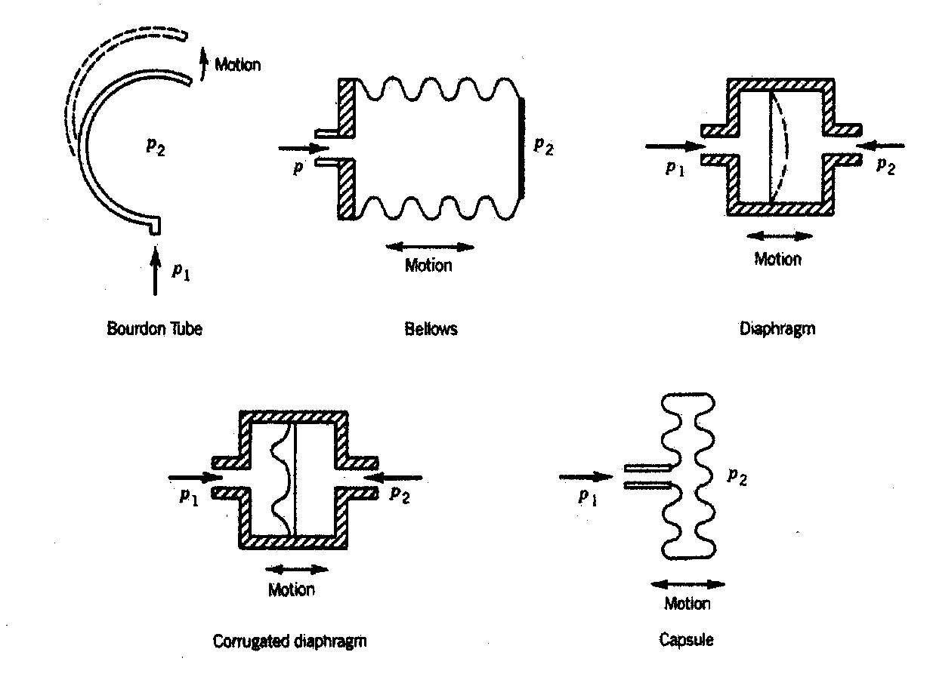

Pressure transducers
A pressure transducer converts the pressure sensed by the instrument probe into mechanical or electrical signals
Pressure transducer
Elastic elements used to convert pressure within transducers
Transducer read out

Slide 9
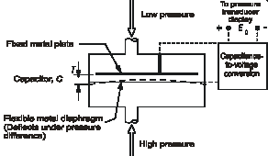
Pressure transducers
Schematic of a membrane-based pressure transducer
A a diaphragm separates the high and low incoming pressures.
The diaphragm deflects under the pressure difference thus changing the capacitance(C) of the circuit, which eventually changes the voltage output(E).
The voltages are converted through calibrations to pressure units.
Pressure transducers are used with pressure taps, pitot tubes, pulmonary functions, HVAC, mechanical pressures, etc.

Slide 10
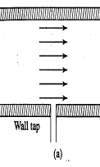
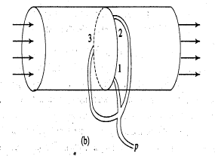
Pressure taps
Static(P_{stat}) and stagnation(P_{stag}) pressures
Pressure caused only by molecular collisions is known as static pressure.
The pressure tap is a small opening in the wall of a a duct (Fig a.)
Pressure tap connected to any pressure measuring device indicates the static pressure. (note: there is no component of velocity along the tap axis).
The stagnation pressure at a point in a fluid flow is the pressure that could result if the fluid was brought to rest isentropically (i.e., the entire kinetic energy of the fluid is utilized to increase its pressure only).
Single and multi pressure taps

Slide 11
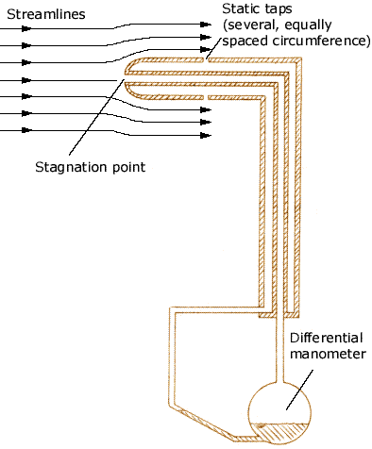
Pitot tube
The tubes sensing static and stagnation pressures are usually combined into one instrument known as pitot static tube.
Pressure taps sensing static pressure (also the reference pressure for this measurement) are placed radially on the probe stem and then combined into one tube leading to the differential manometer (p_{stat}).
The pressure tap located at the probe tip senses the stagnation pressure (p₀).
Use of the two measured pressures in the Bernoulli equation allows to determine one component of the flow velocity at the probe location.
Special arrangements of the pressure taps (Three-hole, Five-hole, seven-hole Pitot) in conjunction with special calibrations are used two measure all velocity components.
It is difficult to measure stagnation pressure in real, due to friction. The measured stagnation pressure is always less than the actual one. This is taken care of by an empirical factor C.
P₀ = stagnation pressure
P_{stat} = static pressure

Slide 12
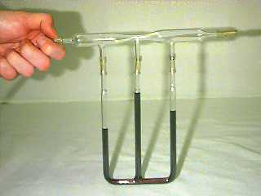
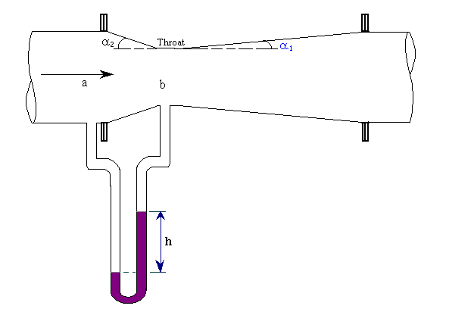
Venturi meter
Venturi meter consists of two conical pipes. The minimum cross section diameter is called throat. The angles of the conical pipes are established to limit the energy losses due to flow separation.
The flow obstruction produced by the venturi meter produces a local loss that is proportional to the flow discharge.
Pressure taps are located upstream and downstream of venturi meter, immediately outside the variable diameter areas, to measure the losses produced through the meter.
Flow rate is calculated using Bernoulli equation and the continuity equation. An experimental coefficient is used to account for the losses occurring in the meter (V_{a} and V_{b} are the upstream and downstream velocities and ρ is the density. (A_{a} and A_{b} are the cross sectional areas).

Slide 13
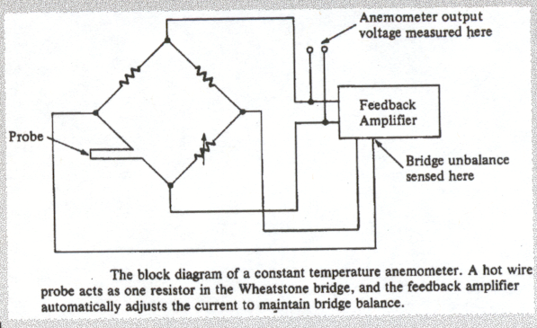
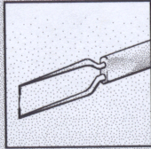
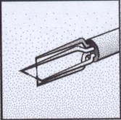
Hotwire
Single hot-wire probe
Platinum plated Tungsten
5 μm diameter, 1.2 mm length
Constant temperature anemometer
Used for mean and instantaneous (fluctuating) velocity measurements
Principle of operation: Sensor resistance is changed by the flow over the probe and the cooling taking place is related through calibration to the velocity of the incoming flow.
The tool is very reliable for the measurement of velocity fluctuations due to its high sampling frequency and small size of the probe.
Cross-wire (X) probe
Two sensors perpendicular to each other
Measures within ± 45°

Slide 14

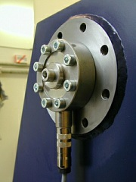
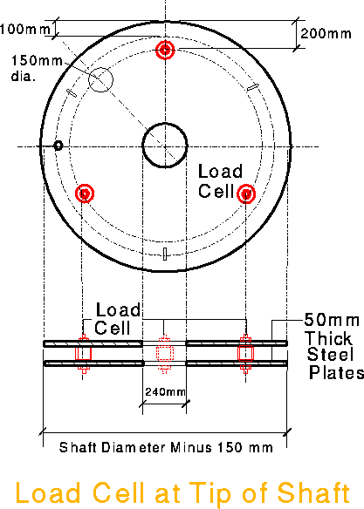
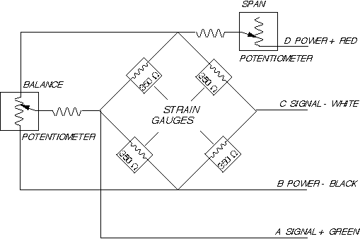
Loadcell
Principle
Load cells measure forces and moments by sensing the deformation of elastic elements such as springs.
Usually it comprises of two parts
  the spring: deforms under the load (usually made of steel)
  sensing element: measures the deformation (usually a strain gauge glued to the deforming element).
Load cell measurement accuracy is limited by hysteresis and creep, that can be minimized by using high-grade steel and labor intensive fabrication.

Slide 15
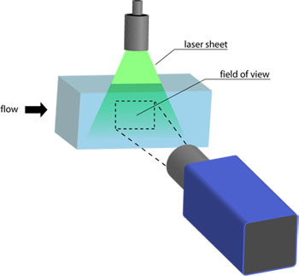
Particle Image Velocimetry (PIV)
PIV setup
Images of the flow field are captured with camera(s).
  1 camera is used for 2-dimesional flow field measurement
  2 cameras are used for stereoscopic 2-dimesional measurement, whereby a third dimension can be extracted → 3-dimensional
  3 or more cameras are used for 3-dimensional measurement
Illumination comes from laser(s), LED’s, or other lights sources
Fluid is saturated with small and neutrally buoyant particles

Slide 16
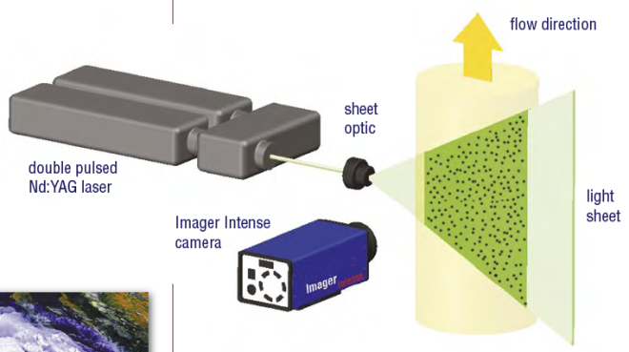
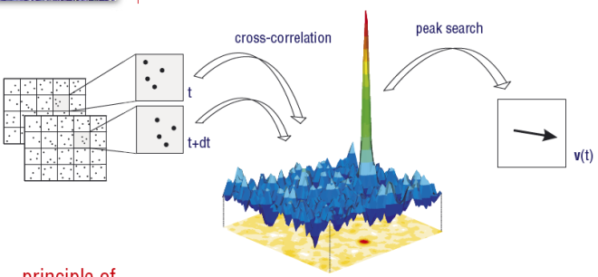
Particle Image Velocimetry (PIV)
Principle of PIV operation
Particles in flow scatter laser(s) light
Two images, per camera, are taken within a small time of one another Δt.
Both images are divided into identical smaller sections, called interrogation windows
Patterns of particles within an interrogation window are traced
Image pixels are calibrated to a known distance
Number of pixels between a particle and the same particle Δt later == a distance
→process called cross correlation
Velocity = direction × (distance a particle travels/ Δt)

Slide 17
Particle Image Velocimetry (PIV)
Advantages of PIV
  Entire velocity field can be calculated
  Capability of measuring flows in 3-D space
  Generally, the equipment is nonintrusive to flow
  High degree of accuracy
Disadvantages of PIV
  Requires proper selection of particles
  Size of flow structures are limited by resolution of image
  Costly

Slide 18
2) Data acquisition - Outline
General scheme of a data acquisition:
Special considerations:
  Correlate sampling type, sampling frequency (Nyquist criterion), and sampling time with the dynamic content of the signal and the flow nature (laminar or turbulent)
  Correlate the resolution for the A/D converters with the magnitude of the signal
  Identify sources of errors for each step of signal conversion

Slide 19
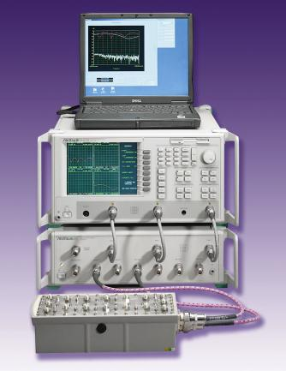



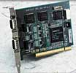
2) Data acquisition - hardware
Adapter cable
8 port smart switch
8 – channel analog
input module
RS232 PCI serial card
Computerized automated data
acquisition system

Slide 20

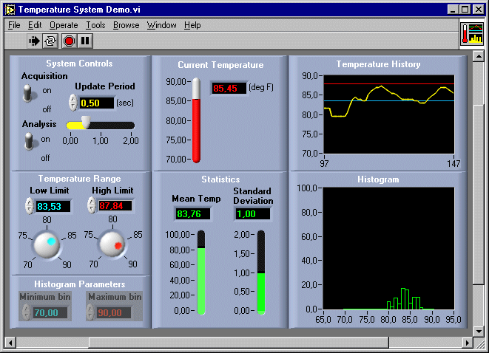
2) Data Acquisition - Software
Introduction to Labview
  Labview is a programming software used for data acquisition, instrument control, measurement analysis, and more.
  Graphical programming language that uses icons instead of text.
  Labview allows to build user interfaces with a set of tools and objects.
  The program is written on block diagrams and a front panel is used to control and run the program.
Typical Labview fron-panel interface

Slide 21
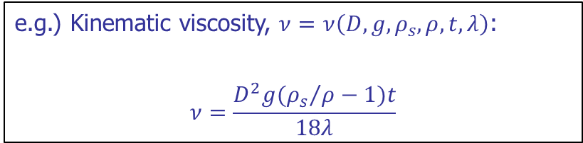
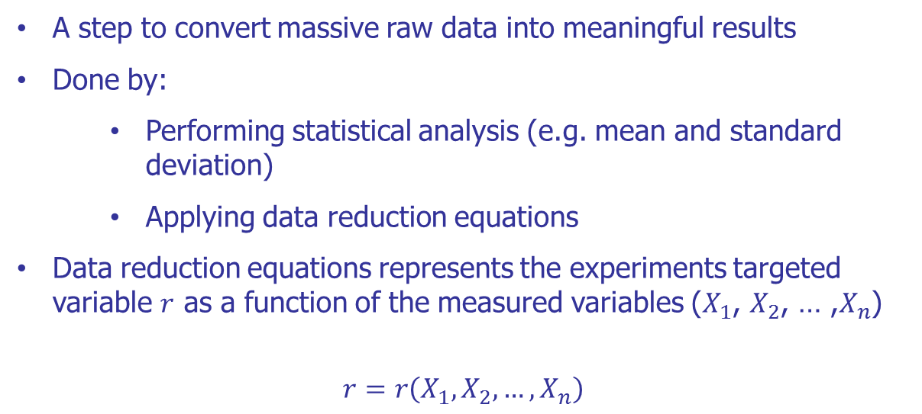
3) Data Reduction
A step to convert massive raw data into meaningful results
Done by:
  Performing statistical analysis (e.g. mean and standard deviation)
  Applying data reduction equations
Data reduction equations represents the experiments targeted variable $r$ as a function of the measured variables ($X_{1}$, $X_{2}$, … ,$X_{n}$)
$$r=r\left(X_{1},X_{2},…, X_{n}\right)$$
e.g.) Kinematic viscosity, $ν=ν\left(D,g,ρ_{s},ρ,t,λ\right)$:
$$ν=\frac{D^{2}g({ρ_{s}}/{ρ−1)t}}{18λ}$$

Slide 22
4) Uncertainty Analysis
Uncertainty analysis (UA) is a rigorous methodology for uncertainty assessment using statistical and engineering concepts
ASME and AIAA standards (e.g., ASME, 1998; AIAA, 1995) and ISO Guide (1995) are the most commonly used of UA methodologies, which are internationally recognized
More recent standard ASME (2005) is a revision of ASME (1998) for a better harmonization with the ISO Guide (1995)

Slide 23
4) Uncertainty Analysis
Definitions:
Error: Difference between measured and true value
Uncertainty: Estimate of errors in measurements of individual variables or results
Estimates of uncertainty is usually made at 95% confidence level
Note:
Accuracy: Closeness of agreement between measured and true value
Notes:
See Coleman and Seele (89)- p.171-181
Analysis in the frequency domain: Figliola and Beasley: pp. 50-53 + 225-233

Slide 24
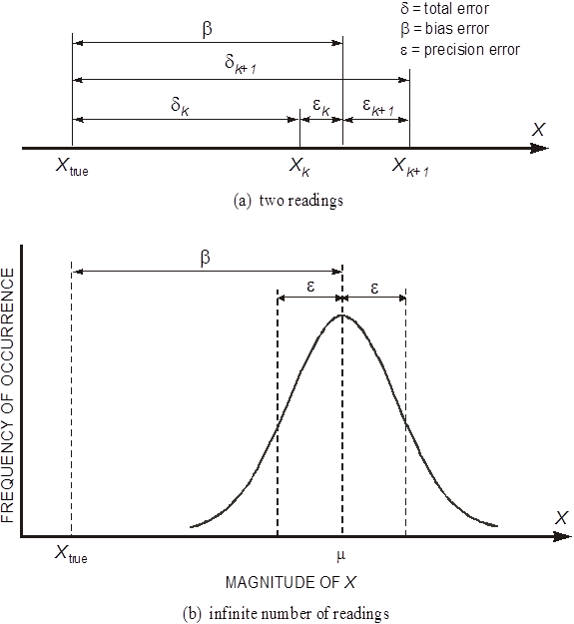
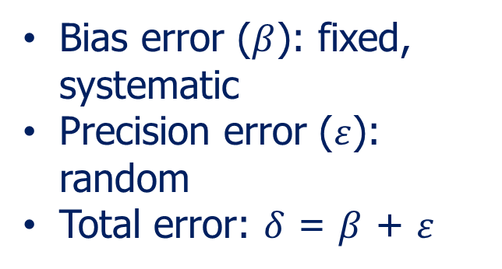
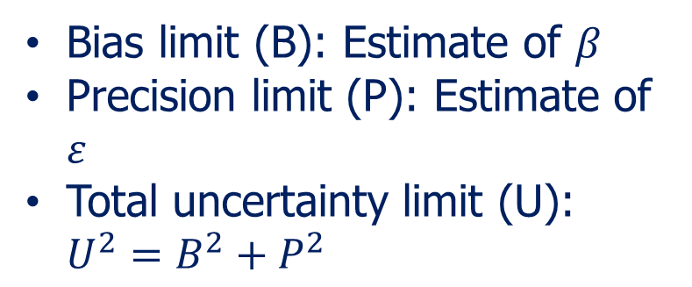
4) Uncertainty Analysis
Error sources:
Uncertainty limits:

Slide 25
4) Uncertainty Analysis
Error propagation: Block diagram shows identifications of elemental error sources for individual measurement system or individual measurement variables and their propagation through data reduction equations and to the final experimental results
Notes:
See Coleman and Seele (89)- p.171-181
Analysis in the frequency domain: Figliola and Beasley: pp. 50-53 + 225-233

Slide 26
5) Data Analysis
Data analysis
  Curve fitting techniques
  Statistical techniques
  Spectral analysis (Fast Fourier Transform)
  Proper orthogonal decomposition
  Data visualizations
Comparisons of the results with bench mark data, CFD, and/or AFD
Evaluate fluid physics
Prepare report

Slide 27
4. 57:020 EFD Labs
Three EFD labs
Each lab consists of two parts: EFD General and ePIV
Total 6 lab activities
Lab | EFD General | ePIV
1 | Viscosity experiment | Cylinder flow
2 | Pipe experiment | Step-up flow
3 | Airfoil experiment | Airfoil flow
Notes:
See Coleman and Steele, 1989- Chapter I

Slide 28
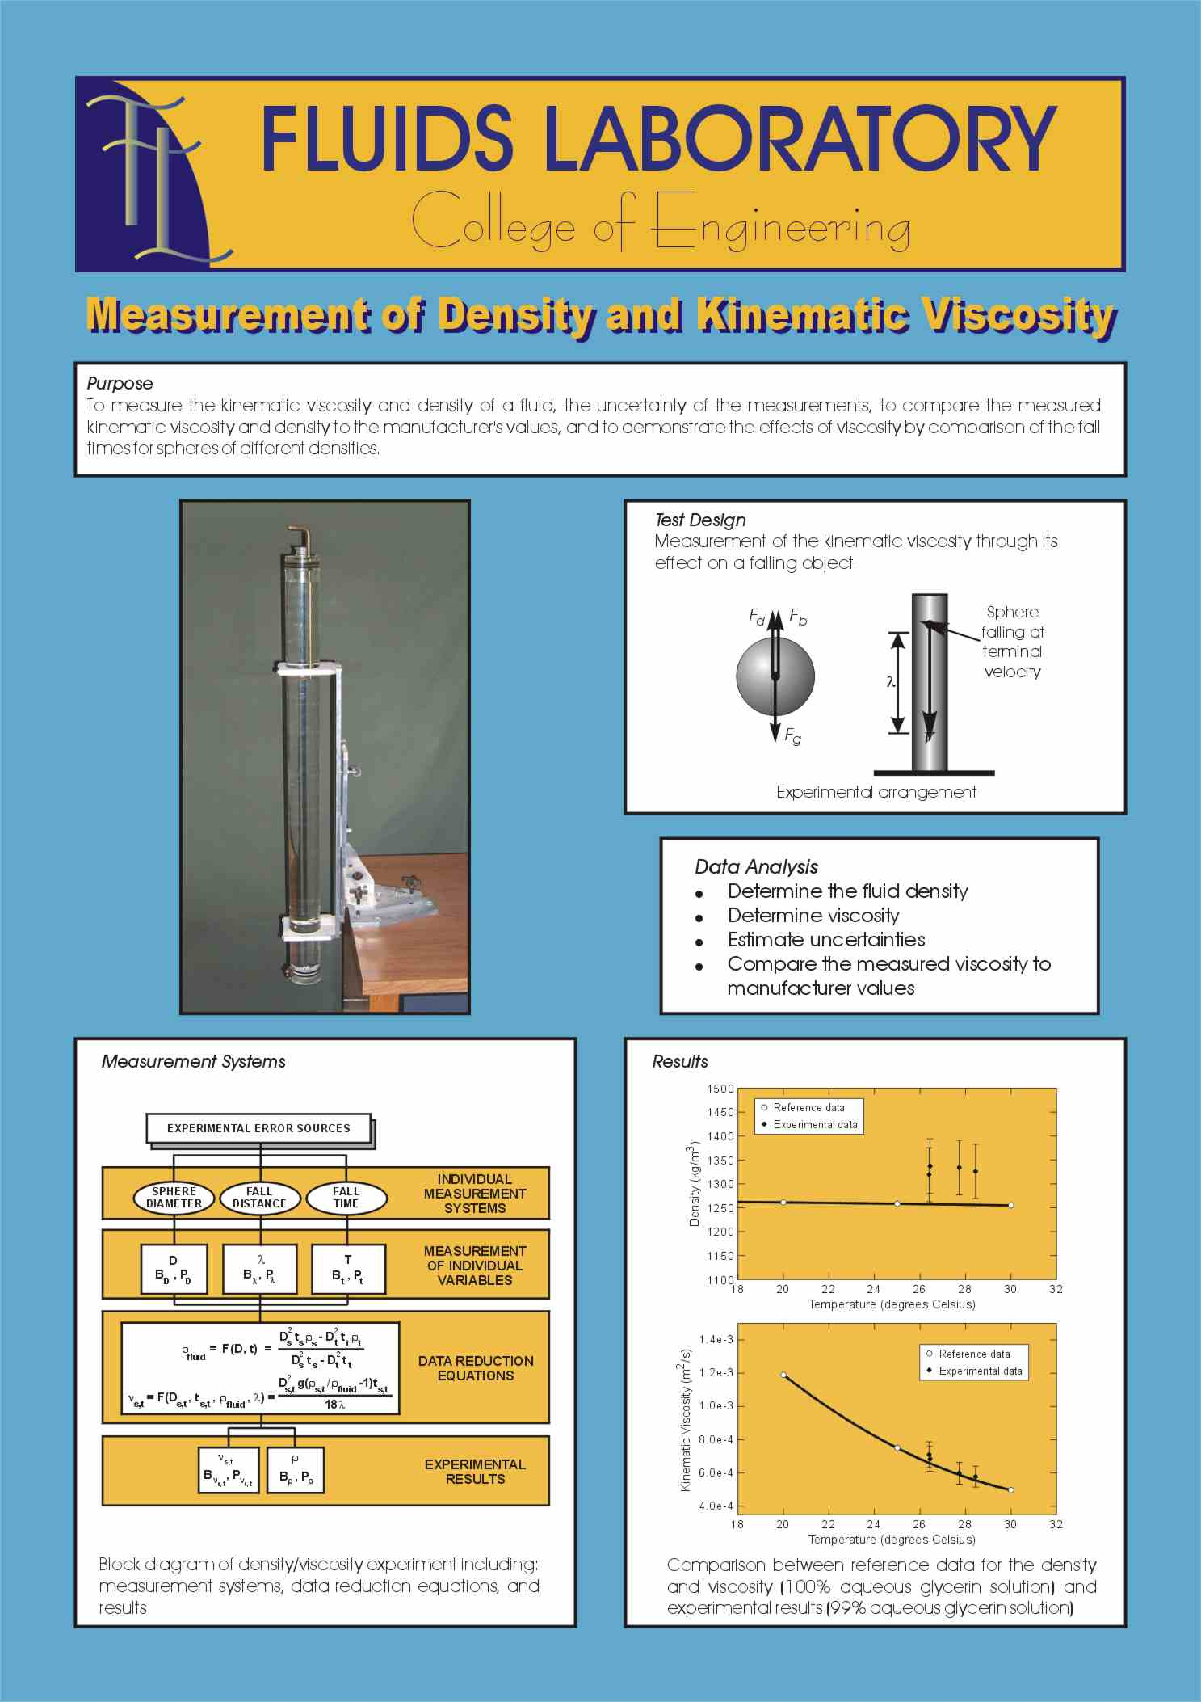
1) Lab 1 – Viscosity experiment
Kinematic viscosity and mass density measurements for Glycerin:
  Definition of “EFD Process”
  Data reduction equation
  Estimates of errors and uncertainties
  Bias, precision, and total uncertainty

Slide 29
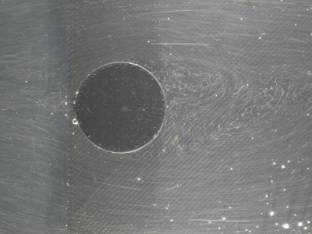
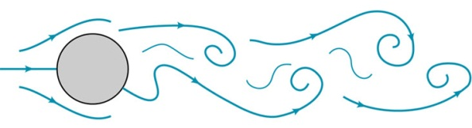

2) Lab 1 – Cylinder flow (ePIV)
Flow streamline visualization around a circular cylinder model
  PIV camera settings
  Flow streamlines visualization around bluff bodies

Slide 30
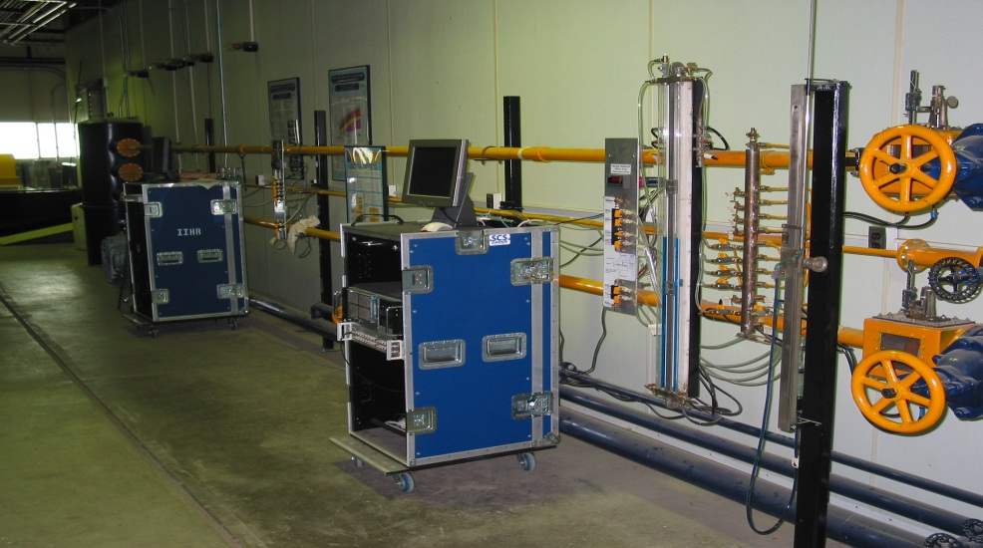
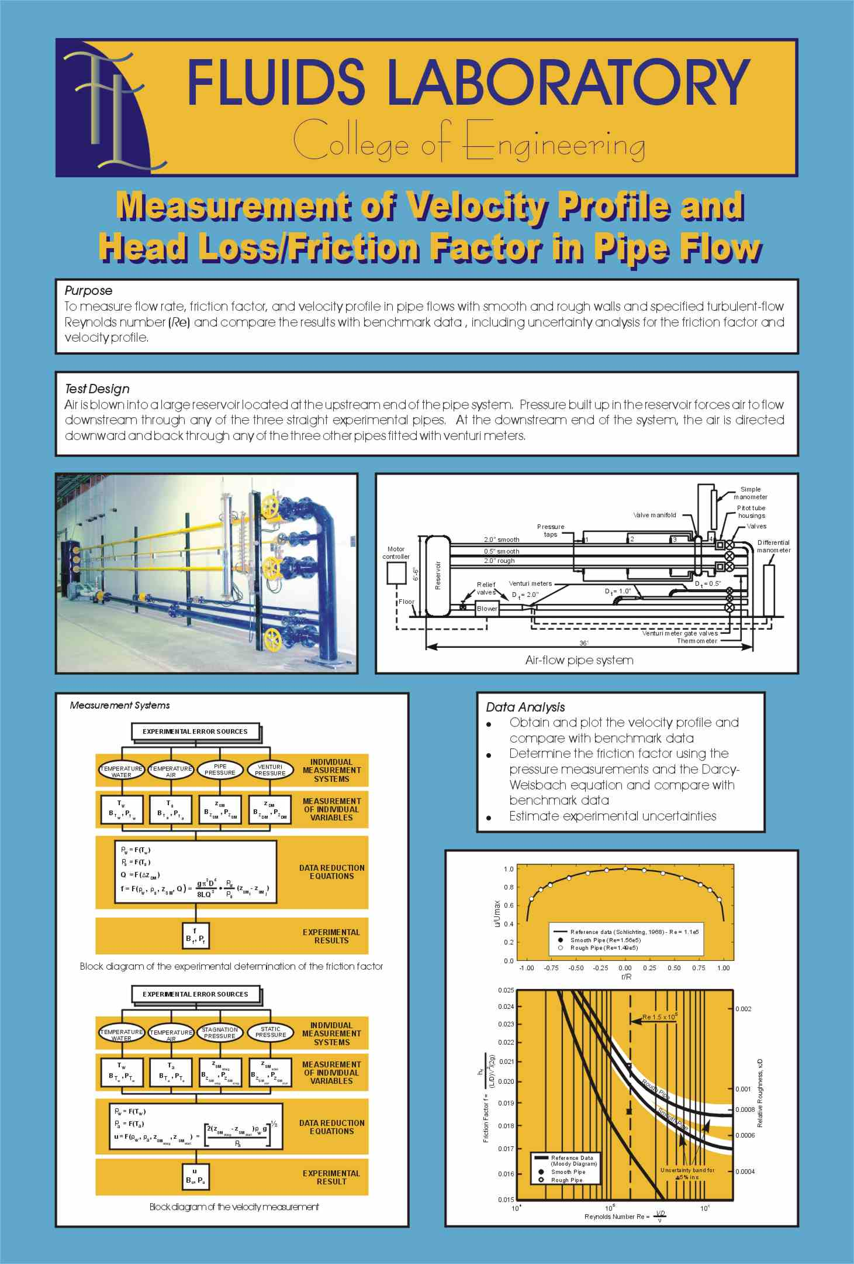
3) Lab 2 – Pipe experiment
Flow rate, friction factor, and velocity profile measurements for smooth and rough pipes
  Comparison between automated and manual data acquisition systems
  Measurement systems using pressure tap, Venturi-meter, and pitot probe
  Automated data acquisition using LabView
  The importance of non-dimensionalization and comparison of results with benchmark data

Slide 31
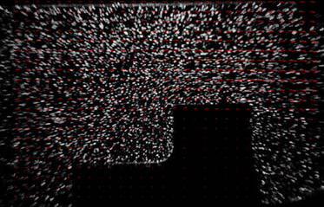
4) Lab 2 – Step-up flow (ePIV)
Flow rate and average velocity for a step-up model
  PIV image correlation parameters and PIV data reduction
  Mass conservation law (flow rate and average velocity)

Slide 32
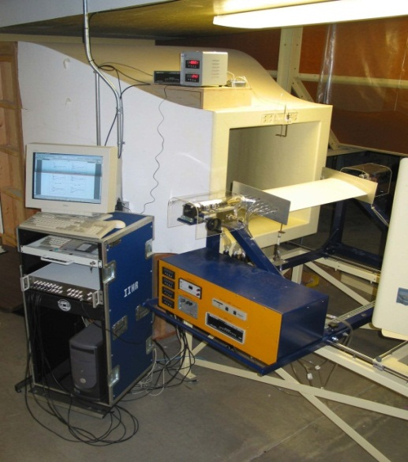
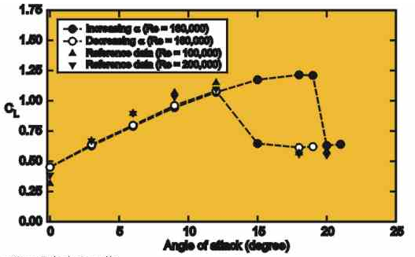
5) Lab 3 – Airfoil experiment
Surface pressure distribution, wake velocity profile, and lift and drag forces measurements for a Clark-Y airfoil model
  Using LabView for setting test conditions and data acquisition
  Calibration of loadcell
  Measurement of lift and drag forces with loadcell
  Measurement of pressure distribution and velocity profile for an airfoil model

Slide 33
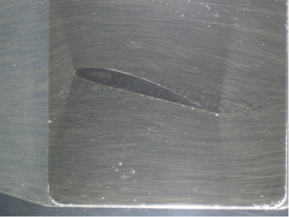
6) Lab 3 – Airfoil flow (ePIV)
Velocity field and flow streamlines around Clark-Y airfoil model (miniature)
  PIV data post-processing using Tecplot software
  Flow around lifting bodies

Slide 34
Lab Schedule and Report Instructions
Lab Schedule:
See the class website:
http://css.engineering.uiowa.edu/~fluids/fluids.htm
Lab Safety:
See the class website:
http://user.engineering.uiowa.edu/~fluids/
Lab report instructions
See the class website:
http://css.engineering.uiowa.edu/~fluids/documents/
instructions_for_lab_report.pdf
Notes:
See Coleman and Seele (89)- p.171-181
Analysis in the frequency domain: Figliola and Beasley: pp. 50-53 + 225-233

Slide 35
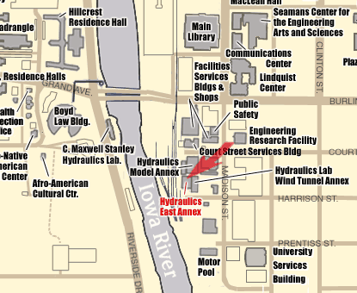
Lab location: general map
Notes:
See Coleman and Seele (89)- p.171-181
Analysis in the frequency domain: Figliola and Beasley: pp. 50-53 + 225-233

