Slide 1
CFD Pre-Lab 2
Simulation of Turbulent Flow Around an Airfoil
Created by Seong Mo Yeon, Timur Dogan
Edited by Dong-Hwan Kim
Notes:
Introduce yourself
Introduce Lab – Simulation of Laminar Pipe Flow in smooth pipe

Slide 2
Outline
Overview of Flow Around Airfoil
CFD Process
Geometry
Mesh
Physics
Results

Slide 3
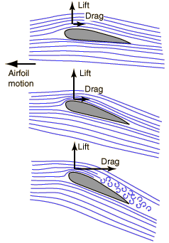
Overview of Flow Around Airfoil
Simulation of the flow around the airfoil will be conducted for this lab
Computational fluid dynamics (CFD) results for drag and lift coefficients, coefficient of pressure around the airfoil will be compared to experimental fluid dynamics (EFD)
This lab will cover concept of boundary layer and flow separation
Flow visualization around airfoil
(starts at 5:34)
Notes:
Questions:
What is the velocity at the wall?
Talking Points:
Simulating laminar pipe flow
Comparing CFD results to AFD solutions
Look at the developing profile
Uniform inlet to quadratic
Linear pressure drop in fully developed flow
Developing length

Slide 4
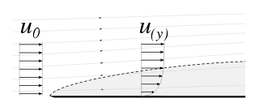
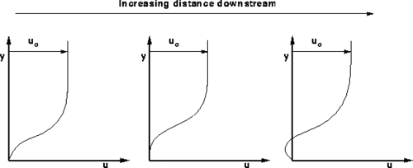
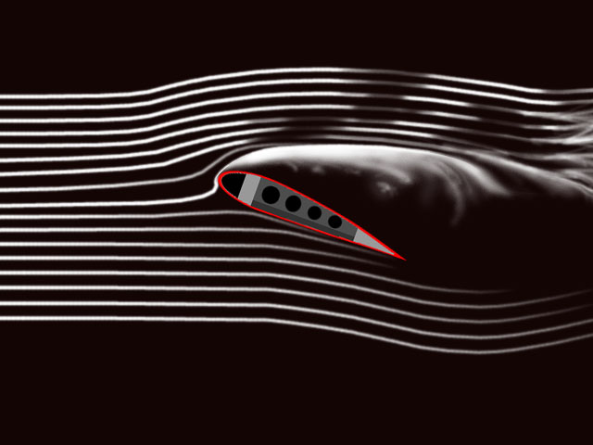
Overview of Flow Around Airfoil
Boundary Layer
  Defined by Ludwig Prandtl
  Generated by viscosity near wall
  Cause of lift and drag forces
  Inviscid vs. viscous flow
  Flow separation
  Note: Refer to Chapter 9 of your book for more details
Flow visualization of boundary layer
(Start at 3:21)
Notes:
Talking Points:
Laminar flow is viscous dominated
Low Re #
Turbulent flow is inertial dominated
High Re #

Slide 5
CFD Process
The overall procedure for simulation of flow around airfoil is shown on chart below
Although we will be making the mesh before we define the physics you have to know the physics to design appropriate mesh.
Geometry
Physics
Mesh
Solution
Results
Airfoil (ANSYS Design Modeler)
General (ANSYS Fluent - Setup)
Structured (ANSYS Mesh)
Solution Methods (ANSYS Fluent - Solution)
Plots (ANSYS Fluent- Results)
C-Domain (ANSYS Design Modeler)
Model (ANSYS Fluent - Setup)
Graphics and Animations (ANSYS Fluent- Results)
Boundary Conditions (ANSYS Fluent -Setup)
Non-uniform (ANSYS Mesh)
Solution Controls (ANSYS Fluent - Solution)
O-Domain (ANSYS Design Modeler)
Monitors (ANSYS Fluent - Solution)
Reference Values (ANSYS Fluent - Setup)
Turbulent
Solution Initialization
(ANSYS Fluent - Solution)
Solution Initialization (ANSYS Fluent -Solution)
Run Calculation
(ANSYS Fluent - Solution)
Notes:
Talking Points:
Physics must be known to properly construct mesh/grid
Example: must know if flow is turbulent to determine grid refinement for B.L.
Need many grid points to resolve large velocity grads noticed in turbulent B.L.
In ANSYS mesh comes before physics

Slide 6
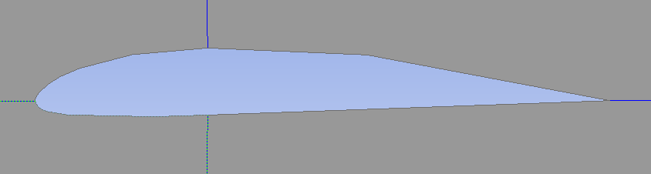
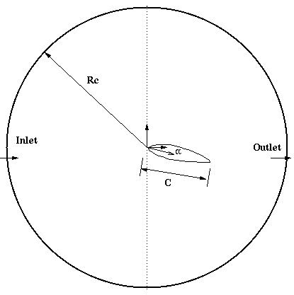
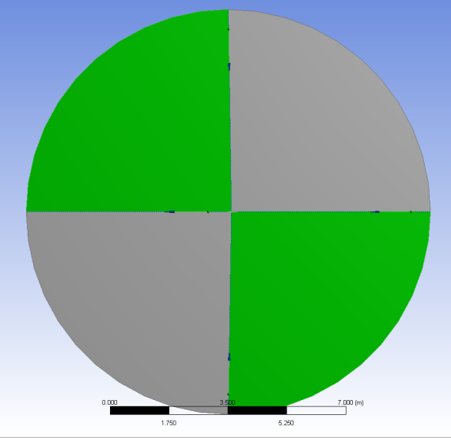
ANSYS Design Modeler (Geometry)
Import Clark-Y airfoil geometry
Split O-type domain into four pieces
Parameter | Value
Chord length, c | 0.3048 m
Diameter of domain, Rc | 12.0 m
Angle of attack, α | 0, 16
Notes:
Talking Points:
In CFD it is best to simplify problem for efficiency
Pipe can be simplified into 2D rectangle axisymmetric about centerline

Slide 7
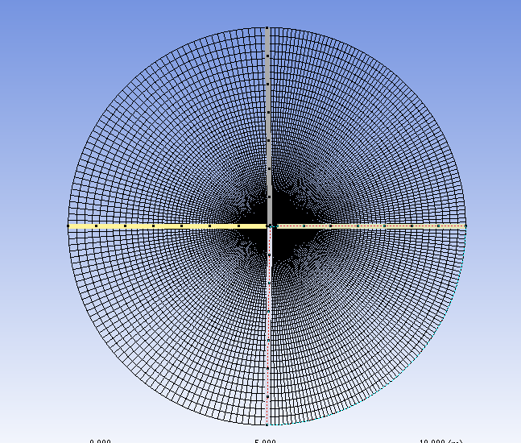
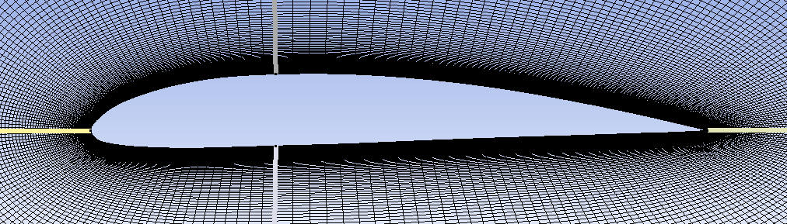
ANSYS Mesh
Fine mesh at the boundary layer region to resolve large velocity gradients
Notes:
Talking Points:
CFD is discretizing the fluid flow and solving N.S. eqns numerically at each grid point
Discretize geometry by splitting sides
Can get information at any discretized point

Slide 8
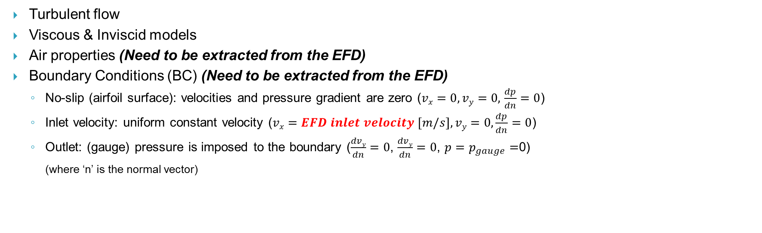
ANSYS Fluent – Physics
Turbulent flow
Viscous & Inviscid models
Air properties (Need to be extracted from the EFD)
Boundary Conditions (BC) (Need to be extracted from the EFD)
  No-slip (airfoil surface): velocities and pressure gradient are zero ($vx=0,vy=0,$ $\frac{dp}{dn}=0$)
  Inlet velocity: uniform constant velocity ($vx=EFD inlet velocity [m/s],vy=0,\frac{dp}{dn}=0$)
  Outlet: (gauge) pressure is imposed to the boundary ($\frac{dvy}{dn}=0$, $\frac{dvy}{dn}=0$, $p=$ $p_{gauge}=$0)
(where ‘n’ is the normal vector)
Wall – No slip BC
Inlet – Velocity inlet BC
Outlet – Pressure outlet BC
Notes:
Talking Points:
No slip wall
Symmetric about axis for axial velocity and pressure
Uniform inlet velocity
Outlet pressure

Slide 9
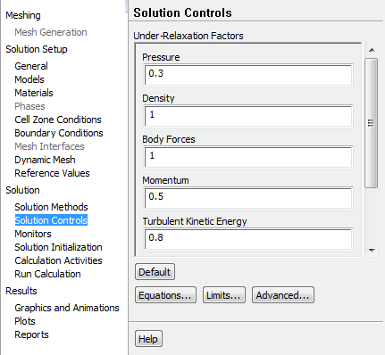
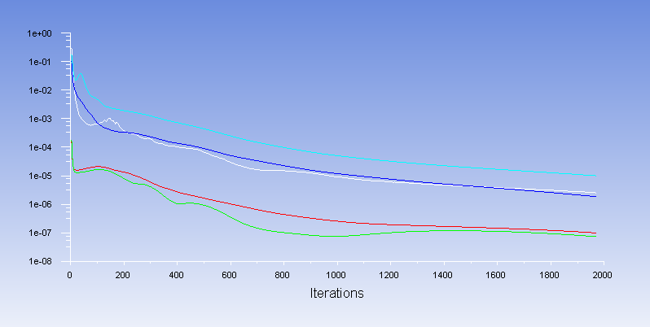
ANSYS Fluent – Solution
If you have problems with solution convergence reduce Under-Relaxation Factors. This issue is more likely to occur for large angle of attack cases.
Also you may need to increase the number of iterations
Notes:
Questions:
Can anyone explain what fully developed flow is?
Why is friction coefficient constant in fully developed
Talking Points:
Explain developing length
Linear pressure drop in fully developed

Slide 10
ANSYS Fluent – Results
Notes:
Questions:
Can anyone explain what fully developed flow is?
Why is friction coefficient constant in fully developed
Talking Points:
Explain developing length
Linear pressure drop in fully developed

Slide 11
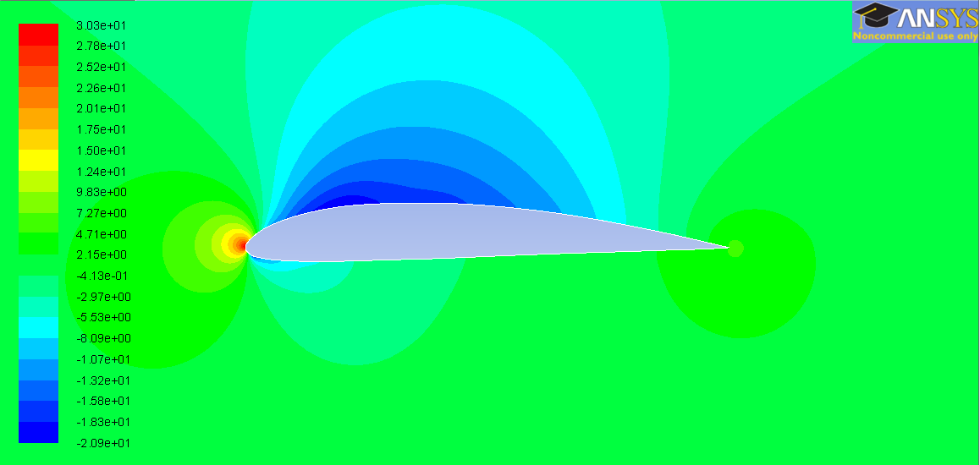
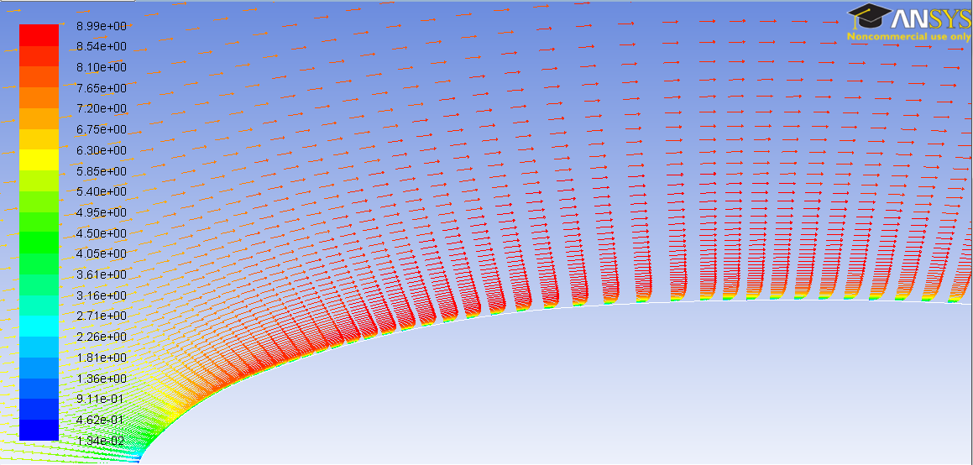
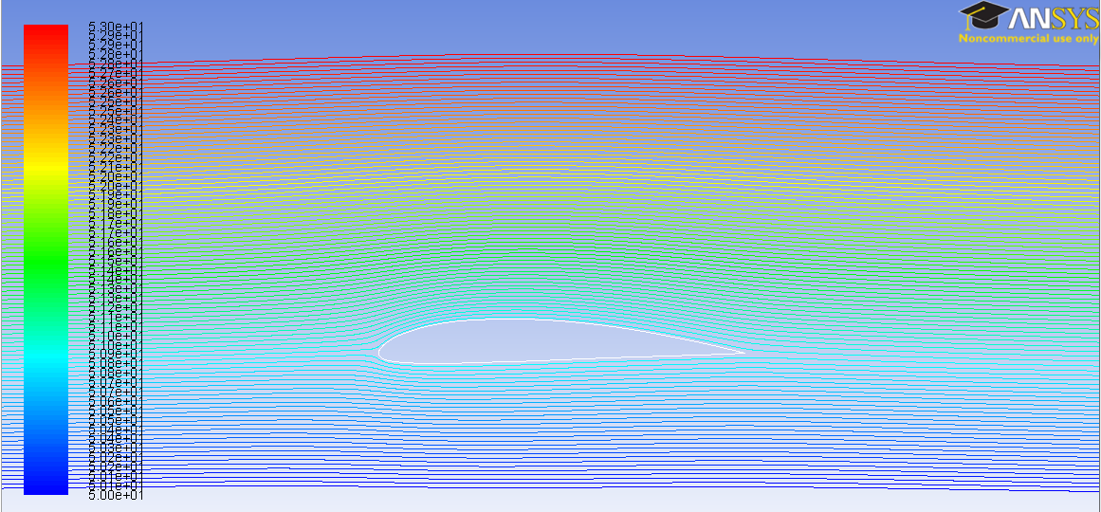
ANSYS Fluent – Results
Pressure distribution around airfoil
Velocity vectors near wall and boundary layer development
Stream lines around airfoil
Notes:
Questions:
Can anyone explain what fully developed flow is?
Why is friction coefficient constant in fully developed
Talking Points:
Explain developing length
Linear pressure drop in fully developed

Slide 12
Questions?
Deadline for the CFD Lab 2 report is two weeks after from your CFD lab 2
(same as CFD Prelab1 & Lab1)
Pre-lab 2 questions will be graded separately, so it doesn’t need to be attached to the report
Bring EFD Lab3 Data Reduction Sheet for CFD Lab2, so that you can simulate AOA=16 degree case
Use the Lab drop-box when turning in your lab reports
Come to the office hours for any help

