Slide 1
CFD Lab 1
Simulation of Turbulent Pipe Flow
Created by Seong Mo Yeon, Timur Dogan
Edited by Michael Conger, Dong-Hwan Kim
Notes:
Introduce yourself
Introduce Lab – Simulation of Laminar Pipe Flow in smooth pipe

Slide 2
Outline
Overview of Pipe Flow
CFD Process
Geometry
Mesh
Physics
Results

Slide 3
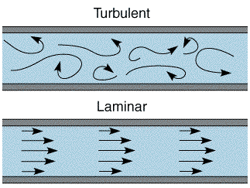
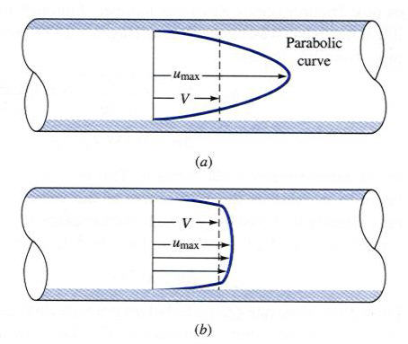
Overview of Pipe Flow
Simulation of turbulent pipe flow will be conducted for this lab
Axial velocity profile, centerline velocity, centerline pressure, and wall shear stress will be analyzed
Computational fluid dynamics (CFD) results for friction factor and velocity profile and centerline pressure will be compared to experimental fluid dynamics (EFD)
This lab will cover concept of laminar vs. turbulent flow and developing length for pipe flows
Notes:
Questions:
What is the velocity at the wall?
Talking Points:
Simulating laminar pipe flow
Comparing CFD results to AFD solutions
Look at the developing profile
Uniform inlet to quadratic
Linear pressure drop in fully developed flow
Developing length

Slide 4
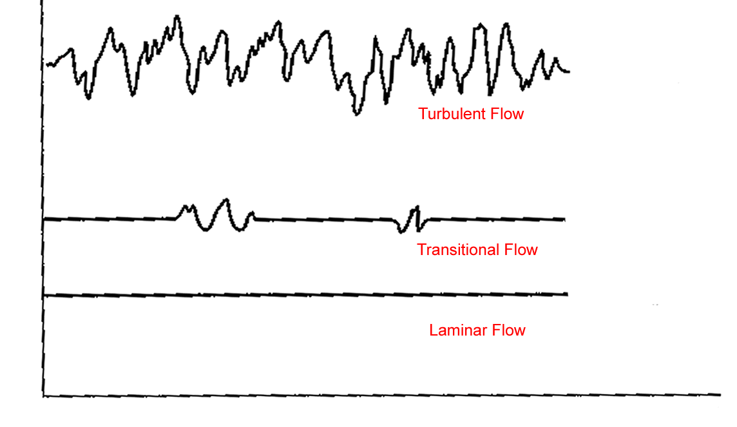
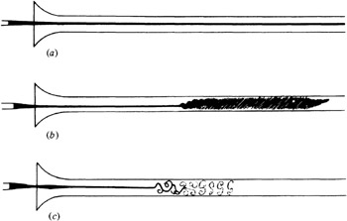
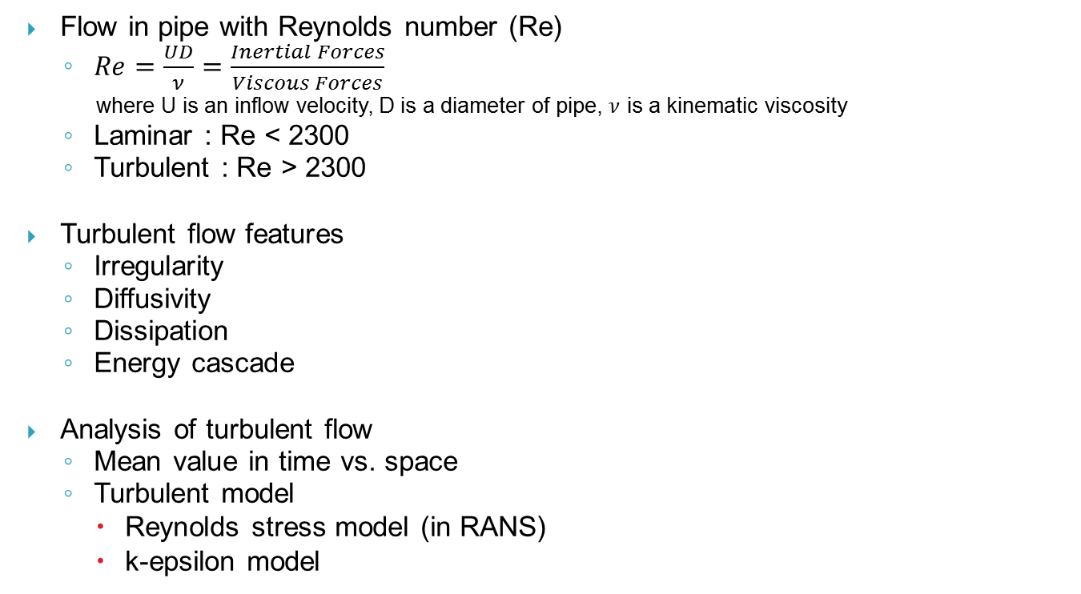
Overview of Pipe Flow
Flow in pipe with Reynolds number (Re)
  $Re=\frac{UD}{ν}=\frac{Inertial Forces}{Viscous Forces}$
  where U is an inflow velocity, D is a diameter of pipe, $ν$ is a kinematic viscosity
  Laminar : Re < 2300
  Turbulent : Re > 2300
Turbulent flow features
  Irregularity
  Diffusivity
  Dissipation
  Energy cascade
Analysis of turbulent flow
  Mean value in time vs. space
  Turbulent model
    Reynolds stress model (in RANS)
    k-epsilon model
Flow visualization of transition from laminar to turbulent flow
Turbulent mixing flow in pipe
Notes:
Talking Points:
Laminar flow is viscous dominated
Low Re #
Turbulent flow is inertial dominated
High Re #

Slide 5
CFD Process
The overall procedure for simulation of pipe flow is shown on chart below
Although we will be making the mesh before we define the physics you have to know the physics to design appropriate mesh.
Geometry
Physics
Mesh
Solution
Results
Pipe (ANSYS Design Modeler)
General (ANSYS Fluent - Setup)
Structure (ANSYS Mesh)
Solution Methods (ANSYS Fluent - Solution)
Plots (ANSYS Fluent- Results)
Model (ANSYS Fluent - Setup)
Non-uniform (ANSYS Mesh)
Graphics and Animations (ANSYS Fluent- Results)
Turbulent
Boundary Conditions (ANSYS Fluent -Setup)
Monitors (ANSYS Fluent - Solution)
Reference Values (ANSYS Fluent - Setup)
Solution Initialization (ANSYS Fluent -Solution)
Notes:
Talking Points:
Physics must be known to properly construct mesh/grid
Example: must know if flow is turbulent to determine grid refinement for B.L.
Need many grid points to resolve large velocity grads noticed in turbulent B.L.
In ANSYS mesh comes before physics

Slide 6
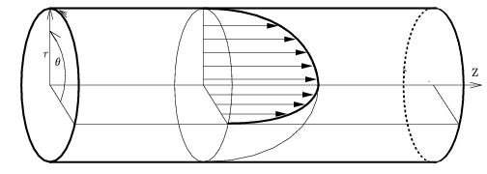
ANSYS Design Modeler (Geometry)
Symmetric property of the flow is used to create 2D representation of the 3D pipe flow
R
D
Parameter | Value
Radius of pipe, R | 0.02619 m
Diameter of pipe, D | 0.05238 m
Length of pipe, L | 6.096 m
L
Wall
Flow
Inlet
Outlet
=location of the EFD pressure tab #4,
and will be treated as an outlet in CFD
Center
Notes:
Talking Points:
In CFD it is best to simplify problem for efficiency
Pipe can be simplified into 2D rectangle axisymmetric about centerline

Slide 7
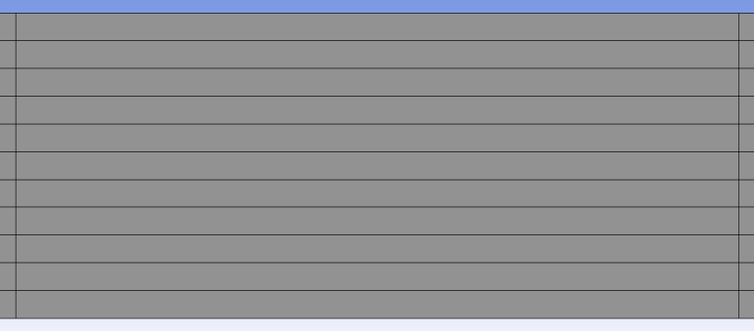

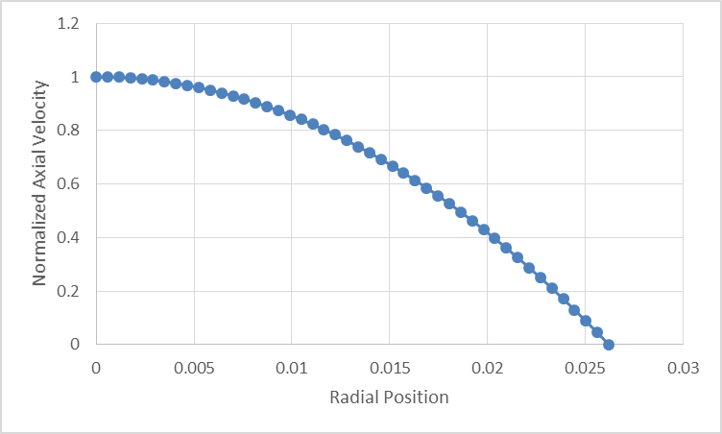
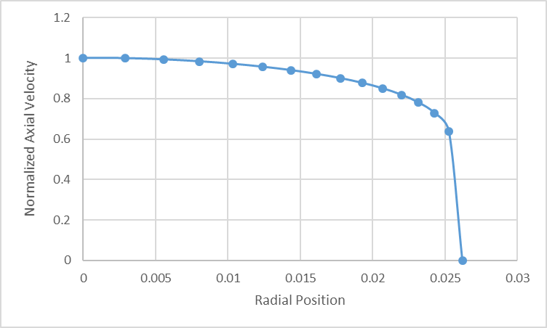
ANSYS Mesh
Previously, in Pre-lab1, uniform grid distribution was used for laminar flow
Velocity profile of turbulent flow need more resolution near the wall
because of its larger velocity gradient (𝑑𝑢/𝑑𝑟) near the wall than in laminar flow
Non-uniform mesh is better for the turbulent flow
Laminar
Turbulent
Notes:
Talking Points:
CFD is discretizing the fluid flow and solving N.S. eqns numerically at each grid point
Discretize geometry by splitting sides
Can get information at any discretized point

Slide 8
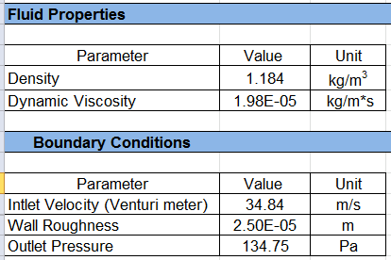
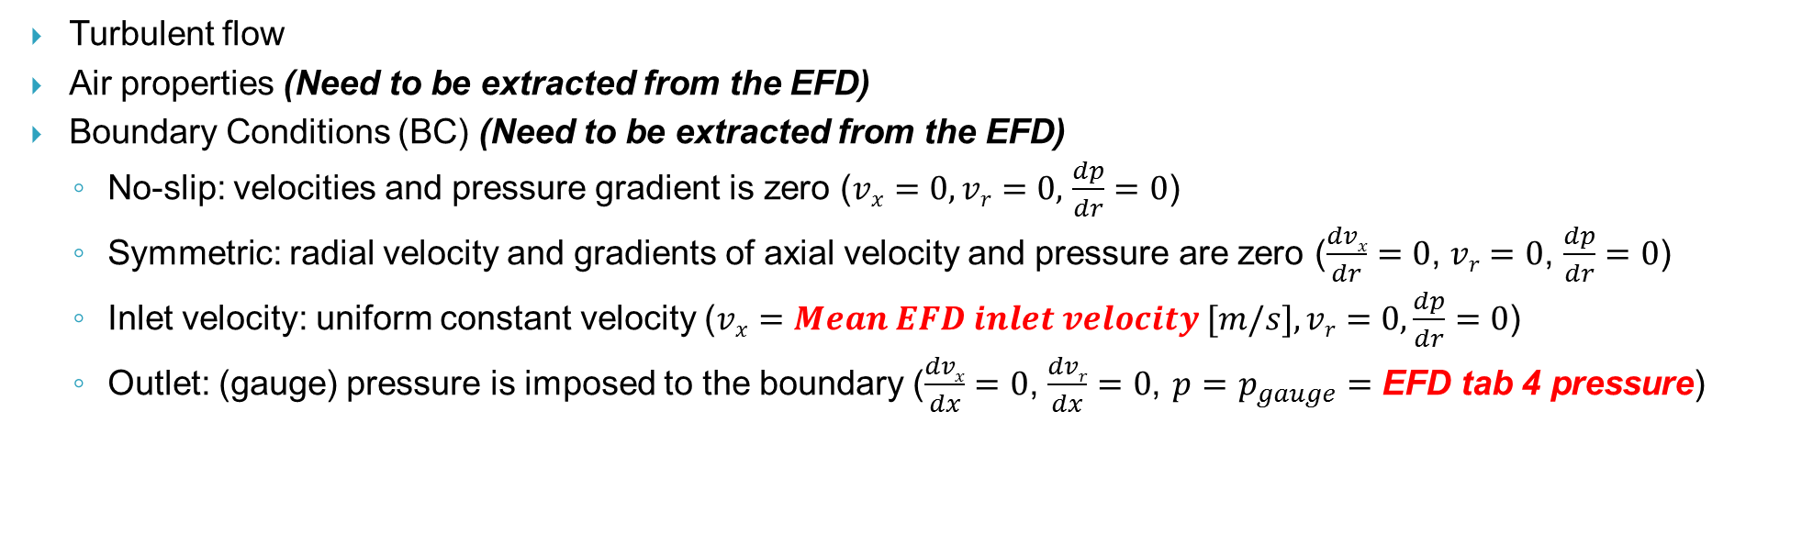
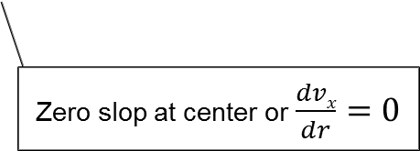
ANSYS Fluent – Physics
Turbulent flow
Air properties (Need to be extracted from the EFD)
Boundary Conditions (BC) (Need to be extracted from the EFD)
  No-slip: velocities and pressure gradient is zero ($vx=0,vr=0,$ $\frac{dp}{dr}=0$)
  Symmetric: radial velocity and gradients of axial velocity and pressure are zero ($\frac{dvx}{dr}=0$, $vr=0$, $\frac{dp}{dr}=0$)
  Inlet velocity: uniform constant velocity ($vx=Mean EFD inlet velocity [m/s],vr=0,\frac{dp}{dr}=0$)
  Outlet: (gauge) pressure is imposed to the boundary ($\frac{dvx}{dx}=0$, $\frac{dvr}{dx}=0$, $p=$ $p_{gauge}=$ EFD tab 4 pressure)
r
Wall – No slip BC
Inlet –
Velocity inlet BC
Flow
Outlet –
Pressure outlet BC
x
Center – Axisymmetric BC
Zero slop at center or $\frac{dvx}{dr}=0$
“CFD Input” tab in “EFD Lab 2 Data Reduction Sheet”
Notes:
Talking Points:
No slip wall
Symmetric about axis for axial velocity and pressure
Uniform inlet velocity
Outlet pressure

Slide 9
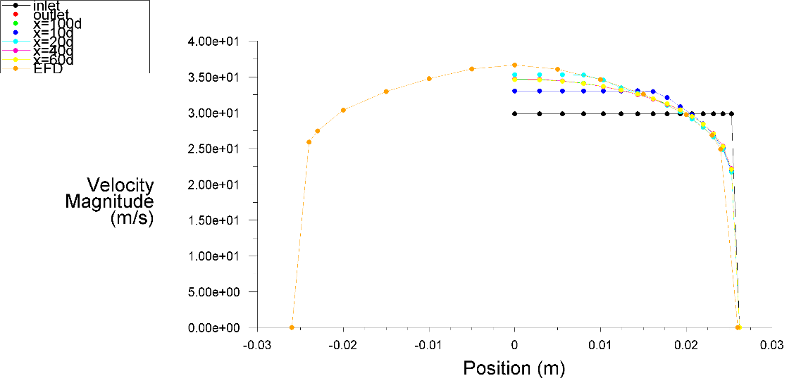
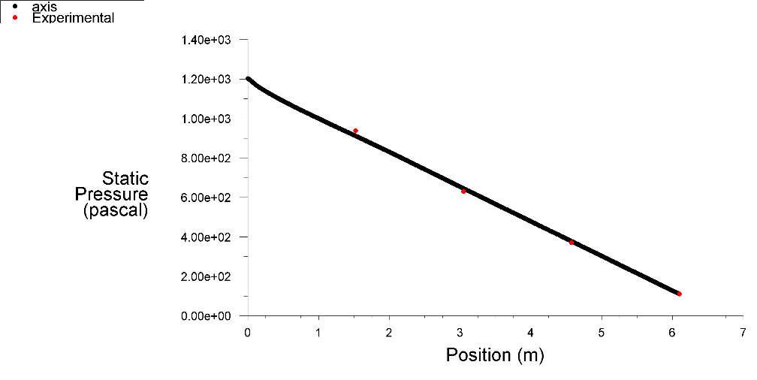
ANSYS Fluent – Results
Validation of the wall friction factor
Factor_{CFD} | Factor_{EFD} | %Error
0.01745 | 0.01801 | 3.07
Validation of the velocity profile at the developed region and the pressure distribution
Notes:
Questions:
Can anyone explain what fully developed flow is?
Why is friction coefficient constant in fully developed
Talking Points:
Explain developing length
Linear pressure drop in fully developed

Slide 10
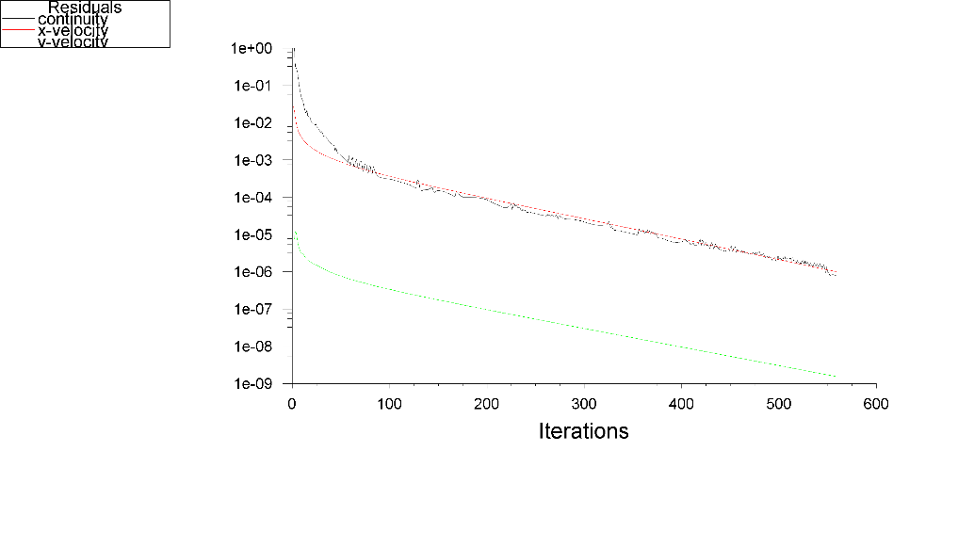
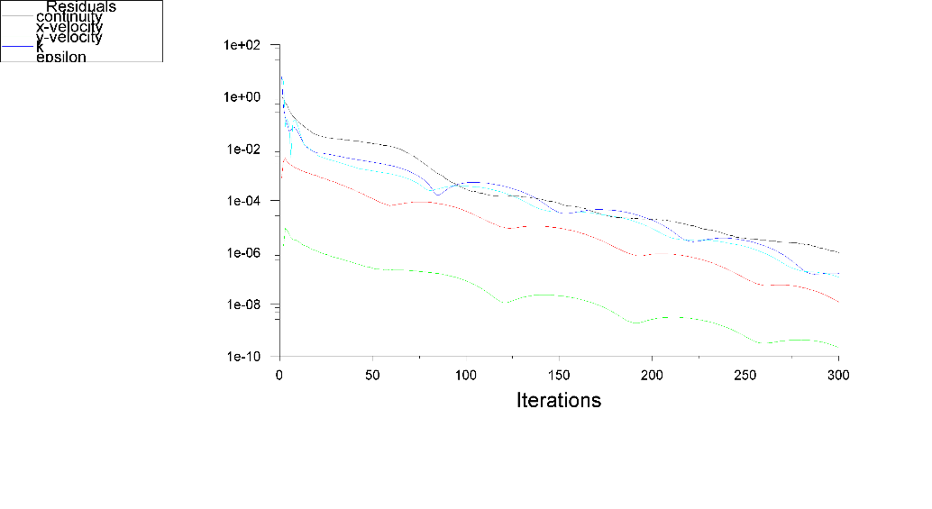
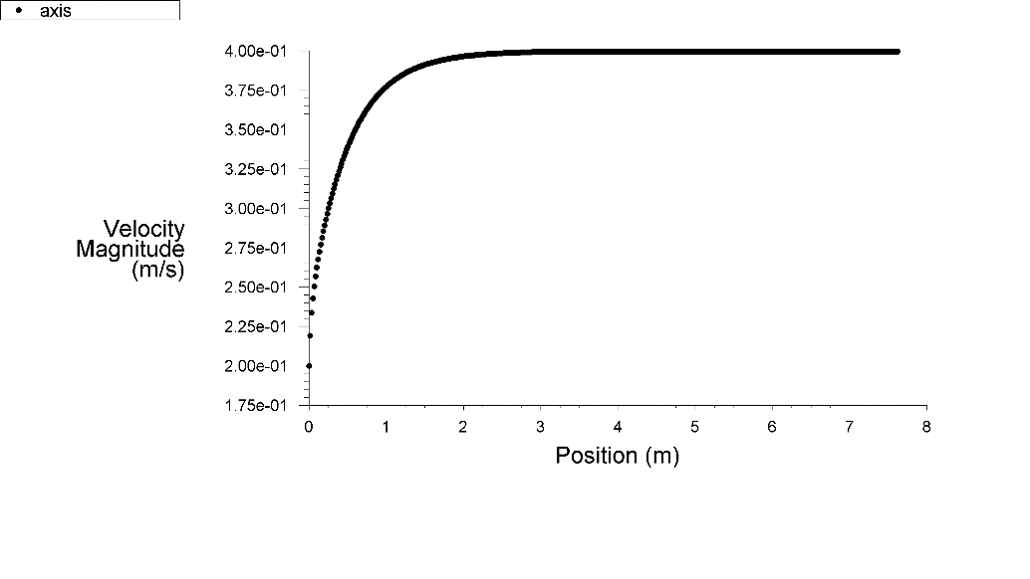
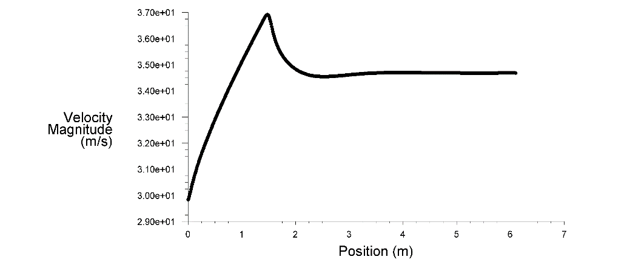
ANSYS Fluent – Results
Laminar
Turbulent
Developing
region
Developed region
Developing
region
Developed region
Notes:
Questions:
Can anyone explain what fully developed flow is?
Why is friction coefficient constant in fully developed
Talking Points:
Explain developing length
Linear pressure drop in fully developed

Slide 11
Questions?
Deadline for the CFD Lab 1 report is two weeks after from your CFD lab 1 (Today)
Please download the “CFD Lab1 Report Template.doc” under the “CFD Lab 1” section in the website, and fill out both Pre-lab1 and Lab1 answers (there’s no separate report for the Pre-lab 1)
Pre-lab 1 questions will be graded separately, so it doesn’t need to be attached to the report
Use the Lab drop-box when turning in your lab reports
Come to the office hours for any help

