Slide 1
CFD Lab 1
Simulation of Turbulent Pipe Flow
Seong Mo Yeon, and Timur Dogan
10/20/2013

Slide 2
Outline
Overview of Pipe Flow
CFD Process
Geometry
Mesh
Physics
Solution
Results

Slide 3
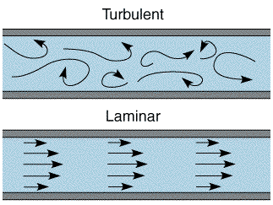
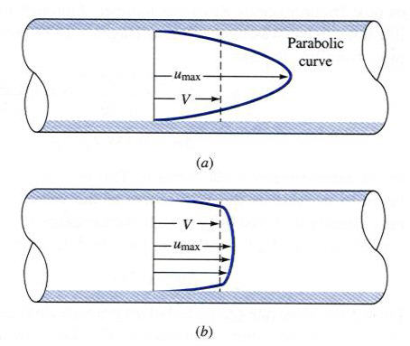
Overview of Pipe Flow
Simulation of turbulent pipe flow will be conducted for this lab
Axial velocity profiles, centerline velocity, centerline pressure, and wall shear stress will be analyzed
Computational fluid dynamics (CFD) results for friction factor and velocity profile and centerline pressure will be compared to experimental fluid dynamics (EFD)
This lab will cover concept of laminar vs. turbulent flow and developing length for pipe flows

Slide 4
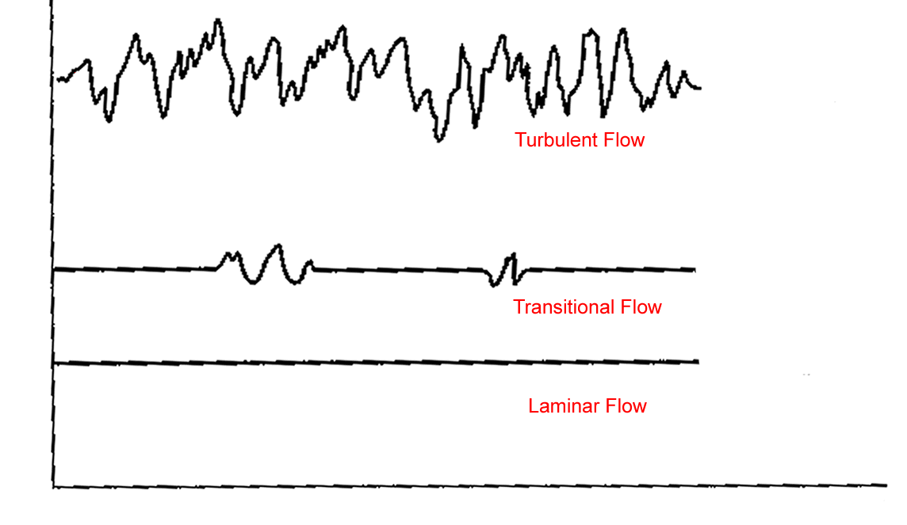
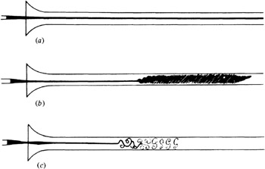

Overview of Pipe Flow
Flow in pipe with Reynolds(Re) number
  $Re=\frac{UD}{ν}=\frac{Inertial Forces}{Viscous Forces}$
  Laminar : Re < 2300
  Turbulent : Re > 2300
Turbulent flow features
  Irregularity
  Diffusivity
  Dissipation
  Energy cascade
Analysis of turbulent flow
  Mean value in time vs. space
  Turbulent model
    Reynolds stress model (in RANS)
    k-epsilon model
Flow visualization of transition from laminar to turbulent flow
Turbulent mixing flow in pipe

Slide 5
CFD Process
Although we will be making the mesh before we define the physics you have to know the physics to design appropriate mesh.
Geometry
Physics
Mesh/Grid
Solution
Results
Pipe (ANSYS Design Modeler)
General (ANSYS Fluent - Setup)
Structure (ANSYS Mesh)
Solution Methods (ANSYS Fluent - Solution)
Plots (ANSYS Fluent- Results)
Model (ANSYS Fluent - Setup)
Uniform (ANSYS Mesh)
Graphics and Animations (ANSYS Fluent- Results)
Turbulent
Boundary Conditions (ANSYS Fluent -Setup)
Non-uniform (ANSYS Mesh)
Monitors (ANSYS Fluent - Solution)
Reference Values (ANSYS Fluent - Setup)
Solution Initialization (ANSYS Fluent -Solution)

Slide 6
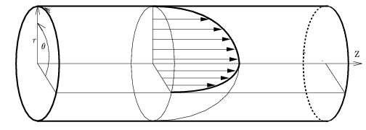
Geometry
Symmetric property of the flow is used to create 2D representation of the 3D pipe flow
R
D
L
Parameter | Value
Radius of pipe, R | 0.02619 m
Diameter of pipe, D | 0.05238 m
Length of pipe, L | 7.62 m
Wall
Flow
Inlet
Outlet
Center

Slide 7
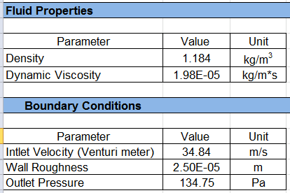
Physics
Extract BC and Fluid Properties information from the EFD
Inlet : Flow rate by Venturi meter measurement
Outlet : Pressure measurement at tap 4

Slide 8
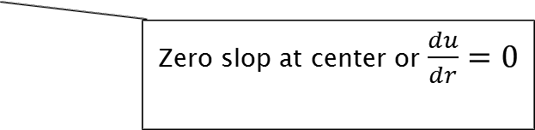
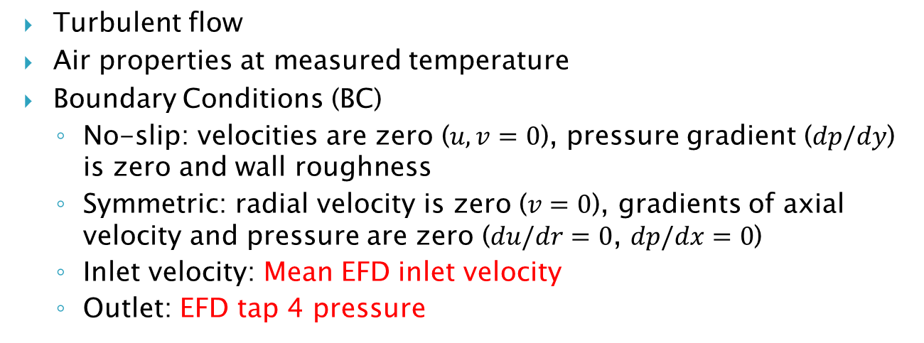
Physics
r
Wall – No slip BC
Inlet – Velocity inlet BC
Flow
Outlet – Pressure outlet BC
x
Center – Axisymmetric BC
Zero slop at center or $\frac{du}{dr}=0$
Turbulent flow
Air properties at measured temperature
Boundary Conditions (BC)
  No-slip: velocities are zero ($u,v=0$), pressure gradient ($dp/dy$) is zero and wall roughness
  Symmetric: radial velocity is zero ($v=0$), gradients of axial velocity and pressure are zero ($du/dr=0$, $dp/dx=0$)
  Inlet velocity: Mean EFD inlet velocity
  Outlet: EFD tap 4 pressure

Slide 9


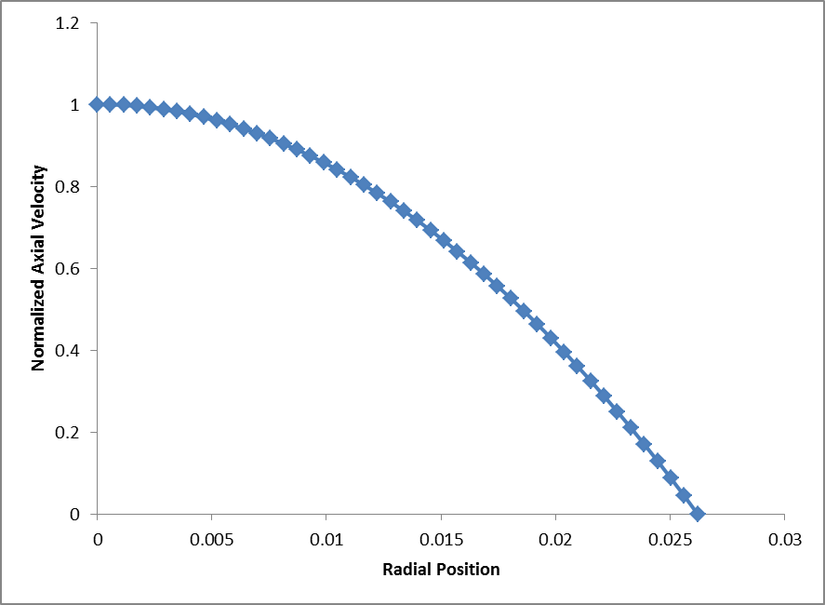
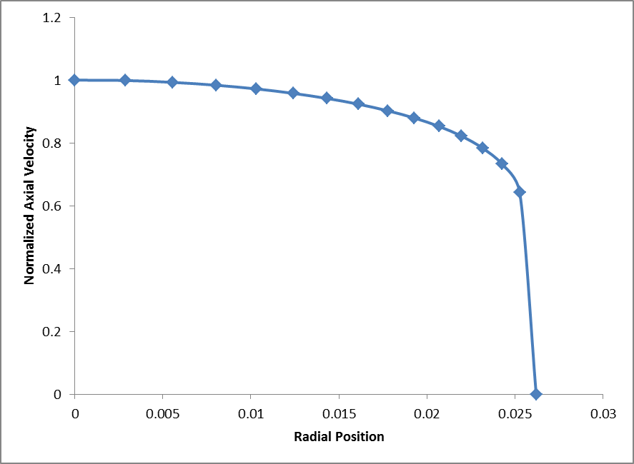
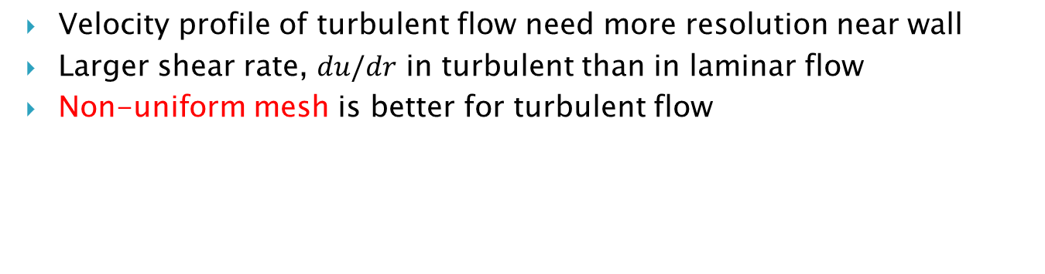
Mesh
Velocity profile of turbulent flow need more resolution near wall
Larger shear rate, $du/dr$ in turbulent than in laminar flow
Non-uniform mesh is better for turbulent flow

Slide 10
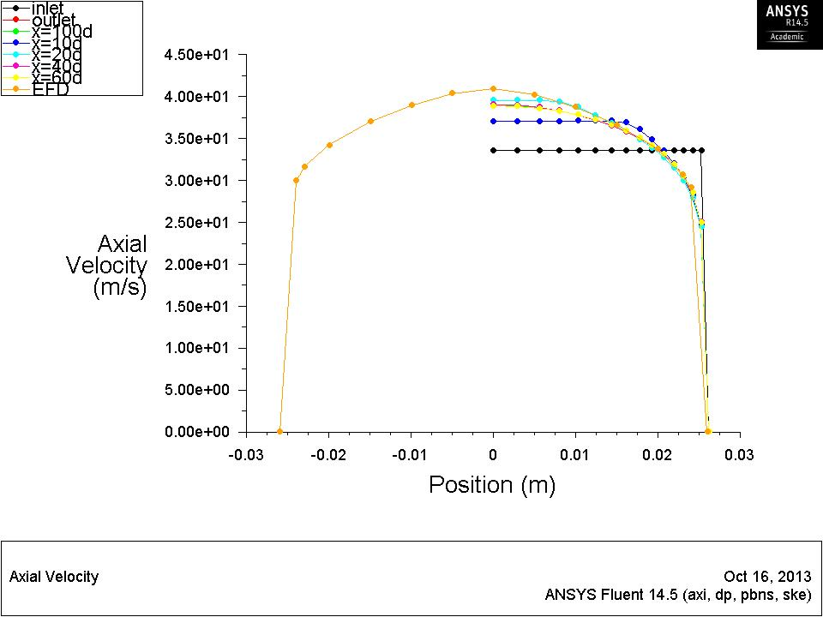
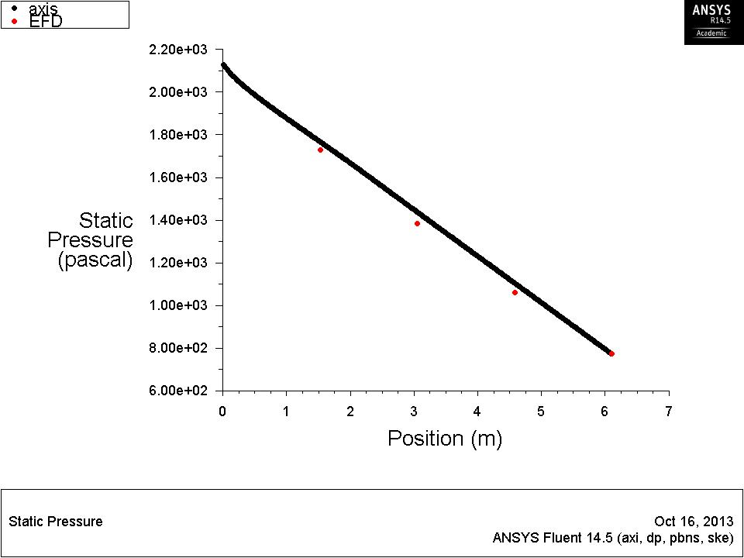
Results
Validation of wall friction factor
Validation of velocity profile at the developed region and pressure distribution

Slide 11
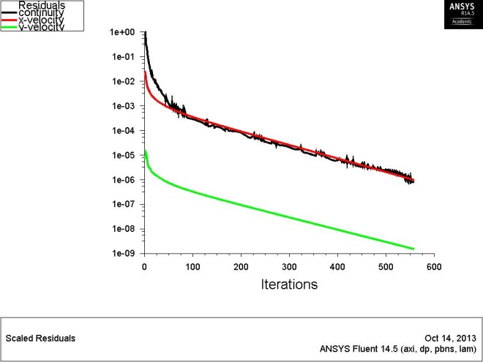
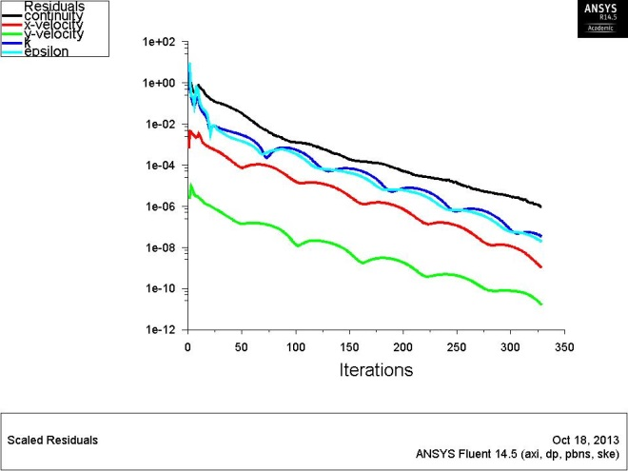
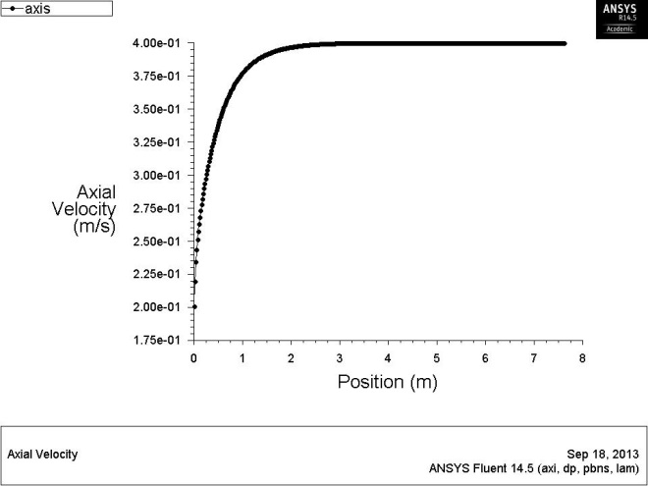
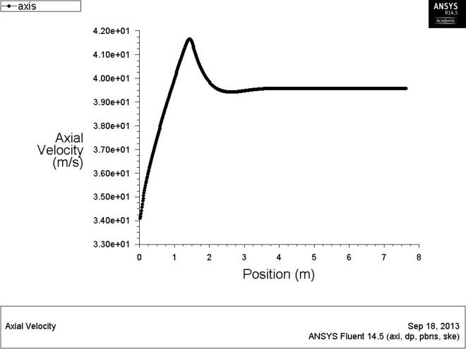
Results
Developing
region
Developed region
Developed region
Developing
region
Laminar
Turbulent

