Slide 1
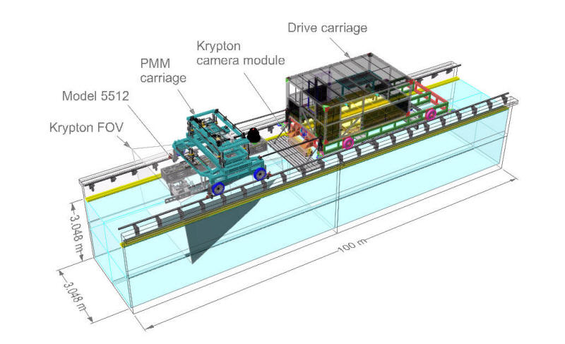
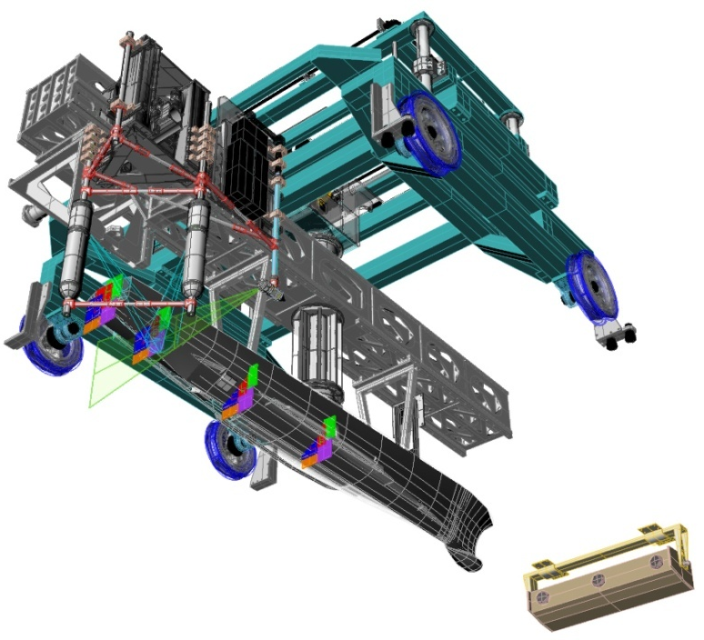
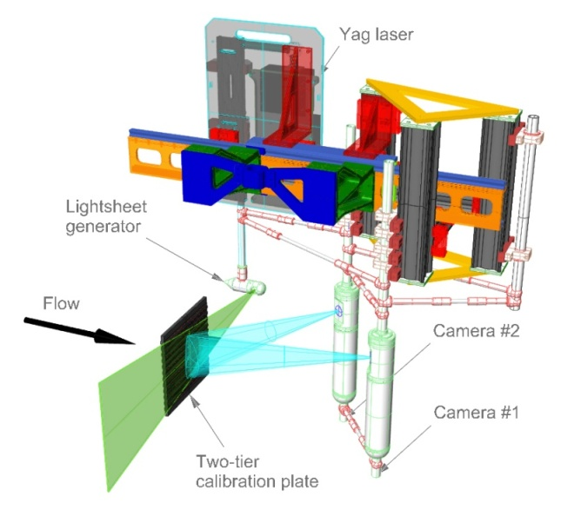
PMM-PIV (Phase-averaged 3D Unsteady flow around a surface ship)
PMM Test:
Static drift test
Pure sway test
Pure yaw test
Yaw and drift test
IIHR Towing Tank Facility
PMM-PIV arrangement
3D Stereo PIV System

Slide 2
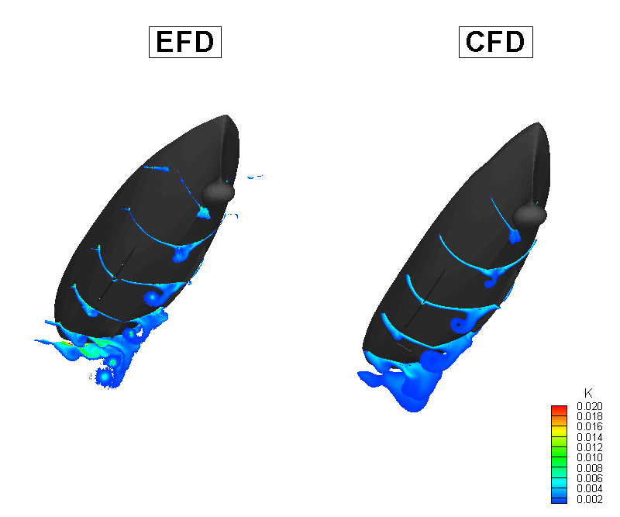
Comparisons with CFD†
^{(Turbulent flow structure)}
† N. Sakamoto, P. Carrica, J. Shao , CFDSHIP-IOWA (2006)

Slide 3
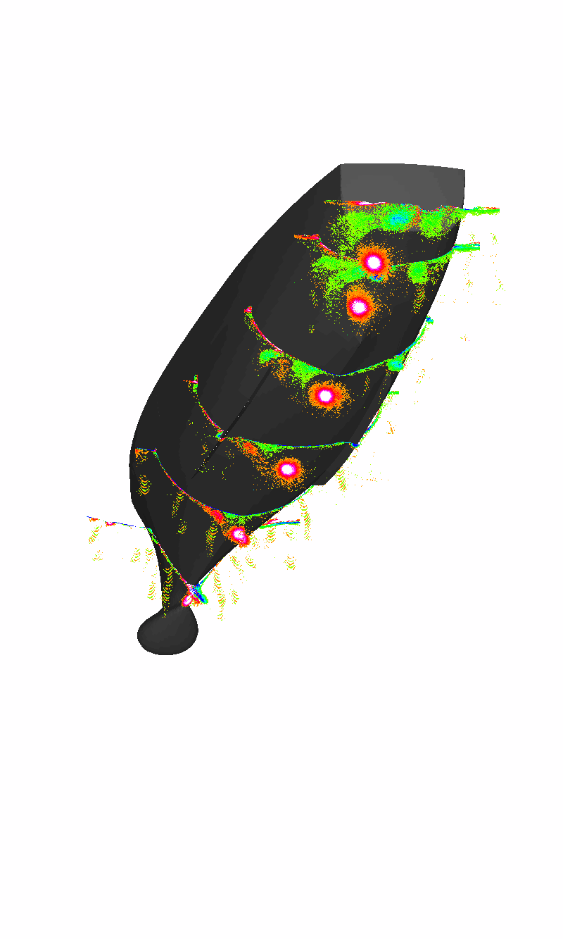
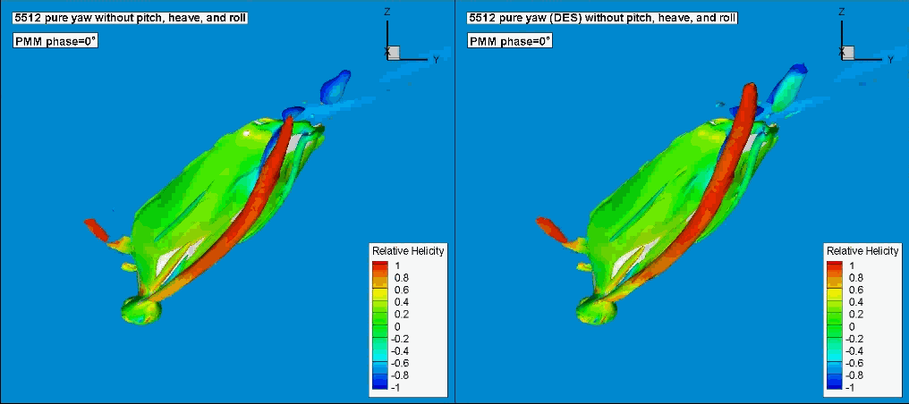
Comparisons with CFD†
^{(Vortical flow structure)}
PIV
RANS
DES
† N. Sakamoto, P. Carrica, J. Shao , CFDSHIP-IOWA (2006)

