Slide 1
FLOWLAB setting and tips
N.Sakamoto
057:020 Fall 2008

Slide 2
Initial setting-Start up
Log-in to the computer.
Create the working directory under:
C:\Documents and Settings\”your HawkID”\myflowlab

Slide 3
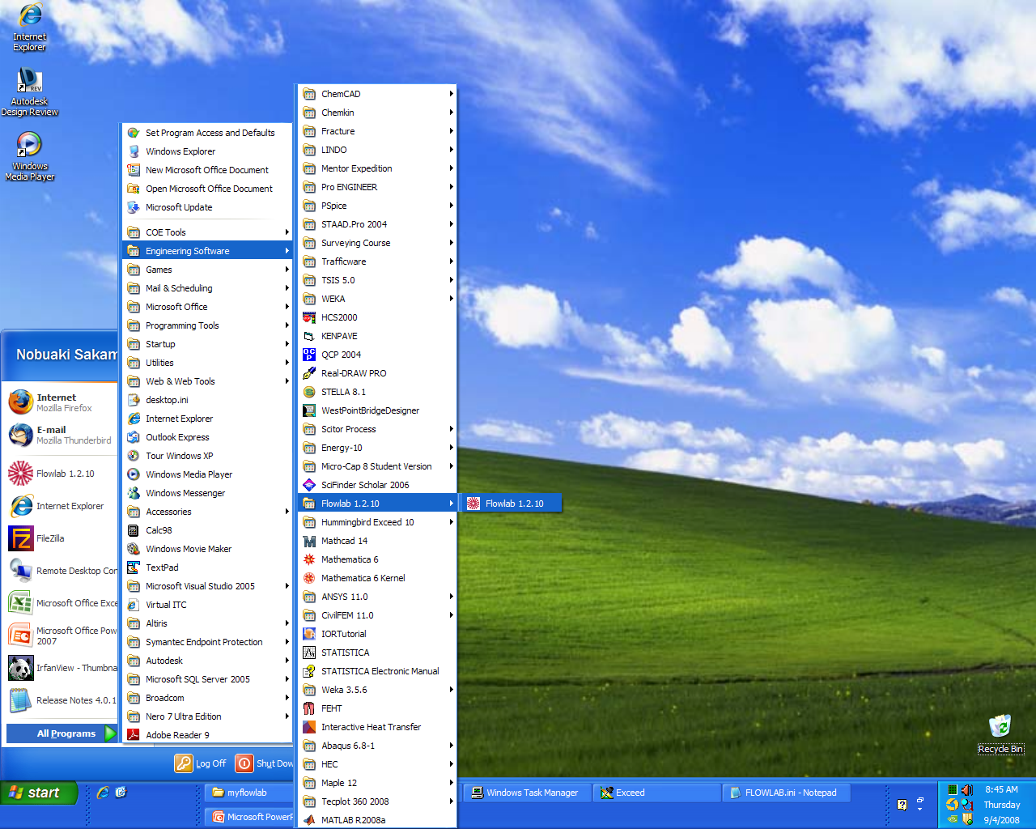
Initial setting-Start up
Start
→All program
→Engineering Software
→Flowlab 1.2.10

Slide 4
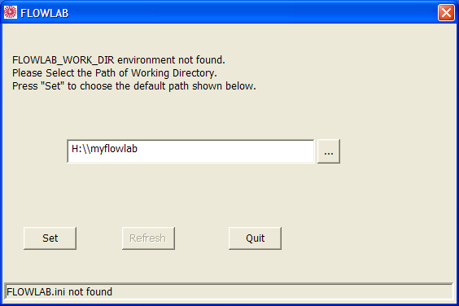
Initial setting-Start up
Click here to set up the working directory under C:\Documents and Settings\”your HawkID”\myflowlab

Slide 5
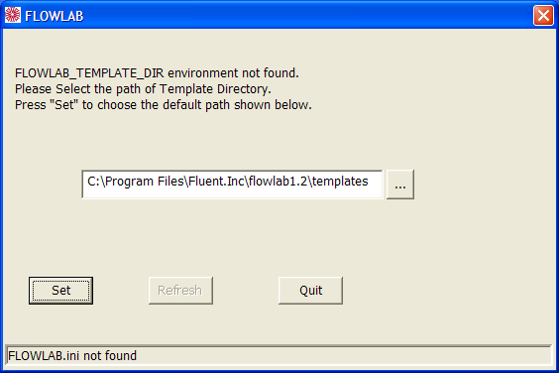
Initial setting-Start up
This can be remain as it is.

Slide 6
Initial setting-Dialog boxes
CONFIRMATION:
Set up your working directory?
DO NOT choose H:/ drive.
-Exceed related?
Ignore or press “No”

Slide 7
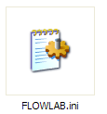
Initial setting-Directory set up
-Find “FLOWLAB.ini” under H drive (network drive)
-Check directory setting in FLOWLAB.ini as:
FLOWLAB_WORK_DIR C:\Documents and Settings\”hawkid”\myflowlab
FLOWLAB_TEMPLATE_DIR C:\Program Files\Fluent.Inc\flowlab1.2\templates
FLOWLAB_SAVE_DIR H:\myflowlab

Slide 8
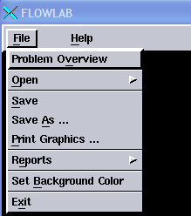
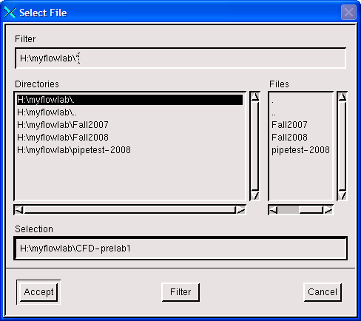
Tips-Save the current work
1
3
2
4

Slide 9
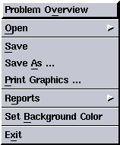
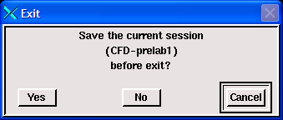
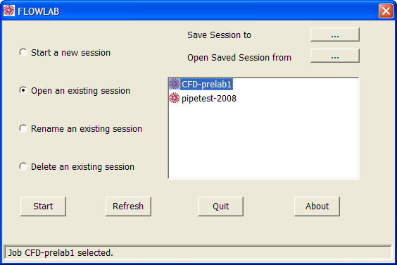
Tips-Open saved session
When you exit the Flowlab:
2
1
When you open saved session:
-Cannot find saved session?
→You might press ‘No’ when you quit.
→Check your Flowlab.ini file settings
→Check your H:/myflowlab

Slide 10
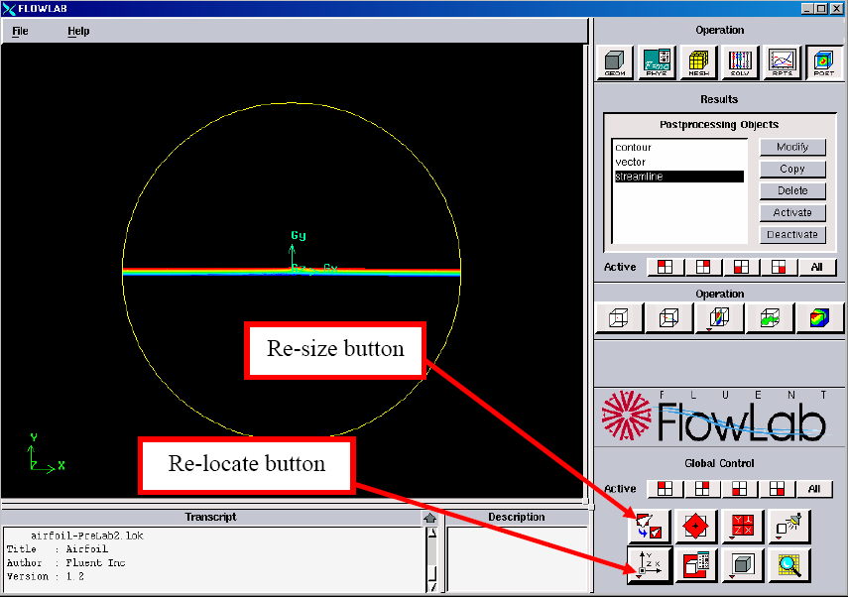
Tips-Figure manipulation

Slide 11
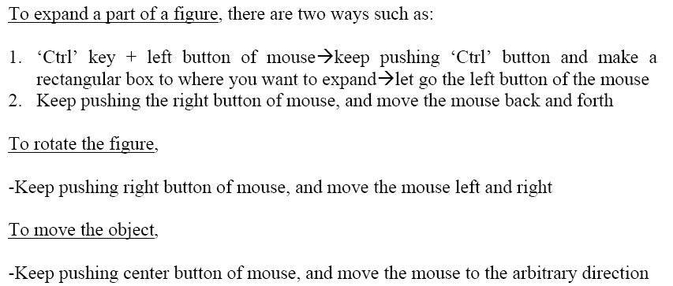
Tips-Figure manipulation

Slide 12
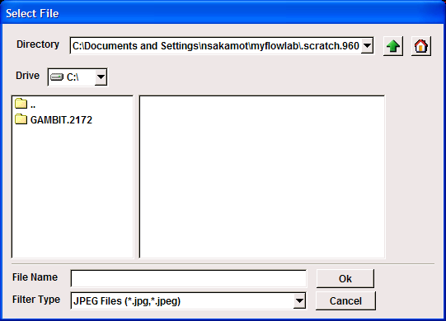
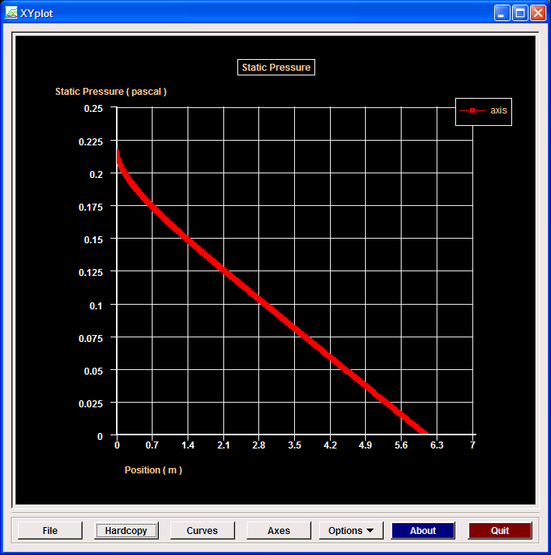
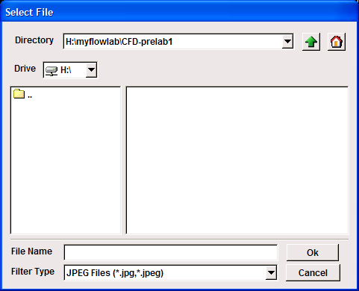
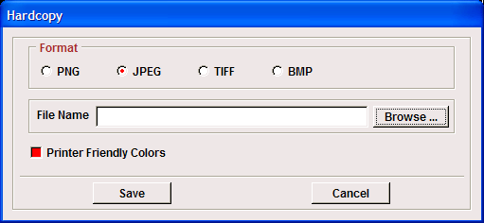
Tips-Save figures
Figures:XY-plots
BEFORE
1
3
2
AFTER
4

Slide 13
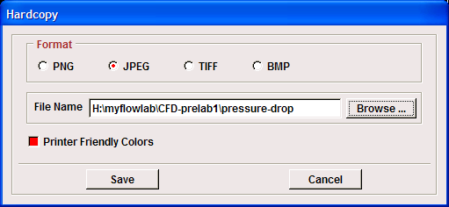
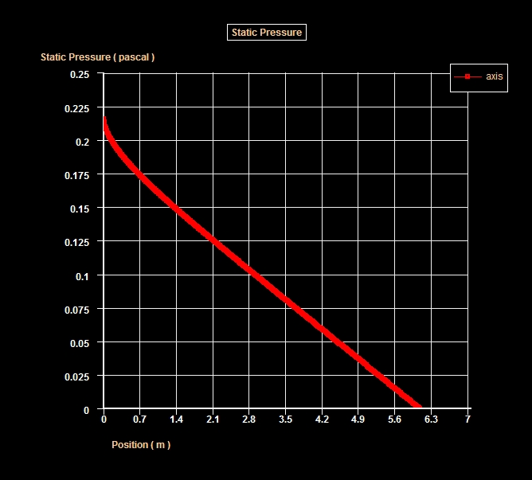
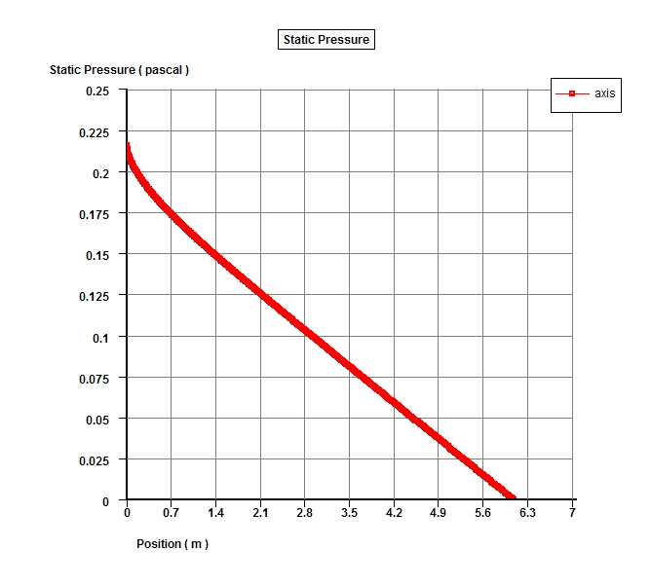
Tips-Save figures
Figures:XY-plots, cont.
5
6
Printer UNfriendly
Printer friendly

Slide 14
Tips-Import data: Ex) Velocity profile
FLOWLAB data format:
(title "Velocity Magnitude")
(labels "Position" "Velocity Magnitude")
((xy/key/label "AFD")
0 0.4
0.1 0.385
0.2 0.342
0.3 0.268
……. …….
)
Graph title
Value name in X-axis and Y-axis
Label of the graph
Y-axis value
X-axis value
Don’t forget to close this bracket!! (Very typical mistake)

Slide 15
Tips-Import data: Ex) Velocity profile
FLOWLAB data format: Where to change?
(title "Velocity Magnitude")
(labels "Position" "Velocity Magnitude")
((xy/key/label "AFD")
0 0.4
0.1 0.385
0.2 0.342
0.3 0.268
……. …….
)
Graph title
Value name in X-axis and Y-axis
Label of the graph
Data sets:
AFD axial velocity profile (CFD Prelab1)
EFD axial velocity profile (CFD lab1)
EFD pressure drop (CFD lab1)
EFD pressure distribution (CFD Prelab2)

Slide 16
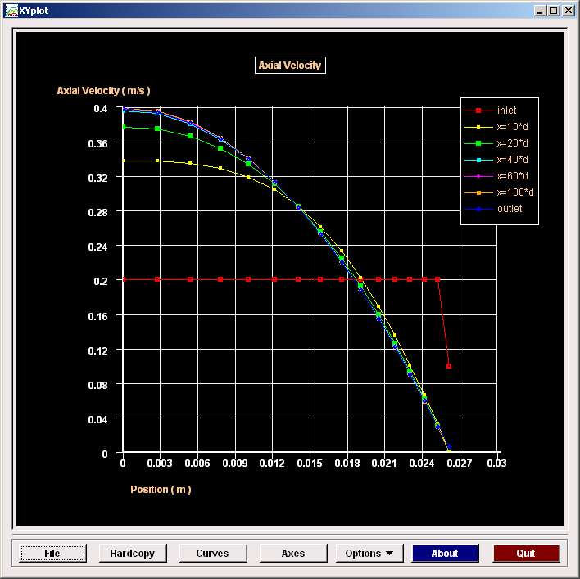
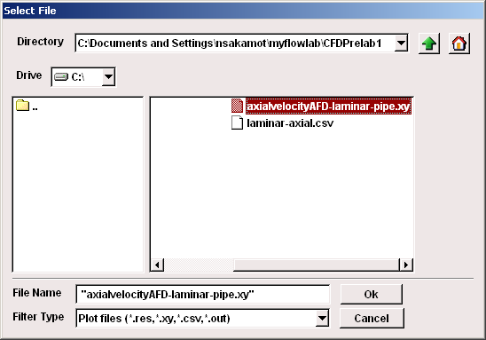
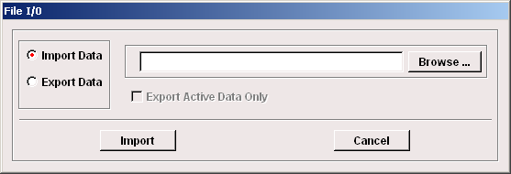
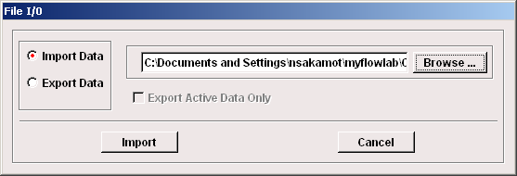
Tips-Import data: Ex) Velocity profile
Locate the data file to be read-in to the FLOWLAB under:
H:\myflowlab
1
3
2
4

Slide 17
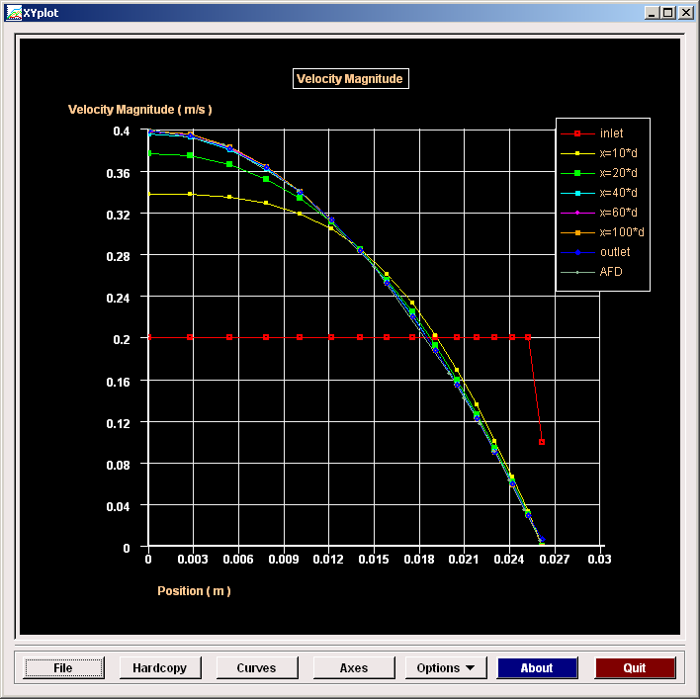
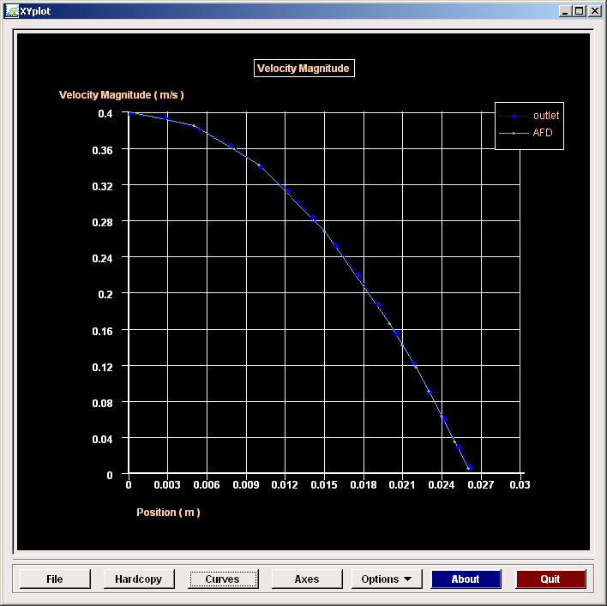
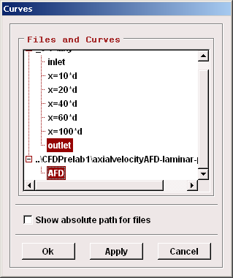
Tips-Import data: Ex) Velocity profile
1
Ctrl+left mouse
to choose
2

Slide 18
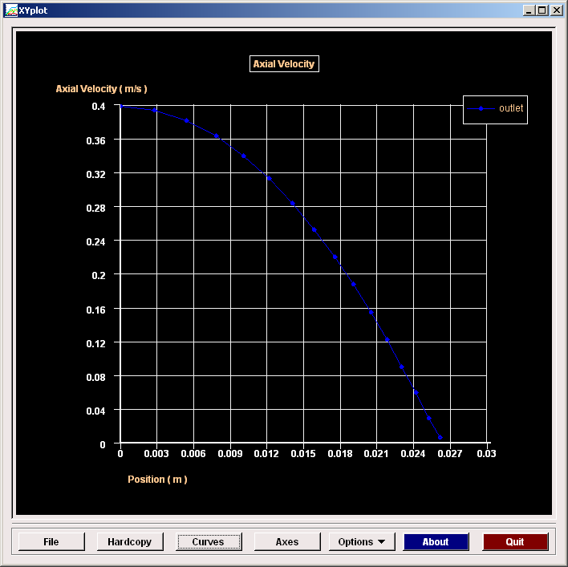
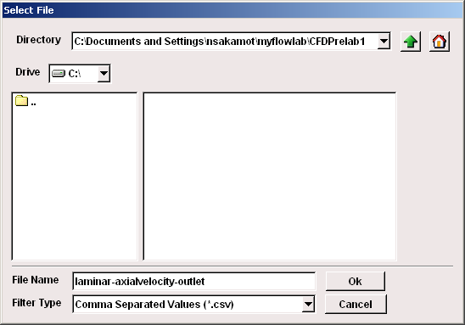
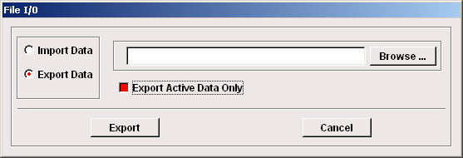
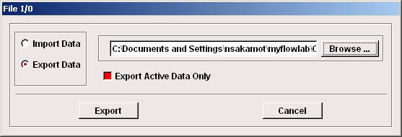
Tips-Export data: Ex) Velocity profile
3
1
Export only necessary information!
Choose unique directory!
Name the file uniquely!
2
4

Slide 19
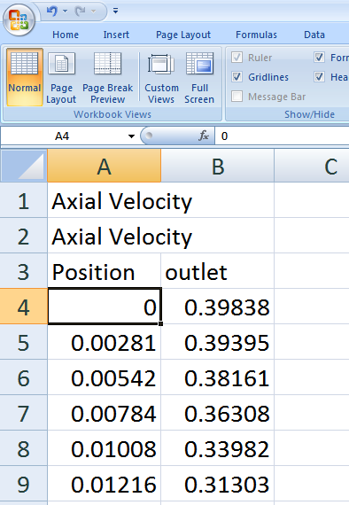
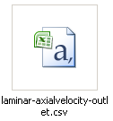
Tips-Export data: Ex) Velocity profile
5
Data is exported as
Comma Separated Variable format (.csv)→Edit by Excel!!

Slide 20
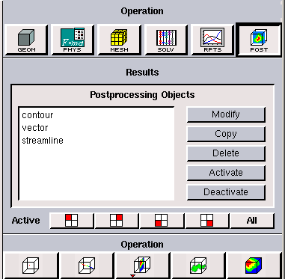
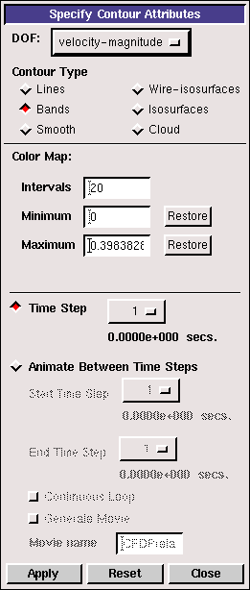
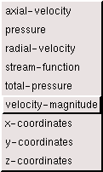
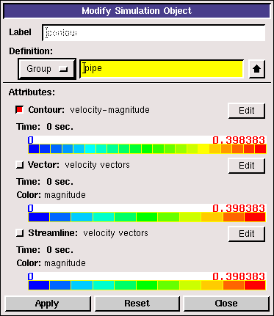
Tips-Change contour views
1
3
2
3
1
Select the target values to be observed
→Apply
→Close
2

Slide 21
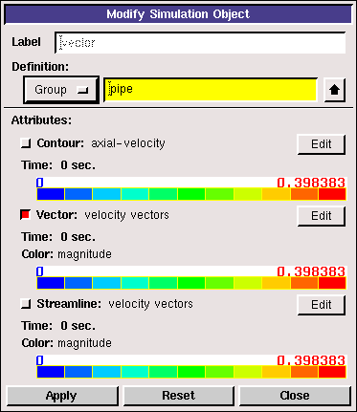
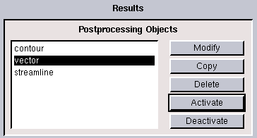
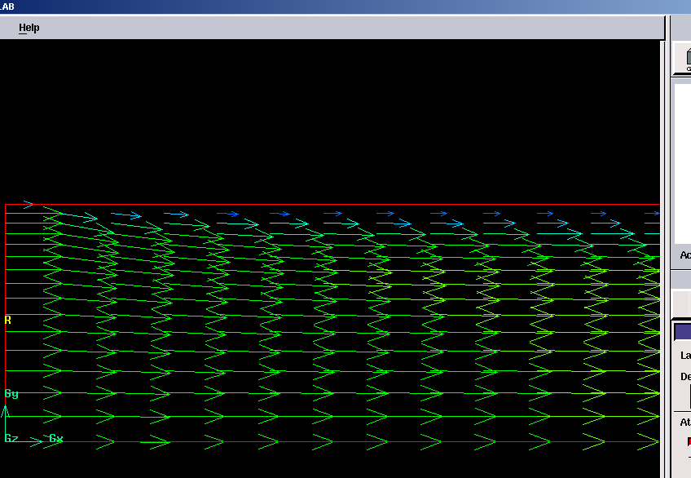
Tips-Change contour to vector
1
2
1
3
1
3
4
2
2
Same procedure for vector→streamline view

Slide 22
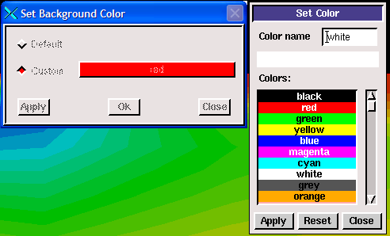
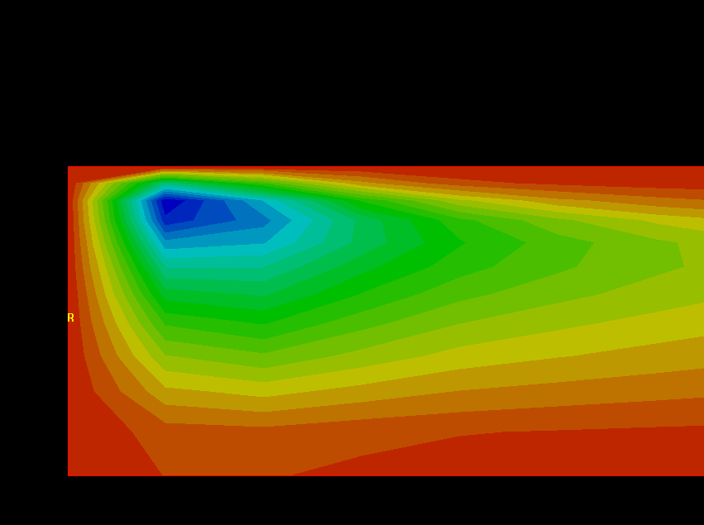
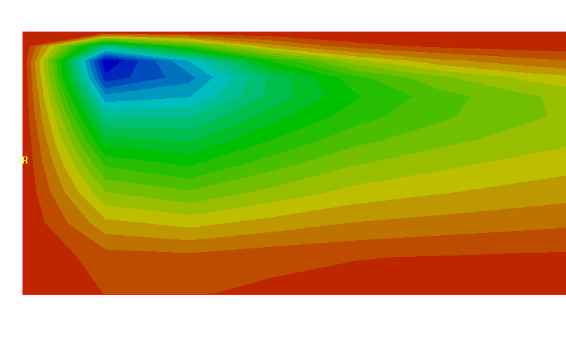
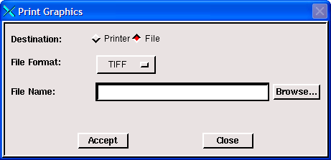
Tips-Save contour figures
Before
1
2
After
4
3

Slide 23
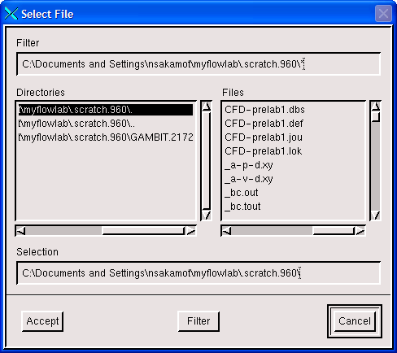
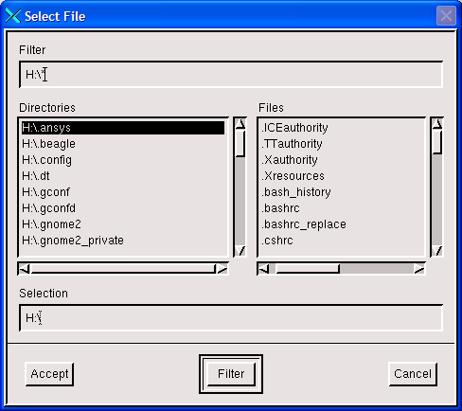
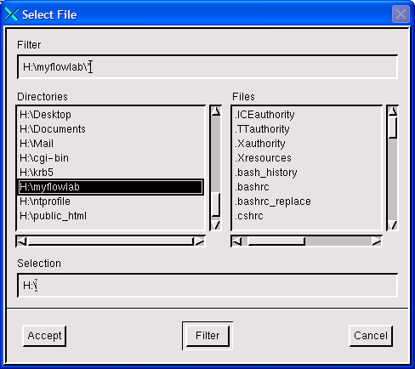
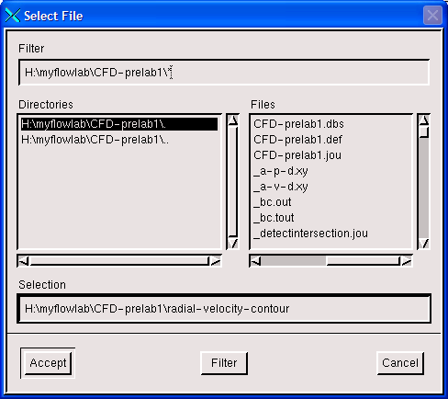
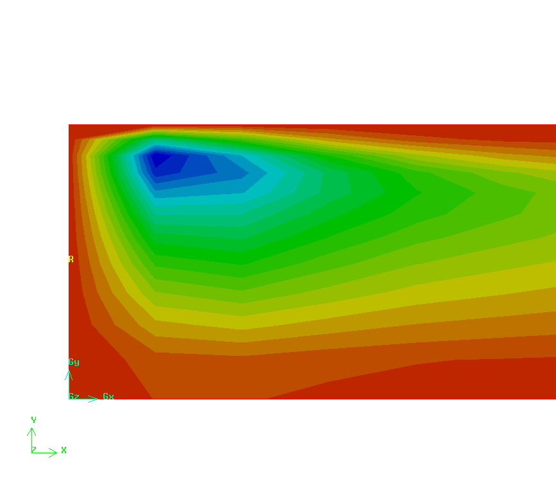
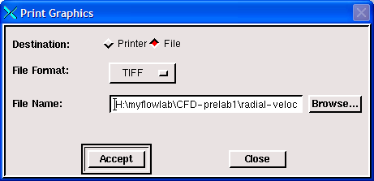
Tips-Save contour figures
5
6
7
8
9

Slide 24
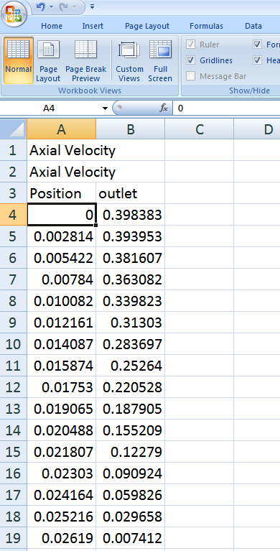
Tips-Normalization (CFD Lab1)
Normalization:
One method to make several data being comparable each other
In CFD Lab1:
Scale both laminar and turbulent axial velocity profile being from 0 to 1
→Comparable each other!!
How to?:
Find maximum value first, then, divide all the variables by the maximum value.

Slide 25
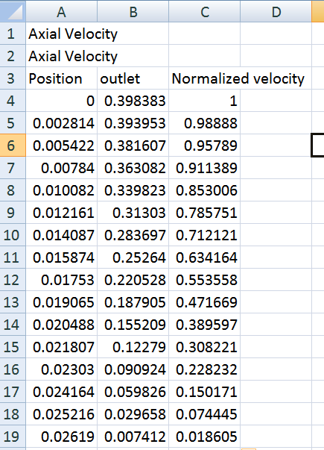
Tips-Normalization (CFD Lab1)

Slide 26
Tips-Streamline band (CFD Prelab2/Lab2)
3
1
1
2
Before
Min=0
Max=85.1065
3
2
After
Min=41.2
Max=42
Control max and min values of stream function to make it narrower!!

