Slide 1
LEGO MINDSTORMS NXT PROGRAMMING
Send questions to TA or Instructor
rachel-loomis@uiowa.edu
er-wei-bai@uiowa.edu

Slide 2
Things we will learn
Components of NXT
NXT Programming
To download the Lego NXT software, go to
https://www.lego.com/en-us/themes/mindstorms/downloads
and follow the instructions for both Mac and Windows users.
or go to
https://education.lego.com/en-gb/product-resources/mindstorms-ev3/teacher-resources/nxt-compatibility
You can program your NXT Brick using the LEGO MINDSTORMS Education EV3 Software.
An example

Slide 3
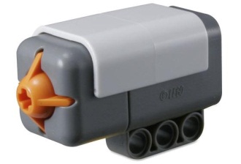
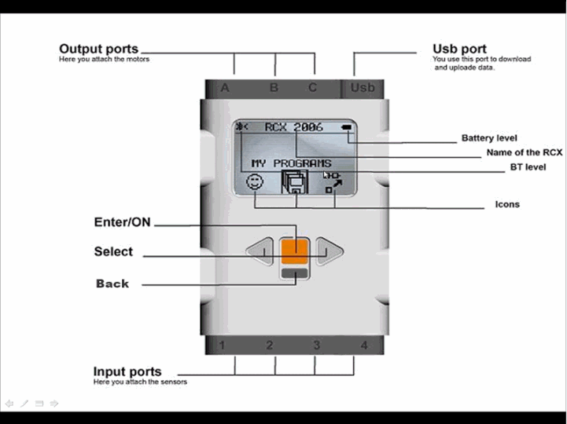
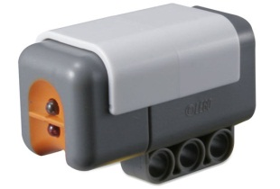
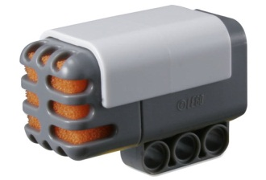
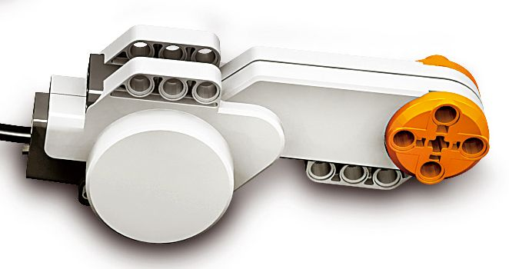
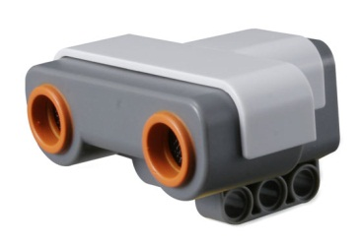
Components of NXT
NXT Brick
Servo Motors (X3)
Sensors
Touch
Light
Sound sensor
Ultrasonic Sensor
Other sensors available, which are not included in kit are, gyroscopic, infrared tracker, accelerometer, temperature sensor etc.

Slide 4
NXT Programming
Type program name in the box under “Start New Program” and click on “Go”
If you are working on a program that is already saved, navigate to it in the box under “Open Recent Program”

Slide 5
NXT Programming
This is the first screen
Click on the middle tab to see “Complete Palette” of icons.
Each of the icons have a flyout menu
Complete Palette

Slide 6
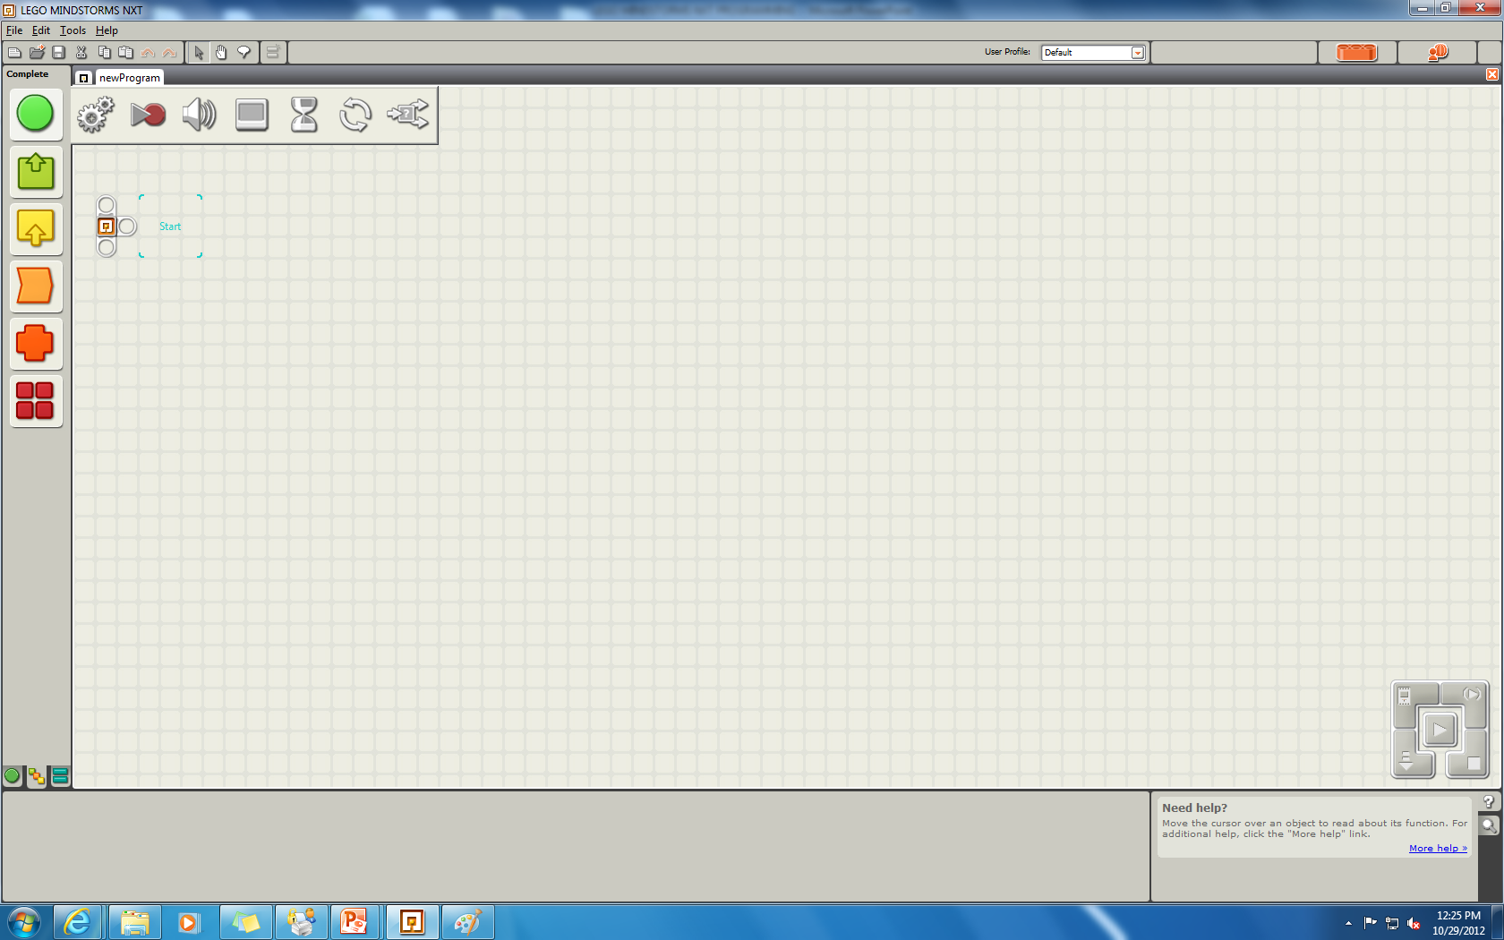
Details on common features
……
……
……
……
……
Flyout menu for the most commonly used features
Starting Block
Move
Sound
Wait
Loop
Switch

Slide 7
Drag and drop the MOVE icon to the starting block
select a gate
on the NXT
define the power
of the engine
Define the distance
NXT has to cover
define the direction:
Forward, backward or stop
make the NXT turn under
a well defined angle
define the next action
NXT has to take

Slide 8
Drag and drop the SOUND icon
Choose sound file or a tone to play
Select a sound file from the list
Select volume

Slide 9
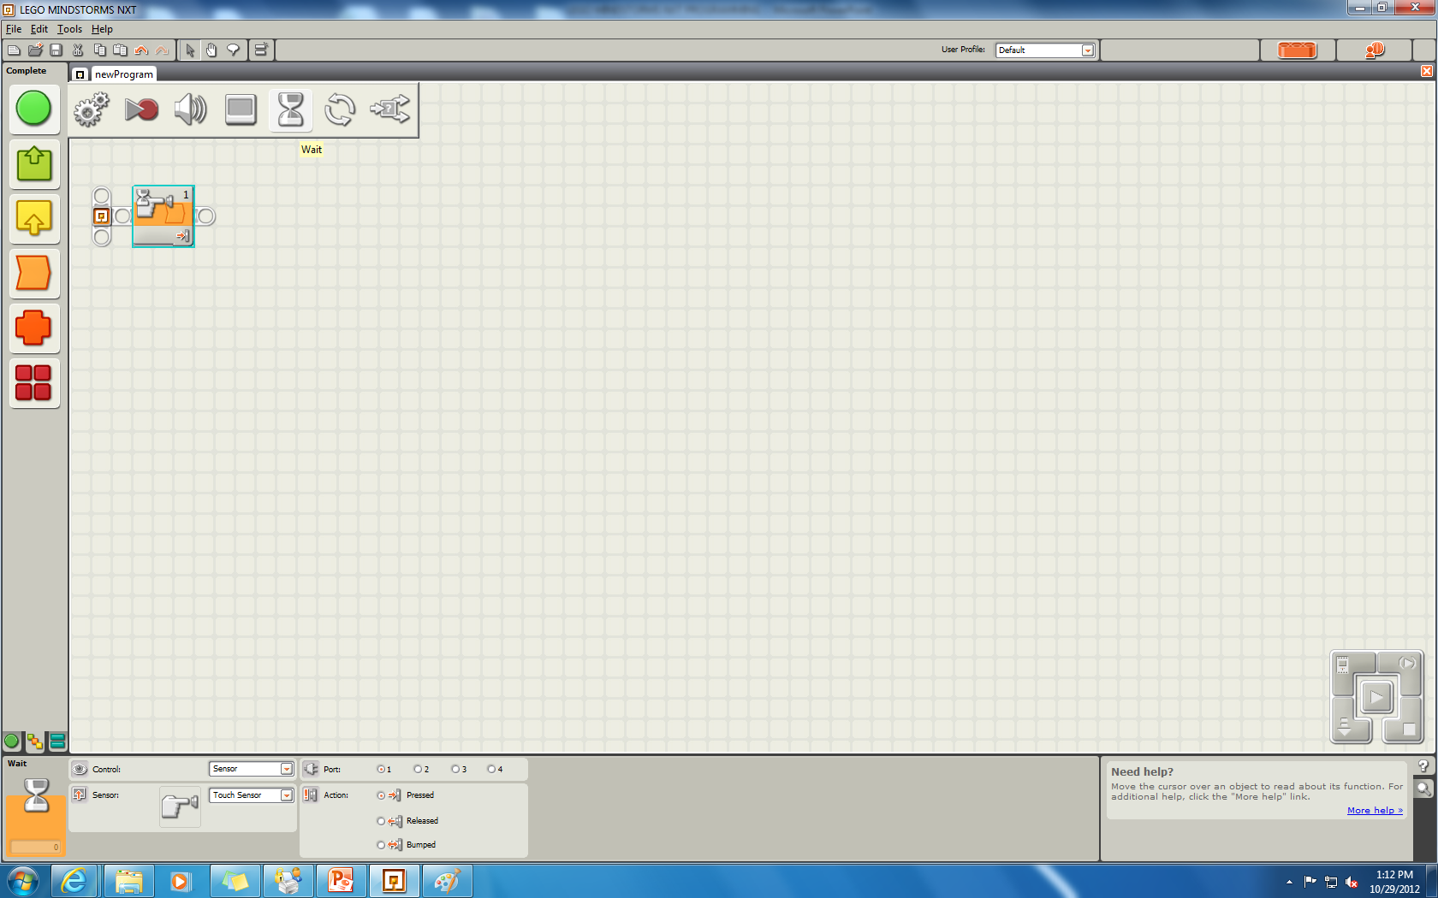
Drag and drop the WAIT icon
Control triggering wait(sensor/time)
Port to which sensor is connected
Choosing sensor type

Slide 10
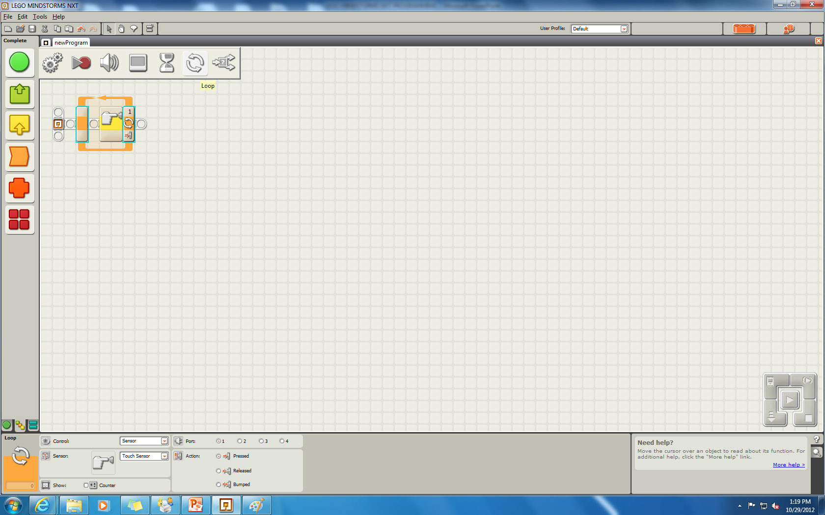
The loop icon should have all the actions inside it and a stopping criteria
Port to which sensor is connected
Stopping criterion for loop: could be forever, time based or sensor based
Selecting the sensor

Slide 11
The switch icon is like if-else. The actions in upper part is executed if condition of switch is true otherwise the actions is lower part are executed.
Control for switch block
Port to which sensor is connected
Choose sensor controlling switch block

Slide 12
What do sensors and motors do?
The 3 identical servo motors are used to drive the LEGO machine. You can select power of engine duration of motion, turning angle etc.
The LEGO touch sensor can sense if it is pressed or not or if it is bumped.
LEGO light sensor can do precise light measurement on the scale of 0 to 100. It can measure the external light intensity and generate light.

Slide 13
What do sensors and motors do?
The main function of LEGO sound sensor is registering sound. It can measure sound level in dB
The ultrasonic sensor has a reliable range of 5 till 220 cm. The distance shown is the distance measured from the back of the sensor, as it were the rear side of the ‘eyes’ of the sensor.

Slide 14
An example
We will see an example using some of the common programming features
The program will execute a few functions in a loop and have a stopping criterion based on information from a sensor.

Slide 15
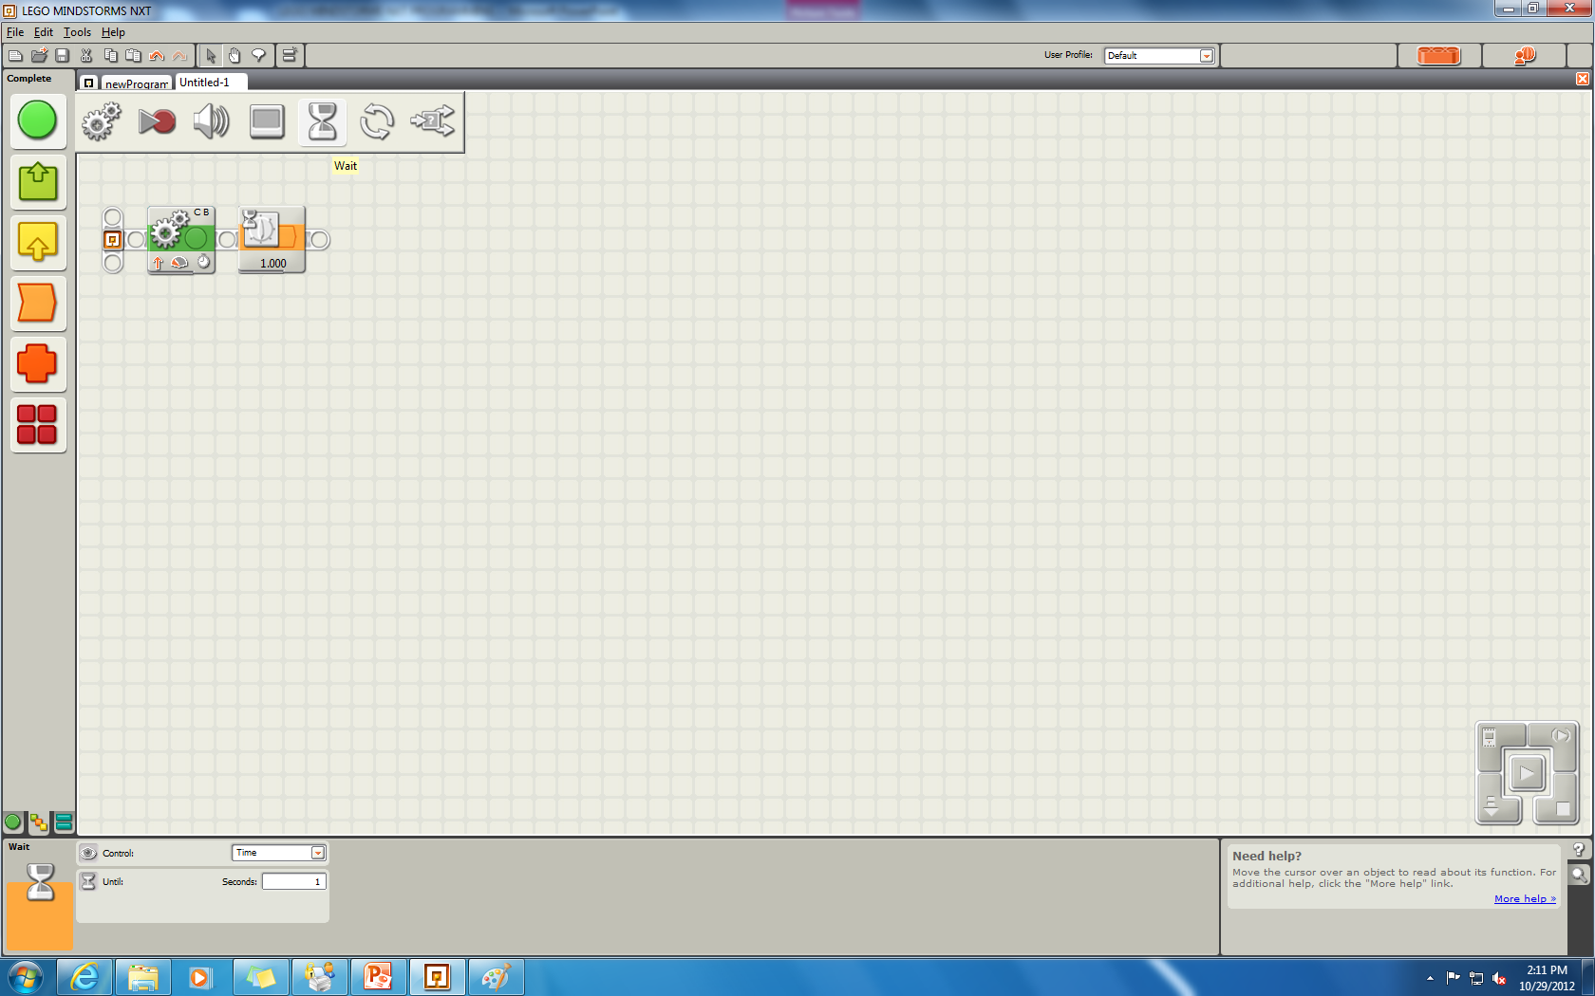
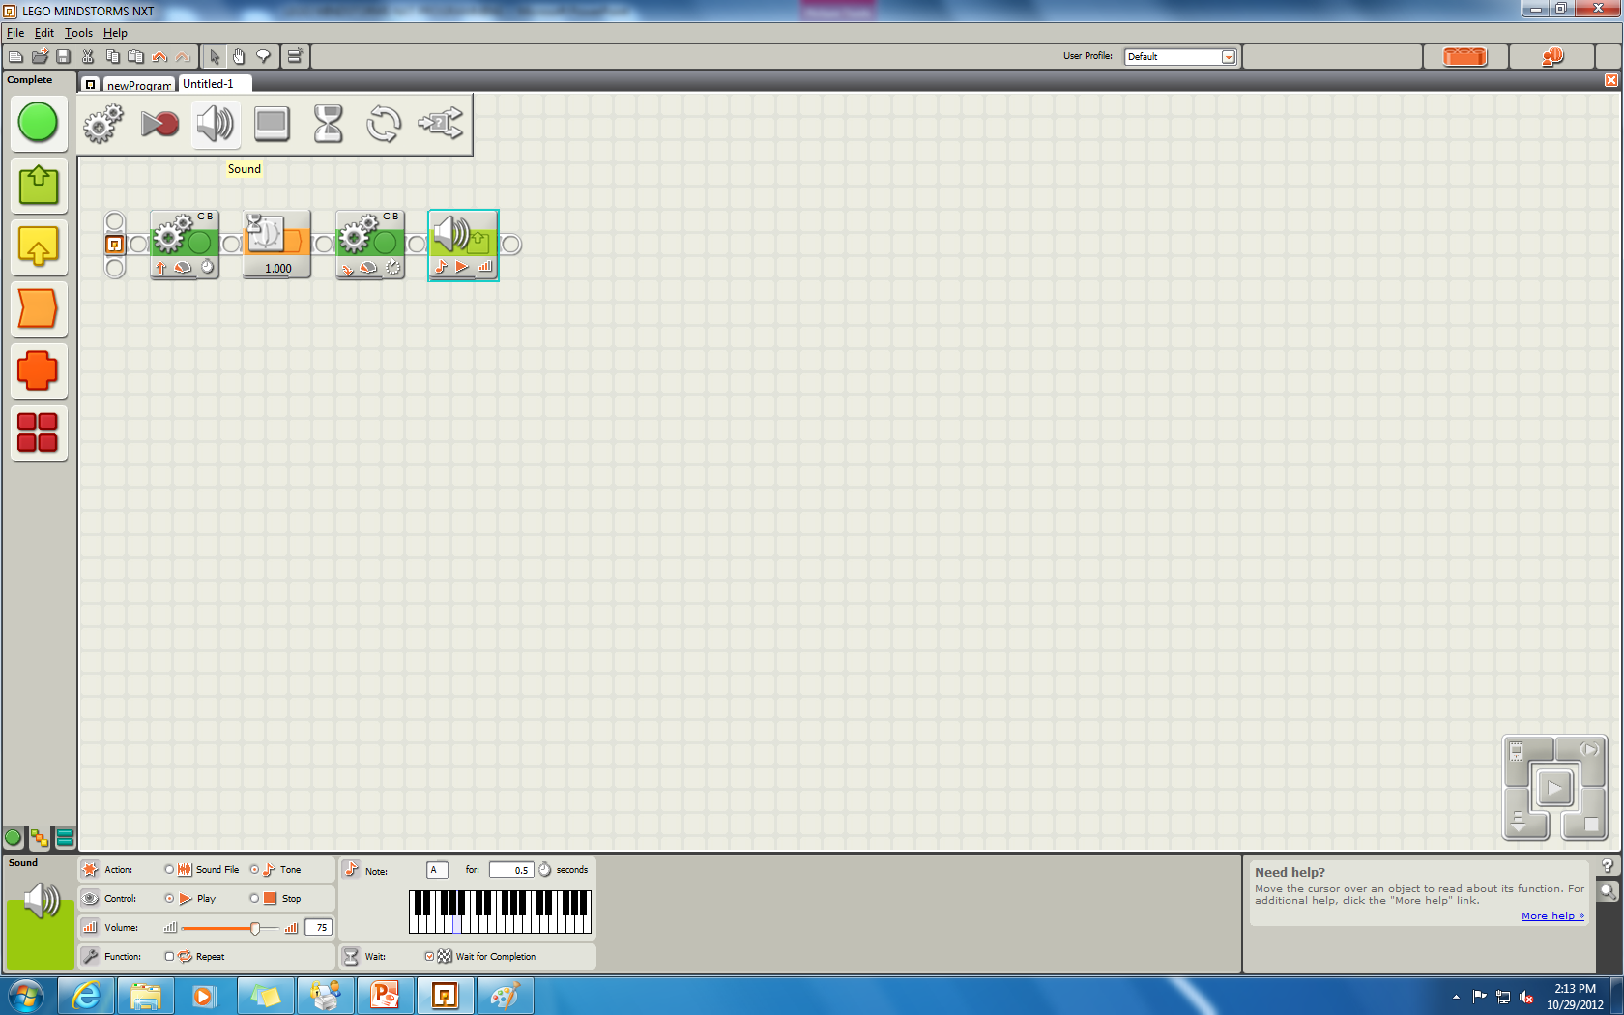
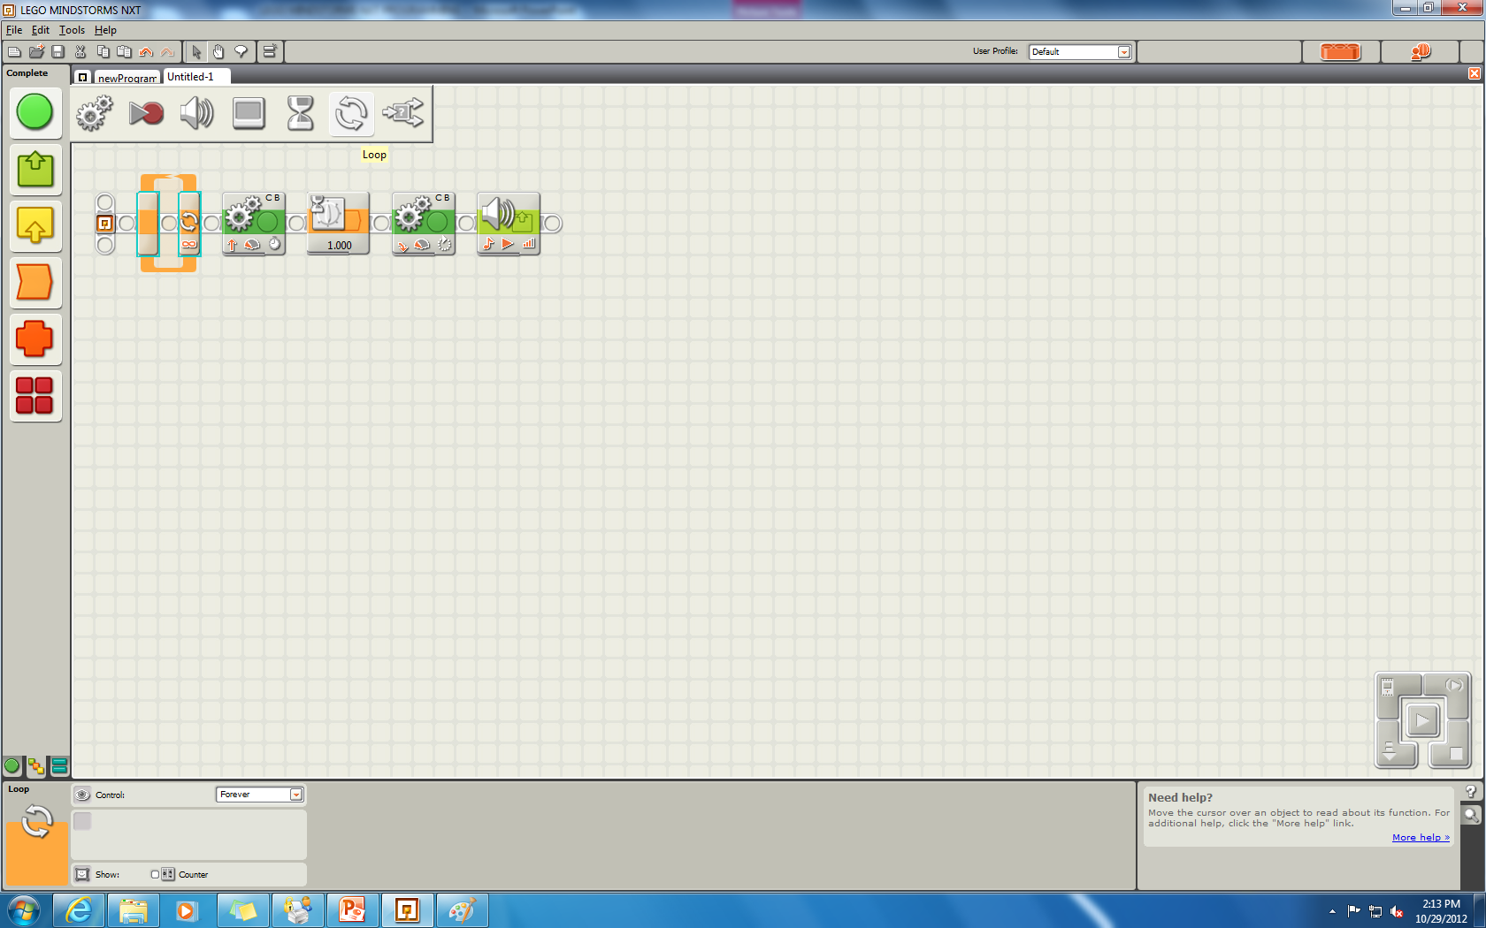
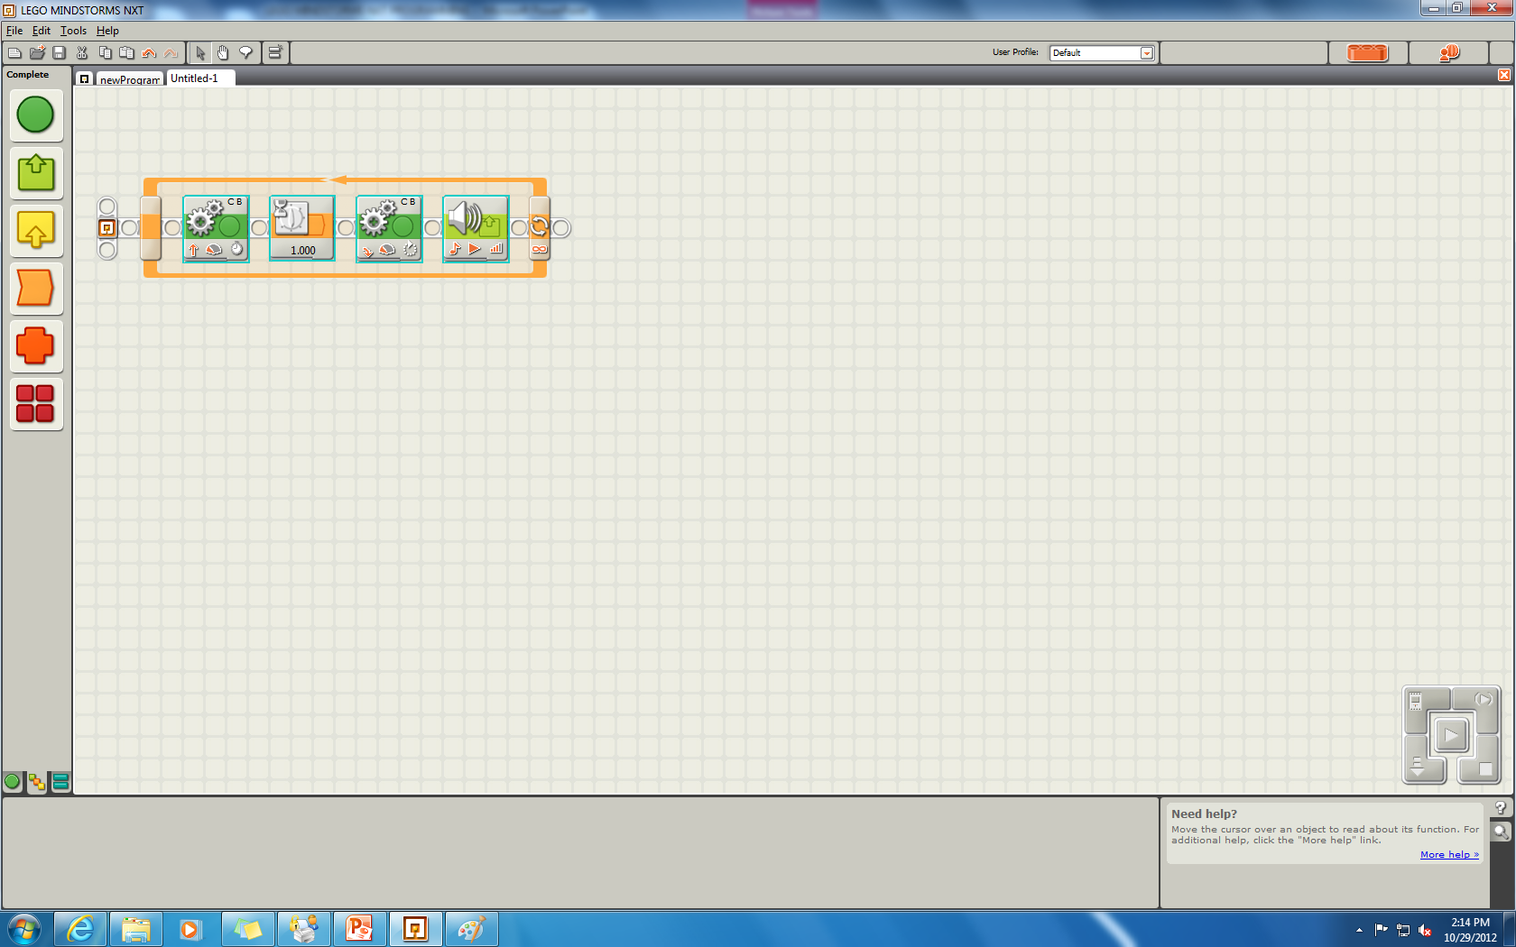
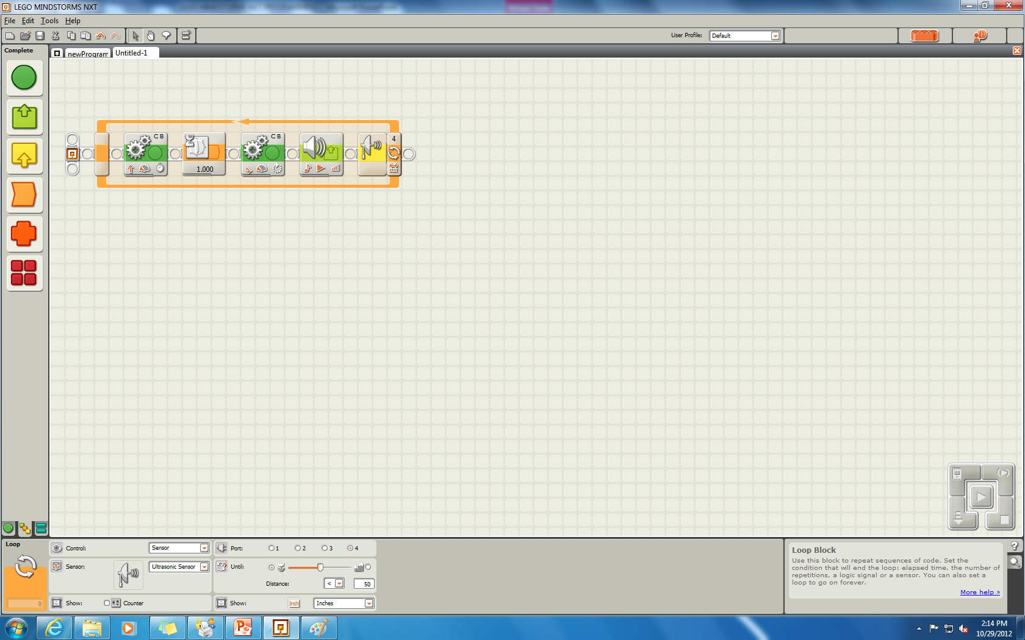
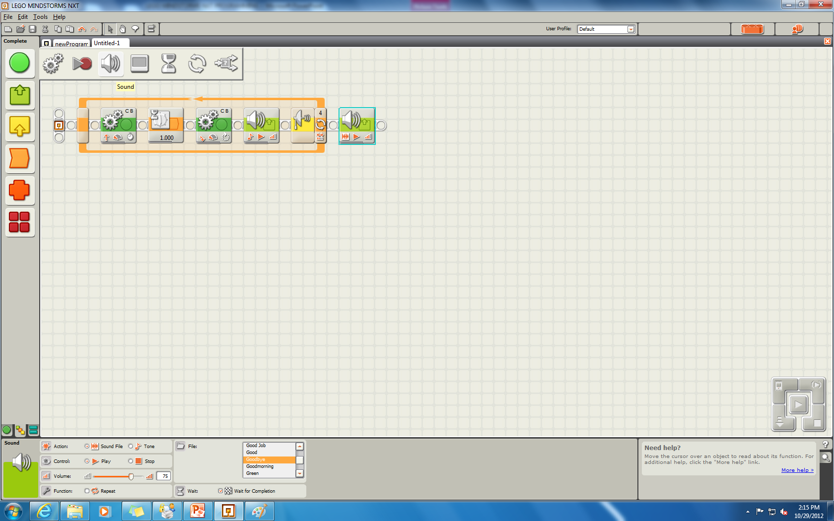
Drag the WAIT icon from the flyout menu
Select TIME as control from the drop menu
Input 1 second as the wait time
Drag another MOVE icon from the flyout menu
Adjust parameters to make the turn
Which way to turn
How long (rotation, time or degrees)
Drag the MOVE icon to the starting block from the flyout menu shown
Select the Ports, Direction, Steering, Power, duration and next action
Drag the LOOP icon from the flyout menu
Drag the SOUND icon from the flyout menu
Select the parameters to play a note for a certain time (in this case note A)
Drag all the placed icons inside the loop
Select the stopping criterion for the loop (Ultrasonic sensor)
Set the parameters and the port to which the sensor is connected
Drag the SOUND icon from the flyout menu
Select a sound file to play (GOOD BYE)

Slide 16
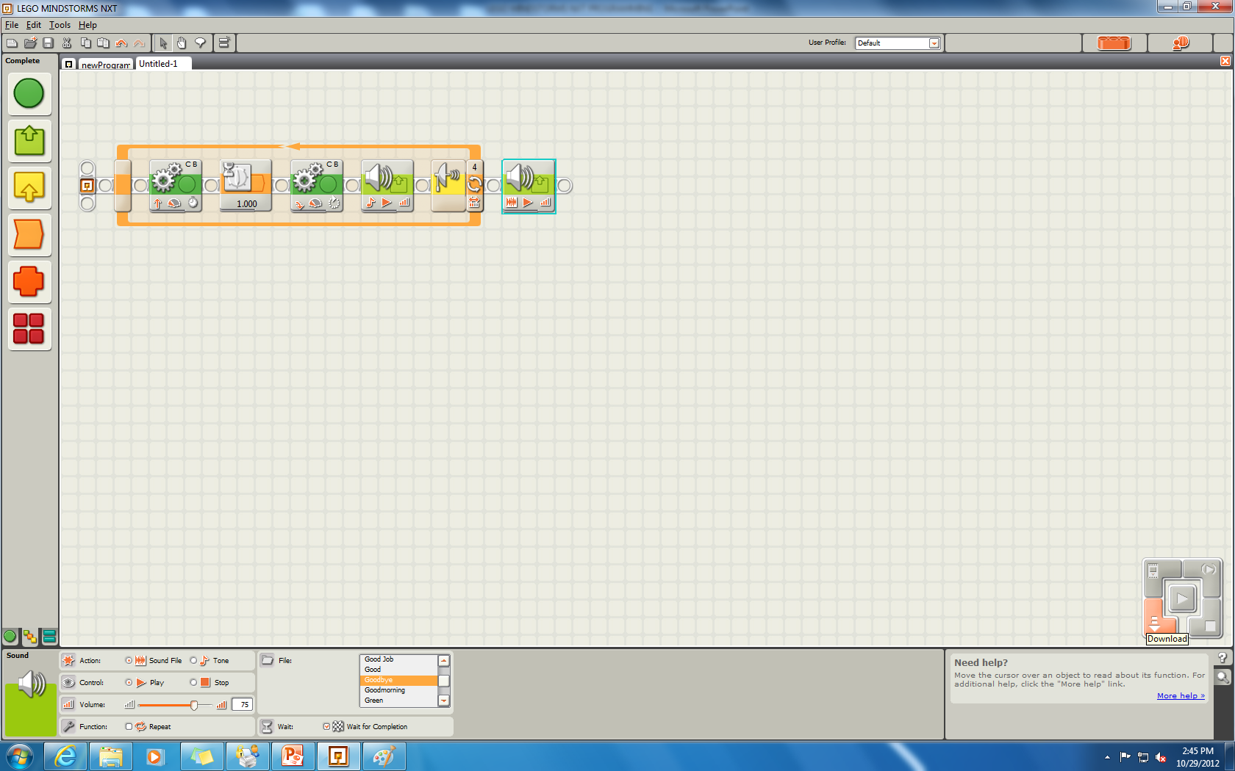
Connect the NXT brick via the USB
Download the program by clicking the download button

Slide 17
The second example is of a multiple sensor robot using switch blocks. The video would explain each step of how the program is written in LEGO NXT . The video begins with the flowchart explaining the task to be executed by the program.

