Slide 1
IDEF

Slide 2
IDEF
Integrated Computer-Aided Manufacturing (ICAM) Definition Languages
Comprehensive, formal syntax for describing a process
Better analysis and communication techniques
Widely used in the government, industrial and commercial sectors

Slide 3
ICAM Definition Languages
IDEF0 - Function Modeling Technique
IDEF1 - Information Modeling Technique
IDEF2 - Dynamic Modeling Technique
IDEF3 - Process Flow Technique

Slide 4
IDEF0 Functional Modeling
Control (C)
Input (I)
Output (O)
Function
Mechanism (M)

Slide 5
IDEF0
Flow from top left to bottom right
Input e.g. raw hamburger meat
Control e.g. order, schedule
Mechanism e.g. machine, oven
Output e.g. cooked hamburger

Slide 6
IDEF0
Diagram not cluttered.
Boxes balanced with regard to detail.
Diagram consistent with readers expertise.
Supplementary text can be used.

Slide 7
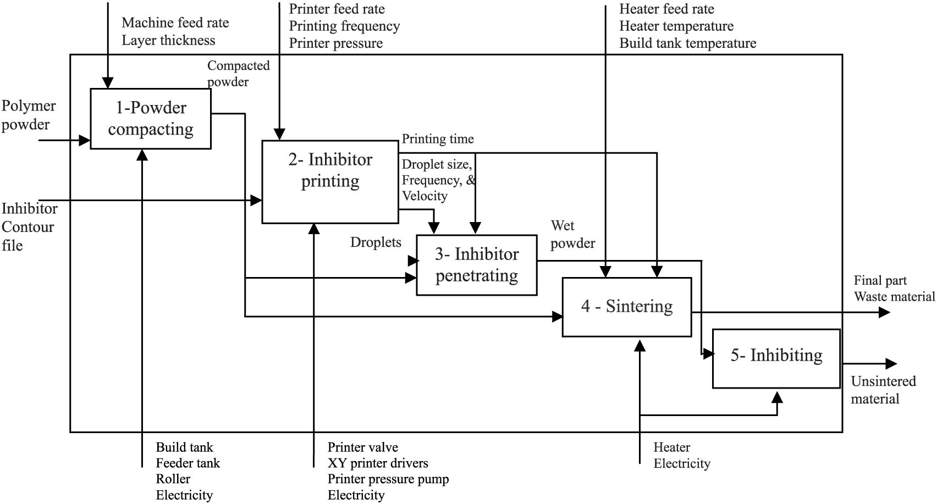
From: http://www.emeraldinsight.com

Slide 8
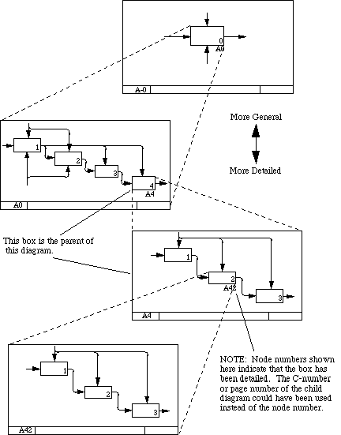
Decomposition
From: http://csob.berry.edu

Slide 9
Motivation for IDEF3
Speed up business process modeling
Support project management process
Facilitate the systems requirements definition process

Slide 10
Potential Uses of IDEF3
Method for recording and analyzing data from interviews
To support simulation models
To collect data for expert systems
To document data flows
To facilitate design of software

Slide 11
Basic Elements of IDEF3
UOBs Unit of Behavior (represented as box) e.g. fall asleep, paint part, do homework
Junctions
Links
Referents
Elaborations
Decompositions

Slide 12
UOB Box
Function, Activity, Action, Process, Operation, Event
UOB Label
Node #
IDEF Ref#

Slide 13
Junction Boxes
Junction Type:
AND ( & )
OR ( O )
XOR ( X )
Junction Type
Asynchronous
Junction Type
Synchronous

Slide 14
Junction Types
Synchronous
Adds that processes start/finish simultaneously
AND ( & )
INPUTS: All preceding processes must complete
OUTPUTS: All following processes will start.
OR ( O )
INPUTS: One or more of the preceding processes must complete
OUTPUTS: One or more of the following processes will start
XOR ( X )
INPUTS: Exactly one of the preceding processes must complete
OUTPUTS: Exactly one of the following processes will start

Slide 15
Junctions in Process Flow Diagrams
Mechanical
design
Revise
design
2
5
Requirements
planning
Evaluate
design
&
&
X
1
4
Electrical
design
Accept
design
3
6

Slide 16
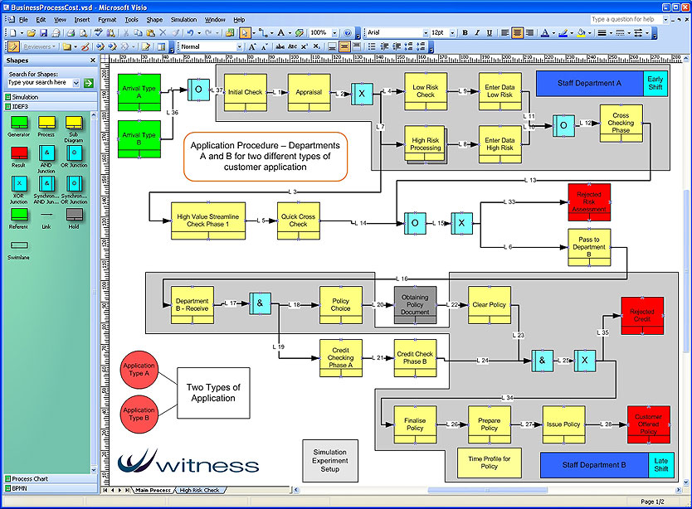
From: http://www.lanner.com

