Slide 1


Visualizing Winter Nitrate Formation
Using CMAQ Process Analysis
Charles Stanier – University of Iowa
charles-stanier@uiowa.edu
319-335-1399
CENTER FOR GLOBAL AND REGIONAL ENVIRONMENTAL RESEARCH

Slide 2
Background
Based on the work in
  Yoo Jung Kim, S.N. Spak, G.R. Carmichael, N. Riemer, C.O. Stanier. Modeled aerosol nitrate formation pathways during wintertime in the Great Lakes region of North America. J. Geophys. Res., vol. 119, no. 21, pp. 12420–12445, doi 10.1002/2014JD022320, 2014.
Charles Stanier and Yoo Jung Kim have given a number of presentations on nitrate formation visualized through process analysis.
These visualizations might be useful in atmospheric chemistry classes, so we are putting the powerpoints up there.
  Please use with the attribution: “Kim, Yoo Jung, et al. J. Geophys. Res. 2014; used with permission of Charles Stanier, Univ. or Iowa”.
  Questions – please contact Charles Stanier charles-stanier@uiowa.edu

Slide 3
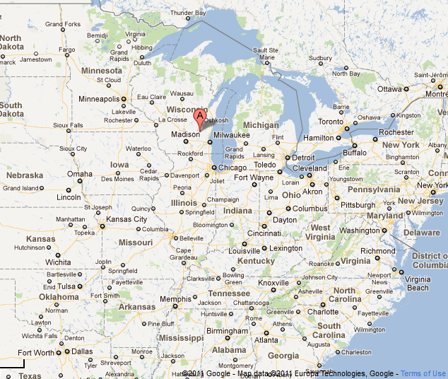
LADCO Winter Nitrate Study
(Jan 1 – Mar 31, 2009)

Slide 4
Nitrate formation analysis by process analysis
Daytime
NO₂ + OH → HNO₃ (b)
NO₂ + O₃ → NO₃ + O₂ (a)
NO₃ + NO₂ ↔ N₂O₅ (c)
NO₃ + VOC→ organic products (g)
N₂O₅ + H₂O(g) → 2HNO₃ (d)
N₂O₅ + H₂O(l) → 2HNO₃ (e)
Nighttime
RH and composition dependent accommodation
coefficient, uncertain

Slide 5
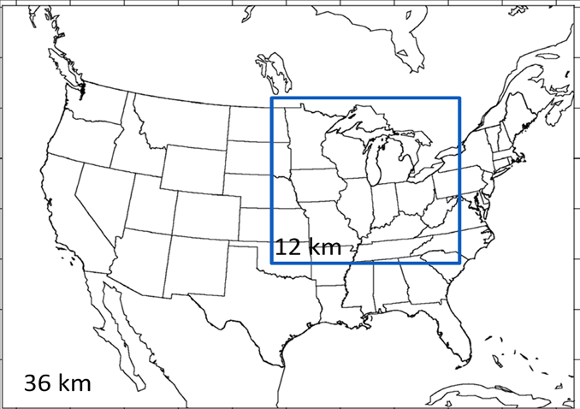
Model Configuration U of Iowa
Community Multiscale Air Quality Model (CMAQ) v4.7.1
  CB05 gas phase / AERO5 aerosol module
  ACM2 PBL closure
  Mass-conserving advection
  35 vertical layers
LADCO’s 12 km regional modeling grid
  Hourly boundary conditions from a 36 km simulation (with the same configuration) covering the continental United States.
Meteorology
  WRF 3.1.1 with the RPO configuration selected by Iowa DNR, SESARM, and LADCO
  ACM2 PBL closure
  Pleim-Xu land surface module
  RRTM radiation
  Morrison microphysics
  Kain-Fritsch cumulus
  NARR 3-hourly met for initial and boundaries
  Analysis nudging on NARR above the PBL, horizontal winds used for observational nudging in the PBL
Emissions
  LADCO’s 2007 emissions inventory used for 12km domain.
  Day-specific biomass burning emissions from MODIS fire detection products.
Process Analysis
  Chemical and process rates stored for all layers up to 550 m, with focus on NOy processing and N2O5 heterogeneous chemistry

Slide 6
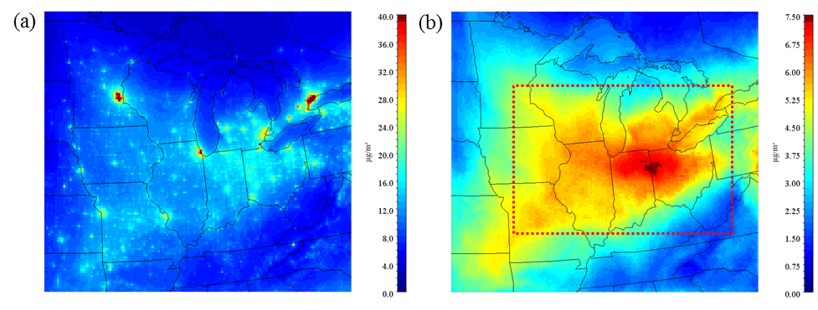
µg / m³
Mean total nitrate Jan – Mar 2009. CMAQ.

Slide 7
Reaction | Reactants | Products
R1 | NO₂ + hν | NO + O
R3 | O₃ + NO | NO₂
R4 | O + NO₂ | NO
R5 | O + NO₂ | NO₃
R6 | O + NO | NO₂
R7 | NO₂ + O₃ | NO₃
R14 | NO₃ | NO₂ + O
R15 | NO₃ | NO
R16 | NO₂ + NO | 2 NO₂
R17 | NO₃ + NO₂ | NO + NO₂
R18 | NO₃ + NO₂ | N₂O₅
R19 | N₂O₅ + H₂O | 2 HNO₃
R20 | N₂O₅ + H₂O + H₂O | 2 HNO₃
R21 | N₂O₅ | NO₃ + NO₂
R22 | NO + NO + O₂ | 2 NO₂
R23 | NO + NO₂ + H2O | HONO
R24 | NO + OH | HONO
R25 | HONO | NO + OH
R26 | OH + HONO | NO₂
R27 | HONO + HONO | NO + NO₂
R28 | NO₂ + OH | HNO₃
R29 | OH + HNO₃ | NO₃
R30 | HO₂ + NO | OH + NO₂
R31 | HO₂ + NO₂ | PNA
R32 | PNA | HO₂ + NO₂
R33 | OH + PNA | NO₂
R46 | NO₃ + O | NO₂
R47 | NO₃ + OH | HO₂ + NO₂
R48 | NO₃ + HO₂ | HNO₃
R49 | NO₃ + O₃ | NO₂
R50 | NO₃ + NO₃ | 2 NO₂
R51 | PNA | 0.61HO₂ + 0.61NO₂ + 0.39OH + 0.39NO₃
R52 | HNO₃ | OH + NO₂
R53 | N₂O₅ | NO₂ + NO₃
R89 | PAN | C₂O₃ + NO₂
R90 | PAN | C₂O₃ + NO₂
Integrated
Reaction
Rate
Analysis

Slide 8
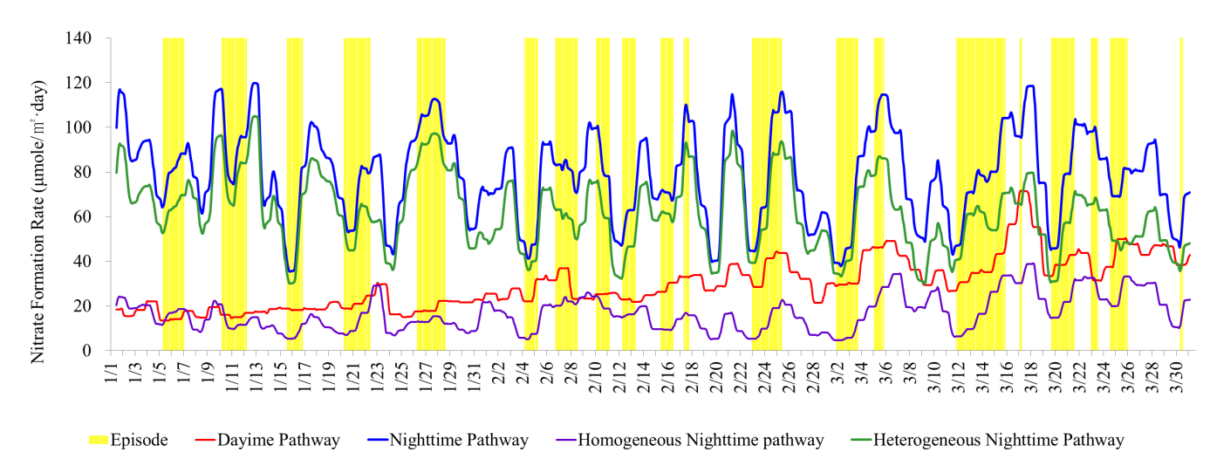
Through model layer 20 (~3.15 km)
Daytime pathway (µmole/m²-day) | Nighttime pathway (µmole/m²-day) | Homogeneous nighttime pathway (µmole/m²-day) | Heterogeneous nighttime pathway (µmole/m²-day)
29.8 | 78.3 | 16.7 | 61.6

Slide 9
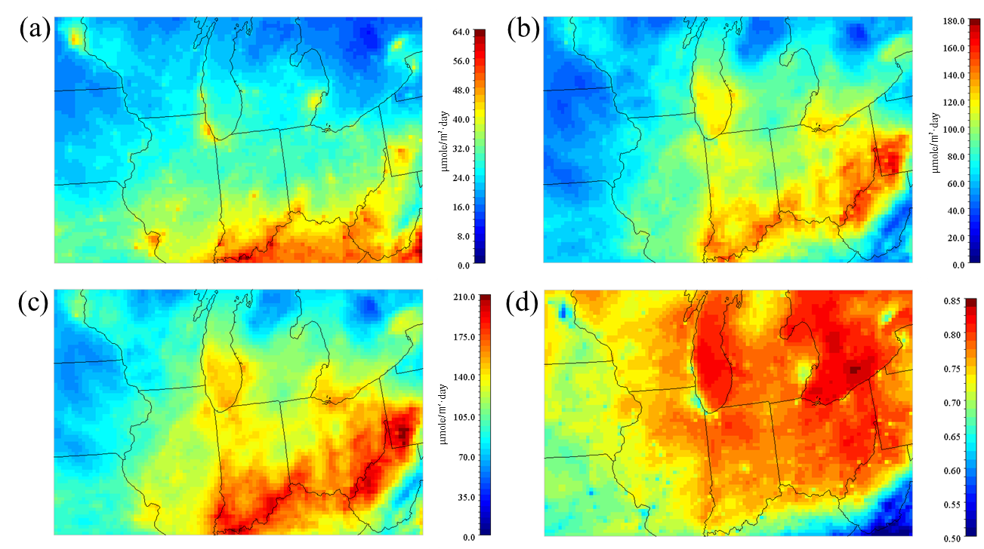
Daytime
Nighttime
Total
Nighttime Fraction

Slide 10
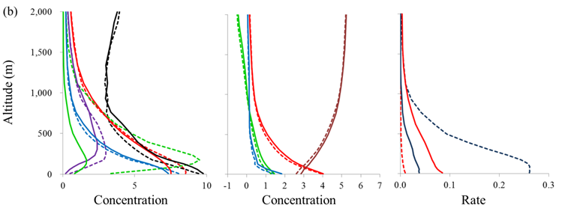
Nitric Acid (ug/m3)
Gas Ratio
Aerosol Nitrate Fraction x10
O₃/10
Nitrate Aerosol (ug/m3)
N2O5 x 100 (ppb)
Total Ammonia
N2O5 pathways
(night)
NH3(g)
Dotted = nighttime period. Solid = daytime.
Mayville episode buildup periods
OH+NO2 (day)

Slide 11
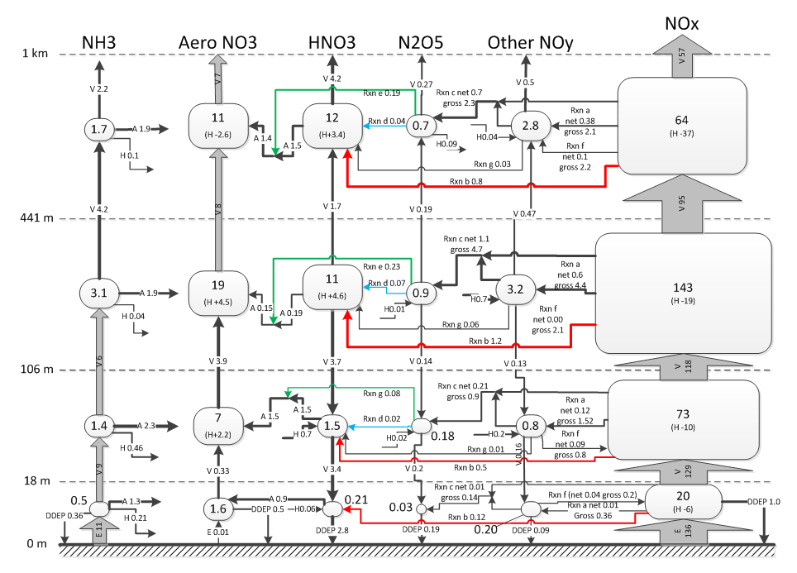
Milwaukee Day
Reservoir in µmole N / m².
Fluxes are in µmole N / m²-hr.
Black lines
Aerosol process
Horizontal advection and diffusion
Vertical advection and diffusion
Emissions
DDEP
a: net NO₃ radical formation
c: net N₂O₅ formation
g: HNO₃ formation from the NO₃ radical
Colored lines
b: NO₂ + OH → HNO₃
d: homogenous formation of HNO₃ from N₂O₅
Flux e: heterogeneous formation of HNO₃ from N₂O₅

Slide 12
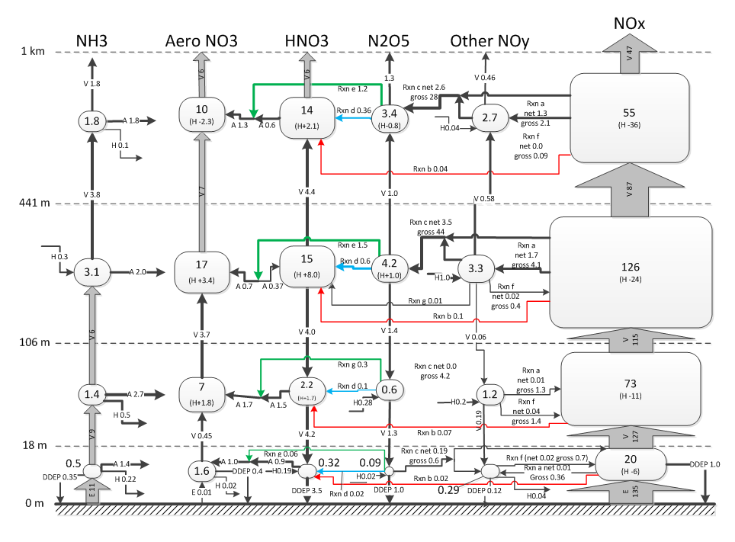
Milwaukee Night
Reservoir in µmole N / m².
Fluxes are in µmole N / m²-hr.
Black lines
Aerosol process
Horizontal advection and diffusion
Vertical advection and diffusion
Emissions
DDEP
a: net NO₃ radical formation
c: net N₂O₅ formation
g: HNO₃ formation from the NO₃ radical
Colored lines
b: NO₂ + OH → HNO₃
d: homogenous formation of HNO₃ from N₂O₅
Flux e: heterogeneous formation of HNO₃ from N₂O₅

Slide 13
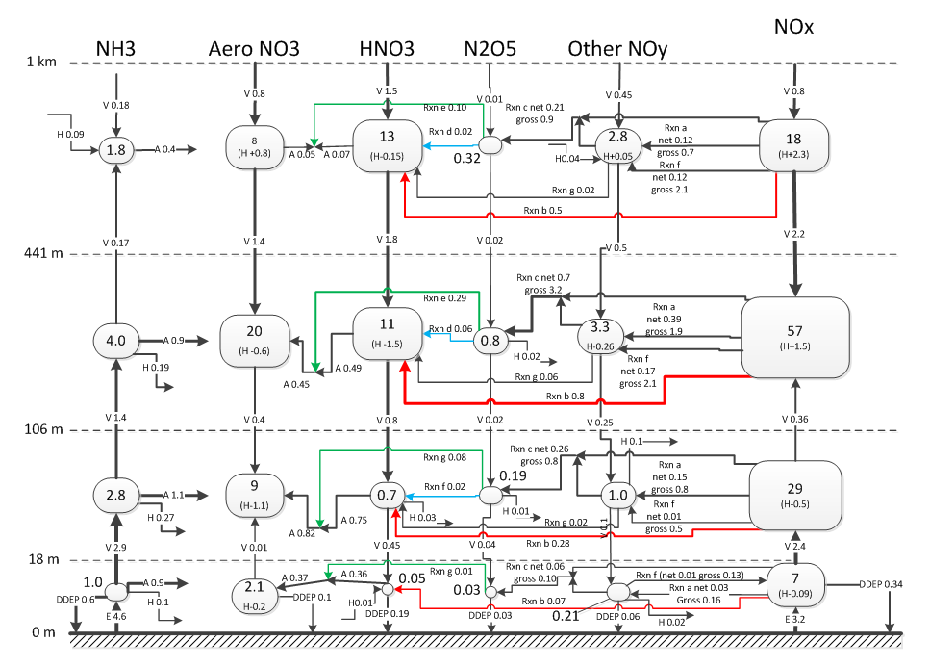
Mayville Day
Reservoir in µmole N / m².
Fluxes are in µmole N / m²-hr.
Black lines
Aerosol process
Horizontal advection and diffusion
Vertical advection and diffusion
Emissions
DDEP
a: net NO₃ radical formation
c: net N₂O₅ formation
g: HNO₃ formation from the NO₃ radical
Colored lines
b: NO₂ + OH → HNO₃
d: homogenous formation of HNO₃ from N₂O₅
Flux e: heterogeneous formation of HNO₃ from N₂O₅

Slide 14
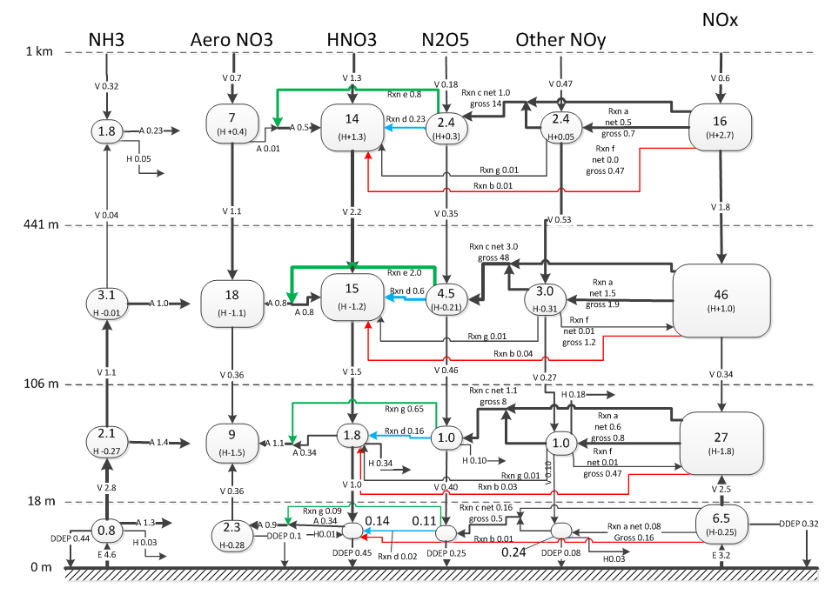
Mayville Night
Reservoir in µmole N / m².
Fluxes are in µmole N / m²-hr.
Black lines
Aerosol process
Horizontal advection and diffusion
Vertical advection and diffusion
Emissions
DDEP
a: net NO₃ radical formation
c: net N₂O₅ formation
g: HNO₃ formation from the NO₃ radical
Colored lines
b: NO₂ + OH → HNO₃
d: homogenous formation of HNO₃ from N₂O₅
Flux e: heterogeneous formation of HNO₃ from N₂O₅

